Slide 1
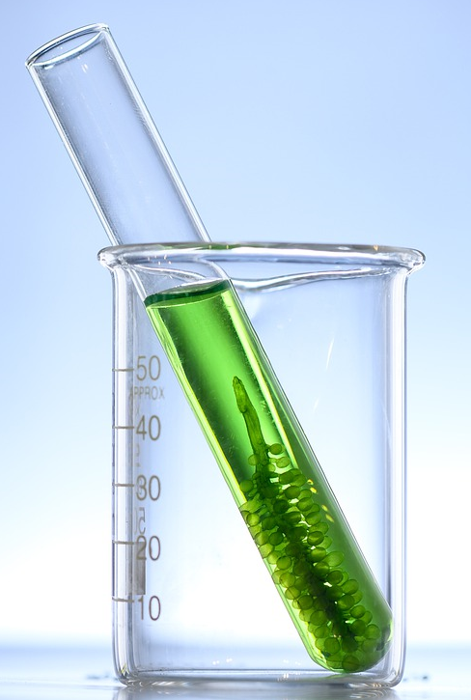
Environalgae’s Sustainability Research Facility (ESRF)
A test-bed site for scaling-up, demonstrating & validating microalgae-based effluent treatment technologies

Slide 2
The Need….and the opportunity
Impact of Climate Change is well known and gets discussed in perhaps every important international convention of developed and developing nations.
The manufacturing sector across the world is now being tasked to audit and reduce Scope 1, Scope 2 and Scope 3 carbon emissions.
In the conventional effluent treatment processes, Scope 1 and Scope 2 emissions are usually significant. Hence, switching to more sustainable wastewater mitigation technologies will soon be a need of the hour for most companies.
(NEED) An ideal sustainable option for wastewater mitigation in the manufacturing sector should:
Utilize less energy
Result in very low carbon emissions
Produce clean water, and
Provide a co-product opportunity to improve the circularity quotient of your carbon!
(OPPORTUNITY) Microalgae-based effluent treatment technology
Relies on sunlight as a source of energy; suitable weather conditions and ample sunlight availability throughout the year over here!
Consumes carbon and emits oxygen
Generates clean and compliant water suitable for discharge/ re-use
Produces microalgae-biomass for various end-use applications, thus recycling the carbon and nutrients from the manufacturing operations

Slide 3
An Exciting Clean-Tech for Effluent treatment….
Sustainable - Sunlight, the primary source of energy for our process, is free of cost, non-polluting and plentiful
Environment friendly* - O₂ released by algae, improves overall air and water quality in the environment
Effective (field data collected from one of our pilot-plant site at customer)
Lucrative – Renewable algae biomass generated has potential value as feed, food and organic fertilizer. Protein content > 50%, high-value fats > 10% and high mineral and antioxidant content.
* – Most of the natural water body pollution by algae is from toxic blue-green algae (cyanobacteria), we are proposing use of beneficial green microalgae for this application

Slide 4
Typical block-diagram for algae-based effluent treatment
Effluent
O₂
Treated water for discharge
Algae biomass for use as co-product

Slide 5
Our Phase-gate approach….
Phase | Phase description | Remarks
SCIENTIFIC FEASIBILITY ASSESSMENT | Algal bioassays at Environalgae lab | One month of studies at low cost
TECHNICAL FEASIBILITY ASSESSMENT | Process development at Environalgae lab | Two-three months paid project
VALIDATION STUDIES | Pilot-scale demonstration-validation studies at Environalgae pilot-plant facility | Max. one month paid project
COMMERCIAL VIABILITY ASSESSMENT | Prefeasibility study to scope out the proposed full-scale process | One month assignment
DESIGN | Design of the full-size ETP plant | Two-Three months paid project
EXECUTION & COMMISSIONING | Execution and Commissioning of the full-size ETP plant | Two-Four months paid execution work

Slide 6
Purpose of ESRF
Demonstrate to new customers the effectiveness of an end-to-end microalgae-based process in treating wastewater and generating renewable microalgae biomass
Develop and scale-up processes for specific customer effluent stream samples
Carry out Validation studies for customers prior to them taking decision on investing in full-scale microalgae-based ETPs/ STPs
Generate treated water samples for customers to analyse and confirm effectiveness of the process in treating effluent streams
Generate microalgae biomass samples from specific customer validation studies for customers to test and scope out the commercial sales potential of microalgae
Carry out validation studies on effectiveness of microalgae as a high-value crop growth stimulant at the same facility

Slide 7
Photographs from ESRF

Slide 8
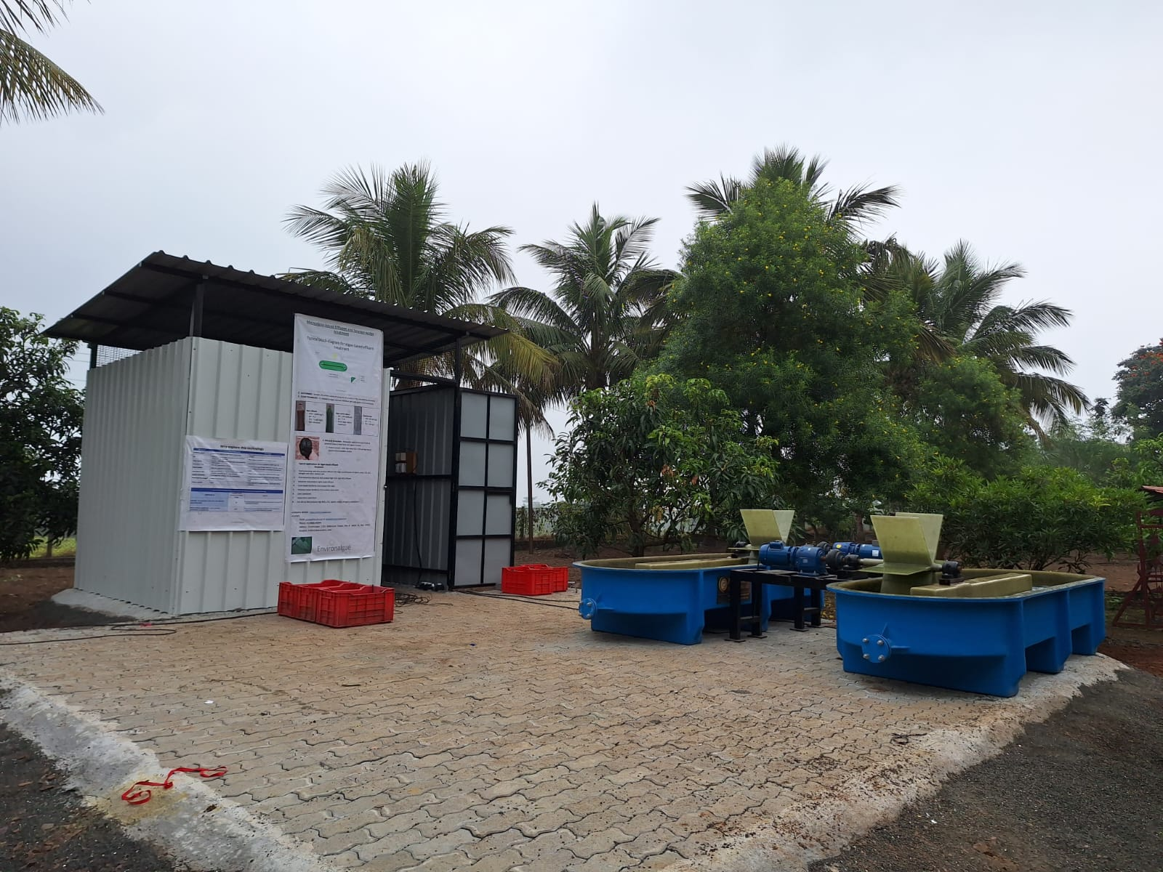
View of the overall Process Facility

Slide 9
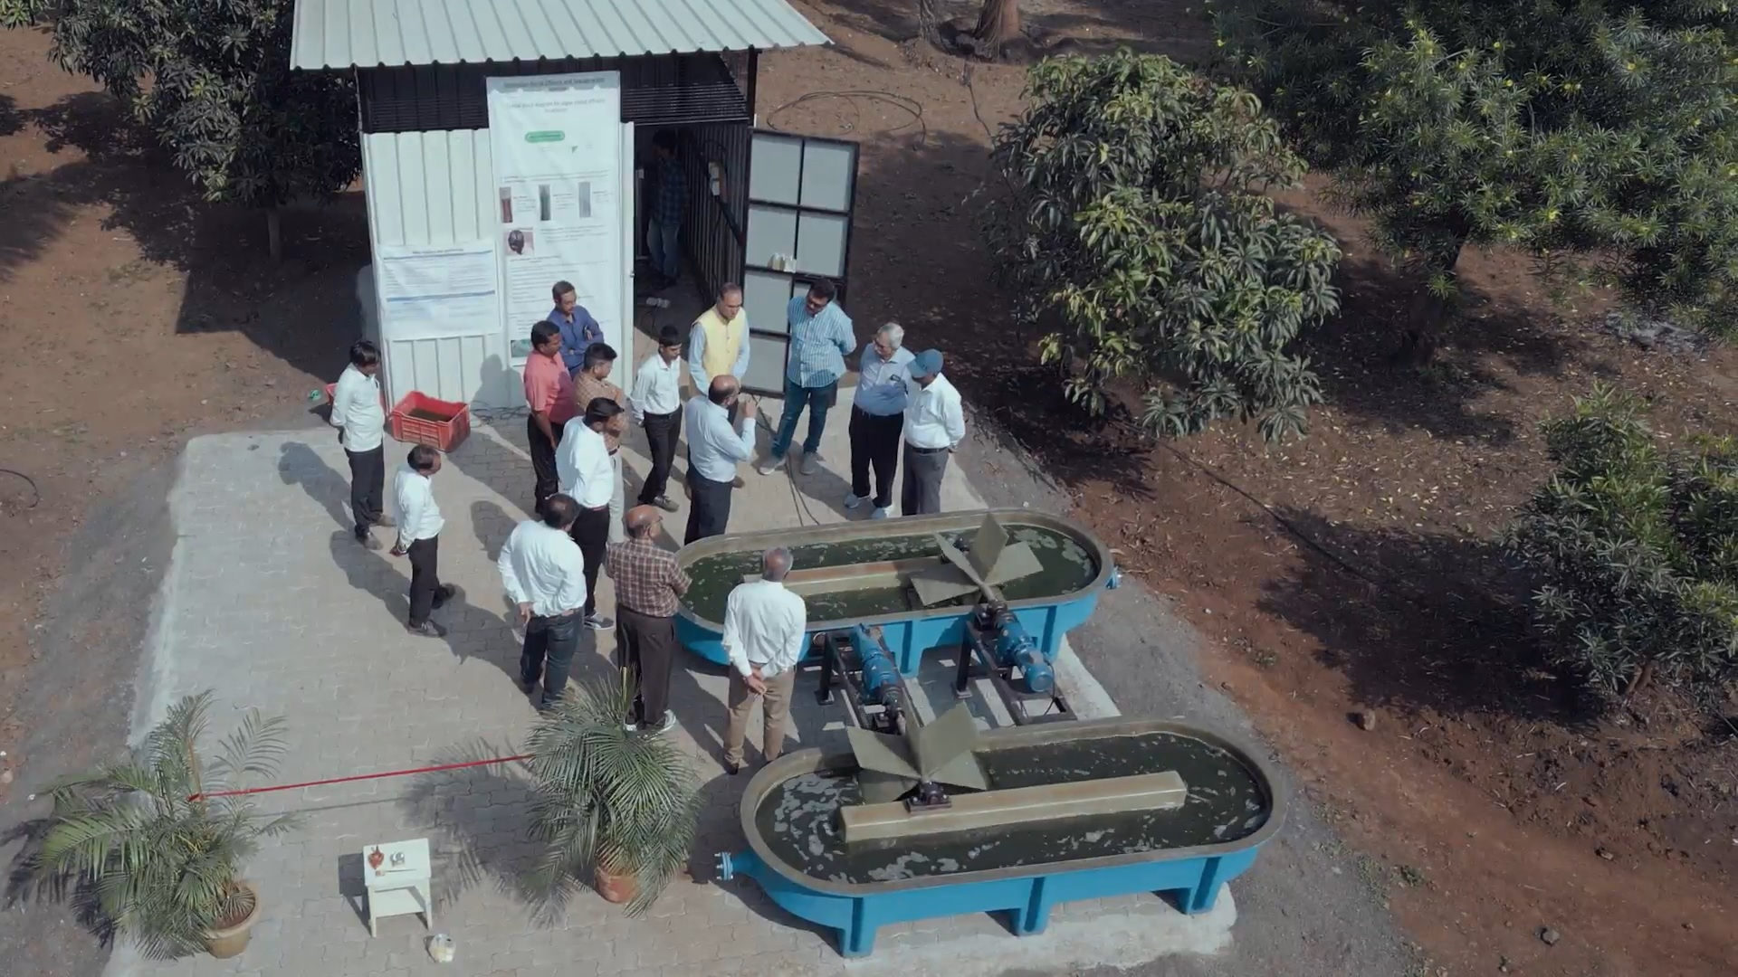
View of the overall Process Facility

Slide 10
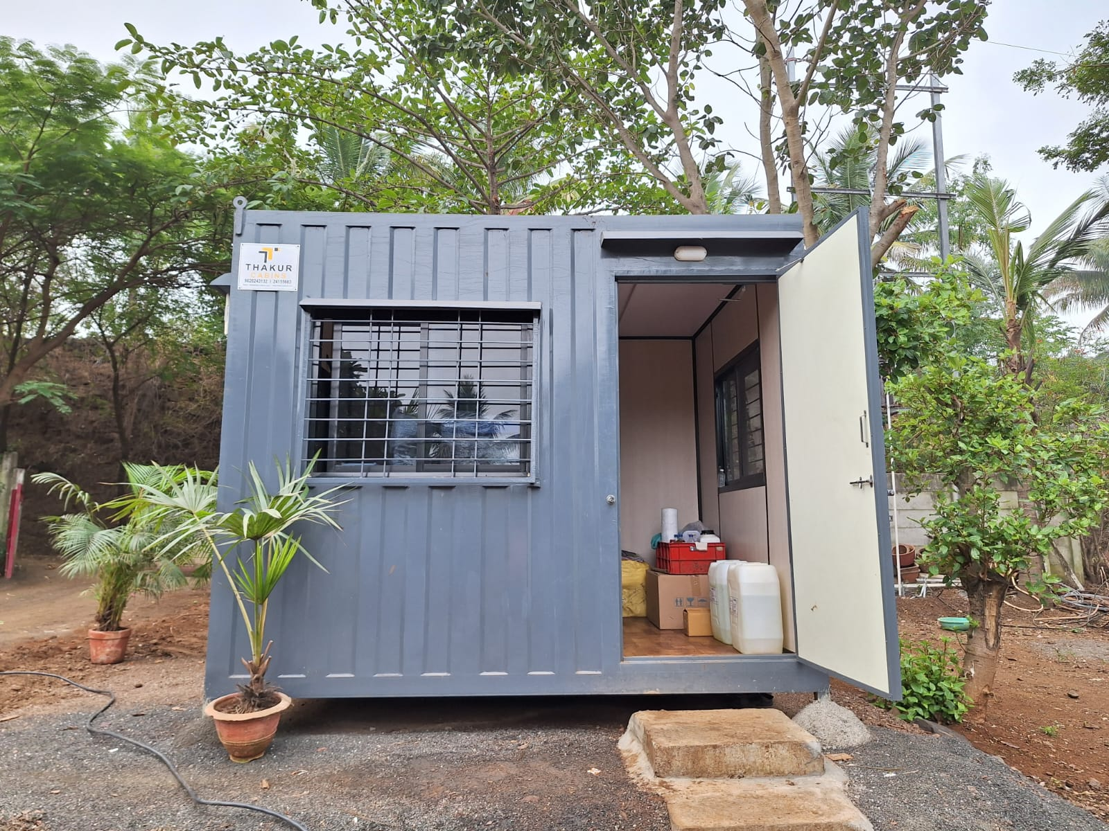
View of the ESRF lab (Portable Cabin)

Slide 11
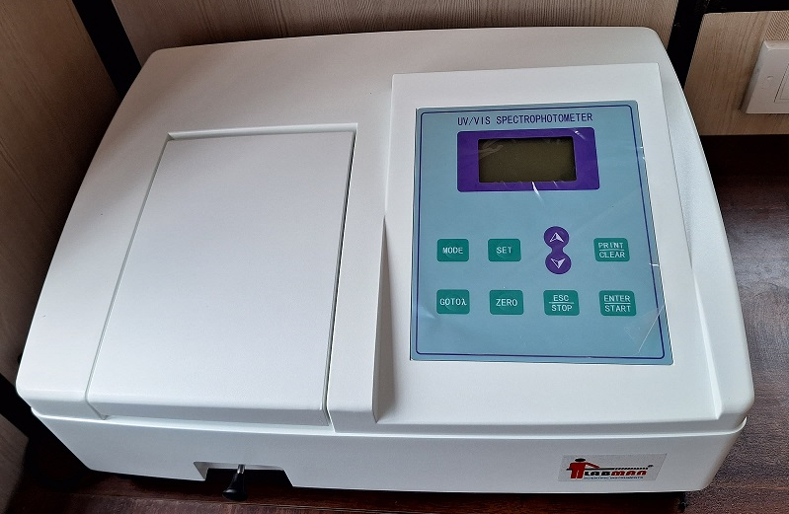
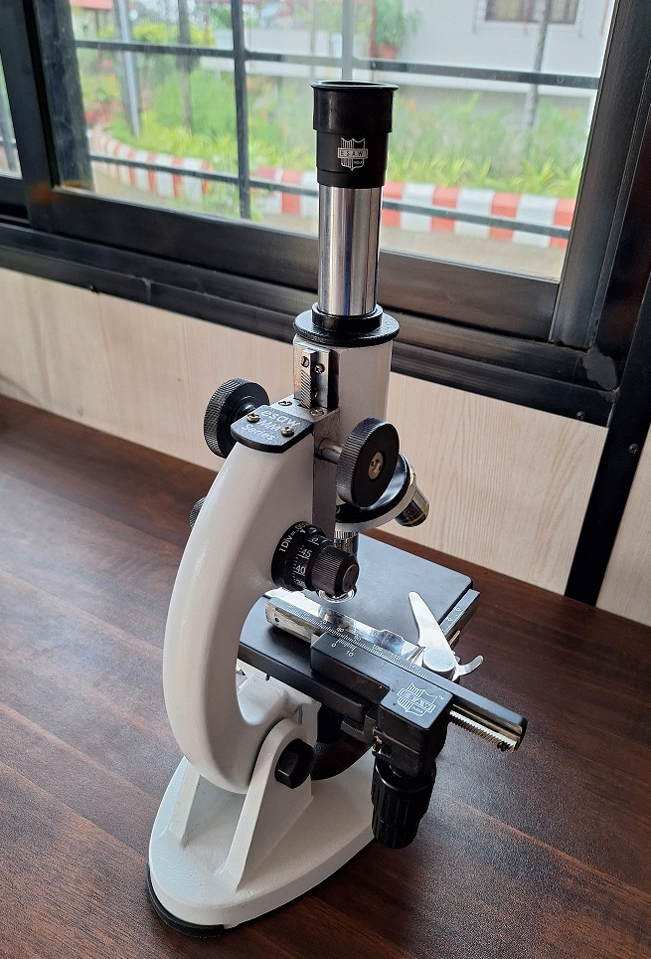
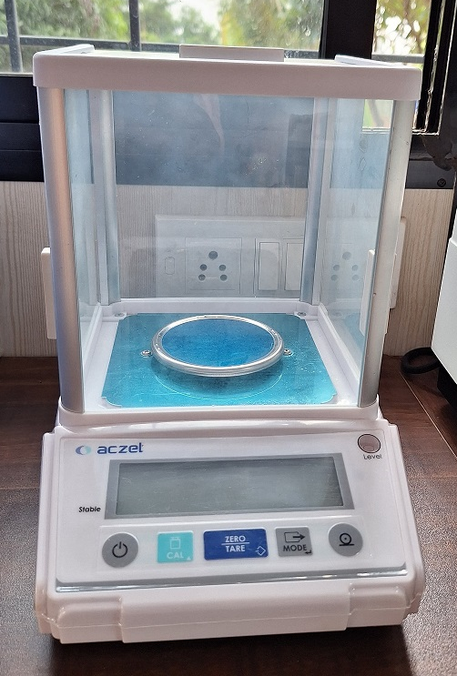
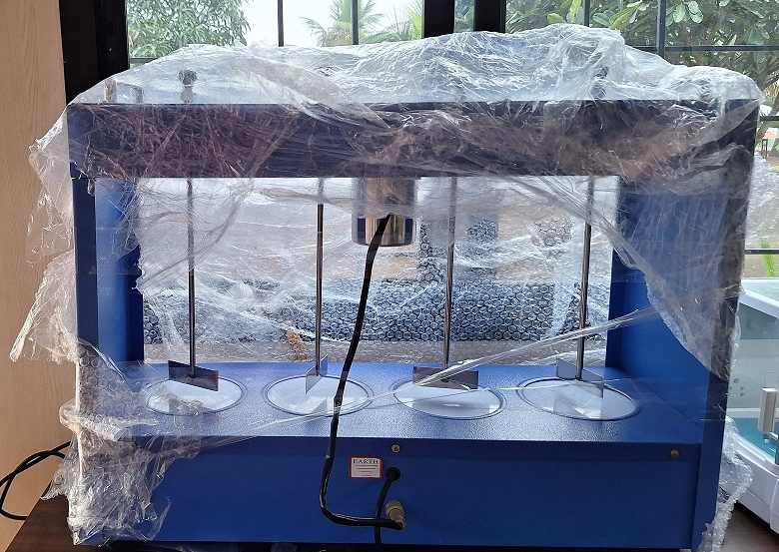
Basic Lab Instruments
Spectrophotometer
Microscope
Weighing balance
Jar Test Apparatus

Slide 12
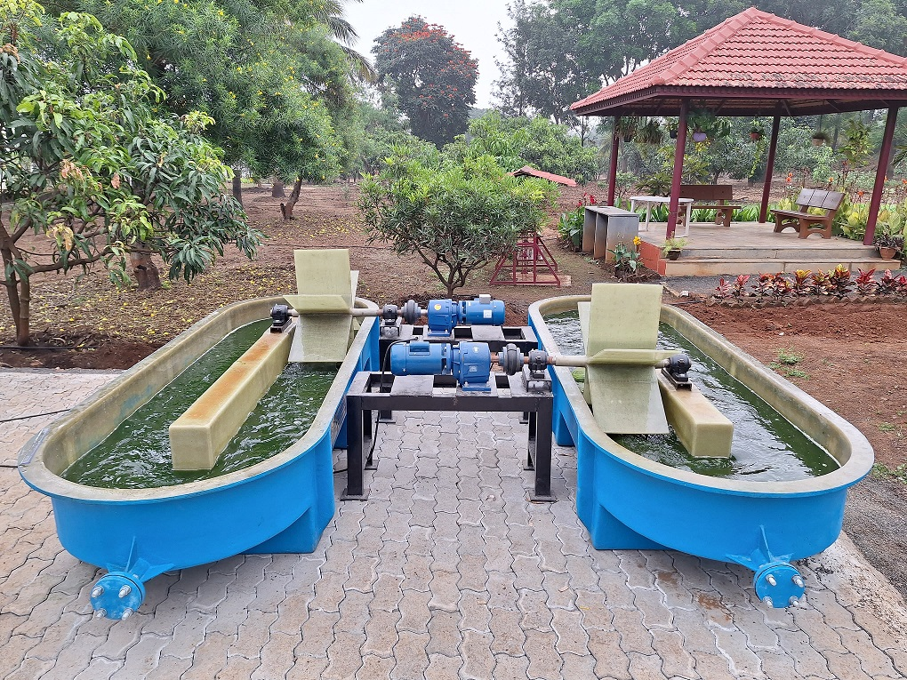
Two microalgae raceway ponds – 3m² each

Slide 13
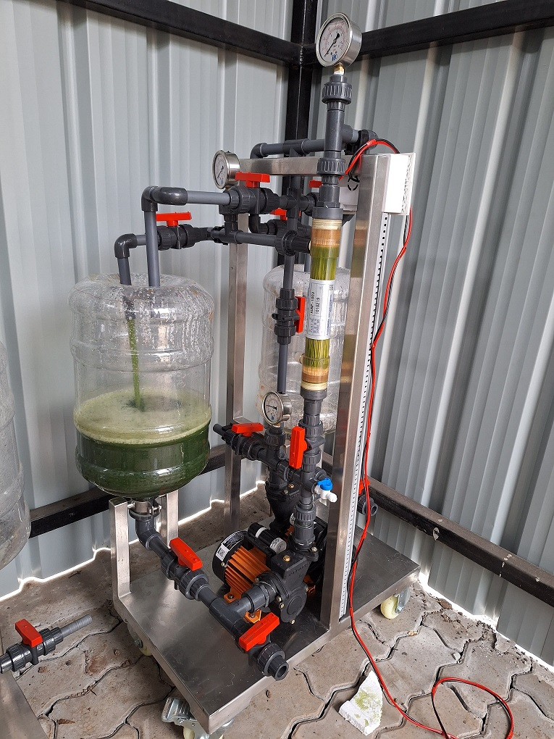
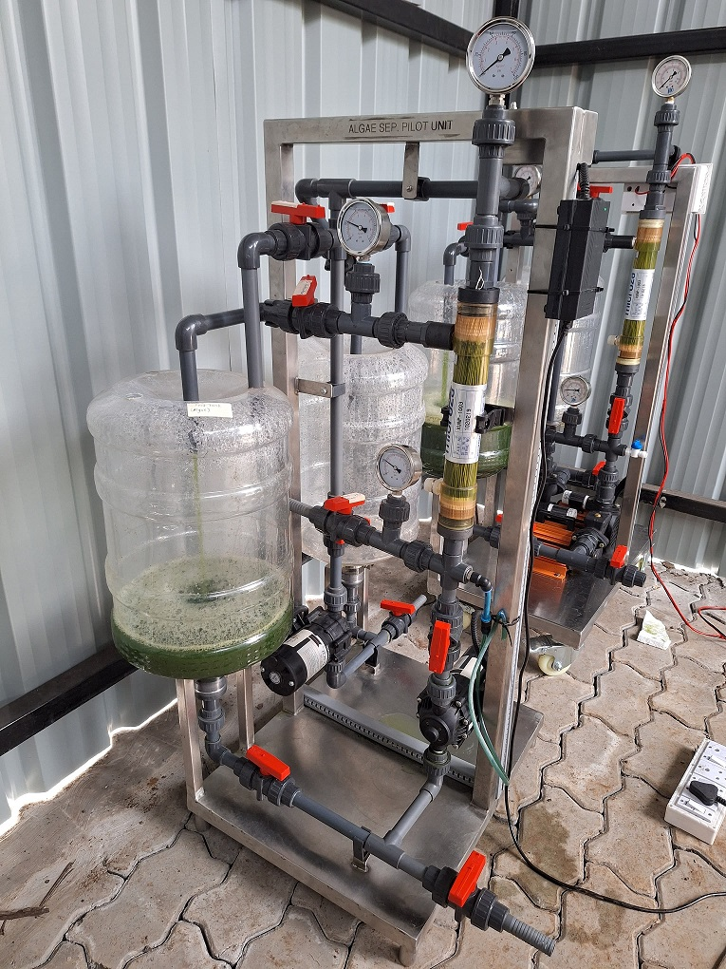
Two bench-top microfiltration skids

Slide 14
Link for a video-tour of the facility
https://drive.google.com/file/d/1-wR0E2DOfM1Ti8gyzxQlUGA8X3_yiwdt/view?usp=drive_link

