Slide 1
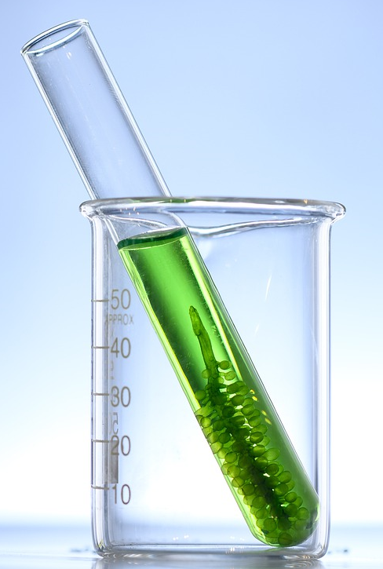
Microalgae for effluent treatment STP, ETP & CETP Models
An effective, sustainable, and revenue-generating process technology

Slide 2
The Need….and the opportunity
Impact of Climate Change is well known and gets discussed in perhaps every important international convention of developed and developing nations.
Our Nation has taken up ambitious NET ZERO goals.
In the conventional effluent treatment processes, Scope 1 and Scope 2 emissions are usually significant. Hence, switching to more sustainable wastewater mitigation technologies will soon be a need of the hour
(NEED) An ideal sustainable option for wastewater treatment should:
Utilize less energy
Result in very low carbon emissions
Produce clean water, and
Provide a co-product opportunity to improve the circularity quotient of carbon!
(OPPORTUNITY) Microalgae-based wastewater treatment technology
Relies on sunlight as a source of energy; suitable weather conditions and ample sunlight availability throughout the year over here!
Consumes carbon and ammonia while it emits oxygen
Generates clean and compliant water suitable for discharge/ re-use
Produces microalgae-biomass for various end-use applications, thus recycling the carbon and nutrients from domestic wastewater streams

Slide 3
An Exciting Clean-Tech for wastewater treatment….
Sustainable - Sunlight, the primary source of energy for our process, is free of cost, non-polluting and plentiful
Environment friendly* - O₂ released by algae, improves overall air and water quality in the environment
Effective (field data collected from one of our pilot-plant sites for treatment of manufacturing effluent streams)
Lucrative – Renewable algae biomass generated has potential value as feed, food and organic fertilizer. Protein content > 50%, high-value fats > 10% and high mineral and antioxidant content.
* – Most of the natural water body pollution by algae is from toxic blue-green algae (cyanobacteria), we are proposing use of beneficial green microalgae for this application

Slide 4
How does our process work?
A short schematics-based animation to illustrate the process of pollutant abatement by photosynthetic microalgae.
PS – You will need to click multiple times on the next slide for the animation to execute

Slide 5
Wastewater-IN
COD
Metals
COD
Algae
Co-product
Water-OUT
N, P
Algae
C0₂
0₂
0₂
0₂
0₂
0₂
0₂
Algae
0₂
Algae
Environalgae

Slide 6
Typical block-diagram for microalgae-based wastewater treatment
wastewater
O₂
Treated water for re-use
Algae biomass for use as co-product

Slide 7
Algae versus conventional option
Parameter | Conventional effluent treatment | Microalgae
Oxidizing agents | Need to be added at high mixing energy costs | Generated by microalgae through photosynthesis using sunlight
Ammonia etc. | Difficult/ expensive to remove, it generally degases out of the system | Decisive advantage through rapid metabolism of ammonia into proteins and amino acids
Operational exposure risks | Foul smell, exposure to pathogens | Shallow (<30 cm deep) water bodies that emit oxygen!
Carbon emissions | Generated and released into the atmosphere | Utilized by microalgae to produce more algal biomass and oxygen
Generated bio-sludge | Needs to be disposed | Platform feedstock for fertilizer, feed and biochemicals
Carbon capture | None | Huge potential to integrate carbon capture with effluent treatment

Slide 8
Why this technology makes more sense now?
Microalgae-based wastewater treatment can positively contribute towards mitigation of ill-effects from Climate Change by the virtue of being Sustainable, Circular, and Clean.
By primarily relying on natural sunlight for photosynthesis-mediated degradation of pollutants from the sewage, this process scores high on Sustainability.
By converting the waste organic carbon, nitrogen, phosphorus, and other nutrients, present in the effluent into nutritious, high-protein algal biomass with potential for use in the feed and fertilizer industry, this process also scores high on Circularity.
Finally, by generating clean water and releasing pure oxygen to the environment, this is essentially a Clean technology option for wastewater treatment.

Slide 9
History of use
Use of hi-rate oxidation ponds for effluent treatment has been practiced in the US since 1960’s. The working principle for these ponds revolves around the ability of algae to produce oxygen for enhancing the rate of effluent treatment
For instance, in the recent decades, a successful demonstration and operation of algae-based treatment was carried out at Christchurch, New Zealand.
Photo graphs and schematics from their website - https://www.waternz.org.nz/Article?Action=View&Article_id=780 are presented below

Slide 10
About Environalgae
Company website - https://environalgae.com
Contact
Email: ninadg@gmail.com or ninad@environalgae.com
Phone: +91-8600140949
Address: Environalgae, 1101 Millennium Empire, Plot 47 Sector 15, Near D-Mart, Kharghar, 410210 Maharashtra, India
We have now commissioned what is one of the largest microalgae-based end-to-end effluent treatment plants ever built. Its a novel, microalgae-based process that converts nutrients present in effluent from their agro-processing unit to high-value algal biomass for use as high-value feed for the aquaculture industry. Treated water generated from this process significantly exceeds the discharge specifications of the pollution control board.
Video of our process demo at pilot-scale
On YouTube - https://youtu.be/17b724g-i1M
On Vimeo - https://vimeo.com/820440530/7ab9f3f906?share=copy

Slide 11
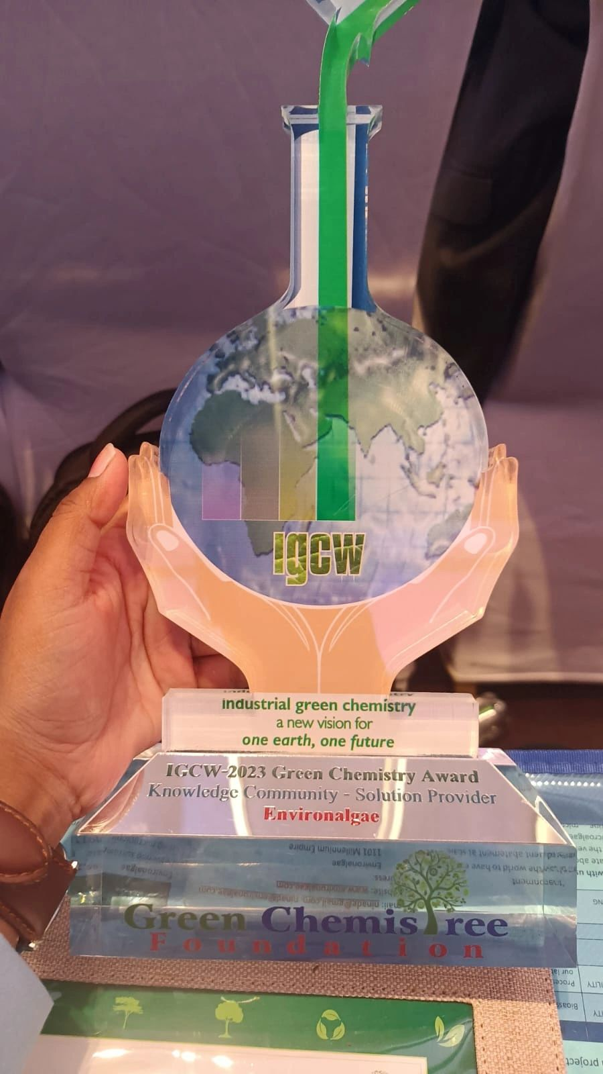
About Environalgae
Team with an ideal of youth and experience
Ninad Gujarathi, PhD (Proprietor and Founder)
Leadership experience in R&D, Techno-commercial, Manufacturing and Business roles, with proven track record of evaluating, conceptualizing, innovating, developing, scaling-up, delivering process & business solutions, and business growth.
Experience in conceptualizing, designing, executing, commissioning and operating some of the world’s first and largest algae-based carbon capture and process effluent treatment plants.
Rahul Patel, PhD (Chief Technologist)
Experience in developing cultivation biology process schemes, executing, commissioning and operating one of the world’s first and largest algae-based carbon capture and process effluent treatment plants.
A team of FIVE Biologists, FOUR Engineers and ONE supervisor to help our customers with research, development, designing, executing, and commissioning this emerging technology
Best Technology Solutions Provider at the Annual IGCW Awards 2023

Slide 12
Why Environalgae?
As a team, we are among the very few across the world to have experience in developing, demonstrating and executing microalgae-based effluent abatement projects
Significant experience in managing large and multi-national microalgae projects across the world
Top management of the team are experienced R&D, technology & business leaders with illustrious corporate careers prior to establishing Environalgae
We develop & provide customized process technology solutions for your effluent treatment needs
We follow a phase-gate approach with focus on developing and demonstrating value-addition at each stage of the project, prior to presenting a business case for further investment by customer
We are passionate about the environment and also about the potential of microalgae for meaningfully contributing towards resolution of some of the greatest climate challenges that mankind has ever faced

Slide 13
Our Phase-gate approach….
Phase | Phase description | Remarks
SCIENTIFIC FEASIBILITY ASSESSMENT | Algal bioassays at Environalgae lab | One month of studies at low cost
TECHNICAL FEASIBILITY ASSESSMENT | Process development at Environalgae lab | Two-three months paid project
VALIDATION STUDIES | Pilot-scale demonstration-validation studies at Environalgae pilot-plant facility | Max. one month paid project
COMMERCIAL VIABILITY ASSESSMENT | Prefeasibility study to scope out the proposed full-scale process | One month assignment
DESIGN | Design of the full-size ETP plant | Two-Three months paid project
EXECUTION & COMMISSIONING | Execution and Commissioning of the full-size ETP plant | Two-Four months paid execution work

Slide 14
What we are offering: Microalgae-based treatment plant process for…..
Segment | Sweet-spot | Remarks
Small ETPs (10-100 KLD) | High TDS or Ammonia containing effluent | Unique and unparalleled experience in scaling up microalgal processes from lab-scale to very large algal facilities (dozens of acres in size) We offer end-to-end services starting with process technology package development, pilot testing to plant commissioning and handover
Large ETPs (100-3,000 KLD) | Superior sustainability impact over conventional processes Attractive ROI
CETPs (2,000⁺ KLD) |  | Option A: Process Technology, Process Design, Process Technology package, pilot testing to full-scale STP commissioning and handover Option B: Pilot/ Demo systems for validation of feasibility & viability at existing CETP units. Option C: Dedicated end-to-end concise sub-plant at existing CETP units for abating specific problem effluent streams (high TDS, high Ammonia, high Chloride, high COD etc.) Option D: Segregated end-to-end ETP for individual member industries that have effluent streams which are out of specifications for the CETP design (high TDS, high Ammonia, high Chloride, high COD etc.)
Small common STPs (1-10 MLD) |  | Unique and unparalleled experience in scaling up microalgal processes from lab-scale to very large algal facilities (dozens of acres in size) We offer end-to-end services starting with process technology package development, pilot testing to plant commissioning and handover
Large common STPs (10-150⁺ MLD)
#Microalgae-based STPs smaller than 1 MLD are not commercially attractive in terms of ROI or payback period as compared to conventional STPs

Slide 15
Microalgae-based Effluent & Sewage-water treatment Sustainability benefits & Revenue potential
 | 30 KLD ETP | 300 KLD ETP | 3,000 KLD CETP | 10 MLD STP | 150 MLD STP
COD assumed, mg/L | 4,500 | 4,500 | 4,500 | 750 | 750
Ammoniacal-N assumed, mg/L | 100 | 100 | 100 | 40 | 40
Land required, acres | 0.33 | 2.8 | 28 | 19 | 278
CAPEX, ₹Crores | 0.83 | 3.5 | 26 | 13.9 | 139
OPEX*, ₹Crores/ year | 0.4 | 1.7 | 8.7 | 4.9 | 56
Algae# generation, MT/year | 134 | 928 | 9,281 | 4,950 | 74,250
Annual Margin, ₹Crores/ year | 0.07 | 1.6 | 24 | 7.4 | 129
Return on CAPEX | 8% | 46% | 90% | 54% | 93%
Payback on CAPEX, years | 12.1 | 2.2 | 1.1 | 1.9 | 1.1
CO₂ Eq. Reduction MT/year | 888 | 9,517 | 95,169 | 63,858 | 957,870
O₂ released MT/year | 78 | 653 | 6,535 | 4,357 | 65,350
# Algae wet cake at 10% solids concentration sold at ₹25/kg from STP and ₹35/kg from ETP; *After accounting for interest on CAPEX @8% and depreciation of CAPEX over 10 years

Slide 16
Typical composition of fresh-wet microalgal slurry
Typical composition of algal biomass (on wet-cake basis; 10% solids) CENTRIFUGED FRESH SLURRY | Remarks
COMPONENT | CONTENT | REMARKS
Water | 90.0% | Over half of this is water present inside the algal cells
Proteins | 5.0% | Attractive amino acid profiles
Fats | 1.5% | High MUFA & PUFA content, no trans fats
Carbohydrates | 1.5% | Fiber content
Minerals | 1.5% | Mg, Ca etc.
High-value phytochemicals | 0.5% | Antioxidants and pigments
Tremendous potential as a feedstock for Feed/ Fertilizers/ Biochemicals/ Food

Slide 17
Potential commercial applications of microalgal biomass
Application as | Minimum price for 10% solids wet slurry (₹/kg) | Remarks
Attractive high-value fertilizer application | 25 | Environalgae can work with the customer for developing off-take options for the microalgal biomass produced through the process
Live feed - for producing “live/ fresh, naturally-fed” aquaculture feed | 50 | Will need to be distributed as “fresh algal slurry” just like milk Can be tested by your acquaintances in the shrimp industry Commercial live-frozen microalgae sells at over $77/Liter
Supplement in aquaculture feed – ingredient rich in proteins, antioxidants & essential fats | 40 | Can be tested in the aquaculture industry Pricing potential will need to be established
Human dietary supplement – rich in proteins, antioxidants & essential fats | 100* | *Will need spray drying into powder/ tablets to remove 90% water Commercial Chlorella tablets available in the market sell at close to ₹5,000/kg

