Slide 1
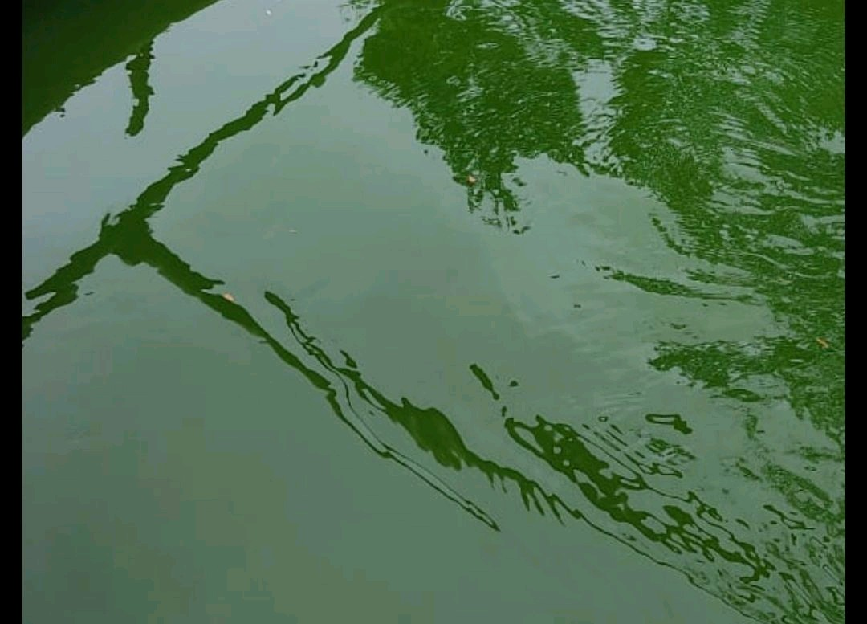
Microalgae for valorization of industrial & municipal wastewater
Environalgae
An effective, sustainable, and revenue-generating process technology

Slide 2
Problem Statement
The UN General Assembly in 2017 approved the global indicator monitoring framework developed by the Inter-Agency and Expert Group on Sustainable Development Goal Indicators (IAEG-SDG), and for the first time put wastewater on the global development agenda. [1]
SDG 6 is about ensuring the availability and sustainability of water and sanitation for all by 2030 and addresses the entire sanitation chain [1]
Globally, ~400 billion m³/year of wastewater is produced, expected to increase by 25% and 50% by 2030 and 2050, respectively [2].
80% of all wastewater is discharged untreated, creating a serious sanitation crisis for 4.5 billion people [2]
Wastewater systems contribute to greenhouse-gas emissions (GHG) both directly through breakdown of organic matter discharged into the environment or during treatment processes, and indirectly through the energy required for treatment steps.
Account for 3% of global electricity consumption & degradation of organic matter contributes ~1.57% of global GHG emissions [3].
Removal of major nutrients (C, N & P) is essential for environmental protection but through sustainable & circular routes [4]
Integration of microalgae-based wastewater treatment can help recover nutrients & reduce cost of aeration by providing oxygen through photosynthesis [4]
[1] UN Habitat and WHO, 2021. Progress on wastewater treatment – Global status and acceleration needs for SDG indicator 6.3.1. United Nations Human Settlements Programme (UN-Habitat) and World Health Organization (WHO), Geneva
[2] Pathways to a net-zero-carbon water sector through energy extracting wastewater technologies. npj Clean Water (2022) 5:49; https://doi.org/10.1038/s41545-022-00197-8
[3] Sustainable sanitation and gaps in global climate policy and financing. npj Clean Water (2020) 3:24; https://doi.org/10.1038/s41545-020-0072-8
[4] Transitioning Wastewater Treatment Plants toward Circular Economy and Energy Sustainability. ACS Omega 2021, 6, 11794−11803

Slide 3
The Need….and the opportunity
Impact of Climate Change is well known and gets discussed in perhaps every important international convention of developed and developing nations.
Our Nation has taken up ambitious NET ZERO goals.
In the conventional effluent treatment processes, Scope 1 and Scope 2 emissions are usually significant. Hence, switching to more sustainable wastewater mitigation technologies will soon be a need of the hour
(NEED) An ideal sustainable option for wastewater treatment should:
Utilize less energy
Result in very low carbon emissions
Produce clean water, and
Provide a co-product opportunity to improve the circularity quotient of carbon!
(OPPORTUNITY) Microalgae-based wastewater treatment technology
Relies on sunlight as a source of energy; suitable weather conditions and ample sunlight availability throughout the year over here!
Consumes carbon and ammonia while it emits oxygen
Generates clean and compliant water suitable for discharge/ re-use
Produces microalgae-biomass for various end-use applications, thus recycling the carbon and nutrients from domestic wastewater streams

Slide 4
An Exciting Clean-Tech for wastewater treatment….
Sustainable - Sunlight, the primary source of energy for our process, is free of cost, non-polluting and plentiful
Environment friendly* - O₂ released by algae, improves overall air and water quality in the environment
Effective (field data collected from one of our pilot-plant sites for treatment of manufacturing effluent streams)
Lucrative – Renewable algae biomass generated has potential value as feed, food and organic fertilizer. Protein content > 50%, high-value fats > 10% and high mineral and antioxidant content.
* – Most of the natural water body pollution by algae is from toxic blue-green algae (cyanobacteria), we are proposing use of beneficial green microalgae for this application

Slide 5
How does our process work?
A short schematics-based animation to illustrate the process of pollutant abatement by photosynthetic microalgae.
PS – You will need to click multiple times on the next slide for the animation to execute

Slide 6
Wastewater-IN
COD
Metals
COD
Algae
Co-product
Water-OUT
N, P
Algae
C0₂
0₂
0₂
0₂
0₂
0₂
0₂
Algae
0₂
Algae
Environalgae

Slide 7
Typical block-diagram for microalgae-based wastewater treatment
wastewater
O₂
Treated water for re-use
Algae biomass for use as co-product

Slide 8
Algae versus conventional option
Parameter | Conventional effluent treatment | Microalgae
Oxidizing agents | Need to be added at high mixing energy costs | Generated by microalgae through photosynthesis using sunlight
Ammonia etc. | Difficult/ expensive to remove, it generally degases out of the system | Decisive advantage through rapid metabolism of ammonia into proteins and amino acids
Operational exposure risks | Foul smell, exposure to pathogens | Shallow (<30 cm deep) water bodies that emit oxygen!
Carbon emissions | Generated and released into the atmosphere | Utilized by microalgae to produce more algal biomass and oxygen
Generated bio-sludge | Needs to be disposed | Platform feedstock for fertilizer, feed and biochemicals
Carbon capture | None | Huge potential to integrate carbon capture with effluent treatment

Slide 9
How would the end-user benefit by deploying this technology?
Effective abatement of pollutants under broad conditions
A process technology that can customised based on the nature of effluent streams generated at customer site
A process that is effective at low pH and high salt concentrations
A process that can not only remove COD & BOD (carbon), but also remove Ammoniacal nitrogen, phosphorus and other nutrients. And hence help avoid Nitrous Oxide emissions; which is otherwise >265 times more potent at global warming than Carbon-dioxide
Sustainable
Uses sunlight as the primary source of energy and generates oxygen and hence reduces energy requirement for aeration-mixing
Explore the potential of Carbon Emissions Reduction (CER) credits.
Clean-tech
Generates clean water that can be re-cycled and re-used; over 90% of the treated water can be viably recycled through Reverse Osmosis
Releases oxygen into the atmosphere and hence cleaning the air
Profitable
Microalgae biomass generated from the process has huge potential as feedstock in the Feed, Fertilizer & Biofuels industries
Improved Brand-value
Deployment of low-carbon & circular solutions for effluent treatment can help improve brand value and reduce Scope 3 emissions for their customers
Positive socio-economic impact on Agricultural economy through production of bio-stimulants & live feed for Farming & Aquaculture, respectively

Slide 10
Why this technology makes more sense now?
Microalgae-based wastewater treatment can positively contribute towards mitigation of ill-effects from Climate Change by the virtue of being Sustainable, Circular, and Clean.
By primarily relying on natural sunlight for photosynthesis-mediated degradation of pollutants from the wastewater, this process scores high on Sustainability.
By converting the waste organic carbon, nitrogen, phosphorus, and other nutrients, present in the effluent into nutritious, high-protein algal biomass with potential for use in the Agriculture & Aquaculture industry, this process also scores high on Circularity.
Finally, by generating clean water and releasing pure oxygen to the environment, this is essentially a Clean technology option for wastewater treatment.

Slide 11
About Environalgae
Company website - https://environalgae.com
Email: ninadg@gmail.com or ninad@environalgae.com
Phone: +91-8600140949
Address: Environalgae, 1101 Millennium Empire, Plot 47 Sector 15, Near D-Mart, Kharghar, 410210 Maharashtra, India
We have now commissioned what is one of the largest microalgae-based end-to-end effluent treatment plants ever built. Its a novel, microalgae-based process that converts nutrients present in effluent from their agro-processing unit to high-value algal biomass for use as high-value feed for the aquaculture industry. Treated water generated from this plant meet the discharge specifications of the pollution control board.
Links to videos on our lab, pilot plants and full-scale plant set-up by us:
Content | Google Drive Links
Environalgae lab | https://drive.google.com/file/d/1l5MLLbTSestZk6fXQrWyot9uCabjPdsl/view?usp=drive_link
Environalgae pilot-test-bed facility | https://drive.google.com/file/d/1-wR0E2DOfM1Ti8gyzxQlUGA8X3_yiwdt/view?usp=drive_link
Pilot-process set-up at customer site | https://drive.google.com/file/d/1vl2Ghuwv4R5BaQ3N-yigcR3ddtpuh40t/view?usp=drive_link
Full-scale process set-up at customer site | https://drive.google.com/file/d/1PHArZ1_oXJr2etdRPC1DAG7KLKIIPqQP/view?usp=drive_link https://drive.google.com/file/d/1Uf2zO3YMF24cR0UpHgOyKvWNVjkS_VYO/view?usp=drive_link

Slide 12
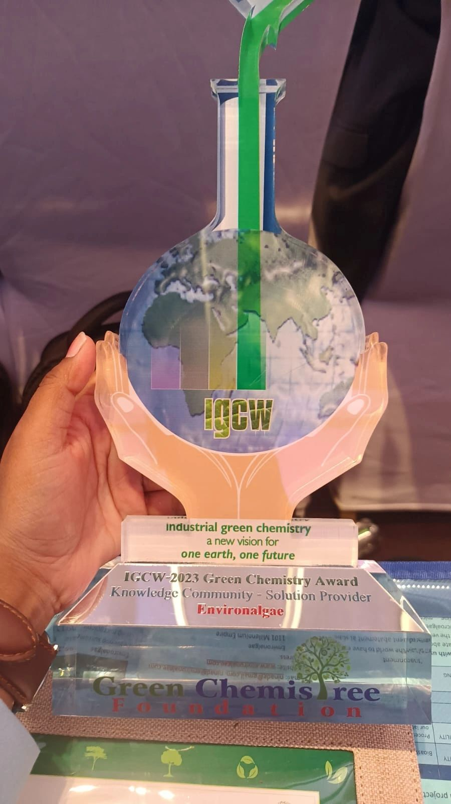
About Environalgae
Team with an ideal of youth and experience
Ninad Gujarathi, PhD (Proprietor and Founder)
Leadership experience in R&D, Techno-commercial, Manufacturing and Business roles, with proven track record of evaluating, conceptualizing, innovating, developing, scaling-up, delivering process & business solutions, and business growth.
Experience in conceptualizing, designing, executing, commissioning and operating some of the world’s first and largest algae-based carbon capture and process effluent treatment plants.
Rahul Patel, PhD (Chief Technologist)
Experience in developing cultivation biology process schemes, executing, commissioning and operating one of the world’s first and largest algae-based carbon capture and process effluent treatment plants.
A team of FIVE Biologists, FOUR Engineers and ONE supervisor to help our customers with research, development, designing, executing, and commissioning this emerging technology
Best Technology Solutions Provider at the Annual IGCW Awards 2023

Slide 13
Why Environalgae?
As a team, we are among the very few across the world to have experience in developing, demonstrating and executing microalgae-based effluent abatement projects
Significant experience in managing large and multi-national microalgae projects across the world
Top management of the team are experienced R&D, technology & business leaders with illustrious corporate careers prior to establishing Environalgae
We develop & provide customized process technology solutions for your effluent treatment needs
We follow a phase-gate approach with focus on developing and demonstrating value-addition at each stage of the project, prior to presenting a business case for further investment by customer
We are passionate about the environment and also about the potential of microalgae for meaningfully contributing towards resolution of some of the greatest climate challenges that mankind has ever faced

Slide 14
Our Phase-gate approach….
Phase | Phase description | Remarks
SCIENTIFIC FEASIBILITY ASSESSMENT | Algal bioassays at Environalgae lab | One month of studies at low cost
TECHNICAL FEASIBILITY ASSESSMENT | Process development at Environalgae lab | Two-three months paid project
VALIDATION STUDIES | Pilot-scale demonstration-validation studies at Environalgae pilot-plant facility | Max. one month paid project
COMMERCIAL VIABILITY ASSESSMENT | Prefeasibility study to scope out the proposed full-scale process | One month assignment
DESIGN | Design of the full-size ETP plant | Two-Three months paid project
EXECUTION & COMMISSIONING | Execution and Commissioning of the full-size ETP plant | Two-Four months paid execution work

Slide 15
What we are offering: Microalgae-based treatment plant process for…..
Segment | Sweet-spot | Remarks
Small ETPs (10-100 KLD) | High TDS or Ammonia containing effluent | Unique and unparalleled experience in scaling up microalgal processes from lab-scale to very large algal facilities (dozens of acres in size) We offer end-to-end services starting with process technology package development, pilot testing to plant commissioning and handover
Large ETPs (100-3,000 KLD) | Superior sustainability impact over conventional processes Attractive ROI
CETPs (2,000⁺ KLD) |  | Option A: Process Technology, Process Design, Process Technology package, pilot testing to full-scale STP commissioning and handover Option B: Pilot/ Demo systems for validation of feasibility & viability at existing CETP units. Option C: Dedicated end-to-end concise sub-plant at existing CETP units for abating specific problem effluent streams (high TDS, high Ammonia, high Chloride, high COD etc.) Option D: Segregated end-to-end ETP for individual member industries that have effluent streams which are out of specifications for the CETP design (high TDS, high Ammonia, high Chloride, high COD etc.)
Small common STPs (1-10 MLD) |  | Unique and unparalleled experience in scaling up microalgal processes from lab-scale to very large algal facilities (dozens of acres in size) We offer end-to-end services starting with process technology package development, pilot testing to plant commissioning and handover
Large common STPs (10-150⁺ MLD)
#Microalgae-based STPs smaller than 1 MLD are not commercially attractive in terms of ROI or payback period as compared to conventional STPs

Slide 16
Microalgae-based Effluent & Sewage-water treatment Sustainability benefits & Revenue potential
Capacity of plant | 30 KLD ETP | 300 KLD ETP | 3,000 KLD CETP | 10 MLD STP | 150 MLD STP
COD assumed, mg/L | 4,500 | 4,500 | 4,500 | 750 | 750
Ammoniacal-N assumed, mg/L | 100 | 100 | 100 | 40 | 40
Land required, acres | 0.33 | 2.8 | 28 | 19 | 278
Algae# generation, MT/year | 134 | 928 | 9,281 | 6,118 | 92,813
Payback on CAPEX, years | 4.3 | 2.5 | 0.9 | 0.7 | 0.5
Min. RO water generated KLD | 17 | 184 | 1841 | 8,500 | 127,000
CO₂ Eq. Reduction MT/year | 888 | 9,517 | 95,169 | 62,996 | 944,933
O₂ released MT/year | 78 | 653 | 6,535 | 4,357 | 65,350
# Algae wet cake at 10% solids concentration sold at ₹60/; *After accounting for interest on CAPEX @8% and depreciation of CAPEX over 10 years

Slide 17
Typical composition of fresh-wet microalgal slurry
Typical composition of algal biomass (on wet-cake basis; 10% solids) CENTRIFUGED FRESH SLURRY | Remarks
COMPONENT | CONTENT | REMARKS
Water | 90.0% | Over half of this is water present inside the algal cells
Proteins | 5.0% | Attractive amino acid profiles
Fats | 1.5% | High MUFA & PUFA content, no trans fats
Carbohydrates | 1.5% | Fiber content
Minerals | 1.5% | Mg, Ca etc.
High-value phytochemicals | 0.5% | Antioxidants and pigments
Tremendous potential as a feedstock for Feed/ Fertilizers/ Biochemicals/ Food

Slide 18
Potential commercial applications of microalgal biomass
Application as | Minimum price for 10% solids wet slurry (₹/kg) | Remarks
Attractive high-value fertilizer application | 60 | Environalgae can work with the customer for developing off-take options for the microalgal biomass produced through the process
Live feed - for producing “live/ fresh, naturally-fed” aquaculture feed | 50 | Will need to be distributed as “fresh algal slurry” just like milk Can be tested by your acquaintances in the shrimp industry Commercial live-frozen microalgae sells at over $77/Liter
Supplement in aquaculture feed – ingredient rich in proteins, antioxidants & essential fats | 50 | Can be tested in the aquaculture industry Pricing potential will need to be established

Slide 19
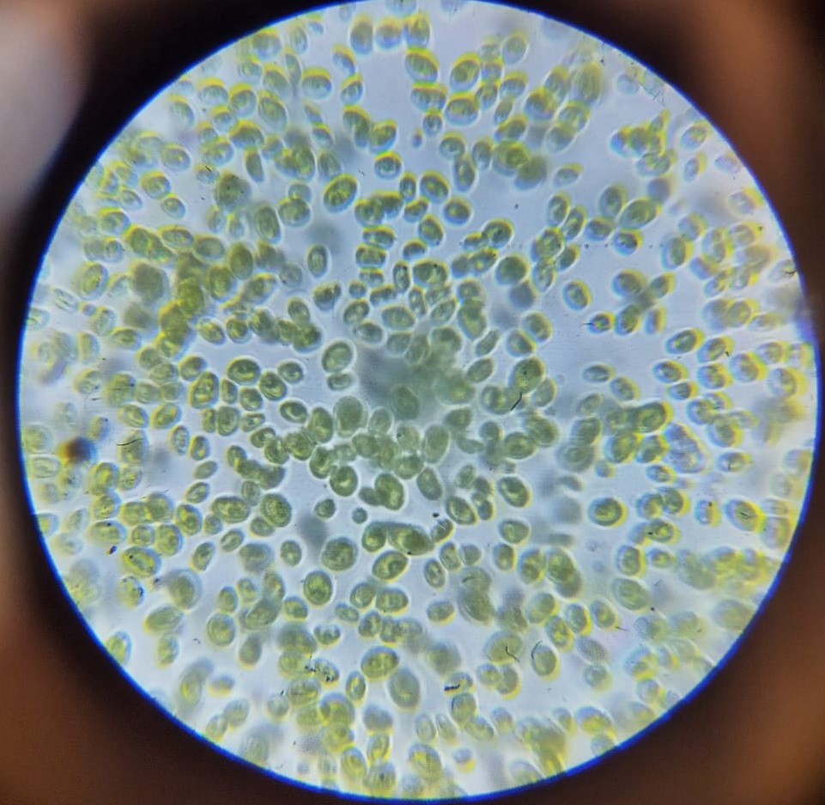
Microalgae For Regenerative Agriculture & Sustainable Aquaculture
Effluent
Carbon, ammonia & minerals
RO Water
Microalgae-production in open ponds
Crop Biostimulant
Aquaculture feed
Global Agriculture Industry
US$ 15 Trillion Industry today!
Regenerative agriculture being encouraged
Population, limited land & water resources
Need higher crop yields
Microalgal Bio-stimulants
Long-known to be an excellent stimulant
Massive scalability when integrated with water treatment
Produced in Sustainable & Circular process
Highly effective in stimulating crop growth, improving crop quality & crop yields
Doesn’t need freshwater or arable land
Global Aquaculture Industry
US$ 300 Billion Industry today!
Sustainable Aquaculture being promoted
Growing protein-meal demand
Overfishing for fishmeal destabilizing ocean ecosystems
Microalgae-based feed
Natural & primary source in food chain
Wholesome & nutritious live-feed for hatcheries
Produce naturally-fed fishes/ shrimps
Use microalgae for producing zooplankton as live-feed!
Microalgae biomass
Proteins, lipids, vitamins, pigments, bio-available minerals & other biomolecules
Nature’s richest food-source
Sustainably produced (GHG emissions reduction)
Circular product (Best out of Waste/ Waste to Gold!)
Massive cost advantage over any other process

Slide 20
Opportunity for Microalgae-based Bio-stimulants (MBST)
Need for Regenerative Agricultural practices to improve sustainability in Agriculture
In 2018, world total agriculture and related land use emissions reached 9.3 billion tonnes of carbon dioxide equivalent (Gt CO2eq). In 2018, agriculture and related land use emissions accounted for 17% of global GHG emissions from all sectors. [5]
Agriculture is a major contributor to global emissions of the GHGs that drive climate change. Action in this arena also makes good business sense. By addressing GHG emissions, companies (and producers) can identify opportunities to bolster their bottom line, reduce risk, and discover competitive advantages [6]
Biostimulants
As per a 2022 report by the Food and Agriculture Organization (FAO), United Nations [7]
Algae and plant extracts, chitosans, and other biopolymers are also used as biostimulants.
Some advantages of biostimulant application include:
Improvement of efficiency in the absorption and assimilation of nutrients,
Tolerance to biotic or abiotic stresses, or improving any of their agronomic characteristics.
They could complement, and in some cases substitute, chemical agro-products; that could improve plants metabolism and biochemical activities.
[5] Emissions due to agriculture Global, regional and country trends 2000–2018. Food and Agriculture Organization of the United Nations. SSN 2709-006X [Print] ISSN 2709-0078 [Online].
[6] GHG Protocol Agricultural Guidance Interpreting the Corporate Accounting and Reporting Standard for the agricultural sector. World Resources Institute. Homepage | GHG Protocol
[7] Soils for nutrition: state of the art. Food and Agriculture Organization of the United Nations Rome, 2022. FAO, 2022. Soils for nutrition: state of the art. Rome. https://doi.org/10.4060/cc0900en

Slide 21
Opportunity for Microalgae-based Bio-stimulants (MBST)
Opportunity
The current global market for plant growth promoters and bio-stimulants is valued at USD 3.2 billion and forecasted to reach USD 5.6 billion by the year 2026 [8].
Price is a factor that could hinder the experimental research and adoption of biostimulants can be more expensive than certain type of fertilizers. [7]
Therefore, any sustainable & circular product that significantly improves agriculture crop quality and crop yields has a massive market potential, if it is priced reasonably
Global Agriculture market size is about $15Trillion and is only expected to grow further
Even a 20% increase in crop productivity and yield, and given the positive impact on sustainability, can create a massive market for Microalgae-based Bio-stimulants (MBSTs).
The current cost of production for our process, as proven at scale, is at least ten times lower than the market prices of other bio-stimulants
[7] Soils for nutrition: state of the art. Food and Agriculture Organization of the United Nations Rome, 2022. FAO, 2022. Soils for nutrition: state of the art. Rome. https://doi.org/10.4060/cc0900en
[8] https://www. marketsandmarkets.com/Market-Reports/biostimulant-market-1081. html

Slide 22
Some examples of successful application of MBSTs
Crop | Microalgae sp. | Mode of application | Results | Reference
Wheat | Chlorella V. | Foliar spray | 140% increase in wheat yield against control | Shaaban, M. M. (2001a). Green microalgae water extract as foliar feeding to wheat plants. Pak J Biol. 4(6):628–32. doi: 10.3923/pjbs.2001.628.632
Onion | Scenedesmus subspicatus | Foliar | 135% increase in onion yield against control | Gemin, L. G., Mógor,Á.F., Amatussi, J., De Lara, G. B., and Mógor, G. (2022). Organic onion growth, yield and storage improved by foliar sprays of microalgae and fulvic acid as a natural biofertilizer. Bioscience J. 38 (e38045), 1981–3163. doi: 10.14393/BJv38n0a2022- 58854
Black Gram | Chlorella V. | Foliar | 119% increase in Black gram yield against control | https://www.researchgate.net/publication/327896307_Prospective_of_Chlorella_vulgaris_to_Augment_Growth_and_Yield_Parameters_Along_with_Superior_Seed_Qualities_in_Black_Gram_Vigna_mungo_L

Slide 23
Why microalgae-based biostimulants (MBSTs) are highly effective
All-in-one recipe
From photosynthetic green microalgae to agricultural crops
Auxins, Cytokinins, Flavonoids & other Natural Growth hormones
Chlorophyll, carotenoids and antioxidants that help Improve Photosynthesis
Organic carbon and other natural chelators that Improve Soil Health and Nutrient update
A complete recipe of micro and macro nutrients that help Optimize Plant Metabolism
Polysaccharides, Amino acids that boost Biotic & Abiotic Stress Tolerance

Slide 24
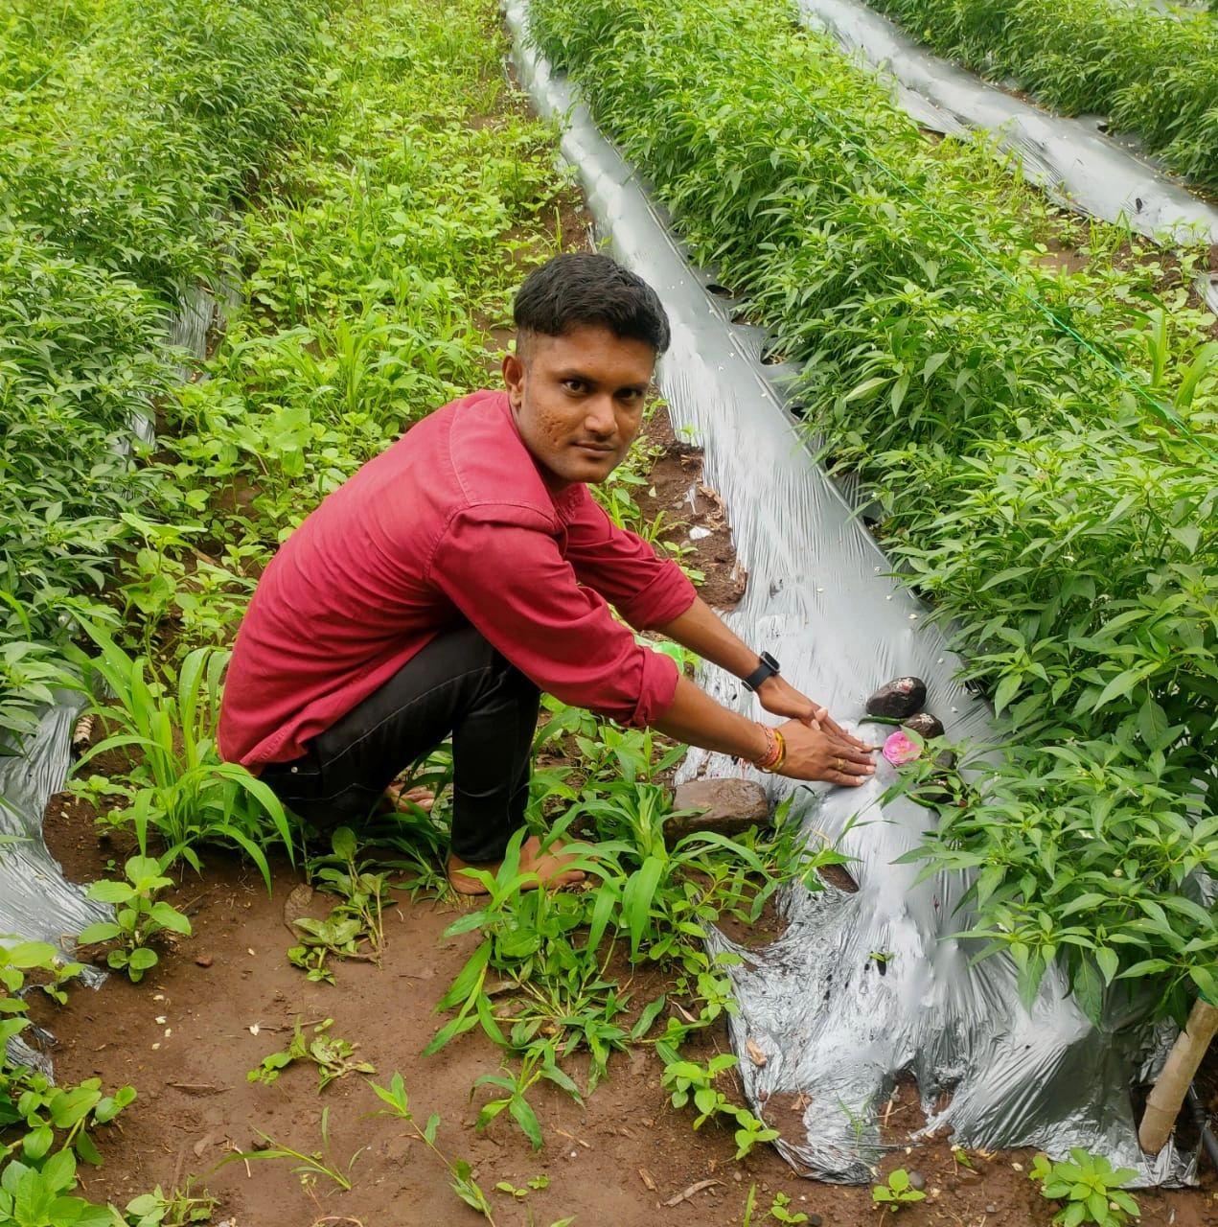
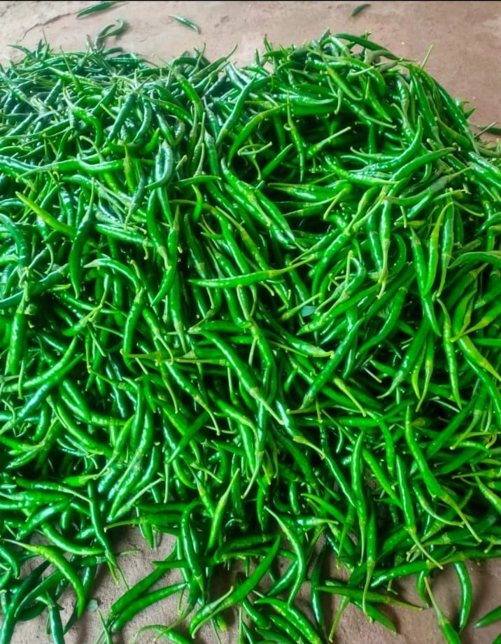
Microalgae-based Biostimulants (MBSTs) tested in fields
The name of this farmer is Mr. Yashpal Patil, and he is from Nandurbar district in Maharashtra, India.
He had applied our microalgae-based Biostimulant as per the following schedule:
1 Liter/acre on day-4 via drenching
0.7 Liters/acre on day-12 via foliar sprays
0.7 Liters/acre on day-28 via foliar sprays
On 19th of July, he was able to take his first harvest from the Crop. He typically takes 8-10 harvests over the crop cycle.
His observations compared to last year are:
Chilies are dark green and more vibrant in appearance
The size of Chilies is bigger this time.
Yield has increased by 25% (5 quintals/acre as against 4 quintals/acre) in the first harvest

Slide 25
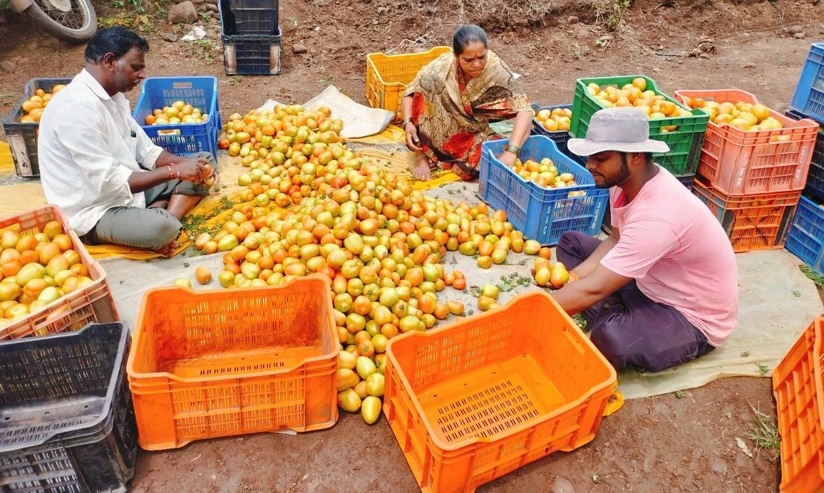
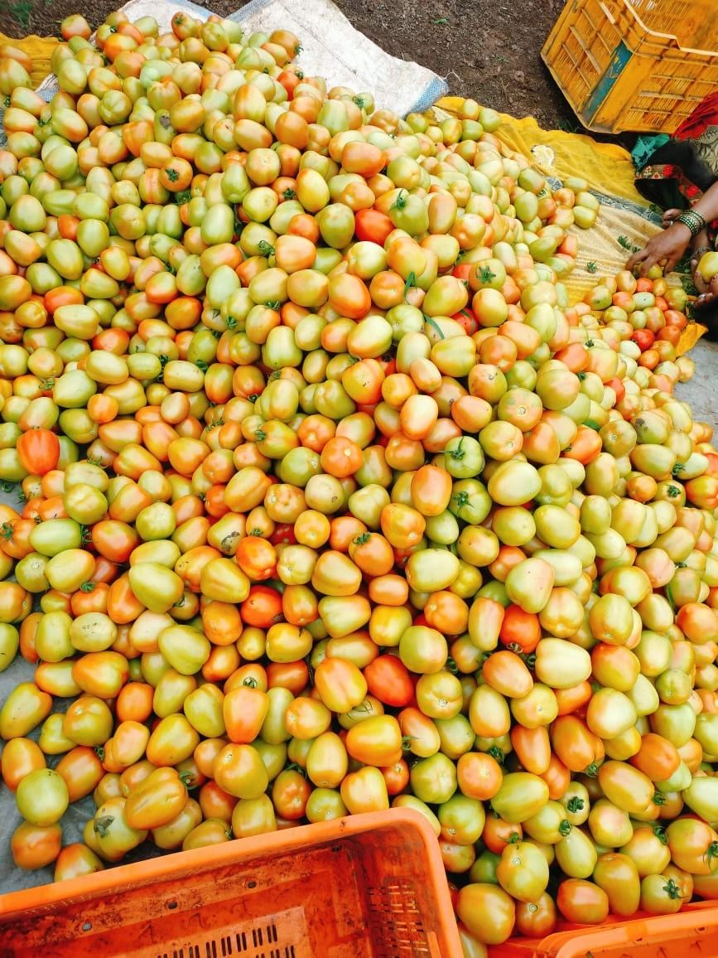
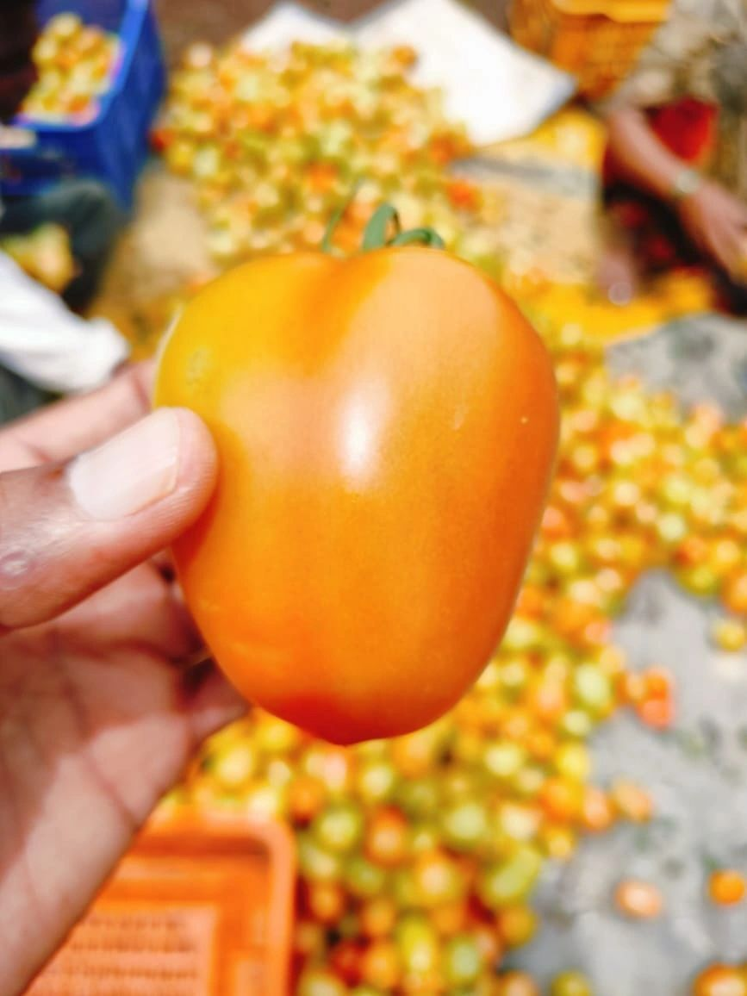
Microalgae-based Biostimulants (MBSTs) tested in fields
The name of this farmer is Mr. Abhishek Jadhav, and he is from Nashik, Maharashtra (India).
He has been applying the MBST in his field since the beginning of his tomato crop this year.
He applies about 1-liter of it per acre per month
His observations compared to last year are:
Tomato size is bigger. Single tomato weighing ~45 gm, which was 30-35 gm last year.
Tomatoes are very lustrous and are also going for export this time
The yield have gone up by twice compared to last year, while the pricing has been about 5-10 times of what he received last year because of the superior quality of the tomatoes
These tomatoes are sweet in taste too.

Slide 26
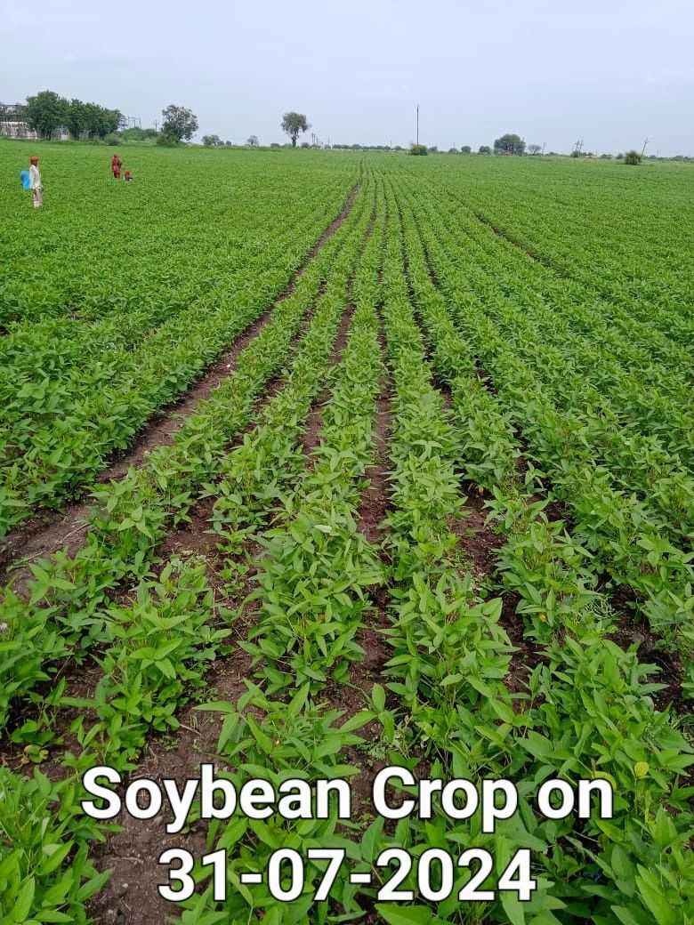
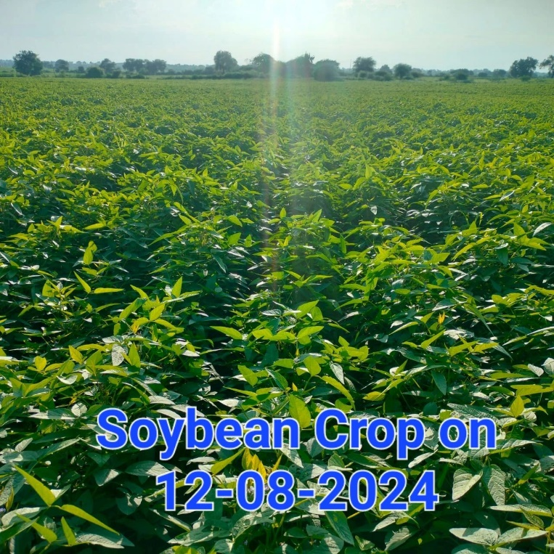
Microalgae-based Biostimulants (MBSTs) tested in fields
The name of the farmer is Mr. Ritesh Patel from Akola, Maharashtra (India). He has tried our MBST on his soybean crop
He had applied our microalgae-based Biostimulant on the 7th of August at about 1 Liter/acre
His observations upon spraying of the Biostimulant as seen on the 12th of August are:
Extensive vegetative growth
Increased leaf size
Flowering

Slide 27
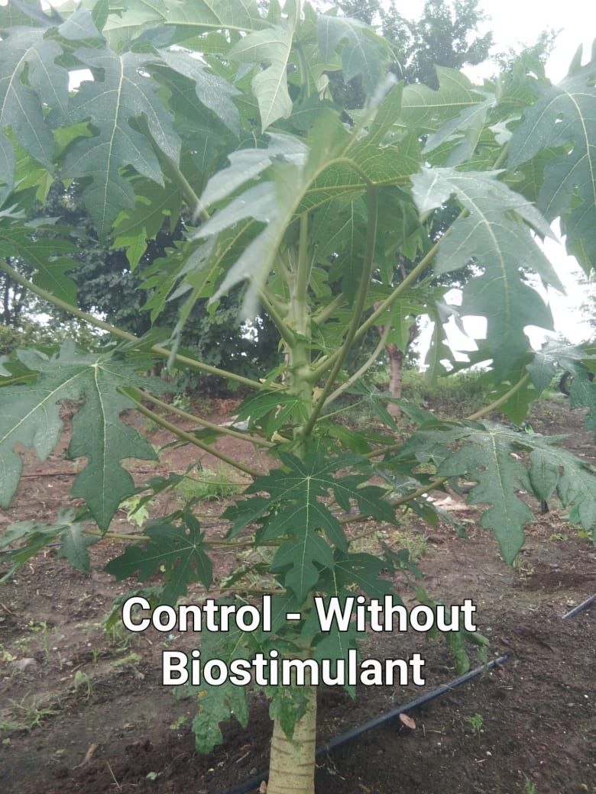
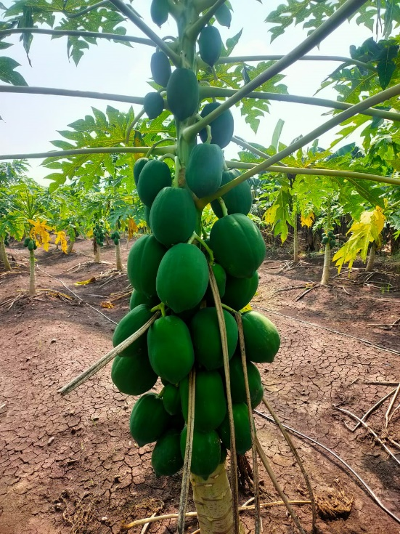
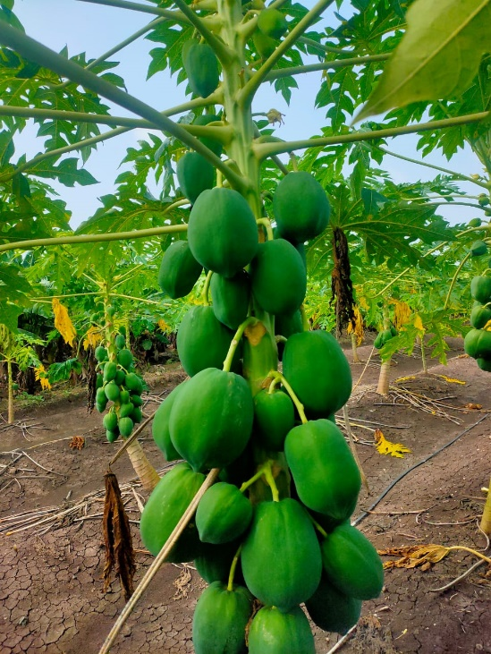
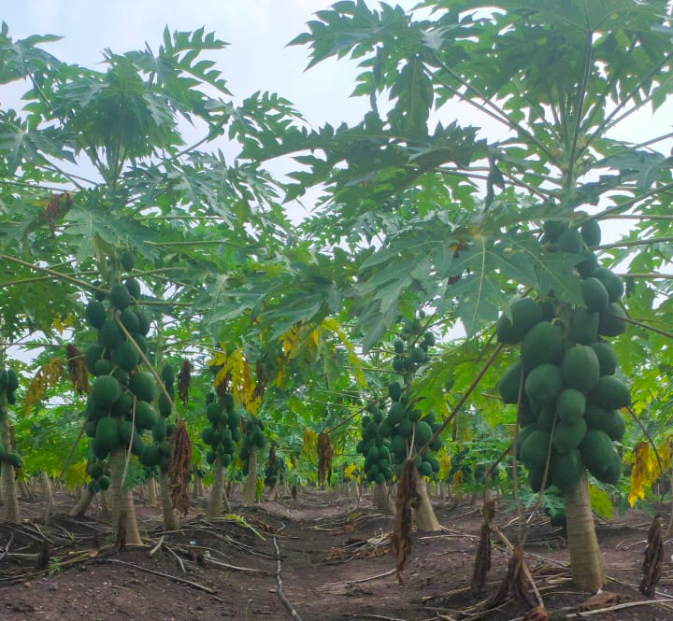
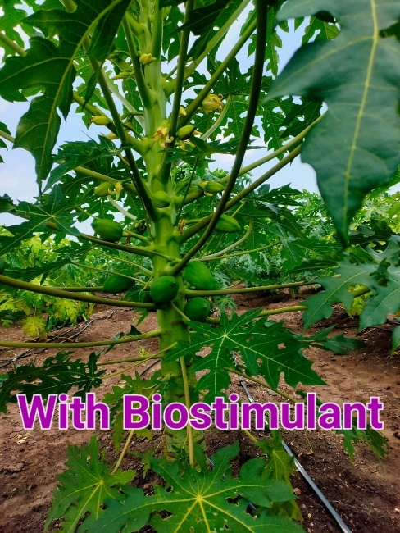
Microalgae-based Biostimulants (MBSTs) tested in fields
This was tested by a Farmer at Nandurbar, Maharashtra (India)
Over a span of four months, he had applied our microalgae-based Biostimulant twice, once at 1-L per acre and the next time at ½-L per acre.
Compared to a neighboring farm, his observations are:
Darker and larger leaves
Greater leaf coverage
Greater girth of stem
Early flowering and Early fruiting
Enhanced fruiting and consistent fruit bearing
Control vs Treatment three months back
The treated farm now!

Slide 28
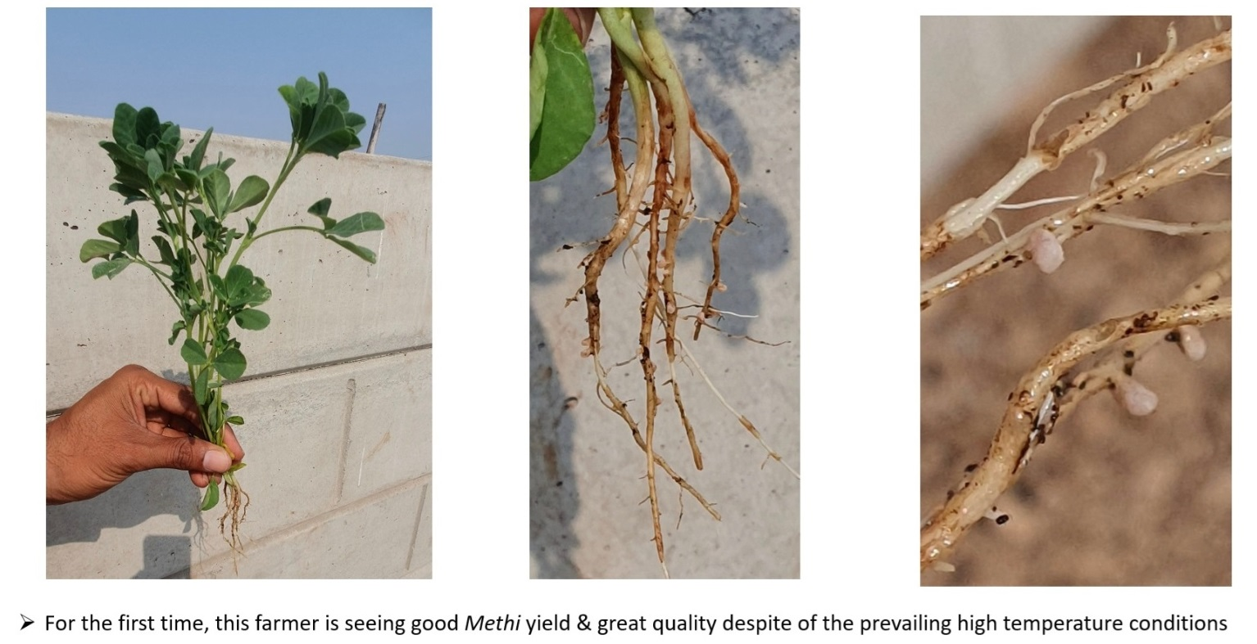
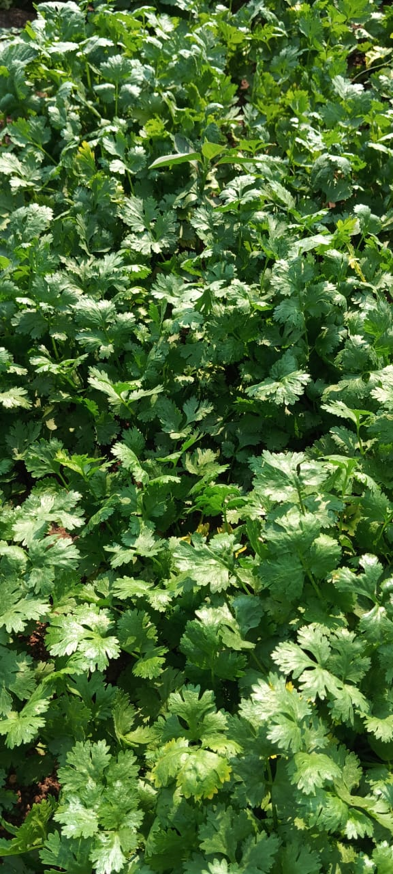
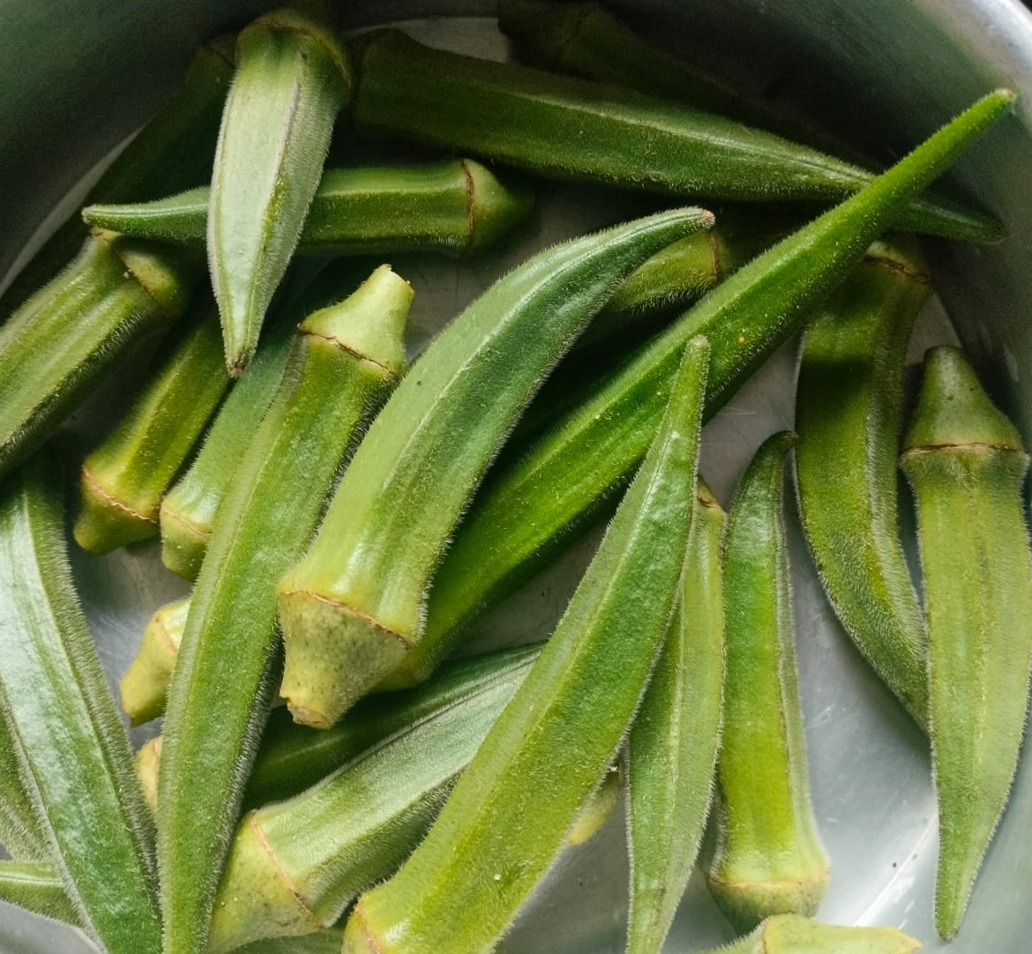
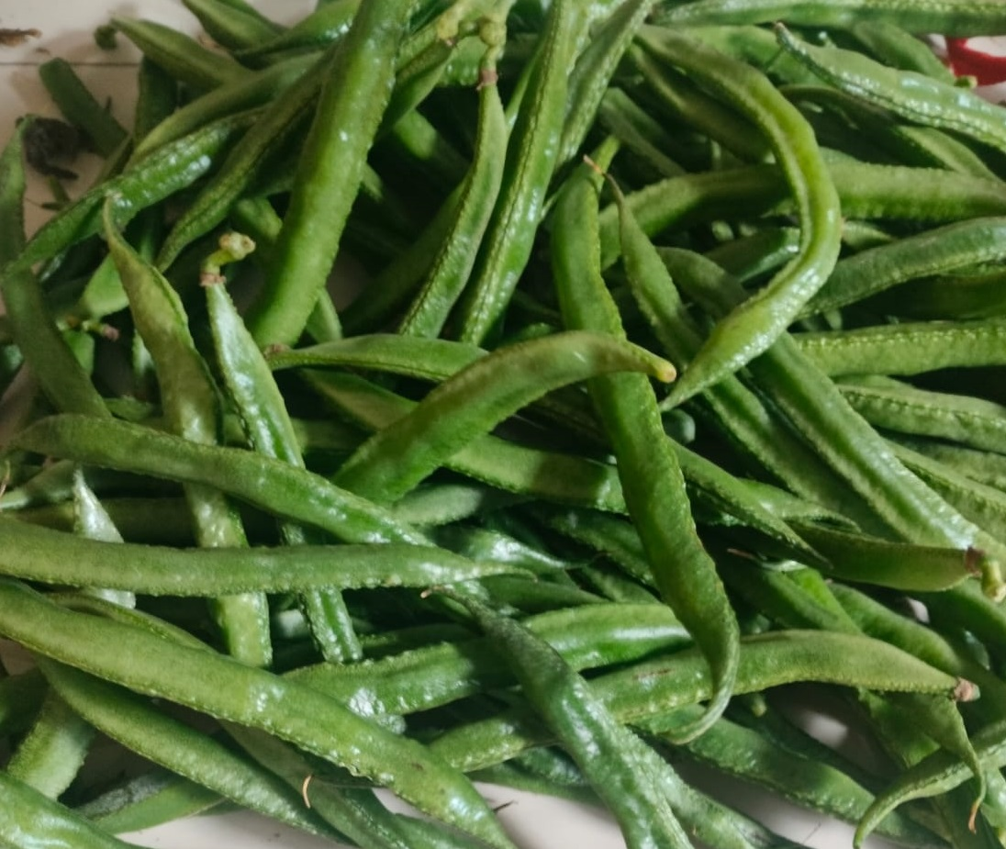
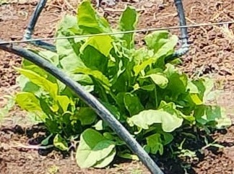
Microalgae-based Biostimulants (MBSTs) tested in fields
Mr. Abhishek Patil from Nashik has also tested the MBST for other vegetable crops such as: Beans, Okra, Coriander, Spinach, Fenugreek etc. with equally good results
Key observations
Shorter crop cycles
Darker leaves
Higher yields
Thicker grains
Ability to grow well in extreme summer conditions
Extended shelf-lives after harvest

Slide 29
Background - Opportunity for live microalgae as primary & natural live-feed in Aquaculture
The Aquaculture industry is almost $300billion globally. For the first time ever, this year, Aquaculture industry has overtaken the ocean/ river fishing industry as a market
Aquaculture industry is facing three major challenges today:
Product quality vis-à-vis wild-catch (nutritional value, antibiotics etc.)
Impact of rising feed prices
Sustainability impact of the sector – accounting for ~1% of global GHG emissions
Green, live microalgae can alleviate some of these issues in Aquaculture farms by:
Helping mimic wild aquatic ecosystems, by becoming the primary food source in aquaculture food-chain. This will help produce more “naturally-fed” fishes/ shrimps
Live microalgae as feed for hatchlings
Live microalgae as a feed for zooplanktons (rotifers, copepods, daphnia etc.)
Helping limit accumulation of organic matter and ammonia by converting them into more microalgal biomass. Thus reducing pathogens, improving oxygen levels & reducing toxicity.
Reducing the carbon-footprint on account of reduced dependence on fishmeal
Improving the efficiency ratios of supplemented feed, by reducing their consumption

Slide 30
Opportunity for live microalgae as primary & natural live-feed in Aquaculture
Environalgae has helped our customers instal very large microalgae projects wherein fresh, green microalgae biomass is generated at large-scale through nutrient recovery from food and agroprocessing operations of our customers
Being a sunlight-driven process with nutrients being recovered from water treatment processes of the food industry, this microalgae biomass is expected to have a tremendous impact on sustainability (negative carbon foot-print).
The microalgae is produced by consuming nutrients present in the agro-processing spent streams, and hence is very rich in its nutritional profile
With water treatment credits and no costs for raw materials, the microalgae biomass produced from these processes will have tremendous pricing advantage over any other green microalgae biomass available in the market
By some estimates, the price of this live microalgae biomass (<$1/Liter) is expected to be over an order of magnitude lower than the currently available biomass (>$30/Liter) [9]
The availability from this one site is greater than 10,000 Liters per day and hence is a SCALABLE option
[9] Commercial live-frozen microalgae sells at over $70/Liter

