Slide 1

BKNHS DLT/CEC
WELCOME BACK SY 20/21

Slide 2
Community Education Council 32
Ms. Sheila S.-Gorski, Community Schools Superintendent
Ms. Janice Ross, Brooklyn North High Schools Superintendent
Calendar and Business Meetings Date:
Thursday, September 17, 2020
Time: 6:00 PM
CEC Board
President Martha Bayona
Vice-President Desines Rodriguez
Recording Secretary Stacie Johnson
Treasurer Maria Lopez

Slide 3

What will love look like in our schools as we welcome students back to the new school year? How will student orientation align to the pedagogy of critical love?

Slide 4
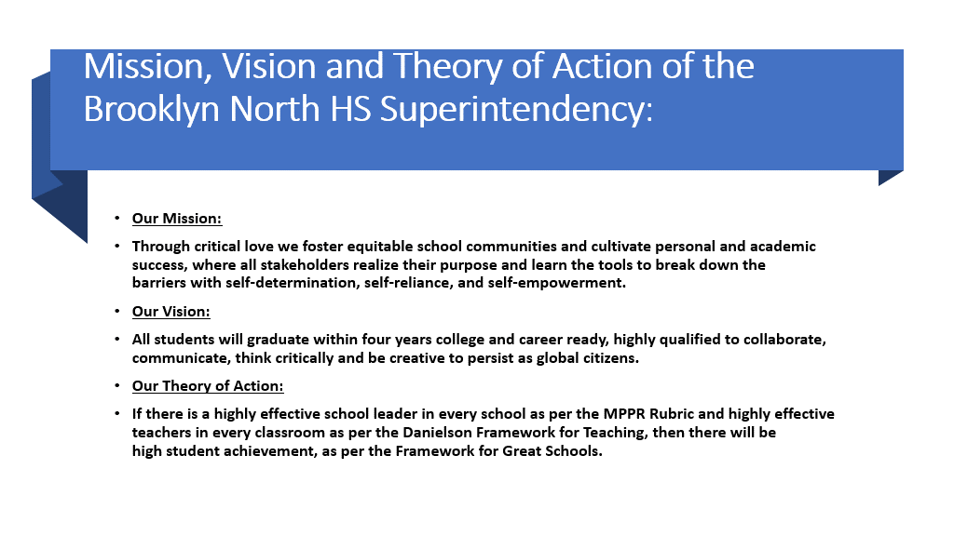

Our Mission and Vision
This Photo by Unknown author is licensed under CC BY-NC.

Slide 5
Brooklyn North High Schools GOALS 2020-21
GOAL 1 Ensure that all work in the superintendency is accomplished through patience, understanding and flexibility and with critical love, equity, and social justice.
GOAL 2 Ensure blended and remote model leadership expertise at all levels of the superintendency.
Digital access included- GOAL 3 Ensure all students will graduate in four years college and career ready through active participation and performance in digitally accessible and in-person advanced academic courses in alignment to the district's Operation College and Career Ready.
GOAL 4 Ensure and maximize transparent communication by providing meaningful feedback and digital accessibility of all resources, and creating space for voice and agency that will promote continuous improvement through empowering partnerships with community stakeholders, families and students.

Slide 6
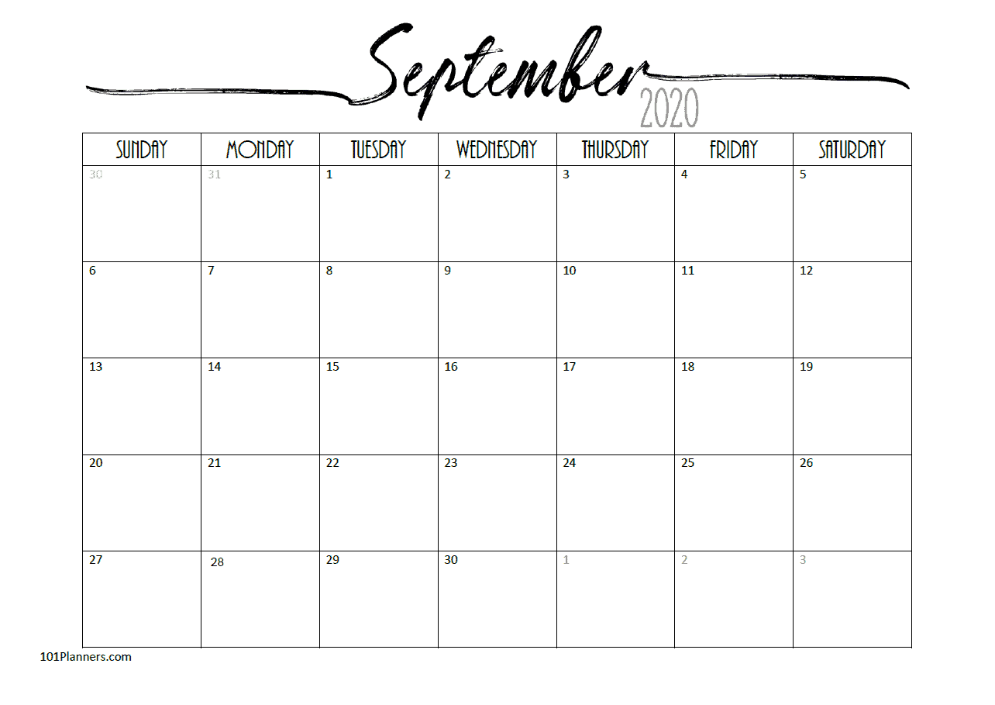
Update on School Opening
Remote Learning Begins for all Students
3-K, Pre-K, District 75 in Person Learning Begins
In Person Learning Begins for MS, HS, Secondary, Transfer/Adult Education
K-5 and K-8 In-Person Learning Begins

Slide 7
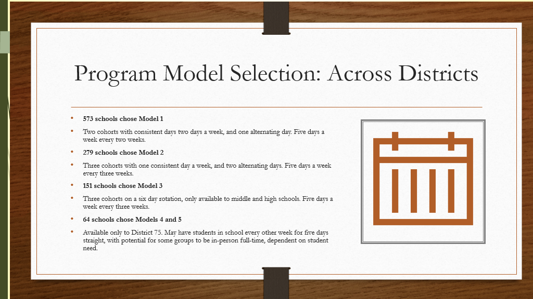

Slide 8
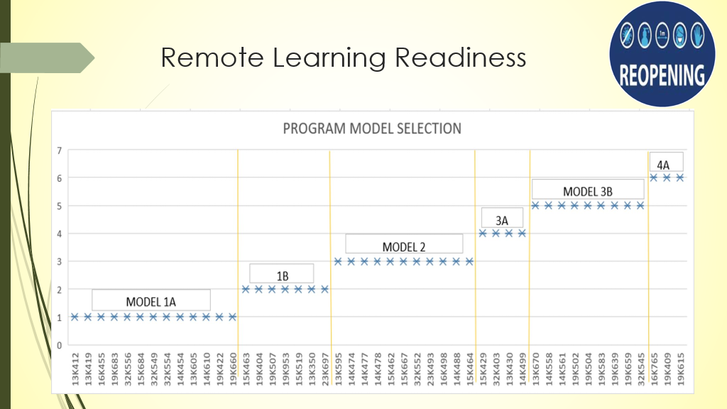

Slide 9
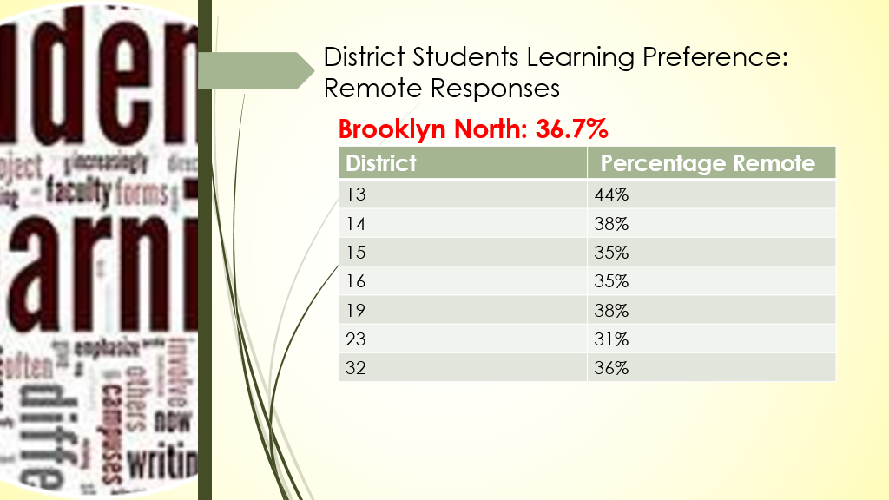

Slide 10
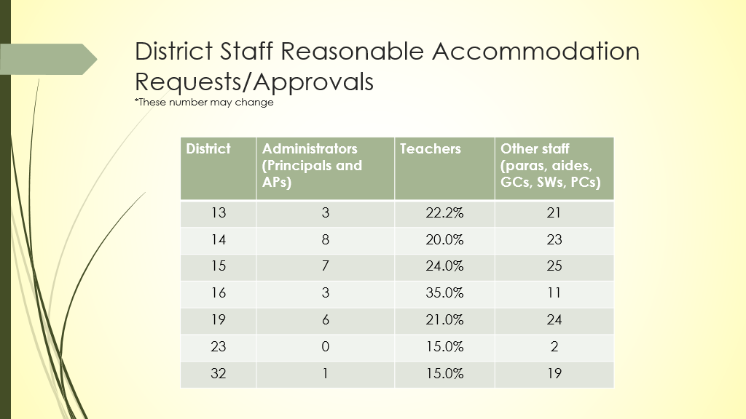

Slide 11
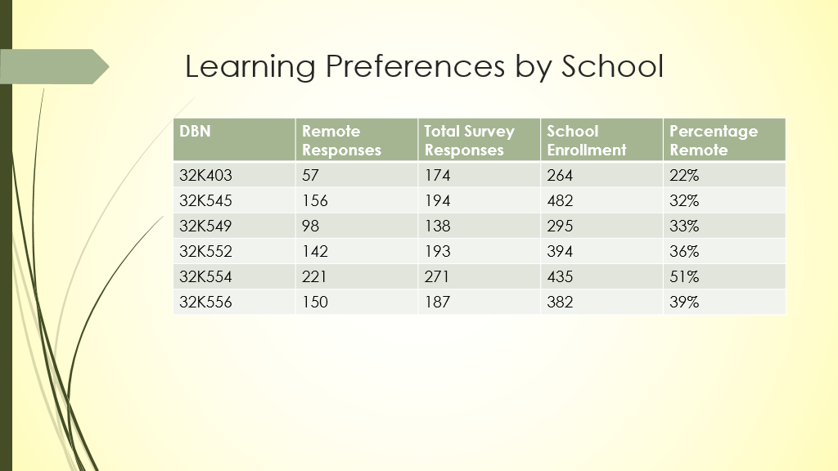

Slide 12
District 32 High Schools and Leaders
32K403 Academy for Excellence in Leadership​- Principal Chantandrea Blissett (Co-located)
32K545 EBC High School for Public Service – Principal Shawn Brown
​32K549 The Brooklyn School for Social Justice​- Principal Ana Marsh (Co-located)
32K552 The Academy of Urban Planning and Engineering​- Principal Jorge Sandoval (Co-located)
32K554 All City Leadership Secondary School​- Principal Daphne Rivera
32K556 Bushwick Leaders High School for Academic Excellence- Catherine Reilly

Slide 13

School Updates
Bushwick Leaders- using Microsoft Planner to create system for tracking program changes
Implementing flipped classroom model
Starting photography program
Academy for Excellence in Leadership- conducting all orientation sessions in English and Spanish

Slide 14

2019-2020 Graduation Rates
June/August
June
32K403 | Ms. ChantAndrea Blissett | 84.85% | 86.36%
32K545 | Dr. Shawn Brown | 87% | 88%
32K552 | Mr. Jorge Sandoval | 93% | 93%
32K554 | Ms. Daphne Rivera | 100% | 100%
August

Slide 15
Brooklyn North BCO and
District Learning Calendar
DIIT PLS: https://docs.google.com/spreadsheets/u/1/d/1joah9igs_Lrw_nOsGC_4oQyyOCSVbVIMHFtyQ4CZe6s/htmlview?pru=AAABcgkYtyQ*JqyISI_P6n0hd7npmoCbeg#gid=675838659
BCO instructional leads are also offering Office Hours to all core content area teachers
MLL and SWD hours will be available as well
BCO PL: https://sites.google.com/strongschools.nyc/bk-north-summer-2019-pl/event-catalog

Slide 16
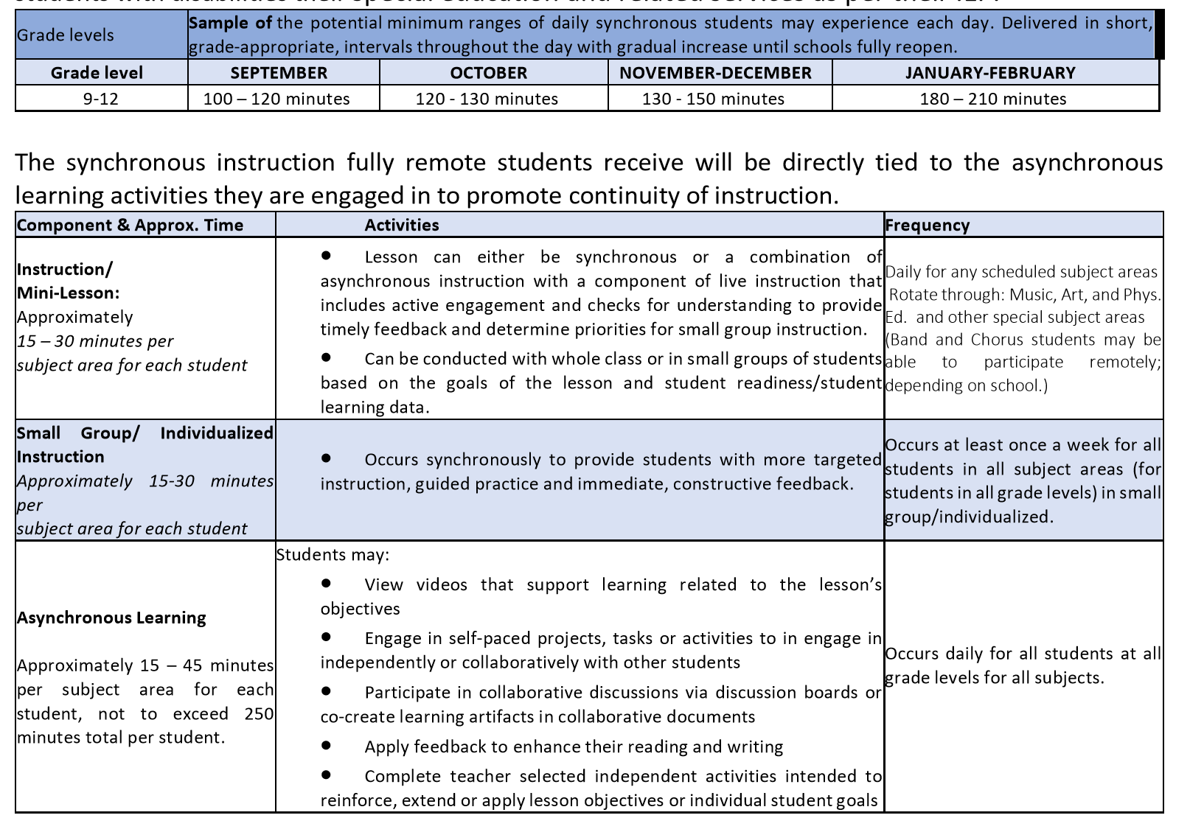
Synchronous vs. Asynchronous Instruction

Slide 17

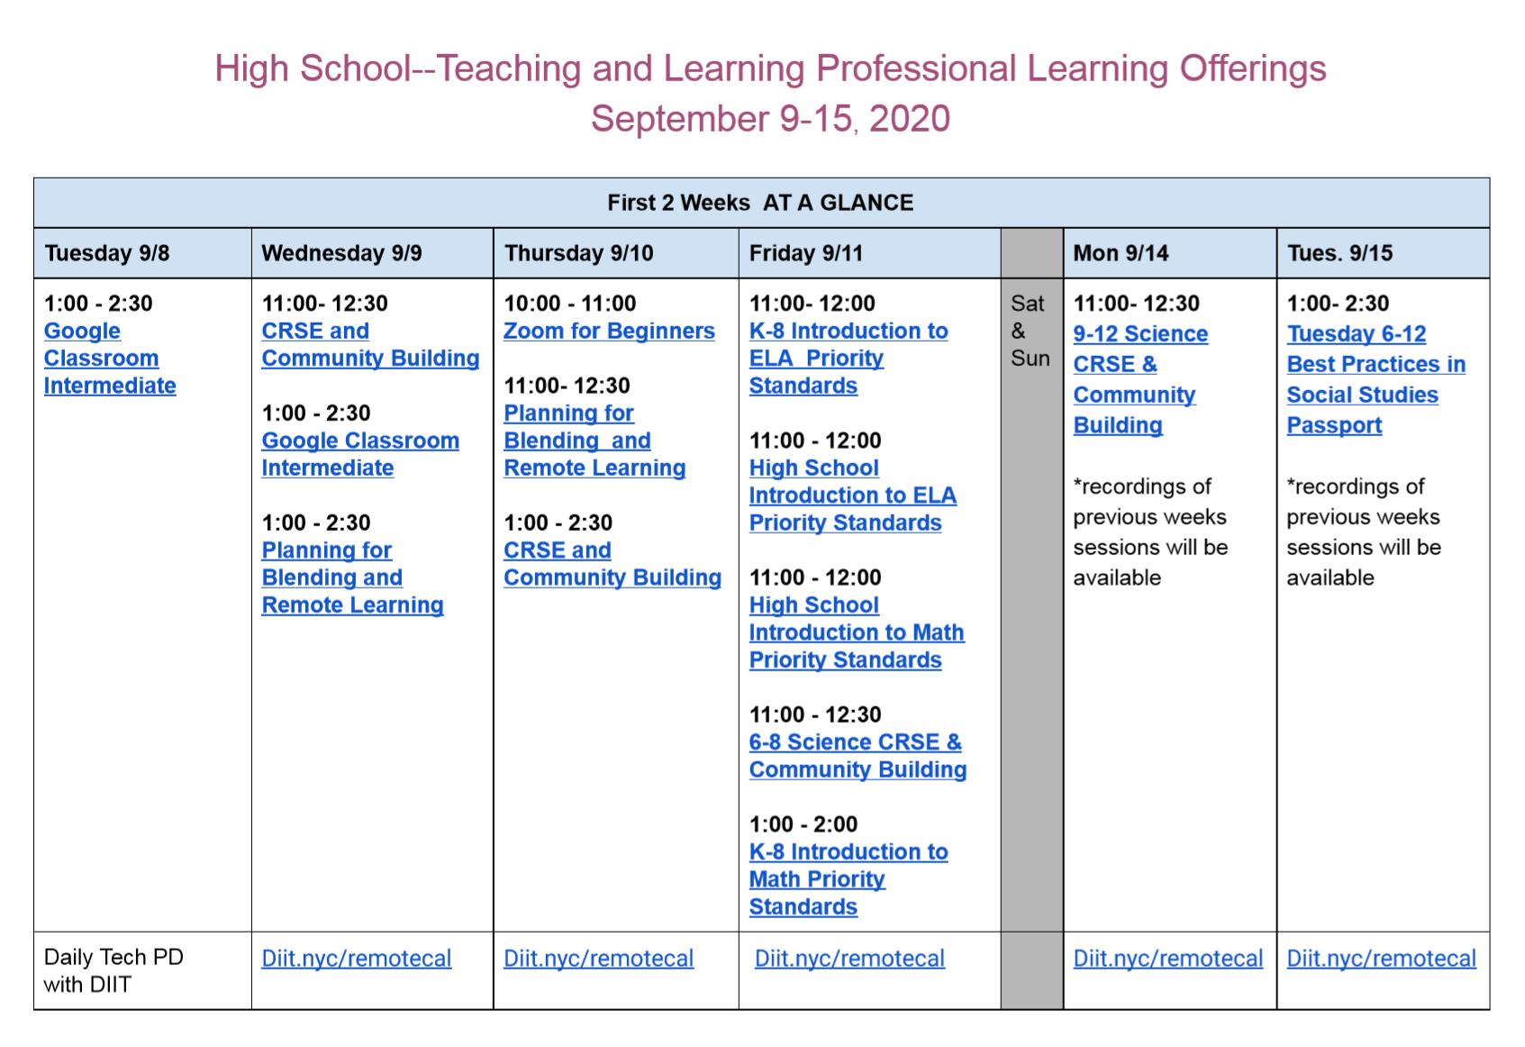

Slide 18
District specific updates – D 32 HS
REMOTE Vs. IN-PERSON
64/36 SPLIT
36 % of families/students chose remote learning
64% of families/students chose in-school learning
SCHOOL READINESS – INSTRUCTION AND SAFETY
All D 32 high schools received a 30-day supply of PPE and developed entry and exit protocols that are student centered
All D 32 high schools have working ventilation systems
All D 32 schools have completed student programming with a few one-off adjustments left to be made

Slide 19
Welcome back events highlights
Beginning Wednesday (09/16) through Friday (09/18) all D 32 high schools will hold Welcome-Back student orientations for all grades.
Student attendance is expected and schools will address safety protocols, instruction/student expectations and other relevant information.

Slide 20


My Brother's Keeper and
My Sister's Keeper @ Brooklyn North High Schools
Brooklyn North currently has approximately 11,000 Black and Latino male students across 47 schools in the superintendency and 9,000 Black and Latino female students. While an average of 82% graduation rate for Black and Latino students in Brooklyn North High Schools in 2018, there is a wide gap of 15% graduation rate when compared to non-Black and Brown students. The MBK and MSK@ Brooklyn seek to provide opportunities for leadership development for these students in order to aide in closing the achievement gap. Leadership training uses three tenets for each program.
-NC.

Slide 21
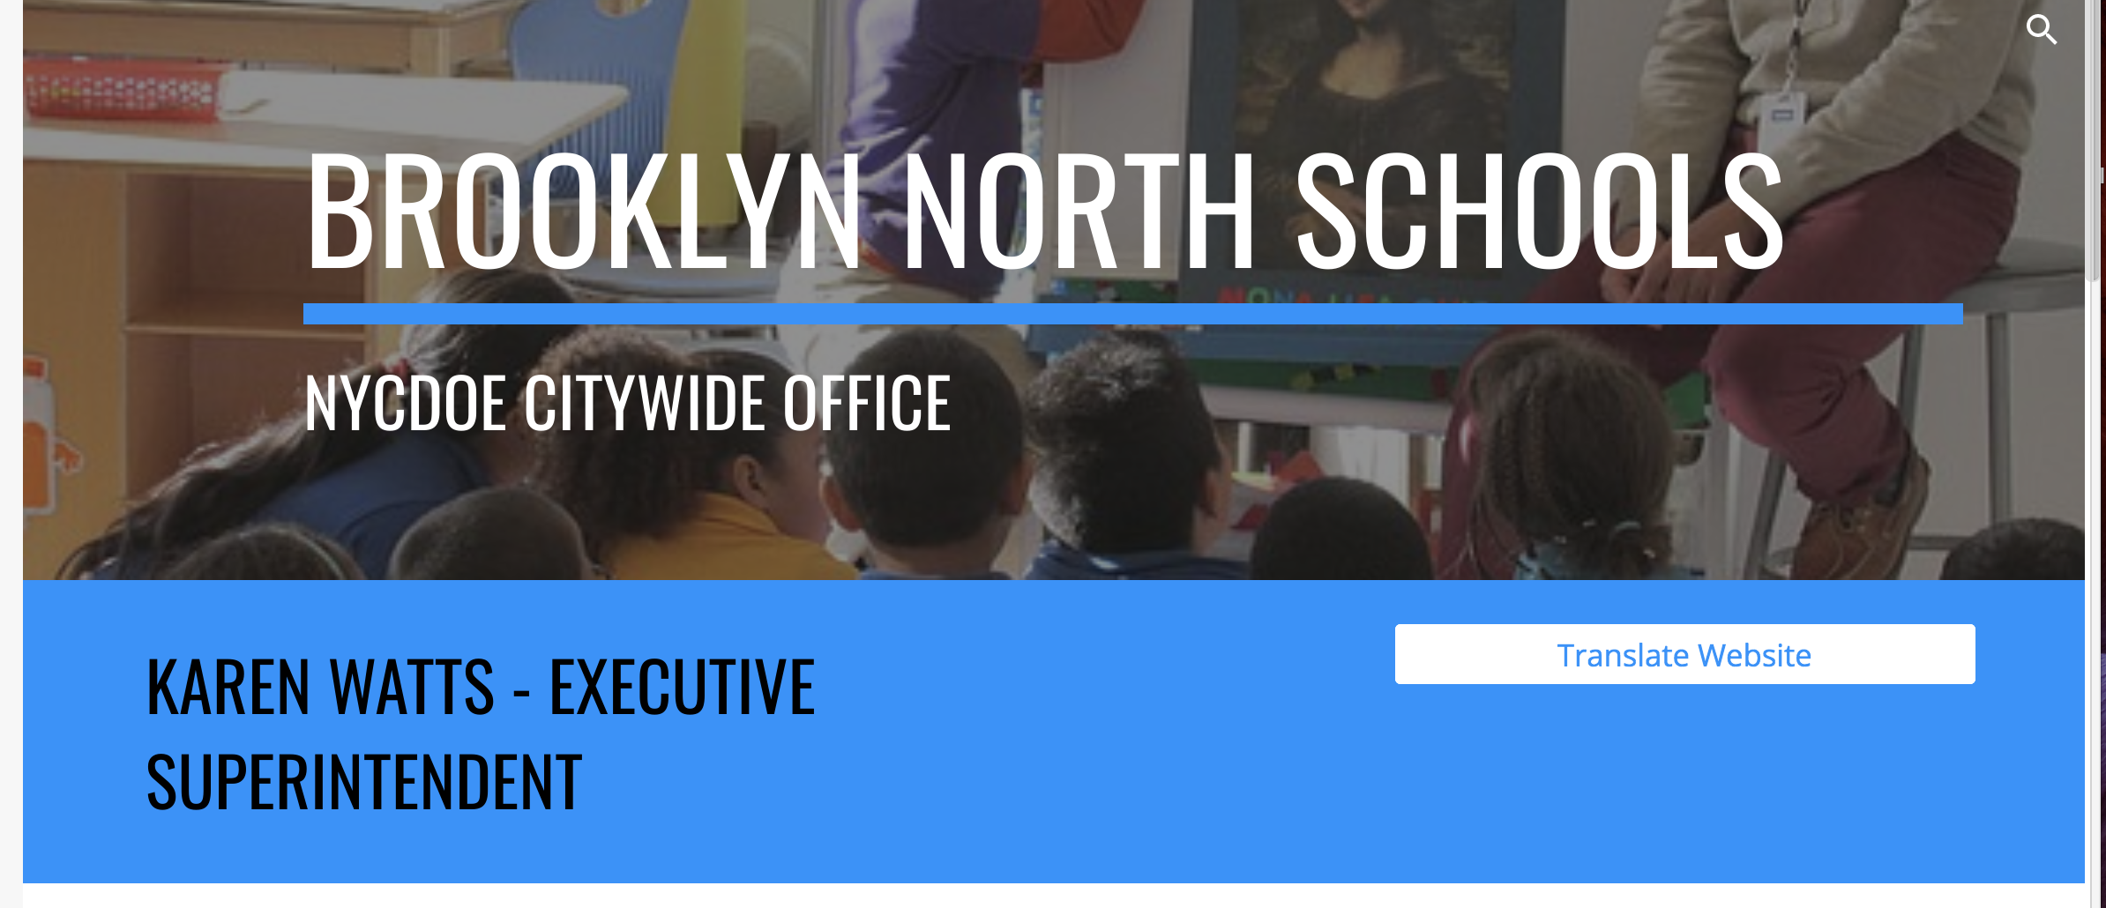
Track Your Child's Work and Learn from Home (found on Brooklyn North's website)
Contact us at bknhsparentinfo@gmail.com
https://brooklynnorth.strongschools.nyc/remote-learning-resources

