Slide 1
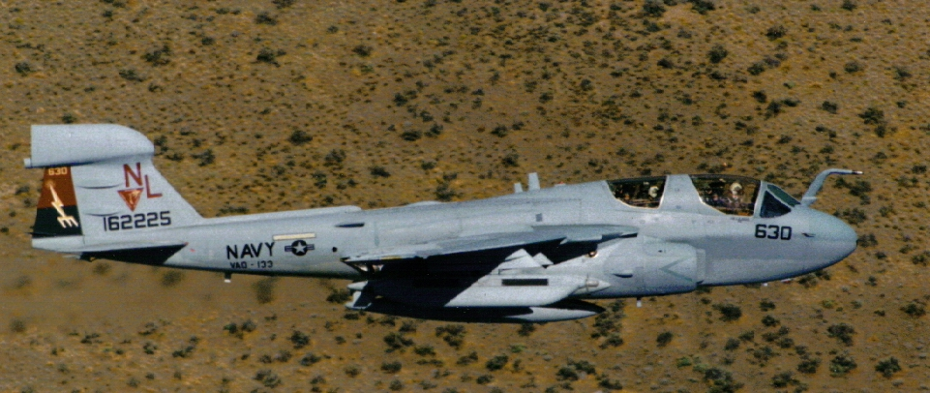
Grumman EA-6B Prowler

Slide 2
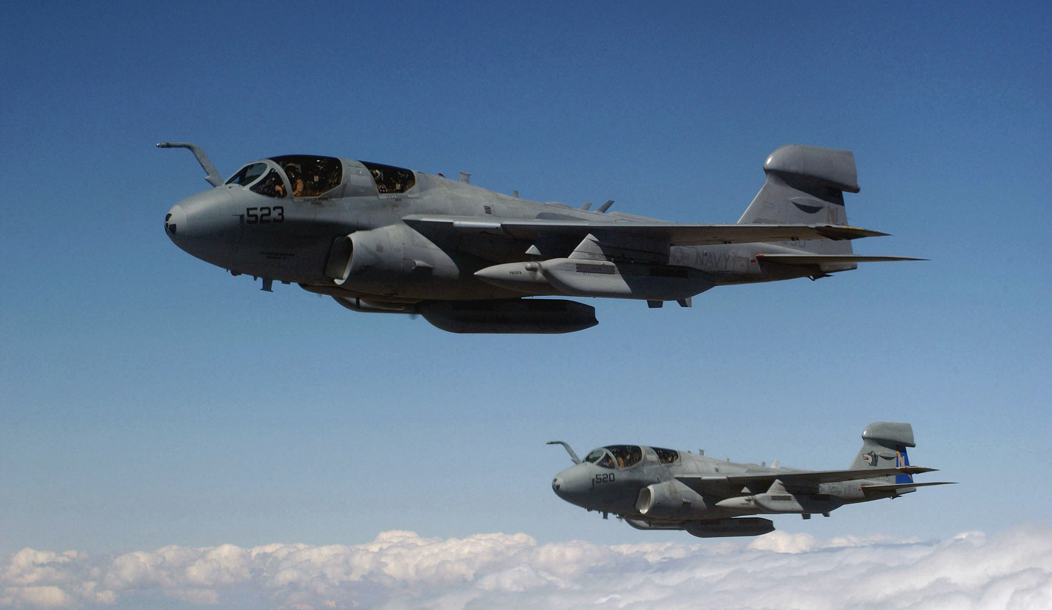
EA-6B General Characteristics
Primary Function: Electronic Attack (electronic countermeasures)
Contractor: Northrop Grumman Systems Corporation
First Flight: May 25, 1968; Operational Capability: July 1971
Propulsion: Two Pratt & Whitney J52-P408 engines (10,400 lbs thrust each)
Length: 59 ft, 10 in, Height: 16 ft, 8 in, Wingspan: 53 ft
Wing area: 528.9 sq ft
Weight: Maximum Take Off Gross Weight: 61,500 lbs, Empty: 31,160 lb
Airspeed: 566 Kts+ (651 mph)
Ceiling: 37,600 ft
Range: 1,000 nm+ (1,150 mi)
Crew: 4, Pilot and three electronic countermeasures officers (ECMOs)

Slide 3
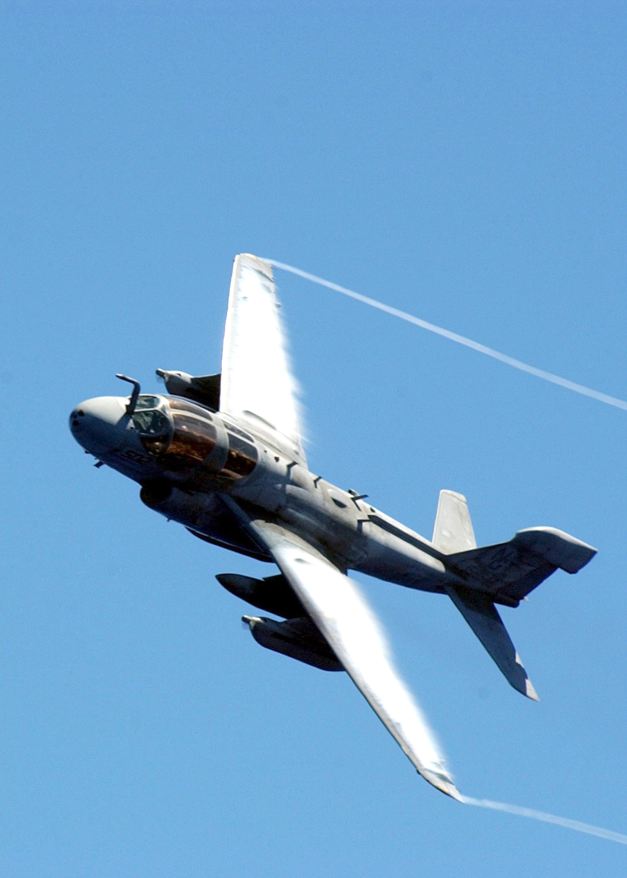
A Short Prowler History
Derivative of the A-6 Intruder (EA-6A)
EA-6B first deployed in 1972, directly into combat and was still in service with the U.S. Navy and Marine Corps over forty years later
While no Prowler has ever been lost in combat, fifty of the 170 built were destroyed in various accidents, 44 crew members lost
Five major system capability improvements
Last Navy squadron transitioned to the EA-18G Growler in 2015, last USMC squadron deployed in 2018, disestablished in 2019

Slide 4
EA-6B ICAP III

Slide 5
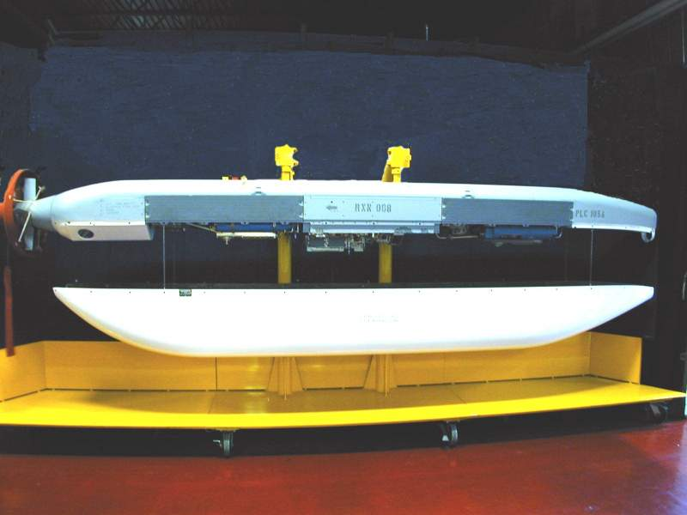
ALQ-99 TJS Transmitters
Ram Air Turbo-Generator (RAT)
Hardback (HDBK) / -521 &-523 Configurations
FWD
AFT
Transmitter (XMTR)
10 Unique
Exciter (EXTR)
Transmitter (XMTR)
Universal Exciter Upgrade (UEU)
(LBT, 1, 2, 2/3, 4, 5/6, 7, 8, 9, 9/10)
Radome (4 Configurations)
Extended Low Band
High Band Extended High Band
Modified Extended High Band

Slide 6

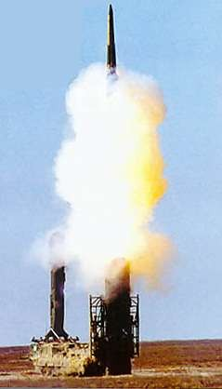


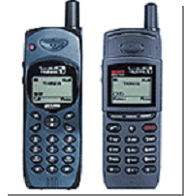
Electronic Attack—What is it?
While modern IADS will continue to be an important focus…
…Ground Force Support (Combined Arms)
  Assisting ground scheme of maneuver
  EW Close Air Support (EW CAS)
  COMMs EA
  Non-traditional target sets
6

Slide 7
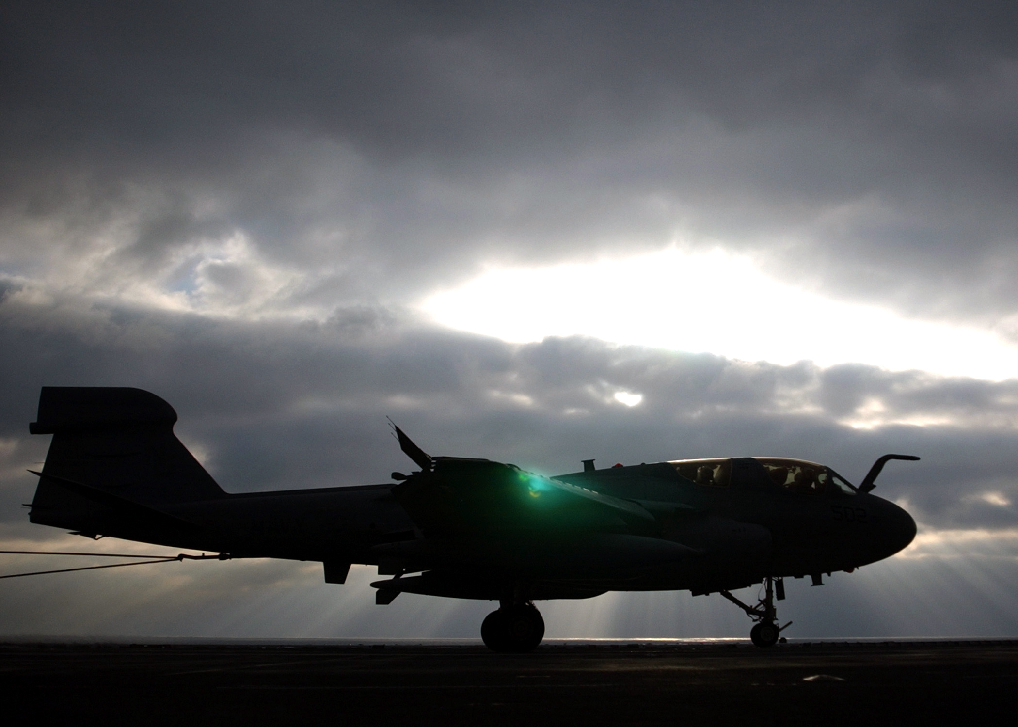
Questions?

