Slide 1

I AM ON THE BATTLEFIELD

Slide 2
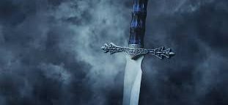
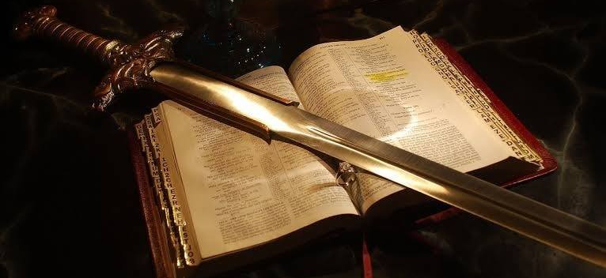
I am on the battlefield for my Lord,
I'm on the battlefield for my Lord;
And I promised Him that I would serve Him till I die.
I am on the battlefield for my Lord.

Slide 3
I was alone and idle,
I was a sinner too,
I heard a voice from heaven
Say there is work to do,
I took the Master's hand,
And I joined the Christian band,
I'm on the battlefield for my Lord

Slide 4
I am on the battlefield for my Lord,
I'm on the battlefield for my Lord;
And I promised Him that I would serve Him till I die.
I am on the battlefield for my Lord.

Slide 5
I left my friends and kindred
Bound for the Promised Land,
The grace of God upon me,
The Bible in my hand,
In distant lands I trod,
Crying, sinner, come to God,
I'm on the battlefield for my Lord.

Slide 6
I am on the battlefield for my Lord,
I'm on the battlefield for my Lord;
And I promised Him that I would serve Him till I die.
I am on the battlefield for my Lord.

