Slide 1
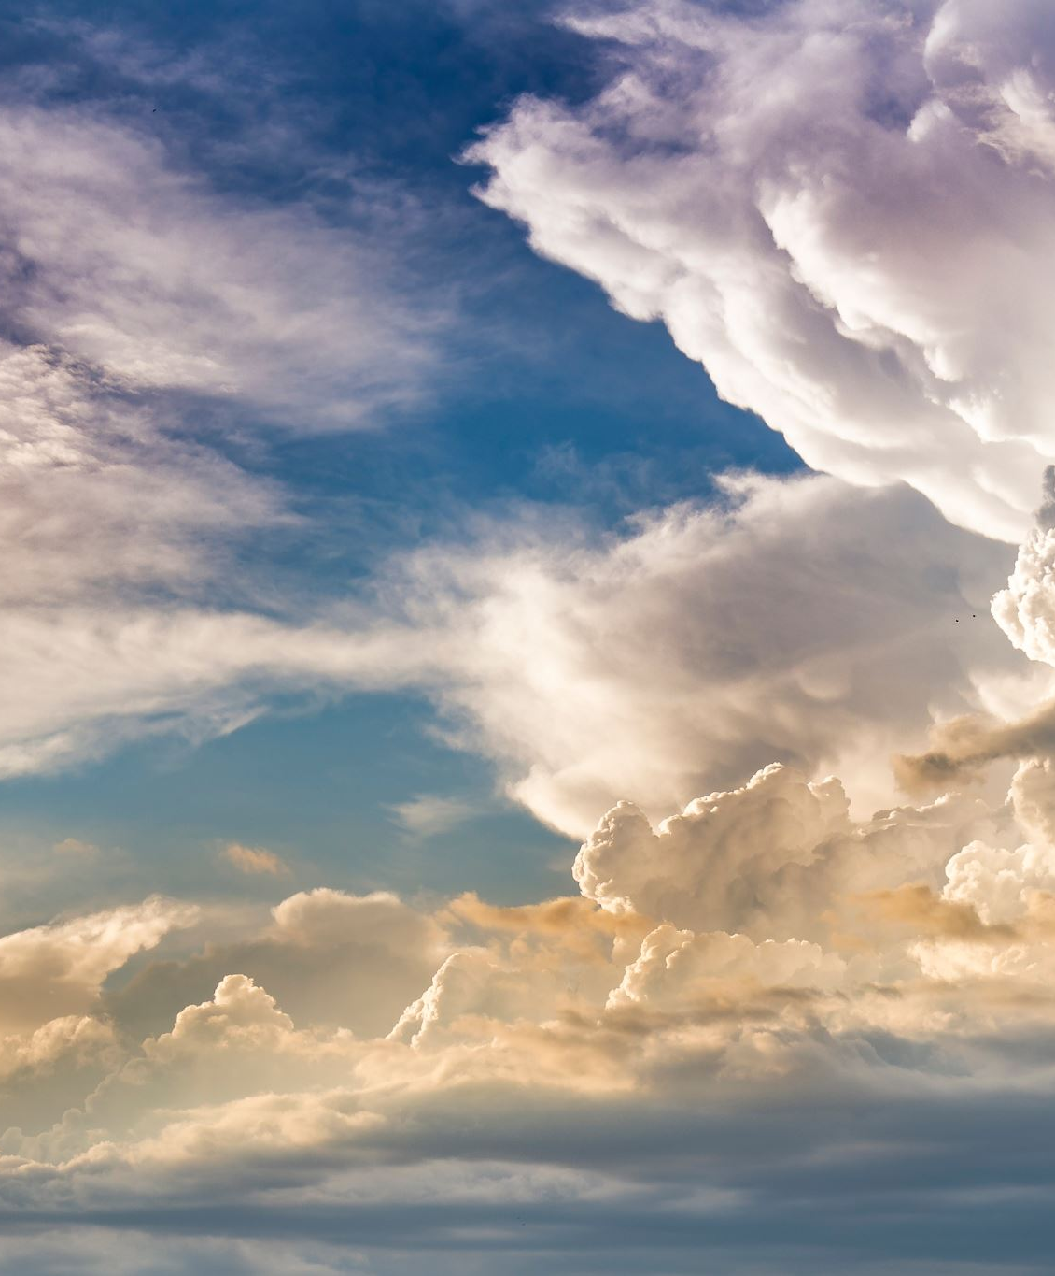
There is a Fountain

Slide 2
There is a fountain filled with blood
Drawn from Immanuel’s veins;
And sinners, plunged beneath that flood,
Lose all their guilty stains:
Lose all their guilty stains,
Lose all their guilty stains;
And sinners, plunged beneath that flood,
Lose all their guilty stains.

Slide 3
The dying thief rejoiced to see
That fountain in his day;
And there may I, though vile as he,
Wash all my sins away:
Wash all my sins away,
Wash all my sins away;
And there may I, though vile as he,
Wash all my sins away.

Slide 4
Dear dying Lamb, Thy precious blood
Shall never lose its power,
Till all the ransomed ones of God
Be saved, to sin no more:
Be saved, to sin no more,
Be saved, to sin no more;
Till all the ransomed ones of God,
Be saved to sin no more.

Slide 5
E’er since by faith I saw the stream
Thy flowing wounds supply,
Redeeming love has been my theme,
And shall be till I die:
And shall be till I die,
And shall be till I die;
Redeeming love has been my theme,
And shall be till I die.

Slide 6
E’er since by faith I saw the stream
Thy flowing wounds supply,
Redeeming love has been my theme,
And shall be till I die:
And shall be till I die,
And shall be till I die;
Redeeming love has been my theme,
And shall be till I die.

