Slide 1
Yield Not To Temptation

Slide 2
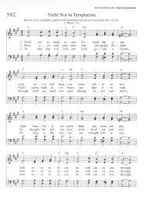
Yield not to temptation, For yielding is sin; Each vict’ry will help you, Some other to win; Fight valiantly onward, Evil passions subdue; Look ever to Jesus, He will carry you through.

Slide 3
Ask the Savior to help you, Comfort, strengthen and keep you; He is willing to aid you, He will carry you through.

Slide 4
Shun evil companions, Bad language disdain; God’s name hold in rev’rence, Nor take it in vain; Be thoughtful and earnest, Kindhearted and true; Look ever to Jesus, He will carry you through.

Slide 5
Ask the Savior to help you, Comfort, strengthen and keep you; He is willing to aid you, He will carry you through.

