Slide 1
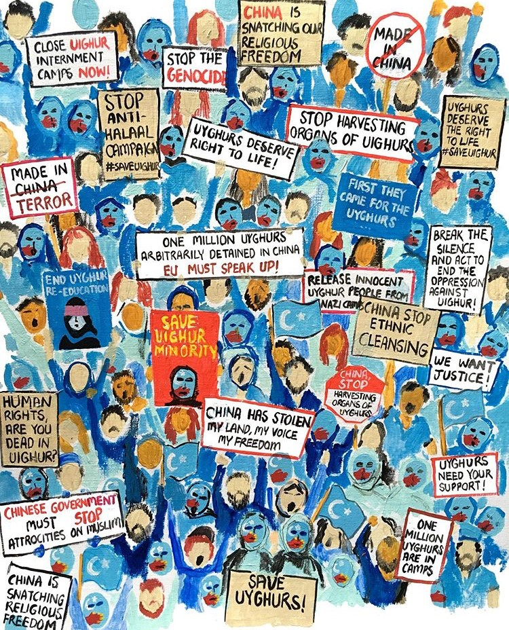
@mfa.studios
Please VOTE YES to H.R.649
Uyghur Human Rights Policy Act of 2019

Slide 2
From
Over 1.5 million Uyghurs and other Turkic people from all walks of life have been extra-judicially detained in concentration camps for political indoctrination by the Chinese government. There have been legitimate claims of torture, forced labor, and organ harvesting. The Uyghur region is one of the most high tech surveillance states in the world, and that tech has been linked to US and European investments. Products from forced labor camps have been directly exported to US companies like Costco. Almost every US resident who has lived in this region knows someone in a concentration camp. Furthermore, the CCP has blackmailed many Uyghurs into silence by threatening their relatives back home.
As someone who believes in the universal values of freedom, human rights, and democracy, I believe it is our duty and America's duty to speak up for the values it was founded upon. In particular, we should condemn these atrocities, and honor the promise the world made when we said "Never Again".
Please vote YES on H.R.649
Uyghur Human Rights Policy
Act of 2019
To
For more info visit: saveuighur.org
uhrp.org

