Slide 1
Empowering First Nations Police Governance
Teddy Manywounds, the Importance of Governance in Our First Nations communities

Slide 3
Governance structures in our camps and in our Nations functioned in a manner that acknowledged the needs, principles, and values which supported the collective. Concerns of the day also accounted for the unique distinctions and circumstances of the surroundings we occupied. The land, the weather, season(s), inhabitants, infrastructure, food systems, education mechanisms, and all the needs of our societies were very much a dependent relationship with the land and with each other.

Slide 4
And how was all this managed? How were the systems we lived by kept in manner that provided order and clarity. How did the systems and mechanisms we lived by keep us safe and sustained before contact with the newcomers.

Slide 5
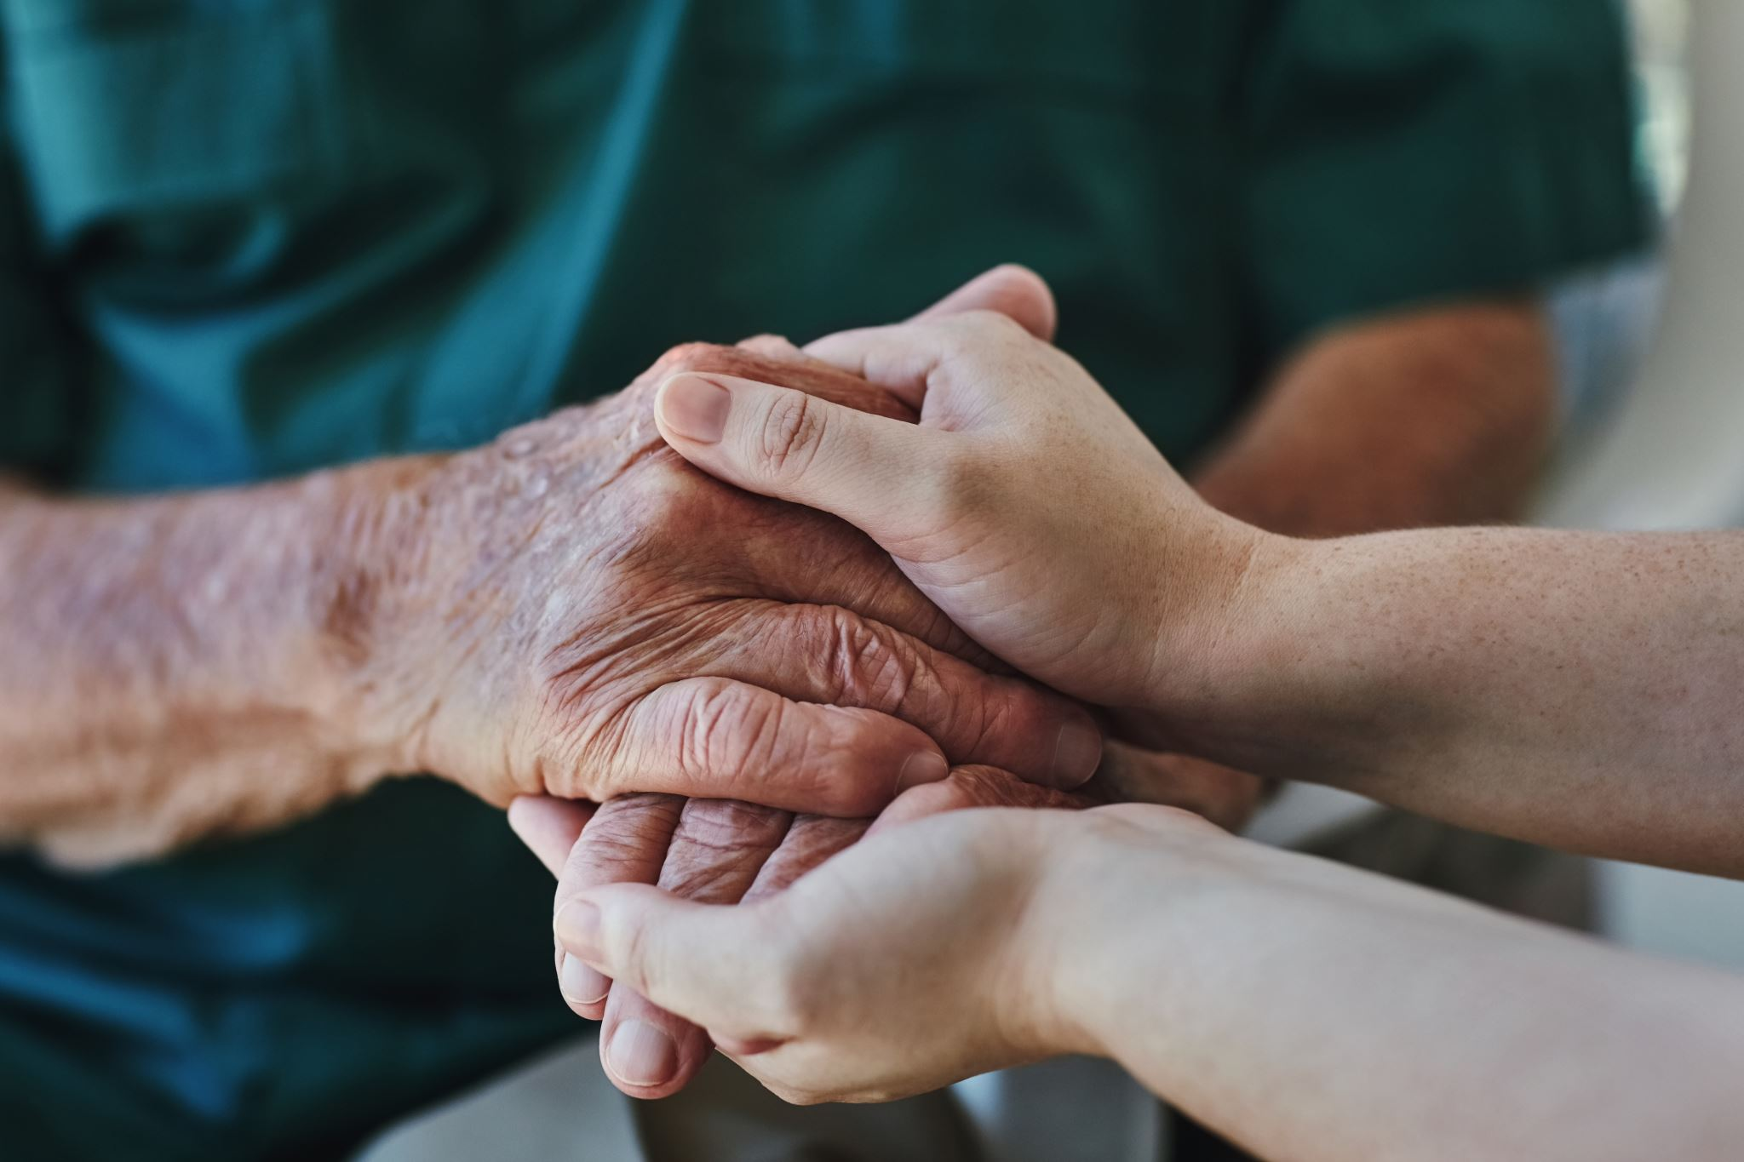
Governance.
In all our distinct languages, governance, may have been described as a system of support, of understanding, of accountability. The individuals who were tasked to make governance decisions were often the wise and informed members of our communities. All individuals in our camps added value to the system. Governance remains an order or mechanism to maintain a homeostatic structure of society. And how can we empower First Nations policing governance structures? what can empowerment look like, and how may this be achieved?

Slide 6
What I have learned, the paths I’ve walked

Slide 7
Public safety is incumbent to the success of any community! Before contact, our Nations maintained order and cohesion by remaining aware of the objectives which supported our way(s) of life, ways of knowing, and our survival.
First Nations over the 20th century and after contact have been largely pre prescribed systems which have left us disconnected from the ways of life which we intrinsically understand as important. Because of this our governance structures require to be built and implemented with an understanding of what “may” work for us. May, as often First Nations are building models that require to align with systems that are not our own making, therefore, successful governance may not always be guaranteed- under pre prescribed conditions.

Slide 8
If people don’t understand how something works, it won’t work!”

Slide 9
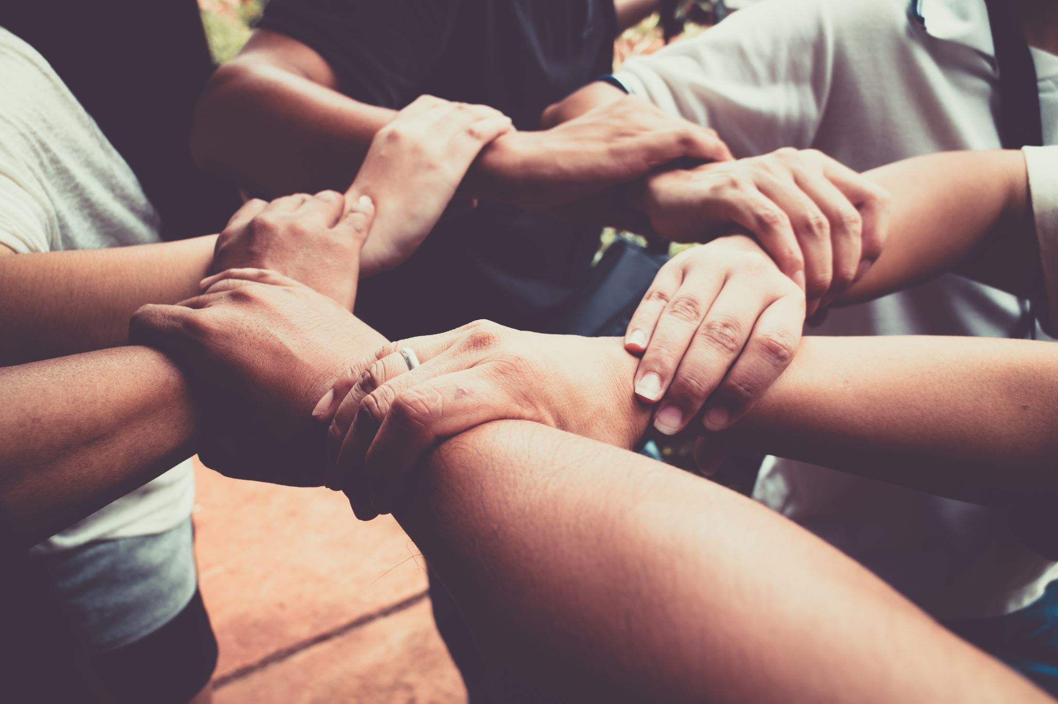
To empower First Nations police governance, we need to determine the objectives and focus of each First Nations policing service, what are the mandates of leadership, and what are the needs within community? 3 eco systems of people need to be considered for First Nations Police governance boards or commissions.

Slide 10
Capacity.
First Nations policing governance is essential for building capacity within communities. Effective governance structures ensure that the unique needs, principles, and values of First Nations are acknowledged and supported. Historically, governance in First Nations communities functioned in a manner that maintained order and clarity, supporting the collective and ensuring the safety and sustainability of the community.

Slide 11
To empower First Nations policing governance, it is crucial to determine the objectives and focus of each policing service, understand the mandates of leadership, and address the needs within the community. Successful governance requires a structured approach, including terms of reference, value statements, mission statements, and, if necessary, ratified legislation. These structures provide a mechanism to maintain cohesive objectives, support the service, and ensure accountability.

Slide 12
Our rights, Treaty and inherent.
Historical Agreements: Treaties are legally binding agreements that were established between First Nations and the Crown. These agreements were meant to ensure mutual respect, cooperation, and the protection of rights and lands. Respecting these treaties is essential to honor the commitments made historically.
Legal Obligations: Treaties are recognized under Canadian law and international law. The Canadian government has a legal obligation to uphold these agreements and ensure that the rights of First Nations are protected and respected.
Cultural Preservation: Treaties often include provisions that protect the cultural practices, traditions, and ways of life of First Nations. Respecting these rights is vital for the preservation and continuation of First Nations cultures and identities.
Social Justice: Respecting treaty rights is a matter of social justice. It acknowledges the historical injustices faced by First Nations and aims to rectify them by ensuring that their rights are upheld and respected.
Building Trust: Respecting treaty rights helps build trust between First Nations and the Canadian government. It fosters a relationship based on mutual respect and cooperation, which is essential for effective governance and collaboration.

Slide 13
Women and girls in our communities; a seat at the table!
Diverse Perspectives: Women and girls bring unique perspectives and experiences that are crucial for comprehensive decision-making. Their involvement ensures that the governance structures are more inclusive and representative of the entire community.
Cultural Continuity: In many First Nations communities, women play a vital role in preserving and transmitting cultural knowledge and practices. Their participation in governance helps maintain cultural continuity and ensures that traditional values and practices are upheld.
Empowerment and Equality: Including women and girls in governance promotes gender equality and empowers them to take on leadership roles. This not only benefits the individuals involved but also strengthens the community as a whole by fostering a more balanced and equitable society.
Holistic Approach: Women and girls often have a holistic approach to community well-being, considering the social, emotional, and physical aspects of safety and security. Their involvement in policing governance can lead to more comprehensive and effective strategies for community safety.

Slide 14
Wisdom and Experience: Elders possess a wealth of knowledge and experience that is invaluable for decision-making. Their insights can guide the governance structures to ensure they are rooted in traditional values and practices, which are crucial for maintaining cultural continuity and community cohesion.
Future Generations: Youth represent the future of the community. Their involvement in governance ensures that the perspectives and needs of younger generations are considered. This helps create policies and strategies that are forward-thinking and sustainable.
Intergenerational Dialogue: Including both elders and youth fosters intergenerational dialogue, which is vital for the transfer of knowledge and cultural practices. This dialogue helps bridge the gap between generations and ensures that governance structures are inclusive and representative of the entire community.
Empowerment and Engagement: Involving elders and youth in governance empowers them to take active roles in their community. This engagement promotes a sense of ownership and responsibility, which is essential for the success and sustainability of governance structures.
Elders and youth!

Slide 15
The value of First Nations. police governance!

Slide 16
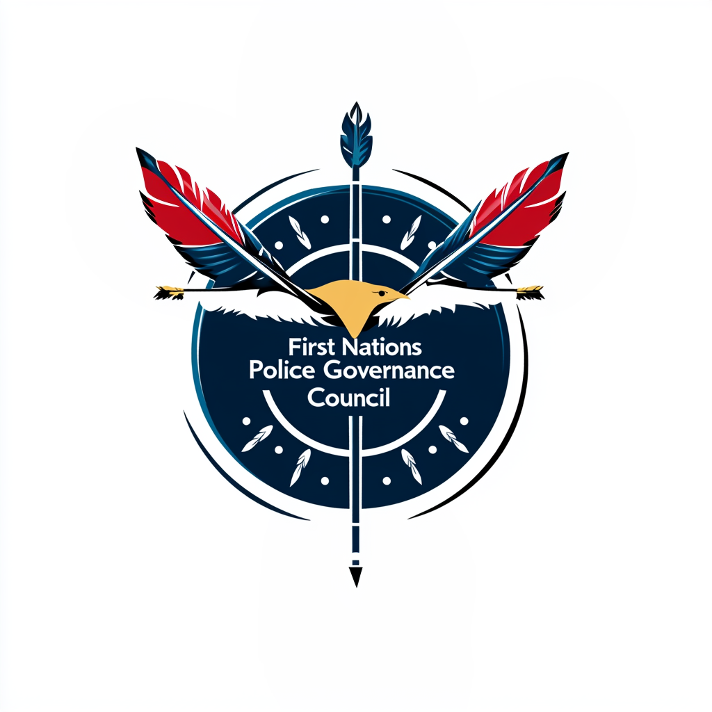
Teddy Manywounds.
Chair First Nations Police Governance Council.
FNCPA.
https://fnpgc.org/
Thank you!
Sīyísgáàs (Thank you, Tsuut’ina)
Îsniyés (Thank you, Stoney)

