Slide 1
Leadership is Everybody’s Business
Capacity Building
Kyela District Chapter, TCCIA
March 13, 2020
Pam Caskie
Expert Volunteer
Pam.Caskie@abryteidea.com

Slide 2
Volunteer organizations are different
You don’t have to belong
You don’t have to pay dues
You don’t have to spend your time participating
You get to chose what you do and when you do it
So why belong

Slide 3
Why people belong to volunteer organizations
Equity/Rewards
It improves their business
It improves their profit
They get something tangible from joining
Meaningfulness
They get personal satisfaction from participating
They feel like they are making a difference for themselves and others that they care about
Brand/Image
They feel good about telling people they are a member
Their status in their community increases
Their friends are participating

Slide 4
Everybody should be a leader
You can lead from anywhere
You can lead with a loud voice
You can lead with quiet actions
You can lead by knowing the answers
You can lead by asking the questions
You can lead by serving others
You can lead by taking charge of something

Slide 5
The difference between members and joiners
Members | Joiners
Regularly participate | Participate when it interests them
Pay their dues | Pay their dues
Volunteer for committees and projects | Are reluctant to volunteer
Are willing to put in the extra time | Make only the minimal commitment
Help lead the organization from wherever they are | Are not willing to lead

Slide 6
Ways to make joiners become members
Show them the value of participation
Ignite their interest and passion in a project
Find their strengths and play to them
Give them a voice to be heard
Don’t wear them out
Make them feel wanted in the organization

Slide 7
Leaders
Leaders are elected in the front
Leaders are self appointed in the rear
Leaders’ job is to guide the organization not direct the organization
A true leader is a servant leader
They see their job as doing the work of the group
Not having the group do their work
All leaders need to stay in their lanes
Fulfill fully the roles and responsibility of the office held
Stay out of the lane of others, let them do their work

Slide 9
Leading from within
Provide feedback
Be the welcoming committee
Willingly take on projects you can do
Help others

Slide 10
Best Volunteer Leadership Traits
Active Listening to the needs and desires of others
Mentoring – Helping other gain the skills and confidence to lead on their own someday
Public Dialogue – talk to the stakeholders about their needs and the direction they want the organization to go
Feedback and Evaluation – Seek feedback from others and periodically do an self and organizational review to see if you are on track

Slide 11
Elected Officers
Chairman
Secretary
Vice-Chairman for Industry
Vice-Chairman for Commerce
Vice-Chairman for Agriculture
Treasurer

Slide 12
Executive Council – Meets 4 times a year
Chairman
Vice-Chairman of Agriculture
Treasurer
Vice-President of Commerce
Vice-Chairman of Industry
Immediate Past President
Representative from Academia
Elected Corporate Member

Slide 13
Management Committee – meets 6 times per year
Without sub-branches, It appears that the management Committee would be the same as the Executive Council.
If sub-branches would ever be used, this would change but for now – they are the same people.

Slide 14
Committee Structure
Commerce Communication & Transport
Vice-Chairman of Commerce (Chair)
2 -4 other members
Industry Mining & Industry
Vice-Chairman of Industry (Chair)
2 -4 other members
Agriculture and Environment
Vice-Chairman for Agriculture (Chair)
2 -4 other members
Finance and Resource Mobilization
Treasurer (Chair)
2 -4 other members
Governmental Affairs
Chair to be appointed by Executive Council
2 – 4 other members
Women and Youth
Chair to be appointed by Executive Council
2 – 4 other members

Slide 15
Recommended Committee
Membership Recruitment
Chair to be appointed by the Executive Council
2 – 4 members
Communications
Chair to be appointed by the Executive Council
2 -4 members

Slide 16
Platforms
Cocoa
Growers
AMCOS
Palm Oil
Growers
AMCOS
Rice
Growers
AMCOS
Buyers
Buyers
Mixed Produce
Growers
Buyers
Buyers
My recommendation is that in the Agriculture Committee, the chairman of each platform be a member of the Agriculture committee

Slide 17
So now we know the structure, what’s next
Members are needed to fill each of these slots
By recruiting a number of people, everyone shares the load
So how do you recruit?
The number 1 way to recruit is by personal appeal
Advertise – promote a Facebook page, WhatsApp page or Instagram account
Put up signs. where you can, advertising a meeting
Hold an information session about a critical topic and invite everyone interested to come, and then pitch membership before, during and after
When new members join – make them feel welcome!

Slide 18
Running a meeting
Fix a date
Fix a place
Know what you are going to talk about
Follow that agenda
Have specific agreed upon actions that come from the meeting
At the end of the meeting, have individuals agree on what they committed to doing
Provide time before, after, and if a long meeting, during for socialization. Remember Social connections is a key reason for joining

Slide 19
After the meeting
Write up the meetings minutes
Distribute the minutes
Know what steps are required to implement before the next meeting
Leaders should check in from time to time on how assignments are coming
Always show your members you are making progress on the goals that they want to achieve.

Slide 20
Setting the next year’s workplan
Solid Organization Structure
Service Delivery
Getting involved outside the District
Seeking Financial Stability
Fundraising
Creating innovative Programs
What we have done here is just a framework
Once the new officers are installed, the working document should be reviewed, expanded and revised to meet the needs of the members
Remember to build your house on a firm foundation

Slide 21
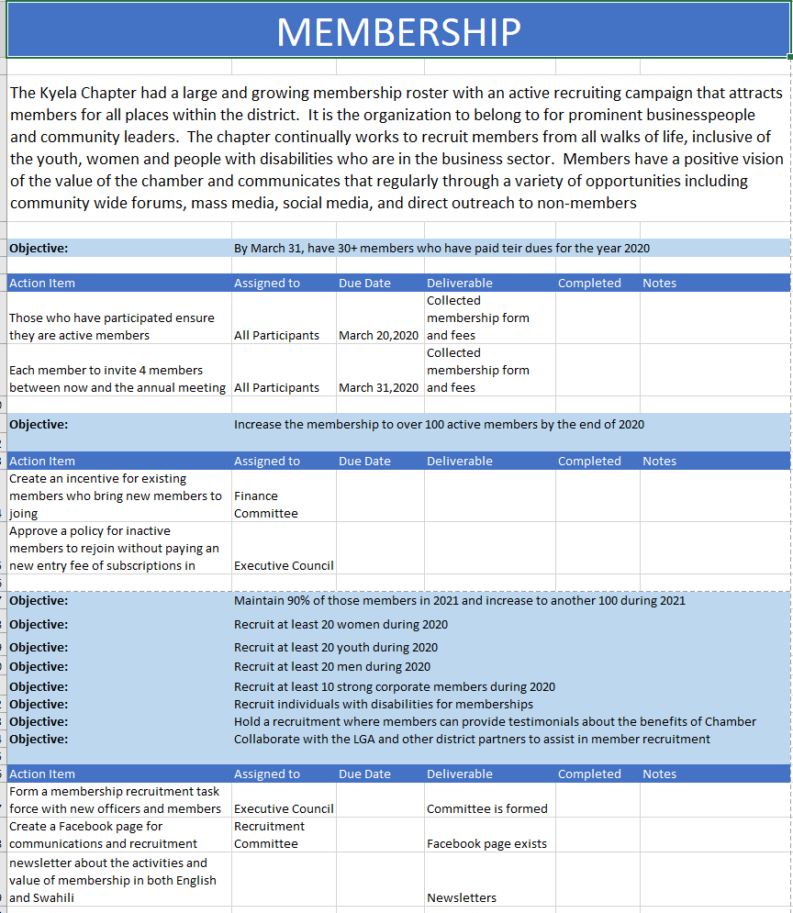
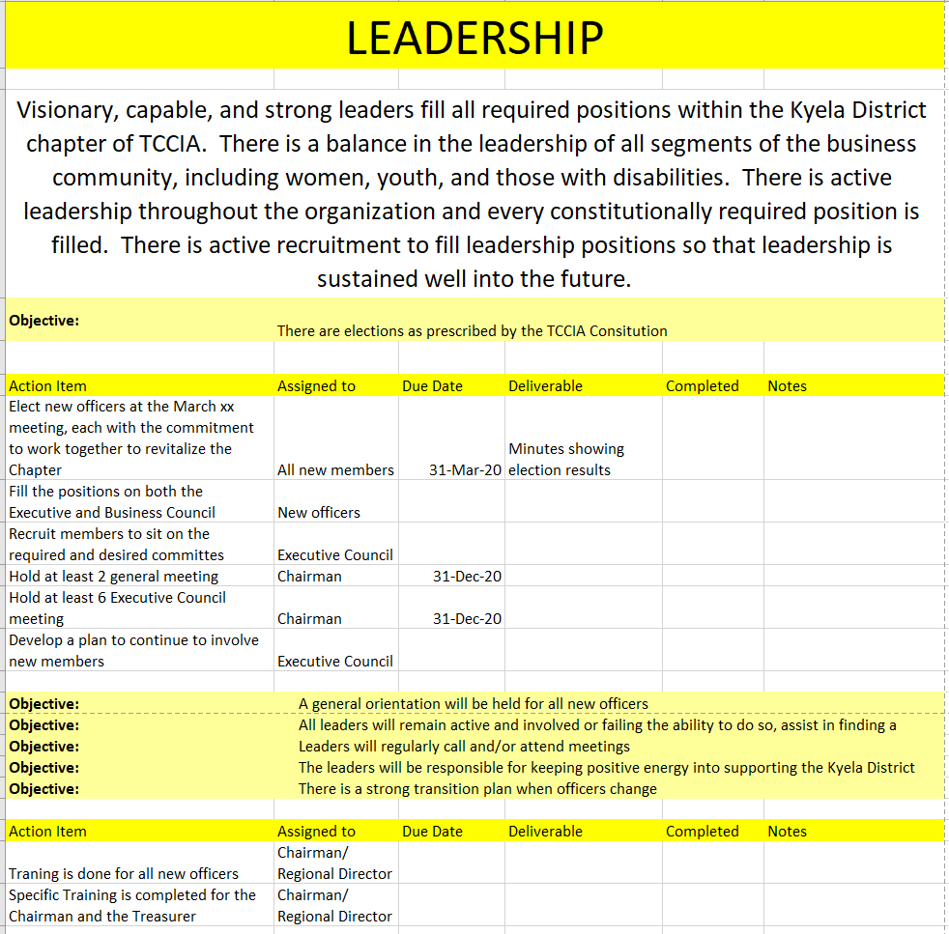

Slide 23
This is not the end…This is the beginning!
This work plan document is yours
Use it, adapt it, make it yours.
I will send this to everyone who wants it
I have it both in Excel format and PDF
In excel format, it can be sorted by who and when or left with the objectives.
It will take more steps than are on here to get where you want to go.
But the first step is the most important

Slide 24
And the first step is
Get Started!

