Slide 1

AFTER Covid-19:
Alien Invasion or Recovery

Slide 2
Way Back Time Machine

Slide 3
Sevier County Economics 2019

Slide 4
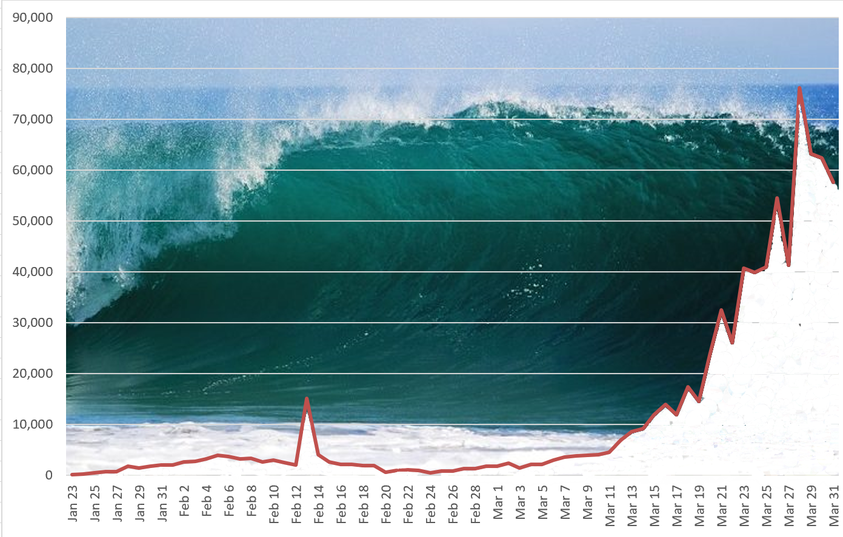
And then the Tsunami Hit in the form of COVID-19

Slide 5
6 days
50 days
COVID TIMELINE
84 days
26 days
45 days
First Case announced in US
36 days
First Tennessee case in Middle Tennessee
23 days
40 days
WHO Declares a Pandemic
21 days
39 days
Wuhan Quarantined
US Declares National Emergency
US Declares Public Health Emergency
First case announced in Wuhan China
Travel ban from Europe
GA Restuarants to reopen
Today
Global Air Restrictions from China to US
US CARES Act Enacted
TN Restaurants at 50% capacity
2020
Jan
Feb
Mar
Apr
May
Jun
Jul
2020
Today
2020
250+ groups are discouraged in TN
KY Closed all restaurants to indoor activities
Tennessee Schools close
TN Restaurants and bars closed to indoor service
Groups larger than 10 prohibited in TN
KY Closed all business
GA Issues Shelter in Place Order
KY Closes the border to Non-essential TN Travel
TN Issues Stay at Home Order
TN Groups of less than 50 may convene

Slide 6
Employment

Slide 7
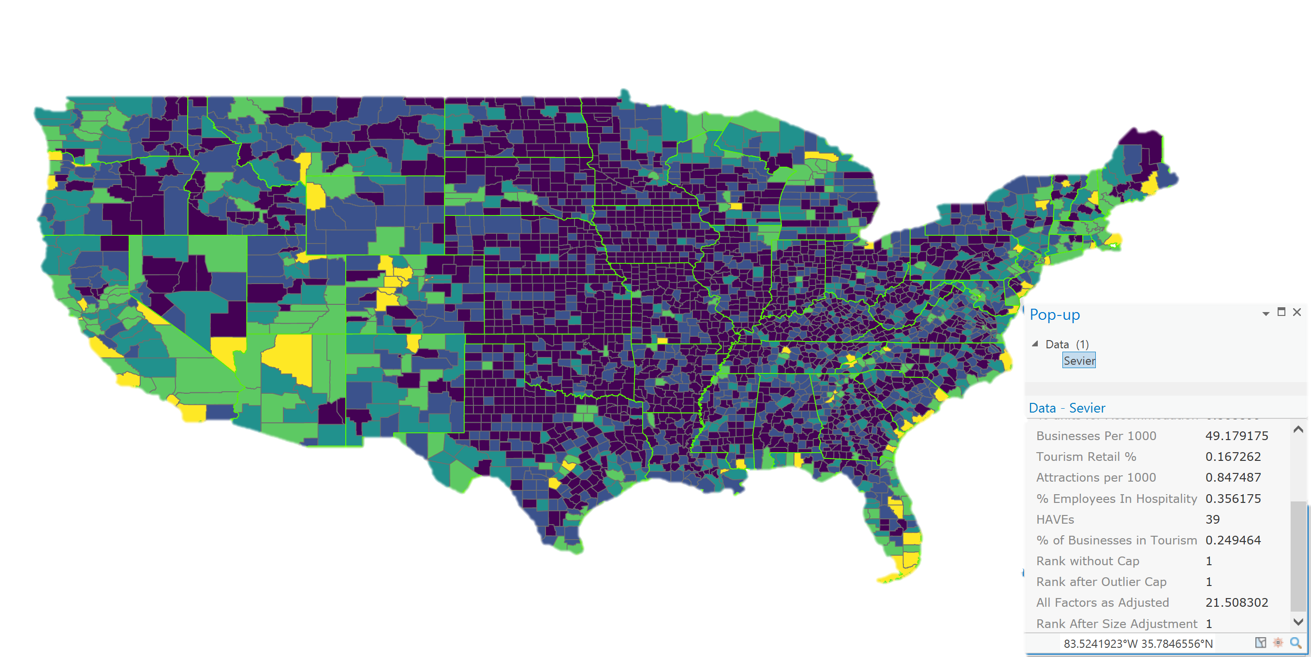
Sevier County’s Economy Is TOURISM!

Slide 8
Impacts from Co-vid 19
Travel Bans
  International Travel to and Through Europe is currently ill advised
  Many states are requiring 14 day quarantines when returning from the South
Shutdown
  A concern about states having to return to shutdown to get control of the surge
Layoffs
  Large travel and hospitality organization who took CARES money did not layoff – but stay tuned
Stimulus Checks
  Made it easier to travel but many used that money to do home improvements and debt reduction
Unemployment check bumps
  Unemployment stays high is many areas while employers struggle for workers because the employees are making twice as much on Unemployment as they will working.

Slide 9
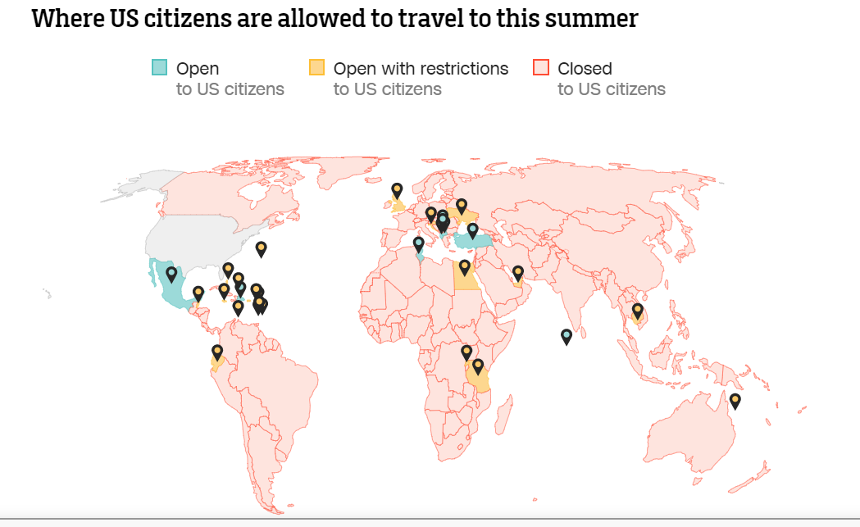

Slide 10
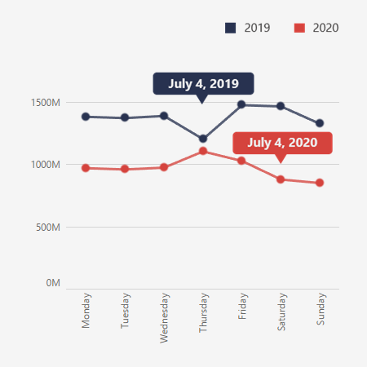
Car Travel as estimated by AAA

Slide 11
Enplanements by the week since march
Over same week last year

Slide 12
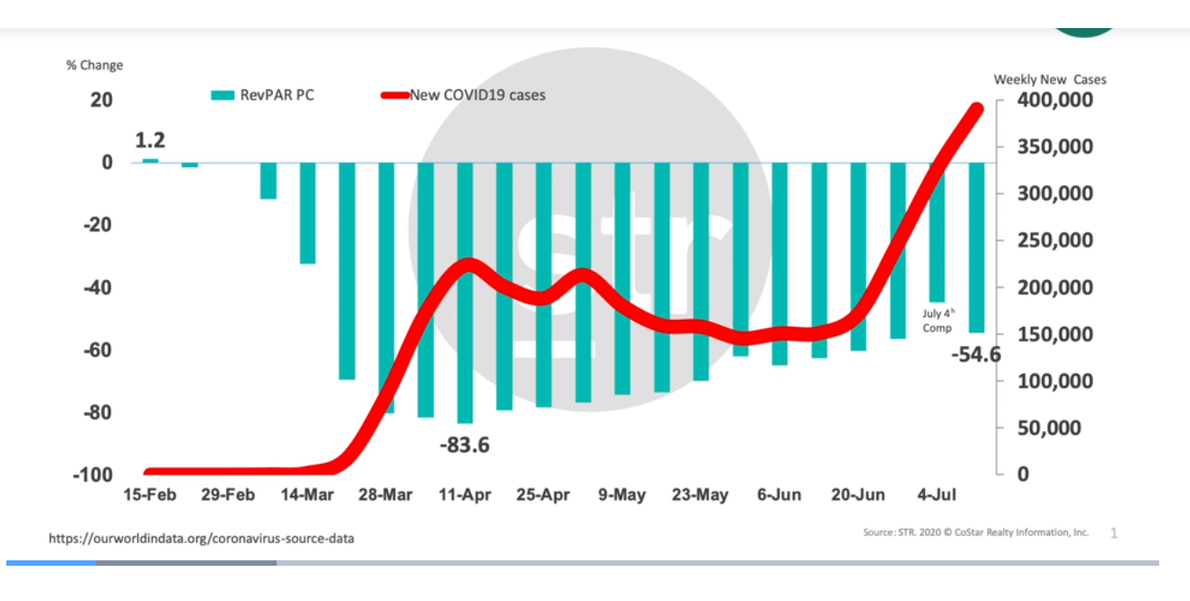
Hotel Revpar vs the virus

Slide 13
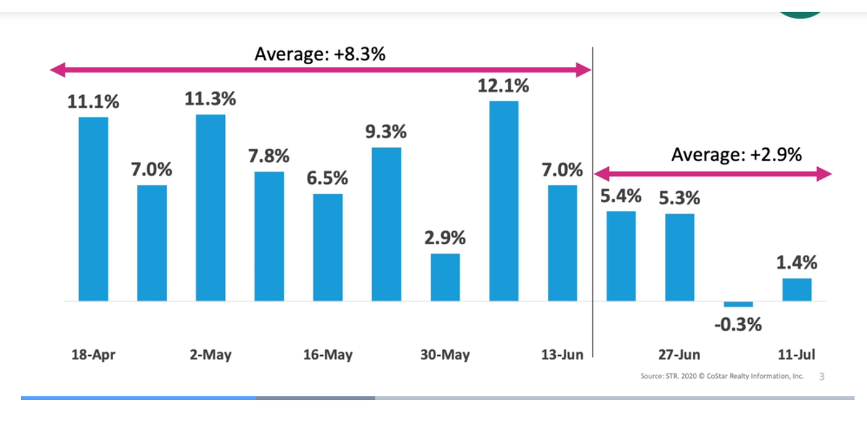
Change in Occupancy week to week

Slide 14
Recent local financials
From lows in the single digits in April, we were about 1/3 occupied in May. June’s is not here yet but we expect it to be in the 50%
Occupancy is expected to drop in July as our cases spike
Sales Revenues for the County were $3.8 Million in June (Apr) versus $9.9 Million for the same period last year.
HART Taxes are expected to be similarly impacted.

Slide 15
Percentage Change – Total Sales

Slide 16
GSMNP Attendance

Slide 17
2019 YTD over 2020 YTD

Slide 18
Mar – May Hotel

Slide 19
Tourism Economics during Covid
US Economy is in the midst of a RECESSION!
The Travel Industry is in a DEPRRESSION!

Slide 20
Historical Perspective
9-11
The Great Depression
  Travel spending declined $65.3 Billion (in 2020 dollars)
CoVID-19 Comparison
  Travel spending is expected to decline $519 Billion
  1933 Unemployment: 25%
Covid-19 Comparison
  Overall Travel Industry – 51%
US TRAVEL ASSOCIATION DATA

Slide 21
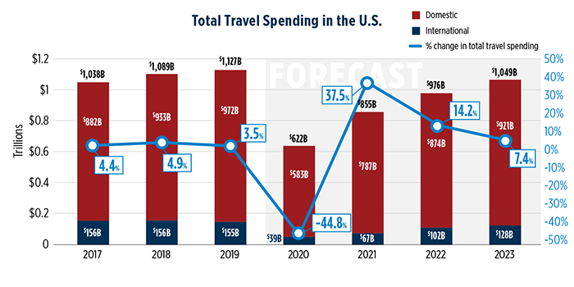

Slide 22
US Travel Association Revised forecast
 | 2018 | 2019 | 2020 | 2021
Travel Spending | 1,089 | 1,127 | 622 | 855
US Leisure Person Trips | 1,820 | 1,858 | 1,332 | 1,685
US Spending Per Trip | 4.0% | 4.2% | -14.7% | 6.5%
Leisure Trips per HH | 1.9% | 2.1% | -28.3% | 26.5%

Slide 23
6 days
50 days
84 days
26 days
45 days
First Case announced in US
36 days
First Tennessee case in Middle Tennessee
23 days
40 days
WHO Declares a Pandemic
21 days
39 days
Wuhan Quarantined
US Declares National Emergency
US Declares Public Health Emergency
First case announced in Wuhan China
Travel ban from Europe
GA Restuarants to reopen
Today
Global Air Restrictions from China to US
US CARES Act Enacted
TN Restaurants at 50% capacity
2020
Jan
Feb
Mar
Apr
May
Jun
Jul
2020
Today
2020
250+ groups are discouraged in TN
KY Closed all restaurants to indoor activities
Tennessee Schools close
TN Restaurants and bars closed to indoor service
Groups larger than 10 prohibited in TN
KY Closed all business
GA Issues Shelter in Place Order
KY Closes the border to Non-essential TN Travel
TN Issues Stay at Home Order
TN Groups of less than 50 may convene

Slide 24
NOISE Makers vs Decision Makers
Noise Makers
  Screaming about this being fake news or a hoax
  Talking about how wearing a mask is a personal choice
  Encourage the world to return to pre-COVID normality
Decision Makers
  55% of public cancelled travel plans, which is a slight increase from last week
  79% of the public are worried to concerned about the effects of the virus
  Only 32% of the public said they had travel plans
    Good news – most of them are planning on travelling by car

Slide 25
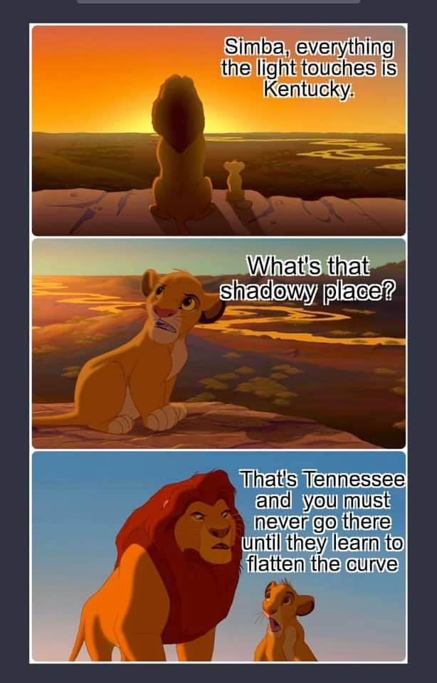
COVID Cases in TN, KY, GA and the USA

Slide 26
Current Conditions
Cases continue to rise
Tourist continue to come
Dollywood open
Soaky Mountain Open
Attractions in Gatlinburg Open

Slide 27
Beginning of the return

Slide 28
Coming months – May get worse
Sept 30, worker layoff freeze expires
Layoffs
  Airline industries - 25%
  Wells Fargo – 10%
  AT&T - up to 10% of retail employees
  Hilton – 22% of its corporate workforce
  Chevron – 15% of its global workforce
  IBM – 10%
  UBER – 14%

Slide 29
Retail Destruction
GNC
Pier 1 Imports
GameStop
Kay’s, Jared, & Piercing Pagoda
Bed, Bath Beyond
Victoria’s Secret
Chicos
Tuesday Mornings
Gap
J.C. Penney
The Children’s Place
Forever 21
Macy’s
Wilson Leather
Office Depot
Brooks Brothers
Sears
Bath & Body Works
Earth Fare
Bose
Christopher & Banks

Slide 30
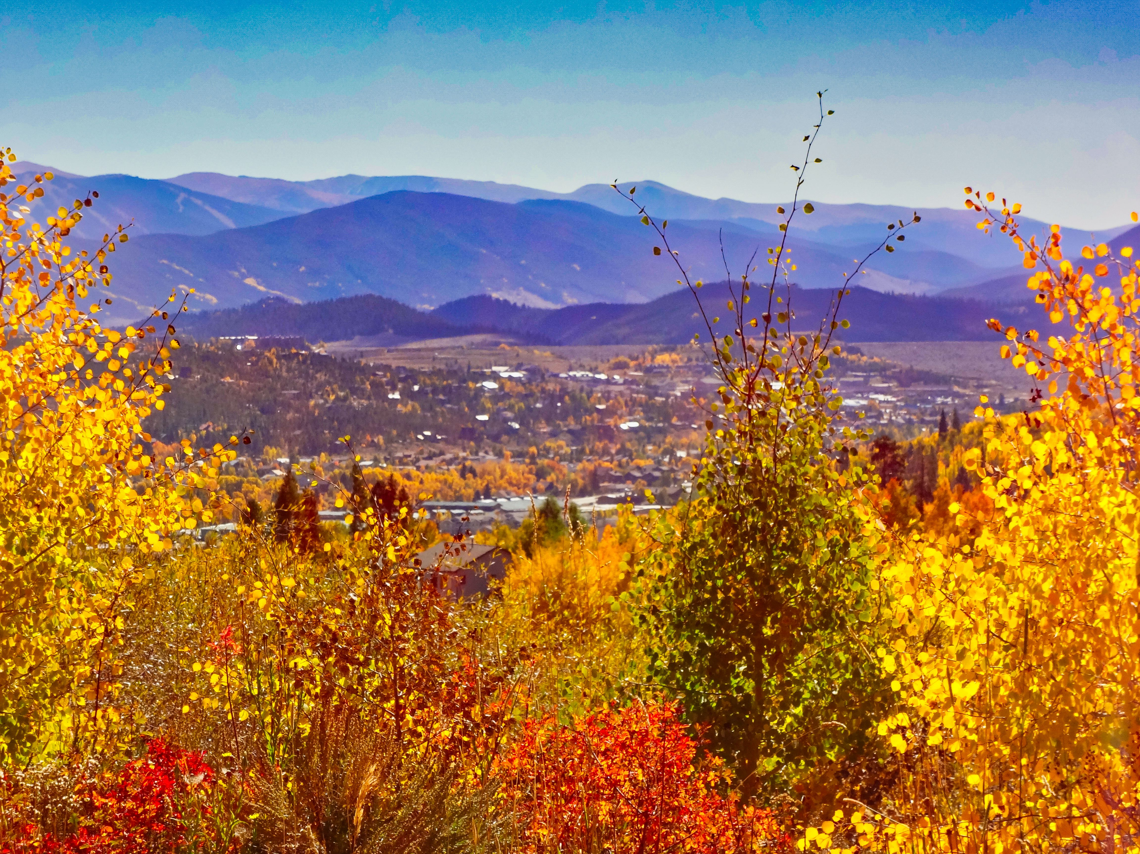
Fall Season
Football
  Will the lack of spectators at football games promote tourism?
Leaf Peeping
  With kids back in school, do we get the regular leaf peeping crowd of seniors
European Lockout
  If the folks that usually go to Europe, can’t – will they come here?
Gas Prices

Slide 31
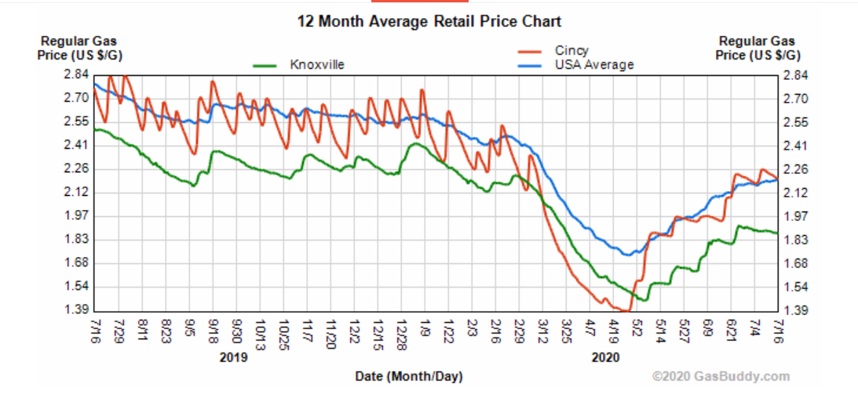
Gas prices are still historically low

Slide 32
Next Season
The Economic forecast
  Bank of America CEO Brian Moynihan says he does not expect a full recovery until next year.
The travel forecast
  US Travel expects it to take until mid 2022 to fully recover
The local forecast
  Due to the National Park, our driving market and our perceived ruralness, we may recover faster

Slide 33

Conventional wisdom
It takes twice as long to recover from a significant dip as you were in the dip

Slide 34
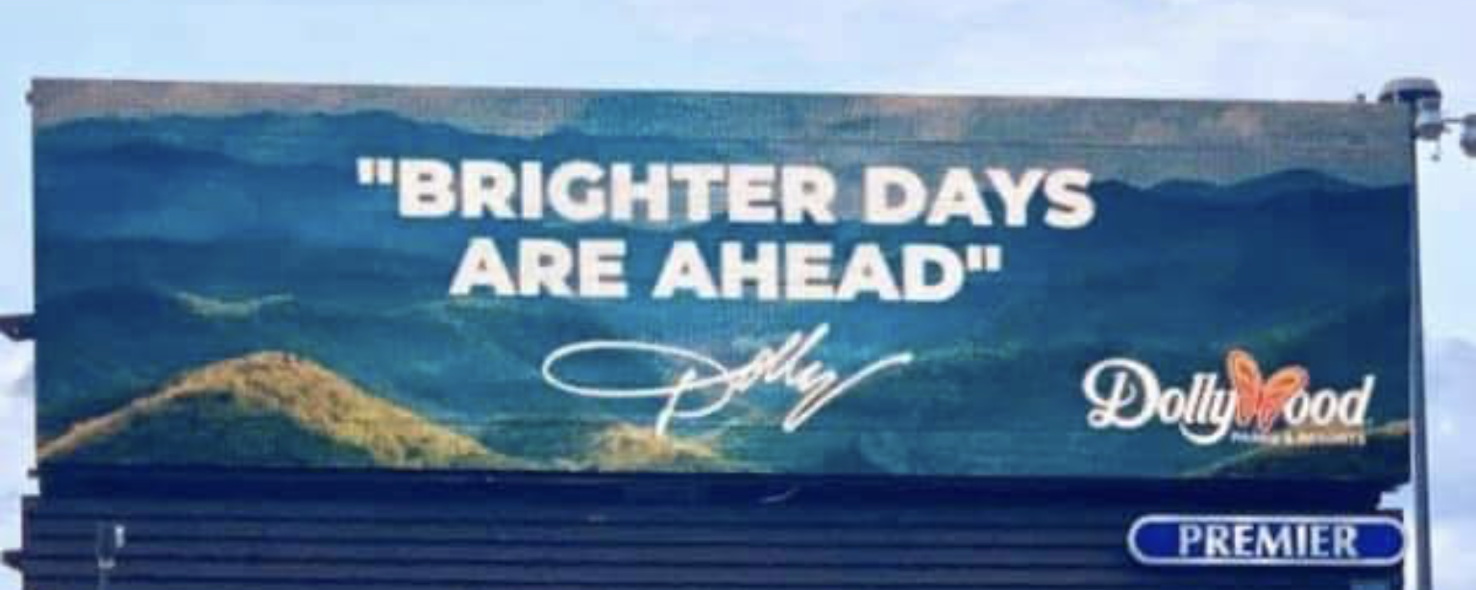

Slide 35
Suggestions
Enhance your outdoor experiences
Work with City Officials to permit more
  Outdoor dining
  Sidewalk sales
  Open now signage
Encourage masks
Provide social Distance clues
Remind people that you are open and how you are accommodating their concerns

Slide 36
The return to a strong economy
Great new businesses in place, ready to fulfill their place in the County
Plenty of housing coming on line for workers
Ability to attract workers as worker surpluses exist in our normal areas of draw

Slide 37
SUMMARY
Wear a Mask
Encourage others around you to do so
Social distance
Wash your hands
Don’t touch your face
And if you are sick, stay away from others.
THAT IS HOW WE WILL BRING THIS ECONOMY BACK FASTER

Slide 38
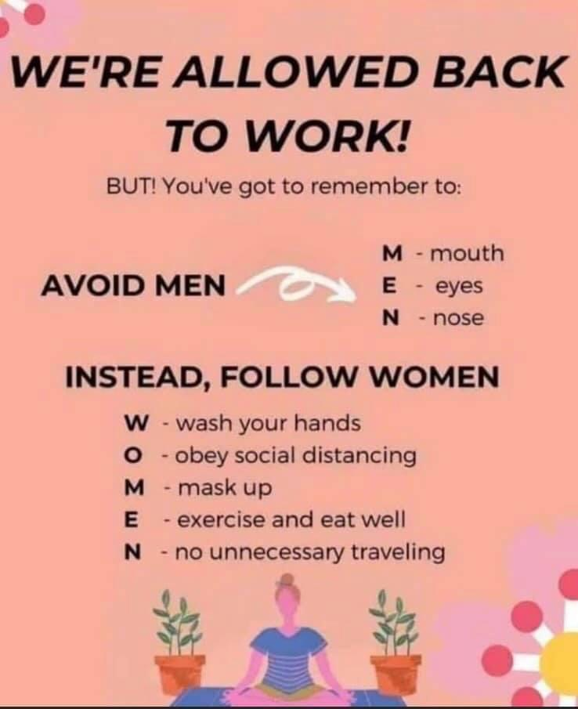

Slide 39
PAMELA S CASKIE
Pam.Caskie@abryteidea.com
308-760-6727
Sevierville, TN 37876

