Slide 1
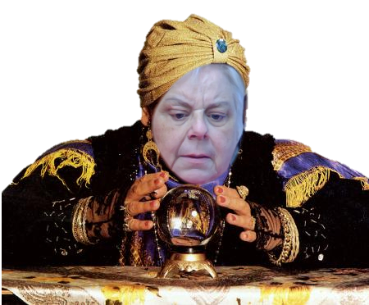

Slide 2
WHAT WE KNOW

Slide 3
Economy was strong

Slide 4
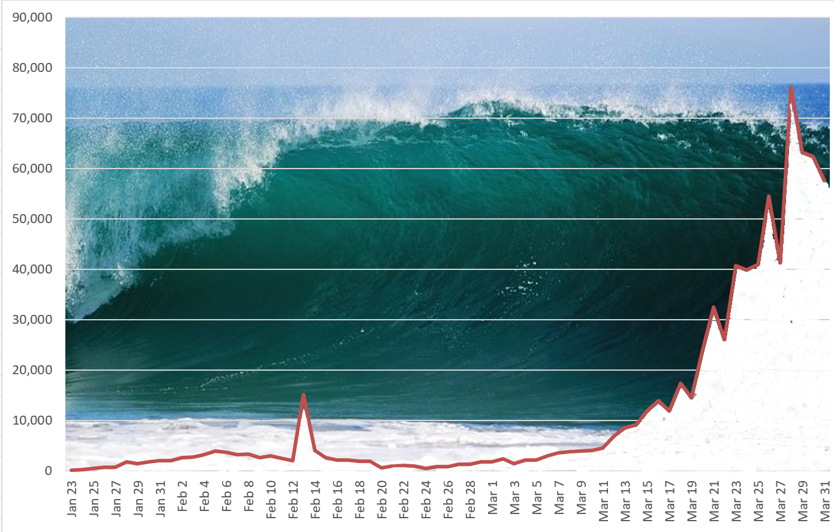
And Then:
The COVID-19 Tsunami Hit

Slide 5
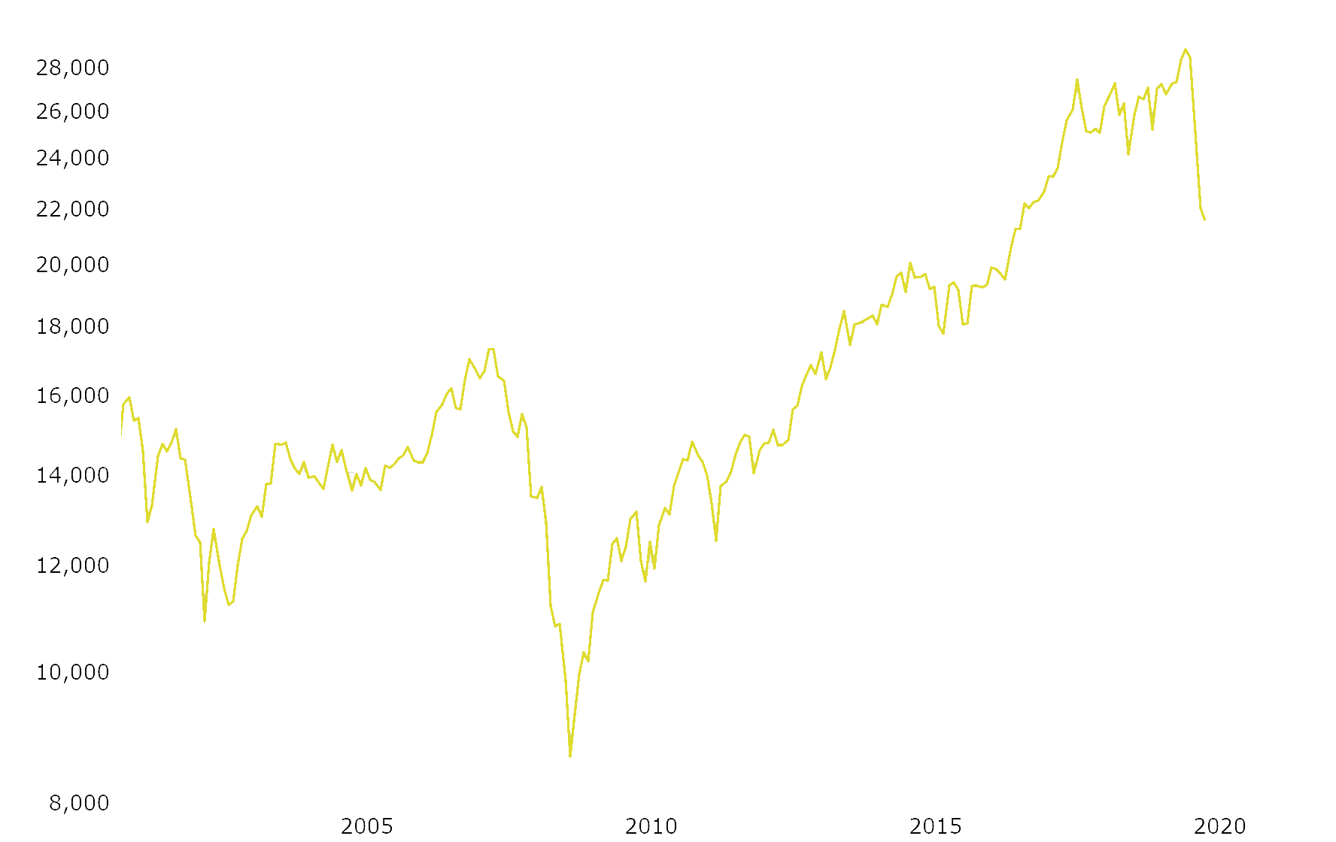
Stock Market
2000 2008 2020

Slide 6
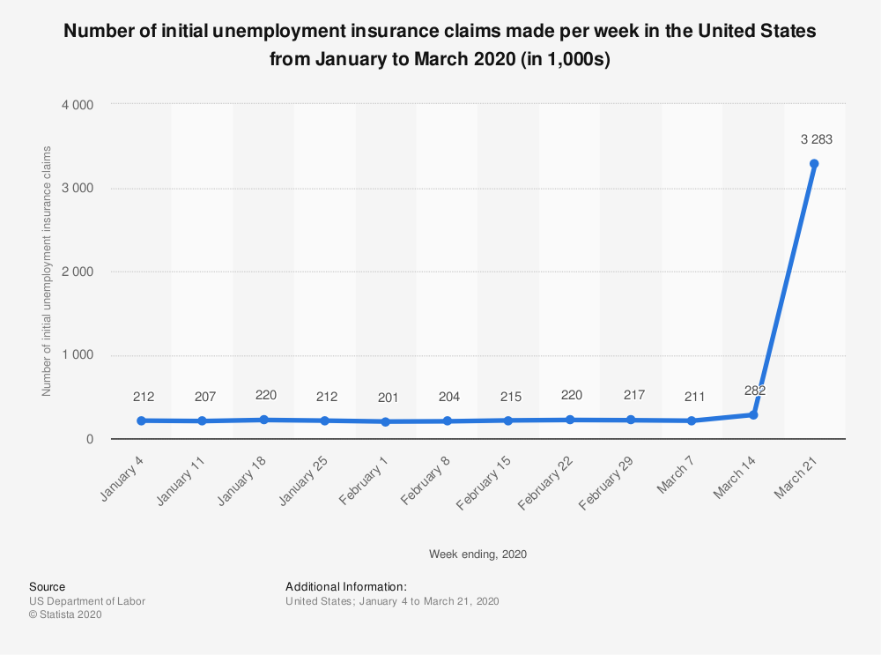
Unemployment

Slide 7
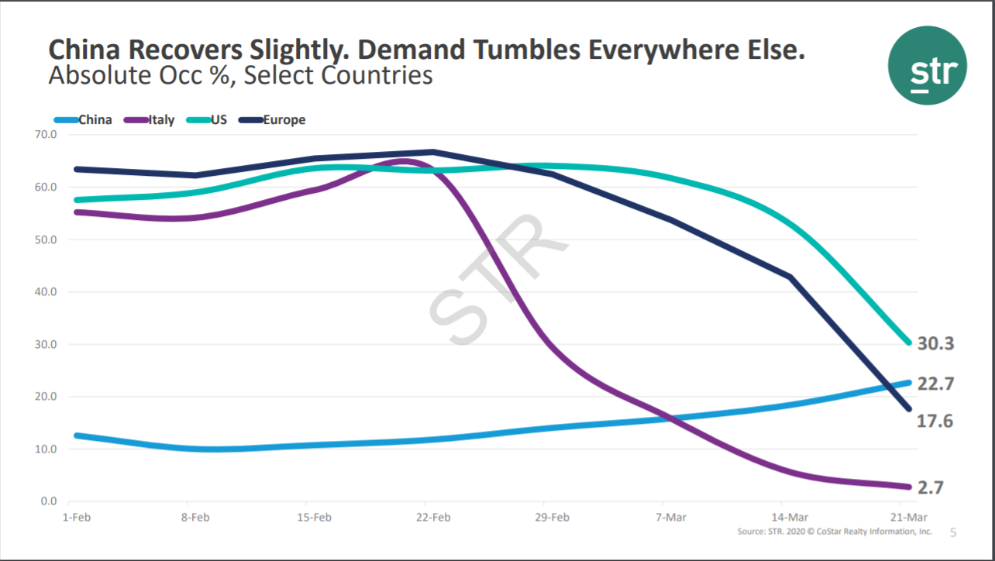
Hotels

Slide 8
Airlines
Passengers through TSA Security during March

Slide 9
Year-over-year daily change in seated restaurant diners due to the coronavirus (COVID-19) pandemic worldwide from February 24 to March 25, 2020
Daily year-on-year impact of COVID-19 on global restaurant dining Feb-Mar 2020
RESTAURANTS
Note: Worldwide; as of March 25, 2020; nearly 60,000 restaurants
Further information regarding this statistic can be found on page 63.
Source(s): OpenTable; ID 1103928
10
Global

Slide 10
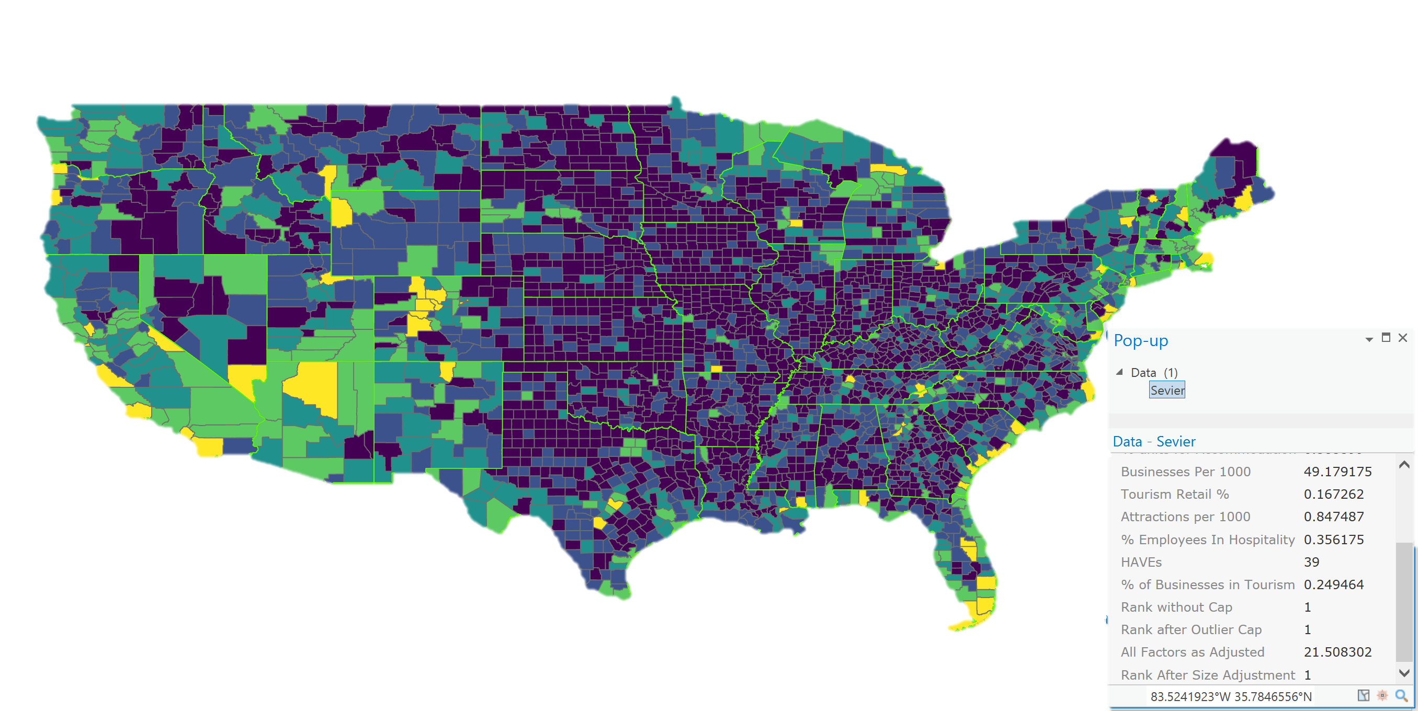
Sevier County most tourism dominant county in the country
TEDI 2.0

Slide 12
Amid the Bad News, There is Some Good News

Slide 13
Dolly Parton is going to read to us each night

Slide 14
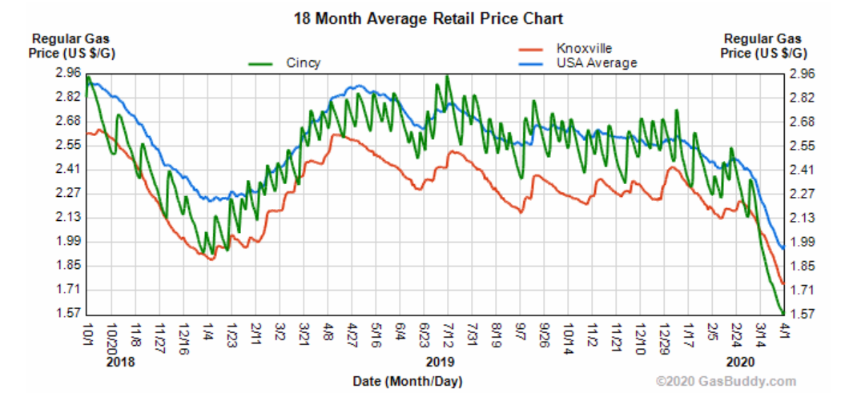
Gas prices are low

Slide 16
CARES Act
Individuals get a check for $1,200
Family of 4 would get a check for $3,400
Unemployment is increased by $600/week over state eligible benefit
Self-employed, gig workers, and freelancers are eligible
Enhanced Small Business loans including forgiveable loans and 30 year payouts.

Slide 17
WHEN?
Who really knows!
Before Memorial Day, likely
Twice as long as it took to bottom out

Slide 18
Our Benefits
We are a driving Destination
Camp Grounds
Cabins and condos
Significant amount of cabins are owned by people outside Sevier County, so they feel like they belong here.
Beautiful places to get outdoors
Even if they don’t own property, it feels like a second home to many

Slide 19
States with significant share of our visitors
Kentucky has a No Travel Order and Shelter In Place
Indiana has closed nonessential businesses
Ohio has a stay at home order
Other states around us has a various levels of restrictions
Canada is locked down

Slide 20
How to make your recovery the strongest possible

Slide 21
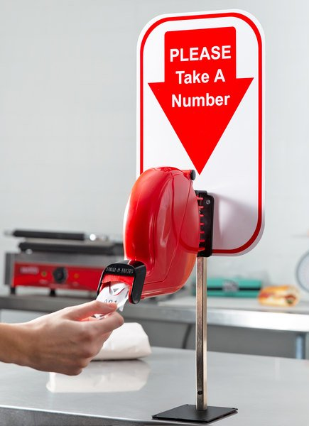
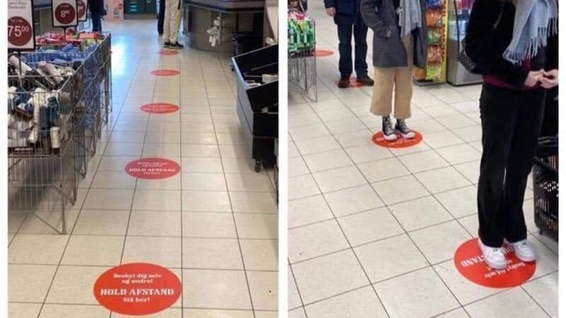
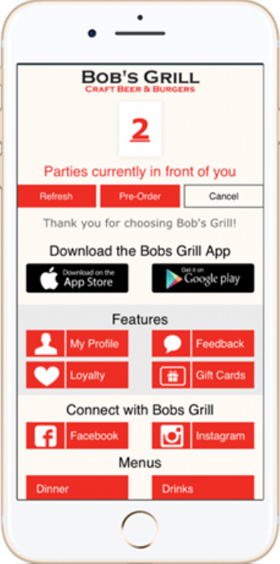
Provide for social distancing

Slide 22
Double clean EVERYTHING and advertise it
Use Lysol and leave the rest of the can in the room
Put Anti-bacterial wipes in the rooms
Make hand wipes available for rides, clubs, etc.
Set up hand wash stations and/or sanitizer

Slide 23
Our Visitors Love it Here!
They will come back, sooner rather than later
This virus is going to be with us for awhile
People are going to be afraid
Give them every reason to NOT be afraid
Money spent during this time going the extra mile will reap big dividends into the future
Stay Strong!

