Slide 1
Welcome
To The
Area Attractions
Economic Update

Slide 2
Travel 2018 - 2019
Domestic Leisure travel grew 2 % in 2018
Travelers spent an estimated $1.1 Trillion in the US
Globally, Vacation Rentals are expected to top the hotel industry within the next 5 years.
RV’ing has seen record level increases of ownership
Total expenditures per trip went up 2.8%
When, if, and how deep will we have a recession?

Slide 3
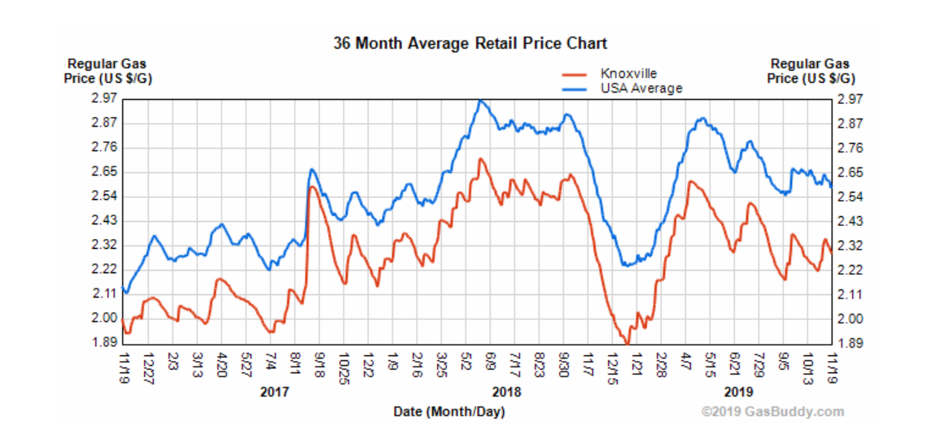
Gas Prices

Slide 4
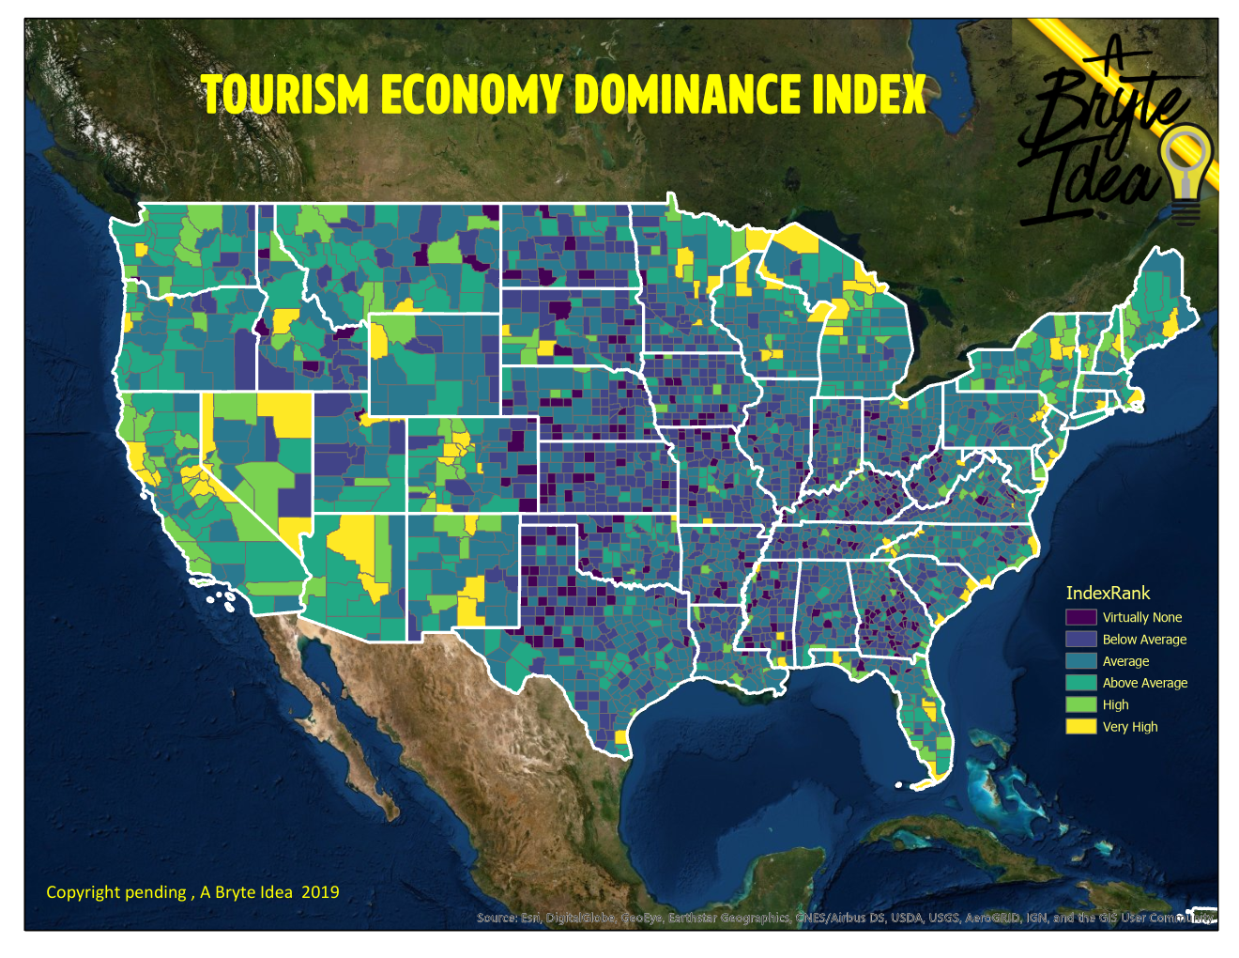

Slide 5
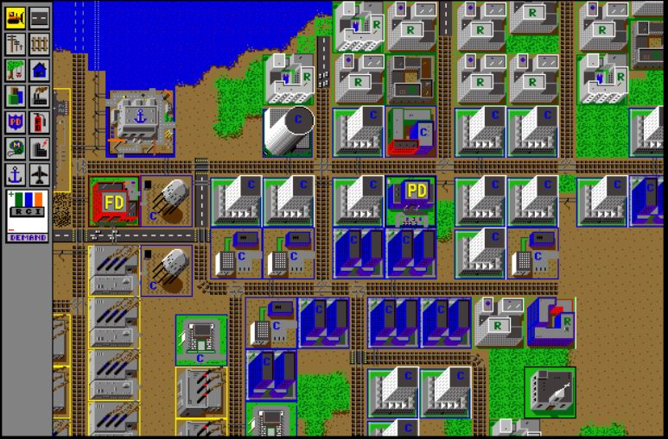
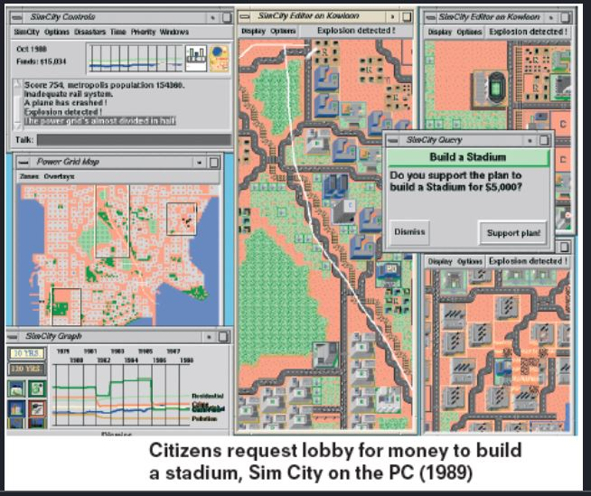

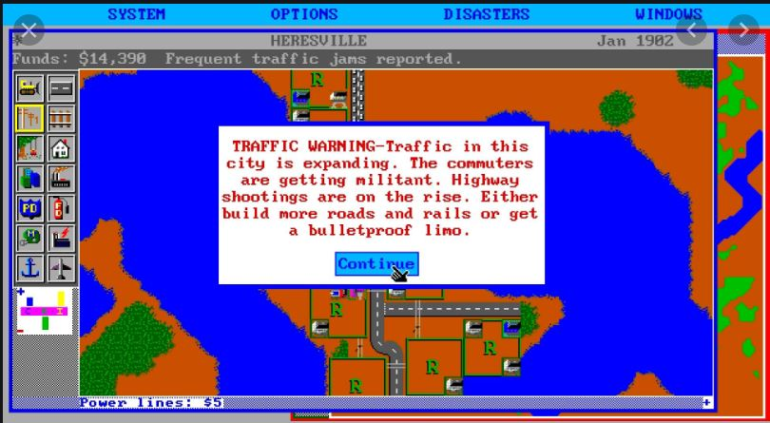

Slide 6
Rooms Per 1,000 Population

Slide 7
Percentage places for Overnight Stays

Slide 8
Places to Eat per 1000 Population

Slide 9
PAID Activities per 1000 Population

Slide 10
Tourist Oriented Retail Stores / 1000 POpulation

Slide 11
ALL Businesses per 1000 Population

Slide 13
What do others look like
 | Business PK | Retail PK | Stay % | Rooms PK | Eateries PK | Attractions PK
Sevier | 28.77 | 4.92 | 39.35 | 183.43 | 3.32 | 1.48
Horry | 27.82 | 3.35 | 34.38 | 95.03 | 3.31 | 0.78
Taney | 33.75 | 5.16 | 47.85 | 253.66 | 3.17 | 1.93
Davidson | 28.70 | 2.04 | 10.91 | 46.46 | 2.44 | 0.70
Shelby | 20.75 | 1.91 | 4.99 | 19.89 | 1.59 | 0.16

Slide 14
Per capita Sales in Tennessee

Slide 15
The 2019 season in review

Slide 16
Rolling 12 Months % Change

Slide 17
% Change from 2014 with Trends

Slide 19
$4,594,821,860 sales in the last 12 months

Slide 20
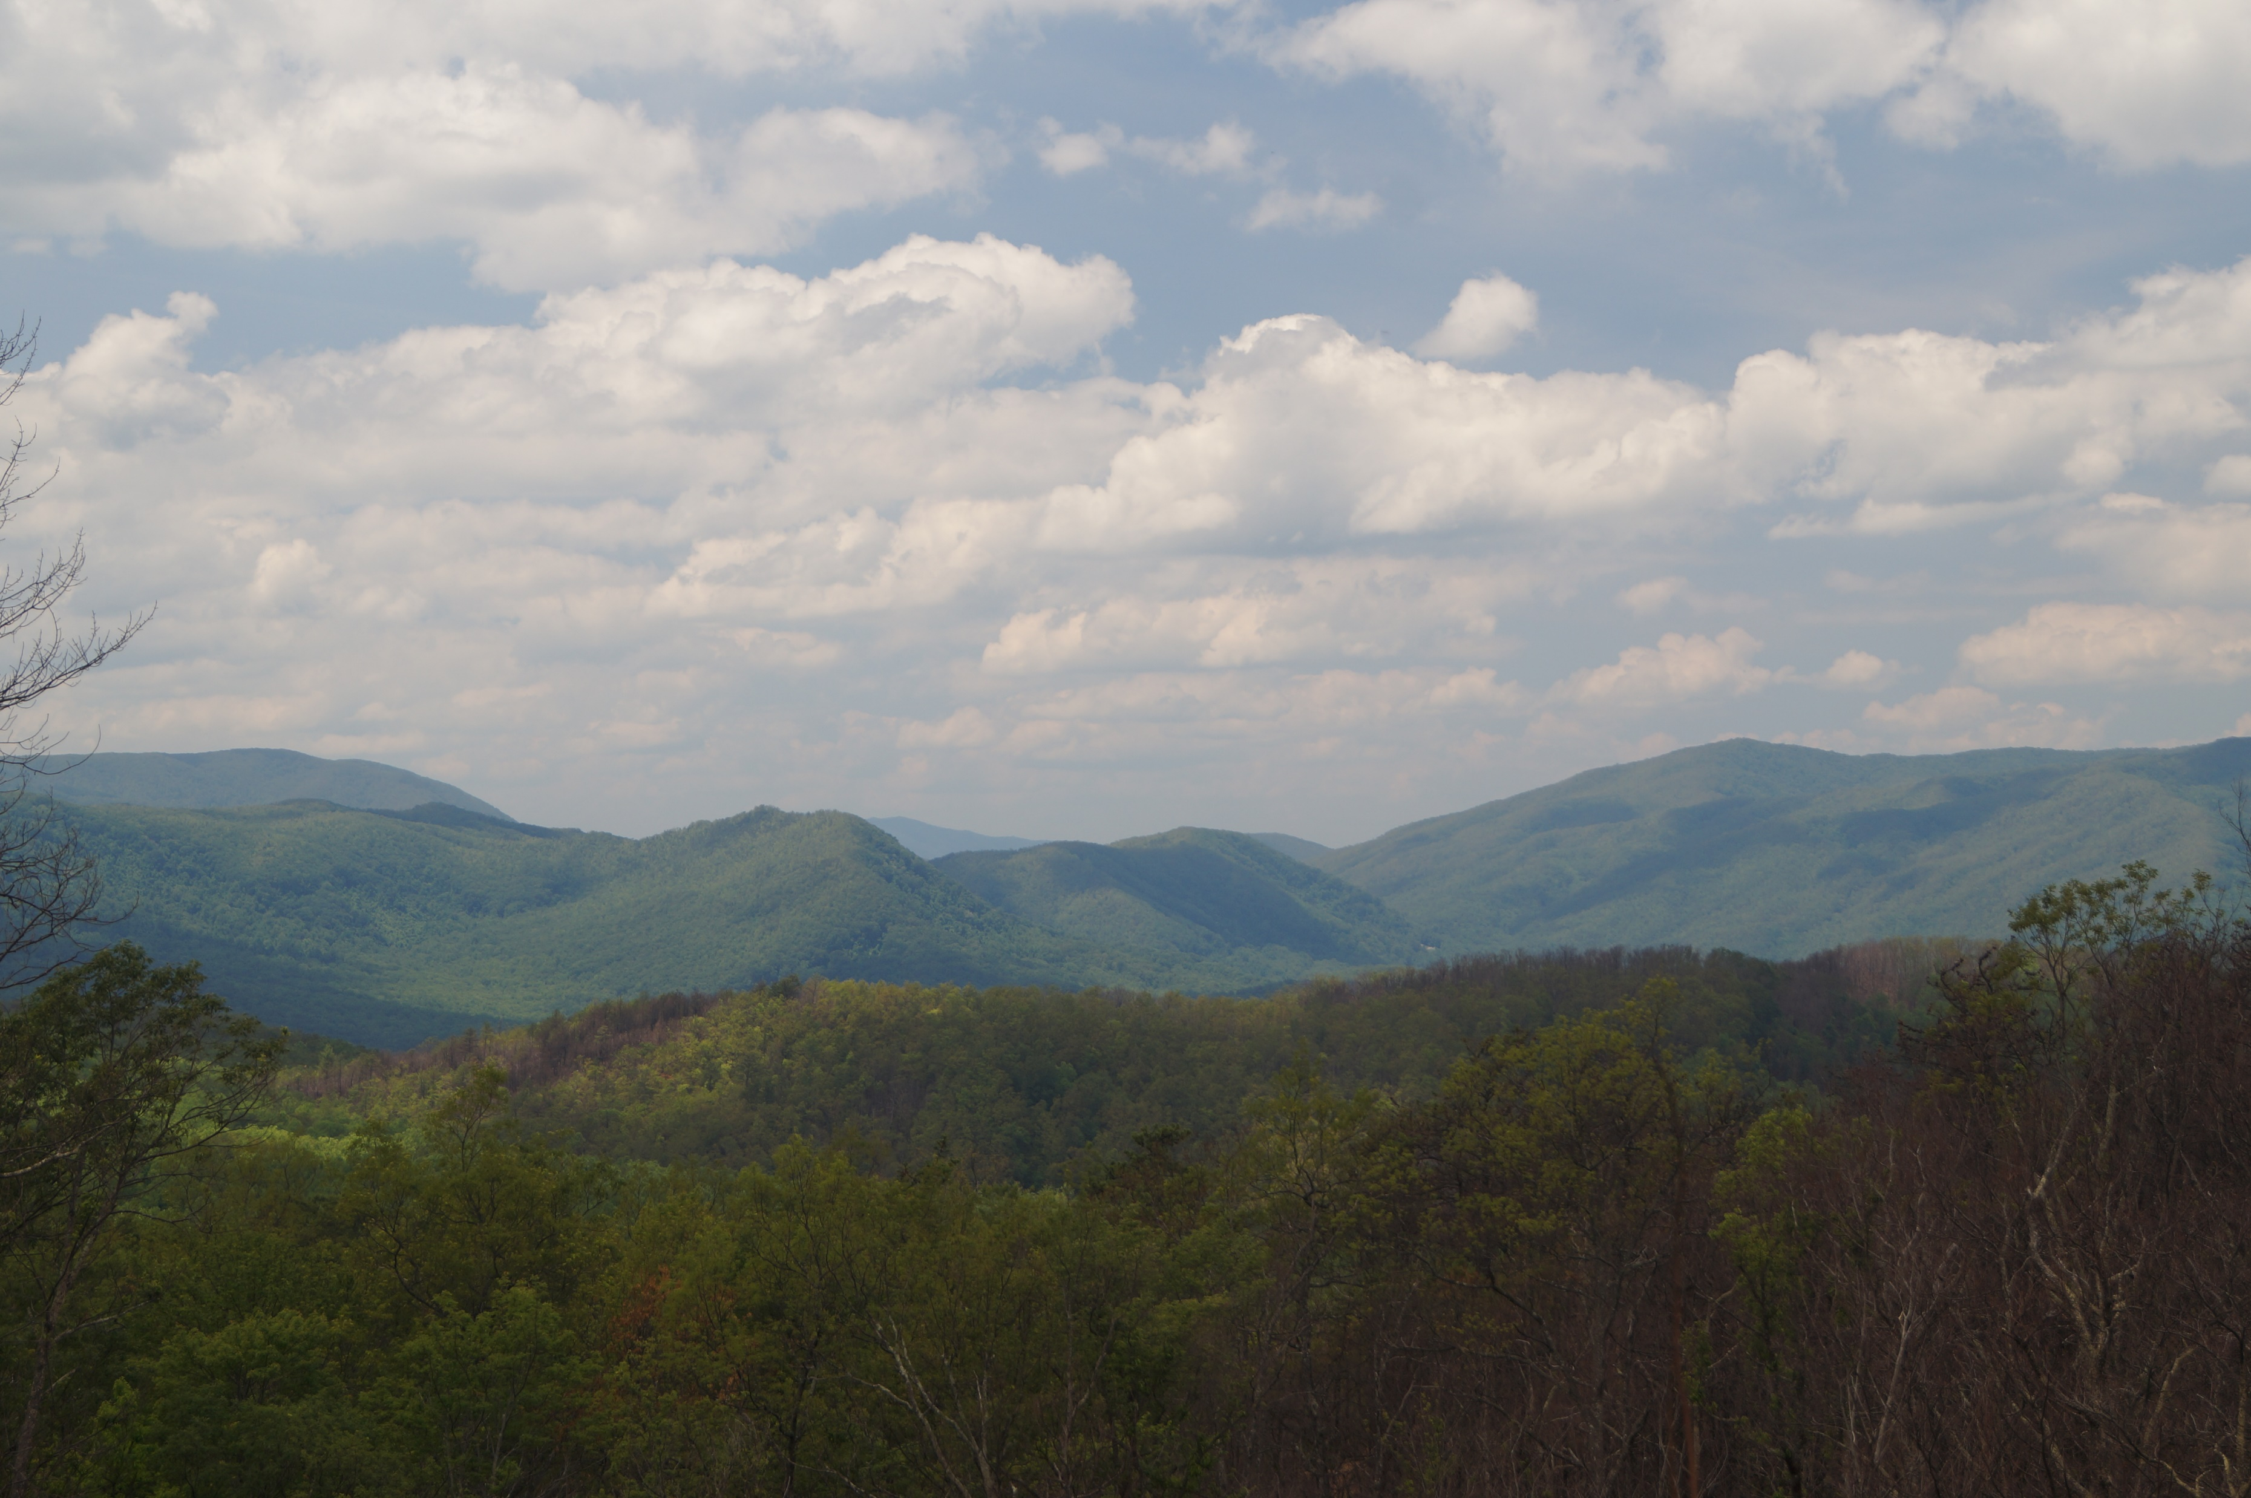
National Average to Sevier County
2.7%
9.8%

Slide 21
Hospitality Taxes

Slide 22
LODGING REVENUE

Slide 23
Restaurant Revenue

Slide 24
Attraction revenue

Slide 25










Slide 26
Unemployment

Slide 27

Adequate
Workforce
Affordable Housing
Affordable Daycare
Reliable Transportation

Slide 28
Exciting things on the horizon
  Soaky Mountain
  407?????
  New significant hotel in Pigeon Forge
  Continued expansion of the Cabins and Condo Market
  Housing for Employees – better opportunities to attract workforce.

Slide 29
DAYCARE!

