Slide 1
How to Fund College
A workshop by Felicia Wise

Slide 2
Join at slido.com #936562
ⓘ Start presenting to display the joining instructions on this slide.
Notes:
📣 This is Slido interaction slide, please don't delete it. ✅ Click on 'Present with Slido' and the joining instructions will appear when you get to this slide.

Slide 3
About Me
Felicia Wise
Senior Program Director
B.A. Mass Communications
M.S. Business Management
Doctoral Candidate (Ed.D Higher Ed. Leadership)
Former D1 Student Athlete
Parent

Slide 4
Talking Points
What are your choices after high school?
Understanding the cost of college
What is Financial Aid?
Types of Financial Aid
Where to get Financial Aid
How to apply to receive Financial Aid
Ways to avoid college debt

Slide 5
What are your choices after high school?
ⓘ Start presenting to display the poll results on this slide.
Notes:
📣 This is Slido interaction slide, please don't delete it. ✅ Click on 'Present with Slido' and the poll will launch automatically when you get to this slide.

Slide 6
What are your choices after high school?
Pursue a degree
Pursue a vocation
Got to work
Join the military

Slide 7
What does the cost of college include?
ⓘ Start presenting to display the poll results on this slide.
Notes:
📣 This is Slido interaction slide, please don't delete it. ✅ Click on 'Present with Slido' and the poll will launch automatically when you get to this slide.

Slide 8
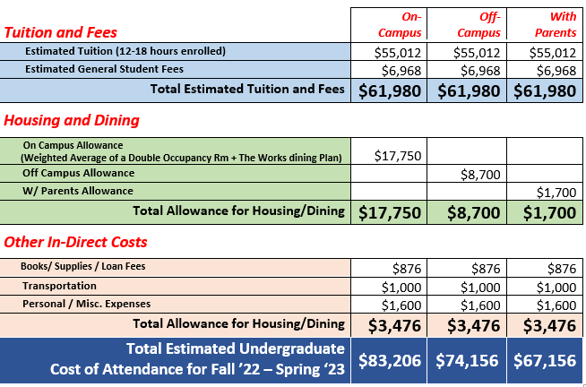
What is the cost of college? What does it include?
Cost
Of
Attendance

Slide 9
Type of College
Public
Public schools are funded mainly by state governments
Lower COA due to government funding
Larger Size
Extracurriculars
Larger Selection of Program/ Major Choices
Private
Private colleges are supported primarily by their own endowments and students’ tuition fees.
Higher COA due to lack of government funding
Smaller Size
Religious Affiliation

Slide 10
Type of College
2 Year
Associate Degrees or Trade/Vocational Certifications
Lower COA
Flexibility
Open admissions/Open Enrollment
4 Year
Bachelor's Degree or Advanced/ Professional Degrees
Higher COA
Admission Requirements/Criteria

Slide 11
How do you plan to pay for college?
ⓘ Start presenting to display the poll results on this slide.
Notes:
📣 This is Slido interaction slide, please don't delete it. ✅ Click on 'Present with Slido' and the poll will launch automatically when you get to this slide.

Slide 12
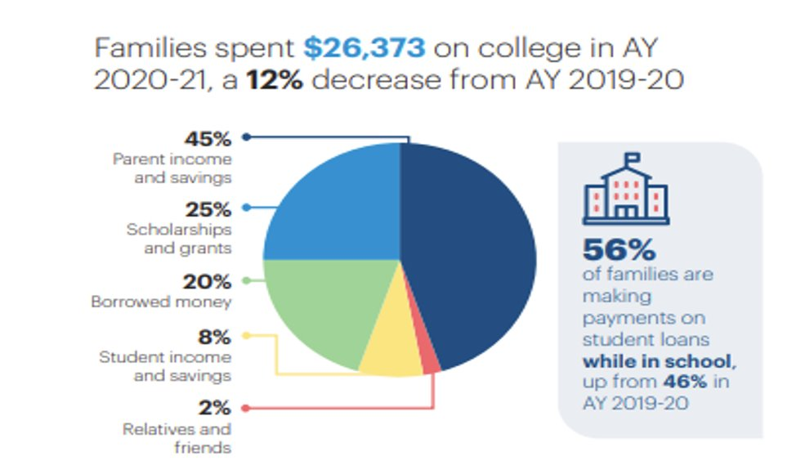
How are you going to pay for college or trade school?
Student Aid by Source

Slide 13
What is Financial Aid?
Financial aid helps students and their families pay for college. It can cover a range of educational expenses, like tuition and fees, room and board, books and supplies, and transportation.
Types of Financial Aid

Slide 14
Where to get Financial Aid, and How to Apply

Slide 15
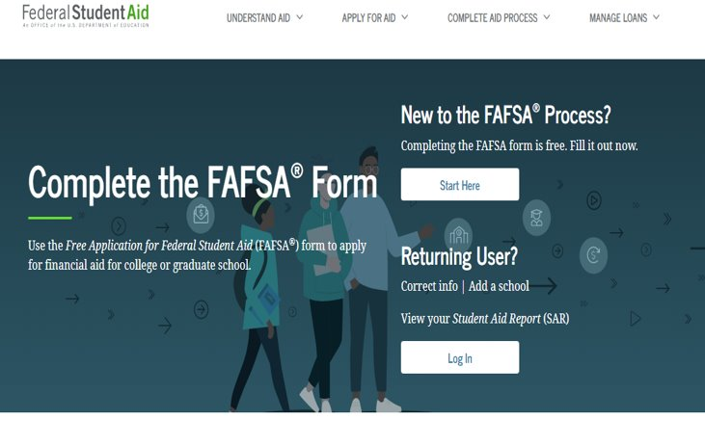
Federal
www.studentaid.gov​
OPENS OCTOBER 1 — APPLY EARLY!​
Priority Deadline - March 1st

Slide 16
State
mhec.maryland.gov

Slide 17
Private
College or University​
Membership Orgs & Associations ​
Corporations​
Athletic clubs

Slide 18
How to avoid student debt
National Student Debt Totals​
$1.75 Trillion​
43.4 Million borrowers have federal student loan debt!​
Average federal student loan debt per person $37,113​

Slide 19
Have a plan and understand it.
Having a Plan gets You ½ Way There
6 out of 10 families created a plan to pay for college​
(includes saving, anticipating and researching costs and expenses, ​
and identifying sources of funding)​
Understanding the Plan ​
How much will all years of college cost?​
What is the starting salary for jobs in your field of study?​
Will you need education beyond an undergraduate degree to achieve career objective?​

Slide 20
Early College Programs
International Baccalaureate
Advanced Placement
Dual Enrollment

Slide 21
Serve
AmeriCorps​
VISTA​
Teach for America​
NCCC​
FEMA​
City Year​
Peace Corps​
Military​
TEACH Grants​
Public Service Loan Forgiveness​

Slide 22
Tips for Applying for Scholarships
Look Early​
Choose wisely ​
Avoid SCAMS- don’t pay​
Meet deadlines​
Follow directions​
Proofread​
Stand OUT​
Be Professional firstname.lastname@mail.com​
Write an interesting essay

Slide 23
How are you being evaluated?
Scoring Rubric

Slide 24
Essay
Start With a Plan ​ (answer the question, outline)​
Clear Message ​ (do not ramble, no tangents)​
Pick one or two strong examples​
(anecdotes, proof)​
Be human ​ (learned, felt, thought, did, will do)​
Proofread ​

Slide 25
Academic Resume - What to Include
Name and contact information.
Add your education.
Include activities.
List athletic participation.
Include work experience.
List special interests.

Slide 26
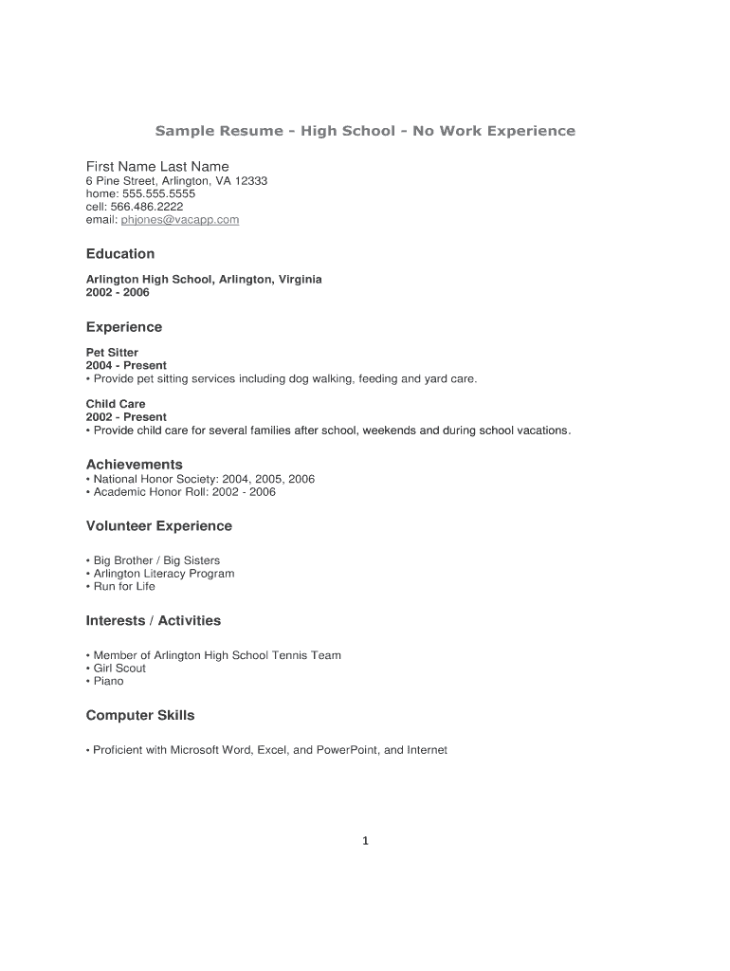
Academic Resume
Sample

Slide 27
Contact Info
Felicia.Holloway52@gmail.com
https://www.linkedin.com/in/feliciaholloway/
THANK YOU!!!

