Slide 1


Greater Pittsburgh CIO & CISO Groups
Peer Networking Group Meeting
2026 Q1
February 18, 2026

Slide 2

Agenda
Welcome and Light Refreshments / Open Peer Networking (30 Mins)
Chapter Group Updates & Key Initiatives/Peer lead Project Use Case Collaboration Session Survey Results – Matt Siconolfi, GM & CTO ivision (15 Mins)
2026 CIO & Tech Titan Award Update- Megan Colf, PTC Senior Director Programs & Events (10 Mins)
CyberHub Initiatives Update - Kayleigh Del Cotto, Innovate PGH Associate Director (10 Mins)
2026 Apprenti and Career Ready Updates -Lelia Broughton, PTC Director of Workforce Innovation (10 Mins)
RESCHEDULED From Q4: “Ransomware, SIM swapping, and Scattered Spider “- Jonathan Holmes, FBI Supervisory Special Agent (45 Mins)
Break / Open Peer Networking (15 Mins)
Innovation Spotlight: Trailblazer in the Region (15 mins)
Adjourn

Slide 3

Quarterly Draft Agenda Format:
Welcome and Light Refreshments / Open Peer Networking (30 Mins)
Chapter Update/Announcements (15 Min)
Key Initiatives/Peer lead Project Use Case Collaboration Session (30 Mins)
External Presentation(s) Placeholder (Industry topic of interest; presentation/speaker will be updated for each event) (45 Mins)
Break / Open Peer Networking (15 Mins)
Innovation Spotlight: Trailblazer in the Region (15 Mins)
Adjourn
Q2 May 20, 2026
Q3 August 19, 2026
Q4 October 21, 2026

Slide 4
Are you open to presenting (10-15 mins discussion) to our chapter peer group a recent project (within the last 12 months) or key initiative you and your team have been working on or completed for your business?

Slide 5
If "Yes" to #1, what type of initiative category would you consider discussing with the group?
Notes:
OTHER:
Operations Technology (Manufacturing)
From AI standpoint: only operationalizing *and* governance, not academic theory. A tie-in would be DLP (data loss prevention) with AI enablement.

Slide 6
If "Yes" to #1, what peer networking session could you be open to discuss an initiative with the group?
Notes:
dreed@maximcrane.com
February 18, 2026
May 20, 2026
August 19, 2026
October 21, 2026
agunnett@busybeaver.com
August 19, 2026
October 21, 2026
zwieryznskipm@koppers.com
May 20, 2026
August 19, 2026
georgerosato@coreresources.com
October 21, 2026
asitnica@duqlight.com
August 19, 2026
October 21, 2026
macarr@cmu.edu
October 21, 2026
jlashley@na.piovan.com
August 19, 2026
October 21, 2026
jeff.hutchens@edged.us
May 20, 2026
August 19, 2026
October 21, 2026
chrisrccaruso@gmail.com
May 20, 2026
steve.agnoli@gmail.com
May 20, 2026
October 21, 2026

Slide 7
If "No" to #1, what type of initiative category would you want to hear about from the group?

Slide 8

Event calendar
Award Nomination Judging March 11/12/13 2026
CIO & Tech Titans Awards (April 16, 2026)
IT DLP Cohort 8 Networking Social (March 17, 2026)
2026 PA Data Center & Energy Summit (March 27, 2026)
2026 Cyburgh (May 14, 2026)
CIO/CISO Q2 Group Session (May 20, 2026)
Pittsburgh Technology Council Events View All the Amazing Events our friends at the PTC provide here !
Notes:
CIO and CISO group general update:
Relaunch, revive
Get back to the regular rotating. hosted sessions
Extend beyond just current role CIO and CISO; retired or moved to another role
Remind peers to register to the groups or send them a note and CC me
Current advisory board
Search for volunteer for board seats
Search for session hosts and session speakers/topics
Leverage the PTC more
Upcoming events and topics
Oct 9 ciso
IT DLP cohort 7
Dec session
February session
Quantum computing
Follow up on Ai
Cyber tabletop

Slide 9
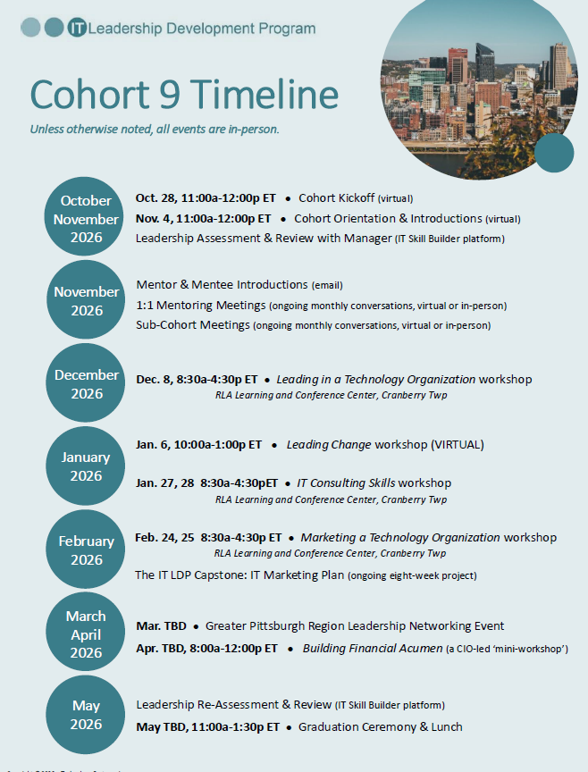
Announcing!
IT Leadership Development Program: Cohort 9
Leading Change module – will include psychological safety, resiliency, resistance, empathy, and commitment vs. compliance.
AI integration – hands-on application of AI woven into the current Marketing Workshop.

Slide 10

Thank You.
The CIO Advisory Board​
Matt Siconolfi- Chair - ivision​
Mike Abram – Westinghouse​
Bill Fortwangler – Dollar Bank​
Katherine Karolick - Armada​
Tushar Lovalekar - Koppers​
Jack Smith – Federated Hermes​
Jack Wolford – Schneider Downs
Open Advisory Role
The CISO Advisory Board​
Matt Siconolfi- Chair- ivision​
Eris Symms​, US Steel
Dave Coughanour​, Ansys
Dr. Trebor Z. Evans – Dollar Bank​
Ryan Shaw - PNC​
Julie Ray- Wabtec
Justin Swanson – ConnectiveRX

