Slide 1



Notes:
‹#›

Slide 2


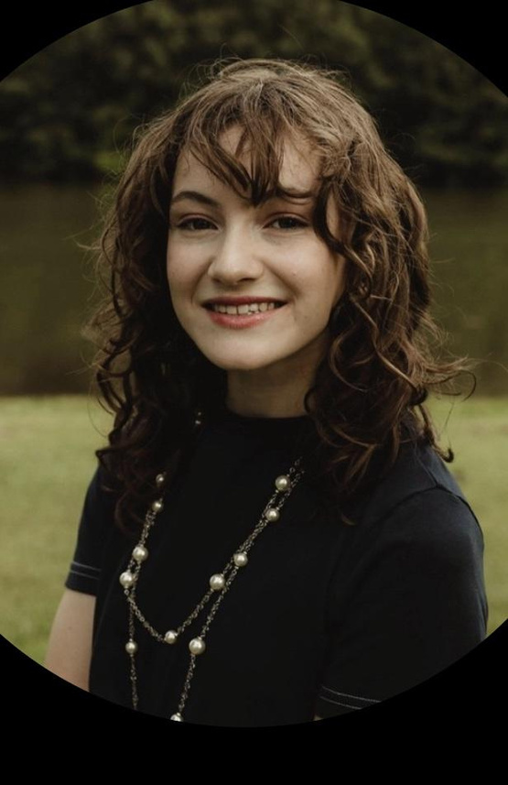
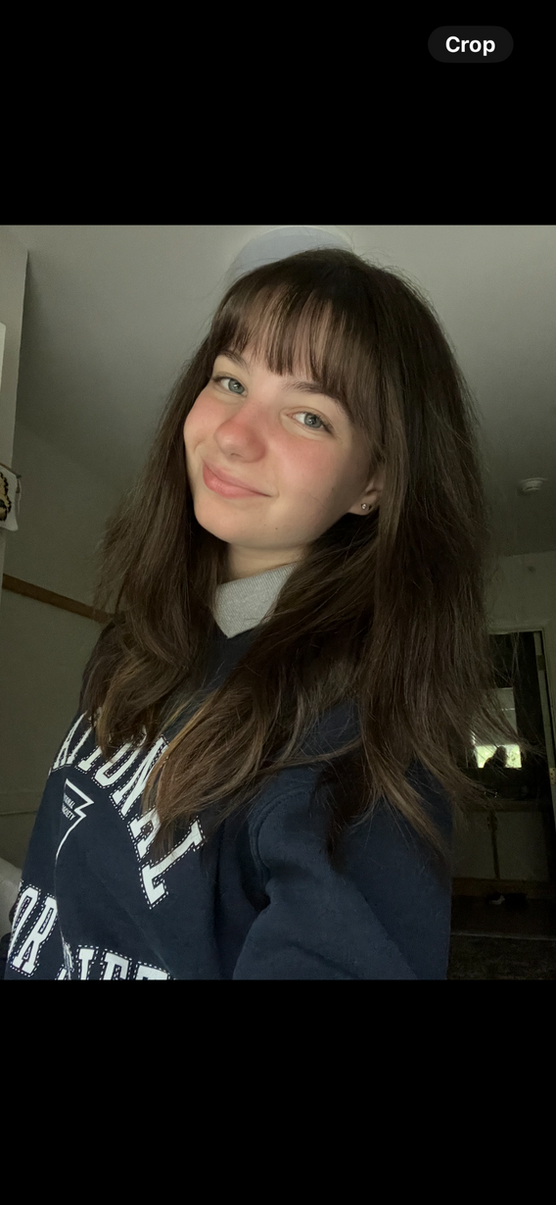
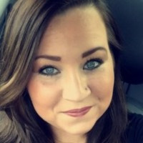
Meet Our Team!
President Advaitha Agastheeswaran | Vice President Sarah Reyer | Business Manager Riley Collins | Faculty Advisor Mackenzie Ball

Slide 3

5.5K+
members
Notes:
‹#›

Slide 4

WiCyS MISSION:
Help build a strong gender-diverse cybersecurity workforce by facilitating…
RECRUITMENT
RETENTION
ADVANCEMENT for women in the field

Slide 5
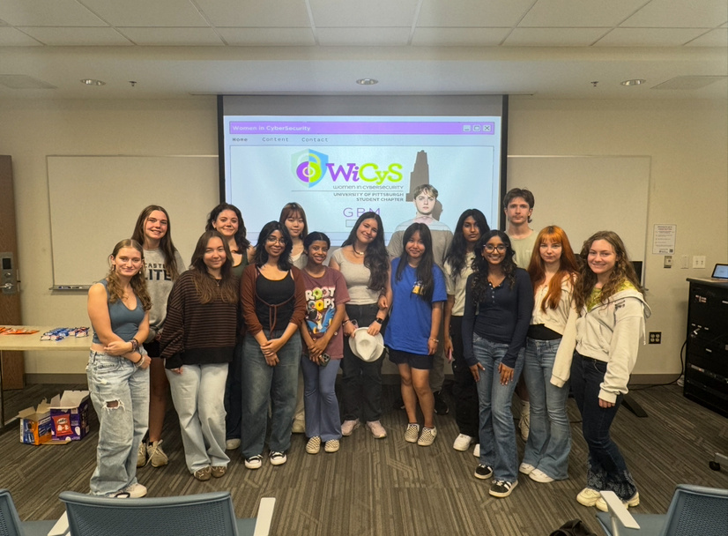
WiCyS Chapter @ Pitt
  Chapter of WiCyS National Organization
  ALL genders, allies, and advocates
  Provides education, mentorship, and networking support to members through the WiCyS community

Slide 6

Our Events
  CTF Hacking Competitions
  Guided Technical Workshops
  Industry Speakers & Panels
  Cyber Law/Policy Competition
  Cyber Movie & Trivia Night
  Resume & Interview Workshop
  Cyber News
  Cyber Safety Outreach
  Executive Roundtables

Slide 7


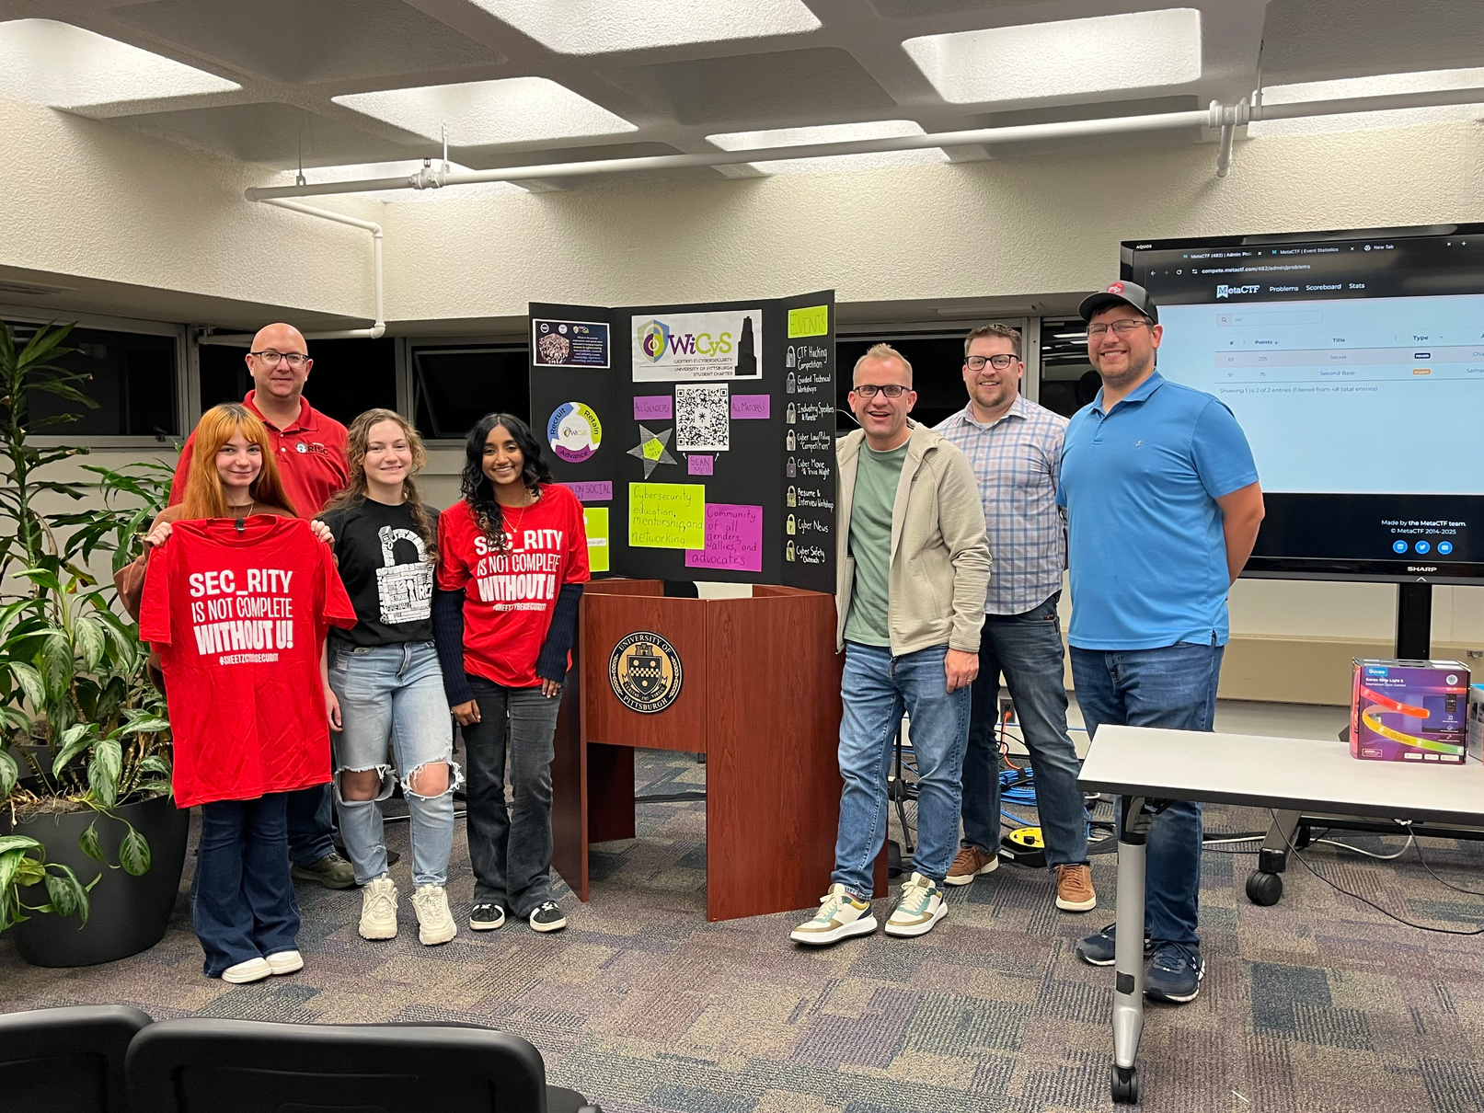
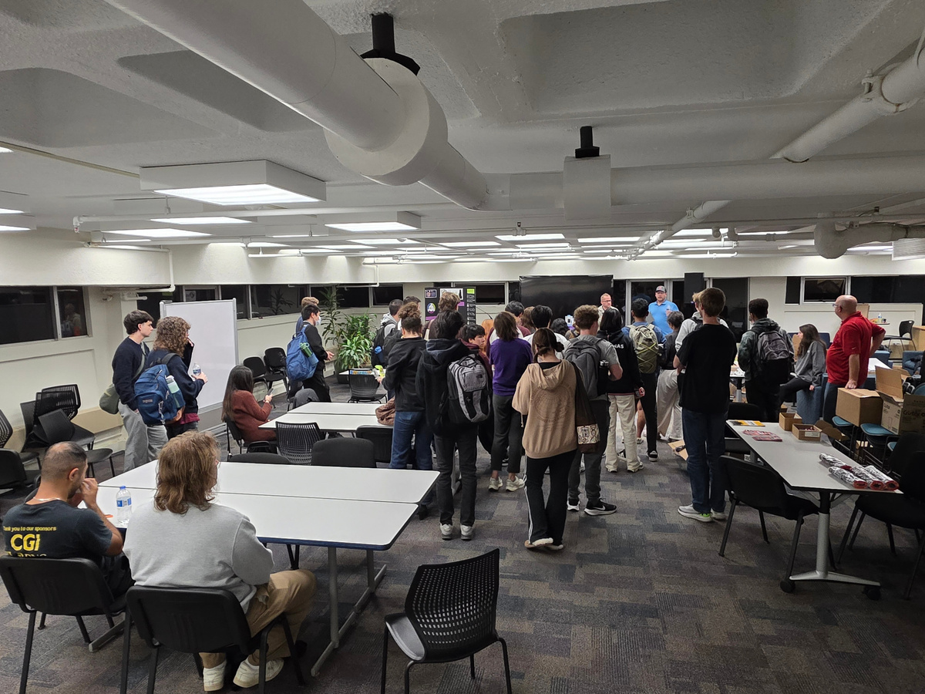
CTF Competition

Slide 8
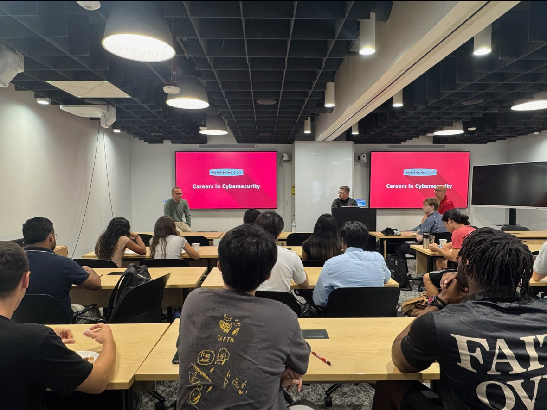
Sheetz - Careers in Cybersecurity Panel

Slide 9
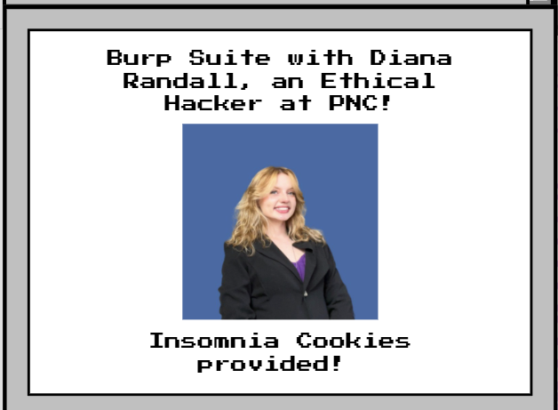
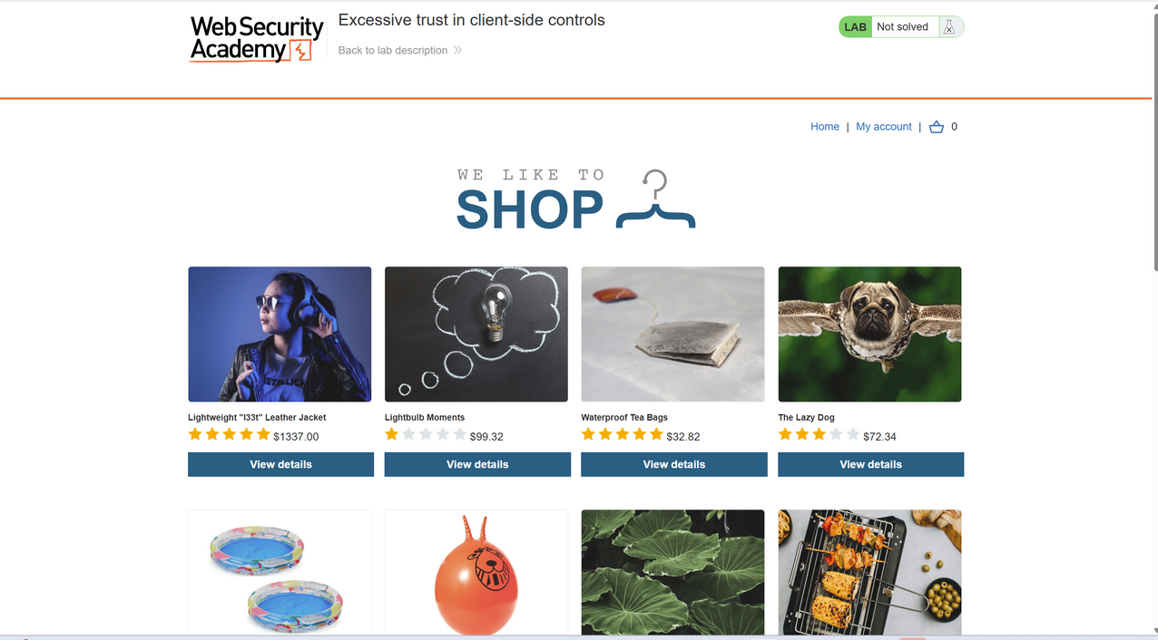
PNC - Burp Suite Workshop

Slide 10
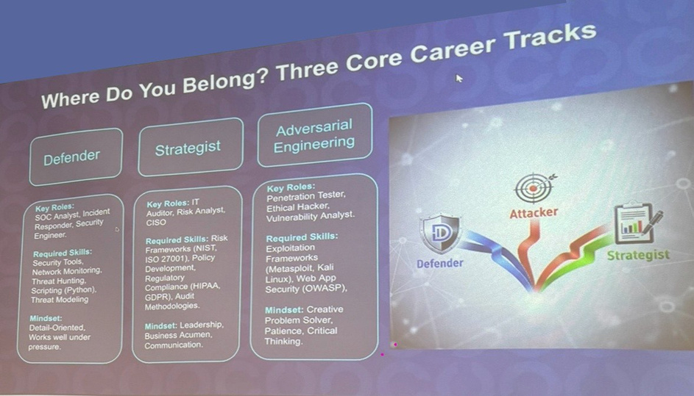
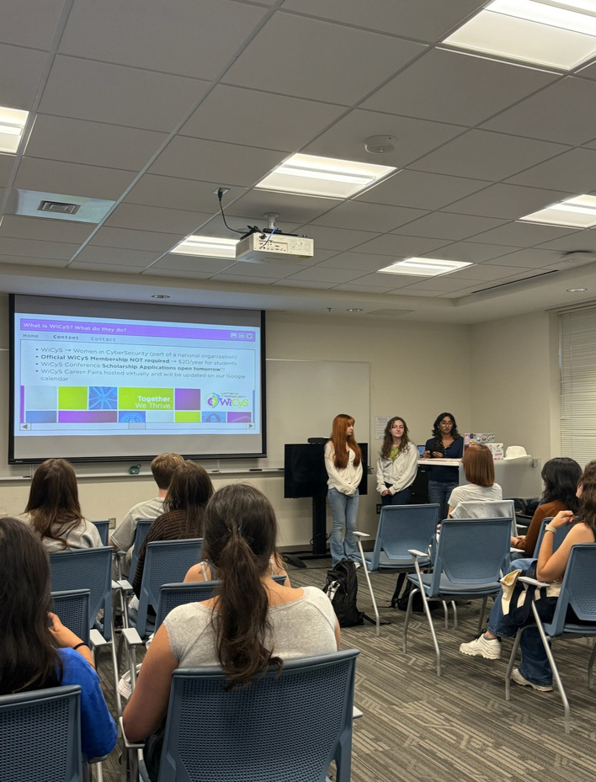
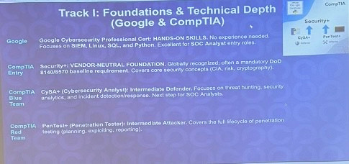
Certification Pathways

Slide 11
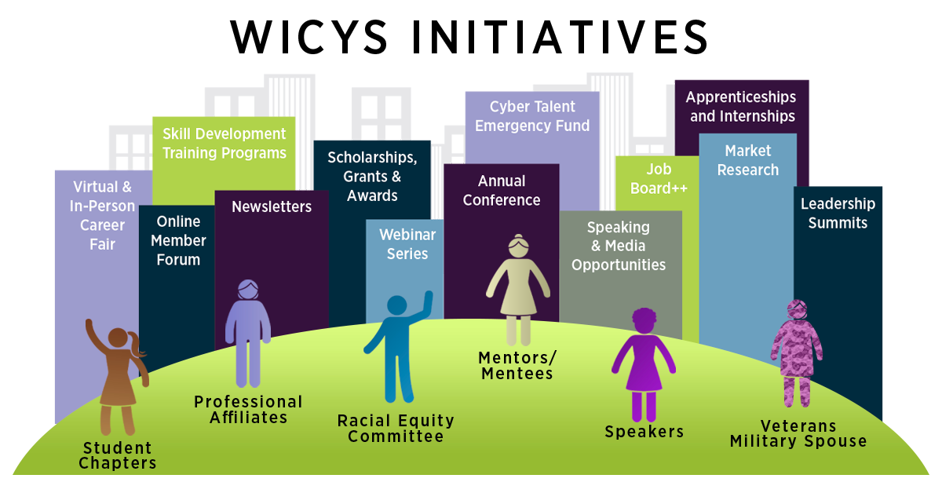
Notes:
‹#›

Slide 12
Examples of WiCyS National Opportunities
  Google Certification in Cybersecurity Scholarship
  ISC2 Certified in Cybersecurity Scholarship
  WiCyS Conference
  Virtual Career Fair

Slide 13
Industry Guests
  Industry Speaker
    Participate in an event in which you speak on your experiences and/or your niche within cyber. Speak on your own or as part of a panel.
    Ex) Sheetz RISC Team talked about career paths
  Workshop
    Lead students through a hands-on exercise. This could be a cybersecurity software, a threat simulation, CTF prep, an activity similar to your daily responsibilities, or any area of interest.
    Ex) Diana Randall from PNC leading Burp Suite workshop

Slide 14
Industry Guests
  Mentorship
    Communicate one on one with our members. Answer questions about resumes, personal projects, career development, etc.
  Resources
    Provide access to any tools, training platforms, or materials that would be valuable to students learning cybersecurity.
    Ex) MetaCTF providing 4 months free training access to members and hosting CTF competitions

Slide 15
Corporate Sponsorship
  Annual Tier: $1,500
    Branding
    May host technical and social event
    Access to student resume book
    Access all other event tiers
  Tech Talk: $500 per event
    Host one tech talk event
    Branding: social media
    Invitation to whole Pitt School of Computing and Information
    Food included in cost
  Social Event: $250 per event
    Host one social event
    Exclusive to WiCyS@Pitt members
    Food included in cost

Slide 16
Collaboration
Open to all forms of collaboration - Even those unlisted and even if sponsorship is not an option
***Site visit cost determined on case-by-case basis

Slide 17


Contact at
wicyspitt@gmail.com | jwelton@pitt.edu | (412) 389-8915
Notes:
btw these QR codes expire in 14 days from 8/15
‹#›

