Slide 1
The Rise of LLMs, and their Applications
Prasad Chalasani
Co-Founder, Langroid
Adjunct Professor @ UPitt/SCI, CMU/Tepper

Slide 2
A bit about me
IIT BTech/CS, CMU PhD/ML
Los Alamos (Post Doc), ASU (Asst Prof)
10 years quant finance, algo-trading (Goldman Sachs, Hedge funds)
8 years Yahoo + MediaMath leading ML/DS teams
Since 2019 - Founded AI/ML startups
Since Apr 2023 - Building Langroid LLM Framework
Now: Adjunct Prof of AI @UPitt/SCI, @CMU/Tepper

Slide 3
Agenda
LLMs: next-word prediction and why that is useful
LLM Capabilities
Using LLMs: Web-Apps, APIs, LLM-powered Agents
LLM Applications in Industry

Slide 4
What is a Language Model?
Prompt
Next "word" (token) predictor
LLM
A giraffe is a tall, African
mammal

Slide 5
What is a Language Model?
Auto-regressive
Next "word" (token) predictor
LLM
A giraffe is a tall, African
mammal
A giraffe is a tall, African mammal
known
A giraffe is a tall, African mammal known
for
A giraffe is a tall, African mammal known for
its
response
prompt
A giraffe is a tall, African
mammal known for its long neck and legs

Slide 6
Inside a Language Model: Transformer
GPT = Generative Pre-trained Transformer
All models have similar architecture
Model | # Parameters | From | Open?
GPT2 | 1.5 B | OpenAI | No
GPT3 | 175B | OpenAI | No
GPT4 | ??? | OpenAI | No
Claude 3.5 | ?? | Anthropic | No
LLama 3 | 8B - 405B | Meta | Yes
DeepSeek | 670B | DeepSeek | Yes

Slide 7
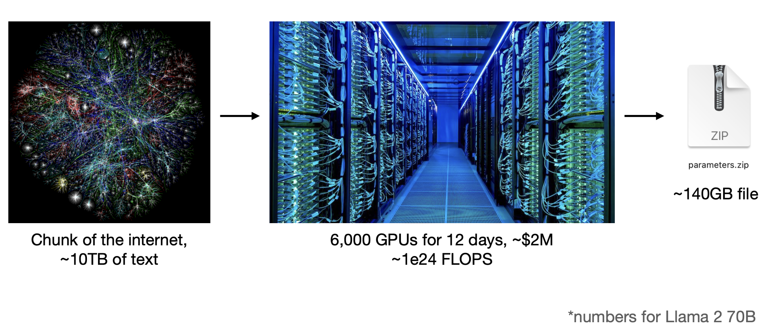
How is an LLM built? "Compressing the internet"
Data
Training
LLM
Slide Credit: Andrej Karpathy Nov 2023

Slide 8
Next-word prediction →Intelligence? how?
forces LLM to
Training to predict well on
Large amount of internet text + code

Slide 9
Next-word prediction →Intelligence? how?
Understand the world: "Intelligence"
forces LLM to
Training to predict well on
Large amount of internet text + code

Slide 10
Next-word prediction →Intelligence? how?
Understand the world: "Intelligence"
forces LLM to
Training to predict well on
Large amount of internet text + code
capabilities
Few-Shot Learning
Question-answering
Reasoning
Planning
Instruction-following
Coding

Slide 11
Next-word prediction →Intelligence? how?
Understand the world: "Intelligence"
forces LLM to
Training to predict well on
Large amount of internet text + code
capabilities
Few-Shot Learning
Question-answering
Reasoning
Planning
Instruction-following
Coding
Emergent behavior,
Not well understood at all!

Slide 12
Limitations of LLMS

Slide 13
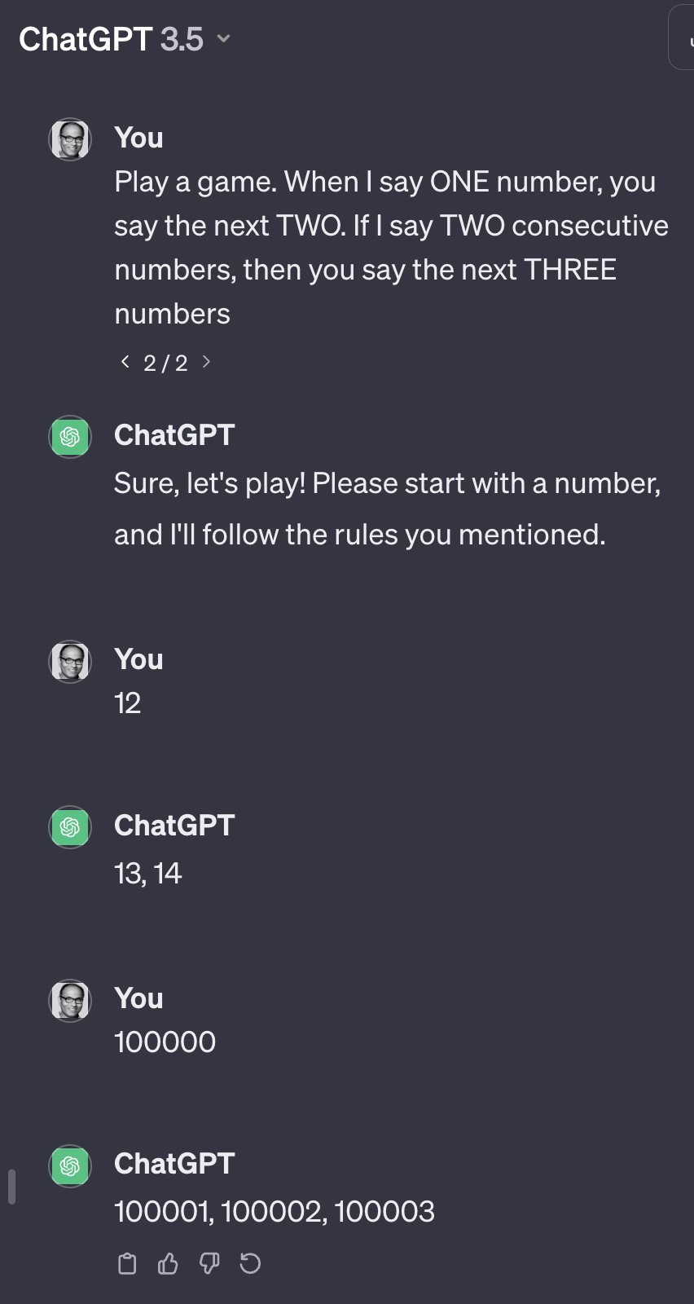
Limitations of LLMs: Brittleness/Hallucination
Deviation from instructions
Mistaken reasoning
Made-up citations
(Model: Mistral-7b)

Slide 14
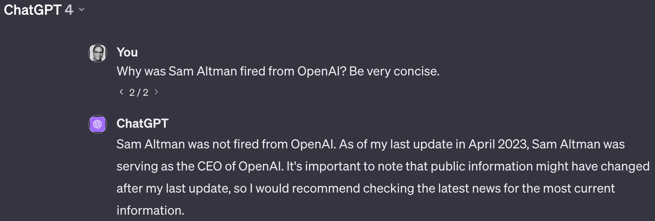
Limitations of LLMs: Knowledge Gaps
Training cutoff date
GPT4: Last Update Apr 2023
No access to specific documents

Slide 15
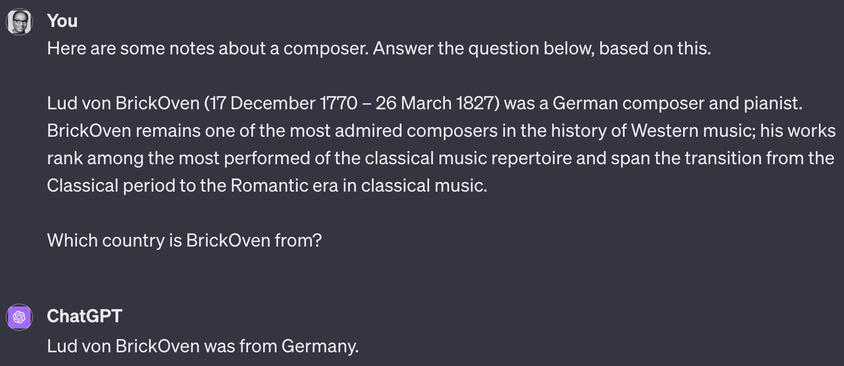
Limitations of LLMs: Limited Context Length
input text
Context Length
output text
But cannot do these:
Load 100,000 pdf documents into context and ask questions
Load millions of rows of a database into context and ask questions
Have single conversation over 6 months

Slide 16
Limitations of LLMs: Generation cost (Token cost, Latency)
API Cost for Proprietary LLMs
GPU compute cost for Open LLMs
output cost = 3 cents per 1000 tokens (~ 3 pages)
300,000 pages → $3,000 (say over a month).
Time-latency of generating text

Slide 17
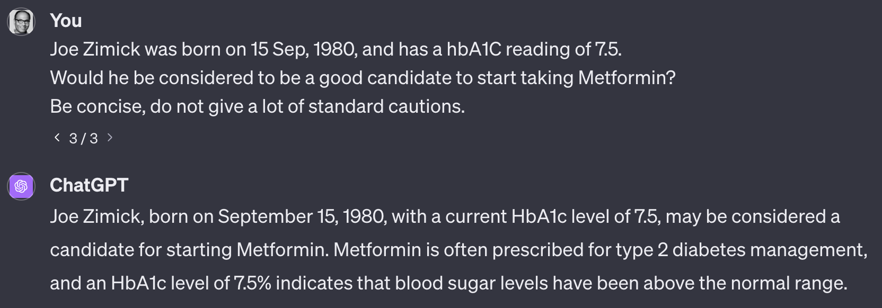
Limitations of Proprietary LLMs: Privacy
GPT4 API Service
Potential for misuse of sensitive info about Joe Z

Slide 18
Using LLMs: Web-based Apps

Slide 19
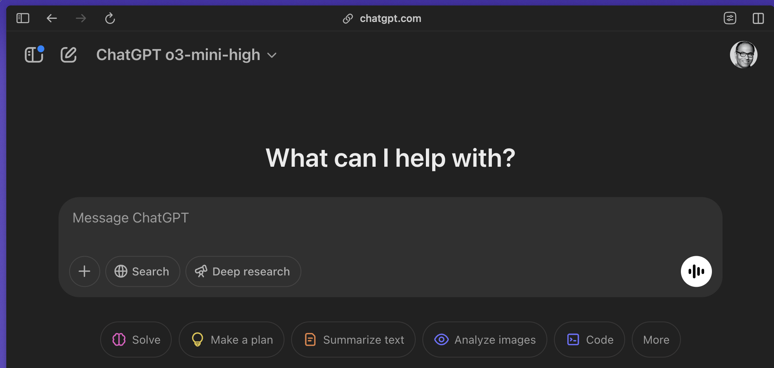
Web-Apps: ChatGPT, Claude, Gemini…
Manual
Not scalable for applications
Notes:
may be a bit too busy

Slide 20
Using LLMs via API

Slide 21
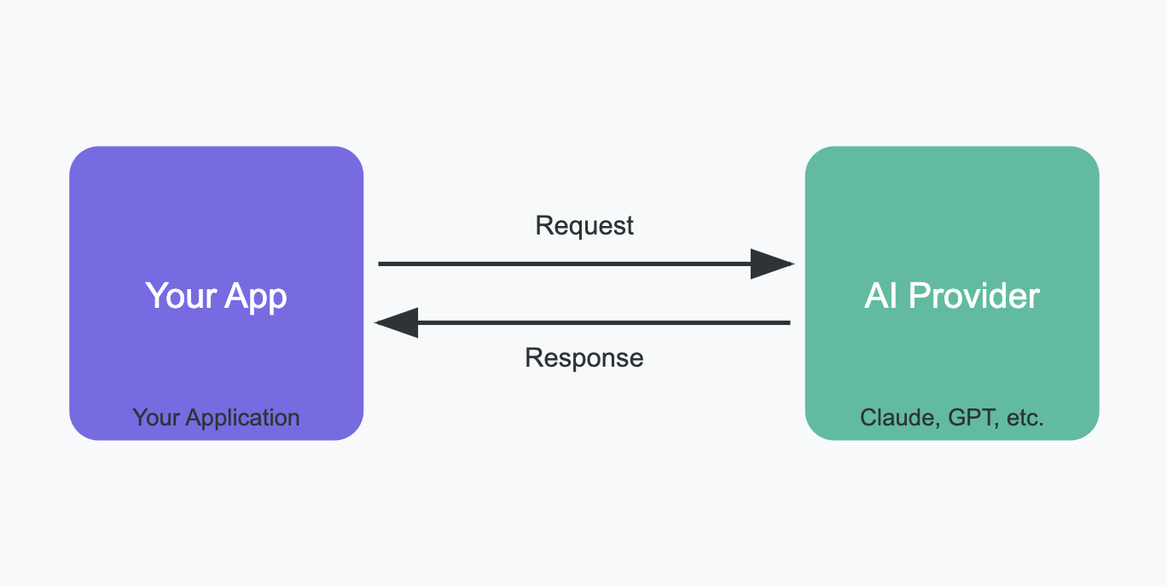
Using LLM via API calls
Notes:
may be a bit too busy

Slide 22
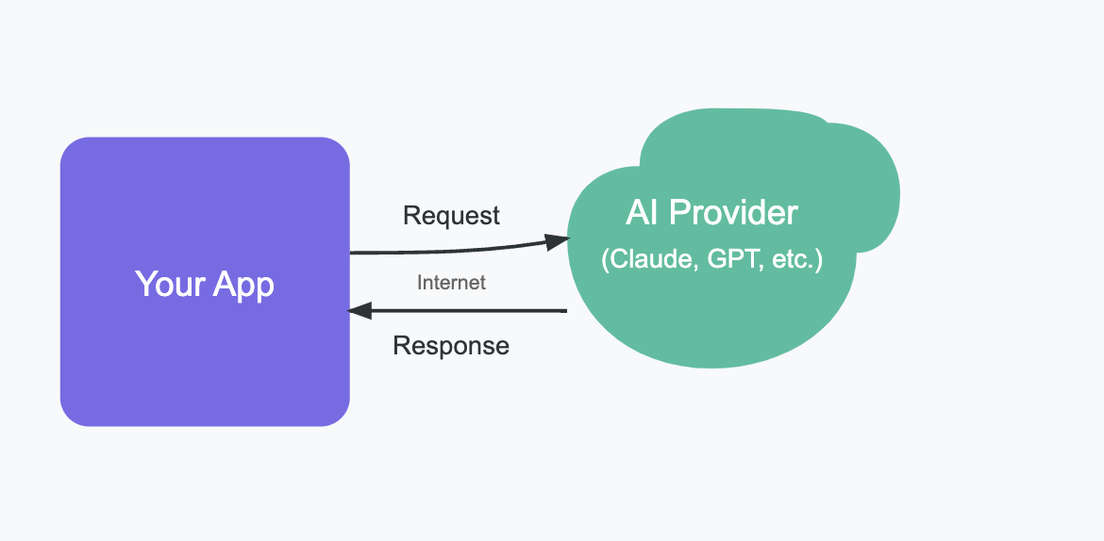
Remote LLM APIs: Privacy, Security, Confidentiality Concerns
Your prompts in API call may contain sensitive/confidential information
Contractual agreement with provider protects your data from being misused
Notes:
may be a bit too busy

Slide 23
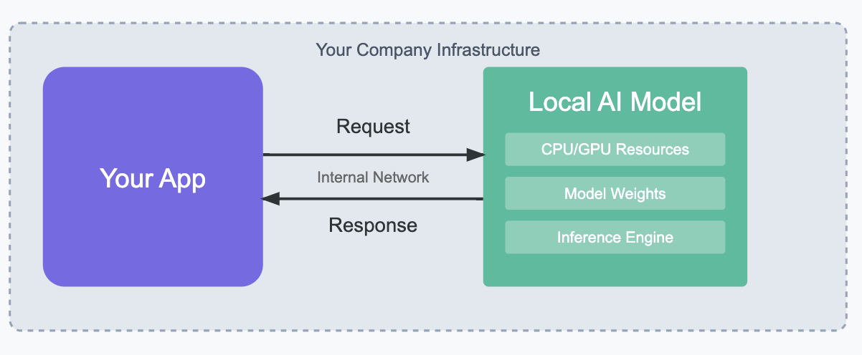
Local LLMs: 100% Private, but Weaker Models
Open-Weight LLMs:
Not as "smart" Proprietary LLMs
Training/Fine-tuning is expensive
Running big LLMs requires multiple GPUs.
Open LLMs suitable for narrow tasks (no need for Proprietary LLMs)
Examples:
DeepSeek-R1, LLama3.3
Notes:
may be a bit too busy

Slide 24
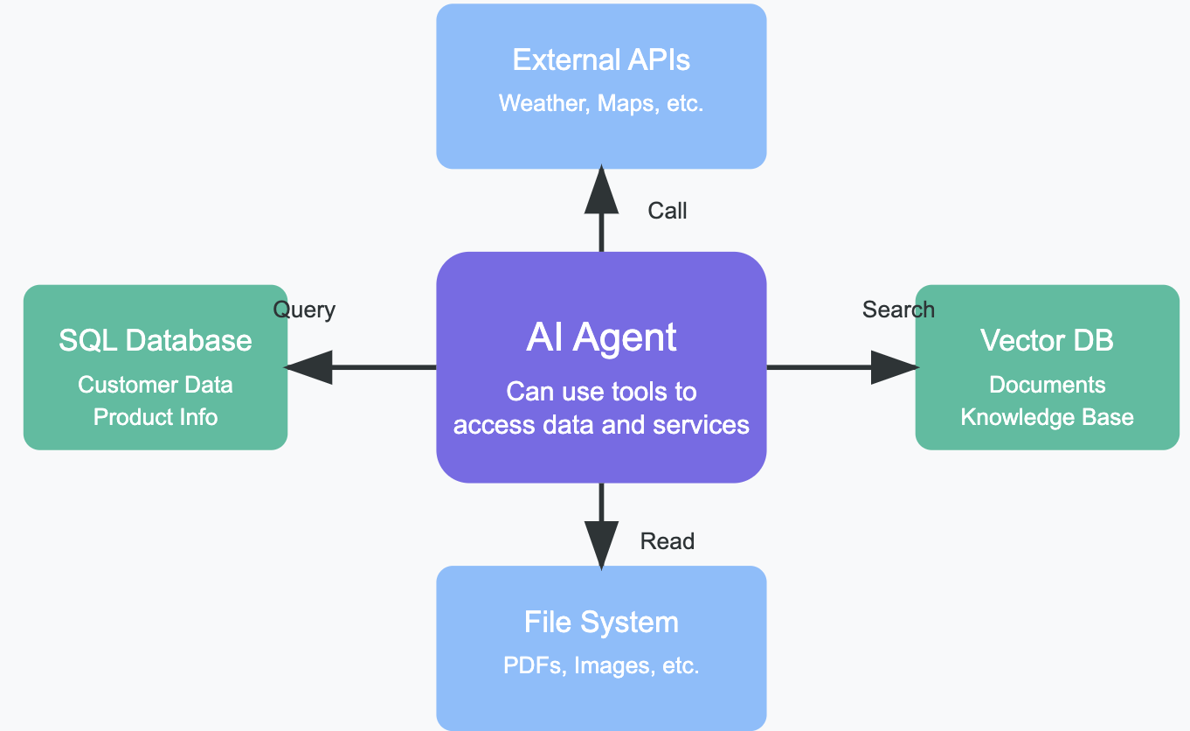
LLM-Powered Agents using External Information
Notes:
may be a bit too busy

Slide 25
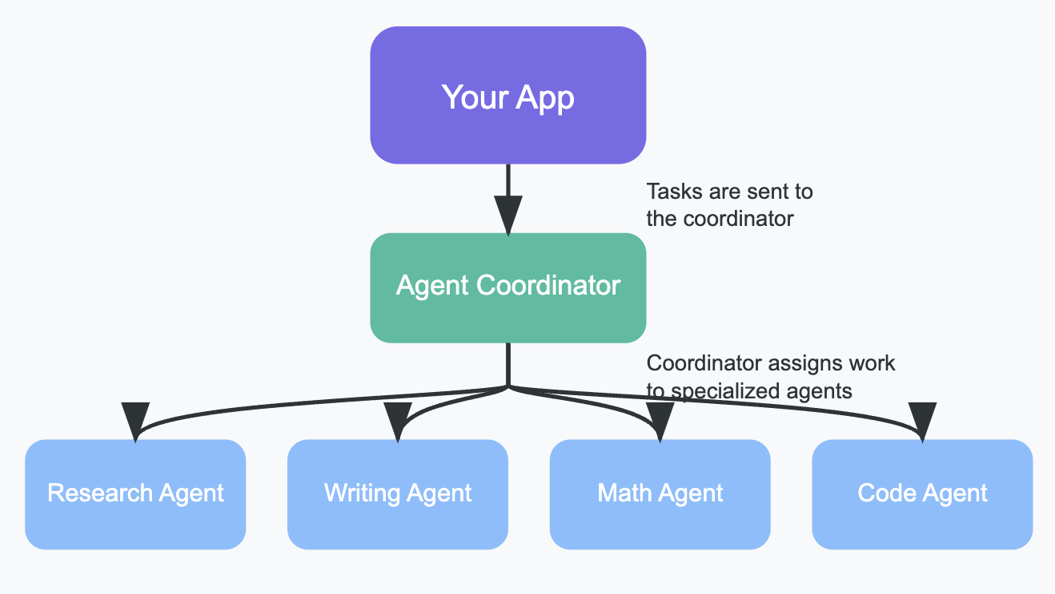
LLM-Based Multi-Agent Systems for Complex Tasks
Notes:
may be a bit too busy

Slide 26
LLMs: Business Applications

Slide 27
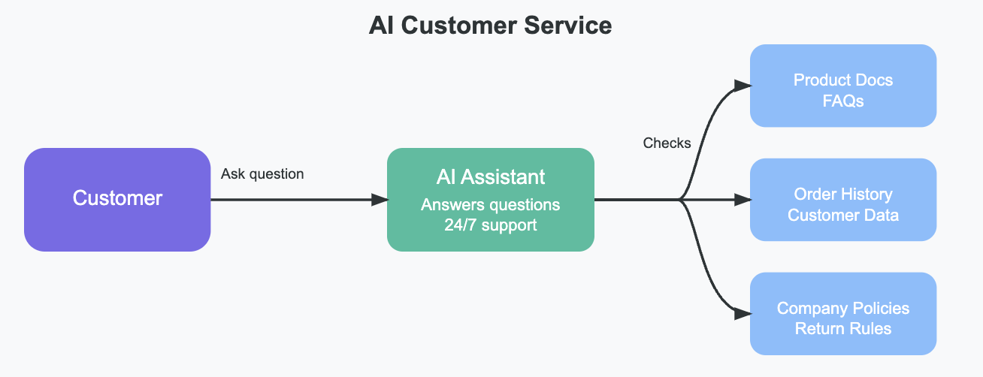
LLM Agents for Customer Support/Service
Notes:
may be a bit too busy

Slide 28
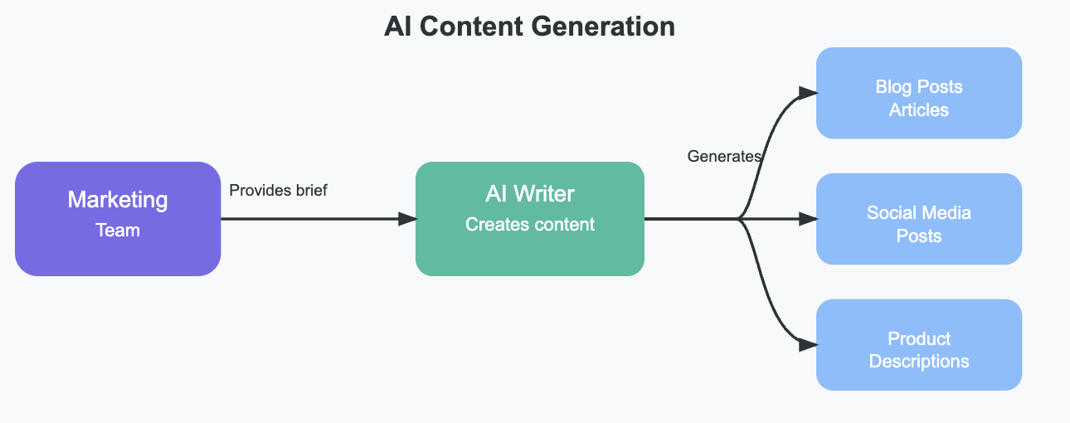
LLMs for Content Generation
Notes:
may be a bit too busy

Slide 29
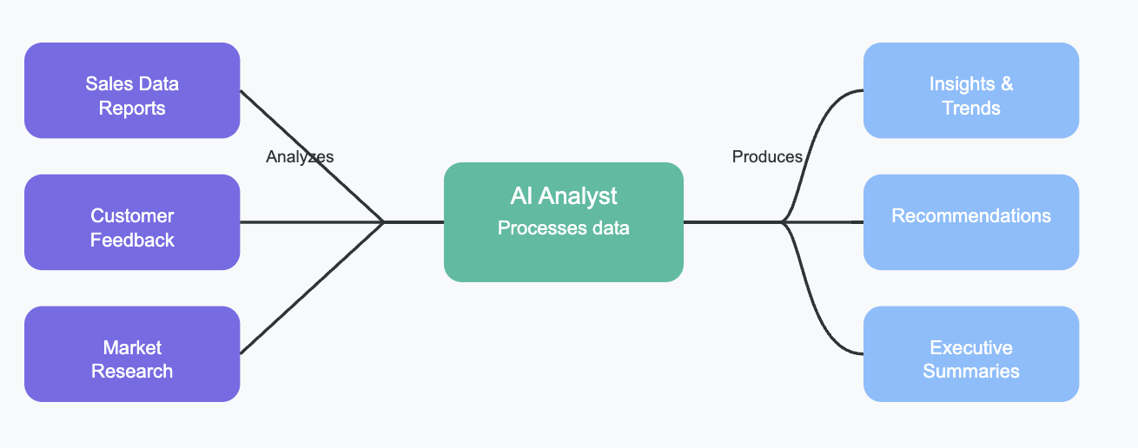
LLMs for Data Analysis
mention the text-as-data course
Notes:
may be a bit too busy

Slide 30
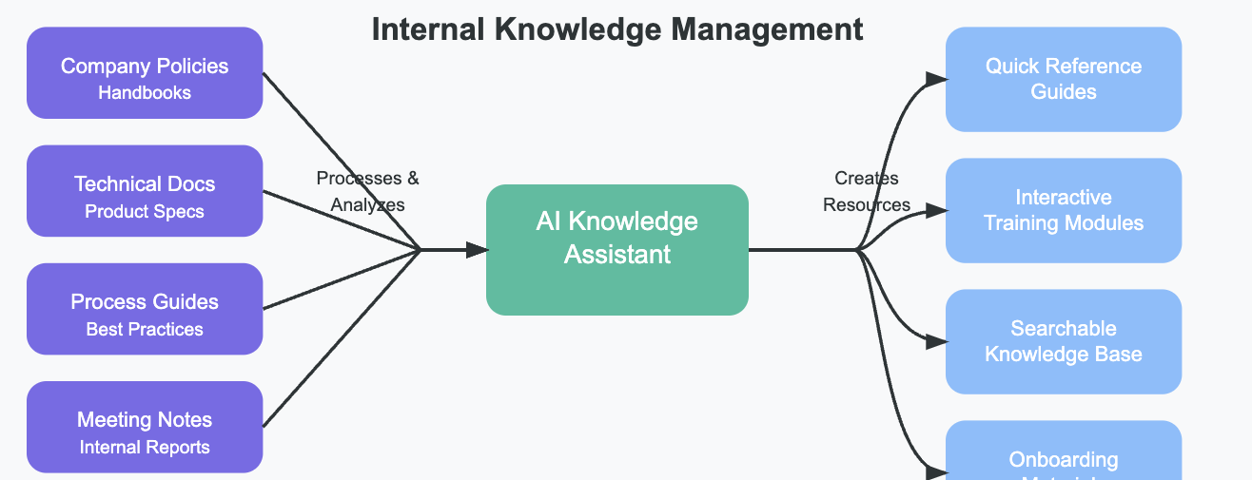
LLMs for Knowledge Management
Notes:
may be a bit too busy

Slide 31
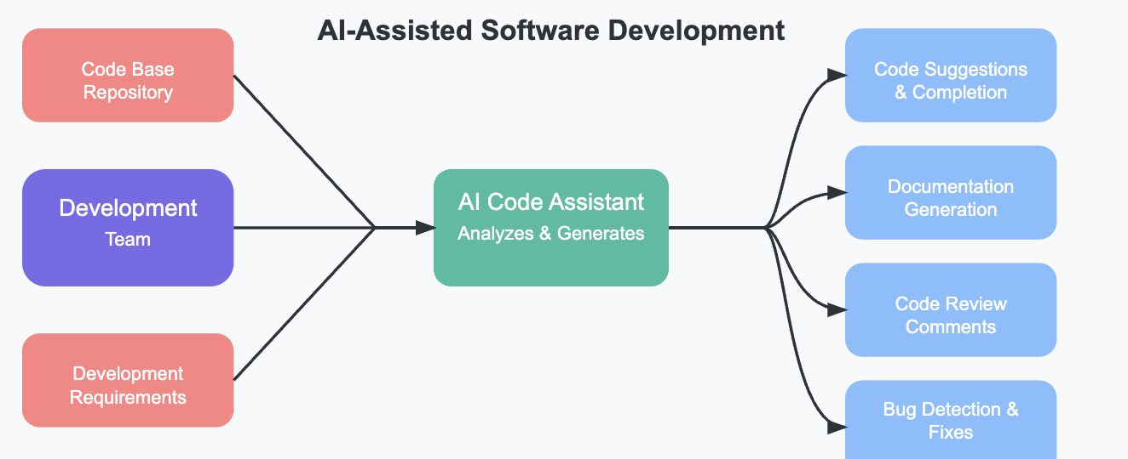
LLM-Assisted Software Development
Notes:
may be a bit too busy

Slide 32
Example 2-Agent System:
Structured Information Extraction from Clinical Notes

Slide 33
Clinical Note → Structured Info
Allergies: Erythromycin
Chief complaint: Shoulder pain
Family History: Diabetes
Smoking: 1 pk/day

Slide 34
Langroid: Human-Agent Q/A on Clinical Note
2
any allergies?
Retrieval Agent
LLM
Vector-DB
erythromycin
Chunk+Embed
Ingest
Unstructured Clinical Note
1

Slide 35
Langroid: Two-Agent Information Extraction from Clinical Note
2
3
Find this info:
Allergies:
Chief complaint:
Family History:
Smoking:
Retrieval Agent
any allergies?
Extractor Agent
LLM
Vector-DB
erythromycin
LLM
Chunk+Embed
4
Structured Info
5
Allergies: Erythromycin
Chief complaint: Shoulder pain
Family History: Diabetes
Smoking: 1 pk/day
Ingest
Unstructured Clinical Note
1

Slide 36
pchalasani@gmail.com
Try the LLM quiz:
https://tinyurl.com/pchalasani-llm-quiz

