Slide 1
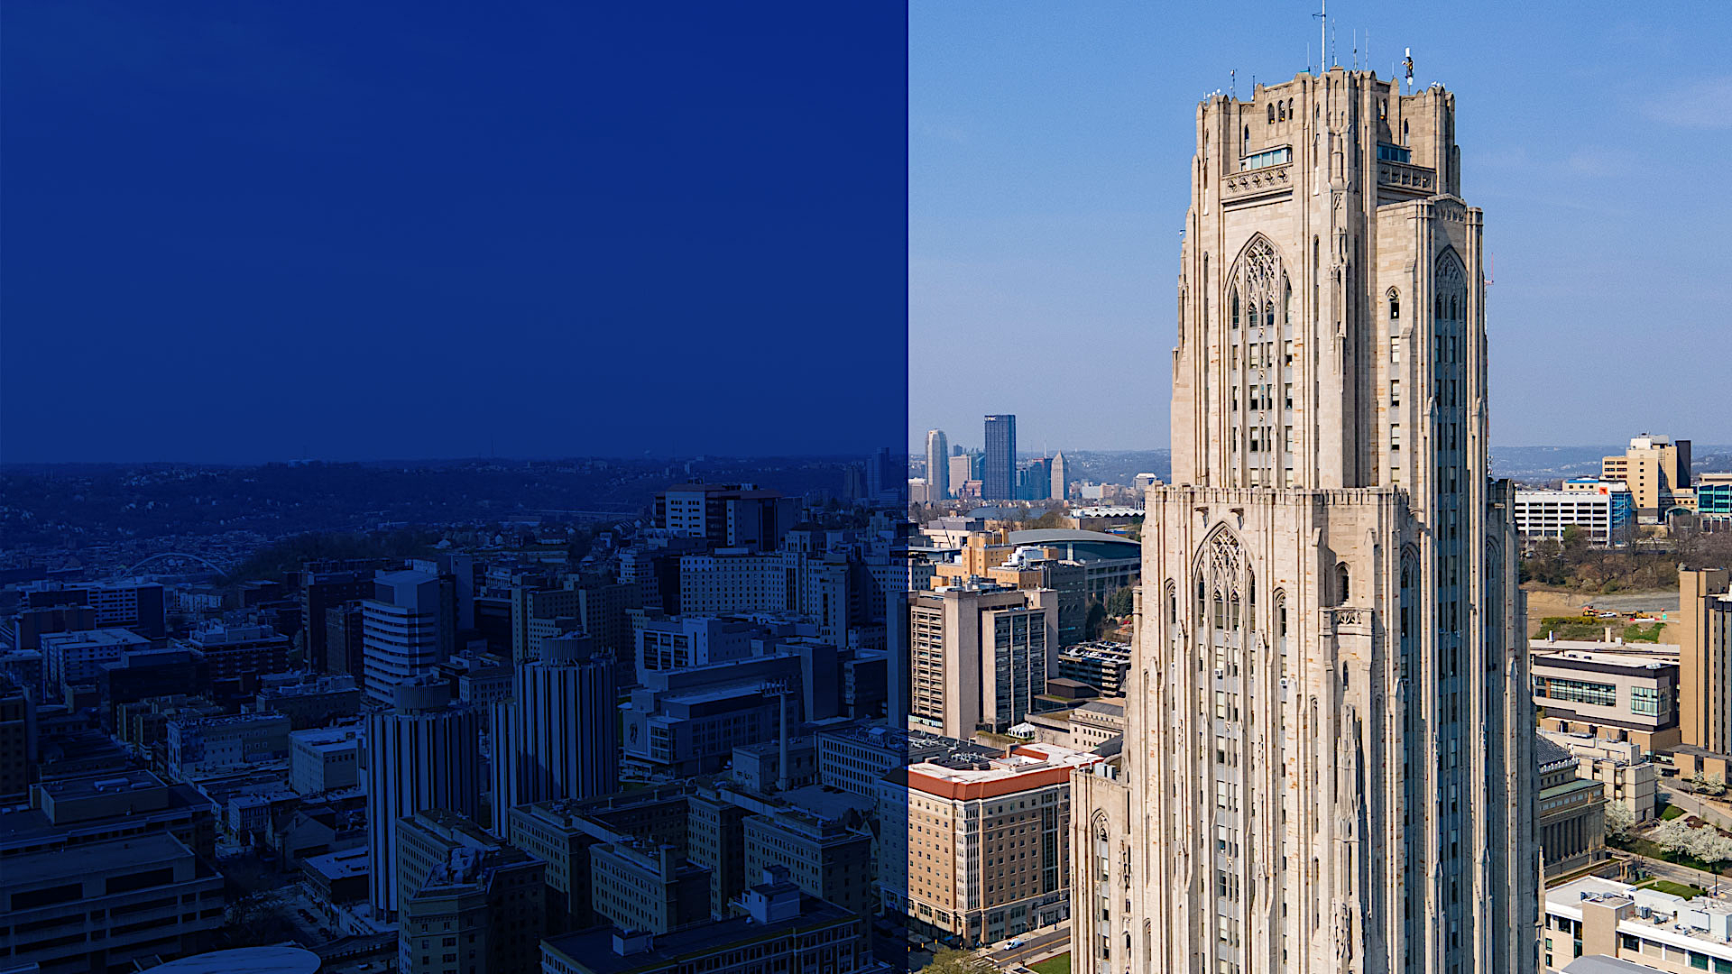
School of Computing and Information
MASTER OF DATA SCIENCE (MDS)
WELCOME!
February 20th, 2025

Slide 2

MDS DESIGN
Designed for: adult learners
and working professionals (upskill and reskill)
No STEM background required (all backgrounds are welcome!);
Faculty: classes delivered by
the same faculty who teach
on campus
Flexible: 100% online and asynchronous (self-paced)
Partnership with Coursera
School of Computing and Information

Slide 3


MDS Features
Curriculum: 10 courses, 3 credits each (total of 30 credits, including a capstone).
Time to complete: 20-36 months.
PBA course as a gateway: Performance-Based Admission as a non-degree seeking student until completion of this course with B or better grade + degree verification.
School of Computing and Information

Slide 4

PBA AS A GATEWAY TO THE MDS
Complete and pass a 3-credit course (Data-Centric Computing) with a minimum grade of B or better.
+
Bachelor’s degree verification (English language proficiency verification).
=
Gain eligibility into the Master of Data Science (MDS) program as a degree-seeking student.
Image rights: https://www.freestock.com/free-photos/3d-man-walking-colourful-puzzle-isolated-58398490">Image used under license from Freestock.com
School of Computing and Information

Slide 5

THE MDS STUDY FLOW:
+
PBA
Bachelors Degree
ESL
MANDATORY ELECTIVES
CAPSTONE
School of Computing and Information

Slide 6

MDS Curriculum: knowledge built step by step
GATEWAY
  Introduction to Data-Centric Computation (PBA course)
  MANDATORY COURSES
  Mathematical and Statistical Foundations for Data Science
  Managing, Querying, and Preserving Data
  Applied Predictive Modeling
  The Art of Data Visualization
  Responsible Data Science
ELECTIVES COURSES (Select 3)
  Applied Bayesian Data Analysis
  Applied Deep Learning
  Cloud Computing
  Text as Data
CAPSTONE
  Case Studies in Data Science
School of Computing and Information

Slide 7

MDS Accessible & Affordable
Full Degree Tuition:
$15,000 (approximately $500 tuition/per credit)
Fees:
Computing and Network Fee: $ 100/ per term
Program Administration Fee: $ 75 (one-time payment)
School of Computing and Information
Notes:
Adjust bullet points

Slide 8
MDS Student Resources
Students will have access to the same resources as on-campus students:
  Live faculty office hours
  Teaching assistants and academic support
  Student services
  Career resources
School of Computing and Information

Slide 9
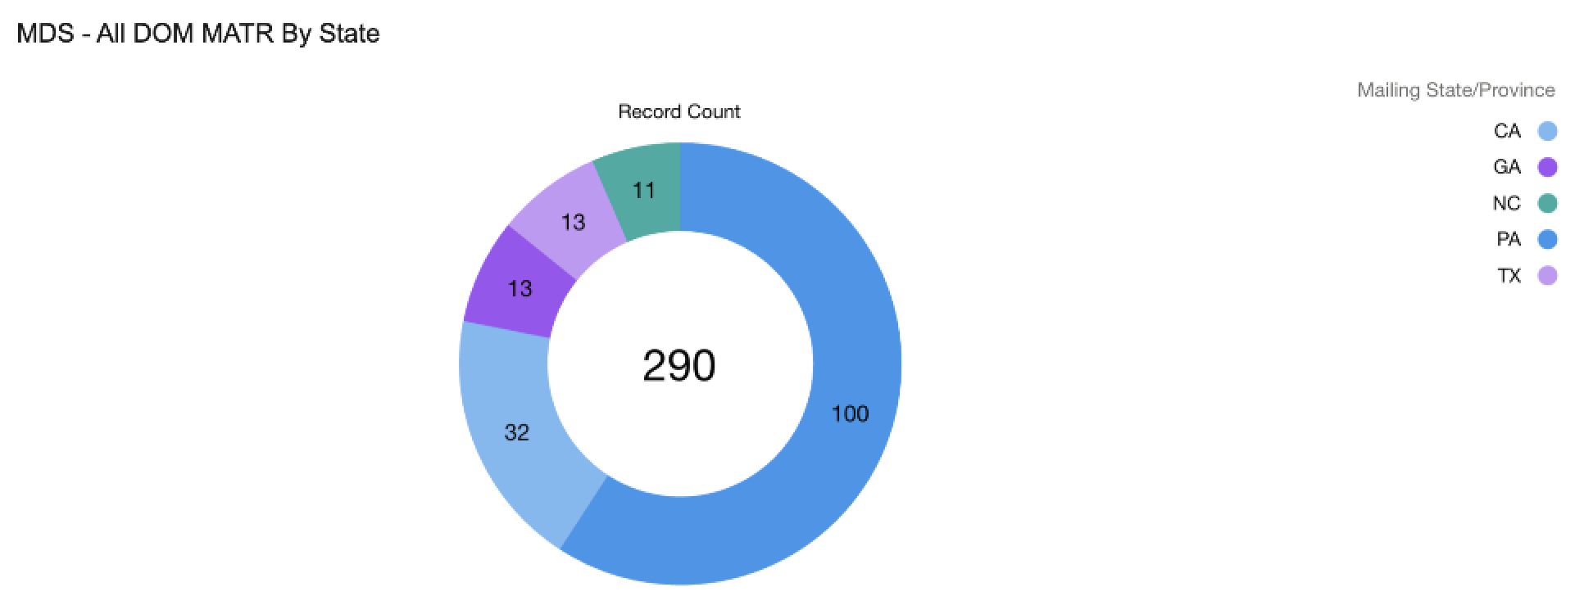
MDS Students per State
School of Computing and Information

Slide 10
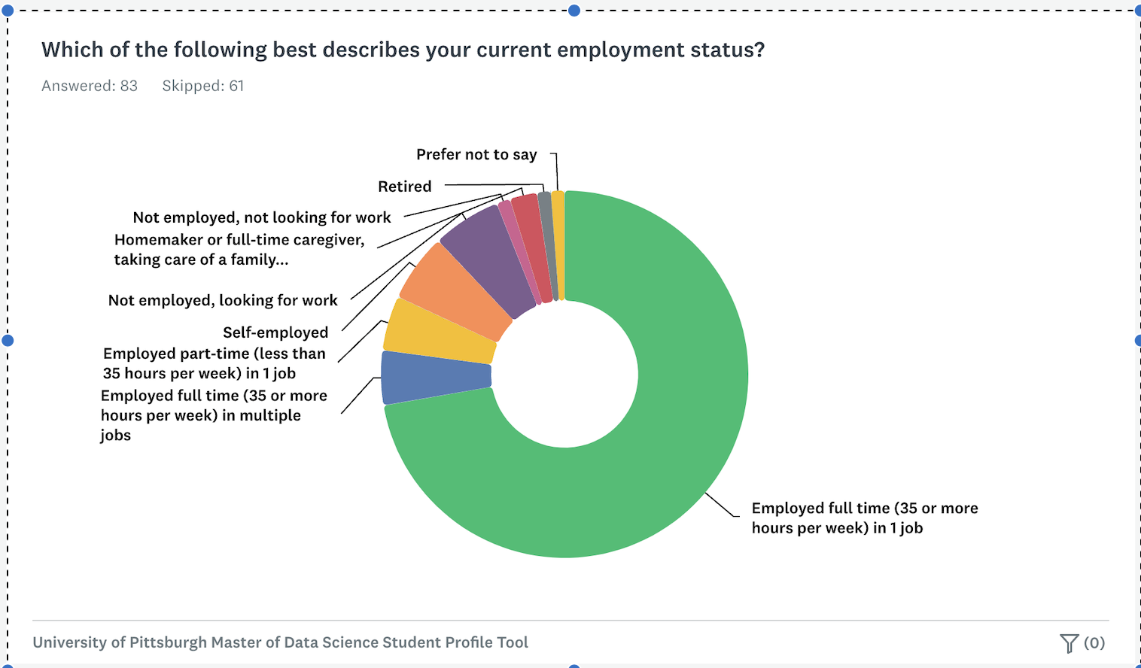
MDS Employment Status
School of Computing and Information

Slide 11
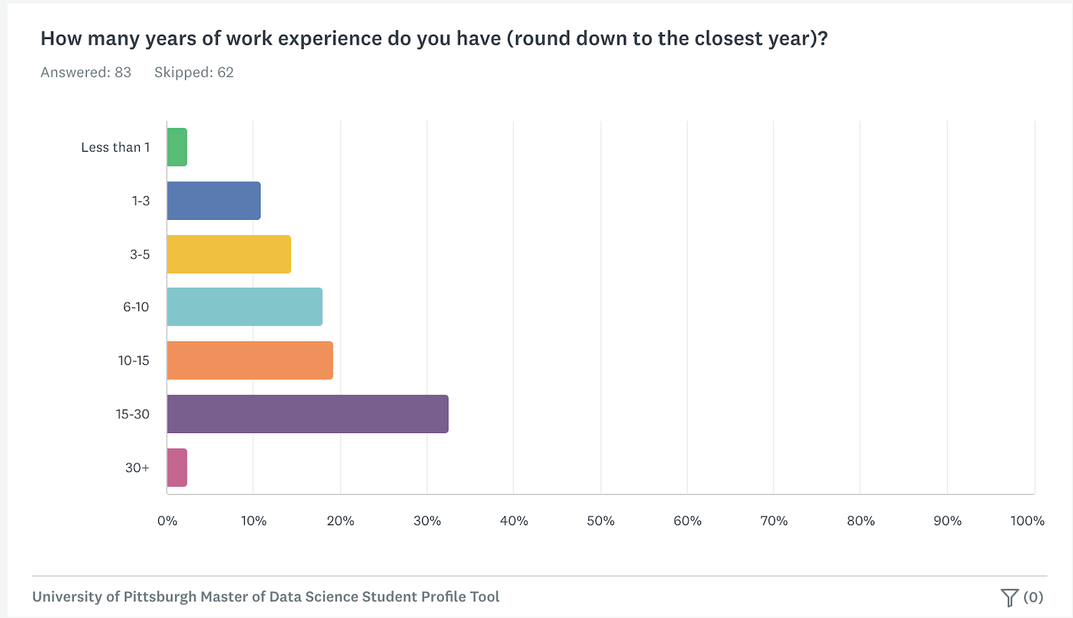
MDS Students Work Experience
School of Computing and Information
Notes:
Pitt MDS at the bottom

Slide 12


MDS Requirements:
PBA Course completion: grade B (minimum)
Letters of recommendation
Bachelor's Degree verification
STEM Background
International Students:
English proficiency
SAT exams or applications process
School of Computing and Information

Slide 13
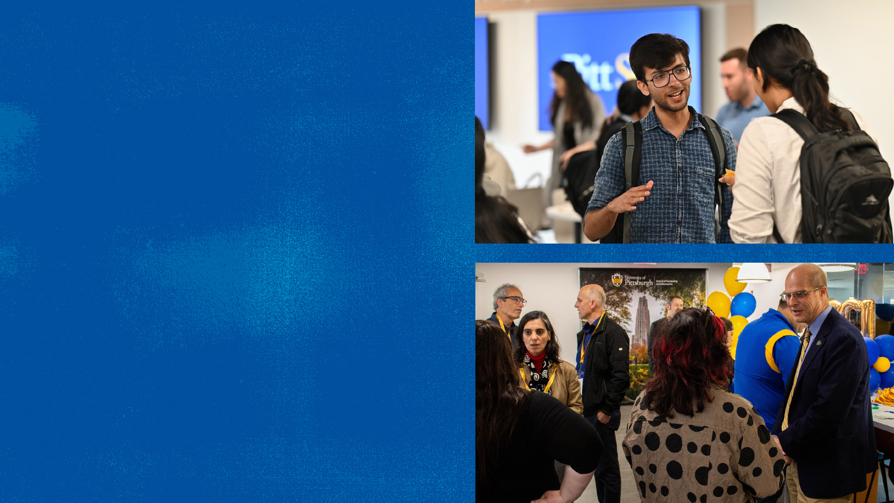

University of Pittsburgh – Coursera Master of Data Science
https://www.sci.pitt.edu/academics/masters-degrees/data-science
https://www.coursera.org/degrees/master-of-data-science-university-of-pittsburgh
twitter.com/SciPitt
University of Pittsburgh:
twitter.com/pitttweet
instagram.com/pittofficial
tiktok.com/@pittofficial
facebook.com/upitt
youtube.com/user/pittweb

