Slide 1
Peer Networking Group Meeting
June 3, 2025
Pgh-cio.com

Slide 2
Agenda
Welcome and Light Breakfast/Coffee
Apprenti & CyberHub Program Updates- Pittsburgh Technology Council
“AI, Skill Complexity, and the Future of Work” Morgan Frank, Univ of Pittsburgh, School of Computing & Information
Panel Discussion, “IT as a Business Enabler: Metrics, Alignment, and Best Practice for Customer Engagement”
Open Networking/Peer Discussions
Adjourn
Notes:
Agenda
830 to 9:00 AM Welcome Arrival and Light Breakfast
9:00 to 9:30 AM “CyberHub Program Update”- Pittsburgh Technology Council, Lelia Broughton
9:30 to 10:15 AM “AI, Skill Complexity, and the Future of Work” – Morgan Frank, Univ of Pittsburgh, School of Computing & Information
10:15 to 11:00 AM “IT as a Business Enabler: Metrics, Alignment, and Best Practice for Customer Engagement"
Tushar Lovalekar (Koppers), Katherine Karolick (Armada), Matt Putila (EnGen) Group Panel - moderated by Matt S

Slide 3
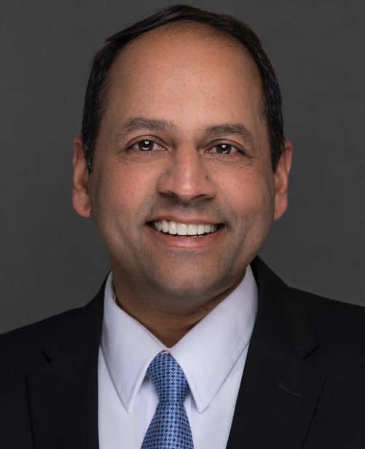
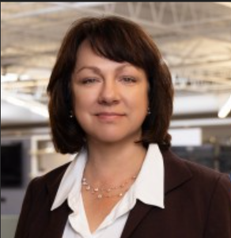
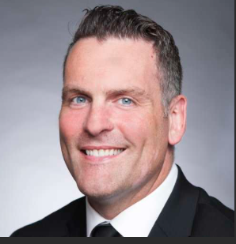
“IT as a Business Enabler: Metrics, Alignment, and Best Practice for Customer Engagement”
VP, IT
Tushar Lovalekar
CIO
Armada Supply Chain
VP, Product Development
EnGen
Group Panel Discussion

Slide 4
Event calendar
IT Leaders Session & Networking Event at the RLA (June 17)- Register Here!
PTC 2025 Annual Golf Outing (August 4)
CIO/CISO Group Session (Pending Date Sep/Oct)
Local Tech Events (PGH CIO and CISO Website)
Notes:
CIO and CISO group general update:
Relaunch, revive
Get back to the regular rotating. hosted sessions
Extend beyond just current role CIO and CISO; retired or moved to another role
Remind peers to register to the groups or send them a note and CC me
Current advisory board
Search for volunteer for board seats
Search for session hosts and session speakers/topics
Leverage the PTC more
Upcoming events and topics
Oct 9 ciso
IT DLP cohort 7
Dec session
February session
Quantum computing
Follow up on Ai
Cyber tabletop

Slide 5
Thank You.
The CIO Advisory Board​
Matt Siconolfi- Chair - ivision​
Mike Abram – Westinghouse​
Bill Fortwangler – Dollar Bank​
Katherine Karolick - Armada​
Tushar Lovalekar - Koppers​
Jack Smith – Federated Hermes​
Jack Wolford – Schneider Downs
Justin Denham – Brentwood Bank
The CISO Advisory Board​
Matt Siconolfi- Chair- ivision​
Eris Symms​, Arconic
Dave Coughanour​, Ansys
Tom Dugas – Duquesne University​
Dr. Trebor Z. Evans – Dollar Bank​
Ryan Shaw - PNC​
Julie Ray- US Steel​
Justin Swanson – ConnectiveRX

