Slide 1
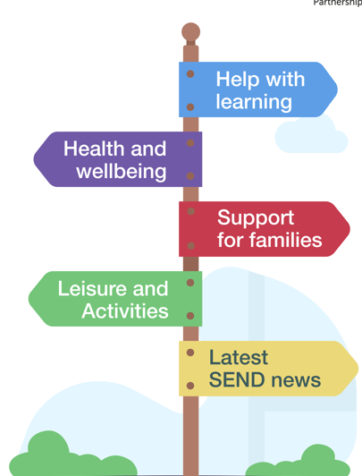




Slide 2


What is the SEND Local Offer website?
The Local Offer is a ‘one-stop’ platform for help, support and advice for families, carers, children and young people on their SEND journey.
It includes information and services for children and young people aged 0-25 years with special educational needs and disabilities (SEND) and their families living in Wolverhampton.
We recently refreshed our SEND Local Offer website, and we wanted to share this with you.
Place image here
Notes:
The Local offer is a helpful place to find information about Wolverhampton’s SEND support services, advice and resources
This includes information for children and young people with SEND aged between 0-25 and helpful advice and support for their families.
We have recently refreshed our SEND Local Offer website which we wanted to share with you.

Slide 3
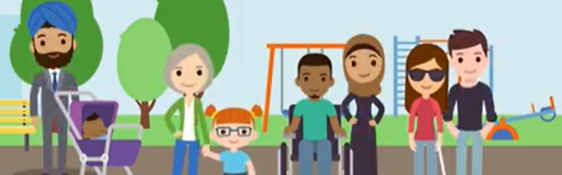
Find information about:
who to speak to if you are concerned about a child’s learning and development
find education, health and wellbeing and social care service for SEND support
browse for local support such as where to find helpful advice, support groups, fun activities or services
travel assistance
support during periods of transition and preparing for adulthood
what to do in a complex situation, for example challenging decisions about support for children with SEND.
What is on the Local Offer website?

Slide 4
What children, young people, parents and carers said about the Local Offer website during the SEND Inspection in September 2021
Cannot find information about the variety of available services
It’s not helpful
It’s too difficult to use and navigate
Don’t understand the local offer’
Don’t know what the Local Offer is or have little awareness of the website
Notes:
During the SEND Inspection in 2021, the following key points were found. Children, young people, parents and carers that were spoken to, reported that they either did not know what the Local Offer was or knew very little about it. Those who used the website found it too difficult to navigate and it was not helpful to find services they were looking for.

Slide 5
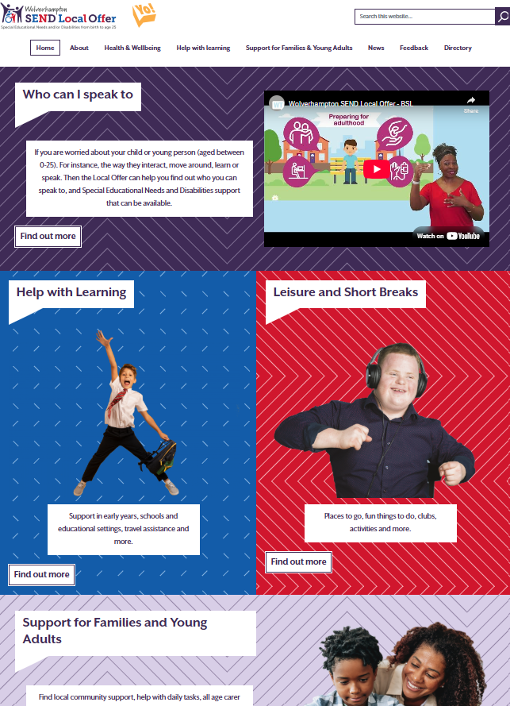
What we have done to improve the website
Talked to a wide range of stakeholders to find out what they wanted to see on the website
User tested the website to see how children, young people, parent carers and professionals were able to navigate the site.
Through the ‘You Said, We Did’ feedback and response process further updates have been made.
Added a video to explain what the Local Offer is and how this could help.
Ensured that SEND systems and processes are explained
Improved navigation and included search button
Made sure it is all up to date
Notes:
Engaged with various stakeholders to find out what they wanted to see on the Local Offer.
User tested the site, with a number of children and young people with SEND and parent carers alongside several professionals.
Through our you said we did process for gathering feedback and responding to this, we have made further improvements.
On the home page we have added a short animated video to explain what the Local Offer is, and how this could help families.
SEND systems and processes are explained.
We have improved navigation and added a search button on each page.
And we are continuously working on keeping the Local Offer up to date with regular review process in place.

Slide 6
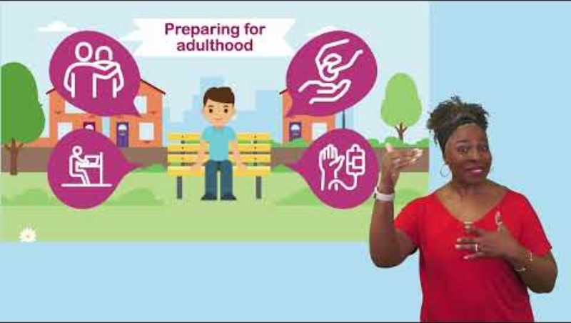
Watch the Local Offer video to find out more
Notes:
All you need to do is –
To Enable Subtitles:
Click on the Subtitles/ closed captions (c) button on the video player to enable subtitles.
Change Subtitle Language:
Click on the Settings (gear icon) in the video player.
Select Subtitles/CC and then Auto-translate.
Choose your desired language from the list.

Slide 7
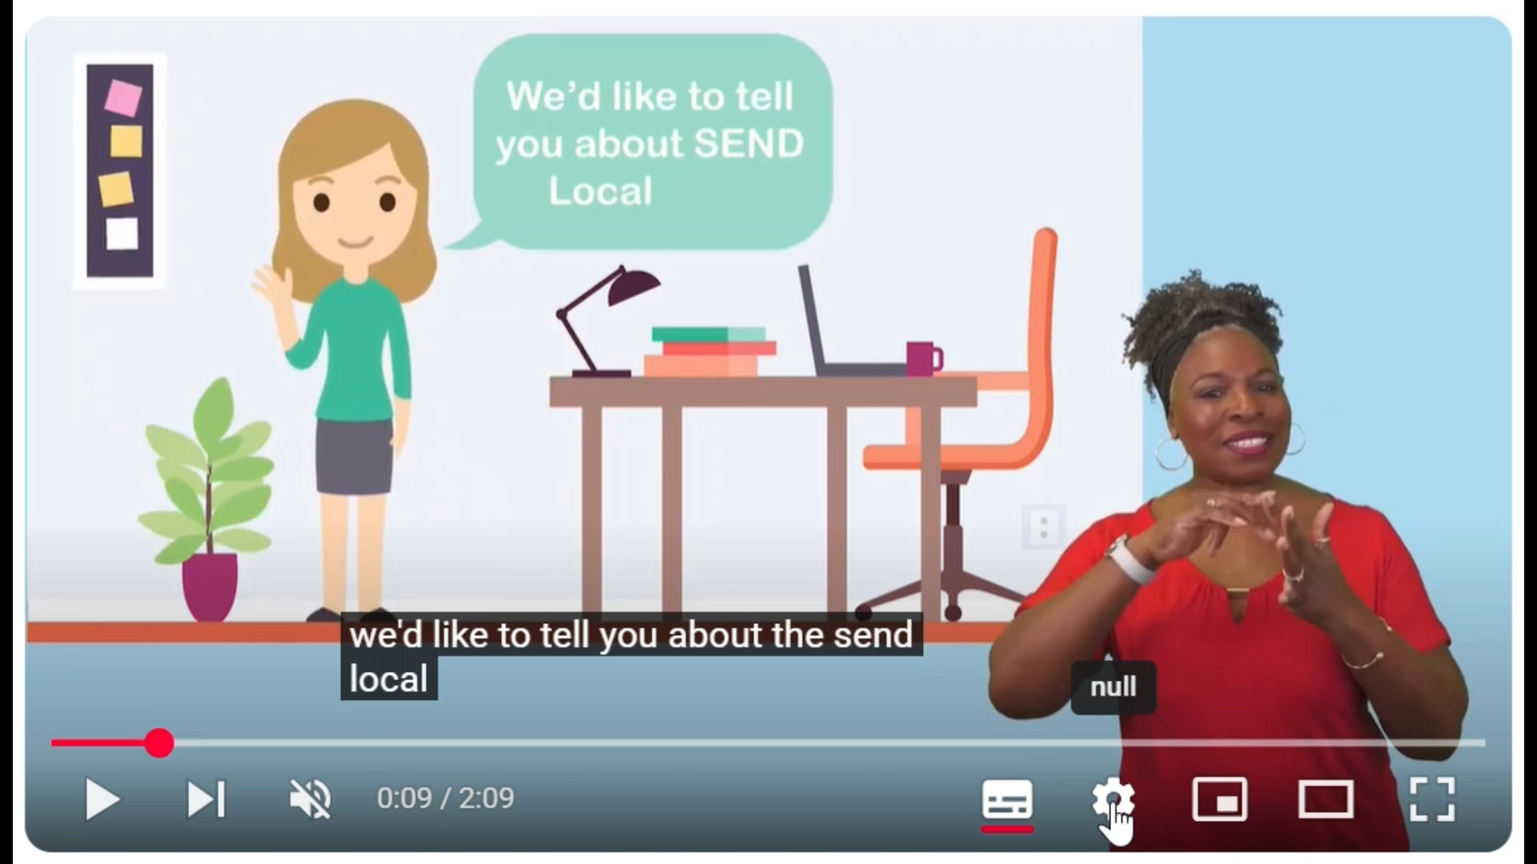
Using YouTube's Auto-Translate Feature
The video includes British sign language, as well as subtitles in many languages. Please can you share this helpful feature with families where needed whilst signposting to the new Local Offer –
https://www.localofferwolves.co.uk/.
Enable Subtitles:
Click on the CC (Closed Captions) button on the video player to enable subtitles.
Change Subtitle Language:
Click on the Settings (gear icon) in the video player.
Select Subtitles/CC and then Auto-translate.
Choose your desired language from the list.
Place image here
Notes:
The home page SEND Local Offer video includes a British sign language interpreter and subtitles in many languages.
Can you share this video clip with families where needed whilst signposting to the Local Offer.
The below written instructions and short demo video clip explains how to change the subtitles into many different languages.

Slide 8

Our ask to you
Help us to reach more families in Wolverhampton by:
Include links to the Local Offer in your communications - https://www.localofferwolves.co.uk/
Hand out or display the Local Offer leaflets, posters or digital screen promotional material - https://www.localofferwolves.co.uk/about/promote-wolverhampton-local-offer
Include the Local Offer in your e-bulletins or social media networks
Provide information at meetings and workshops.
Invite Local Offer team to community events to raise awareness of the site.

Slide 9
Have your say about the Local Offer
Your feedback about the quality of services, any gaps in provision and how easy the information in the Local Offer is to find and understand will be most appreciated.
Your views are important.
If you would like to give feedback or
ask a question, please
contact us.
localofferenquiries@wolverhampton.gov.uk
We want the website to be helpful, with meaningful information. We use your feedback and comments to try and make things better.
Have your say
Place image here
We publish anonymous responses and how we can make things better.
Our ‘You Said, We Did’ annual report
You Said – We Did/Are Doing
Notes:
Your feedback about the quality of services, any gaps in provision and how easy the Local Offer is to understand will be most appreciated.
You can also feedback about how the Local Offer has been developed or reviewed by emailing localofferenquiries@wolverhampton.gov.uk
We want to make sure that the local offer is helpful, meaningful and relevant to local need. Your feedback will help us to make things better for children and young people with SEND.
We publish anonymous responses within the you said, we did annual report to share what has been done and how we have made improvements over the year.

Slide 10



How to access the Local Offer Service
Website
www.localofferwolves.co.uk
Email
localofferenquiries@wolverhampton.gov.uk
Telephone
01902 552998

