Slide 1
PORTER HAUS
WELCOME EVERYONE!!

Slide 2
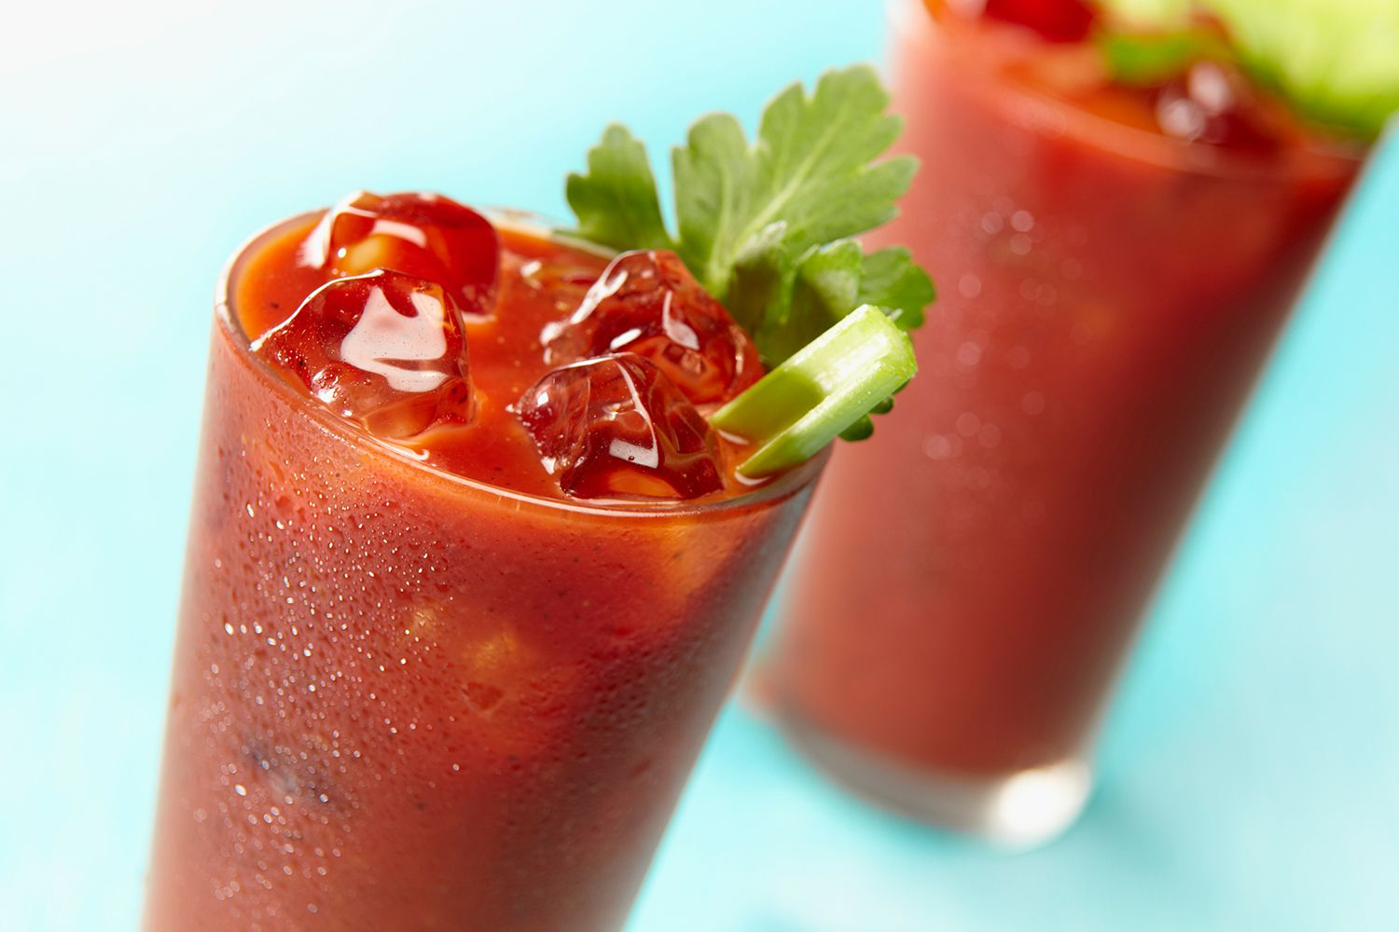
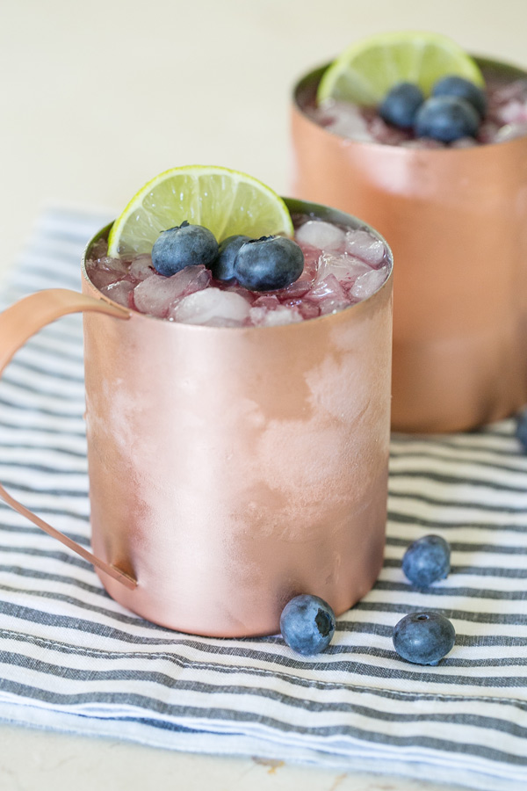
First start with something deliciously refreshing!

Slide 3
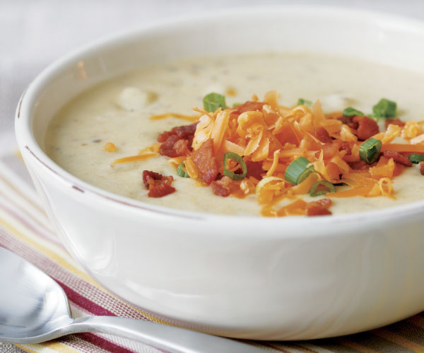
Or maybe you need to warm up a bit first?....

Slide 4
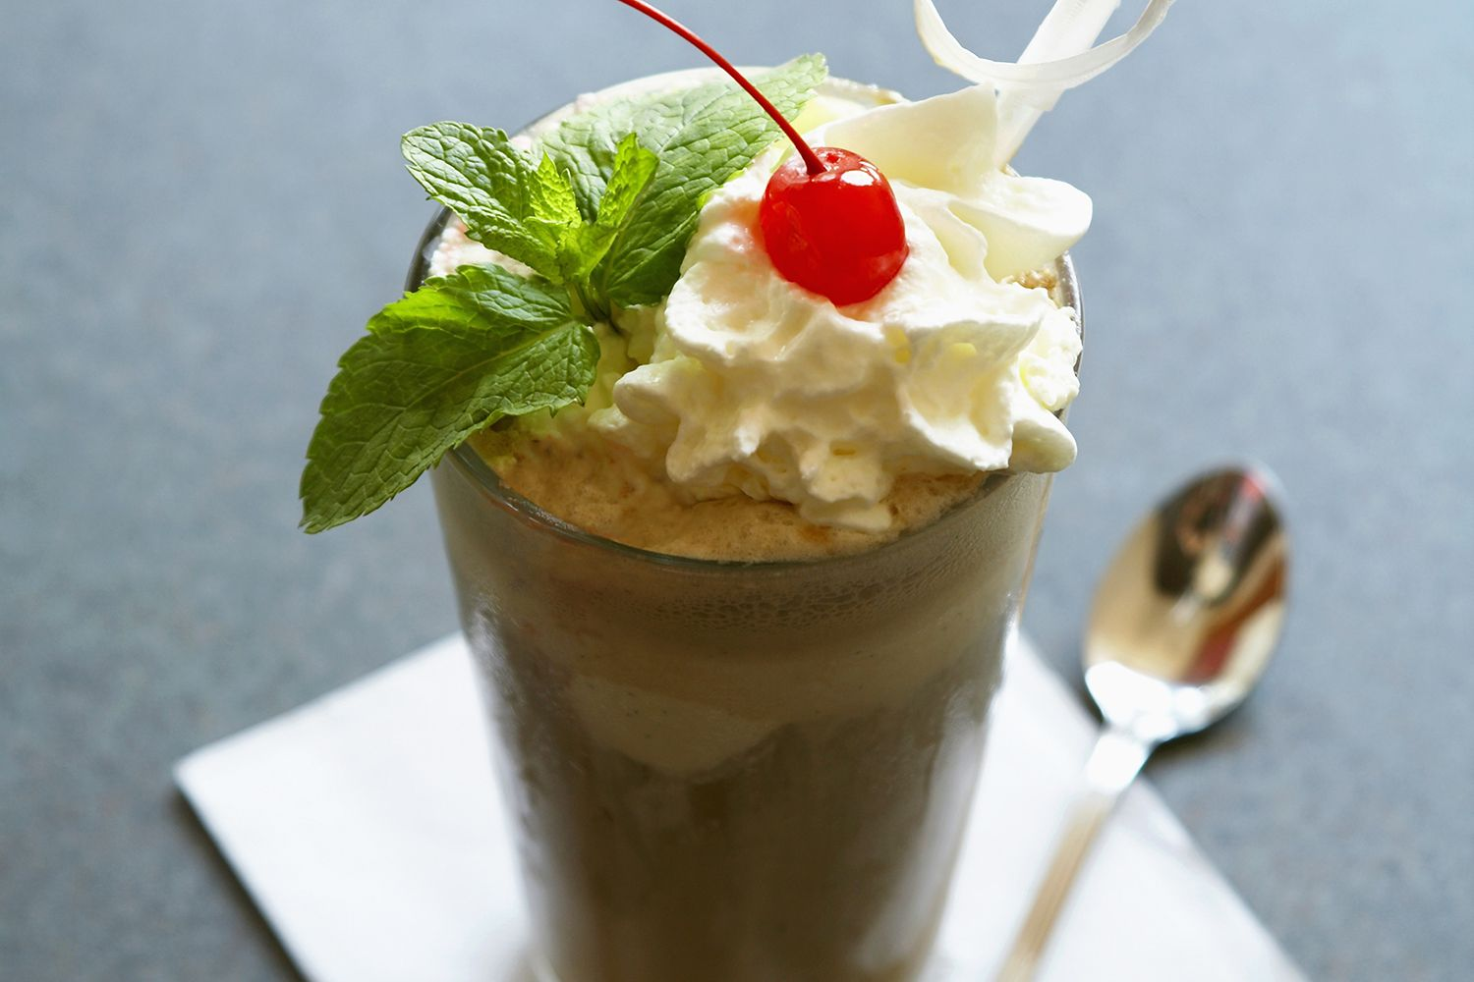
At ph, we like Starting off with Happy kid’s!! Happy kiddo’s = very happy parents!!

Slide 5
Get munchin’ with our loaded bacon ranch fries or alligator to start!

Slide 6
FEELING CHILI?

Slide 7
Perhaps you’re thinking more towards…..
Buffalo wings
bruschetta

Slide 8
Either way…… you’ll love it!
SO now onto the Big Decisions!...

Slide 9
Mmmmmm……bbq Ribs ………..double decker grilled cheeseburger

Slide 10
BEEF IT UP!

Slide 11
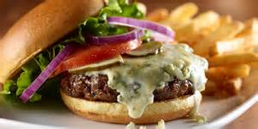
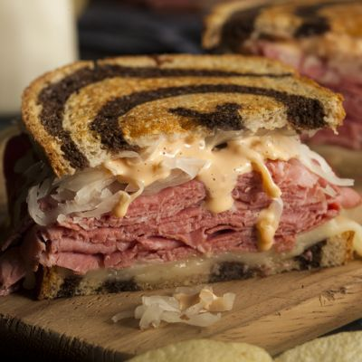
French dips burgers reubens

Slide 12
Feeling a little fancier?.....

Slide 13
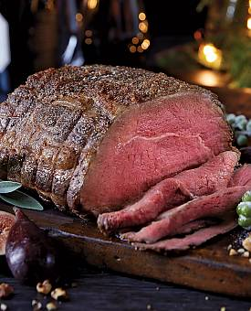
PRIME RIB FRIDAY & SATURDAY 4PM-CLOSE

Slide 14
Did you know?...

Slide 15
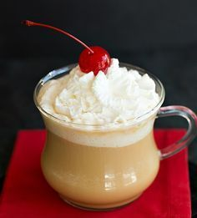
No matter what your sweet tooth prefers

Slide 16
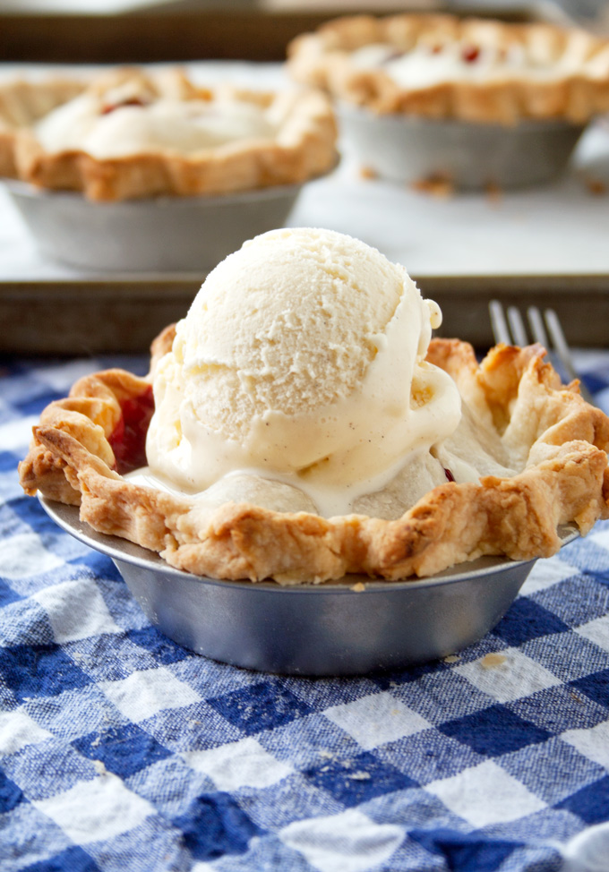
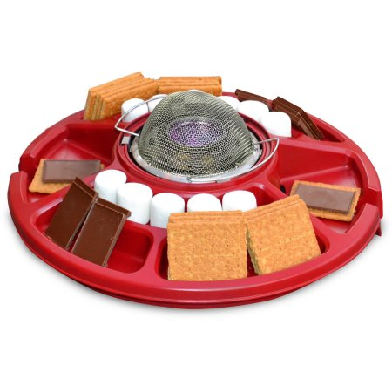
We got you covered☺

Slide 17
Thanks for dining with us tonight!!

Slide 18
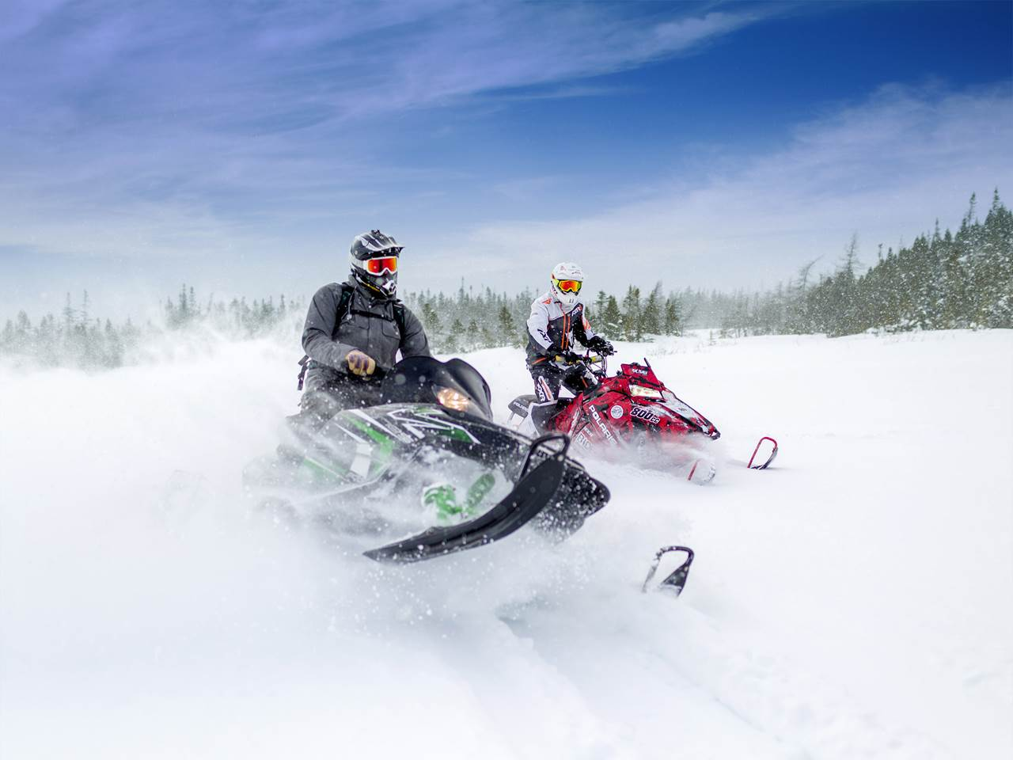
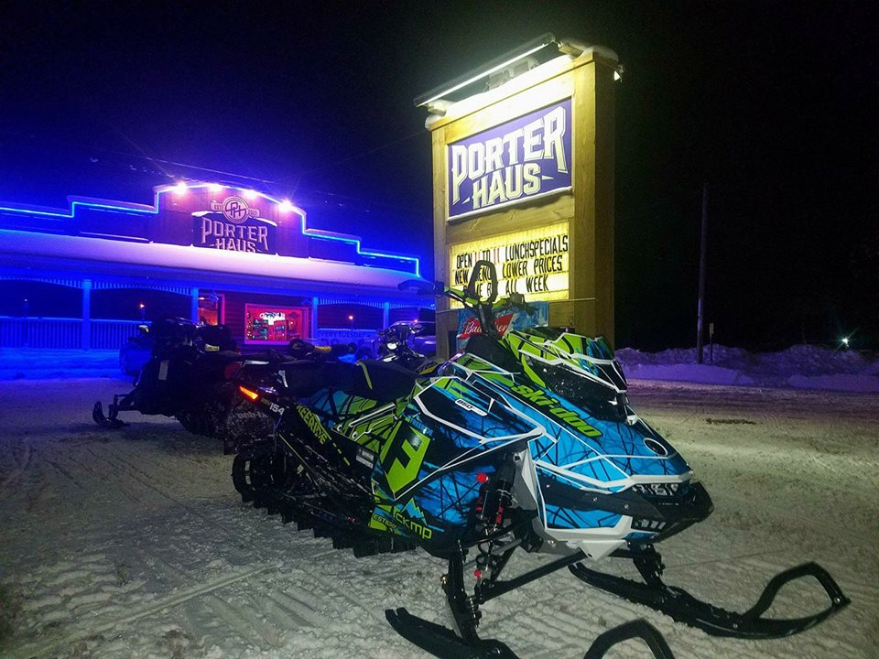
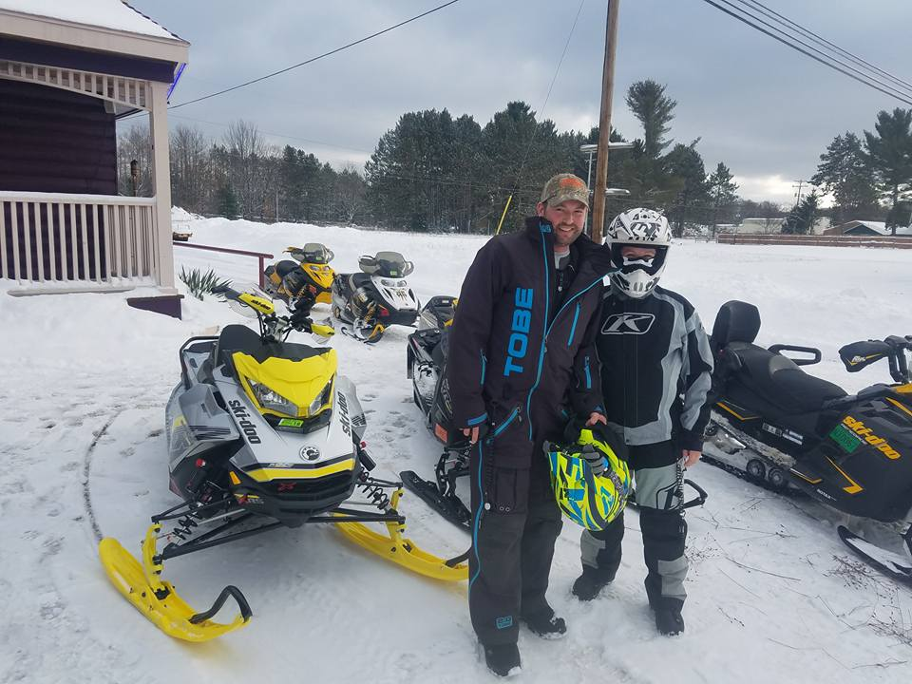
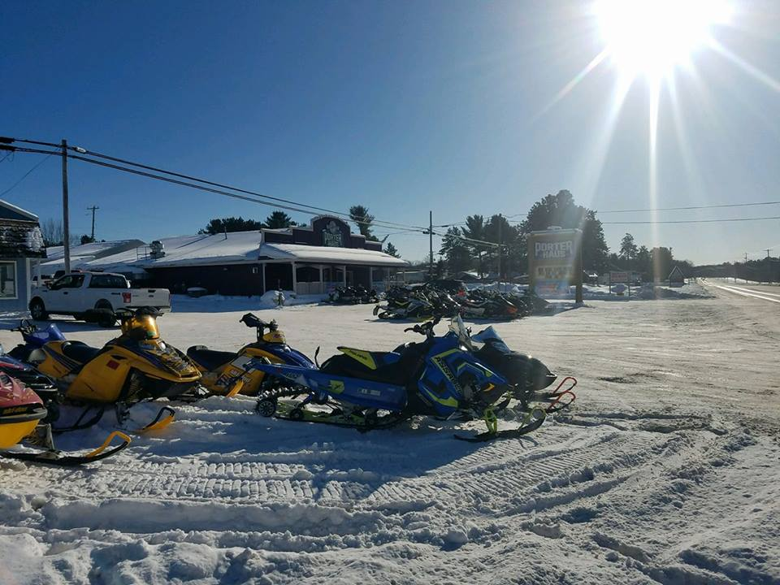
WELCOME SNOWMOBILERS!!
JOHNDEE.COM

Slide 19
Join us for the 2018 12TH ANNUAL PINK RIBBON RIDERS snow run tour JANUARY 19TH & 20TH!

Slide 20
THE FROSTY PLUNGE BACK AT OTSEGO LAKE ON FEBRUARY 3RD 2018! REGISTER HERE @ PH !

Slide 21
THE CRAWFORD COUNTY UNITED WAY ANNUAL SNOWMOBILE FUN RUN FEBRUARY 10TH 2018!

Slide 22
JOIN US FOR HAPPY HOUR ALL DAY DURING…

