Slide 1
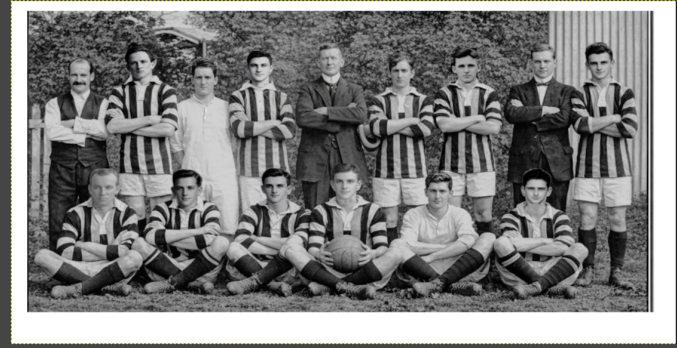
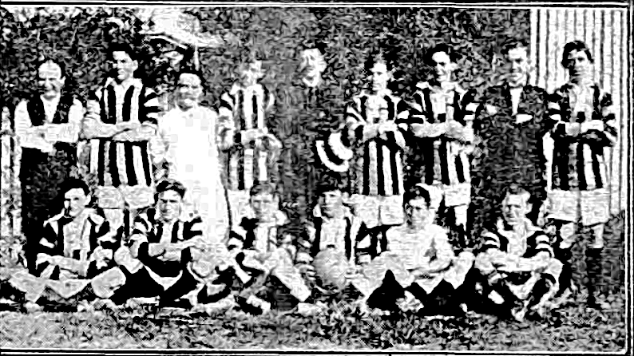
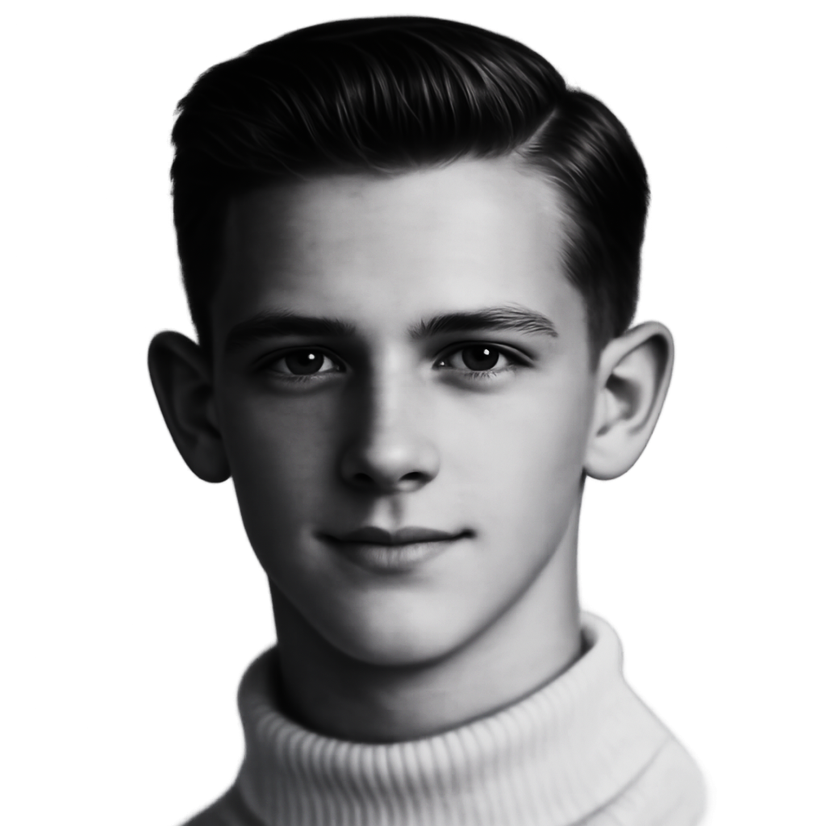
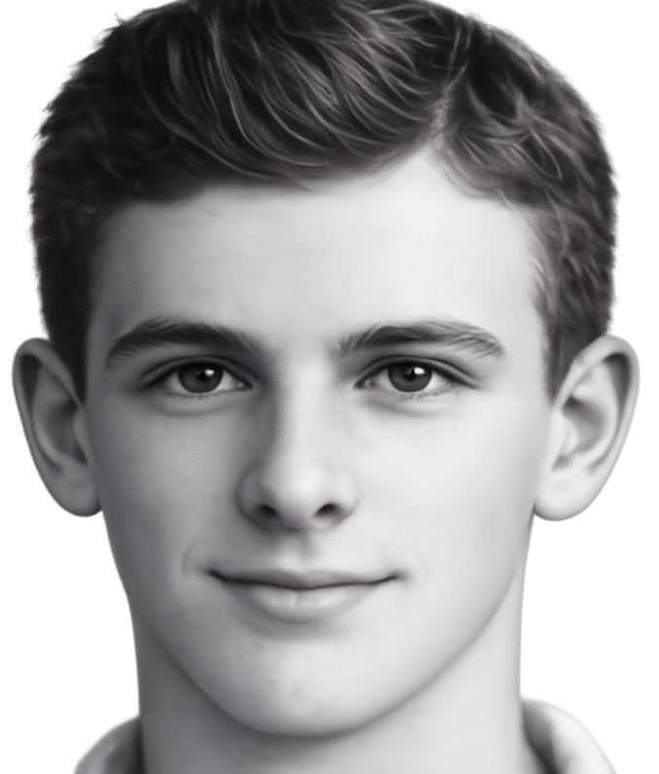
-1919-
Ipswich Junior Minor
No order:Eric Nunn, William Burns,Les Halls,William Skellern,Robert Campbell
William Skellern,Joe Kitching,James Duff,Robert Hamilton,M Donald,James Noonan,Thomas Quirk

Slide 2
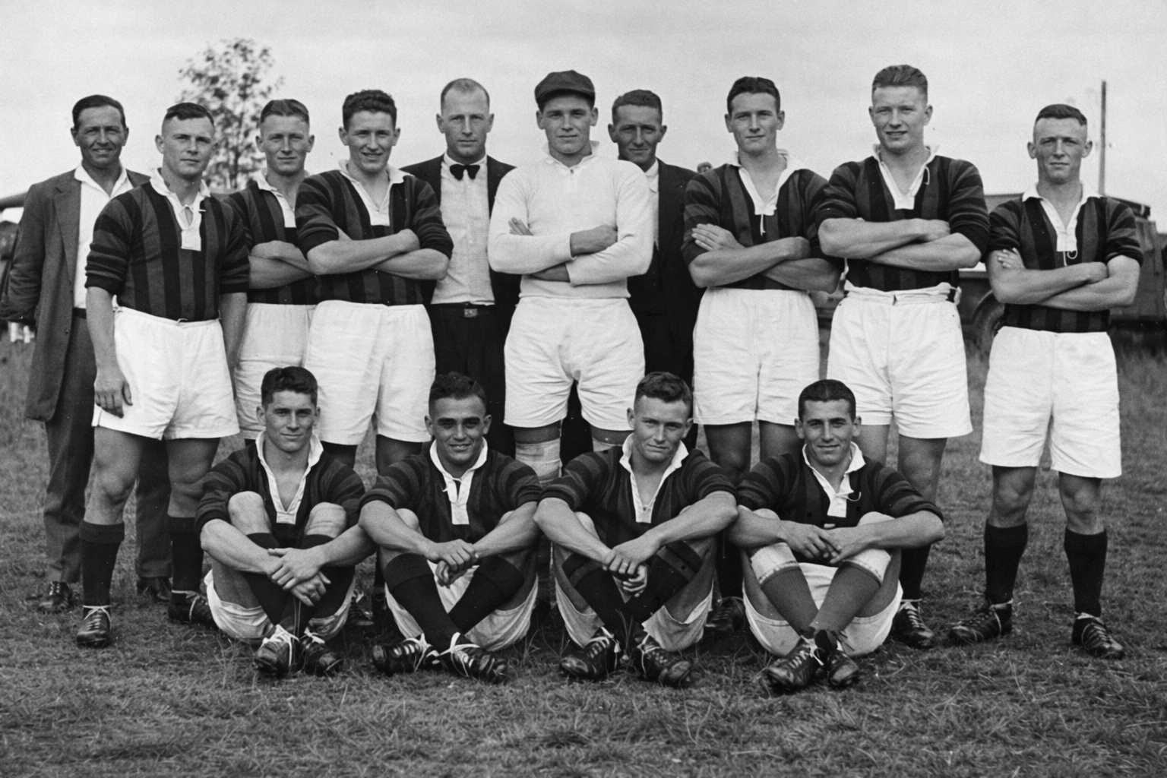
,
-1935-
Ipswich Junior
Back row- D Johnson (Referee) Samuel Purnell,T Johnson,Ron Jones,Jim Maxwell (President) Mervyn Richardson,W Smith (Secretary) George Dale, Thomas Purnell,A Parsons
Front row- Joe Bell (Captain) George Williams Ken Wall,P Warren
Others M Simpson,Leonard Cook,Lloyd Jones

Slide 3
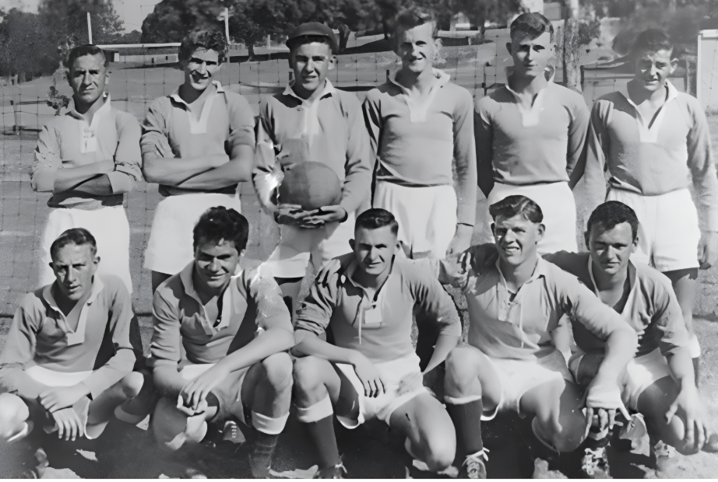
-1957-
Ipswich Under 18 Representative team
Back row L-R: Bob Kucks,Nev Sloan,Les Healing,Des Brown,Errol Jones,Ken Grice
Front:Merv Hurley,Bill Cadoo,Lance Petie (Captain) Elwyn Humphries,Max Pedley Absent Russell Norrish

Slide 4
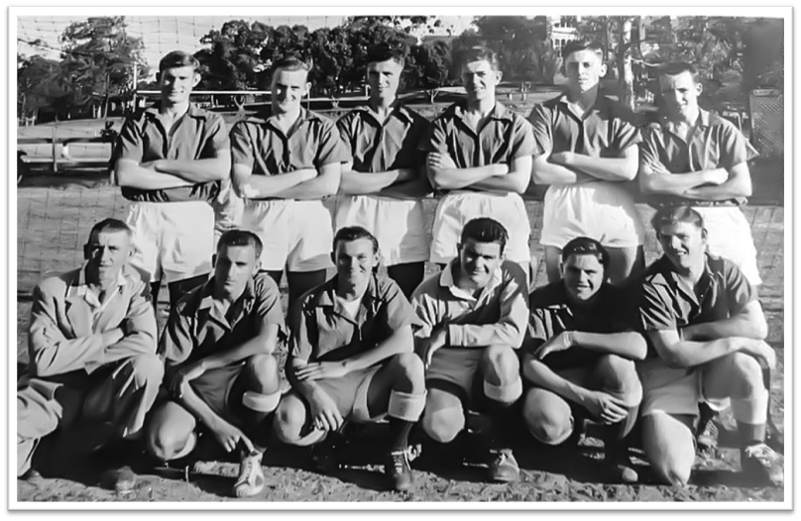
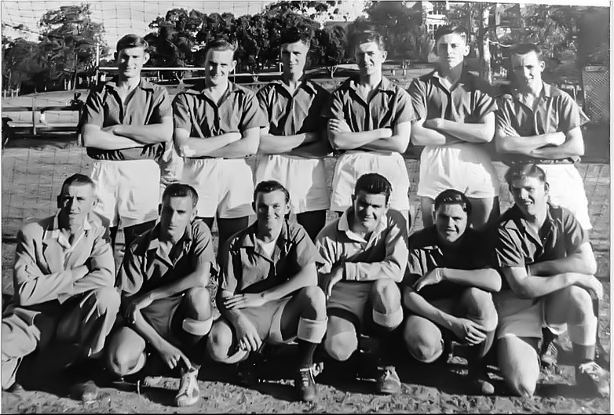
-1957-
Ipswich Under 21 Representative team
Back row L-R: Graham Dann,Cecil Hoffman,Tom Gorman,Frank Johnston,Merv Lotz,Bill Pitcairn
Front:John Pitcairn,Bob Kucks,Keith Besgrove,Murray Kruger,Nev Fountaine,Elwyn Humphreys

Slide 5
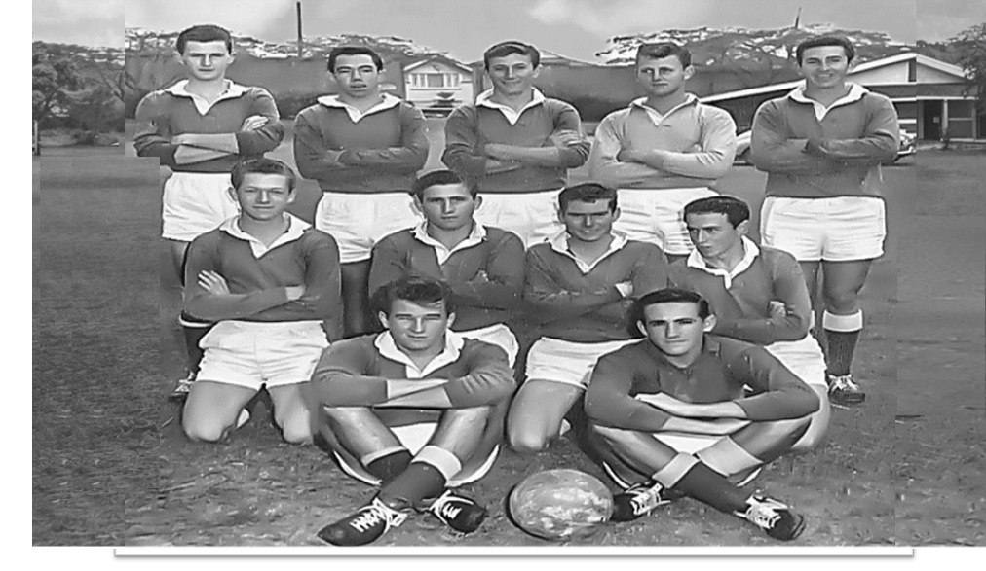
-1962-
Ipswich Under 18
Back Row: Terry Petie,Noel Puet,Barry Payne,Owen Williams,Graham Chandler
Middle Row: Noel Carter,Trevor Payne,John Roderick,Barry Gillow
Front Row: Ross Grant,Kevin Page
Source:Private Collection /Roderick family

Slide 6
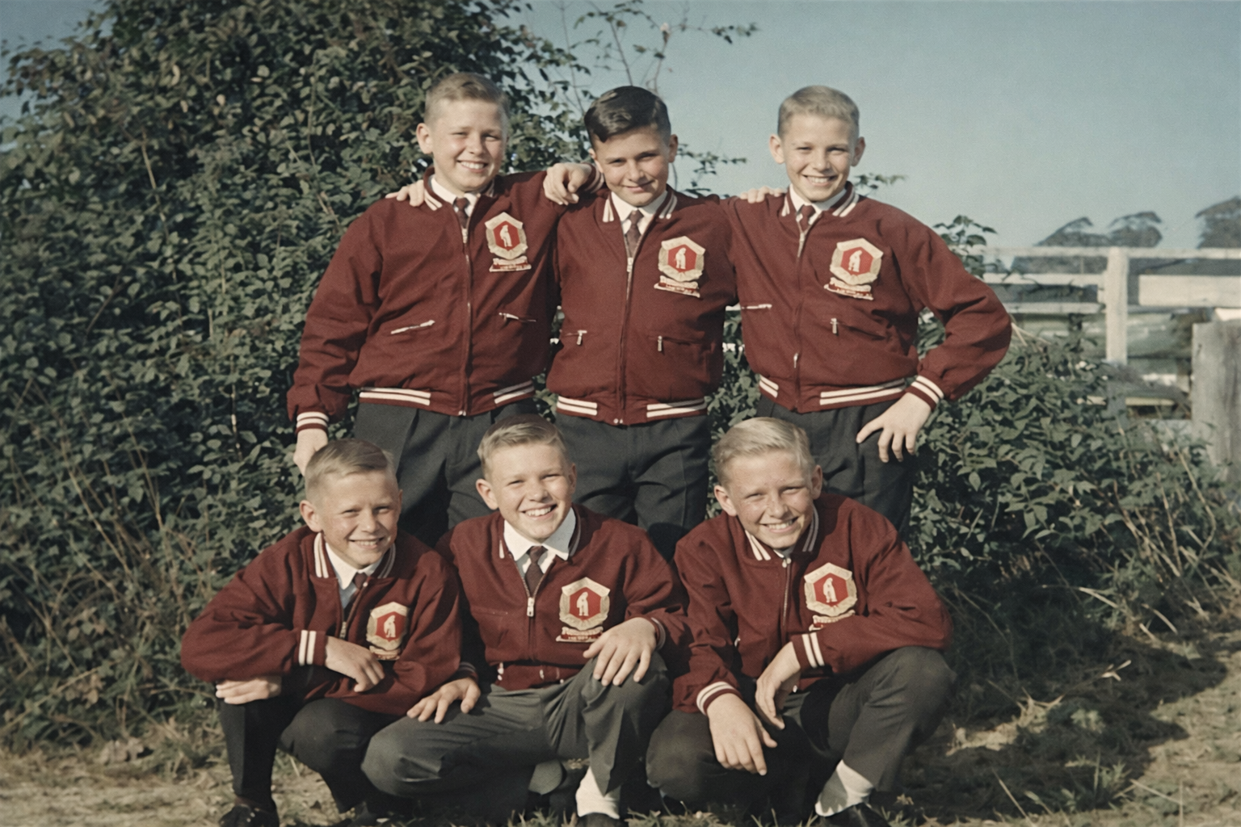
-1967-
Brisbane and Districts
Back row: Chris Gay, Trevor Broadbent,Garry Leo
Front: Greg Dobbie, Rick Kitching,Steve McDowall

Slide 7
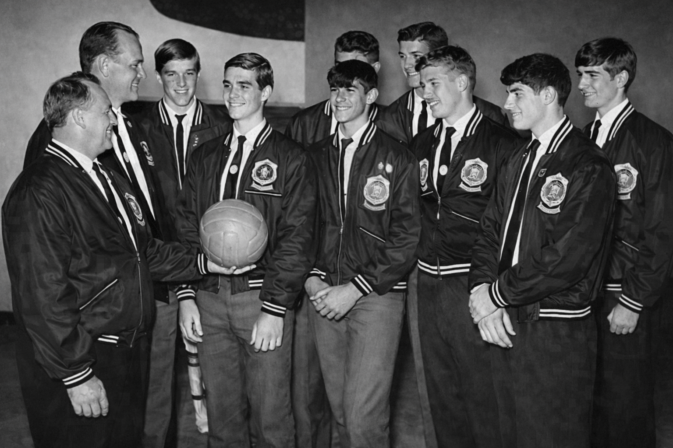
-1969-
Brisbane and Ipswich
Under 15
Back:Alan Freese (second on left) Paul Ross (fourth on left)
Front:Mick Kassambas (first on left) Tony Kassambas (second on left) Erroll Evans (fourth on left)

Slide 8
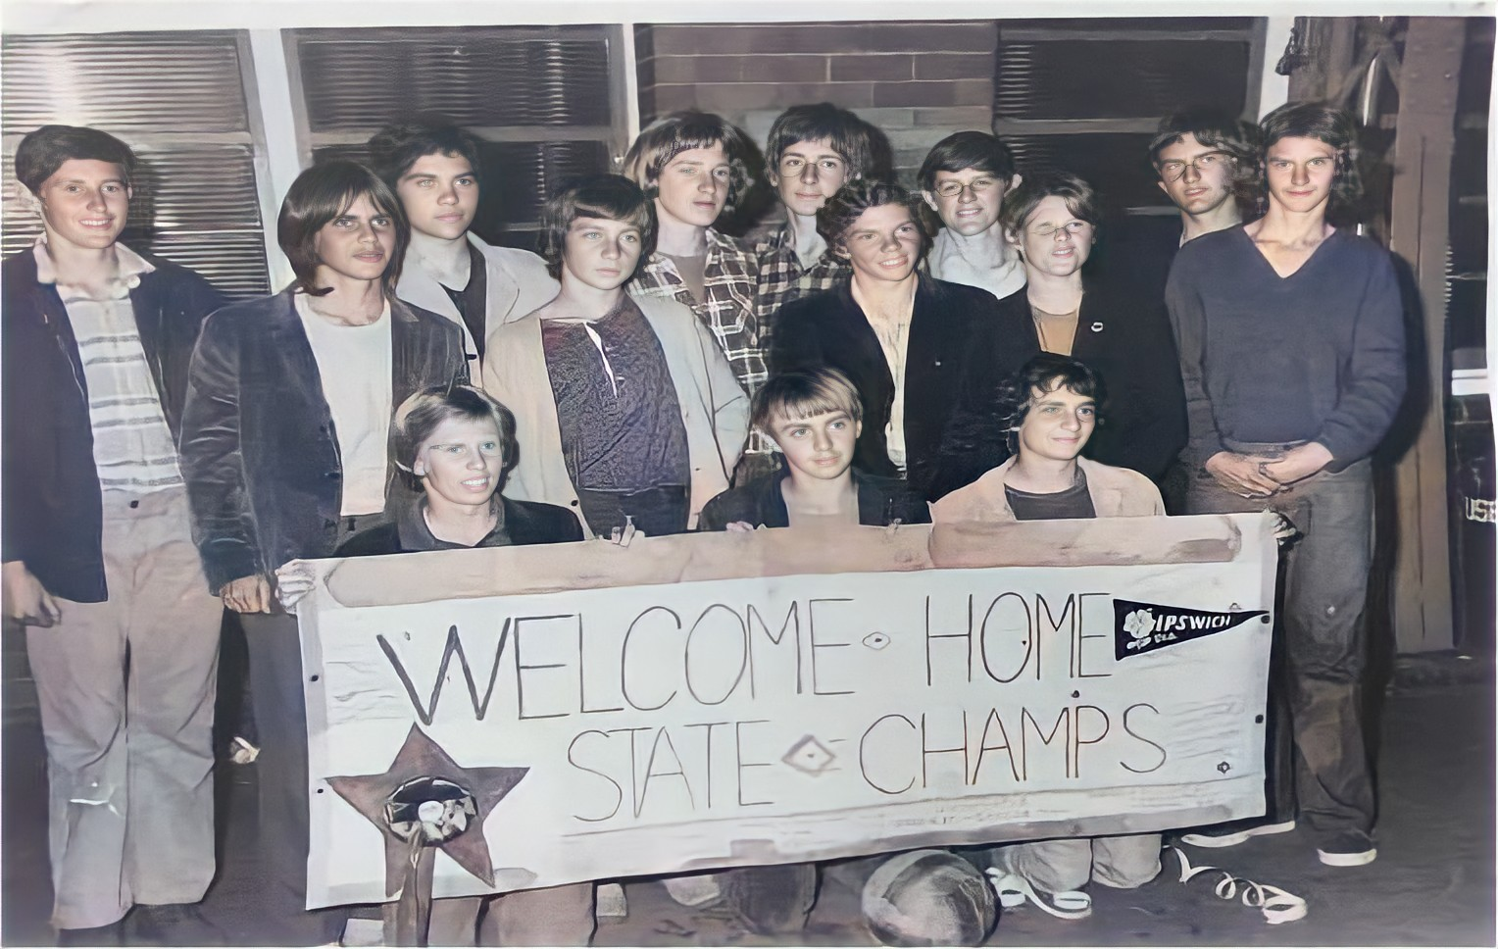
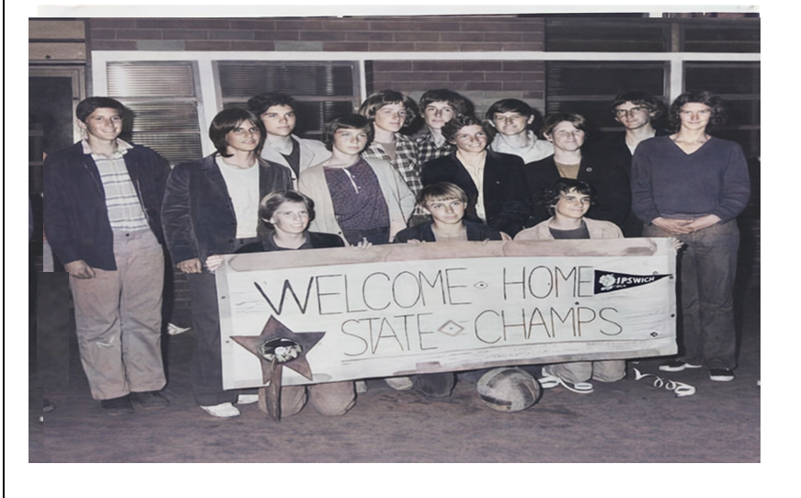
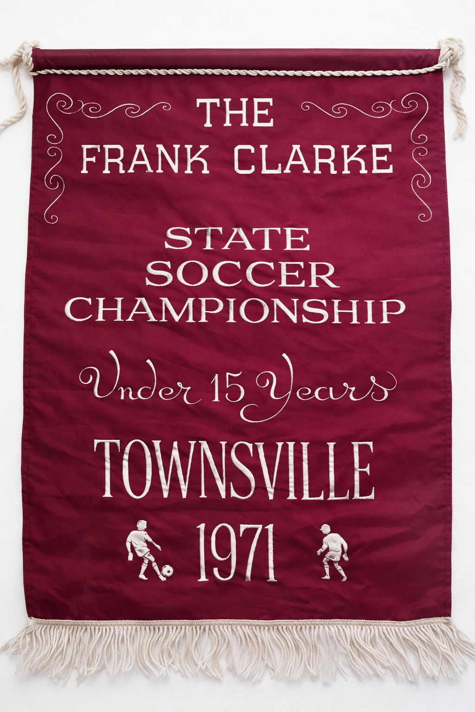
-1971-
Under 15 Ipswich State champions
Back Row L-R:- Gavin Johnston,Bob Purdie,Mike Watson-Graham Sothers,Russell Turner,Gavin Greisbach,Gary Kathage
Kim Wishart- Ashley Reiddel,Ian Lawrie-Ken Aubrey
Front row- Laurie Devereaux- Ken Perry-Jeff Dann

