Slide 1

NEPOT Governor Gina’s Monthly Meeting
March 23rd at 6:30 pm
Agenda
  Spring Convention
  Key Strategies and Concepts
  about Leadership
  3. Opportunities for growth

Slide 2
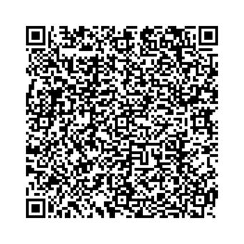

NEPOT Spring Convention
34 Pilots have Registered
April 10-12 (Fri.-Sun.) 2026
Holiday Inn express
STONY BROOK, NY
$150 per night
GMR is our Code

Slide 3
Thank you for Your Registration!
(as of 3/23/26 @ 3:00pm)
Natalie Abram
Susan Auer
Karen Beck
Linda Burke
Alicia Catania
Cathy Cieslinski
Diane Cloud
Daniella DiLorenzo-Moyer
Karen Ferguson-Bain
Sue Ferrara
Jean Fleischer
Judy Harding
Joan Herr
Dora Hillegas
Susan Kahl
Kathleen LaMonica
Lori LaRocco
Divina Leitch
Joann Lewald
Joan McIntosh
Bonnie Misko
Gina Monteleone
Renee Negron
Kelly Parker
Linda Pickford
Jean Ann Saville
Linda Tabatchnik
Kathleen Tarlecki
Frances Wiener
Kortnee Winters
Marie McGee
Lisa Palmquist
Mollieann Gray
Sharon Garloff

Slide 4
Thank you for Ordering Extra Tickets!
(as of 3/23/26 @ 3:00pm)
Installation Tickets
Charlotte Cassarino (1)
Kathy Daly (1)
Sharon Garloff (1)
Joan Herr (1)
Lori LaRocco (6)
Linda Schaefer (1)
Awards Luncheon Tickets
Sharon Garloff (1)
Joan Herr (1)

Slide 5
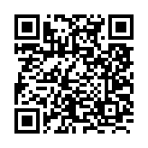
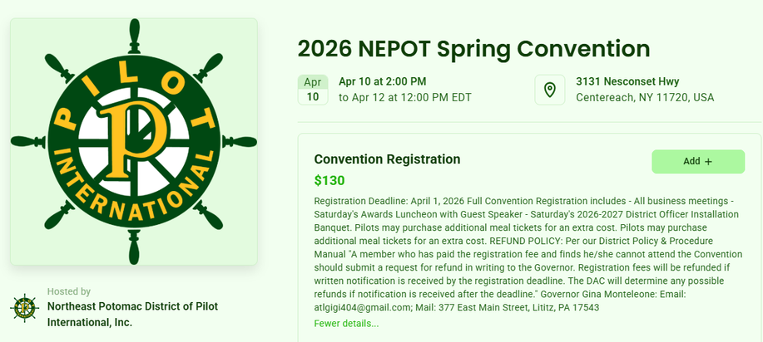
CLICK HERE
Registration - Zeffy
QR CODE REGISTER WITH ZEFFY
CLICK HERE

Slide 6
Key Strategies and Concepts
How to Work with Complicated People
See People, Not Problems: View challenging people as humans with their own struggles, not just obstacles, to foster understanding and reduce conflict.
Let Go of Unrealistic Expectations: Release the need for others to be differnt than they are to avoid frustration.
Communicate Effectively: Learn to communicate in complex environments to navigate different styles and personalities.
Embrace Healthy Disagreement: Use disagreement as a tool to find better solutions, rather than a source of conflict.
Set Boundaries: Establish healthy boundaries to protect yourself without shutting people out.

Slide 7

Who is with you when
you get to your destination?

Slide 8
Who is with you when you get to your destination?
  How many complicated individuals do you deal when involved with Pilot?
78% of Americans say they deal with
complicated people on a weekly basis!

Slide 9
Who is with you when you get to your destination?
  Why do you think Gen Z believes they are more complicated to work with than other generations?
41% of Gen Z think their co-workers would
say they are a complicated person to work
with (much higher than any other
generation)

Slide 10
Who is with you when you get to your destination?
  Thinking about a complicated person in Pilot, what made them complicated?
44% of working American say they have
quit a job because their “boss” was too
complicated to work with (including 50% of
Gen Z).

Slide 11

How to Work with Complicated People
by Ryan Leak
Link to Ryan Leak
“The State of Complicated People in the Workforce”
(CLICK ON “Download the White Paper” once on website.)
CLICK HERE

Slide 12
How to Work with Complicated People
by Ryan Leak
Worksheets to Use While Reading
CLICK HERE FOR LEADER GUIDE
CLICK HERE FOR STUDY QUESTIONS

