Slide 1

NEPOT Governor Gina’s Monthly Meeting
April 27th at 6:30 pm
Agenda
  Spring Convention - Feedback
  Oklahoma City, OK
  May/June Meeting Combined 6/22/26

Slide 2
Thank you for attending the
80th Annual Spring Convention!
Natalie Abram
Susan Auer
Karen Beck
Linda Burke
Alicia Catania
Cathy Cieslinski
Diane Cloud
Daniella DiLorenzo-Moyer
Karen Ferguson-Bain
Sue Ferrara
Jean Fleischer
Judy Harding
Joan Herr
Dora Hillegas
Susan Kahl
Kathleen LaMonica
Lori LaRocco
Divina Leitch
Joann Lewald
Joan McIntosh
Bonnie Misko
Gina Monteleone
Renee Negron
Kelly Parker
Linda Pickford
Jean Ann Saville
Linda Tabatchnik
Kathleen Tarlecki
Frances Wiener
Kortnee Winters
Marie McGee
Lisa Palmquist
Mollieann Gray
Sharon Garloff

Slide 3
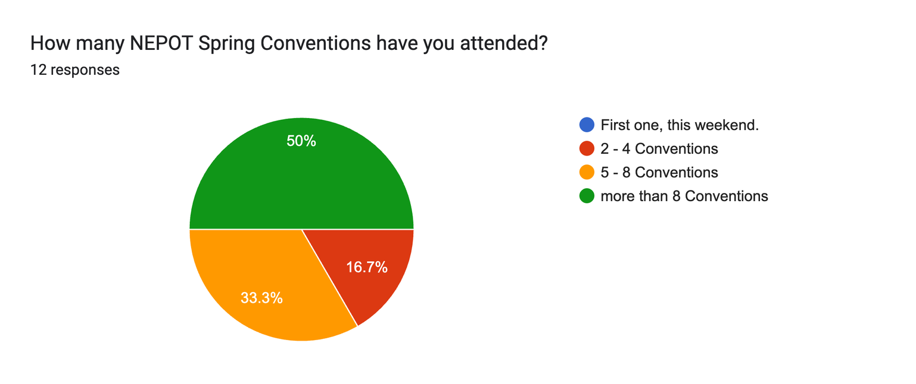
Attendance:
50% = Long-active Members
0% = 1st time Members

Slide 4
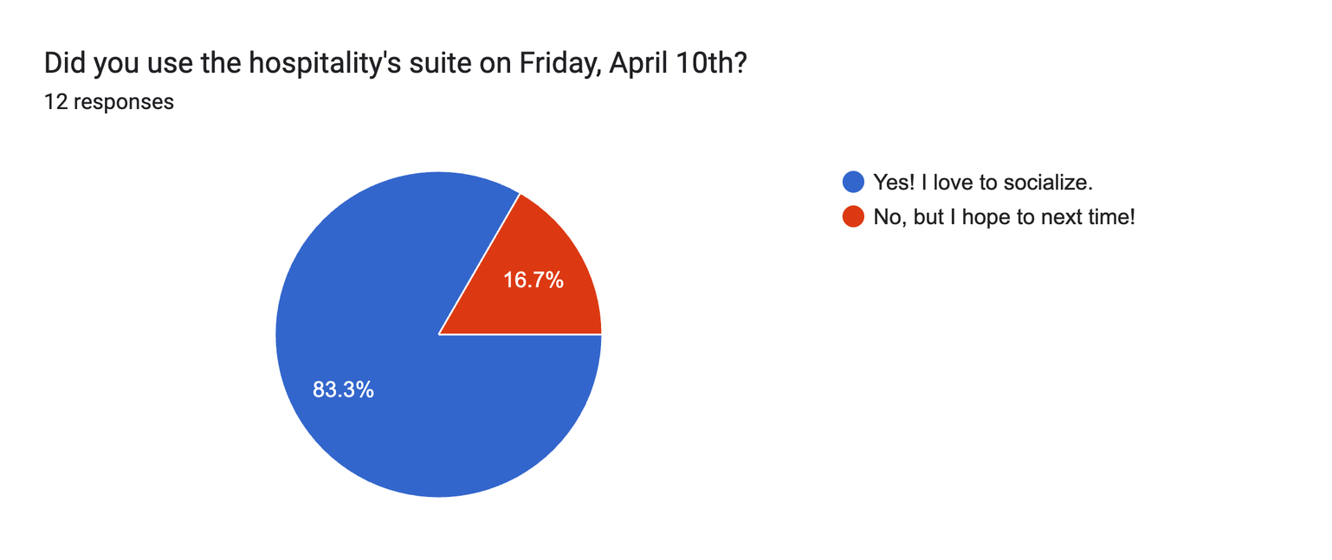
NEPOT Spring Convention
Hospitality Suite = FUN time!

Slide 5
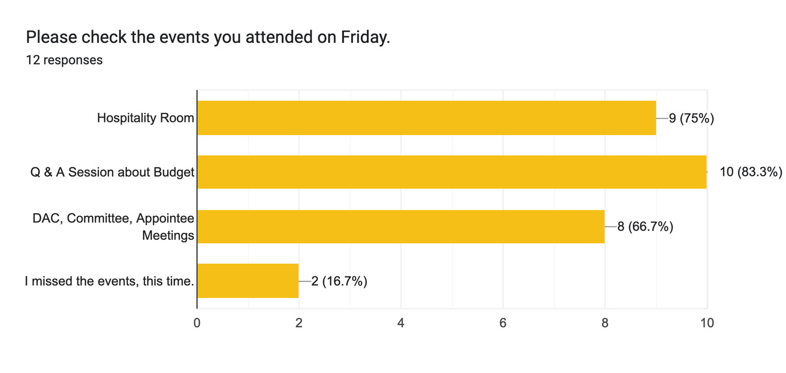
NEPOT Spring Convention
Friday Attendance

Slide 6
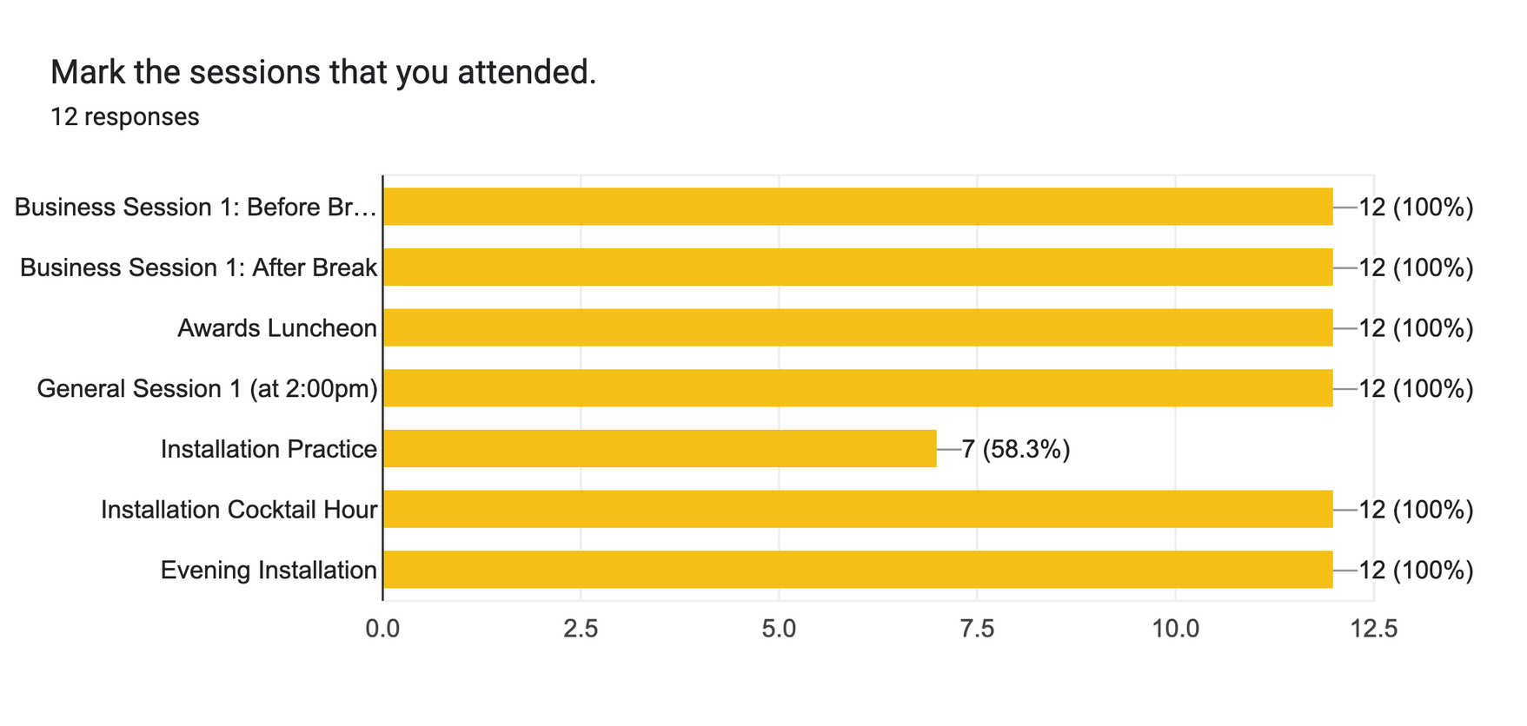
NEPOT Spring Convention
Sessions Attended

Slide 7
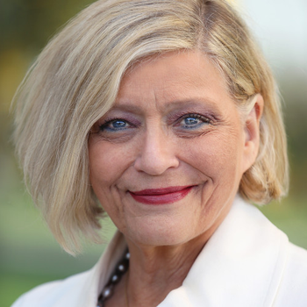

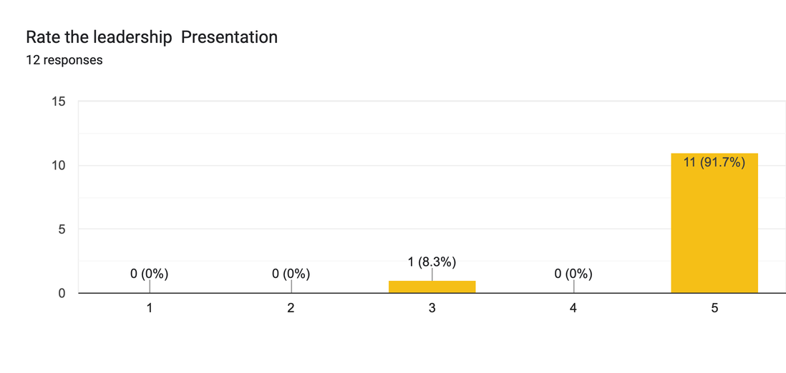
NEPOT Spring Convention
Susan Zeidman ~ Guest Speaker
Pilot Members’ Take-Aways:
Loved her response for when someone interrupts you
Wonderful thoughts for empowering women
Be confident
Confidence
Do what you can, learn the rest.
Be positive and keep trying.
All of it!
Women are strong
Women and leadership go hand in hand.
She was fabulous.
She inspired good participation from my fellow Pilots
The Big NO
Trust in yourself

Slide 8
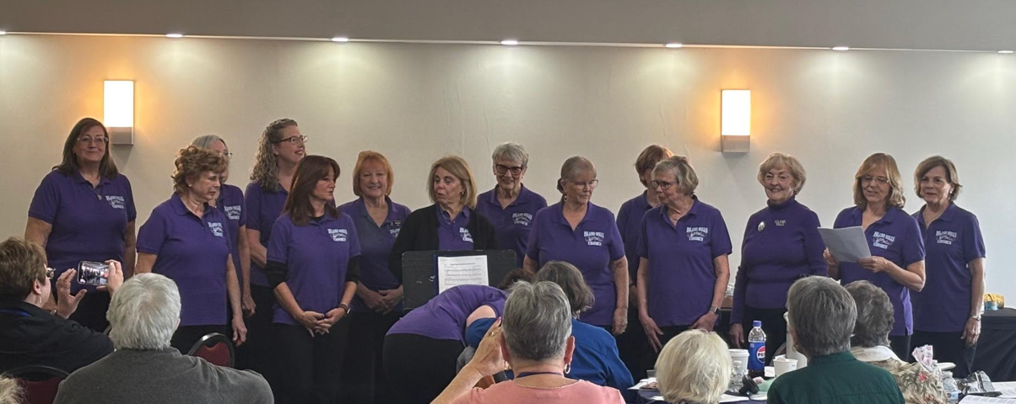
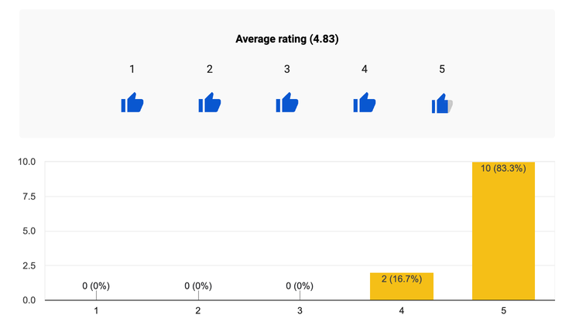
NEPOT Spring Convention
Music Performance
Sweet Adelines
Island Hills Chapter
Super Proud of our Pilot Sisters
Diane Cloud & Sue Ferrara

Slide 9
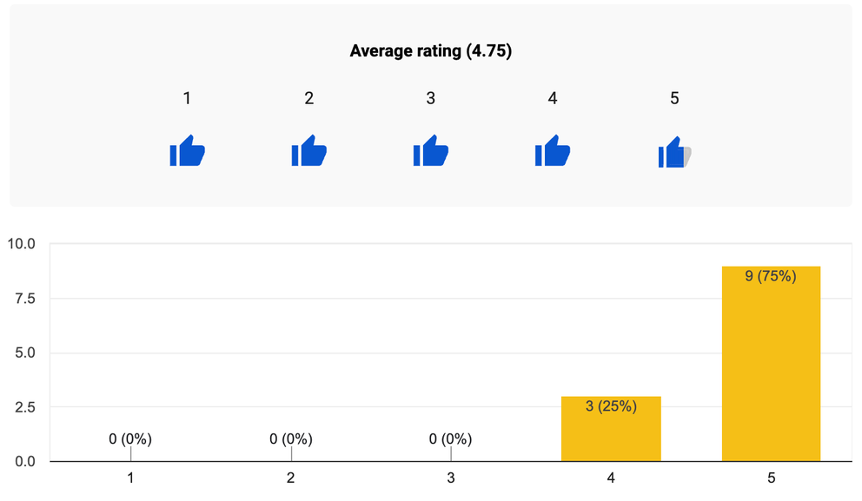
NEPOT Spring Convention
Social Story & Skit Activity
Pilot Members’ Take-Aways:
The treasurer has 9 responsibilities
That there are lots of doubts about a position and education is needed
You can do any job in Pilot
Keep at it !
No matter the position, there is always someone to
contact if you have questions.
There is a lot involved. Someone will help you.
All of it!
Nice break
It is okay to make mistakes at any of the offices.
It presented all of the fears and hesitations the treasurers were feeling.
As Lancaster's Leadership Coordinator, i plan to share it at a meeting.
It doesn't take a CPA to be a treasurer
It’s not as scary when you are informed

Slide 10
Positive “Way-to-go” Comments
Liked the convention site. Everything moved along smoothly.
It was all very well organized
Empowerment for all
Lots of good information
Learning new information.
All of it.
I thought this was the best one. Cutting back on sll business wad much better.
I enjoyed watching the Pilots in the skit as well as everyones' reactions.
Include time for Club fundraising on Friday next year.
It ran smoothly and stayed on time
I’m looking forward to coming back to this hotel again and
combining the workshop and conventions next year

Slide 11
Needs Improvement
Comments
Better organization of rooms for meetings
It was a long day
Service project on Friday night
More games
More affordable. More days would mean more money for room and food.
Maybe some downtime like taking a tour somewhere around or a museum or even shopping
Stop demanding answers
By having more breaks and making sure that people can hear and see the speakers.
Making it a 4 day I’m not in favor of. I think it will be to long.
Let's get the word out to get more people to attend.
Advanced notice of what is included for the convention.
The crazy auction and basket raffles were not announced at Club meeting or during the zoon prior to convention.
Zoom meetings prior should encourage convention participation.
Perhaps the banquet room layout due to some table having 9 chairs while others had 6 or 7.
Food was amazing but there was too much! Smaller portions would be great.

Slide 12
Best Part of the Convention
The informality of the proceedings.
Leadership training.
Reflection service
It was all nice, but the cocktail party was fun and the speaker was great
Comaraderie
Leaders training
The food was very good.
Seeing everyone and learning from experienced Pilots.
Spending time with Pilots we don’t get to see.
The skits having a break from business
Seeing my Pilot friends and learning with each other.
The Friday budget discussion. It was amazing how quickly the budget lines could be adjusted from that discussion and emailed to attendees. If there are many Standing Rules amendments for next year, they can be segmented for discussion using the zoom meeting prior to convention.
It was all very good! My favorite part was seeing Lori smile and be so happy at Installation!
The friendship and meeting new Pilots

Slide 13
Comments, questions, and concerns . . . .
None
Good job
None at this time, just the service project for the community or school or hospital
All good
Excellent coordination
Thank you to all of the participants for their work in preparing for the Convention.
Not at this time
I enjoyed the Convention.
Less food for the lunch and banquet. We are older/on diets and eat less. Sometimes the member participation is low on zoom meetings. It sounds stupid, but do we need to train these members how to zoom on laptops and phones?
Are new members trained on the attributes of the PI , District and Club websites?
Fantastic job! Congratulations to all!
2026-2027 DAC is an amazing team

Slide 14
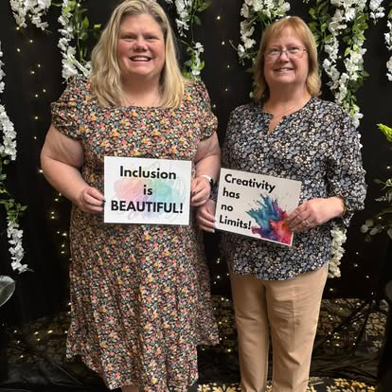
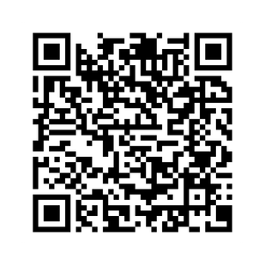
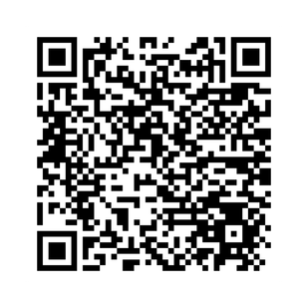

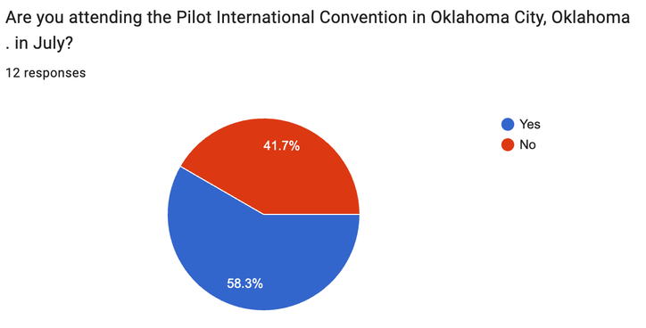

Pilot International Convention
Oklahoma City, OK
Registration for PI Convention
Hotel Reservation - Special Block
Congratulations, Lisa Palmquist, soon to be
Pilot International President

Slide 15
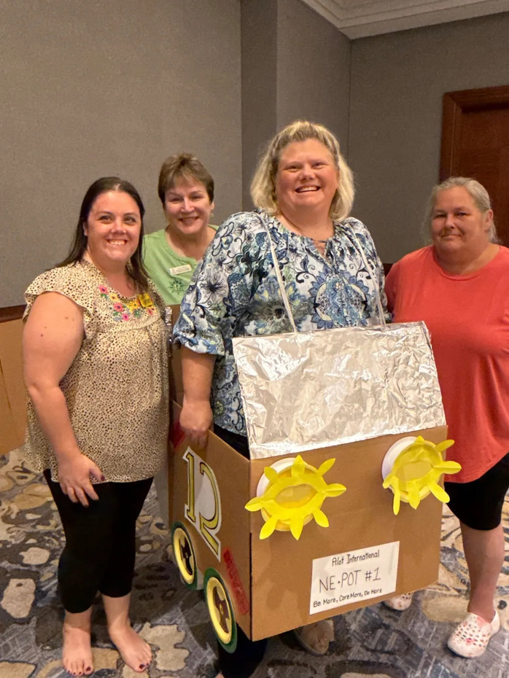
The Northeast
Potomac DAC
wants to thank you for making our convention an awesome experience!

