Slide 1





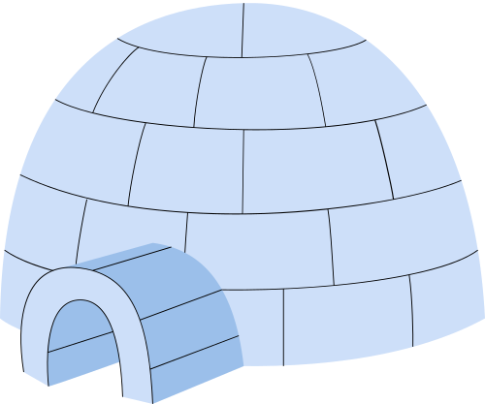
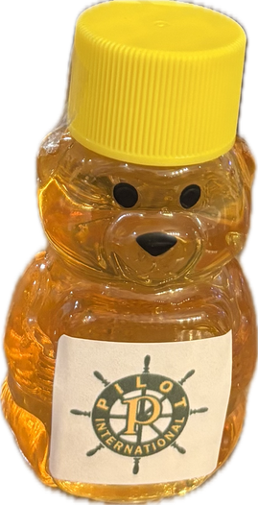
NEPOT ~ JANUARY
Governor Gina Monteleone

Slide 2

NEPOT SPRING CONVENTION
APRIL 10-12 (FRI.-SUN.) 2026
HOLIDAY INN EXPRESS
STONY BROOK, NY
$150 PER NIGHT

Slide 3
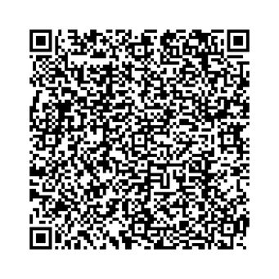
REGISTRATION ~ ZEFFY
HOTEL RESERVATIONS
3 WAYS TO RESERVE:
#1
Will be shared after the
DAC’s mid-year meeting on
February 7th.
CLICK HERE
#2
#3
call 1 800 HOLIDAY
ASK FOR THE BLOCK
GMR

Slide 4

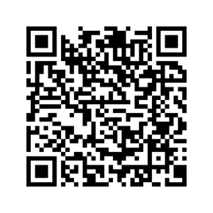
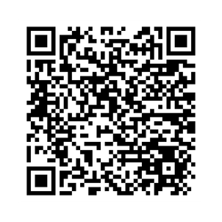
PI CONVENTION
JULY 12TH - 19TH
OKLAHOMA CITY, OK
REGISTRATION
CLICK HERE
HOTEL RESERVATION
CLICK HERE

Slide 5
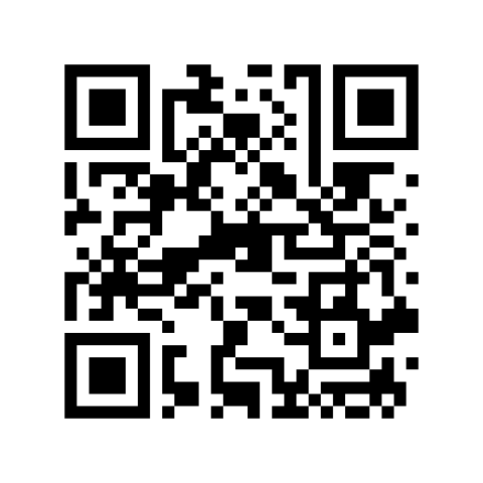
PLANNING ON PI CONVENTION
Use the QR code if you are attending the PI Convention.
or
CLICK HERE

Slide 6
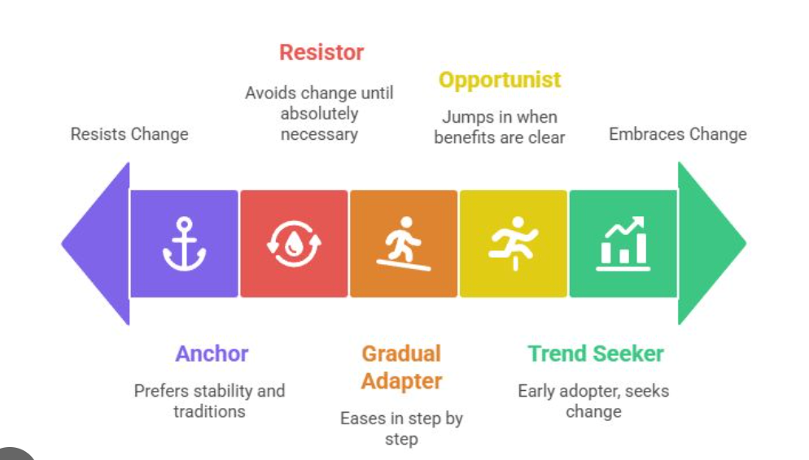
ADAPTABILITY QUOTIENT CONNECTION
Your AQ Connection is about how quickly and effectively you adjust to people’s differences.
Can you pivot and change where needed in order to work with a wide range of people?

Slide 7
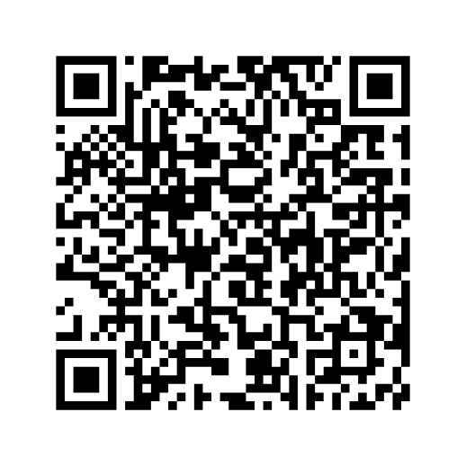
YOUTUBE VIDEO ~ AQ
CLICK HERE
AQ PROFILE TEST
CLICK HERE

Slide 8
YOUR GOVERNOR’S RESULTS
C O R E
1. ___ 2. ___ 3. ___ 4. ___
7. ___ 6. ___ 5. ___ 8. ___
13.___ 11.___ 9. ___ 10.___
15.___ 16.___ 12.___ 14.___
17.___ 18.___ 20.___ 19.___
TOTAL C =___ TOTAL O =___ TOTAL R =___ TOTAL E =___
TOTAL C+O+R+E X 2 = ARP SCORE =________
Total C 17
Total O 16
Total R 14
Total E 15
62 x 2 = 124
The average ARP score is 147.5.
What’s your score?

Slide 9
YOUR AQ RESPONSE IS COMPRISED OF FOUR CORE DIMENSIONS. UNDERSTANDING THEM IS THE FIRST STEP TOWARD IMPROVING YOUR RESPONSE TO ADVERSITY, EXPANDING YOUR CAPACITY, AND, ULTIMATELY, INCREASING YOUR OVERALL AQ.
  C = Control
  O = Ownership
  R = Reach
  E = Endurance
REACH
Keeping the fallout under control and limiting the reach of adversity is essential for efficient and effective problem solving. Those with higher AQs keep setbacks and challenges in their place, not letting them infest the healthy areas of their work and lives. Those with lower AQs tend to catastrophize, allowing a setback in one area to bleed into other, unrelated areas and become destructive.

Slide 10
THANK YOU

