Slide 1
Social anxiety vs. Personality Disorder Vs. AsPerger’s Syndrome
Nolan Blanchard
Ross University School of Medicine

Slide 2
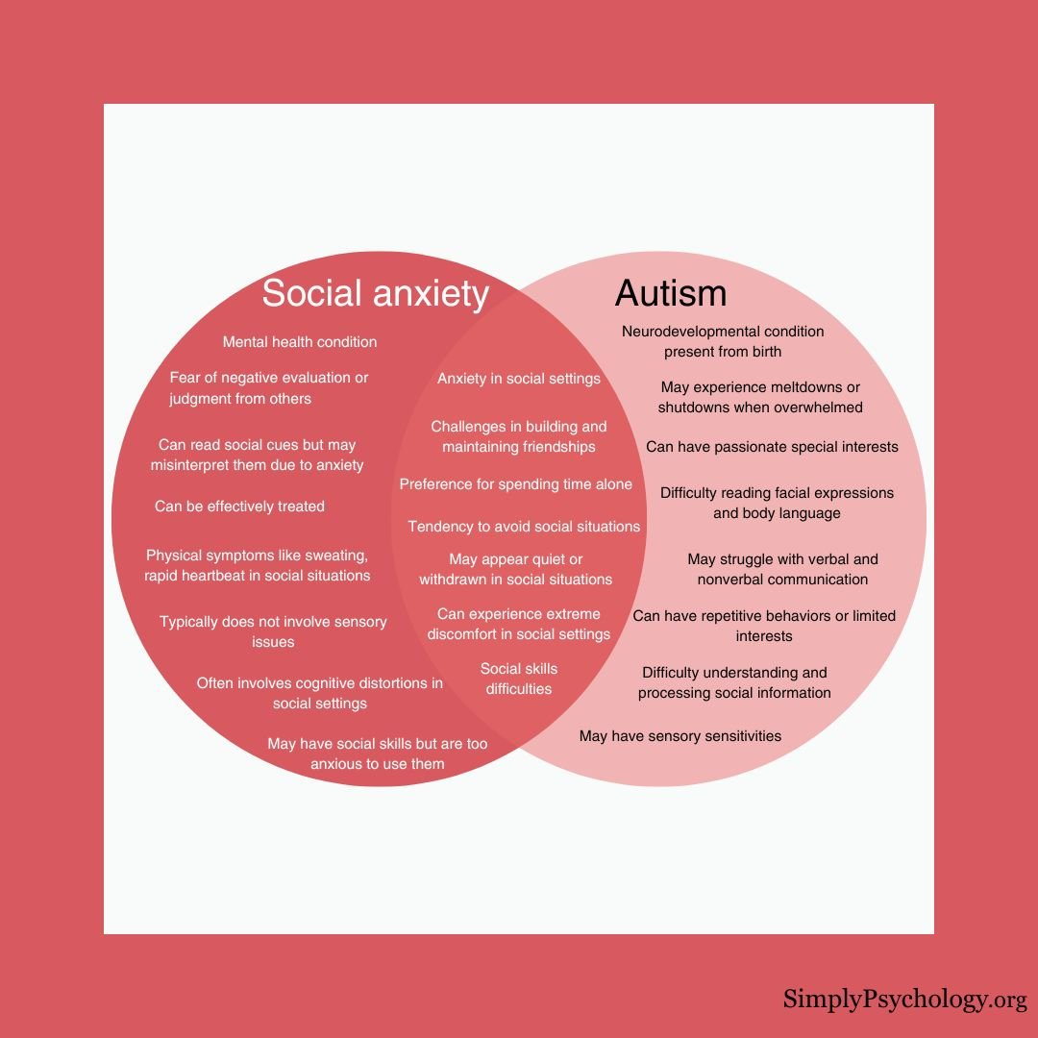
Social Anxiety (SAD)
Definition: Intense anxiety or fear of being judged, negatively evaluated, or rejected in a social or performance situation.
Diagnostic clues/what to look for:
Anxiety while having a conversation, meeting unfamiliar people, being observed eating, or giving a speech in front of others
Feeling that you will be humiliated or embarrassed by your actions or physical anxiety symptoms
Avoiding social situations
Having impairment in social, occupational, or other important areas

Slide 3
Asperger’s Syndrome
Definition: Asperger’s is a form of autism spectrum disorder where patients may have a hard time relating to others socially, perform repetitive behaviors, and have a narrow range of interests
Children with Aspergers may perform well in school without having intellectual or language difficulties, but can have trouble socially like understanding body language, humor, and sarcasm
Diagnostic clues/what to look for:
Not using or understanding nonverbal communication, such as gestures, body language, and facial expression
Having conversations that only revolve around themselves or a certain topic
Speech that sounds unusual, such as flat, high-pitched, quiet, loud, or choppy
An intense obsession with one or two specific, narrow subjects
Performing repetitive behaviors or repeated routines and having difficulty with change

Slide 4
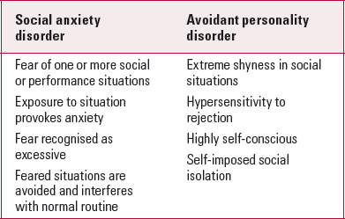
Avoidant Personality Disorder (AVPD)
Definition: Avoidant personality disorder is described as having a widespread pattern of social anxiety, extreme sensitivity to rejection, and feelings of inadequacy, but with a strong underlying desire for companionship.
Diagnostic clues/what to look for:
Avoidance of social, interpersonal, and occupational activities that involve frequent contact due to an underlying fear of criticism, disapproval, or rejection.
Low self-confidence. Unwillingness to become involved with new or intimate relationships
Avoidant personality disorder involves avoidance of most or all social areas of life, while social anxiety may only involve avoidance of a few specific situations like giving a speech.
AVPD is thought to be linked to a belief of inadequacy where as people with SAD often realize that their anxiety is disproportionate to the situation.
* There is significant overlap between SAD and AVPD and they commonly occur together

