Slide 1
Treatment-Resistant Depression (TRD) Options and Post Partum Depression (PPD)
By John Nobles, MS4
Ross University School of Medicine
2025

Slide 2
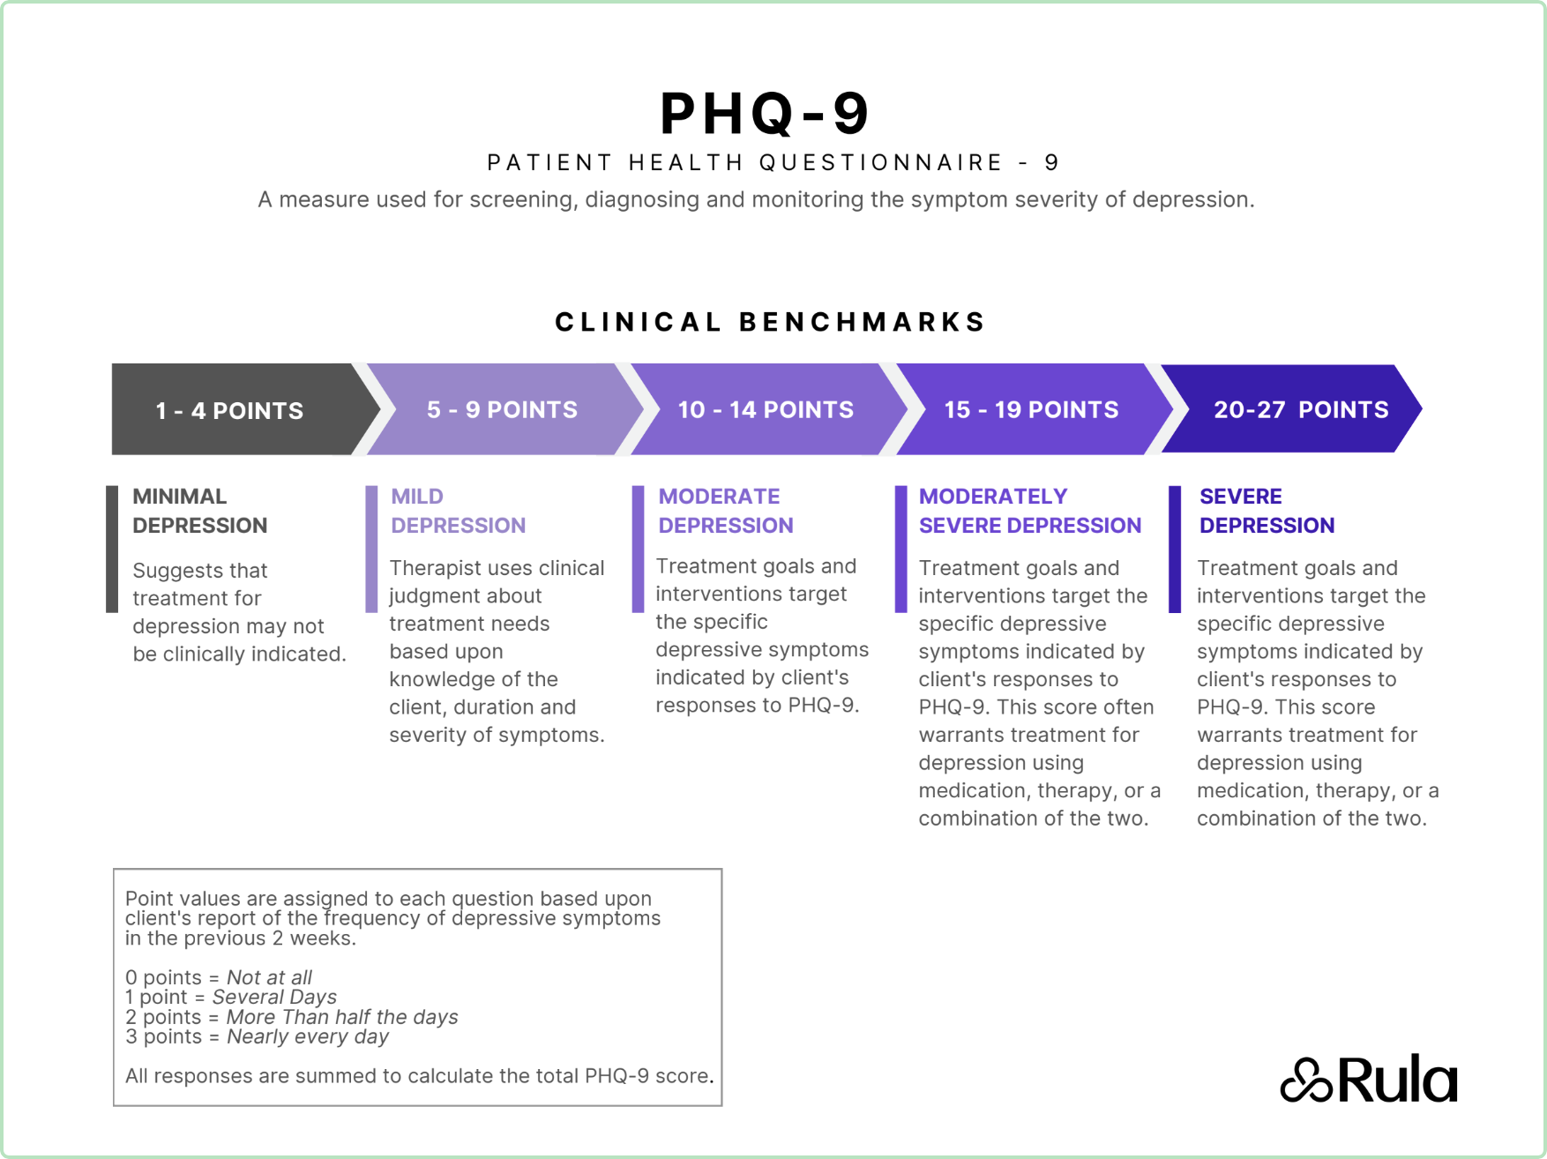
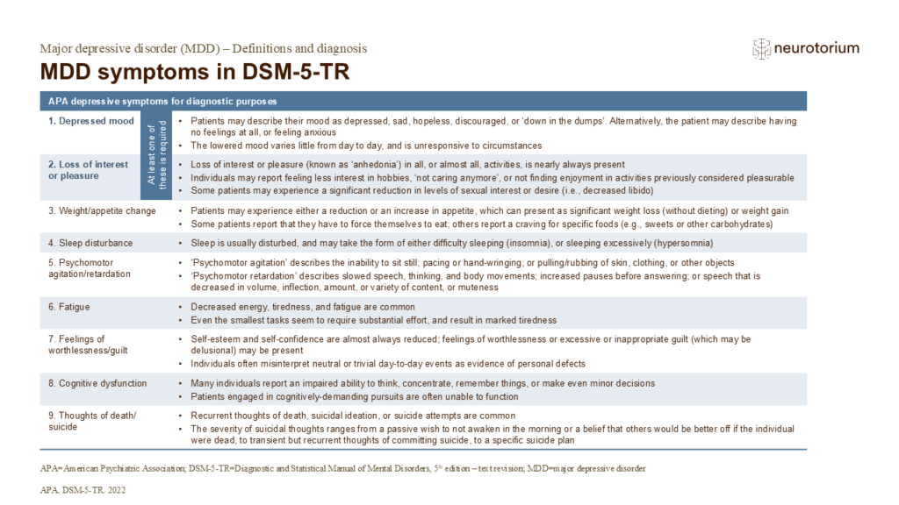
Major Depressive Disorder (MDD)
Divided into levels of severity with differing standards of care:
Mild: low intensity psychosocial care and lifestyle changes
Moderate: CBT/IPT/behavioral acitivation or a antidepressant based on patient preference, pregnancy status, and past response.
Severe: Start antidepressant treatment and psychotherapy.

Slide 3
Treatment-Resistant Depression
A clinical diagnosis that is considered when failure to achieve a satisfactory response after at least two adequate trials of antidepressants from different classes, each at:
Adequate dosage
Adequate duration
With confirmed adherence
Different staging models of TRD include Thase and Rush and STAR*D models.
Thase and Rush model is from Stage 0 to Stage 5 as you escalate from no adequate treatment to failure of 1 medication, 2 medications from different classes, failure of 2 medications from different classes plus augmentation failure, failure of 2 medications from different classes plus 2 augmentation failures, and finally failure of ECT after all the above.

Slide 4
A treatment guideline
1. Check for Partial Response and confirm adequate trial of first-line antidepressant
2. Optimize dose/duration & adherence
3. Psychotherapy & lifestyle integration
4. Switch within or between classes including SNRIS, atypicals, and triple action.
5. Augmentation strategies (non-antidepressants)
6. Neuromodulation & advanced therapies
7. Consider Esketamine/ECT/TMS for severe cases

Slide 5

Telling me there is a chance..? Partial Response?
Follow up with patient in around 2 weeks and see if there is a partial response.
If yes, evaluate whether you should increase to the therapeutic dosage or follow up with the patient in 2-4 weeks.
If no partial response, you can either continue the trial of the medication, increase to the therapeutic dosage, or decide to switch to a different antidepressant.
Continue close monitoring of patient as their highest risk of suicide when starting or changing medications is in the first few weeks.
Remember,

Slide 6

If at First You Don’t Succeed…..
Switching Antidepressants should be considered if side effects are intolerable or if there is no symptom relief on a therapeutic dosage.
Switching to a medication that can target multiple disorders or better address atypical symptoms is also a option.
Pros:
- May respond to different mechanism of action, SNRI vs SSRI vs atypical
- Simple change if side effects are intolerable
Cons:
- Delayed response time (4–6 weeks)
- Risk of discontinuation syndrome
- Trial-and-error process

Slide 7

Let’s Talk it Out!
Psychotherapy (CBT, IPT, etc.) can help the patient develop coping mechanisms and is considered the gold standard of care with/without antidepressant medication.
Pros:
- Evidence-based, effective especially with meds
- Improves coping & relapse prevention
- No systemic side effects
Cons:
- Access may be limited
- Time-intensive
- Requires patient engagement

Slide 8

The Hard To Do Stuff
Lifestyle & Integrative Approaches
Works better as a treatment for mild depression or as an adjuvant.
In parts of the world this is considered first line treatment for those with mild depression.
Examples: Exercise, sleep hygiene, omega-3, mindfulness
Pros:
- Broad health benefits
- Empowering, patient-driven
Cons:
- Modest standalone efficacy
- Requires adherence & motivation

Slide 9

If One isn’t enough, try two medications.
Augmentation:
Atypicals
Antipsychotics
Examples: Aripiprazole, Quetiapine,
Brexpiprazole
Pros:
- FDA-approved adjuncts for MDD
- Often effective in resistant cases
Cons:
- Metabolic side effects (weight gain, diabetes)
- EPS/akathisia risk
- Cost considerations

Slide 10

Lithium If You Must
Augmentation:
Lithium
Pros:
- Evidence-based augmentation strategy
- Reduces suicidal risk
Cons:
- Requires blood monitoring
- Risk of renal/thyroid toxicity
- Side effects (tremor, weight gain)

Slide 11

Sometimes newer is better
Newer Antidepressants (Triple-Action)
Examples: Vortioxetine, Vilazodone
Mechanism:
- Target serotonin, norepinephrine, and dopamine pathways
Pros:
- Broader neurotransmitter coverage
- Vortioxetine may improve cognition
- Generally well tolerated
May have less sexual side effects.
Cons:
- Expensive
- Limited long-term data
- GI side effects (nausea

Slide 12
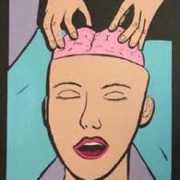
Let Me Massage Your Brain
Transcranial Magnetic Stimulation (TMS)
Pros:
- Non-invasive, fewer side effects than meds
- Outpatient procedure
Cons:
- Daily sessions for weeks
- Not universally effective
- Cost/insurance barriers

Slide 13
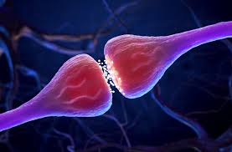
Here For a Good Time and a Long Time
Esketamine (Nasal)
Pros:
- FDA-approved for TRD
- Rapid reduction in depressive symptoms &
suicidality
Cons:
- Requires in-clinic administration
- Dissociation, BP increases
- Expensive

Slide 14
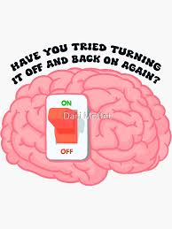
Have You Tried Turning it Off and On Again?
Electroconvulsive Therapy (ECT): 1st line treatment for patients with severe risk of suicide or with psychotic features, with severe functional impairment or refusal of food/fluids, or severe depression with catatonia.
Pros:
- Highly effective, especially for severe TRD & suicidality
- Rapid onset of effect
Cons:
- Requires mild anesthesia, usually done in a hospital.
- Memory/cognitive side effects
- Stigma & accessibility issues

Slide 15

Treatment of TRD in a pregnant patient:
Pick agents with best pregnancy safety data such as sertraline which is favorable even in breastfeeding as well.
If on tolerated meds, weigh maternal benefits vs fetal risk with many augmentation medications having unsure or increased risk for the fetus. This includes lithium, atypical antipsychotics, and T3.
Best evidence rapid option is ECT and is explicity recommended in pregnancy when indicated.
rTMS has growing evidence of safety and efficacy in pregnancy and is a reasonable option.
Plan postpartum care and treatment.

Slide 16

Post Partum Depression
Stems from a combination of hormonal changes, genetic predisposition, and environmental factors, yet up to 50% of cases remain undiagnosed due to the stigma surrounding the condition and patients' reluctance to disclose symptoms
Longer than the Post Partum Blues and the DSM classifies it as a major depressive episode that begins during pregnancy or within 4 weeks after delivery.
Before new FDA approved medications, SSRIs and SNRIs were prescribed off label but were not FDA approved.
Two new medications have been FDA approved for treatment of PPD:
Brexanolone (Zulresso) which is an continuous IV infusion over 60 hours and Zuranolone (Zurzuvae) which is a oral 14-day course.
Both are neuroactive steroids that mimic allopregnanolone and act as GABA-A receptor positive allosteric modulators enhancing the effects of GABA and reducing neuronal excitability.
It is theorized that the rapid drop in allopregnanolone after delivery may contribute to PPD.

Slide 17
Thank You

