Slide 1

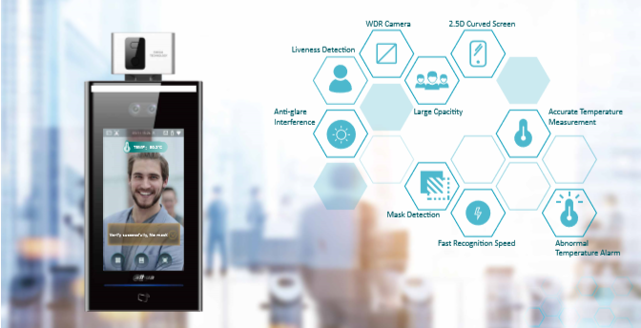

Slide 2
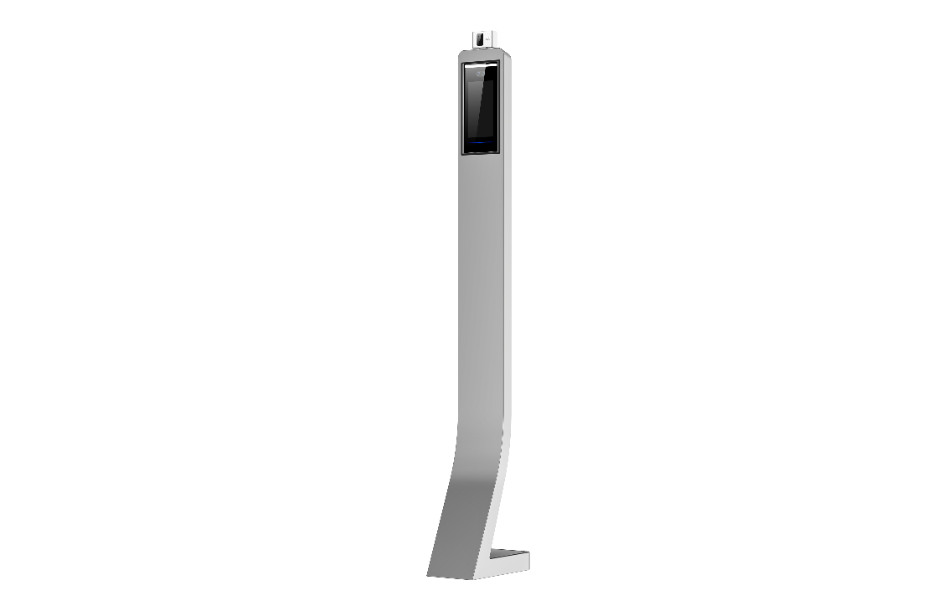
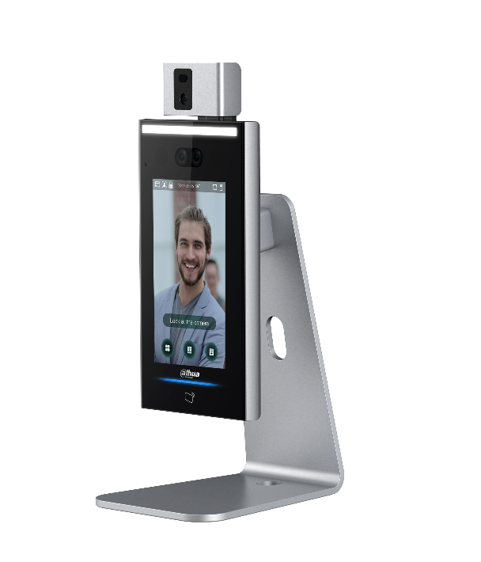
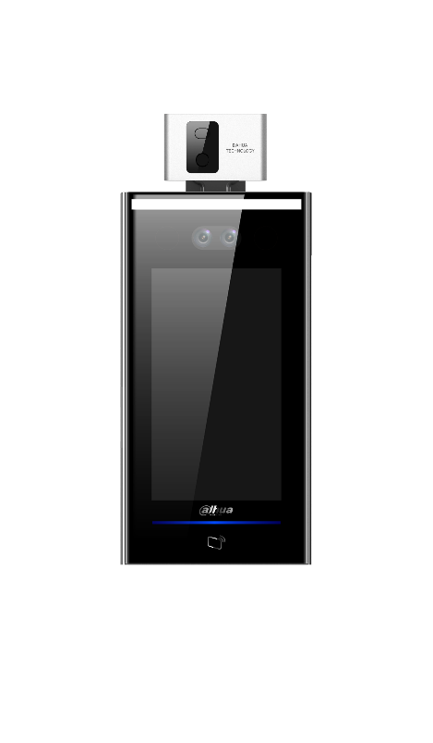
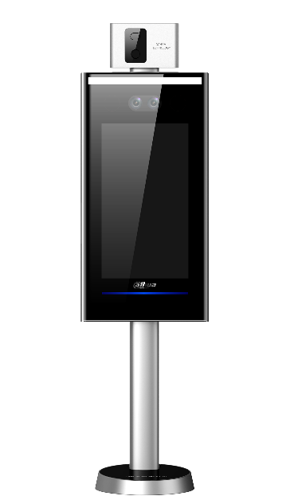
Product selection
Floor stand mount
Desk mount
Work with turnstiles
Wall mount
Solution video
https://www.youtube.com/watch?v=uUSPi8ZTDys

Slide 3
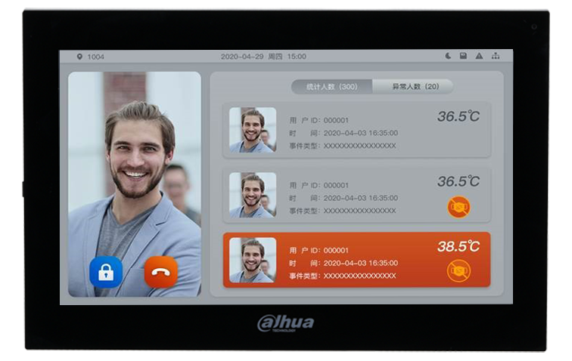
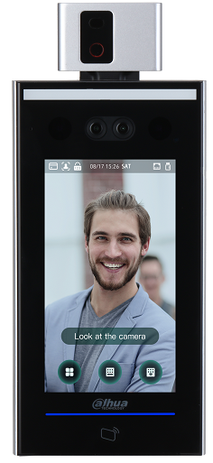
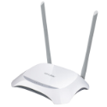
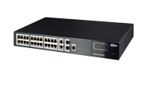
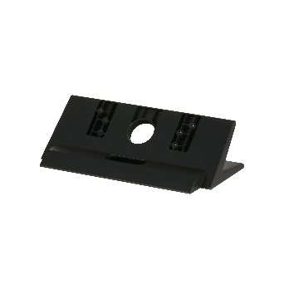

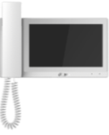
Access Control & Temperature Monitoring System Architecture
<Cat 5e>
All terminal model
Show detect result on VTH monitor
VTH5341G-W
10” Capacitive
Android 8.1
Standard POE WiFi
VTH5421E(W)-H
7” Capacitive
Handset
Standard POE WiFi
VTM23
Desktop Mounted Bracket
Real-time surveillance
Real-time personnel information and alarm
(high temperature ) display
Remote door release

Slide 4
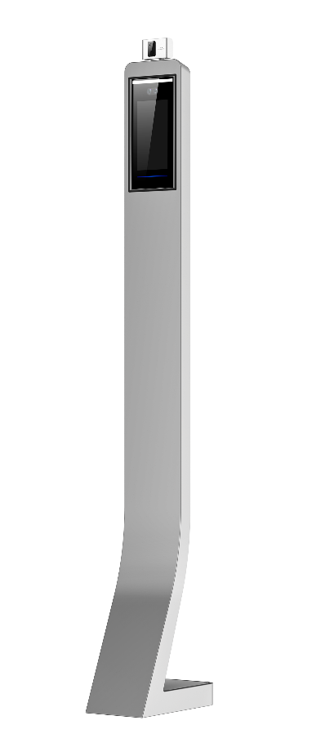
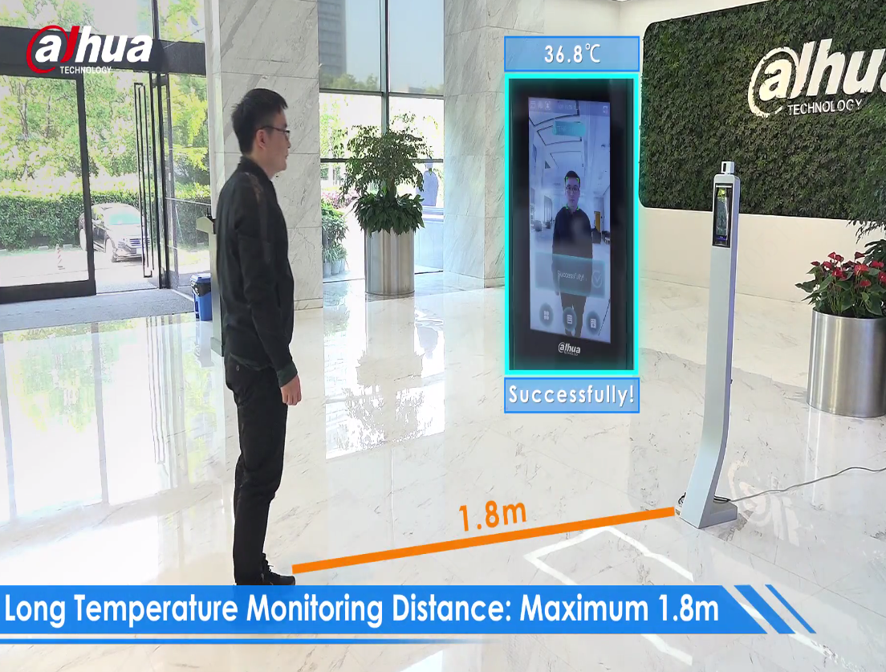
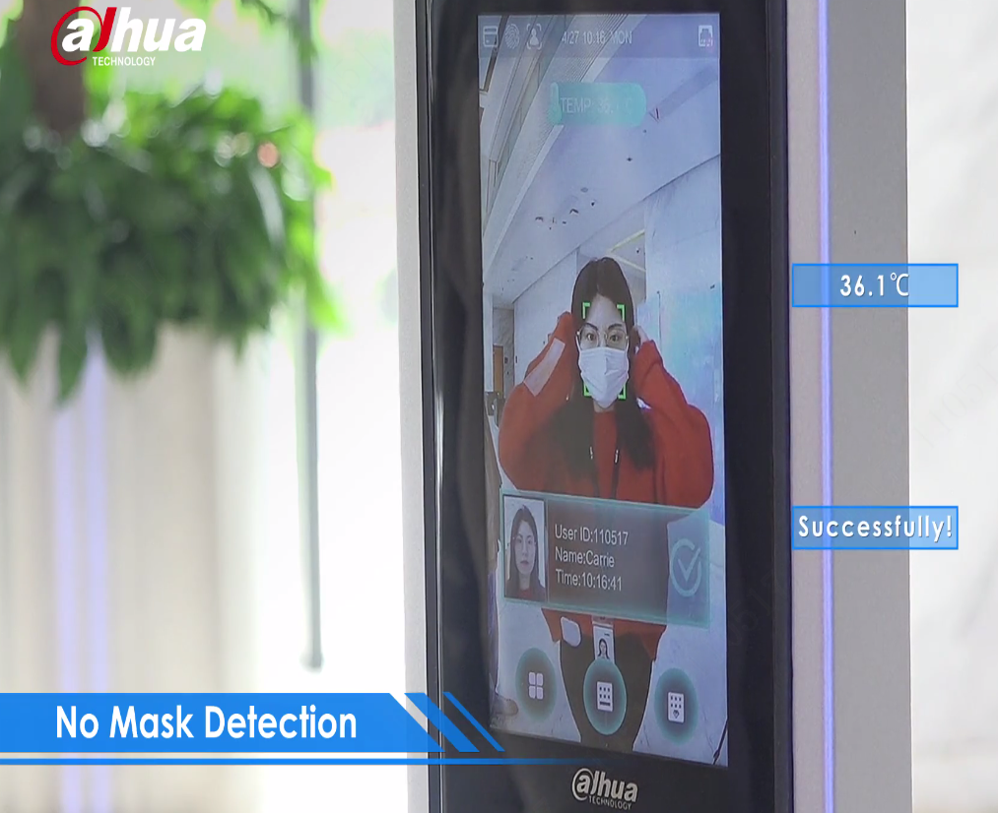
Floor Stand Solution
7-inch touch screen
Ambient temperature range ：16°C~32°C
Temperature accuracy: ≤0.5℃
Temperature monitoring distance：0.3m ~ 1.8m
Sound prompt: Temperature abnormal alarm
Unlock Mode: Face/Card/Password
Terminal height: 1.47 meter
Building Entrance
Device BOM：
DHI-ASI7213X-T1 | 1.0.01.25.11065 | Terminal machine
ASF172X-T1 | 1.0.01.25.11069 | floor stand bracket
Notes:
疫情会持续存在

Slide 5


Desktop Solution
7-inch touch screen
Ambient temperature range ：16°C~32°C
Temperature accuracy: ≤0.5℃
Temperature monitoring distance：0.3m ~ 1.8m
Sound prompt: Temperature abnormal alarm
Unlock Mode: Face/Card/Password
Reception Desk
Device BOM：
DHI-ASI7213X-T1 | 1.0.01.25.11065 | Terminal machine
ASF072X-T1 | 1.0.01.25.11087 | Desktop bracket
Notes:
疫情会持续存在

Slide 6
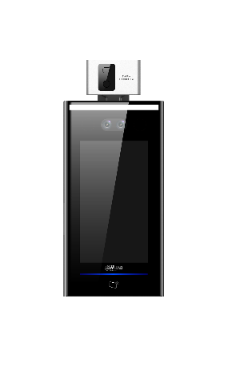
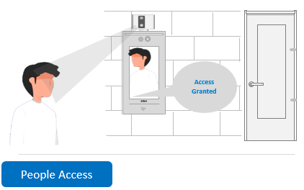
Wall Mount Solution
7-inch touch screen
Ambient temperature range ：16°C~32°C
Temperature accuracy: ≤0.5℃
Temperature monitoring distance：0.3m ~ 1.8m
Sound prompt: Temperature abnormal alarm
Unlock Mode: Face/Card/Password
Wall mount
Device BOM：
DHI-ASI7213X-T1 | 1.0.01.25.11065 | Terminal machine
 | Included in the terminal box | Wall mount bracket
Notes:
疫情会持续存在

Slide 7
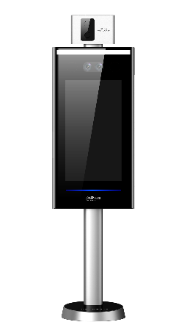
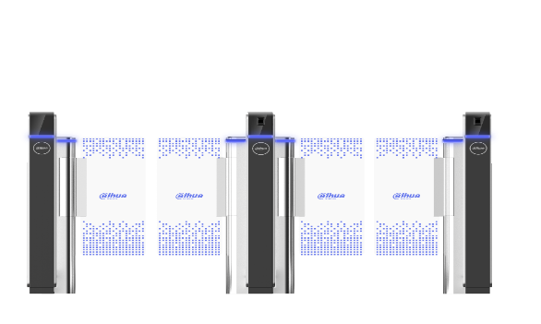
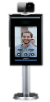
Turnstiles Solution
7-inch touch screen
Ambient temperature range ：16°C~32°C
Temperature accuracy: ≤0.5℃
Temperature monitoring distance：0.3m ~ 1.8m
Sound prompt: Temperature abnormal alarm
Unlock Mode: Face/Password
Turnstiles
Device BOM：
DHI-ASI7223X-A-T1 | 1.0.01.25.11066 | Terminal machine
Notes:
疫情会持续存在

Slide 8
ENABLING A SAFER SOCIETY AND SMARTER LIVING

