Slide 1



we are Aman Enterprises
Aman Enterprises Established in Rudrapur (Uttarakhand) India in the year 2009, we “Aman Enterprises” providing Industrial civil construction services, commercial Construction, building project that including Electrical and interior Works. We are fully aware of the future challenges & we are well equipped to face them through conscious and continuous effort for improvement in service & adopting latest technical known how.
Our team of experts and professional engineers are gaining experience from past many years in the field of civil engineering. we have achieved excellent exposure in civil engineering services by providing complete client satisfaction.
Trust our Experience to Build your Project !
We are the next generation building solutions Ever

Slide 2
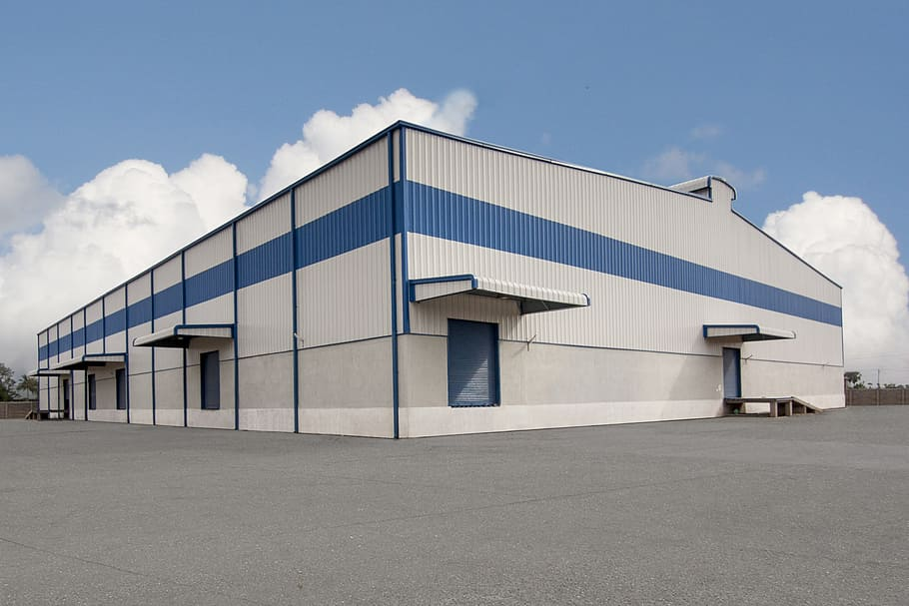
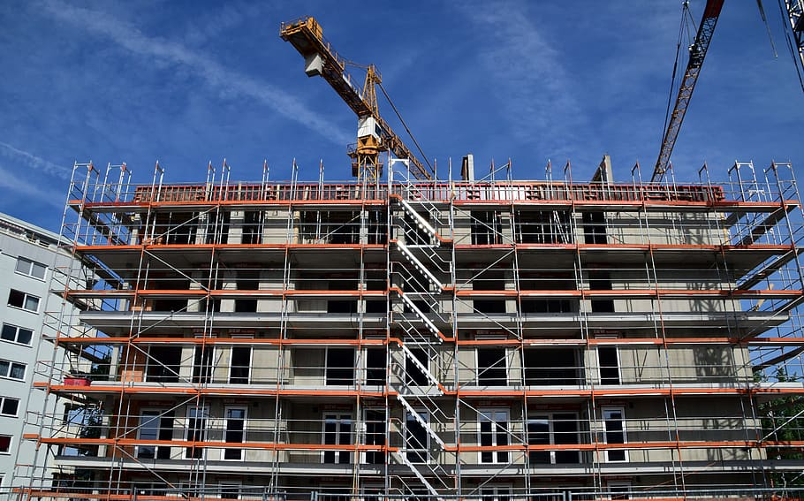
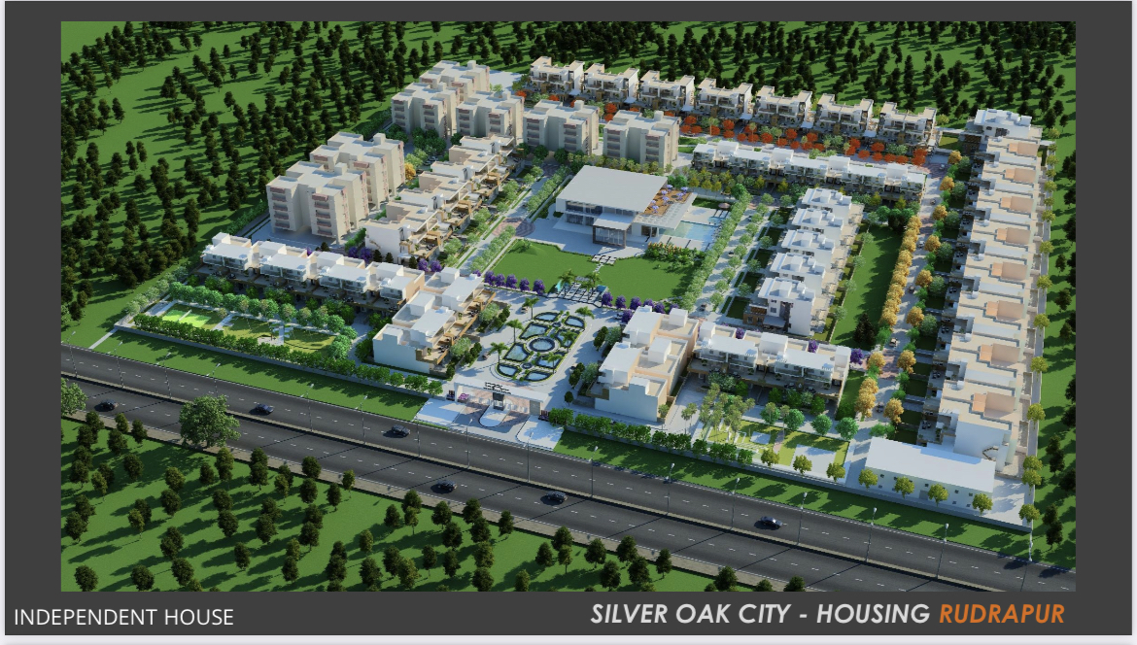
We are expert in three type of construction
industrial construction.
commercial construction
residential construction

Slide 3
INDUSTRIAL PROJECTS

Slide 4
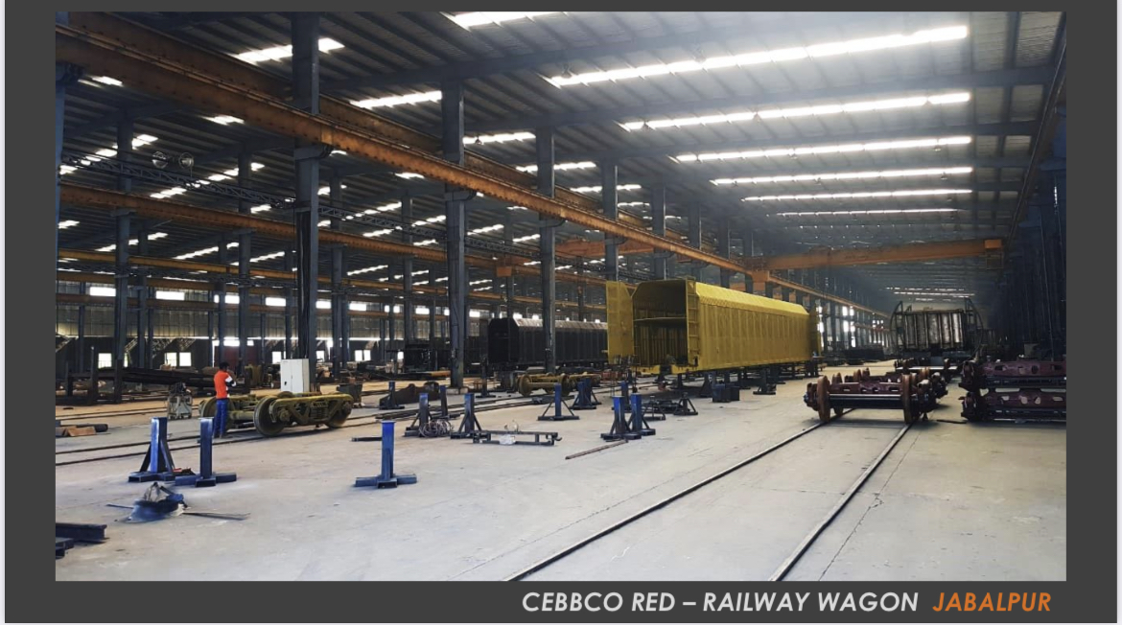
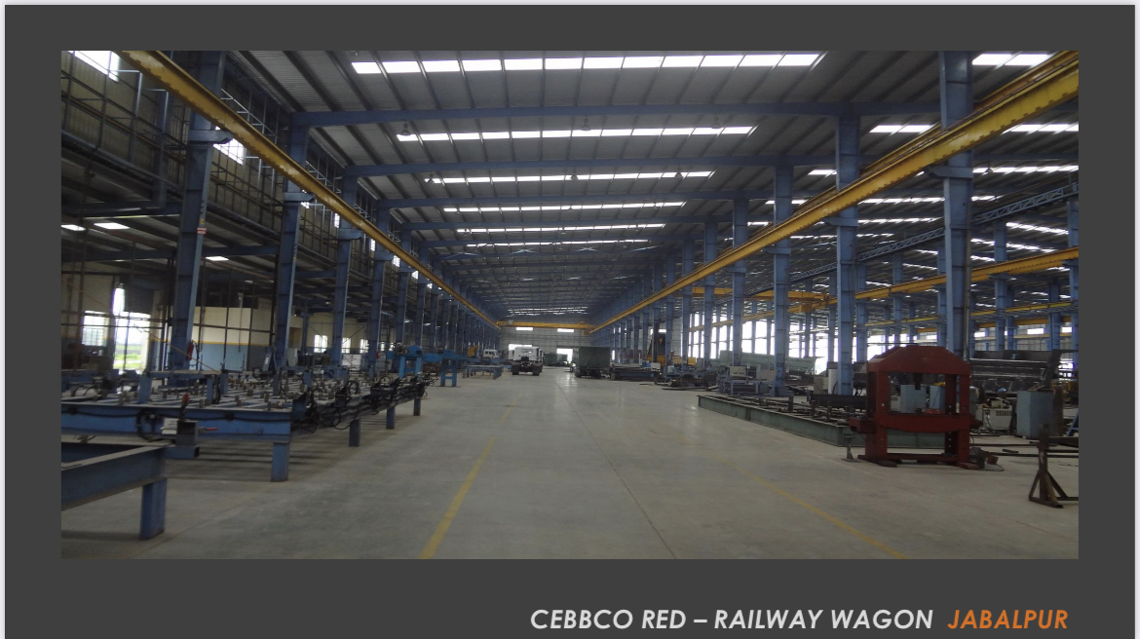
I want to sow some of industrial projects

Slide 5
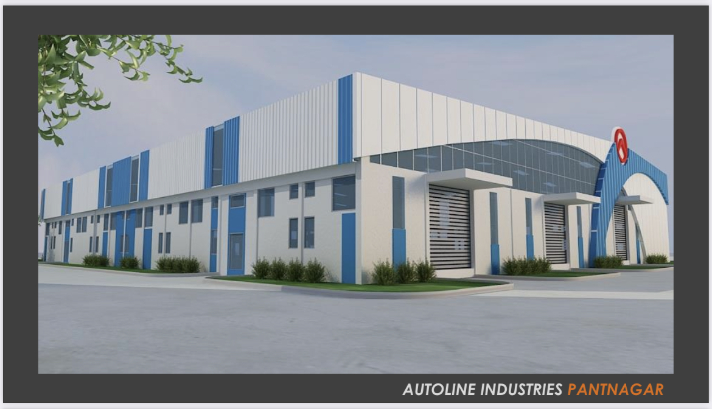
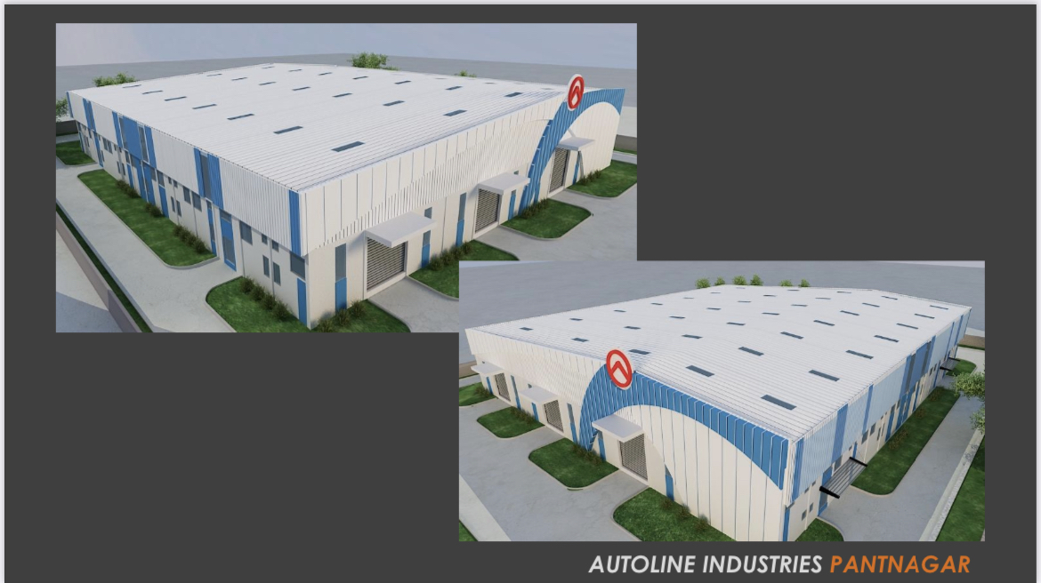

Slide 6
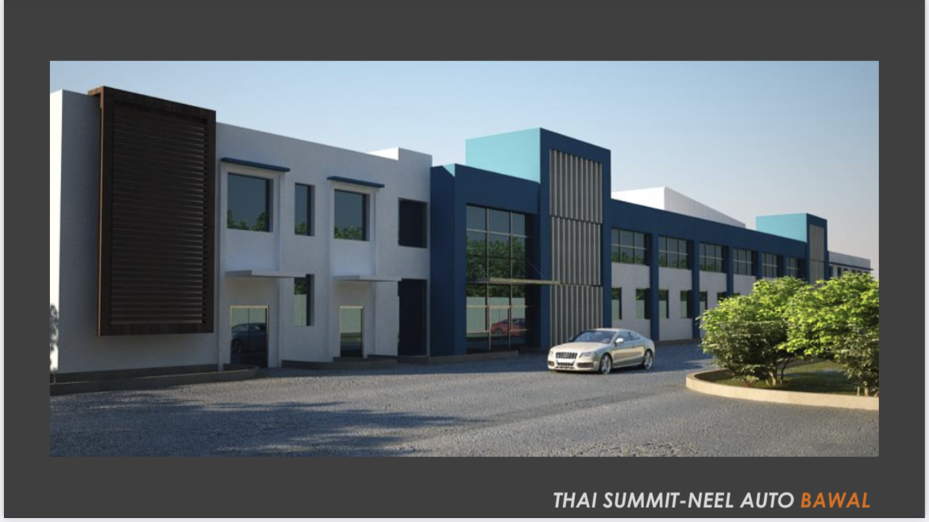
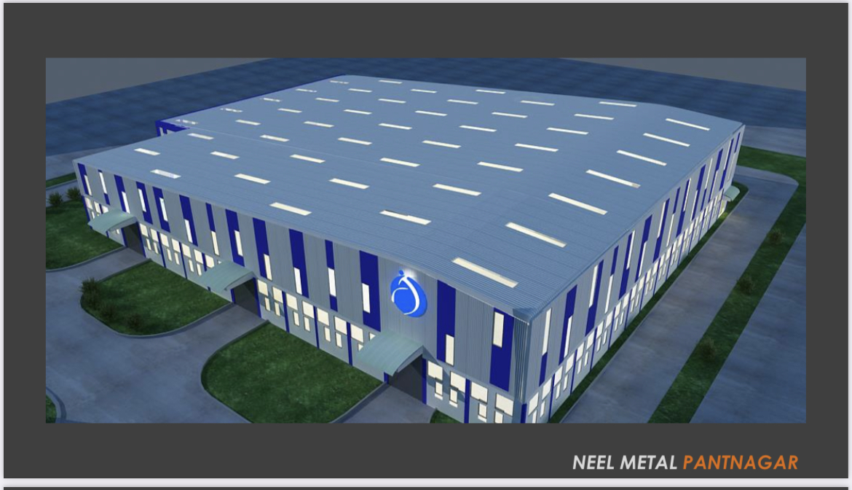

Slide 7
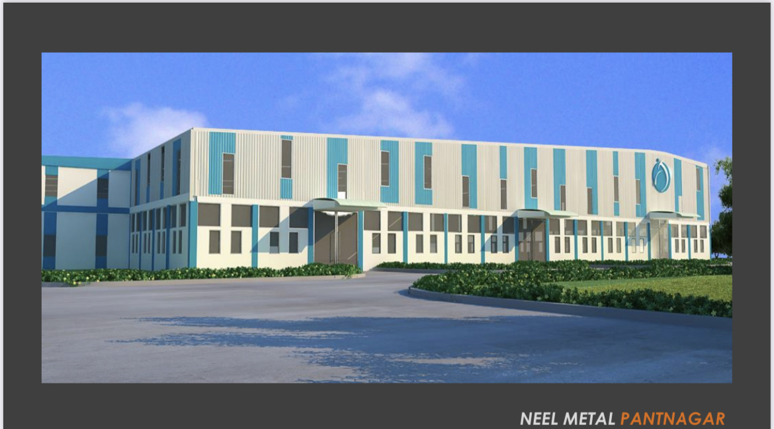
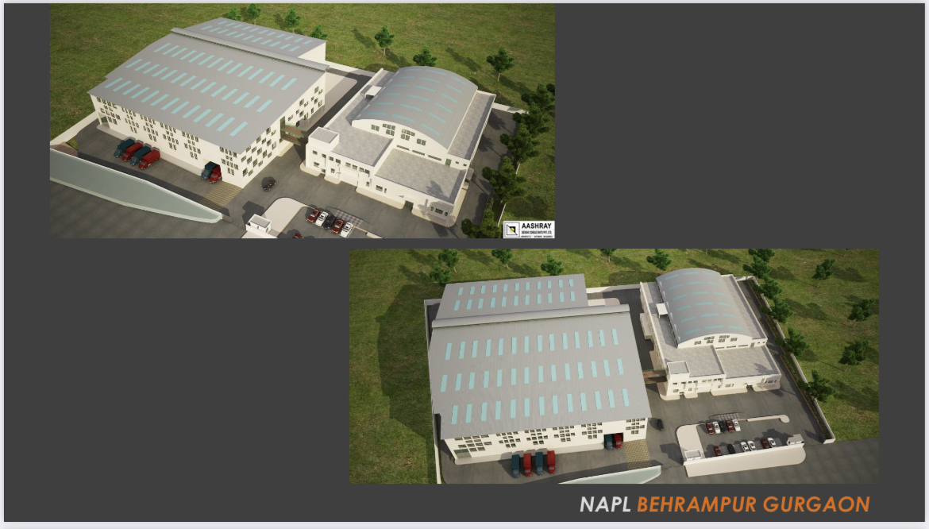

Slide 8
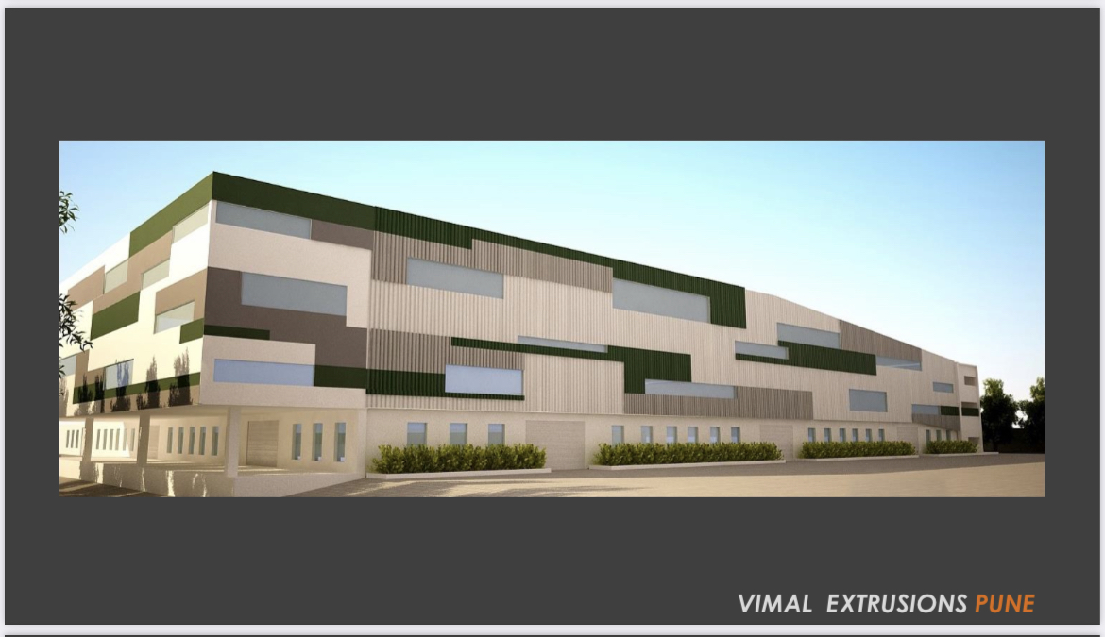
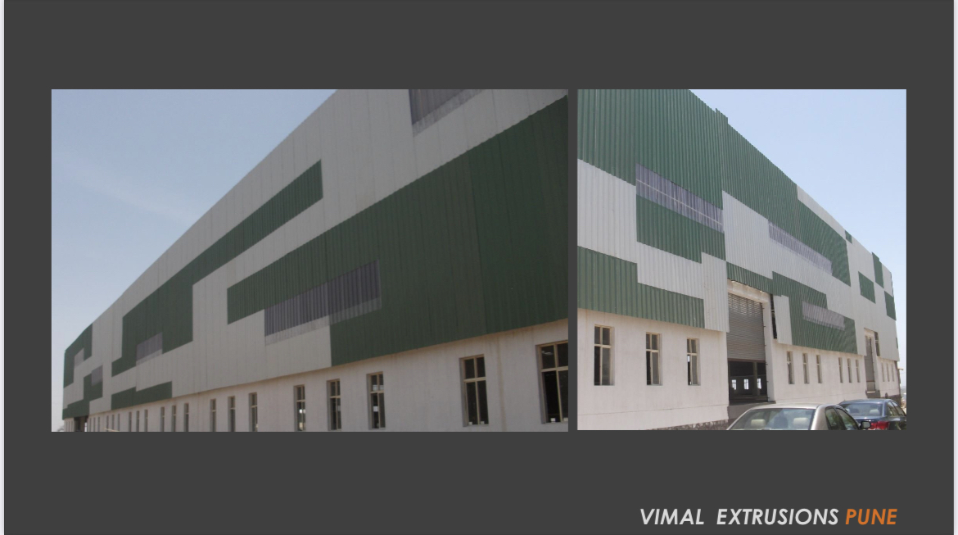

Slide 9
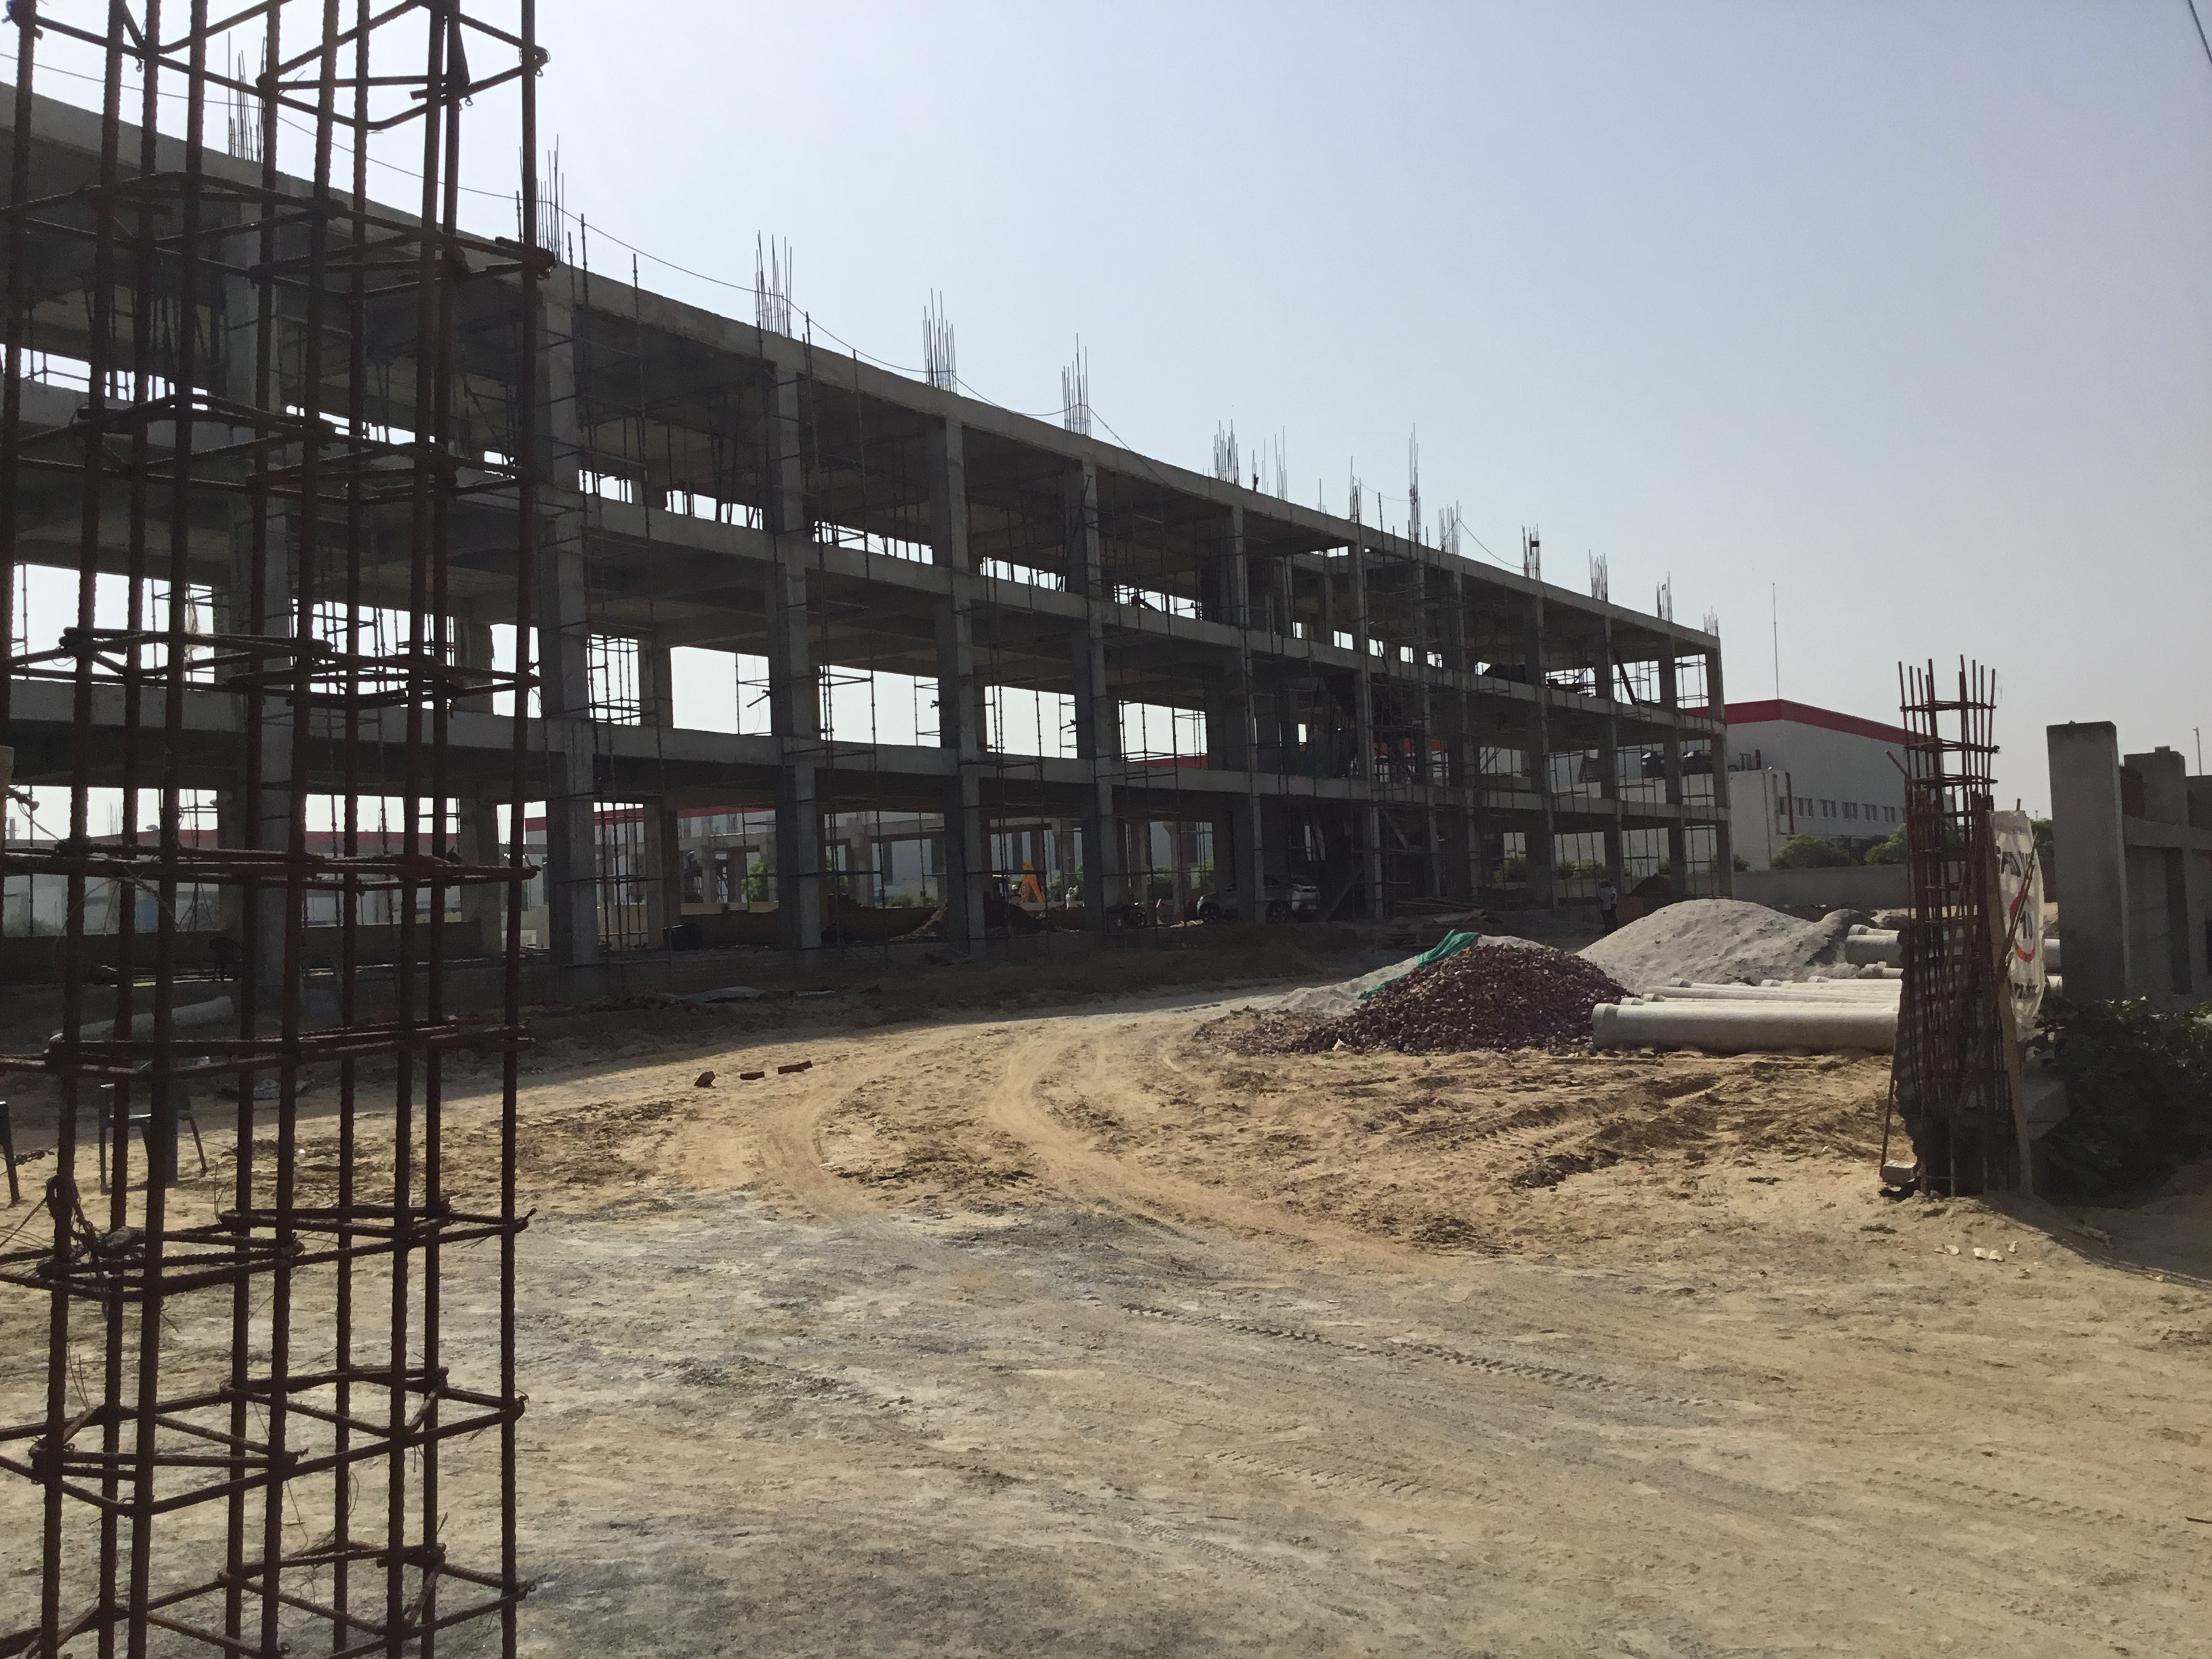
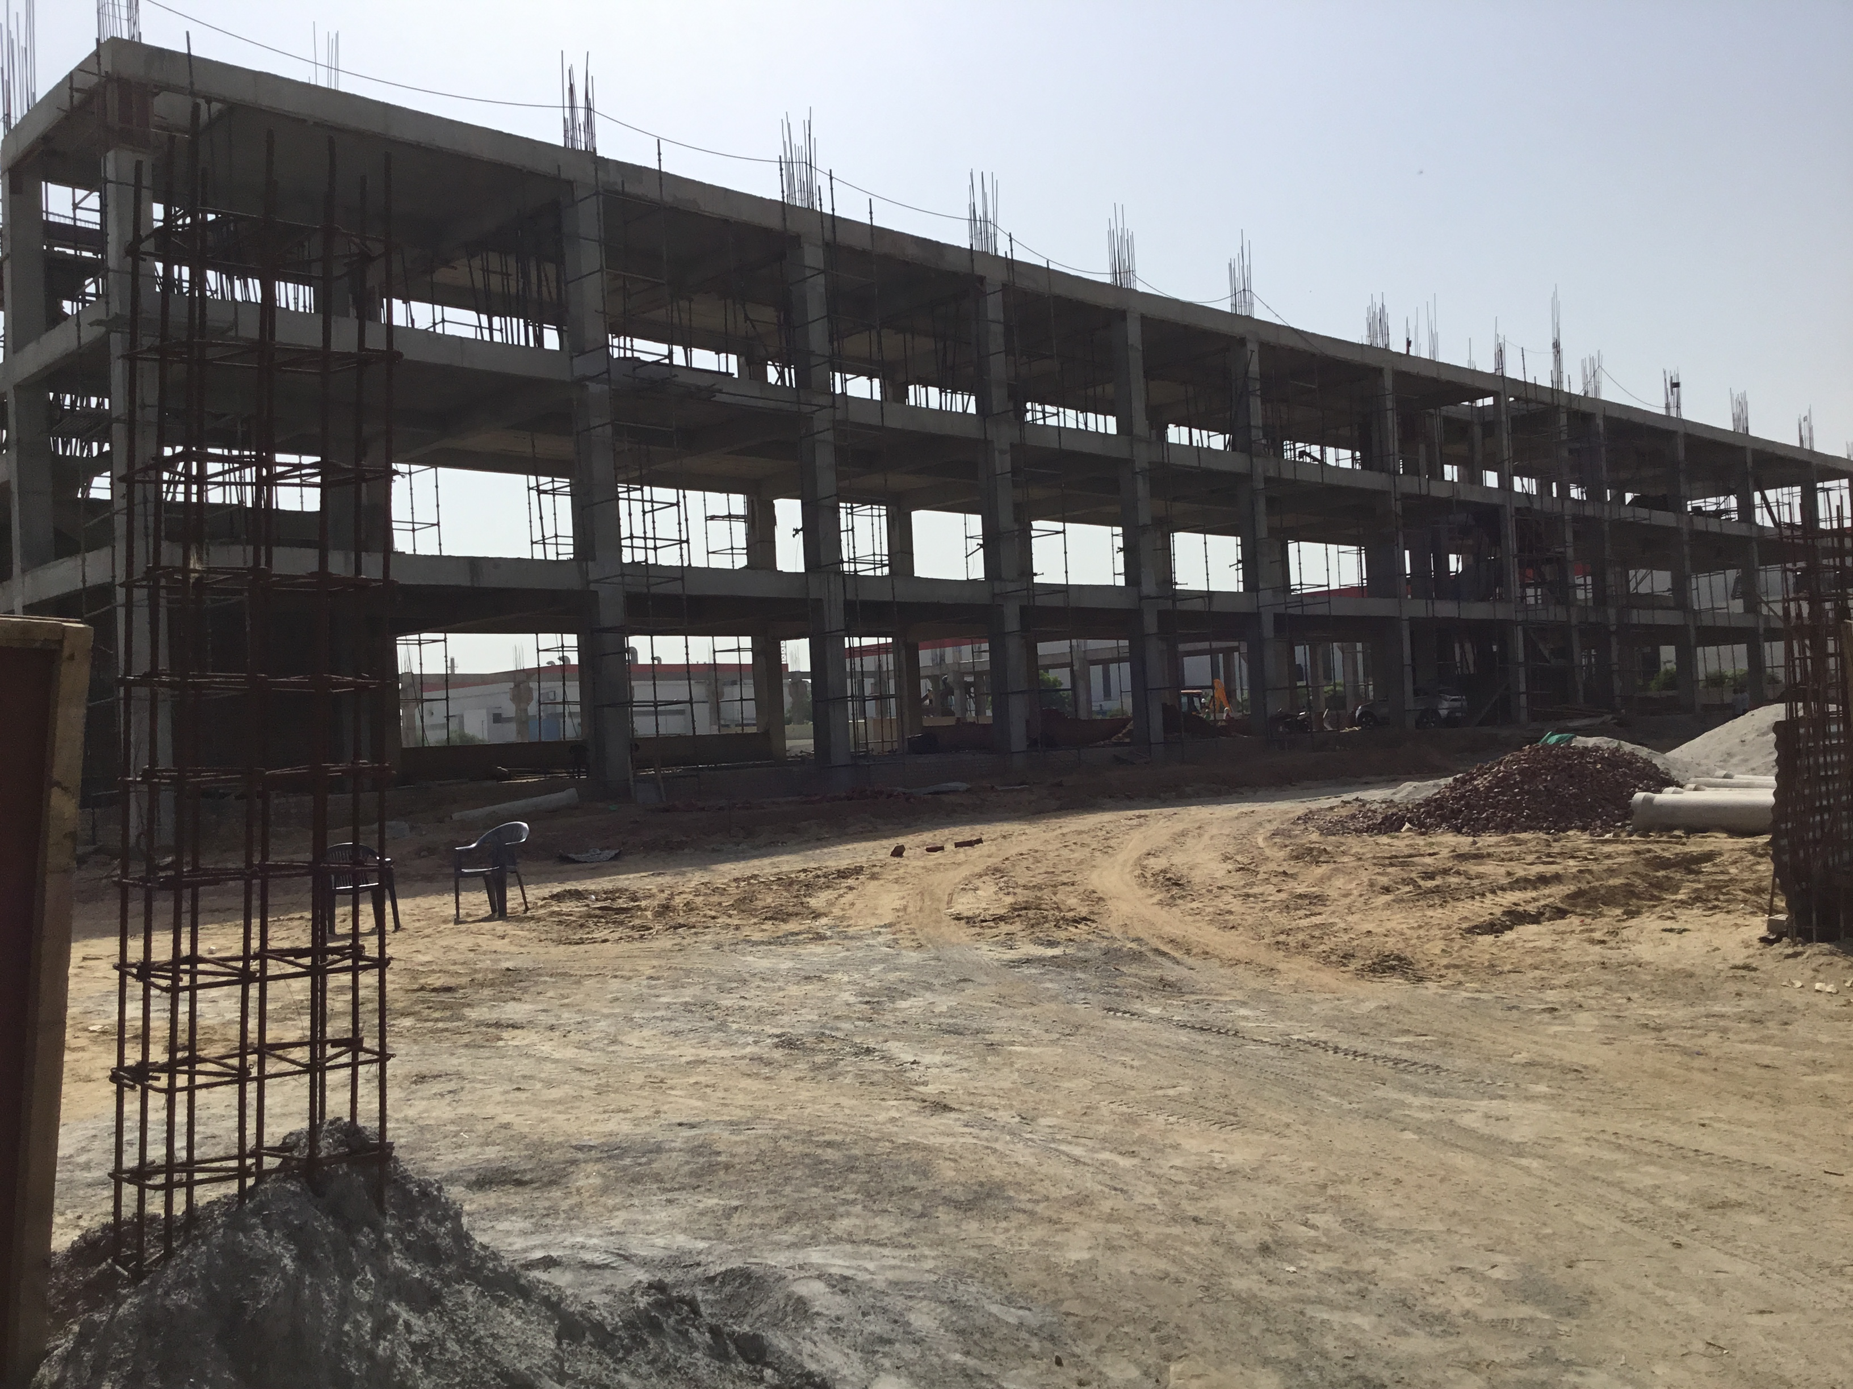
Lumax DK Bawal HR.

Slide 10
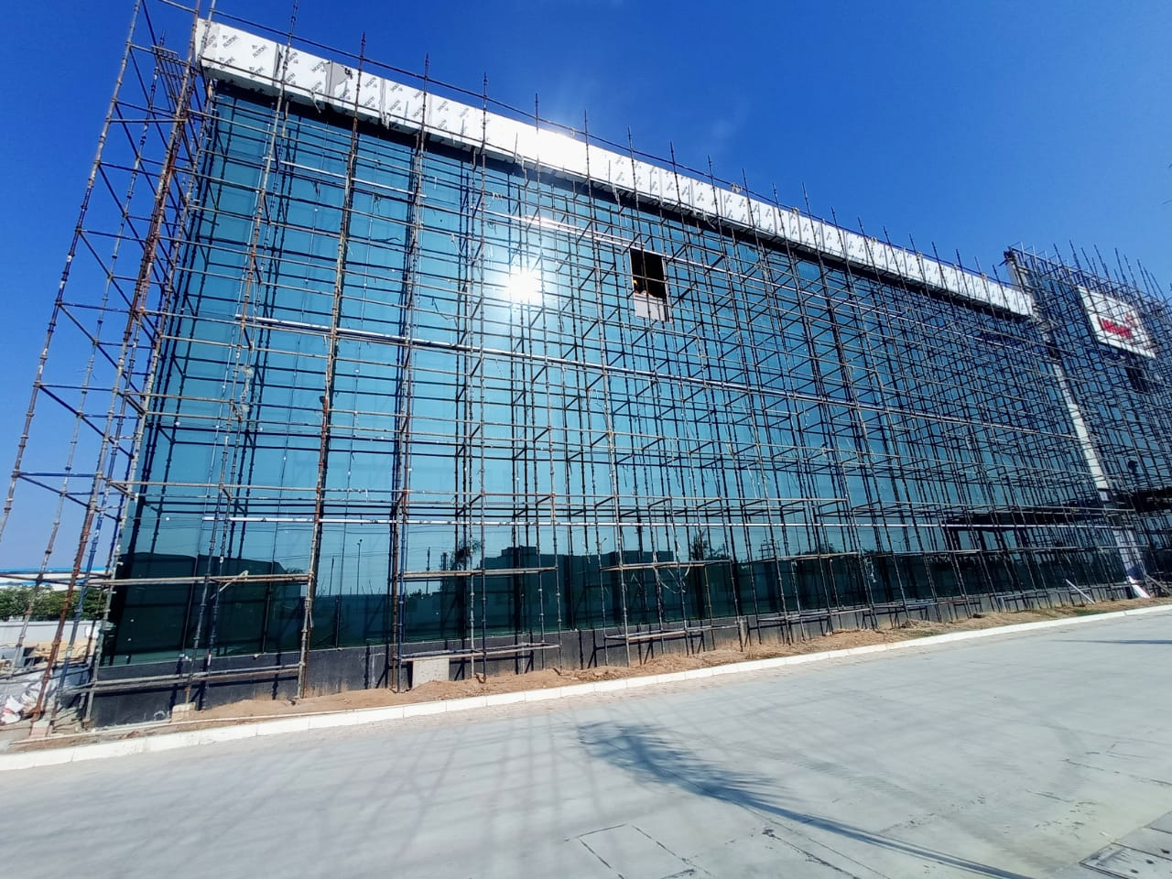
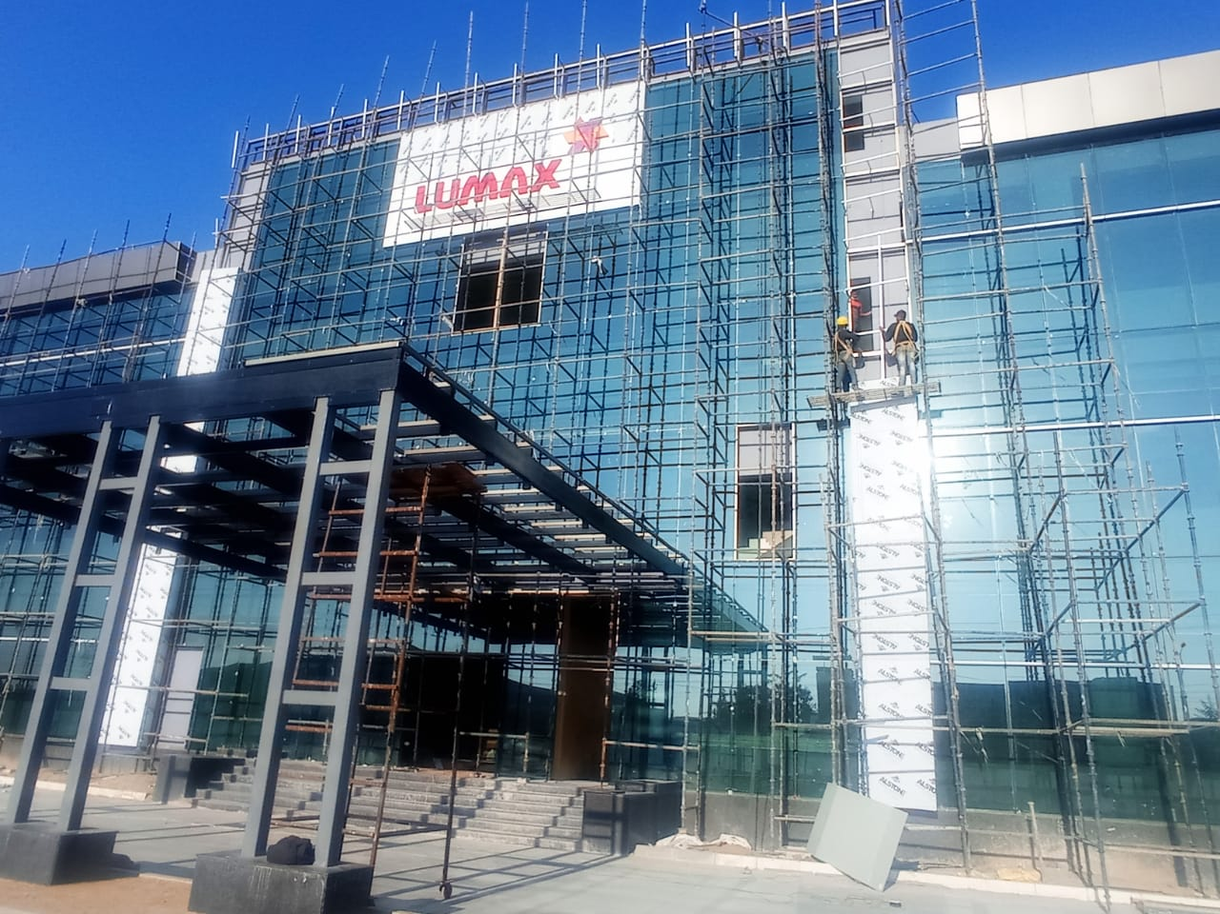
Lumax DK Bawal HR.

Slide 11
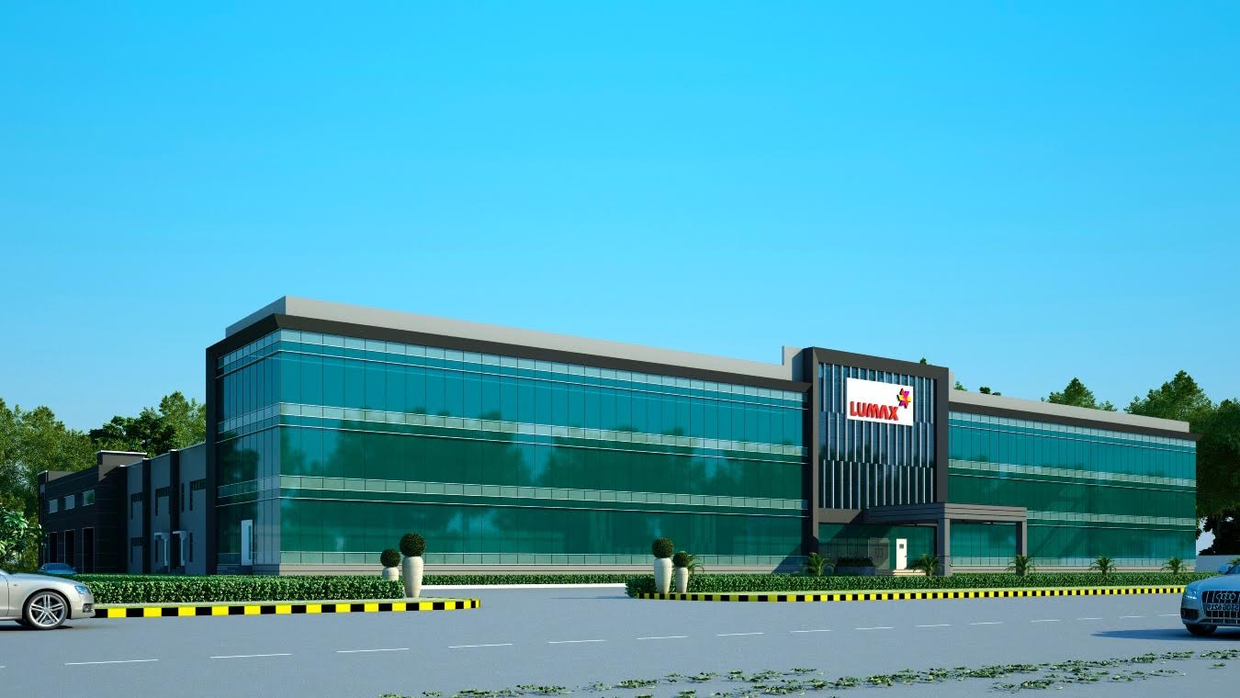
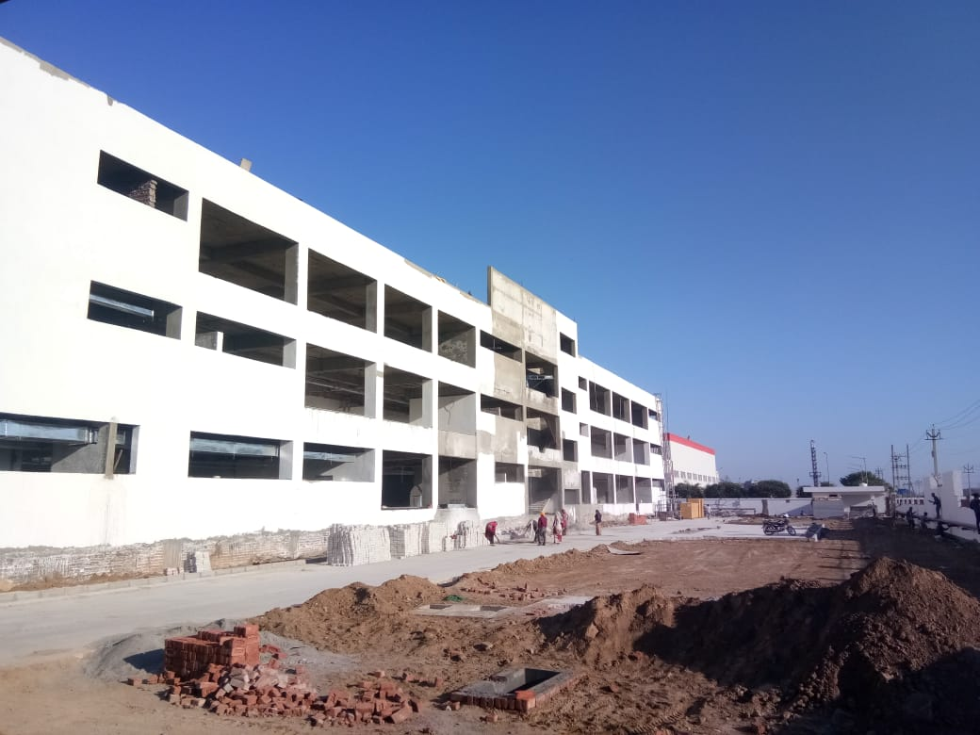
Lumax DK Bawal HR.

Slide 12
COMMERCIAL PROJECTS.

Slide 14
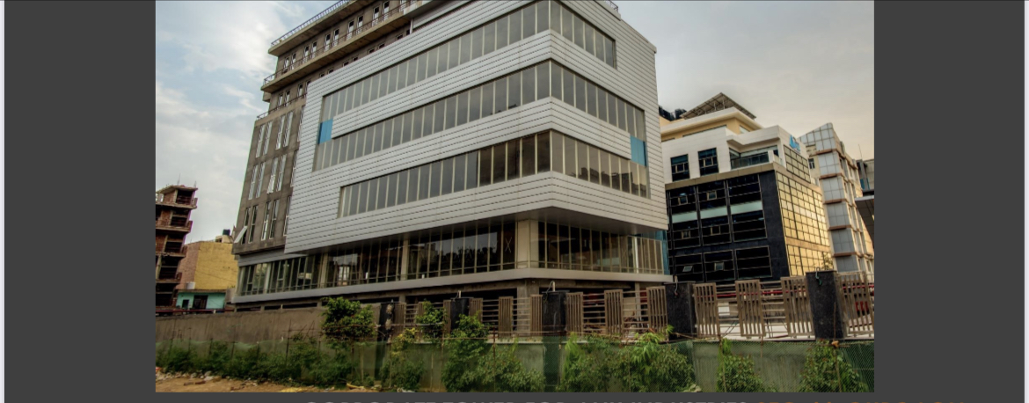
Shopping Complex Hubbal Benglore KTK.

Slide 15
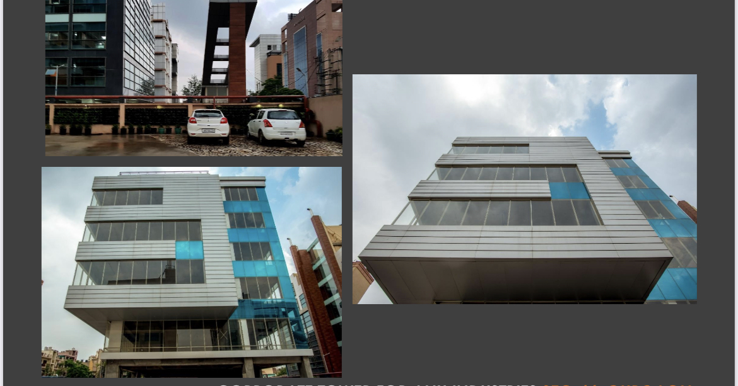
Shopping Complex Hubbal Benglore KTK.

Slide 16
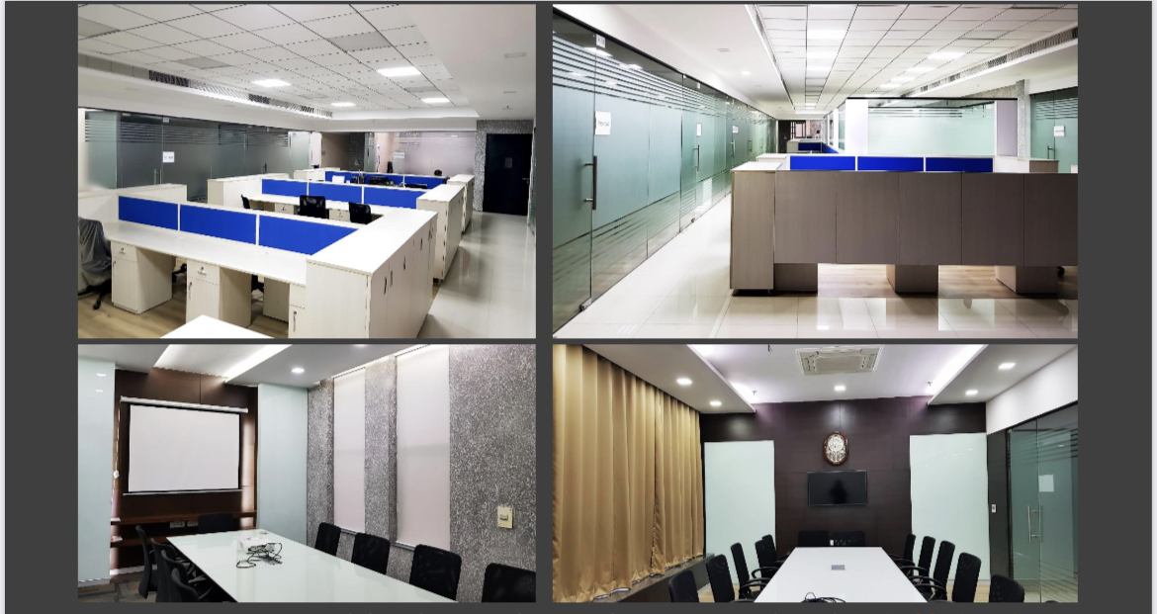
Xzone Call Center Gurugram HR.

Slide 17
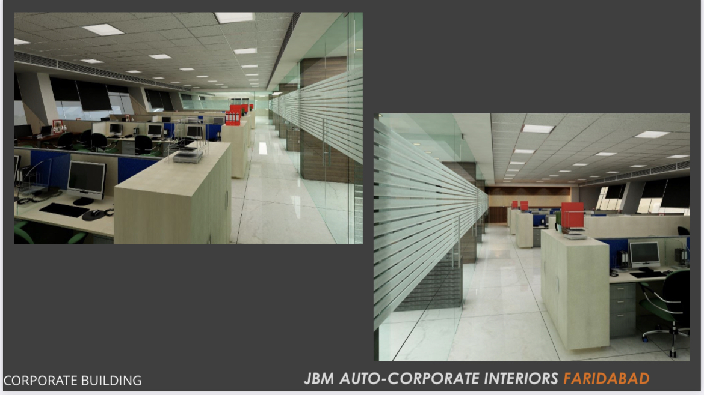

Slide 18
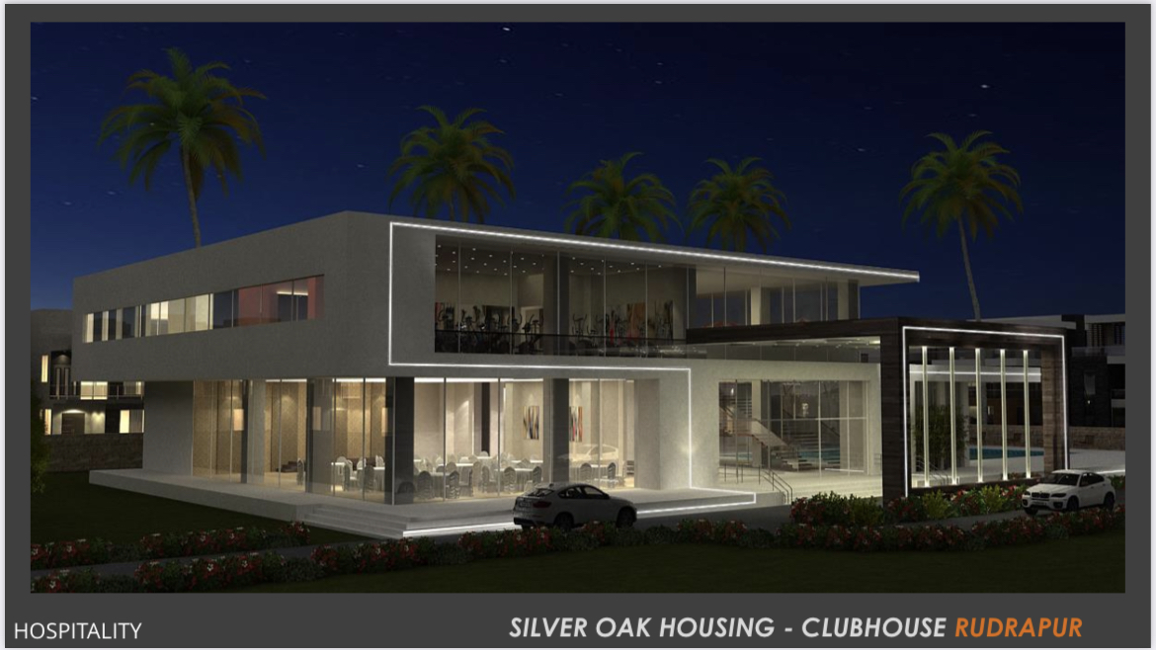

Slide 19
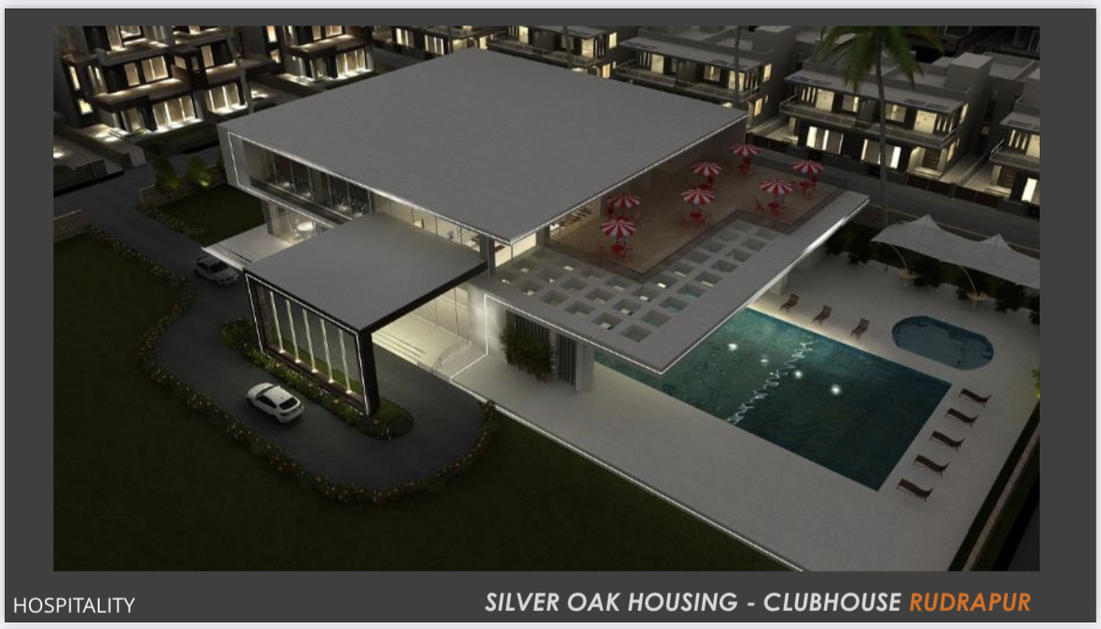

Slide 20
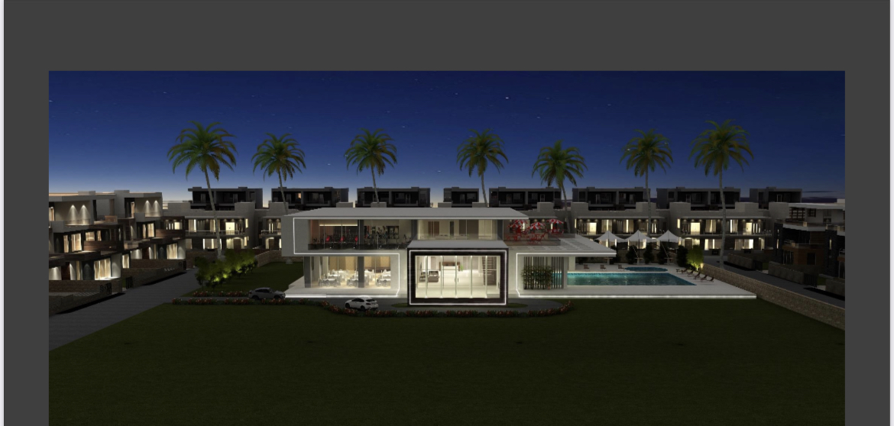
Club House Silver Oak City Rudrapur

Slide 21
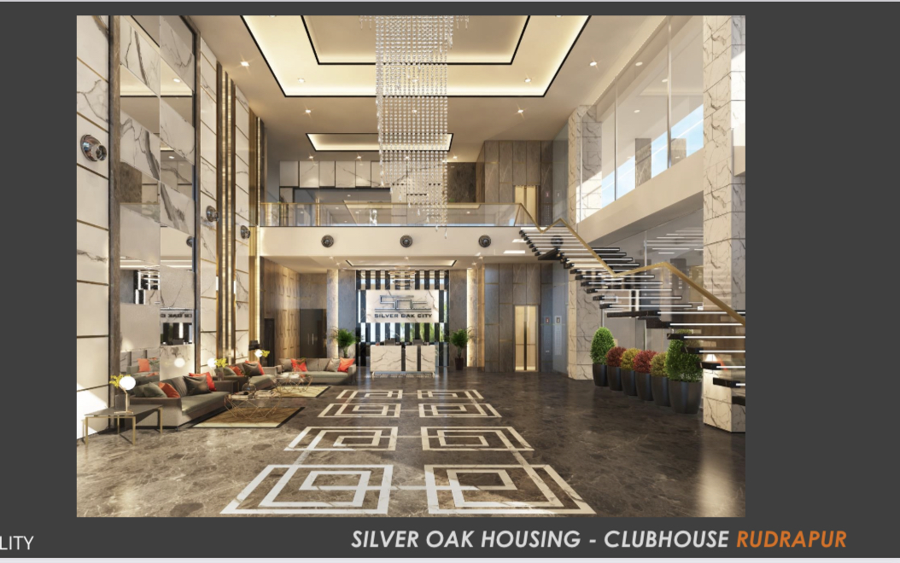

Slide 22
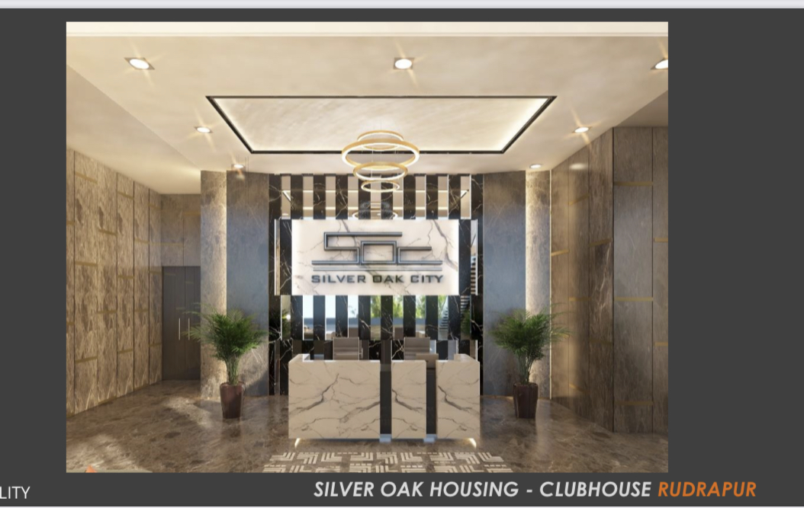

Slide 23
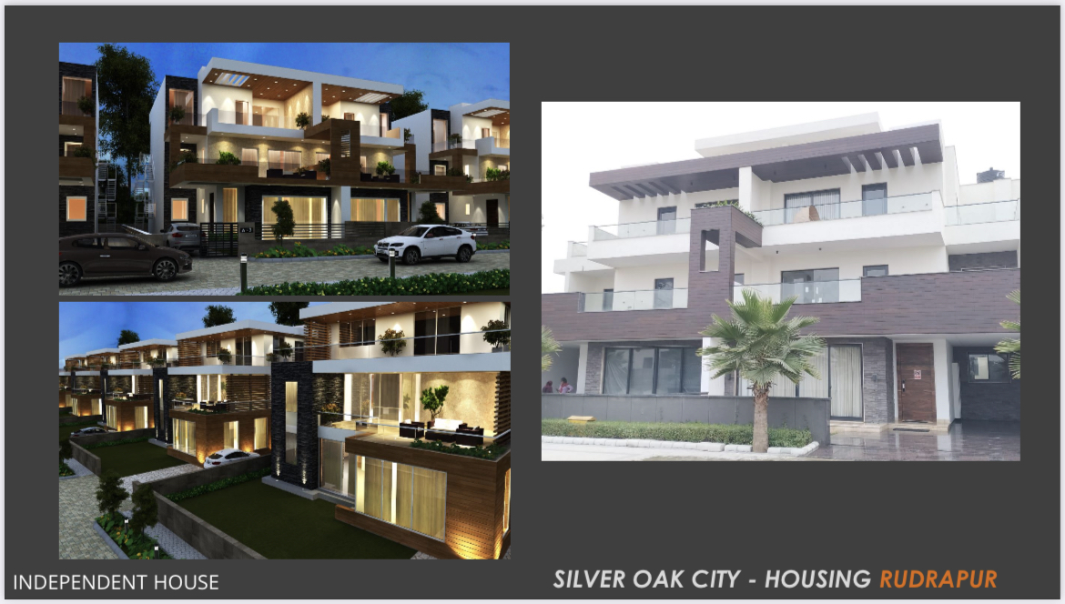

Slide 24
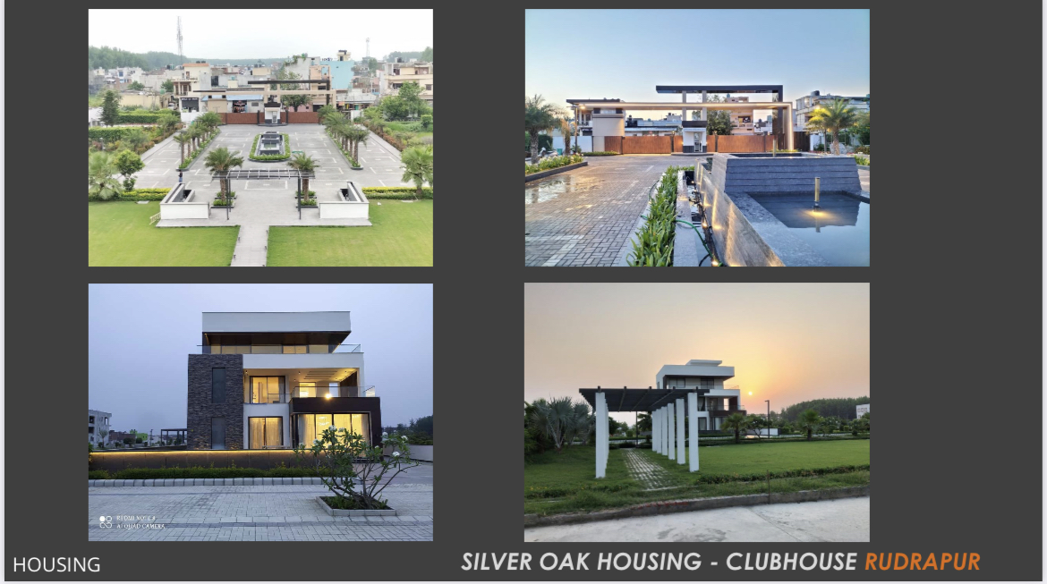

Slide 25
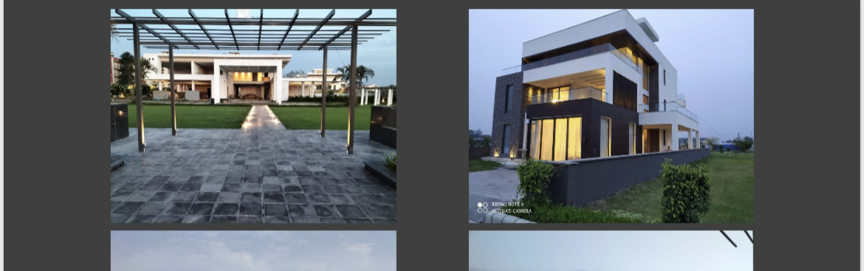

Slide 26
RESIDENCIAL PROJECTS.

Slide 28
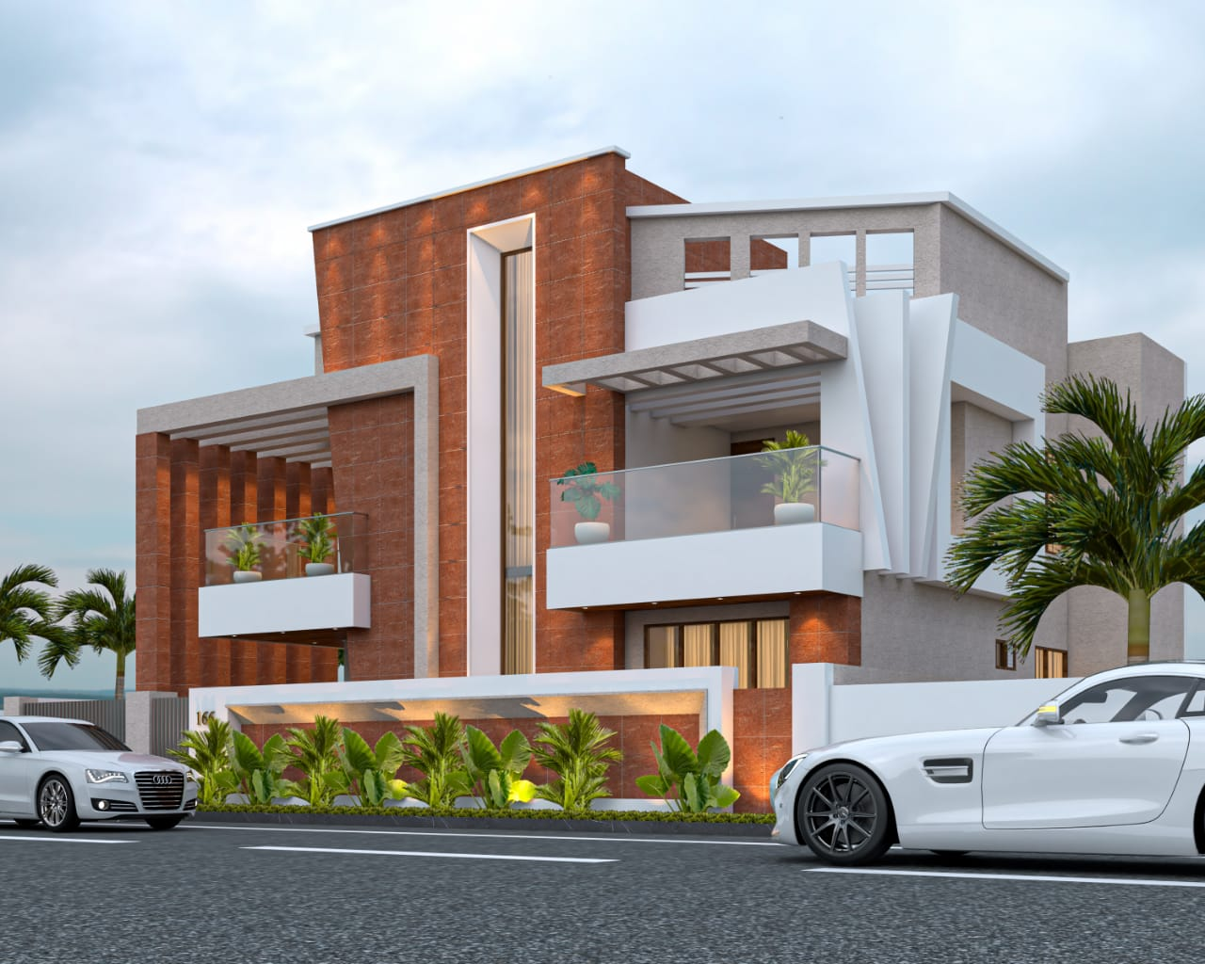
Ashirwad Bhawan Kausalya Enclave

Slide 29
Ashirwad Bhawan Kausalya Enclave

Slide 30
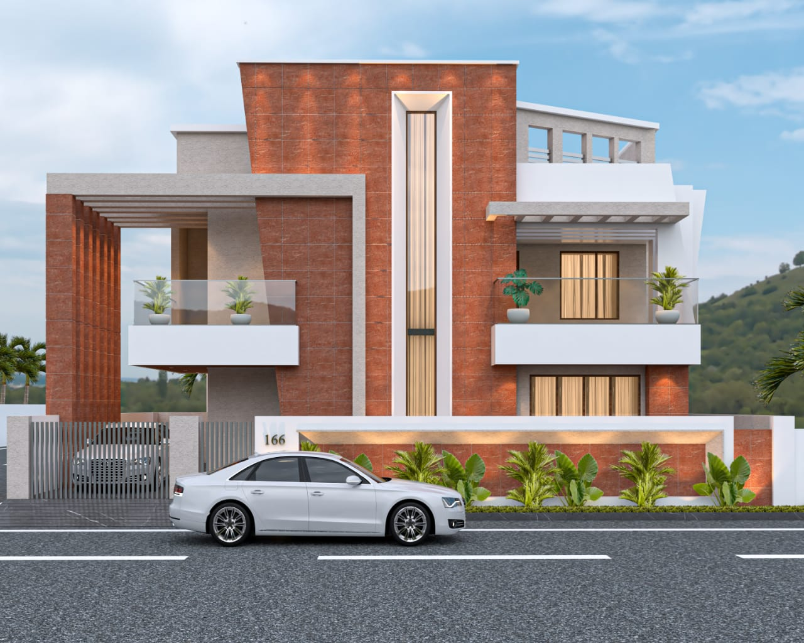
Ashirwad Bhawan Kausalya Enclave

Slide 31
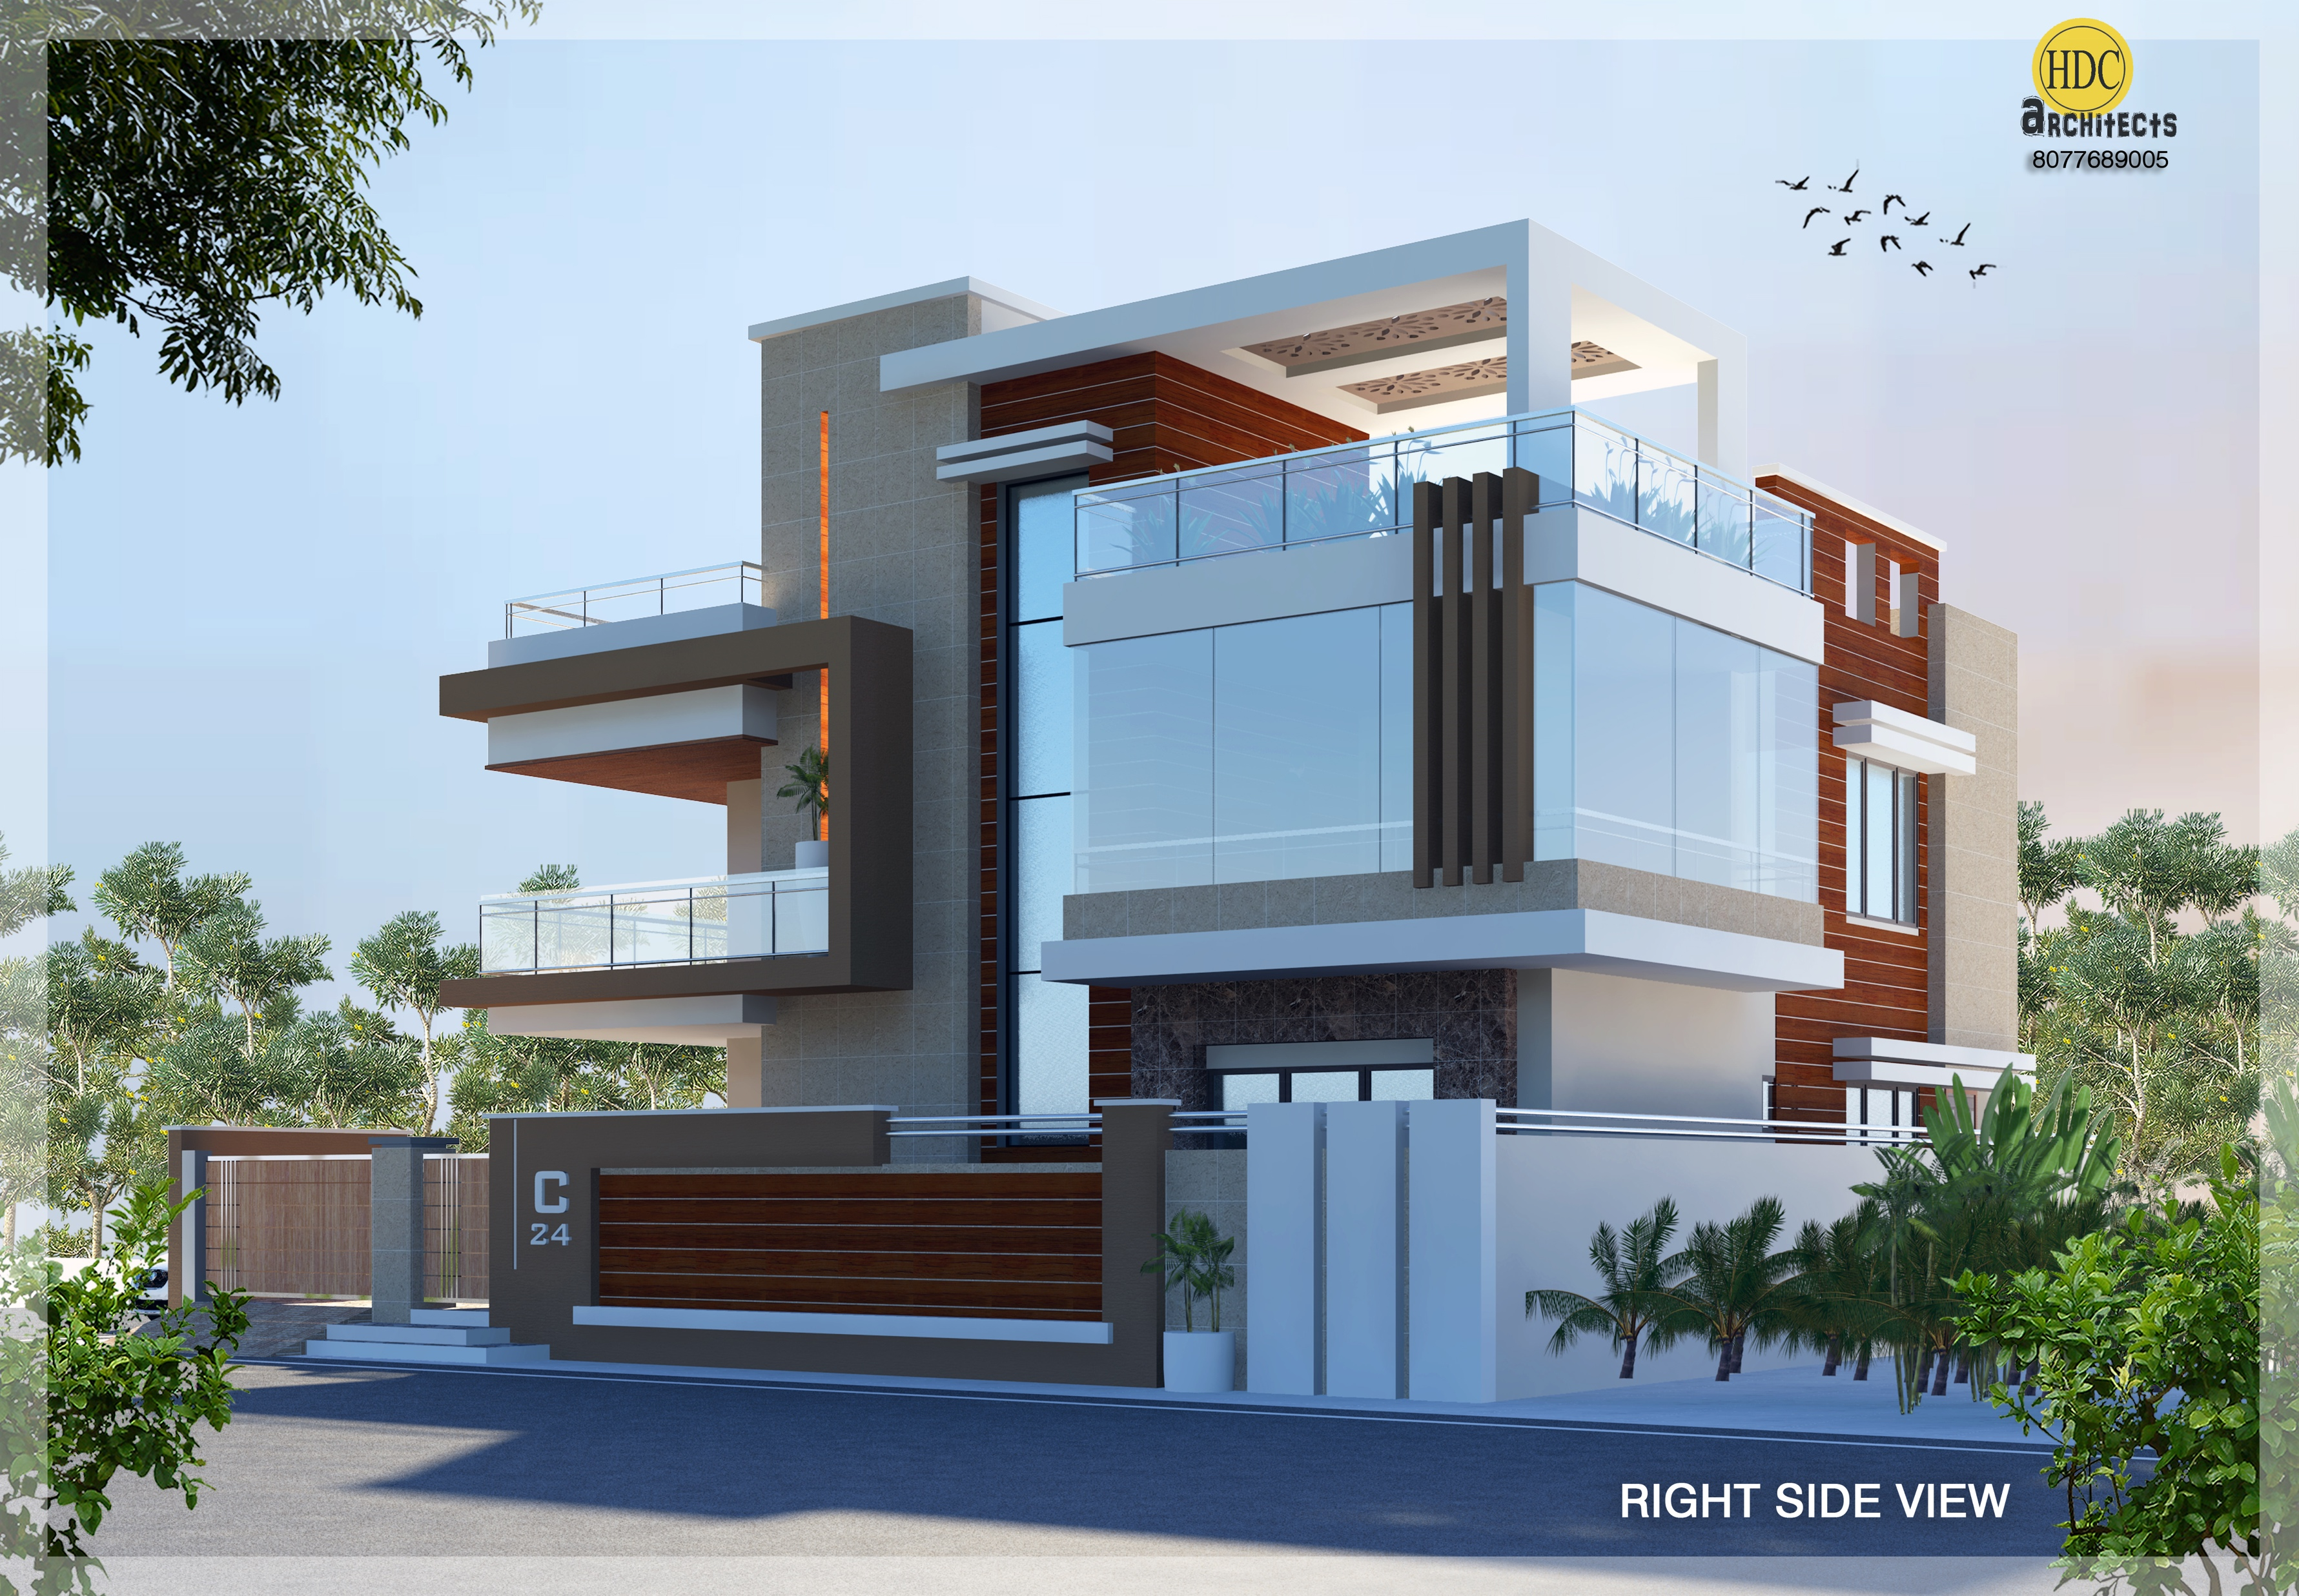
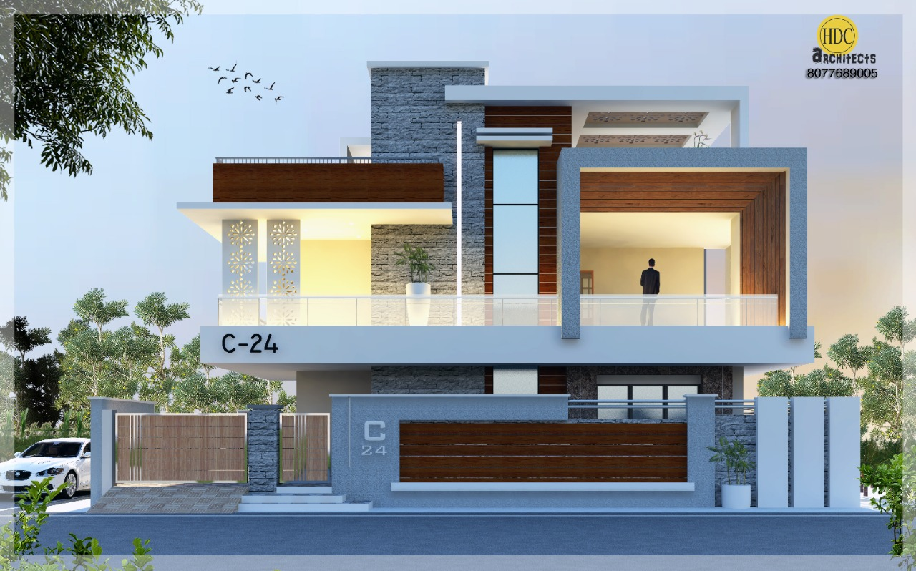
Agrawal House Manesar HR.

Slide 32
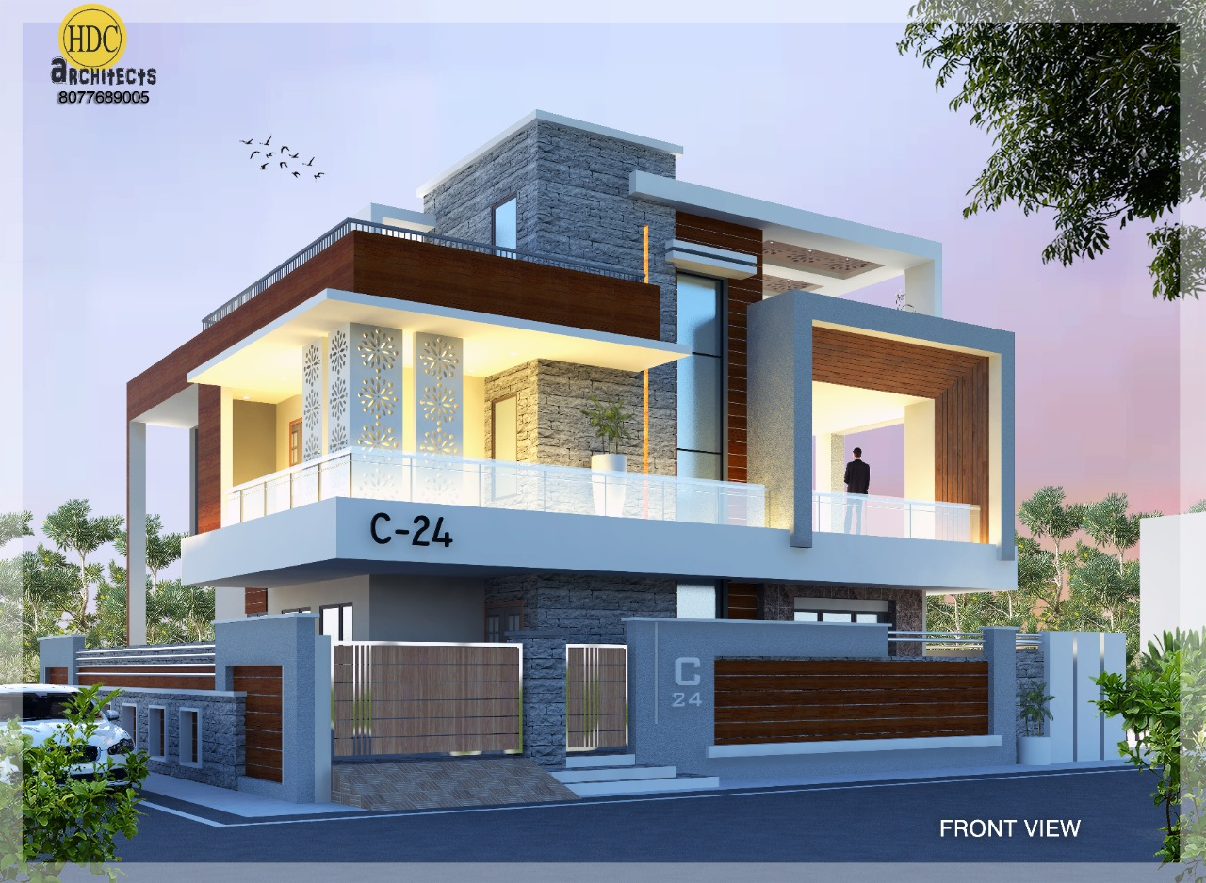
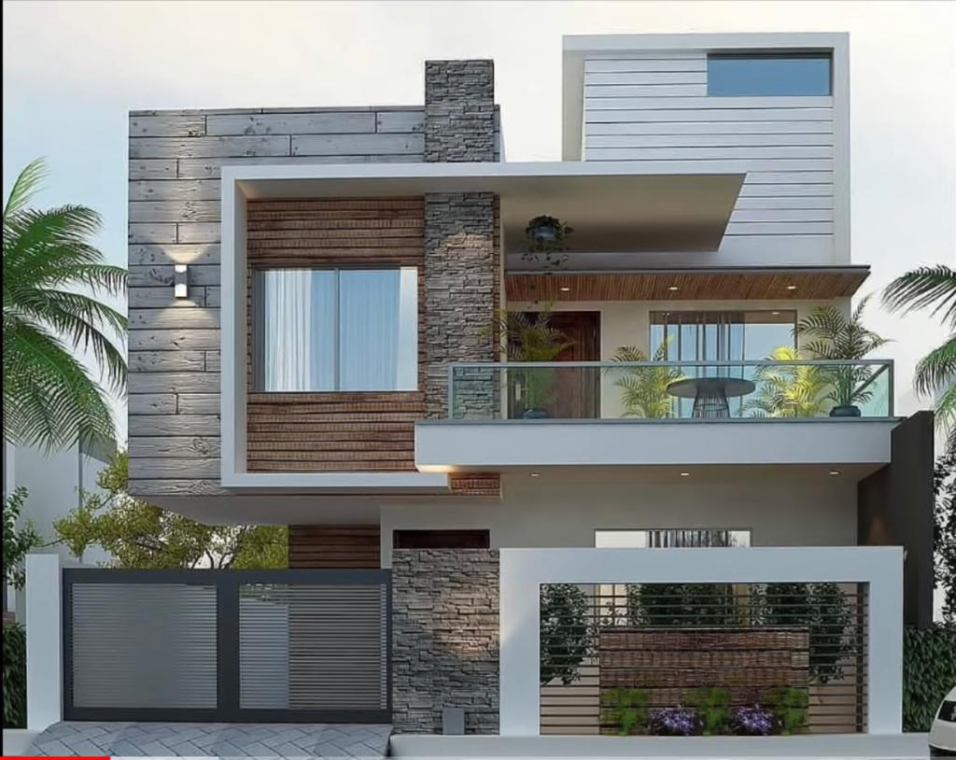
Agrawal House Manesar HR.

Slide 33
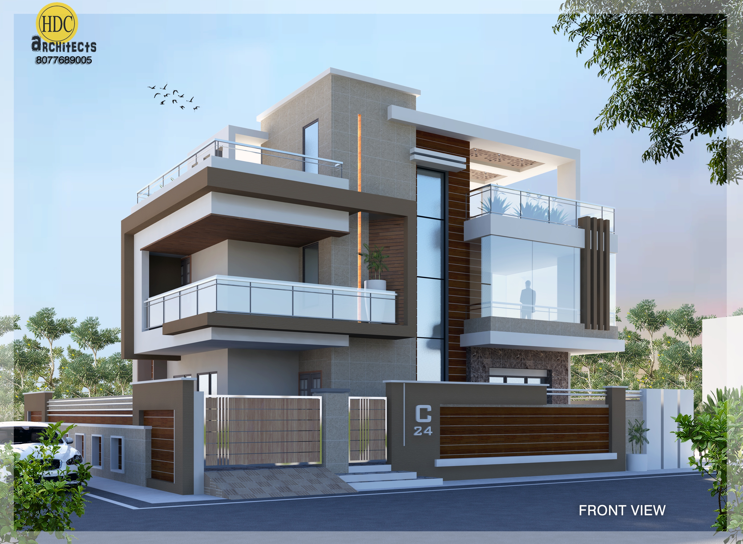
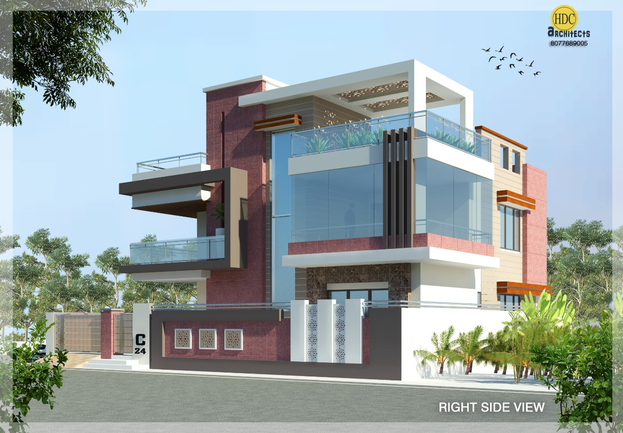

Slide 34
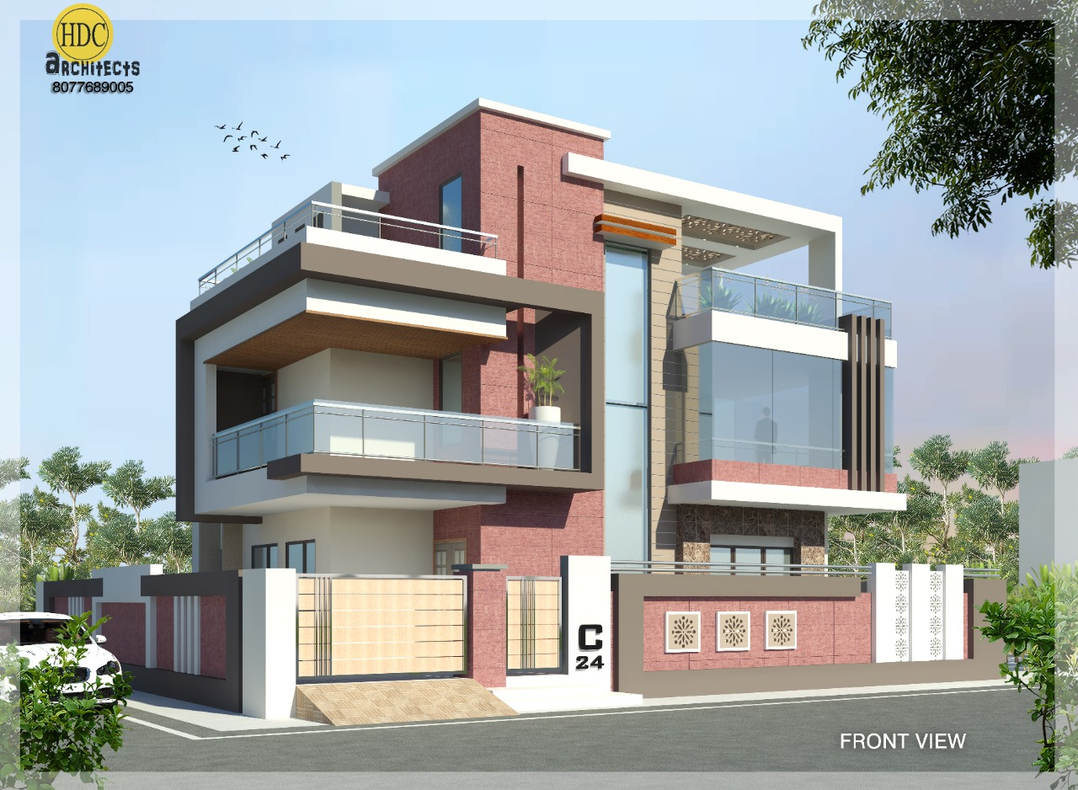
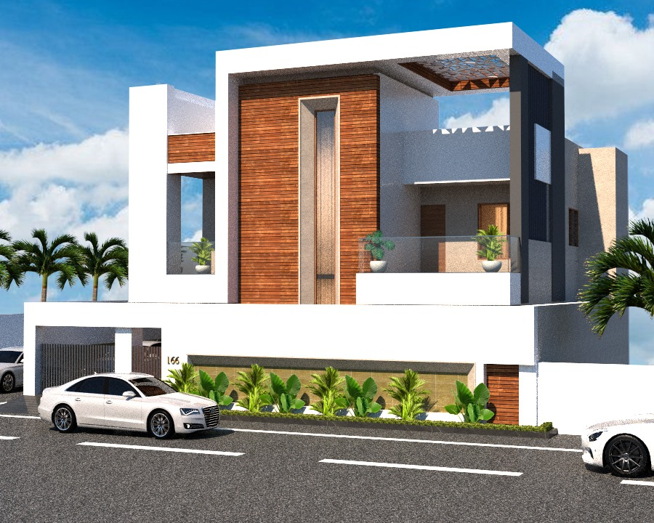
Agrawal House Manesar HR.

Slide 35
THANK YOU FOR WATCHING

Slide 36


