Slide 1
PostGRES and Spatial SQL
for
Spatial Data Analysis

Slide 2
Who Are
You?

Slide 3
Todd Barr MSc, MA, MS
Spatial Data
Scientist

Slide 10
“Agenda”
Yammer about the history of Spatial SQL and Databases
Install some software
Build a Database
Import some Shapefiles
Write some queries
Play with Q
PROFIT

Slide 13
Why use FOSS4G Technology
Build on Open Standards so data and code are shareable and interoperable
Increases Flexibility to respond to needs
Rapid Innovation pushes Geospatial Technology forward
Core Product can be customized to your need
Lower Cost of Software Ownership
Control When Patches are Introduced

Slide 15
What is Spatial SQL
Just like normal SQL but with Spatial Functions
Geometry/Geography stored as a Binary Large Object (BLOB)
Spatial Data is just another column in a database
Attribution is maintained like other data within the database

Slide 16
Drivers
Increase in Desire for Location Data (Social Media)
Increased Use of Mobile
Big Data/Large Amounts of Unstructured Data
Increased understanding of Geography and its role in general data analysis

Slide 17
Databases that Support Spatial SQL
Oracle
MySQL
SQL Server (starting in 2008)
Spatial Lite
PostGRES

Slide 18
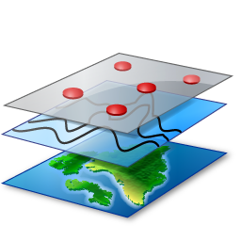
+
=
PostGRES
Spatial Data
PostGIS

Slide 19
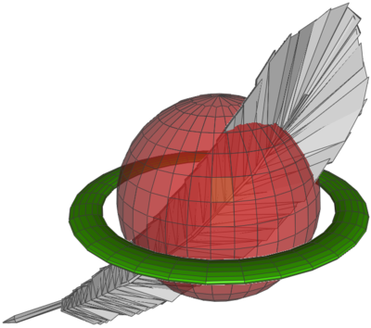
Costs & Fees
Functionality

Slide 20
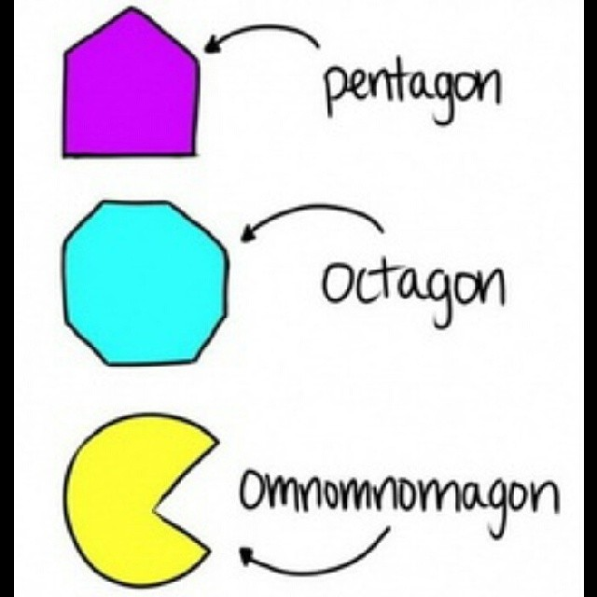

Slide 21
Shapefiles
Shapefiles are a sort-of-open format for geospatial vector data. They can encode points, lines, and polygons, plus attributes of those objects, optionally bundled into groups. I say 'sort-of-open' because the format is well-known and widely used, but it is maintained and policed, so to speak, by ESRI, the company behind ArcGIS. It's a slightly weird (annoying) format because 'a shapefile' is actually a collection of files, only one of which is the eponymous SHP file.

Slide 22
Shapefile verses PostGIS
Shapefiles cannot support more than 70m rows
Limitations for field names
Disk Space Hogs
Difficult to share data
Limitations to Date Field name
Do not support nulls
Files that exist in folders are difficult to manage (backups,size)
Only support Spatial Tools, not BI or non Spatial software (this is changing)

Slide 23
PostGIS verse a “Geodatabase” (Personal, File, ArcSDE)
Spatial SQL allows to query and analyze Spatial Data, a Geodatabase is just for data management – Still relies on GUI to preform analysis
Spatial SQL is build on Open Geospatial Consortium (OGC), Geodatabases are not
Spatial SQL can support a variety of applications, Geodatabases only supports desktop GIS software and proprietary Web Servers

Slide 24
Spatial Data Management with PostGIS
Writing SQL to query data opposed to generating new files
Increasing performance and response speeds through Indexing
PostGIS takes advantage of multiprocessing hardware
Users can access PostGIS through the network or Internet, without a specialized web viewer or desktop software
PostGIS maintains data integrity and replication
PostGIS can handle multiple users accessing the same data
Can store Spatial Data as Text (geojson, WKT) or as Binary (BLOB or WKB)

Slide 25
PostGIS Spatial Capabilities
Supports all Geometry Types
Point
Multipoint
Line
Linestring
Polygon
MultiPolygon
Collections
Projections
Supports all known map projections
Allows reprojection within query
Spatial Relationships
Measure
Serialize/Deserialize
Intersect
Buffer
Point n Polygon
Overlap/Touch/Cross

Slide 26
Geometry Vs. Geography
Geography is always in WGS84
Geography has limited Spatial Functions
Geography views the world as 2D
Geography is faster for generating visualizations
Geometry allows for full analysis
Geometry allows for 3D Analysis

Slide 27
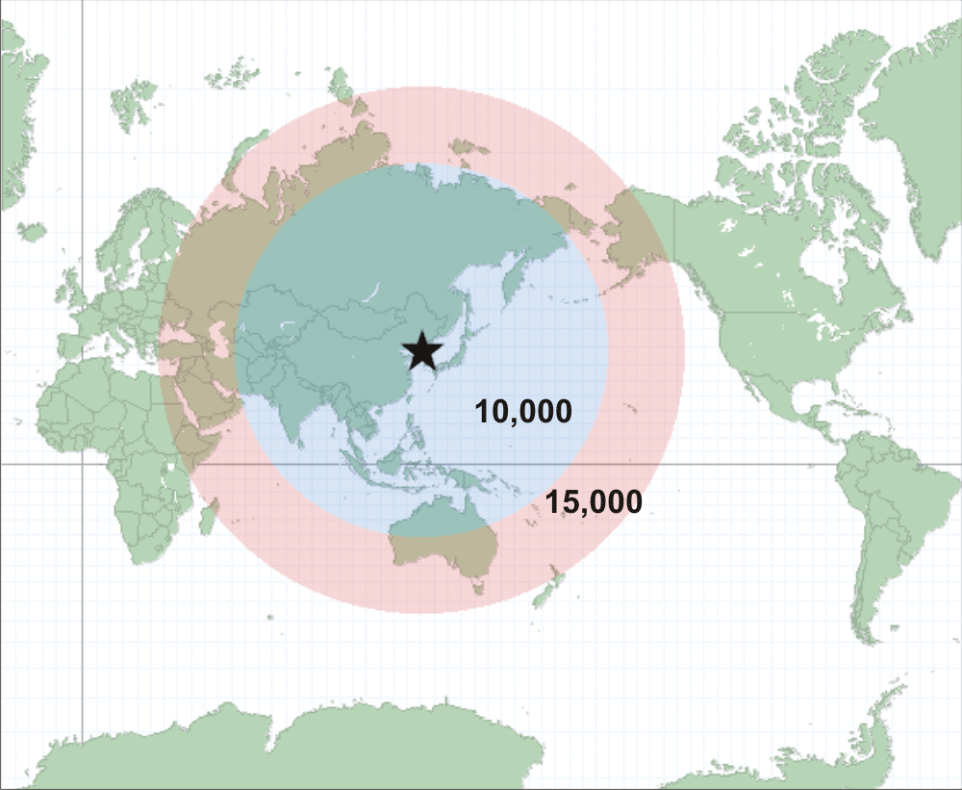
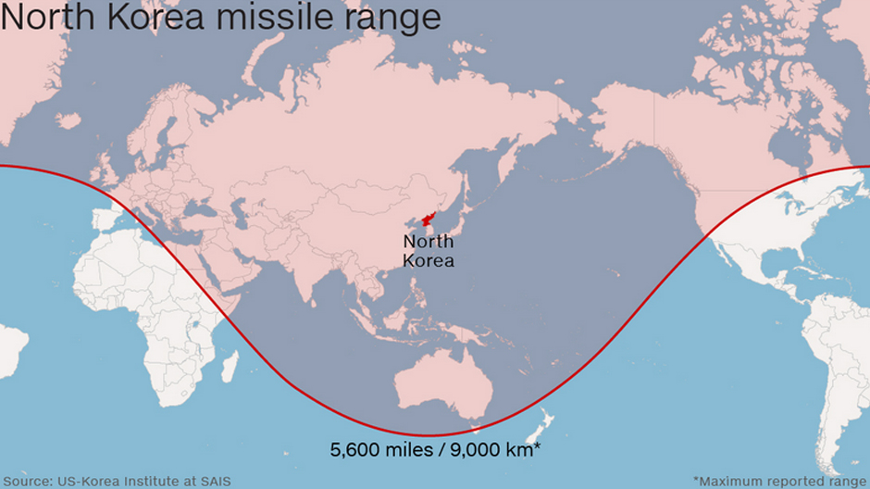
Geography
Geometry

Slide 28
Metrics (Unscientific)
400K buffers generated
PostGIS: Shorter than a ½ mile walk with “the dog”
Proprietary Desktop GIS: 4 hours
1.5 Billion Point in Polygon Analyses
PostGIS: Shorter than a commercial free episode of “The Walking Dead”
Proprietary Desktop GIS: Kept spinning, turned off after 24 hours
1.5 Billion Measurements
PostGIS: a bit longer than a commercial free episode of “The Walking Dead”
Proprietary Desktop GIS – Error 99999 after 3 hours of the process

Slide 30
LET’s Spatialize
Some Data or
SOMETHING

Slide 31
Requirements
PostGRES 9.4
PostGIS 2.3.x
QGIS 2.1x – for Map Making and Visualization

Slide 32
https://www.enterprisedb.com/downloads/postgres-postgresql-downloads#windows

Slide 33
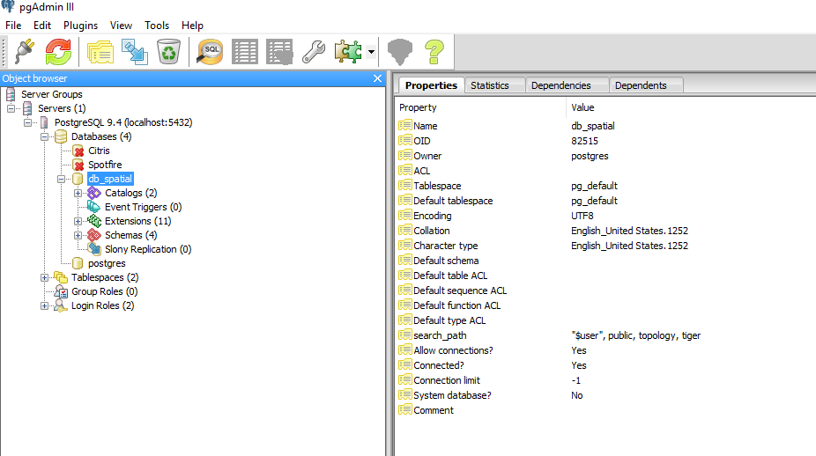
Getting Comfortable With pgAdmin 3

Slide 34
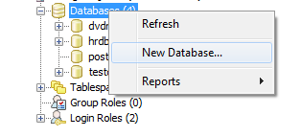
Creating the Database

Slide 35
Making the Database Spatial

Slide 37
CREATE EXTENSION postgis;

Slide 40
SELECT postgis_full_version()

Slide 41
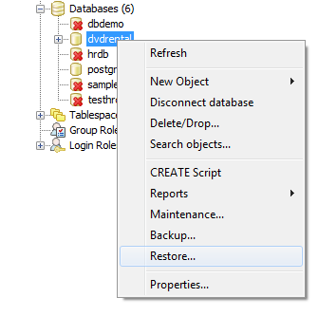
Restoring the .backup

Slide 42
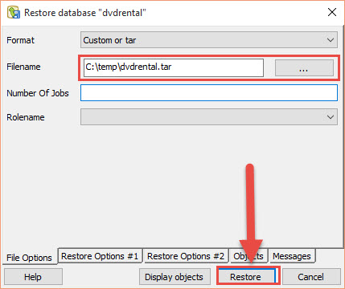

Slide 43
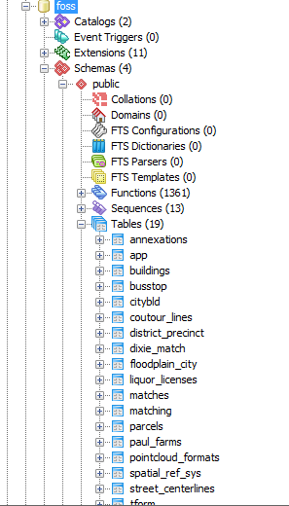

Slide 44
Uploading a Shapefile

Slide 45
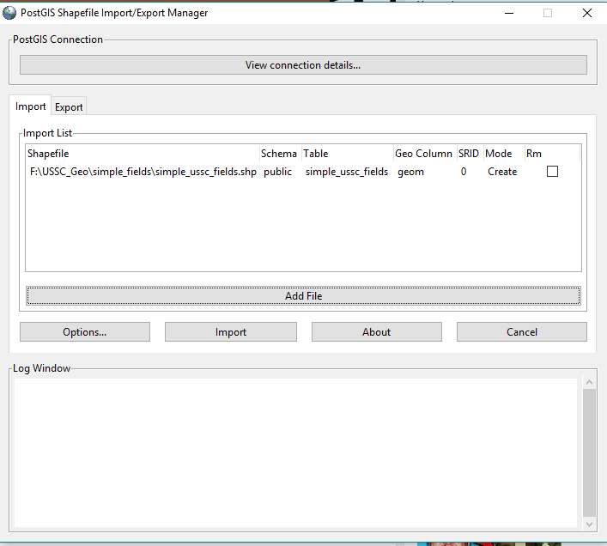
Uploading a .shp

Slide 46
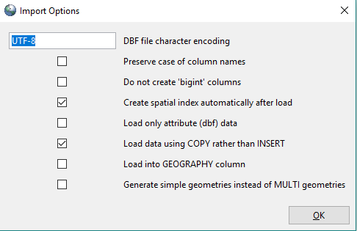

Slide 49
SQL Warm up
SELECT
*
FROM
liquor_licenses

Slide 50
The WHERE Clause
SELECT
*
FROM
liquor_licenses
WHERE license_ty='Tavern'

Slide 51
Adding some Function
SELECT
COUNT(establish)
FROM
liquor_licenses
WHERE
license_ty='Brew Pub’

Slide 52
Group By
SELECT
AVG(char_length(establish)), license_ty
FROM
liquor_licenses
GROUP BY
license_ty

Slide 53
Standard Deviation (last non GEO one I promise)
SELECT
AVG(char_length(establish)),
STDDEV(char_length(establish)),
license_ty
FROM
liquor_licenses
GROUP BY
license_ty

Slide 54
The GEOM
SELECT
ST_AsText(geom)
FROM liquor_licenses

Slide 55
ST_Length
SELECT
ST_LENGTH (geom) ,
strname
FROM
street_centerlines

Slide 57
¯\_(ツ)_/¯ ST_Transform
SELECT
ST_LENGTH(ST_TRANSFORM(geom,2876),
strname
FROM
street_centerlines

Slide 58
ST_AREA
SELECT
objectid,
ST_AREA(ST_TRANSFORM(geom,2876))
FROM
buildings

Slide 59
(╯°□°）╯︵ ┻━┻ Projections

Slide 60
Methods
ST_Transform
UpdateGeometry
Select UpdateGeometrySRID(‘db_table’,’geometry_field’,ESPG)

Slide 62
ST_Buffer v/ ST_DWithin
ST_Buffer
Creates Geometry
Prepares for analysis
Persistent
Great for setting up a trigger around a feature
Can Control all aspects of the geometry

Slide 63
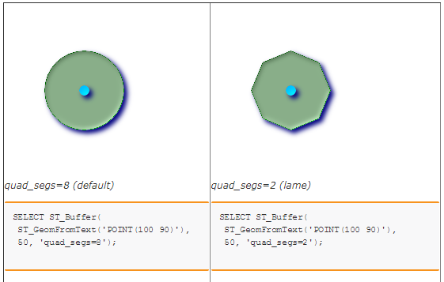

Slide 64
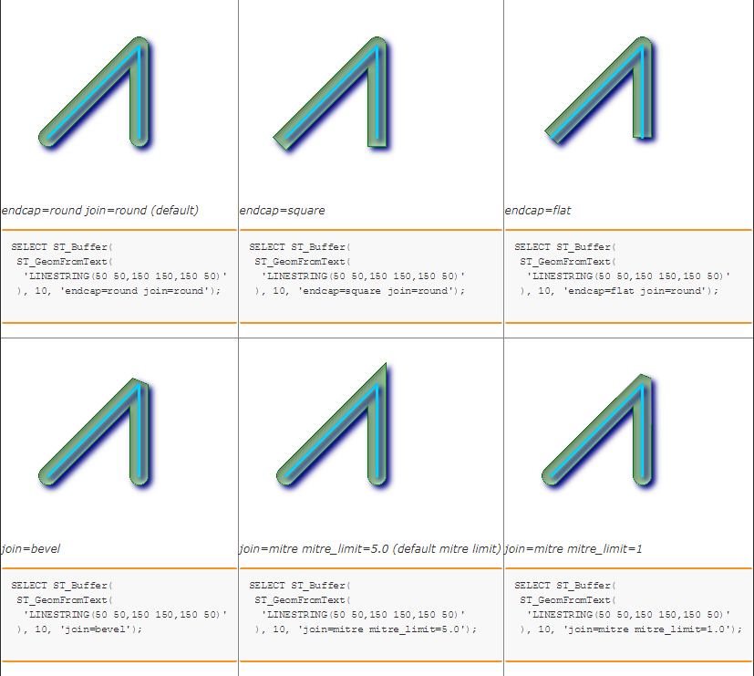

Slide 65
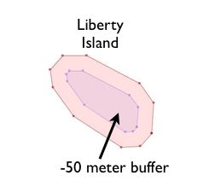

Slide 66
ST_BUFFER
ALTER TABLE
liquor_licenses
ADD Column
buffer geometry(Polygon,4326)

Slide 67
ST_BUFFER
UPDATE
liquor_licenses
SET
Buffer=
ST_TRANSFORM
(ST_BUFFER(ST_TRANSFORM(geom,2876),30),4326)

Slide 68
ST_DWithin
Doesn’t generate Persistent geometry
Measures the distance from Points, Lines and Polygons
Used mainly for queries without generated Geometry

Slide 69
ST_DWithin
SELECT
a.flood_type
FROM
floodplain_city a, liquor_licenses b
where ST_Dwithin(ST_Transform(b.geom, 2876),ST_Transform(a.geom,2876),2500) and b.establish='Social'

Slide 70
ST_Within vs ST_Contains
ST_Within means the whole geometry has to be within the polygon
ST_Contains means that one point has to be within the polygon
So for points they’re basically the same, but for lines N stuff is where the variance occurs

Slide 71
Exporting as Different Data Types
SELECT ST_AsGeoJSON(geom) FROM floodplain_city
SELECT ST_AsGML(geom) FROM floodplain_city

Slide 72
ST_NPoints
SELECT
ST_NPoints(geom)
FROM
street_centerlines

Slide 73
Import Data from CSV
CREATE TABLE pot_dispense
(
name character varying(255),
address character varying(255),
lat character numeric,
long character numeric,
phone character varying(255)
)

Slide 74
Import CSV
copy pot_dispense(name,address,lat,long,phone) from ‘$CSV_FILE_LOC’ DELIMITER ’,’ CSV Header;

Slide 75
Generating a point feature from XYs
Create Geometry Column
ALTER TABLE
pot_dispense
ADD Column
geom geometry(point,2876)

Slide 76
Make the Damn Point
update pot_dispense set geom=ST_SetSRID(ST_MakePoint(lat,long),2876)

Slide 77
There’s the Point

Slide 79
What is an Index
A database index is a data structure that improves the speed of data retrieval operations on a database table at the cost of additional writes and storage space to maintain the index data structure. Indexes are used to quickly locate data without having to search every row in a database table every time a database table is accessed. Indexes can be created using one or more columns of a database table, providing the basis for both rapid random lookups and efficient access of ordered records.

Slide 80
PostGIS Spatial Capabilities
Can import/export any Spatial Data Type
Spatial Indexing
Allows user to reduce query time

Slide 81
Index Drawbacks
Drag on modifying records
Performance Hit On Updates and Modificiation
Use up disk space

Slide 82
When should build an index
Large Tables
Not Frequently Updated
Disk Space Isn’t a Concern
When there is a Primary Key

Slide 83
When you should not Index
Indexes should not be used on small tables.
Tables that have frequent, large batch update or insert operations.
Indexes should not be used on columns that contain a high number of NULL values.
Columns that are frequently manipulated should not be indexed.

Slide 84
Spatial Indexing in PostGIS
When making a Spatial Index its best if you use a Generic Index Structure (GIST).
Using the default of B-Tree, the index will be the geometry itself, not just a bounding box around the geometry
R-Tree indexs are possible, but tests have shown there is no performance improvement over GIST and it does not handle NULL values very well
CREATE INDEX <NAME of INDEX> on <TABLE NAME> Using GIST <Geometry Column>

Slide 86
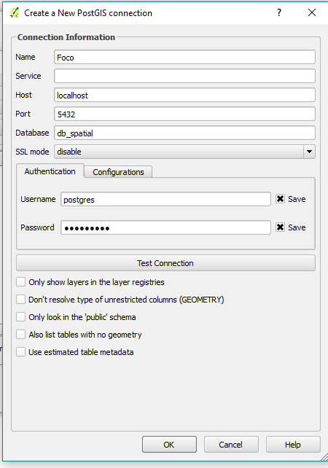

Slide 88
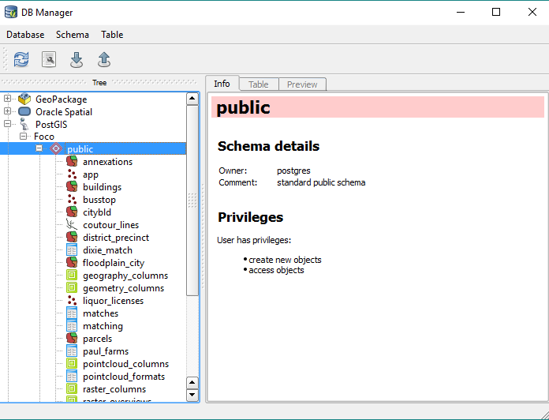

Slide 89
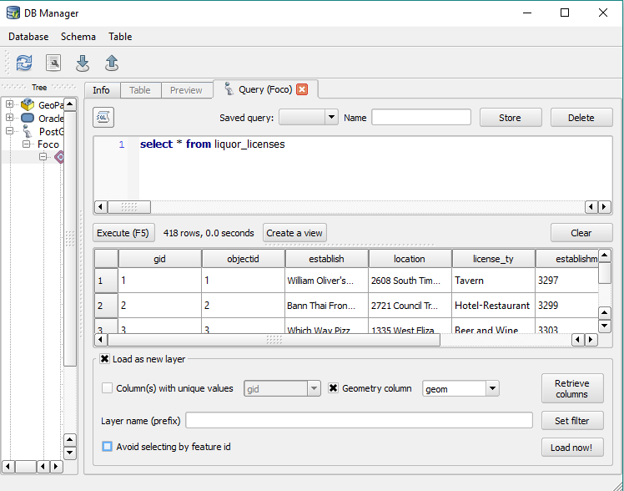

Slide 90
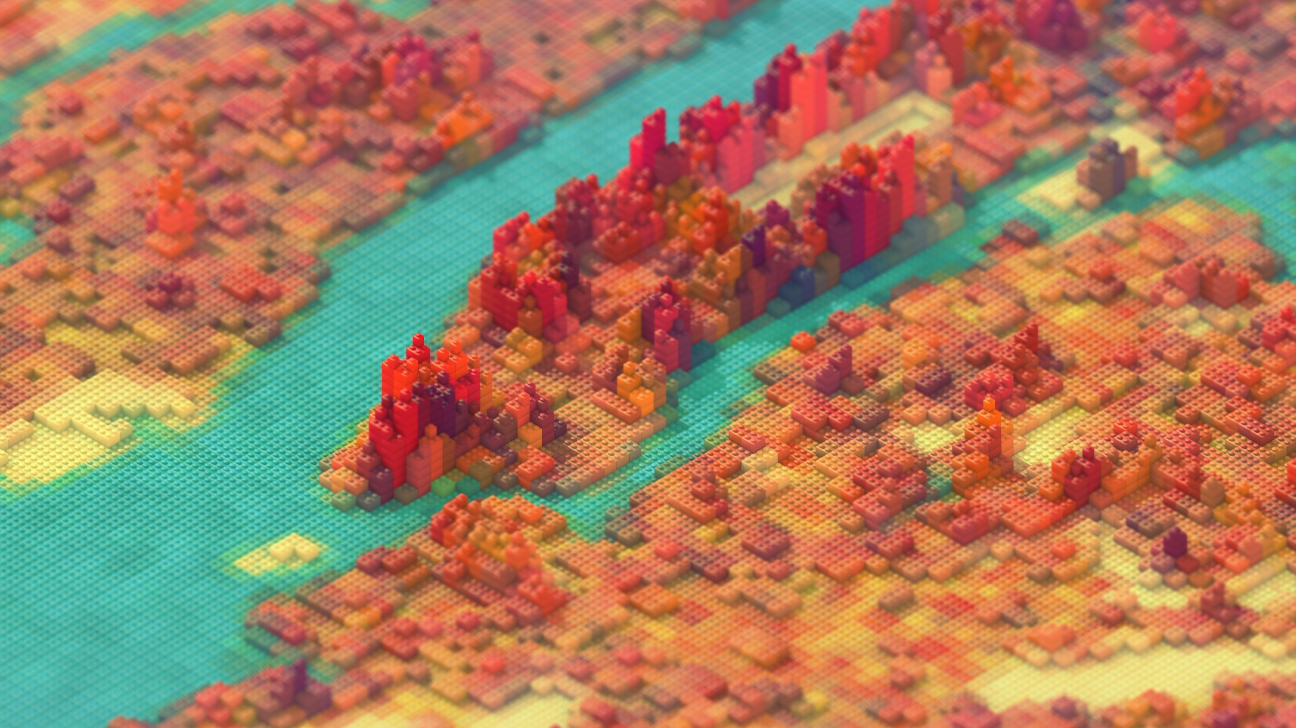
Contact
TWITTER:@Spatial_Punk
EMAIL: todd.barr@gmail.com
Slack:http://thespatialcommunity.slack.com
Handle: too_drunk_to_truck

