Slide 1
AP GOV STUDENT BINDER
Foundational deocuments, SCOTUS cases, FRQ tips, and Key Legislation
Created by Michael-Ann Cerniglia; modified from 5/4/2020 materials
made by Lori Ferrington; and thanks to Streetlaw.org

Slide 2
TABLE OF CONTENTS
The AP US Government and Politics exam requires that you know and be able to apply 9 foundational documents and 15 required Supreme Court (SCOTUS) cases. There are also many key pieces of legislation that are encouraged but not required, as they will be useful throughout the exam. The exam is formatted with 55 Multiple Choice questions and 4 different types of Free Response Questions (FRQs), each which has its own requirements and rubric.
.
TOPIC A: 9 foundational documents
TOPIC B: 15 required Supreme Court (SCOTUS) cases.
TOPIC C: Key Legislation
TOPIC D: Free Response Questions (FRQs)

Slide 3
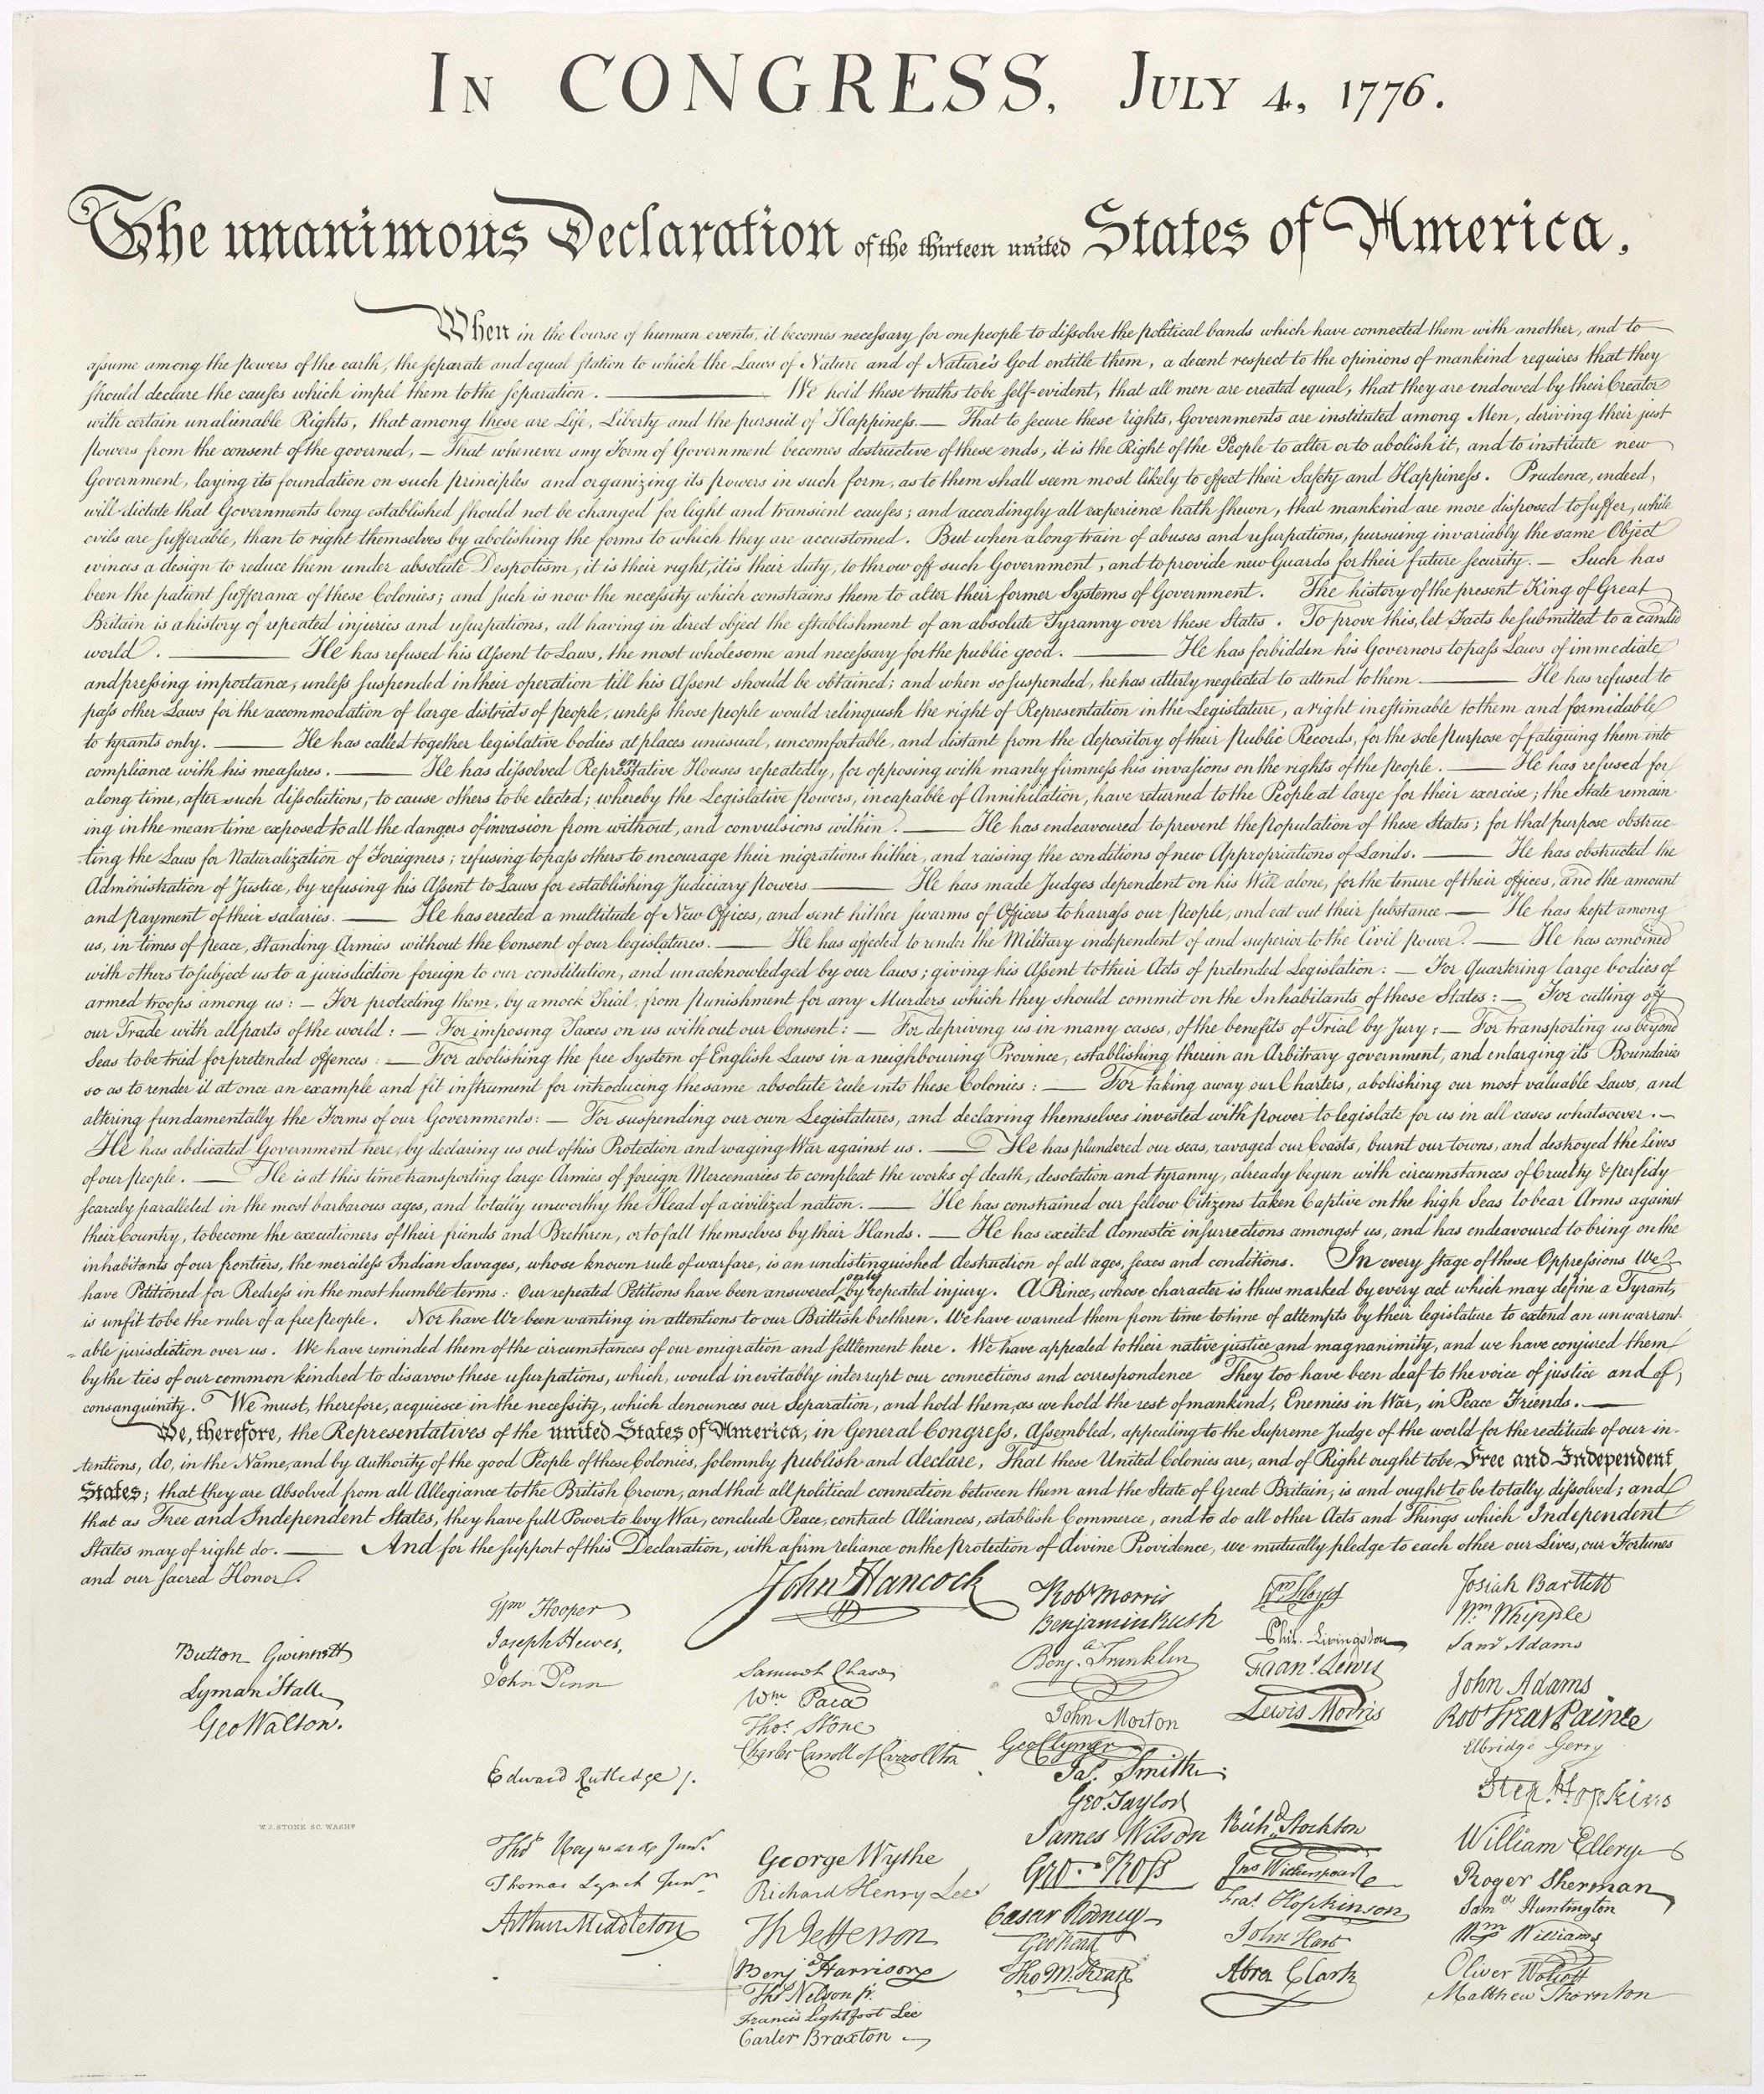
FOUNDATIONAL DOCUMENTS

Slide 4
FOUNDATIONAL DOCUMENTS (9 required)
Document | Author | Main Points
Declaration of Independence
Articles of Confederation
U.S. Constitution
Federalist No. 10
Brutus 1

Slide 5
FOUNDATIONAL DOCUMENTS
Document | Author | Main Points
Federalist No. 51
Federalist No. 70
Federalist No. 78
Letter from a Birmingham Jail

Slide 6
Summary of Constitution
(A Quick, Simplified Summary)
PREAMBLE
We, the people of the United States, in order to form a more perfect Union, establish justice, insure domestic tranquility, provide for the common defense, promote the general welfare, and secure the blessings of liberty to ourselves and our posterity do ordain and establish this Constitution for the United States of America.
ARTICLE I
Section 1:
Section 2:
Section 3:
Section 7:
Section 8:
Section 9:
ARTICLE II
ARTICLE III
ARTICLE IV
ARTICLE V
ARTICLE VI
ARTICLE VII

Slide 7
Summary of Bill of Rights
AMENDMENTS BILL OF RIGHTS (1791)
ADDITIONAL AMENDMENTS
(date) )
(date) )
(date) )
(date) )
(date) )
(date) )
(date) )
(date) )
(date) )
(date) )
(date) )
(date) )
(date) )
(date) )
(date) )
(date) )
(date) )

Slide 8
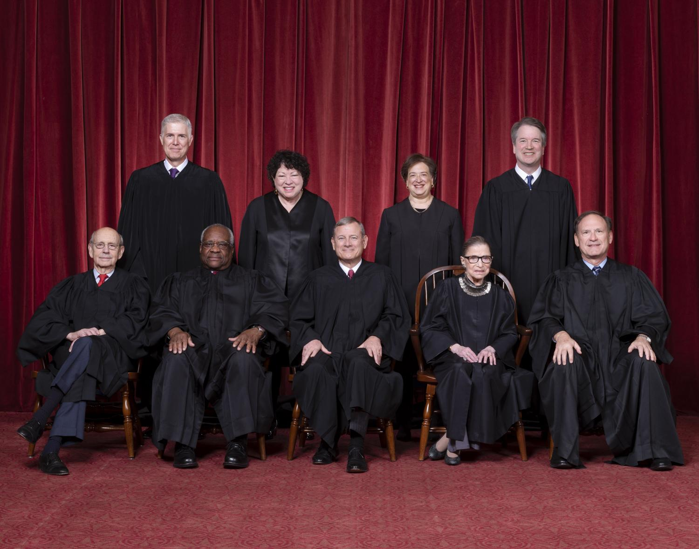
SCOTUS CASES

Slide 9
SCOTUS CASES (15 required)
Case | Precedent and Constitutional Reasoning | Relevant Vocabulary / Key Terms
Case about Checks and Balances and Separation of Powers
Marbury v. Madison (date)
Cases about Federalism
McCulloch v. Maryland (date)
United States v. Lopez (date) )
Cases about the Bill of Rights, balance between power of government and individual liberties
Engel v. Vitale ( (date)
Wisconsin v. Yoder (date)
Tinker v. Des Moines School District (date)
New York Times v. United States (date)
Schenk v. US (date)

Slide 10
SCOTUS CASES (15 required)
Case | Precedent and Constitutional Reasoning | Relevant Vocabulary / Key Terms
Cases about Selective Incorporation via the 14th amendment’s due process clause
Gideon v. Wainwright (date)
Roe v. Wade (date)
McDonald v. Chicago (date)
Cases about the 14th amendment’s equal protection clause supports equality of individuals
Brown v. Board of Education (date)
Cases about campaigning, election rules, and redistricting
Baker v. Carr (date)
Shaw v. Reno (date)
Citizen United v. Federal Election Commission (date)

Slide 11
KEY
LEGISLATION
(not required but useful)

Slide 12
KEY LEGISLATION
Affordable Care Act (date) --
American with Disabilities Act (date) --
Bipartisan Campaign Reform Act (date) --
Clean Air/Water Acts (date) --
Civil Rights Act of 1964 --
Fair Housing Act (date) --
Federal Election Campaign Act (date) --
Hatch Act (date) --
Help American Vote Act (date) --

Slide 13
KEY LEGISLATION
Medicare/Medicaid Acts (date/s) --
Motor Voter Act (date) --
No Child Left Behind Act (date) --
Presidential Succession Act (date) --
Social Security Act (date) --
Temporary Assistance for Needy Families (TANF) (date) --
Title IX of Education Acts of 1972 --
Voting Rights Act of 1965 --

Slide 14
KEY LEGISLATION
War Powers Act (date) --
Welfare Reform Act (date) --

Slide 15
FREE RESPONSE QUESTIONS
(FRQ)

Slide 16
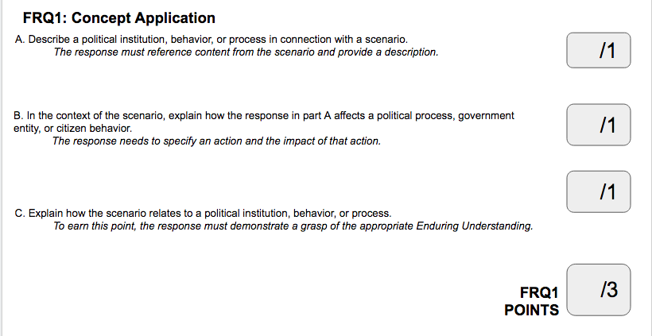
FRQ 1: CONCEPT APPLICATION
Free-response question 1: Concept Application
Respond to an authentic political scenario, describe and explain the effects of a political institution, behavior, or process. This question assesses student ability to:
describe and explain the effects of a political institution, behavior, or process
transfer understanding of course concepts and apply them in a new situation or scenario.
*Rubric below is approximate and may vary based on stimulus and task verbs used in the prompt.

Slide 17
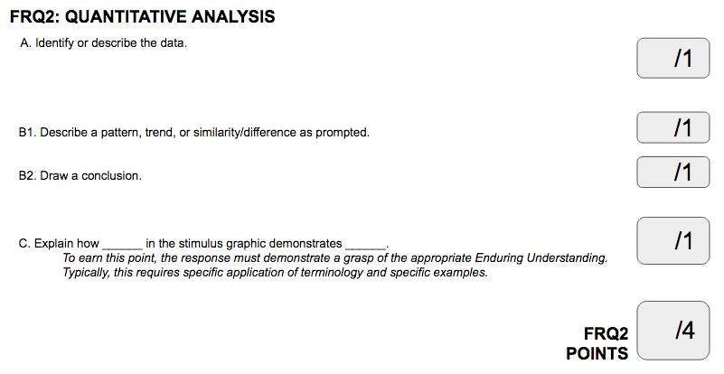
FRQ 2: QUANTITATIVE ANALYSIS
Free-response question 2: Quantitative Analysis
Analyze quantitative data, identify a trend or pattern, or draw a conclusion from a visual representation and explain how it relates to a political principle, institution, process, policy, or behavior. This question assesses students’ ability to perform the following:
Describe the data presented
Describe a pattern, trend, similarity, or difference in the data presented
Draw a conclusion based on the data
Explain how the data demonstrate a political principle, institution, process, policy, or behavior
*Rubric below is approximate and may vary based on stimulus and task verbs used in the prompt.

Slide 18
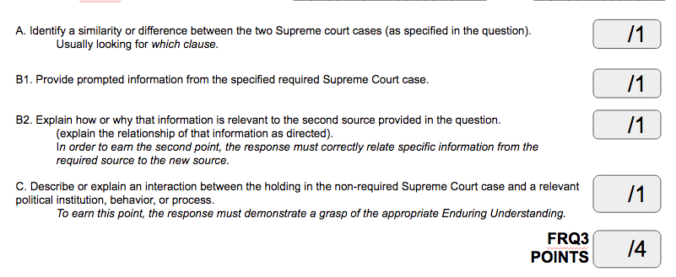
FRQ 3: SCOTUS COMPARISON
Free-response question 3: SCOTUS Comparison
Compare a nonrequired Supreme Court case with a required Supreme Court case, explaining how information from the required case is relevant to the nonrequired one. This question assesses students’ ability to do the following:
Identify a similarity or difference between the non-required Supreme Court case and a specified Supreme Court case required in the course
Describe the details, reasoning, or holding of the required Supreme Court case specified in the question
Explain a similarity or difference in the reasoning or holding of the two Supreme Court cases
Explain how the reasoning or holding in the non-required Supreme Court case demonstrates a political principle, institution, process, policy, or behavior
*Rubric below is approximate and may vary based on stimulus and task verbs used in the prompt.

Slide 19
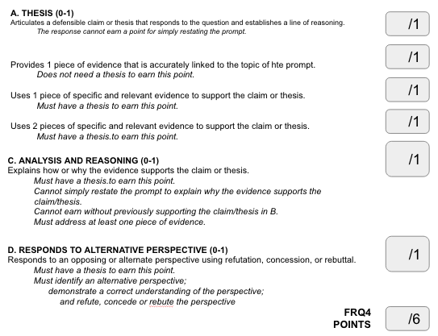
FRQ 4: ARGUMENT ESSAY
Free-response question 4: Argument Essay
Develop an argument in the form of an essay, using evidence from required foundational documents and course concepts. This question assesses students’ ability to do the following:
Articulate a defensible claim or thesis that responds to the question and establishes a line of reasoning
Provide evidence from one of the foundational documents listed in the question to support the claim
Provide evidence from a second foundational document or from knowledge of course concepts to support the claim
Use reasoning to explain why the evidence supports the claim
Respond to an opposing or alternate perspective using refutation, concession, or rebuttal
*Rubric below is approximate and may vary based on stimulus and task verbs used in the prompt.

Slide 20
FRQ TASK VERBS
Identify | Describe | Explain
Answer the prompt, no elaboration 1 sentence | Provide details, essential characteristics of what you are describing Can give an example if it’s helpful 2-4 sentences | Define all relevant terms Elaborate, Evidence, Example; show you know by being specific Answer “How?” or “Why?” does the relationship exist, use the word “because” “close the loop” by referencing the topic of the question 1 paragraph
When you think about the differences in the verbs & what they are asking you to do...consider the following questions:
Identify your favorite food. | Describe your favorite food. | Explain how your favorite food is relevant/connects to the prompt.

