Slide 1
Constitution

Slide 2
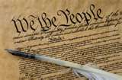
The Constitution
It’s basic definition:
  A nation’s basic law.
  It creates political institutions, allocates power within the government, and often provides guarantees to citizens.
  It is the supreme law of the United States of America. The first three Articles of the Constitution establish the rules and separate powers of the three branches of the federal government: a legislature, the bicameral Congress; an executive branch led by the President; and a federal judiciary headed by the Supreme Court. The last four Articles frame the principle of federalism. The Tenth Amendment confirms its federal characteristics.
The constitution sets rules that are never neutral.
  Meaning that some participants and policy options are given some advantage over others in the policymaking process.

Slide 3
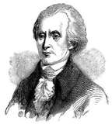
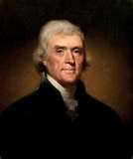
Origins of the Constitution
Declaring Independence:
  Talk of independence was common among the
  delegates of the Continental Congress.
  Richard Henry Lee enforced “that these United States are and of right ought to be free and independent states”.
  On July 2, Lee’s motion to declare independence from England was approved, causing the Declaration of Independence to be adopted two days later on July 4.
The Declaration of Independence:
  Written primarily by Jefferson
  The document, which was approved by representatives
  of the American colonies in 1776, that stated the
  grievances against the British monarch and declared
  independence.

Slide 4
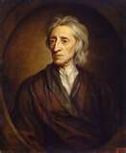
Origins of the constitution cont.
The English Heritage: The Power of Ideas
  John Locke was one of the most influential philosophers
  read by the colonists. (Two Treatises of Government)
  Locke built his philosophy on the belief of natural rights.
    The rights inherent in human beings.
    The right to life, liberty, and property (altered by Jefferson to “life, liberty, and the pursuit of happiness”).
  Locke argued that government should be built on the consent of the governed and should be a limited government.
    In other words, the people must agree on who their rulers will be and there must be clear restrictions on what rulers can do.
The “Conservative” Revolution
  It’s primary goal was to restore rights the colonists felt were already theirs.

Slide 5
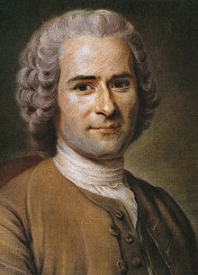

Jean-Jacques Rousseau
The Social Contract Theory:
Man is born free, and everywhere he is in chains.
The Sovereign, having no force other than the legislative power, acts only by means of the laws; and the laws being solely the authentic acts of the general will, the Sovereign cannot act save when the people is assembled.
Every law the people have not ratified in person is null and void — is, in fact, not a law.
The legislative power belongs to the people, and can belong to it alone.

Slide 6
Locke and the Declaration of Independence: some parallels
John Locke | The Declaration of Independence
Natural Rights: “The state of nature has a law to govern it” “life, liberty, and property” | “Laws of Nature and Nature’s God” “life, liberty, and the pursuit of happiness”
Purpose of Government: “to preserve himself, his liberty, and property” | “to secure these rights”
Equality: “men being by nature all free, equal, and independent” | “all men are created equal”
Consent of the Governed: “for when any number of men have, by the consent of every individual, made a community, with a power to act as one body, which is only by the will and determination of the majority” | “Governments are instituted among men, deriving their just powers from the consent of the governed.”
Limited Government: “Absolute arbitrary power, or governing without settled laws, can neither of them consist with the ends of society and government.” “As usurpation is the exercise of power which another has a right to, so tyranny is the exercise of power beyond right, which nobody can have a right to.” | “The history of the present King of Great Britain is a history of repeated injuries and usurpations”.
Right to Revolt: “The people shall be the judge…Oppression raises ferments and makes men struggle to cast of an uneasy and tyrannical yoke.” | “Prudence, indeed, will dictate that Governments long established should not be changed for light and transient causes…But when a long train of abuses and usurpations, pursuing invariably the same Object evinces a design to reduce them under absolute Despotism, it is their right, it is their duty, to throw off such Government.”

Slide 7
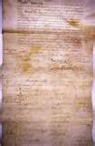
The government that failed: 1776-1787
The Articles of Confederation:
  The nation’s first government
  Adopted by Congress in 1777 and enacted in 1781
  The Articles established a government dominated by the states because the founders feared government and its powers.
    The Articles established a national legislature with one house; states could send up to seven delegates or as few as two, but each state had only one vote.
    There was no president and no national court, and the powers of the national legislature- the Congress- were limited.

Slide 8
The government that failed: 1776-1787
Most authority rested with the state legislatures because the new nation’s leaders feared a strong central government would become as tyrannical as British rule.
Even after the ratification of the Articles, Congress was plagued with problems:
  Congress had few powers outside maintaining an army and navy.
  Congress had to request money from the states because it had no power to tax. If states refused, Congress did without. In the end Congress voted to disband the army, despite continuous threats from Britain and Spain.
  Congress lacked the power to regulate commerce.
  Took 9 states to agree to a new law which was difficult.
In general, the weak and ineffective national government could take little independent action.

Slide 9
THE GOVERNMENT THAT FAILED: 1776-1787
Changes in the States:
  The most important change was a dramatic increase in democracy and liberty.
  Many states adopted bills of rights.
  An expansion in political participation brought a new middle class to power, power shifted from a handful of wealthy individuals to a more broad-based group including farmers and other less wealthy groups.
  Structure of government in the states became more responsive to the people.
  The idea of equality became very popular.
Economic Turmoil:
  A few states, notably Rhode Island, demonstrated their support of debtors, passing policies favoring them over creditors.
  States printed their own paper money, which was worthless.

Slide 10
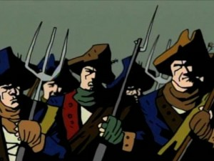

The government that failed: 1776-1787
Shays’ Rebellion:
  Many lost their land due to creditors
  Led by Daniel Shays, Shays’ Rebellion was a series of attacks on courthouses to prevent judges from foreclosing on farms.

Slide 11
The Agenda in Philadelphia cont.
The Economic Issues:
  The states established tariffs against products from other states
  Paper money was worthless
  Congress was having trouble raising money because the economy was in a recession
All the delegates believed a strong national government was needed to bring economic stability to the union of states that existed under the Articles of Confederation.
Solutions:
  The delegates made sure that the Constitution clearly spelled out the economic powers of Congress.
  Prohibitions were put on the states.

Slide 12
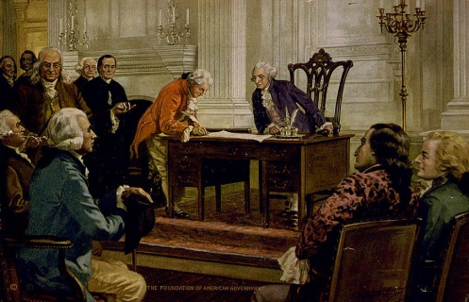
Making a constitution: the Philadelphia convention
Representatives from twelve states came to
Philadelphia; Rhode Island refused to send
delegates and Virginia, fearing a centralization
of power, did not attend.
The U.S. Constitution was written in 1787 and ratified in 1788, replacing the Articles of Confederation. (Forced to since Rhode Island did no show up)
Philosophy into Action:
  The 55 men all agreed on the questions of:
    Human Nature (Government should play a key role in containing the natural self-interest of people and believed in the writings (Leviathan) of Thomas Hobbes)
    Political conflict (Government s that are run by factions are prone to instability, tyranny, and possibly violence. There for the effects of factions had to be checked)
    Objects of government (“The preservation of property is the end of government”)
    Nature of government (A complex network of checks and balances and separation of powers would be required for a balanced government)

Slide 13
The agenda in Philadelphia
The Equality Issues:
  The Declaration of Independence states that all men are created equal; the Constitution however, is silent on equality.
  Three issues occupied the policy agenda in Philadelphia:
    Equal representation
      The New Jersey Plan called for each state to be equally represented in the new Congress. Drafted by William Paterson.
      The opposing strategy was the Virginia Plan, which called for giving each state representation in Congress based on the state’s population. Drafted by James Madison.
      Conflict resolved with the Connecticut Compromise, which created two houses in Congress: the Senate and the House of Representatives. The Senate would have 2 members from each state and the House would have representation based on population. Drafted by Roger Sherman.
    Slavery (Outlawed importation of slaves in 1808; 3/5th Compromise, where every five slaves would count as 3 people)
    Political Equality (Should the right to vote be based on universal manhood suffrage or should it be very restricted?)

Slide 14
The agenda in Philadelphia
Taking Ideas from both plans
Virginia Plan | New Jersey Plan
Bicameral legislature Lower house elected by the people Upper house chosen by lower house from the nominations submitted by state legislatures. | Unicameral legislature Representatives chosen by state legislatures. Each state receives one vote
Representation in each house based on population and/or monetary contributions to the National government by the state. | Representation in the house would be equal among the states
Single executive chosen by legislative branch, limited to one term only, could veto legislative acts, removed by Congress. | Plural executive chosen by legislative branch, no veto powers, removal by the states.
Judges chosen by legislative branch | Judges appointed for life by the executive

Slide 15
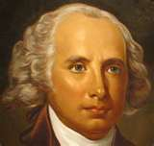
The Agenda in Philadelphia cont.
The Individual Rights Issues:
Most of the delegates believed that the various states were
already doing a sufficient job of protecting individual rights.
The Constitution says very little about personal freedoms.
The protections it does offer are:
  It prohibits suspension of the writ of habeas corpus (a court order requiring jailers to explain to a judge why they are holding a prisoner custody).
  It prohibits Congress and the states from passing bills of attainder (which punishes people without a judicial trial).
  It prohibits Congress and the states from passing ex post facto laws.
  It prohibits the imposition of religious qualifications for holding office in the national government .
  It defines strict rules of evidence for conviction of treason.
  It upholds the right to trial by jury in criminal cases.

Slide 16
Preamble: Introduction
Article 1: Legislature (Congress)
Article 2: Executive (President)
Article 3: Judicial (Supreme Court)
Article Four: Full Faith and Credit Clause
Article Five: Amending the Constitution
Article Six: Supremacy Clause
Article Seven: Ratification

Slide 17
Preamble
We the people of the United States, in order to form a more perfect union, establish justice, insure domestic tranquility, provide for the common defense, promote the general welfare, and secure the blessings of liberty to ourselves and our posterity, do ordain and establish this Constitution for the United States of America.

Slide 18
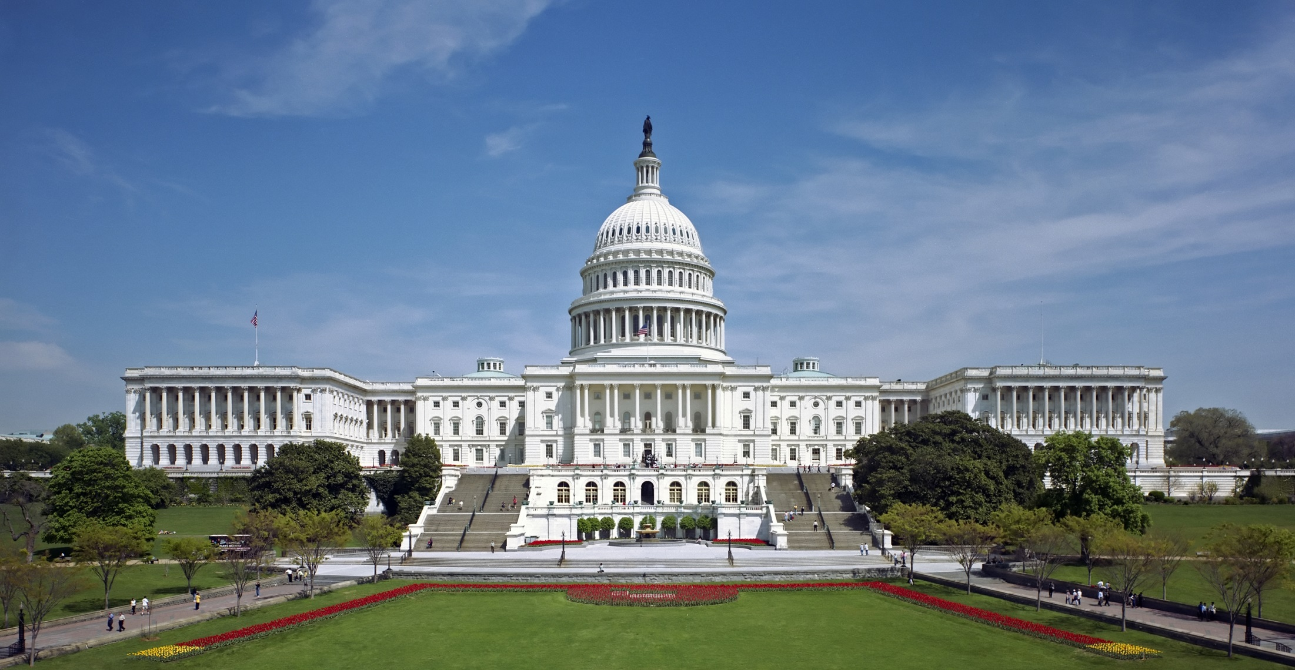
Legislature- Congress
A group of elected officials that create the laws
House of Representatives
Senate

Slide 19

Executive Branch – President
Enforces the law

Slide 20

Judicial Branch-Supreme Court
Interprets the law

Slide 21
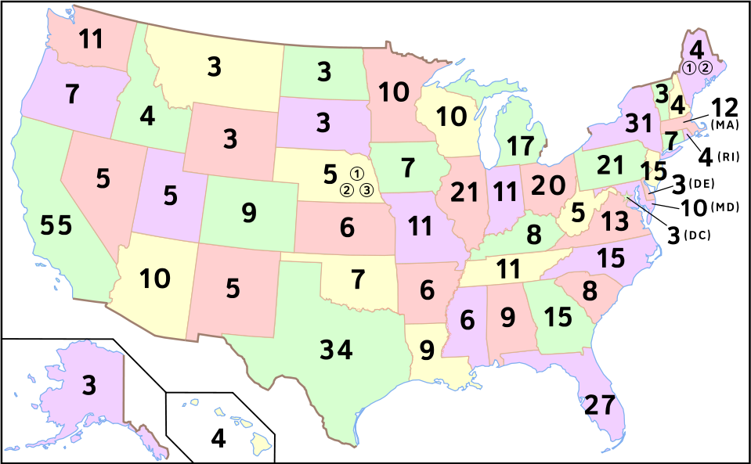
Electoral College
Group that elects the President

Slide 22
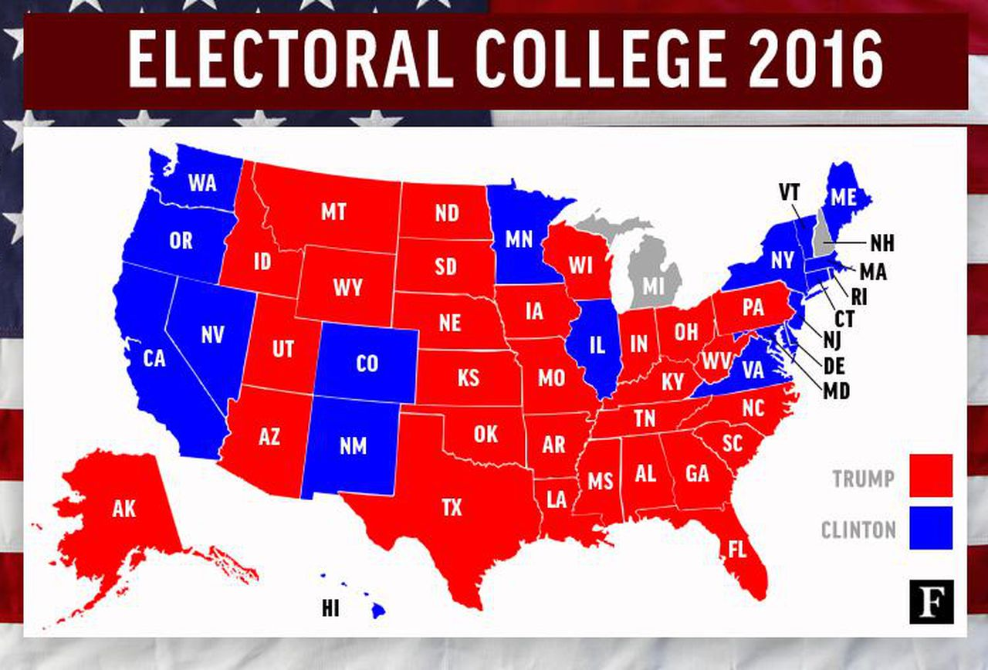
Today the popular vote of each state determines who wins that state’s electoral college votes

Slide 23

The Constitution – Solving all of our problems

Slide 24
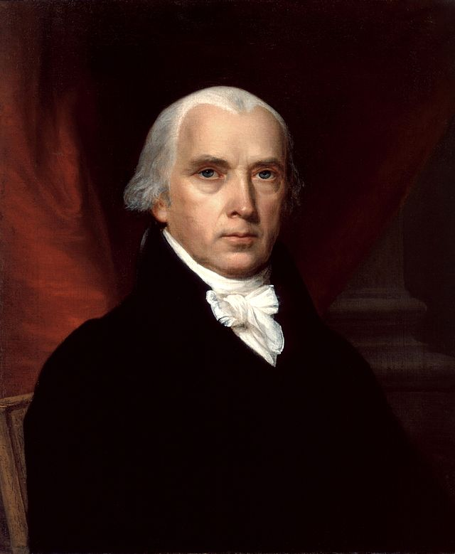
The Madison Model

Slide 25
The Madisonian Model
To prevent the possibility of a tyranny of the majority, James Madison proposed the following:
  Popular Sovereignty
  establishes that all power rests with the people, and that the people have given the government its power through the Constitution. The government can only function with the consent of the people.
  Limiting Majority Control
    Madison believed that most governmental power had to be kept away from the majority.
  Separating Powers
    Each of the three branches of government –Executive, Legislative, and Judicial –would be independent of one another so that no single branch could control the others.
    Power was shared among the three institutions.
  Creating Checks and Balances
    Reflected Madison’s goal of setting power against power to constrain government actions.
    Favors the status quo.
  Establishing a Federal System
    Divided the power of government between a national government and the individual states.

Slide 26
The Madisonian Model

Slide 27
Beware of the factions (groups)
Be afraid! Be very afraid!

Slide 28
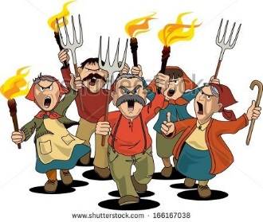
Two different types of factions
Minority Factions- easy to control, majority will vote them out
Majority Factions- Harder to control, they will control most of the government

Slide 29

Take power away from the majority
President elected by the Electoral College
Supreme Court appointed by the President
Senators appointed by state legislators

Slide 30
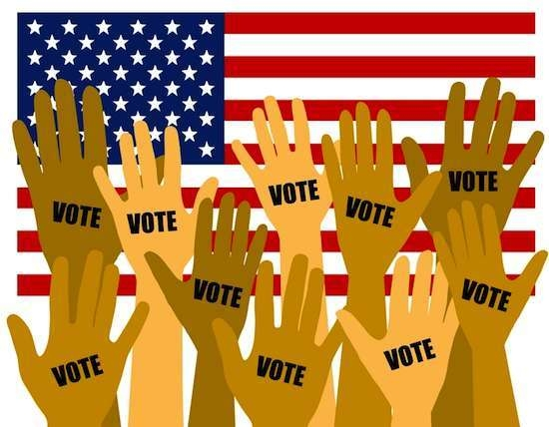
The only branch of government that was elected by the majority was the House of Representatives

Slide 31
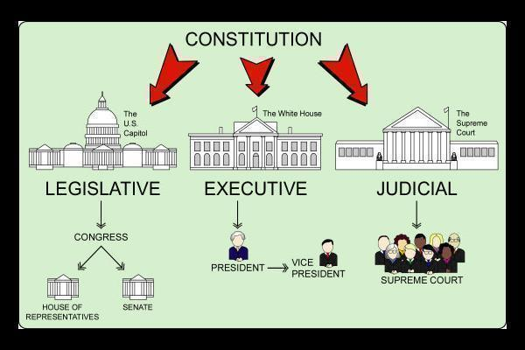
Separation of Powers

Slide 32
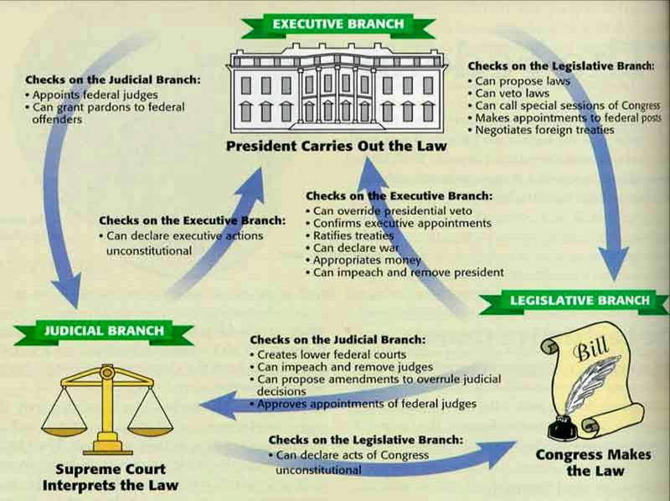
Checks and Balances

Slide 33

Economic issues
Problems in the economy
Paper money was worthless
Tariffs between the states restricted commerce
Congress couldn’t raise money

Slide 34

Solutions
Congress can tax, borrow, spend
Pay Debts
Coin money
Congress can regulate interstate and foreign trade

Slide 35
Important clauses of the Constitution

Slide 36
Necessary and Proper Clause- Elastic Clause
Article I, Section 8
The Congress shall have Power ... To make all Laws which shall be necessary and proper for carrying into Execution the foregoing Powers, and all other Powers vested by this Constitution in the Government of the United States, or in any Department or Officer thereof.

Slide 37
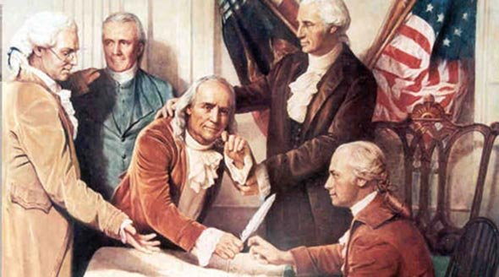
Necessary and Proper Clause Elastic Clause
The national government can do whatever it needs to do to operate the government

Slide 38
Amending the Constitution
The Congress, whenever two thirds of both houses shall deem it necessary, shall propose amendments to this Constitution, or, on the application of the legislatures of two thirds of the several states, shall call a convention for proposing amendments, which, in either case, shall be valid to all intents and purposes, as part of this Constitution, when ratified by the legislatures of three fourths of the several states, or by conventions in three fourths thereof, as the one or the other mode of ratification may be proposed by the Congress.

Slide 39
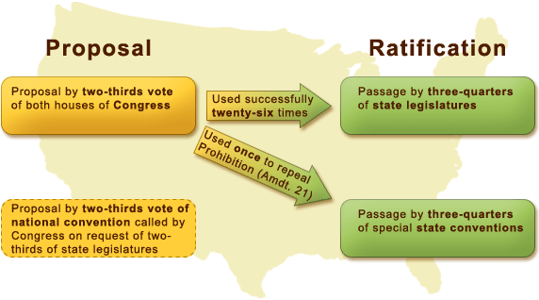
Article V: Amending the Constitution

Slide 40
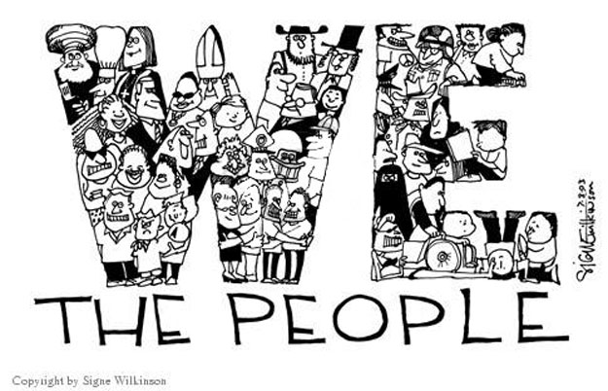
Informal way of amending the Constitution
Judicial interpretation
Political practice
Changes in technology
Demands by policy makers and the electorate

Slide 41
Supremacy Clause
This Constitution, and the laws of the United States which shall be made in pursuance thereof; and all treaties made, or which shall be made, under the authority of the United States, shall be the supreme law of the land; and the judges in every state shall be bound thereby, anything in the Constitution or laws of any State to the contrary notwithstanding.

Slide 42

Article VI: Supremacy Clause
States must do whatever the national government want it to.

Slide 43
Full Faith Credit Clause
Full faith and credit ought to be given in each state to the public acts, records, and judicial proceedings, of every other state; and the legislature shall, by general laws, prescribe the manner in which such acts, records, and proceedings, shall be proved, and the effect which judgments, obtained in one state, shall have in another.

Slide 44
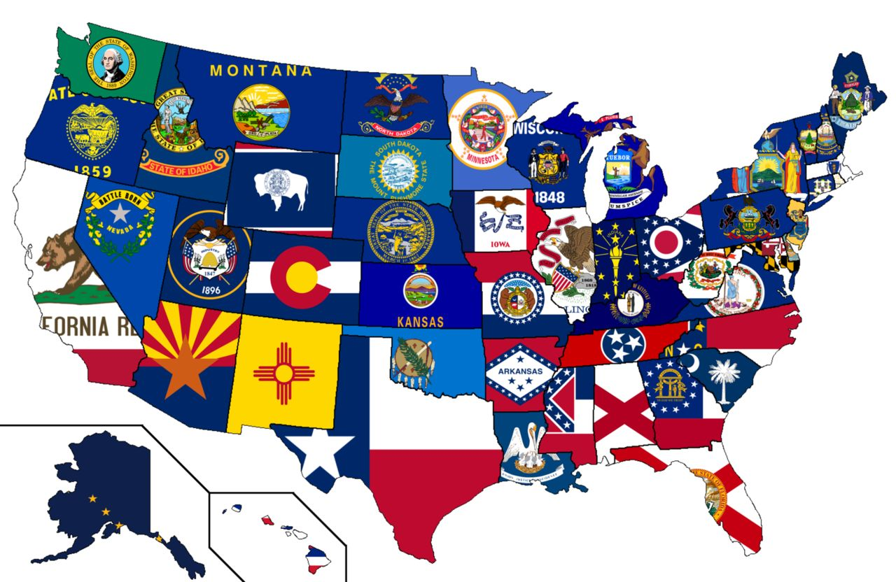
Article 4 Full Faith and Credit Clause
Every state must respect each other’s law’s.

Slide 45

Extradition

Slide 46
Major Constitutional “Clauses”
Admissions Clause
Advice and Consent Clause
Appointments Clause
Arising Clause (U.S. Supreme Court Original Jurisdiction cases)
Commerce Clause*
Compact Clause (No state can enter into war without the approval of Congress)
Contract Clause (States can not interfere with contracts)
Establishment Clause*
Exceptions Clause (Creates the appeals power of the U.S. Supreme Court)
Free Exercise Clause*
Full Faith and Credit Clause* (must respect the public records and acts of other state courts)
General Welfare Clause*
Guarantee Clause (National government with protect states from invasion, and will provide a Republican form of government as well as protect us from domestic violence)
Necessary and Proper Clause (Elastic Clause, Implied Powers Clause, Sweeping Clause)*
Origination Clause (All Revenue Bills must start in the House of Representatives) AKA Power of the Purse
Presentment Clause (explains how a bill becomes a law)
Privileges and Immunities Clause*
Supremacy Clause (Supervising Clause)*

Slide 47
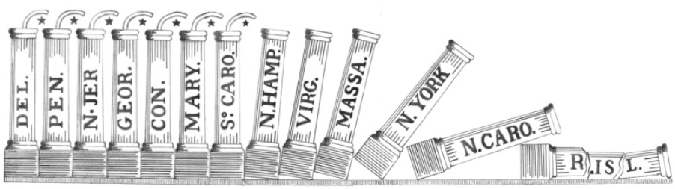
Article VII: Ratification
States legislatures need to now approve the Constitution

Slide 48
What’s missing?

Slide 49
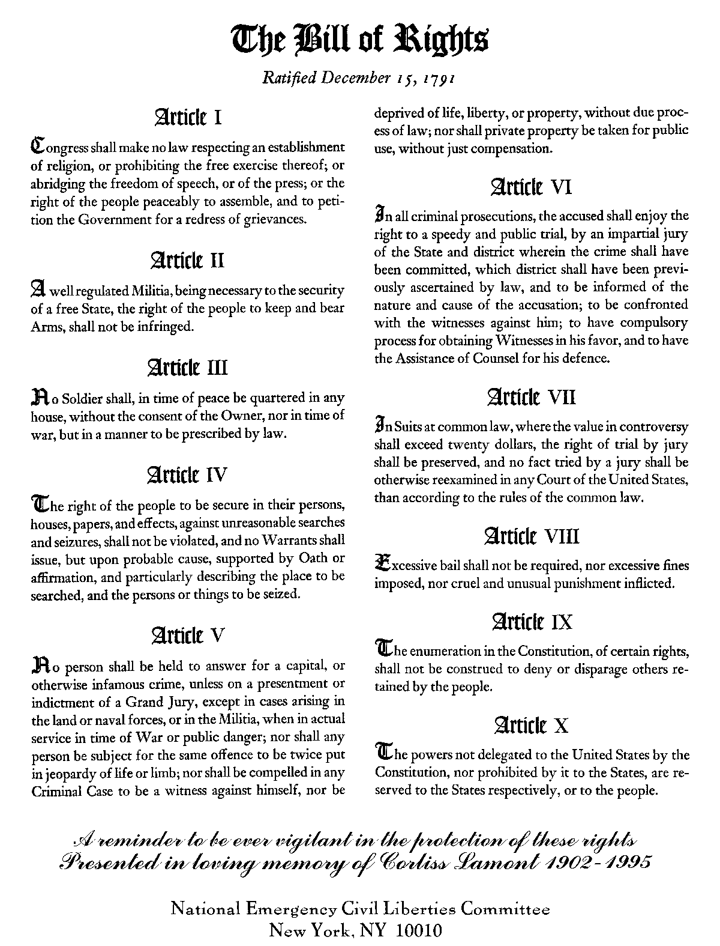
Bill of Rights –civil liberties to the people

Slide 50
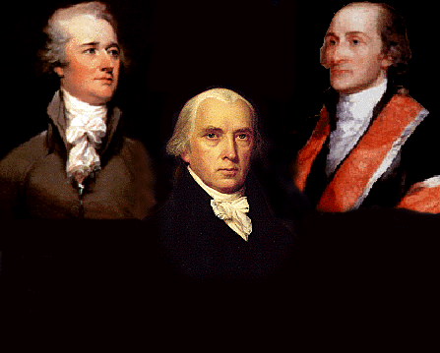
Federalists – In favor of ratification of the Constitution

Slide 51
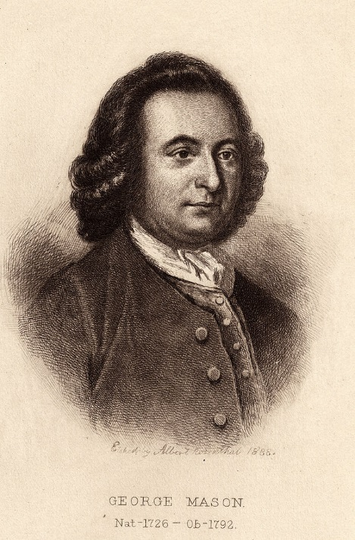
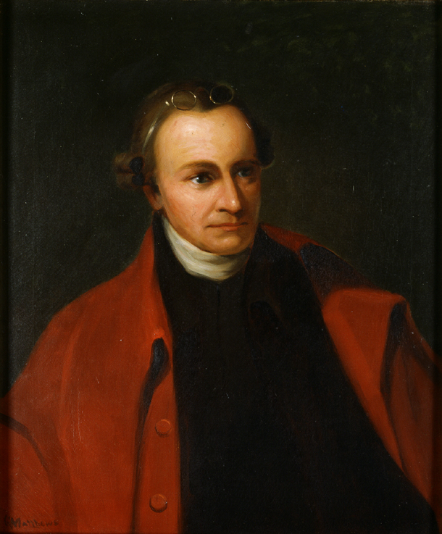
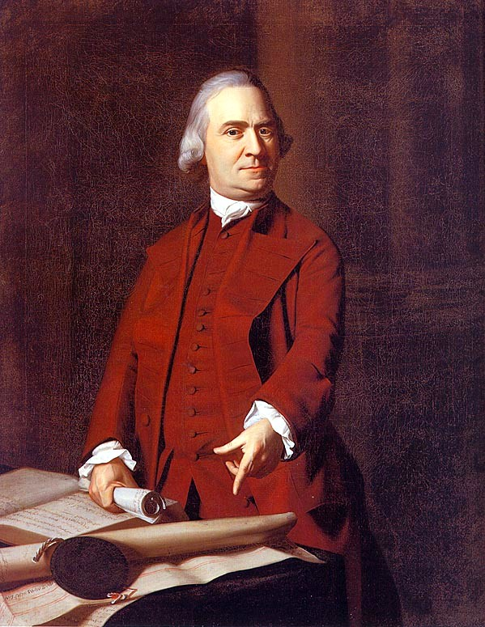
Anti-federalists – against ratification

Slide 52
Federalists vs. Anti-Federalists
Federalists | Anti-Federalists
Favored the Constitution as written | Opposed the Constitution as written
Led by James Madison, Alexander Hamilton, John Jay | Led by Patrick Henry, Richard Henry Lee, George Mason and Samuel Adams
Stressed weaknesses of Articles; strong government needed to protect the nation and solve domestic problems | Wanted strong state governments; feared a strong national government. Fear was they would be “distant” from the problems
Checks and balances would protect against abuses. | Fear it Created a strong executive similar to monarchy
Protection of property rights | Wanted fewer limits on popular participation. (more people in the government process)
Constitution is a bill of rights with limitations and reserved powers for the states; state constitutions already had protections like the bill of rights. | Wanted a bill of rights to protect citizens against government.
Favored Federal Taxes to pay for funding the government. | Federal power to tax was a dangerous control over citizens and states.
Citizens would control the House and state government would control the Senate. | No limits on what laws the legislative branch could make.
This new, single executive held powers that were all checked at almost every level.

Slide 53
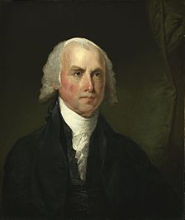
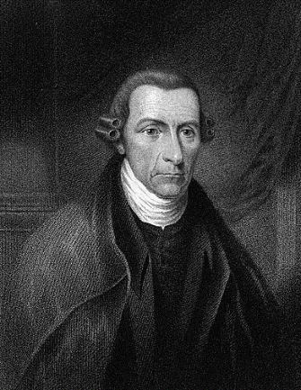
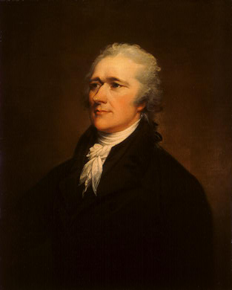
Federalists vs. Anti-Federalists
Federalists 9 & 10: This essay addresses how and why to guard against the rise of factions. Also predicted the rise of interest groups and partisan politics. Federalists 78: Advantages and need to have the judicial branch. (Supreme Court)
Federalists 46: 2nd Amendment advantages of America
Brutus 1
Federalists 51: The Structure of the Government Must Furnish the Proper Checks and Balances Between the Different Departments
Alexander Hamilton
Patrick Henry
James Madison

