Slide 1
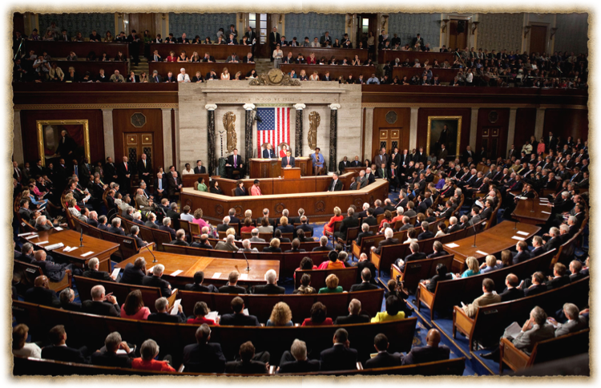
Congress (114th )
Textbook Chapter 12
Studyguide book Chapter 10
A.P. Government

Slide 2

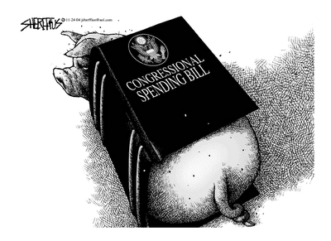
The Incumbency Advantage
  Advertising:
    The goal is to be visible to voters.
    Frequent trips home & newsletters are used.
  Credit Claiming:
    Casework: providing help to individual constituents.
    Pork Barrel: federal projects and grants that benefit a congressional district or state.
    Earmark: a provision in a bill that benefits a particular group.

Slide 3
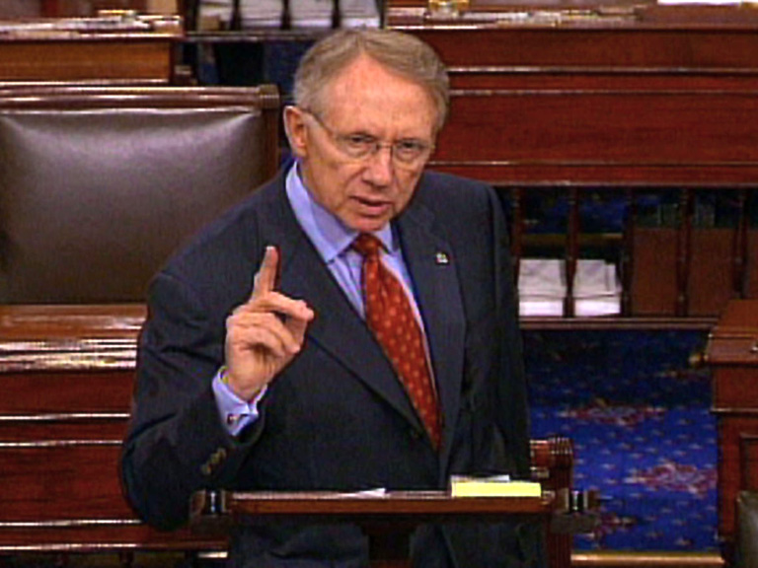
The Incumbency Advantage
  Position Taking:
    Portray themselves as hard working, dedicated individuals.
    Occasionally take a partisan stand on an issue.
  Weak Opponents:
    Most opponents are inexperienced in politics.
    Most opponents are unorganized and underfunded.

Slide 4
Incumbency in the House and Senate
The House (90% approx.) has a higher rate of incumbency reelection than the Senate (80% approx.)
  House members serve in small, often safe districts
  House members serve two year terms.
  House members run for reelection almost all of the time.

Slide 5
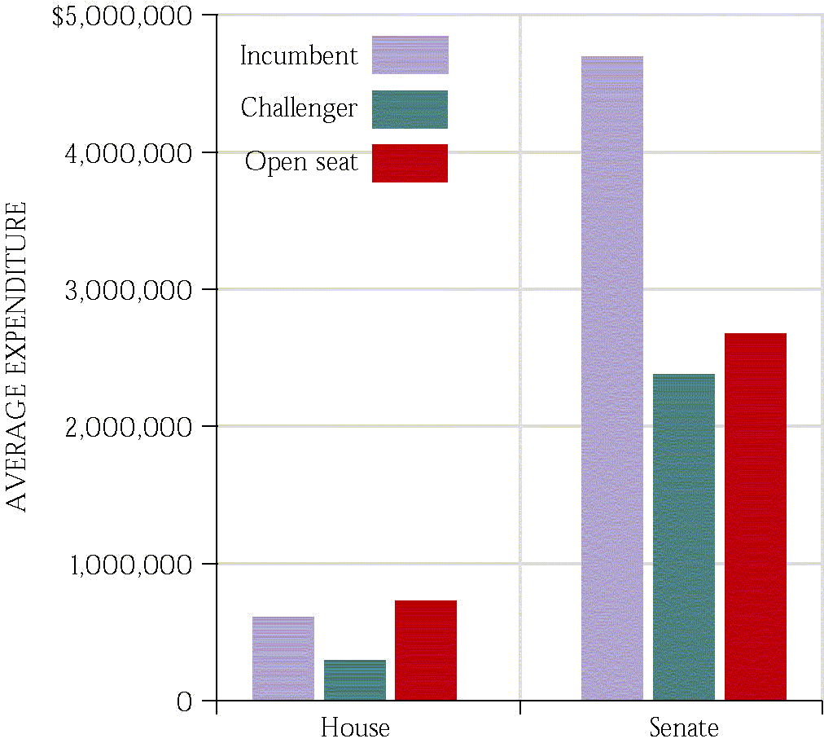
Spending in Congressional Elections
  Open seats are expensive.
  PACs contribute directly to candidates.
  527s and 501(c)(3)s spend independently.
  Spending lots of money does not guarantee a win.

Slide 6
Why Incumbents Sometimes Lose
Incumbents may become involved in a scandal.
Incumbents may be redistricted out of their seat and may face another incumbent in their new district.
Redistricting may cause a seat to become competitive.
There might be a “throw the bums out” sentiment.

Slide 7

The Role of Party Identification
Most members of Congress come from a district that is a majority of the party that they represent.
Malapportionment: When districts in a state are unequal in size and population.
Promotes the concept of gerrymandering
Districts can change over time as people move in or out and also as the community ages.
Key Cases:
Baker v. Carr
Wesberry v. Sanders
League of United Latin American Citizens v. Perry Governor of Texas

Slide 8
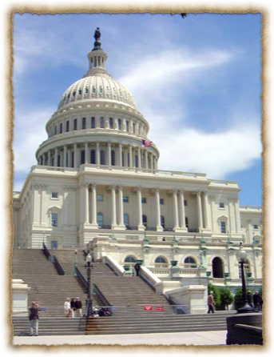
Being a Congressmen
The average salary of a congressmen is approx. $189.000 per year.
Some leadership positions like the Speaker of the House makes $223,500 a year.
Great benefits including retirement for all members who serve.
58% of all members are millionaires

Slide 9
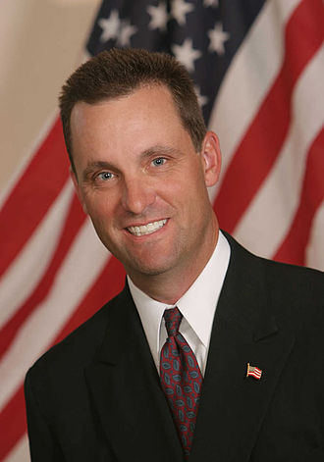
Being a Congressmen
Main job is to serve their Constituents
Office space in Washington as well as in the community or state the serve.
Travel allowances and the use of "junkets".
Franking privileges.
Free flowers from National Botanical Gardens.
Research services from Library of Congress.
Rep. Steve Knight

Slide 10
Serving Constituents
Party Views. Congress is organized primarily along party lines, so party membership is an important determinant of a member�s vote.
Delegate – An official who is expected to represent the views of his or her constituents even when personally holding different views; one interpretation of the role of legislator.
Trustee – An official who is expected to vote independently based on his or her judgment of the circumstances; one interpretation of the role of the legislator.

Slide 11
How Members Make Decisions
Interest Groups
Colleagues
Caucuses
Party &
President
Representative
Constituents
Staff
Political Action Committees

Slide 12
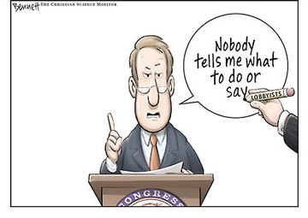
The Congressional Process
Lobbyists and Interest Groups
  There are over 26 lobbyists for every member of Congress- the bigger the issue, the more lobbyists will be working on it.
  Lobbyists can be ignored, shunned and even regulated by Congress.
  Ultimately, it is a combination of lobbyists and others that influence members of Congress.

Slide 13
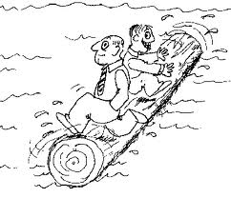
Logrolling
Logrolling means exchanging votes for favors.
“I’ll vote for your bill if you vote for my bill.”

Slide 14
Powers of Congress
Lawmaking
Lay and collect taxes
Spend Money
Regulate commerce
Declare war
Create courts

Slide 15
House of Representatives
Must be 25 years or older.
American citizen for seven years.
Must live or at least own a home in the district they represent.

Slide 16
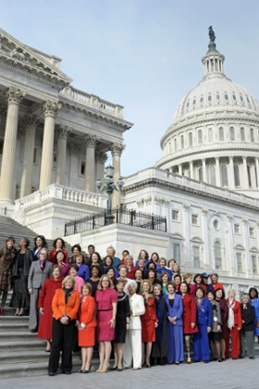
The House Of Rep's
435 Members
2 years per term
institutionalized (lots of rules and procedures)
party loyalty is King
Led by the House Rules Committee (Traffic Cop)
Led daily procedures by the speaker of the house.
Focus on domestic issues

Slide 17
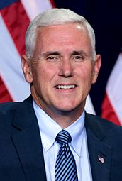

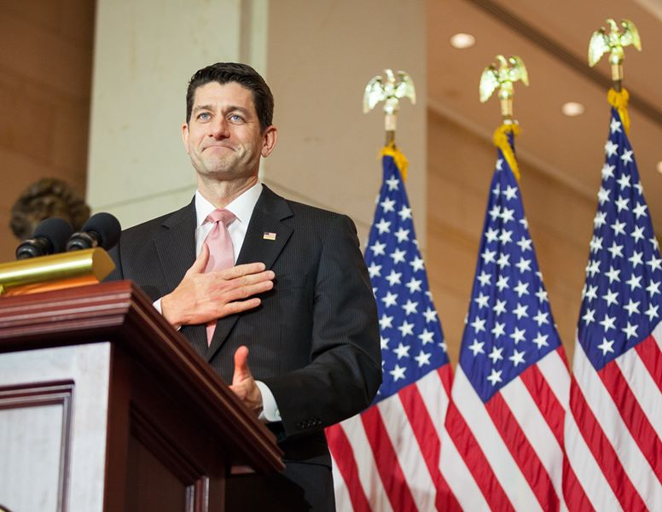
The make up of Congress
Senate President: Mike Pence (R)
Senate President Pro-Tempore: Orrin Hatch (R)
House Speaker: Paul Ryan (R)
Total members: 535+ 6 non members.
100 senators
435 members of the House of the Representatives.

Slide 18








Other House Leadership
Majority Leader
Rep. Kevin McCarthy (R)
Majority Whip
Rep. Steve Scalise (R)
Republican Conference Chair
Rep. Cathy Rodgers
Republican Policy Committee Chair
Rep. Luke Messer
Democratic Leader
Rep. Nancy Pelosi (D)
Democratic Whip
Rep. Steny Hoyer (D)
Assistant Democratic Leader
Rep. James Clyburn (D)
Democratic Caucus Chair
Rep. Xavier Becerra (D)
There maybe a few changes to leadership during the start of the 115th Congress that starts on January 3rd, 2017

Slide 19
Senate
Must be 30 years of age.
Citizen of the United States for at least 9 years.
Must live in the state in which they serve.

Slide 20
The Senate
100 Members (2 per state)
6 year terms
Meant to protect the elites interests and play the role of watchdog of the House and of the Presidency.
Gives “advice & consent”
Very influential on foreign affairs.
Unlimited debate
Filibuster
Cloture

Slide 21
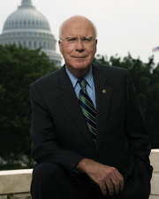
Senate Leadership
Constitutionally Mandated Officers
Vice President
Mike Pence (R)
President Pro Tempore
Orrin Hatch (R)

Slide 22
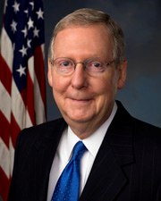
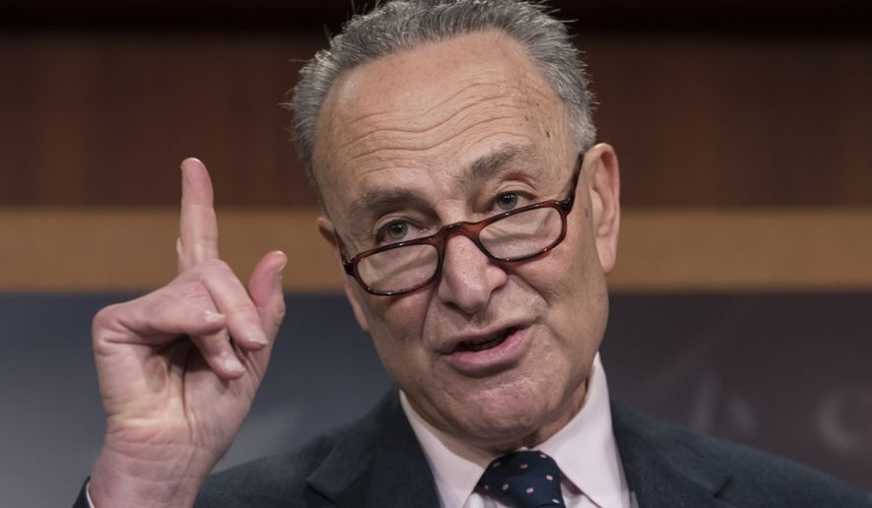
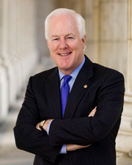
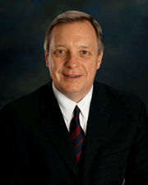
Other Senate Leadership
Majority Leader
Mitch McConnell
Minority Leader
Charles E. Schumer (D)
Majority Whip
John Comyn (R)
Minority Whip
Richard Durbin (D)

Slide 23

Characteristics of members
Does the ethnic background matter in our Rep's?
Members are not able to claim descriptive representation. Meaning they do not look like the USA in a snapshot.
They do, however, engage in substantive representation. Meaning they fight for certain groups, so that all groups have a voice.

Slide 24
115th Congressional Make up
House Of Representatives
241 GOP and 194 Dems
Senate
46 Dems
2 Independents
52 GOP

Slide 25
115th Congressional Make up
A record 104 women with a record 21 in the Senate
(19 percent of the total membership)
49 African American members (9 percent of the total membership)
38 Hispanic or Latino Members in the 115th Congress, 7.0 percent of the total membership
4 male Hispanic Senators (three Republicans, one Democrat).
2 American Indian (Native American), both of whom are Republican Members of the House.
98 percent of the members of the 115th Congress are reported to be affiliated with a specific religion. Of the 98 percent, the vast majority (92 percent) are Christian.

Slide 26
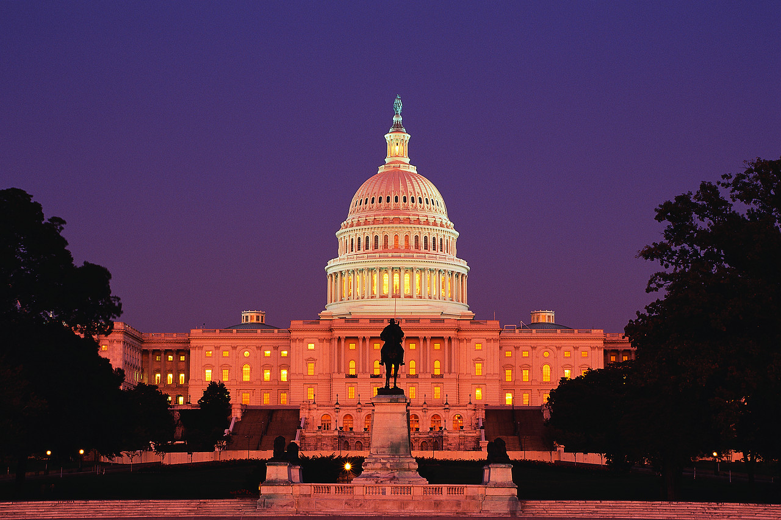
"Congress in session is Congress on public exhibition, whilst Congress in its committee-rooms is Congress at work.”

Slide 27
How Congress is Organized to Make Policy
Committees and Subcommittees
  Standing committees: subject matter committees that handle bills in different policy areas
  Joint committees: a few subject-matter areas—membership drawn from House and Senate (example: Printing and Taxation committiees.
  Conference committees: resolve differences in House and Senate bills
  Select committees: created for a specific purpose, such as the Watergate investigation

Slide 28
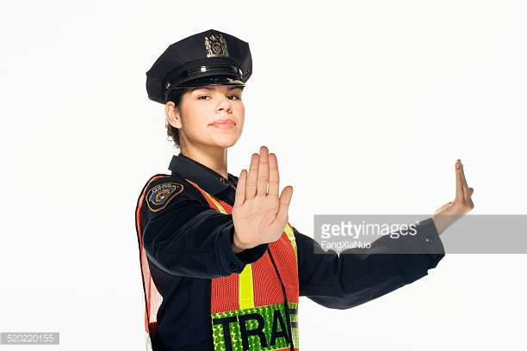
Rules Committee
Why is it important?
  The rules committee is like the “traffic cop”

Slide 29
Some other important Committees
House Appropriations Committee: sets funds for specific projects and programs.
House Ways and Means Committee: considers tax bills
Senate Finance Committee: considers tax bills

Slide 30
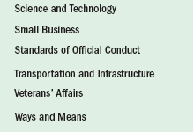
How Congress is Organized to Make Policy

Slide 31
The Committees at Work: Legislation and Oversight
How Congress is Organized to Make Policy
  Legislation
    Committees work on the 11,000 bills every session
    Some hold hearings and “mark up” meetings
    Pigeonholed: when a bill is forgotten, delayed or dead in committee.
  Legislative oversight
    Monitoring of the bureaucracy and its administration of policy through committee hearings
    As publicity value of receiving credit for controlling spending has increase, so too has oversight grown
    Oversight usually takes place after a catastrophe

Slide 32
How Congress is Organized to Make Policy
Getting Ahead on the Committee
  Committee chair: the most important influencer of congressional agenda
    Dominant role in scheduling hearings, hiring staff, appointing subcommittees, and managing committee bills when they are brought before the full house
  Most chairs selected according to seniority system.
    Members who have served on the committee the longest and whose party controlled Congress become chair

Slide 33
How Congress is Organized to Make Policy
Caucuses: The Informal Organization of Congress
  Caucus: a group of members of Congress sharing some interest or characteristic
  About 300 caucuses
  Caucuses pressure for committee meetings and hearings and for votes on bills.
  Caucuses can be more effective than lobbyists.

Slide 34
How Congress is Organized to Make Policy
Congressional Staff
  Personal staff: They work for the member, mainly providing constituent service, but help with legislation too.
  Committee staff: organize hearings, research and write legislation, target of lobbyists
  Staff Agencies: CRS, GAO, CBO provide specific information to Congress

Slide 35
The Congressional Process
Legislation:
  Bill: a proposed law
  Anyone can draft a bill, but only members of Congress can introduce them.
  More rules in the House than in the Senate
  Party leaders play a vital role in steering bills through both houses, but less in the Senate
  Countless influences on the legislative process

Slide 36


The Congressional Process

Slide 37
Some key Terms
Committee of the Whole: 100 members needed to have a quorum where the bill would be discussed on the floor. The bill then goes onto the full floor.
Germane: means that a amendment to the bill must be relevant to the bill being considered.
Super majority when one party holds 60 votes in the Senate.
Rider:In legislative procedure, a rider is an additional provision added to a bill or other measure under the consideration by a legislature, having little connection with the subject matter of the bill. Riders are usually created as a tactic to pass a controversial provision that would not pass as its own
Christmas-tree bill: A bill with many riders.

Slide 38
Types of Resolutions
Simple Resolution: if passed establishes rules, regulations or practices that do not have the force of law.
Concurrent resolution: comes from both houses, and often settles housekeeping and procedural matters that affect both chambers of Congress.
Joint Resolution: requires approval of both chambers and the signature of the president. (Law)

Slide 39
Congressional Procedure Terms
Closed rule – A procedural rule in the House of Representatives that prohibits any amendments to bills or provides that only members of the committee reporting the bill may offer amendments.
Open rule – A procedural rule in the House of Representatives that permits floor amendments within the overall time allocated to the bill. (bills must be germane which means they must have to deal with the subject of the bill)

Slide 40
Congressional Procedure Terms
Hold – A procedural practice in the Senate whereby a senator temporarily blocks the consideration of the bill or nomination. (sometimes called Pigeon Hold)
Filibuster – A procedural practice in the Senate whereby a senator refuses to relinquish the floor and thereby delays proceedings and prevents a vote on a controversial issue.
Cloture – A procedure for terminating debate, especially filibusters, in the Senate.

Slide 41
Congressional Procedure Terms
Earmarks – Special spending projects that are set aside on behalf of individual members of Congress for their constituents.
Pork Barrel: the use of government funds for projects designed to please voters or legislators and win votes.
Example: Bridge to Nowhere:
Hidden Earmarks- Are Earmarks that are placed in bills that are not seen by Congress as a whole so they are not actually voted on.
Seniority rule – A legislative practice that assigns the chair of the committee or subcommittee to the member of the majority party with the longest continuous service on the committee.

Slide 42
How voting occurs in Congress
Teller Vote: in which members file past the clerk stating their “yeas” and “nays”
Voice Vote: members shout “yea” or “nay”
Division Vote: members stand to be counted
Roll Call Vote: Members answer “yea” and “nay” when name is called.
Electronic Voting: using a plastic card in a machine to place vote: (like in the movie)

Slide 43
The Congressional Process
Presidents and Congress: Partners and Protagonists
  Presidents attempt to persuade Congress that what they want is what Congress wants.
  Presidents have many resources to influence Congress.
  But to succeed, the president must win at least 10 times.
  Ultimately, residential leadership of Congress is at the margins.

Slide 44
Understanding Congress
Congress and Democracy
Representation versus Effectiveness
  Supporters claim that Congress is:
  a forum in which many interests compete for policy
  is decentralized, so there is no oligarchy to prevent comprehensive action
  Critics argue that Congress:
  is responsive to so many interests that policy is uncoordinated, fragmented, and decentralized
  is so representative that it is incapable of taking decisive action to deal with difficult problems

