Slide 1
Civil Liberties
Textbook Chapters 4
Studyguide Book Chapter 15
Coach Flu
Revised 2017-2018

Slide 2
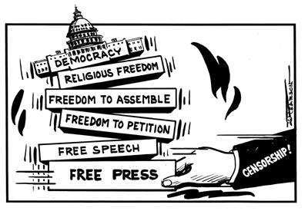
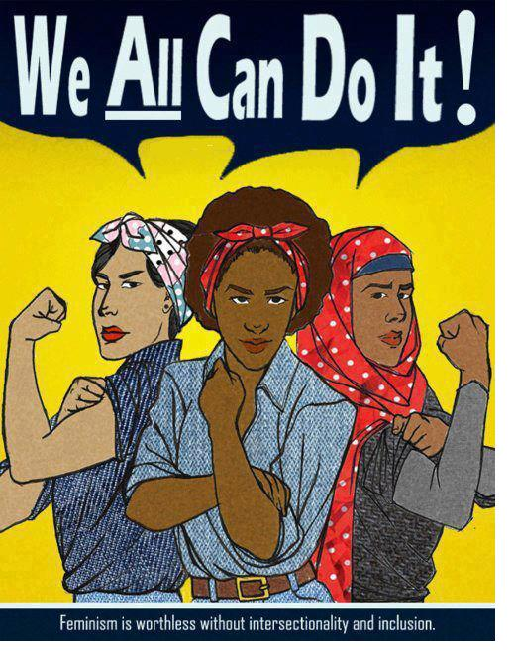
Civil Liberties vs. Civil Rights
Civil liberties
Civil rights
place limits on government
give the individual "liberty" from the actions of the government
provide “due process” of the laws
Bill of Rights
deliberate actions taken by government to create equal conditions for all
provide equal protection of groups in the minority
14th Amendment
“equal protection”

Slide 3
What influenced establishment of American civil liberties?
The Age of Enlightenment 1650s-1780s
  Challenged the authority of the Catholic Church
  Idea of reforming society with toleration, science and skepticism
  Idea of natural rights—all humans are born with these
    life
    liberty
    property
  Idea of the social contract—people need protections and agree to give up certain freedoms for that protection. What is the best form of protection?
    absolute monarchy (Hobbes)
    Constitutional monarchy or republic (Locke)
    Limited government with the consent of the governed (Locke)
    Democracy or whatever is decided directly by the people (Rousseau)

Slide 4
Definitions simplified
Civil Liberties
Rights that need protection from the government having too much control
Bill of Rights
Amendments 1 through 10 of the US Constitution
Incorporation
use of the 14th amendment in case decisions to make the Bill of Rights apply to actions of the states
Civil Rights
Rights that need protection by the government supporting a specific group
Due process
a legal understanding that you are owed certain rights from the government
Equal protection
a constitutional guarantee that no person or class of persons shall be denied the same protection of the laws that is enjoyed by other persons or other classes of people

Slide 5
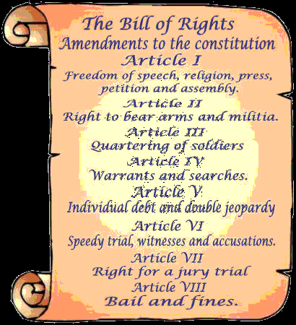
The Bill of Rights then and Now
The Bill of Rights is the first 10 amendments to the U.S. Constitution which defines the basic civil liberties that are protected for the people from the government.

Slide 6
The Bill of Rights Then and Now
Most of the amendments apply not only to the national government, but states as well. A state can not infringe on our rights that are protected by the Constitution.
First Amendment: establishes the four great liberties: freedom of press, speech, religion, and assembly.
Barron v. Baltimore: 1833 Supreme court decision holding that the Bill of Rights restrained only the national government, not the states and cities.
Gitlow v. New York: 1925 Supreme court decision holding that freedoms of press and speech are “fundamental personal rights and liberties protected by the due process clause and fourteenth amendment from impairment by the states” as well as by federal government.
Fourteenth Amendment: an amendment to the U.S. Constitution, ratified in 1868, defining national citizenship and forbidding the states to restrict the basic rights of citizens or other persons.
Due Process Clause: a clause in a constitution prohibiting the government from depriving a person of life, liberty, or property without due process of law.
Incorporation (Selective) Doctrine: The legal concept under which the supreme court has nationalized the Bill of Rights by making most of its provisions applicable to the states through the 14th Amendment. (must understand this concept)

Slide 7
The Bill Of Rights: 1st Amendment
First Amendment rights include:
  Freedom of Expression
    Freedom of speech
    Freedom of the press
    Freedom to assemble peaceably
    Freedom to petition the government for a redress of grievances
  Freedom of Religion
    Establishment clause
    Free exercise clause

Slide 8
Freedom of Religion
Establishment Clause: Part of 1st Amendment stating “Congress shall make no law respecting an establishment of religion.”
  There can be no established national religion.
1984 Equal Access Act made it so all people, even students, from Parochial schools could use another public schools facilities.
Neutrality when it comes to religion is not easy for people or the Government.
Zelman v. Simmons-Harris: 2002 court decision that upheld a state providing familes with vouchers that could be used to pay for tuition at religious schools.
Engle v. Vitale: 1962 court decision holding that state officials violated the 1st Amendment when they wrote a prayer to be recited by New York’s schoolchildren. Can not hold prayers in school.
School District Abington v. Schempp: 1963 court decision holding that Pennsylvania law requiring Bible reading in schools violated 1st Amendment.
Lee v. Weisman (1992) No inviting clergy to recite prayers at graduation ceremonies

Slide 9
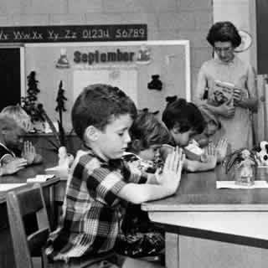
Religious Freedom
Is School Prayer protected?
  Mandatory?
  Daily bible readings?
  Moment of silent prayer?
  Moment of silence for non-religious reasons?
  Prayer at a High School graduation okay?
No. Engel v. Vitale (1962)
No. Abington School District v. Schempp (1963)
No. Wallace v. Jaffree (1985)
    Yes. Brown v. Gwinnett County S.D. (1997)
No, Lee v. Weisman (1992)

Slide 10
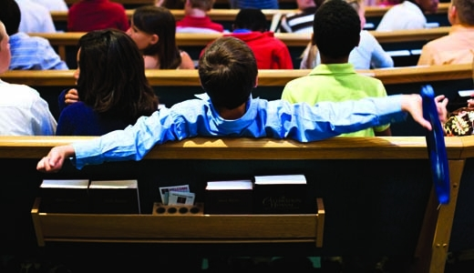
Religious Freedom
Permissible to have school functions (like graduation) in a church, with religious icons on display?
  No. Elmbrook School District v. John Doe (2015)

Slide 11
Religious Freedom
Does the government assist religious schools with tax dollars today?
  Yes.
  Courts have ruled that it is ok for tax dollars to be spent on: school lunch, transportation, speech/hearing support, standardized tests, computer purchases and internet access, vouchers; subject to Lemon test restrictions (Lemon v. Kurtzman 1971)

Slide 12
Freedom of Religion
The Free Exercise Clause
Free Exercise Clause: A 1st Amendment provision that prohibits government from interfering with the practice of religion.
What if something interfered with your religious belief? (Military, drugs, transfusions)
*you still have to abide by the laws of states and national government*
Religious restoration act 1993: right to perform their religious rituals unless the government can show that the law or regulation in question is narrowly tailed and in pursuit of a “compelling interest.”
The restoration act, however, was deemed unconstitutional in 1997 but, it a few parts still applies to the federal government today.

Slide 13
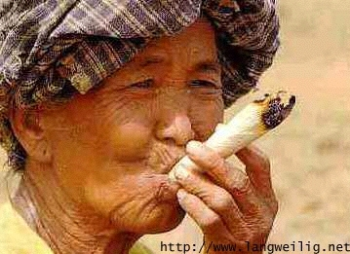
Religious Freedom
Free Exercise
  Distinction between belief and practice
  Courts have upheld state intervention in religious practices
    Drug Use permissible?
    No. Oregon v. Smith (1990) state unemployment
    benefits were denied even though peyote was
    used as a religious ritual
Yes. Gonzales v O Centro Espirita Benficiente Unaio do Vegetal (2006) hallucinatory tea was acceptable as part of a religious ceremony

Slide 14
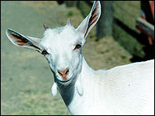
Religious Freedom
Free Exercise
  Is animal sacrifice permissible?
    Yes.
    Church of the Lukumi Babalu Aye
    (Santeria) v. City of Hialeah (1993)

Slide 15
Recent Landmark Cases
Santa Fe Independent School Dist. v. Doe,(2000),
Case heard before the United States Supreme Court. It ruled that a policy permitting student-led, student-initiated prayer at high school football games violates the Establishment Clause of the First Amendment. The court announced its decision on June 19, holding the policy unconstitutional in a 6–3 decision.

Slide 16
Freedom of Expression
Free Speech and Public Order:
Some free speech can be limited if it disrupts public order, otherwise it is allowed.
Schenck v. United States: 1919 decision upholding the conviction of a socialist who had urged young men to resist the draft during WWI. It was declared that government can limit speech if it provokes a “clear and present danger” of substantive evils.

Slide 17
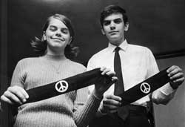
Symbolic Speech
Is this protected speech?
Can kids wear protest armbands in school, if they do not disrupt the educational process?
Yes.
  Tinker v. Des Moines School District (1969)

Slide 18
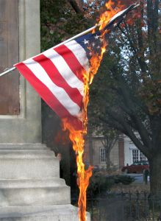
Symbolic Speech
Is this protected speech?
Can you burn the flag in peaceful protest?
Yes.
Texas v. Johnson (1989)

Slide 19
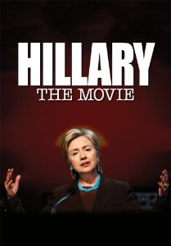
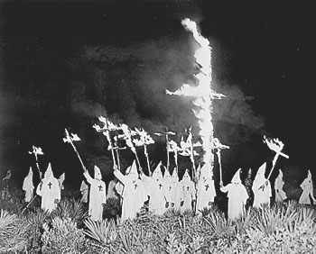
Freedom of Expression
  Are these both protected speech?
  Yes.

Slide 20
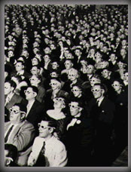
Freedom of Expression
When is speech NOT protected?
    Schenck v. United States (1919) – not if it demonstrates a “clear and present danger”
    Gitlow v. New York (1925) – not if it “advocated the violent overthrow of the government”
    Brandenburg v. Ohio (1969) – not if the speaker caused “incitement to imminent lawlessness”
    “fighting words”--words which would likely make the person to whom they are addressed commit an act of violence (intended to cause the hearer to react toward the speaker)

Slide 21
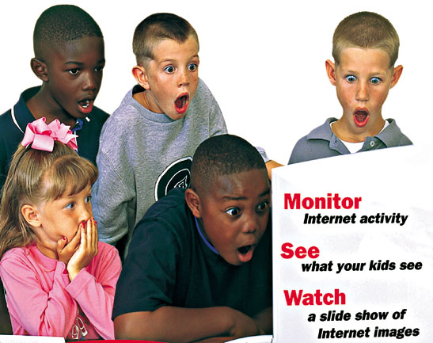

Freedom of Expression
  When is speech NOT protected?
  Obscenity is not Protected Roth v. United States (1957)
  A legal definition
  Pornography ≠ obscenity
Miller v. California (1973)
  Average person finds it violates
  contemporary community standards
  Work taken as a whole appeals to a prurient interest in sex
  Work depicts patently offensive sexual conduct
  Work lacks serious redeeming literary, artistic, political, or scientific value
  A community-based standard
    Almost all internet speech is unregulated in America because there is no “community standard” on the worldwide web
    (Reno v. ACLU, 1997)

Slide 22
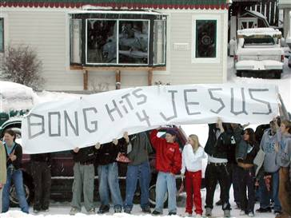
Freedom of Expression
  Is this protected speech?
No. Morse v. Frederick (2007)
Court made three legal determinations:
First, that "school speech" doctrine should apply because Frederick's speech occurred "at a school event";
Second, that the speech was "reasonably viewed as promoting illegal drug use";
Third, that a principal may legally restrict that speech
Based on the three existing First Amendment school speech precedents, other Constitutional jurisprudence relating to schools, and a school's "important, indeed, perhaps compelling interest" in deterring drug use by students.

Slide 23
Freedom of Expression
Obscenity:
Courts can restrict obscenity, but they can not ban it because it’s protected under the 1st Amendment.
Roth v. United States: 1957 court decision ruling that “obscenity is not within the area of constitutionally protected speech or press.”
Miller v. California: 1973 court decision that avoided defining obscenity by holding that community standards be used to determine whether material is obscene in terms of appealing to a “prurient interest” and being “patently offensive” and lacking in value.

Slide 24
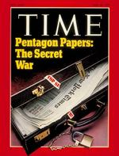
Freedom of the Press
Does the media have unlimited free speech?
Print media enjoys freedom from “prior restraint”
Broadcast media must obey certain restrictions enforced by the FCC

Slide 25
Freedom of Expression
Most forms are protected under the constitution.
Prior Restraint: A government preventing material from being published. Limits press.
Government can restrict/censor certain material that is published.
Near v. Minnesota: 1931 court decision holding that 1st Amendment protects newspapers from prior restraint.

Slide 26
New York Times Co. v. United States (1971)
Landmark decision by the United States Supreme Court on the First Amendment. The ruling made it possible for the New York Times and Washington Post newspapers to publish the then-classified Pentagon Papers without risk of government censorship or punishment.
President Richard Nixon had claimed executive authority to force the Times to suspend publication of classified information in its possession. The question before the court was whether the constitutional freedom of the press, guaranteed by the First Amendment, was subordinate to a claimed need of the executive branch of government to maintain the secrecy of information. The Supreme Court ruled that the First Amendment did protect the right of the New York Times to print the materials.

Slide 27
Freedom of Expression
Libel and Slander:
Another restriction that still can not be banned.
There are many cases against it, but it’s hard to say what is right or wrong because of the grey area of opinion and facts and what the intentions of the accused where when they write or say it.
Libel: The publication of false or malicious statements that damage someone’s reputation.
New York Times v. Sullivan: 1964 case that established the guidelines for determining whether public officials and public figures could win damage suits for libel. To win the case the victim must prove that the statements were made with “malicious intent” and reckless disregard for the truth.

Slide 28
Freedom of Expression (Press and Courts)
Free Press and Fair Trials:
Press usually has freedoms when it comes to reporting on court cases because the public has a right to know what goes on.
Fair trials are also protected so press can be limited if it interferes with a fair trial.
Shield laws were created to protect reporters during court cases.
Zurcher v. Stanford Daily: 1978 court decision holding that a proper search warrant could be applied to a newspaper as well as anyone else without necessarily violating the 1st Amendment rights to freedom of press.

Slide 29
Commercial Speech
Commercial Speech: Communication in the form of advertising. Can be restricted more so than other types of speech.
Advertising is regulated by Federal Trade Commission (FTC) and it makes sure advertisements are truthful.
Regulation of Public Airwaves:
Federal Communications Commission (FCC) regulate what goes on TV or radio. Restrictions are not unconstitutional.
Miami Herald Publishing Co. v. Tornillo: 1974 case that held that a state could not force a newspaper to print replies from candidates it had criticized, illustrating the limited power of government to restrict the print media.
Red Lion Broadcasting co. v. FCC: 1969 case that upheld restrictions on radio and TV broadcasting. They are less restrictive than those on print media because there are less broadcasting frequencies available.

Slide 30
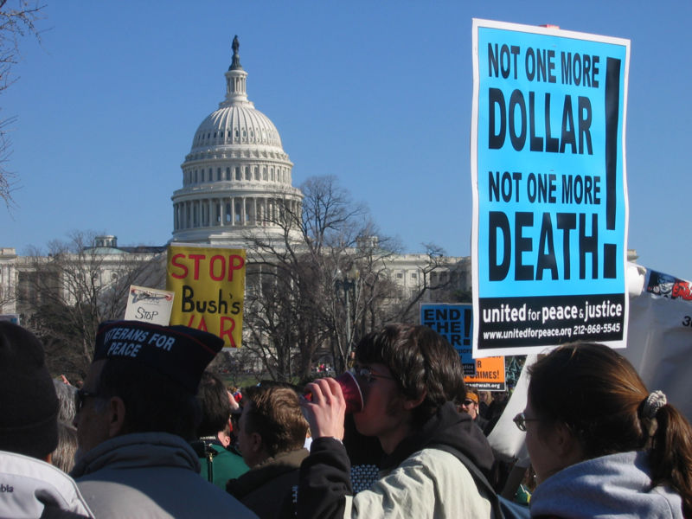
Freedom to Peaceably Assemble
Balance right to free association with right for public order
Permissible for localities to require permits in order to protest
Can a predominantly-Jewish town withhold a permit allowing the NAZIs to hold a rally?
No. National Socialist Party of America v. Village of Skokie (1977)

Slide 31
Freedom of Assembly
Basis for forming interest groups, political parties etc.
Right to Assemble:
People are allowed to assemble and protest as long as it’s on private property and they demonstrate during times when police can come if needed.
Right to Associate:
Everyone has the right to associate with people who share a common interest.
NAACP v. Alabama: The Supreme court protected the right to assemble peaceably in this 1958 case when it decided the NAACP did not have to reveal its membership list and thus subject its members to harassment.

Slide 32
Other Amendments in the Bill of Rights
2nd: right to bear arms
3rd: no quartering during peacetime
4th: no unreasonable search and seizure
5th:
  right against self-incrimination (“I plead the fifth”)
  right to grand jury
  no double jeopardy
  cannot be deprived of life, liberty or property without due process of law
  eminent domain/just compensation
6th:
  right to counsel and a speedy, public trial with a jury
  right to be informed of charges and confront witnesses against you
7th: right to a jury if you are suing for over $20 (adjusted with inflation of course)
8th: no excessive bail nor cruel or unusual punishment
9th: the people retain any rights not listed in the constitution
10th: any rights not granted to the federal government reserved for states

Slide 33
Recent Landmark Cases
McDonald v. Chicago (2010)
Determined whether the Second Amendment applies to the individual states. The Court held that the right of an individual to "keep and bear arms" protected by the Second Amendment is incorporated by the Due Process Clause of the Fourteenth Amendment and applies to the states.
Simple english: States and cities can not take away a persons 2nd Amendment rights. Except:"prohibit...the possession of firearms by felons or mentally ill" and "laws forbidding the carrying of firearms in sensitive places such as schools and government buildings, or laws imposing conditions and qualifications on the commercial sale of arms"

Slide 34
Defendant's Rights
Crime followed by arrest, followed by prosecution, followed by trail, followed by verdict. (Stages of criminal justice system)
Courts apply the protections of the accused in the 4th, 5th, 6th, 7th, 8th amendments. (Procedural Due Process is the following of these rights to protect people’s rights from being overrun by the government)

Slide 35
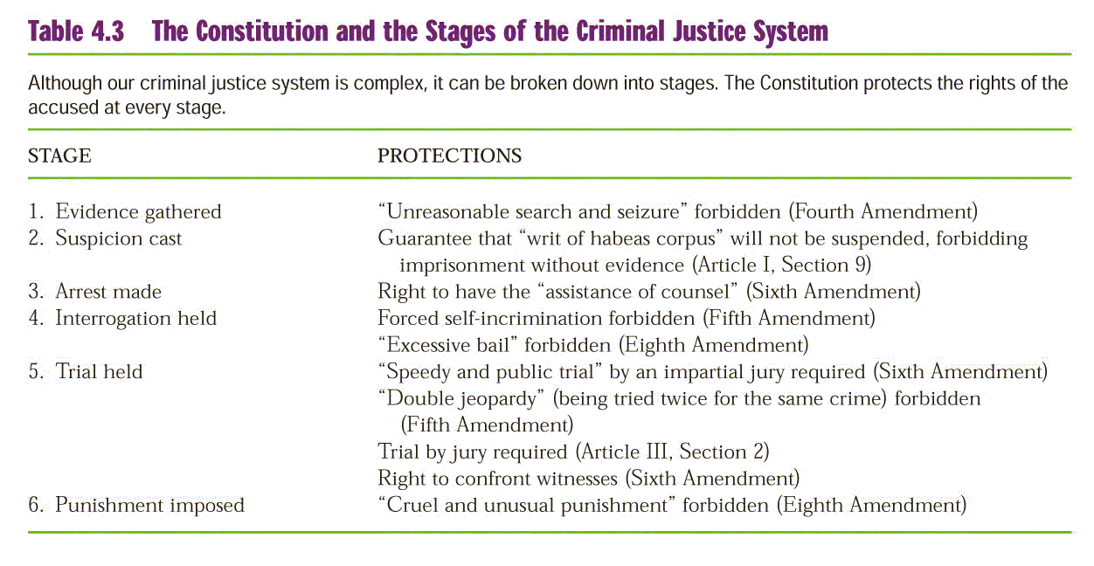
Stages of Criminal Justice System

Slide 36
Defendant's Rights
Searches and Seizures:
Must have a probable cause to search and/or seize from a search warrant.
Probable Cause: The situation occurring when the police have a reason to believe that a person should be arrested.
Most searches/seizures take place with no warrant.
You can not be searched unannounced with out probably cause.
Patriot Act is a new limit on privacy.
Unreasonable Searches and Seizures: Obtaining evidence in a haphazard or random manner, a practice prohibited by the 4th Amendment.
Search Warrant: A written authorization from a court specifying the area to be searched and what the police are searching for.
Exclusionary Rule: The rule that evidence, no matter how incriminating, cannot be introduced into trial if it was not constitutionally obtained.
Mapp v. Ohio: 1961 decision ruling that the 4th amendment’s protection against unreasonable searches and seizures must be extended to the states as well as to the federal government. (overturns Wolf v. Colorado that stated the rule did not apply to states 1949)
United States v Leon (1984) “good Faith” exception to the exclusionary rule allowing the introduction of illegally obtained evidence where police officers can prove that the evidence was obtained without violating due process principles of Mapp v Ohio

Slide 37
Terry v. Ohio (1968)
Landmark decision by the United States Supreme Court which held that the Fourth Amendment prohibition on unreasonable searches and seizures is not violated when a police officer stops a suspect on the street and frisks him or her without probable cause to arrest, if the police officer has a reasonable suspicion that the person has committed, is committing, or is about to commit a crime and has a reasonable belief that the person "may be armed and presently dangerous.
For their own protection, police may perform a quick surface search of the person’s outer clothing for weapons if they have reasonable suspicion that the person stopped is armed. This reasonable suspicion must be based on "specific and articulable facts" and not merely upon an officer's hunch.
The meaning of the rule is to protect persons from unreasonable searches and seizures aimed at gathering evidence, not searches and seizures for other purposes (like prevention of crime or personal protection of police officers).

Slide 38
Defendant's Rights
Self-Incrimination:
You have a set of Miranda Rights when arrested:
1. Right to remain silent
2. Right to an attorney (One will be provided to those who cant afford one)
3. Anything you say can and will be used against you in a court of law.
Fifth Amendment: Designed to protect the rights of persons accused of crimes, Including prosecutions against double jeopardy, self-incrimination, and punishment without due process of law.
Self-Incrimination: Occurs when an individual accused of a crime is compelled to be a witness against himself or herself in court.
Miranda v. Arizona: 1966 decision that sets guidelines for police questioning of accused persons to protect them against self-incrimination and to protect their right to counsel.

Slide 39
Defendant's Rights
Right to Counsel:
Everyone has a right to counsel; used mostly in capital crimes and then later extended to state courts on felonies (Gideon v. Wainwright)
Sixth Amendment: Designed to protect individuals accused of crimes. Includes right to counsel, right to confront witnesses, and right to a speedy and public trial.
Gideon v. Wainwright: 1963 decision holding that anyone accused of a felony where imprisonment may be imposed, however poor he or she might be, has a right to a lawyer.

Slide 40
Defendant's Rights
Trials:
Most court cases don’t have hearings, just a plea bargaining.
Jury can have from 1-100 jurors chosen by lawyers from both sides. Traditional size=12. (Most juries are granted sentencing)
The only time names were withheld, reducing detainees rights for access to courts and to counsel was terrorist cases after September 11, 2001.
Plea Bargaining: a bargain struck between the defendant’s lawyer and the prosecutor to the effect that the defendant will plead guilty to a lesser crime in exchange for the state’s promise not to prosecute the defendant for a more serious crime.

Slide 41
Defendant's Rights
Cruel and Unusual Punishment:
Death penalty does not fit under cruel and unusual punishment.
Punishment has a range from mild being probation and severe being death.
States decide the type of punishment the criminal will receive.
Eighth Amendment: Forbids cruel and unusual punishment, although it does not define the phrase. Through the 14th amendment this decision is decided by states.
Cruel and Unusual Punishment: Court sentences prohibited by the 8th amendment. The court has ruled the death penalty for some offenses as unconstitutional, but the sentence itself is not considered cruel and unusual.
Gregg v. Georgia: 1976 decision that upheld the constitutionality of the death penalty. It was decided that it is an extreme punishment for extreme crimes.
McCleskey v. Kemp: 1987 decision that upheld the constitutionality of death penalty against charges that it violated the 14th amendment because minority defendants were more likely to receive the sentence over whites.

Slide 42
Right to Privacy
Bill of Rights cast “Penumbras” (Shadows)-unstated liberties implied by explicitly stated rights-protecting a right to privacy. (ex:3rd and
Right to Privacy: The right to a private personal life free from the intrusion of government.er Abortion:
Roe v. Wade: 1973 decision holding that a state ban on all abortions was unconstitutional. Made 3 rules: women were free from state intrusion in first trimester, states could limit abortions in second trimester, and it was illegal to get an abortion the third trimester.
Planned Parenthood v. Casey: 1992 case that loosened its standard for evaluating restrictions on abortion from one of “strict scrutiny” of any restraints on a “fundamental right” to one of “undue burden” that permits considerably more regulation.
Griswold v Connecticut (1965) Struck down a law that prohibited the use of contraceptives. (people have the right to privacy in their sex lives)

Slide 43
Understanding Civil Liberties
American government is democratic and constitutional. Democratic by the officials that run the government being elected by the people they govern, and constitutional by having a constitution that limits the ultimate power of the government.
Majority rule is part of the democracy, but civil liberties are still protected from majority rule.
Civil liberties are the foundation for our nations reflection on individualism, thus they limit the scope of government
Expansion of freedom requires expansion of government.

