Slide 1
Public Opinion & Political Participation
Unit Two
Textbook: Chapter 6
Studyguide book: Chapter 4 and some of 5
Coach Flu
Revised 2017-2018

Slide 2
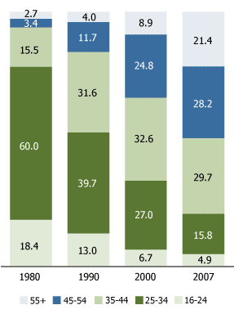
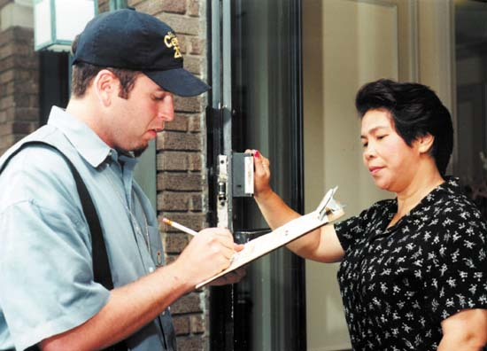
Introduction
Some Basics:
Demography
  The science of population changes.
Census
  A valuable tool for understanding population changes- required every 10 years.

Slide 3
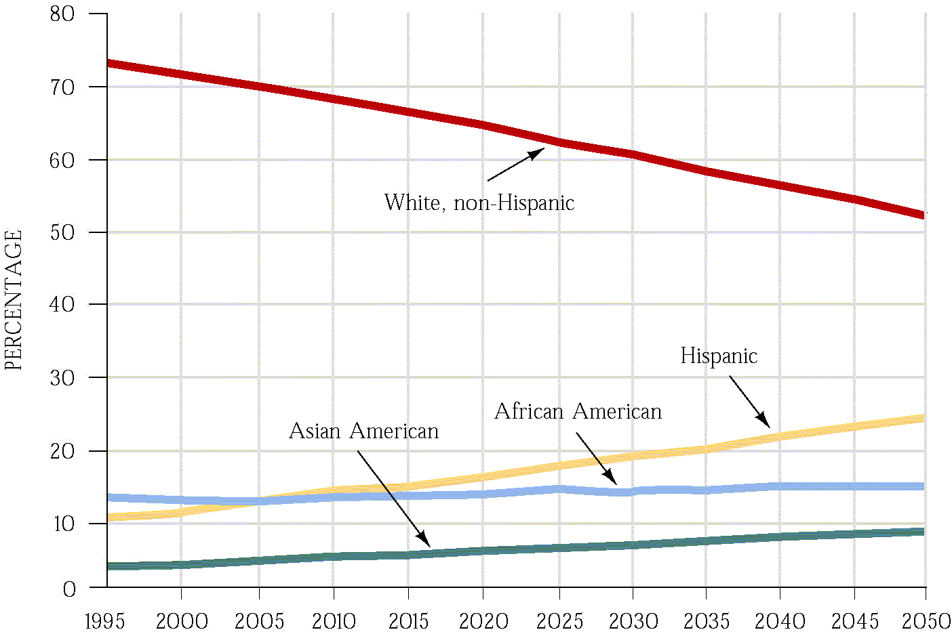
The American People

Slide 4
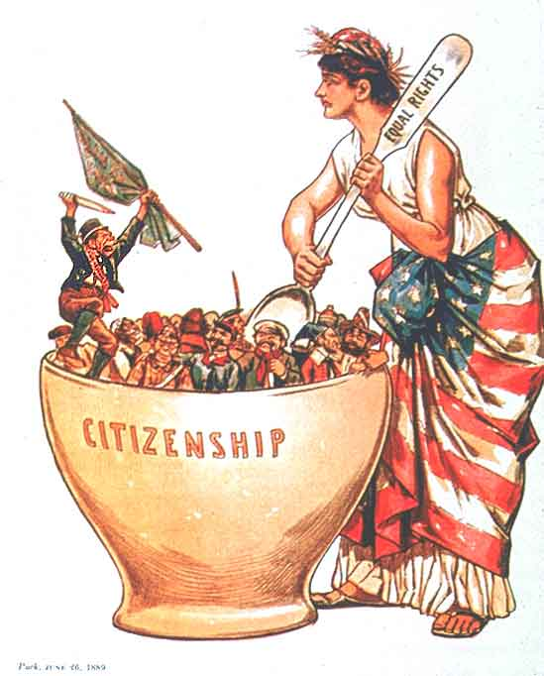
The American Melting Pot
Melting Pot- The mixing of cultures, ideas, and peoples that has changed the American nation.
Minority Majority- that America will eventually cease to have a White, generally Anglo-Saxon majority.
Political Culture- overall set of values widely shared within a society.

Slide 5

The Graying of America
Nationwide, the fastest-growing age-group in America is composed of citizens over 65.
Social Security is structured as a pay-as-you-go system
  Today’s workers pay the benefits for today’s retirees.
  In 1940, there were 42 workers per retiree; today there are 1.4

Slide 6
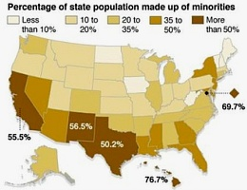
The American People
  Political Culture: An overall set of values widely shared within a society. How will this change as the country changes?
Which party will benefit from the minority majority?
Notes:
“Minority Majority” links to previous slide- for the graph.

Slide 7
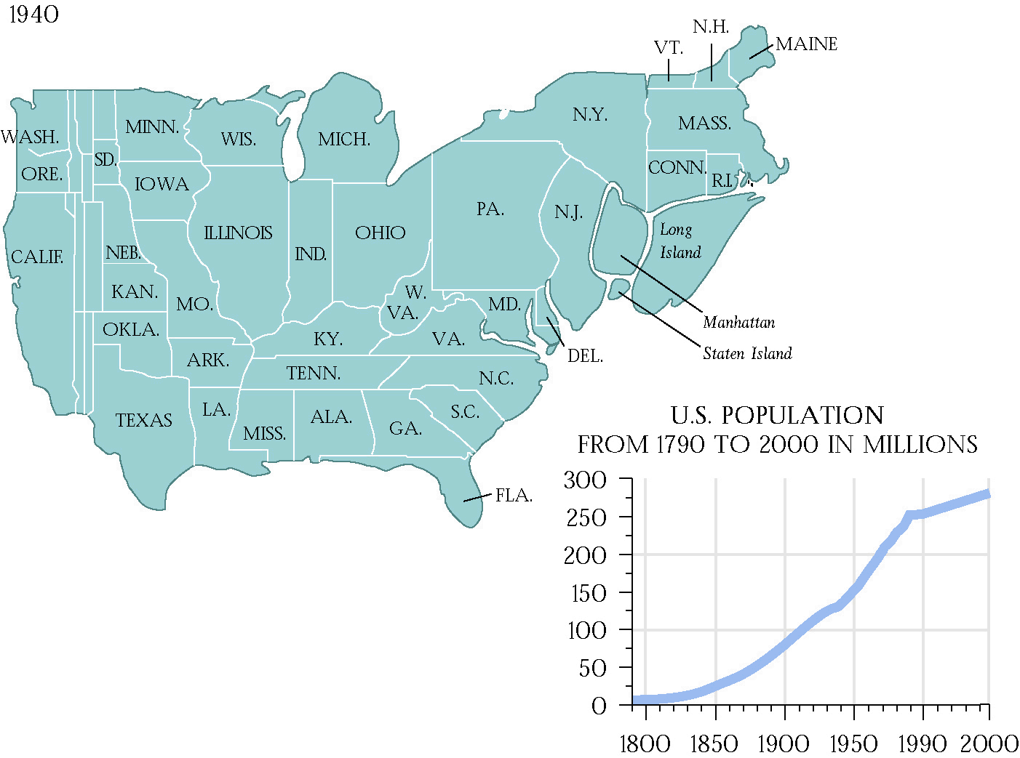
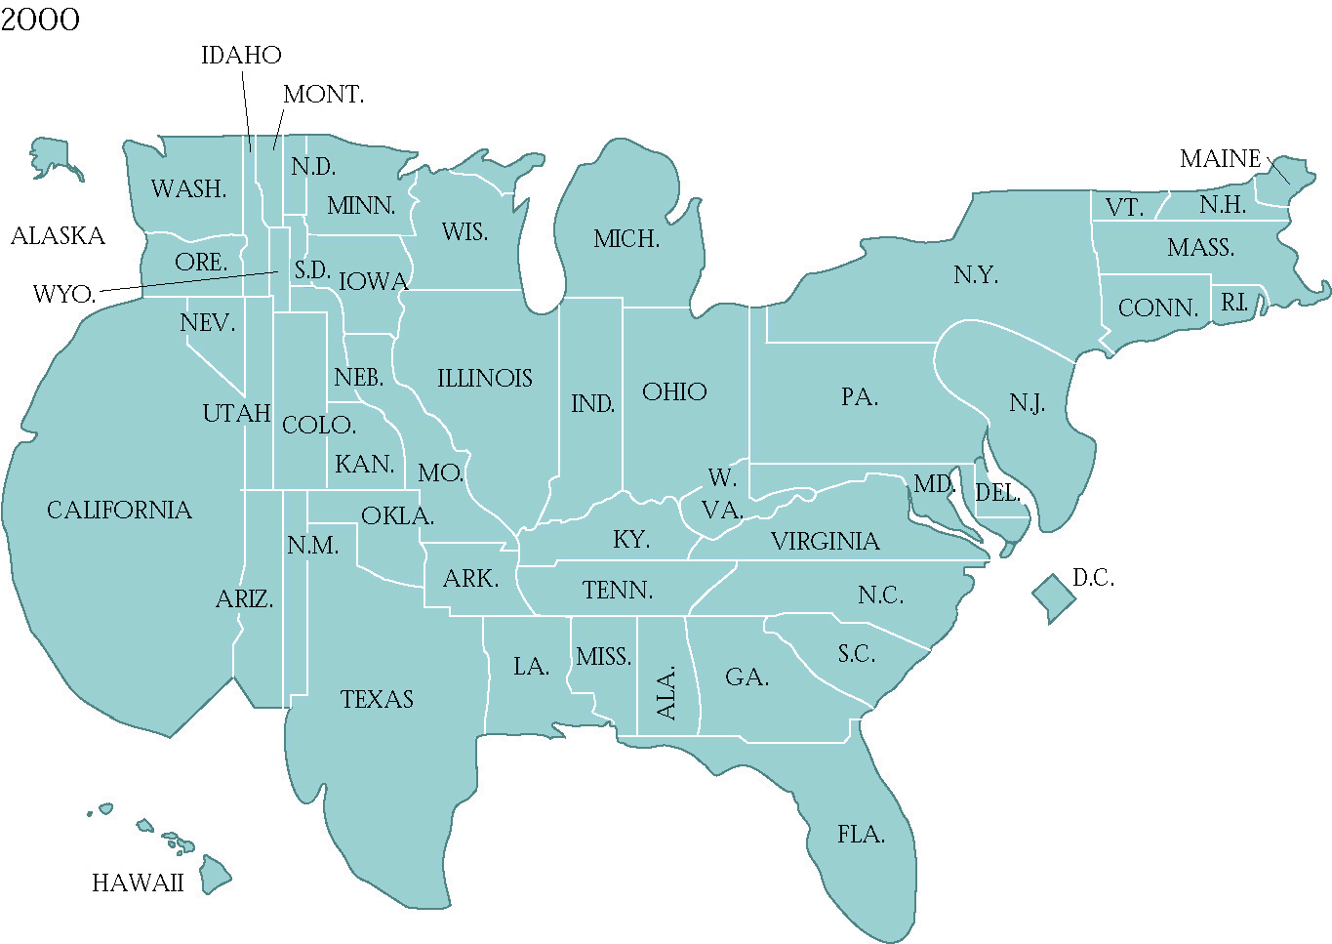
The American People
The Regional Shift
  Reapportionment: The process of reallocating seats in the House of Representatives every 10 years on the basis of the results of the census.
  Redistricting is done by state legislatures.
  Historically has led to Gerrymandering.

Slide 8
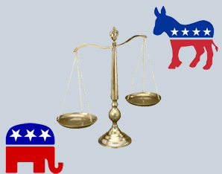
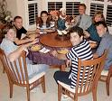
How Americans Learn About Politics: Political Socialization
Political Socialization:
  the process through which an individual acquires his or her political orientation
The Process of Political Socialization
  The Family
    Time & emotional commitment
    Political leanings of children often mirror their parent’s leanings

Slide 9
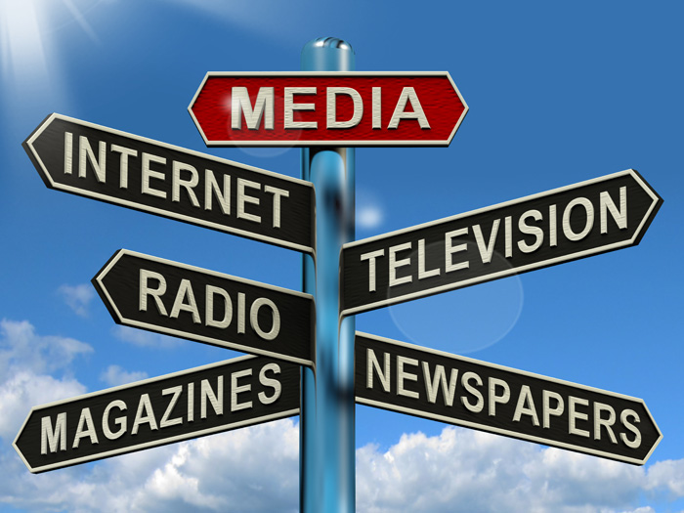
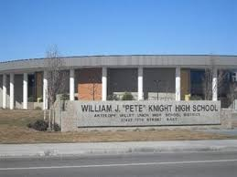
How Americans Learn About Politics: Political Socialization
The Process of Political Socialization
  The Mass Media
    Generation gap in TV news viewing
  School / Education
    Used by government to socialize the young into the culture and government

Slide 10
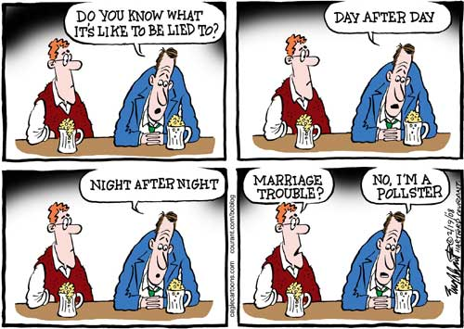
Measuring Public Opinion and Political Information
How Polls Are Conducted
-Random Sampling: The key technique employed by sophisticated survey researchers; operates on the principle that everyone should have an equal probability of being selected for the sample
-Representative Sample: Draws from all groups
-Sample size 1500
-Sampling Error: The level of confidence in the findings of a public opinion poll, =/-3%

Slide 11
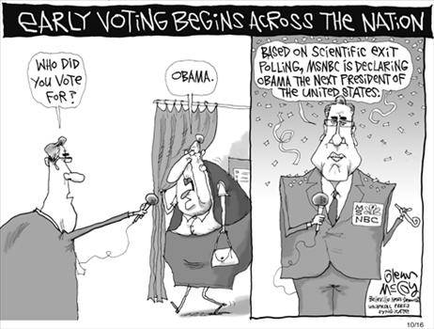
Measuring Public Opinion and Political Information
Role of Polls in American Democracy
  Help politicians figure out public preferences.
  Exit Polls- used by the media to predict election day winners.
  Straw Poll-an unofficial ballot conducted as a test of opinion.
  Wording of question makes a difference.
  Polls reflect the policy agenda—problems the people inside and outside of government believe must be addressed.

Slide 12
Measuring Public Opinion and Political Information
How Polls Are Conducted
  Sample- relatively small proportion of people who are chosen in a survey so as to be representative of the whole
  Random sampling- which operates on the principle that everyone should have an equal probability of being selected as part of the sample
  Sampling Error- level of confidence in the findings of a public opinion poll.
  Random-digit dialing- technique used by pollsters to place telephone calls randomly to both listed and unlisted numbers when conducting a survey

Slide 13
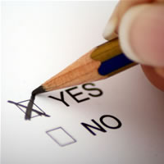
What Polls Reveal About Americans’ Political Information
Americans don’t know as much as they should know about politics.
American political system works as well as it does given the discomforting lack of public knowledge about politics.

Slide 14
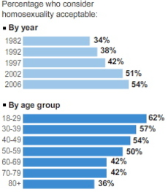
Attitudes Toward Gays and Lesbians

Slide 15
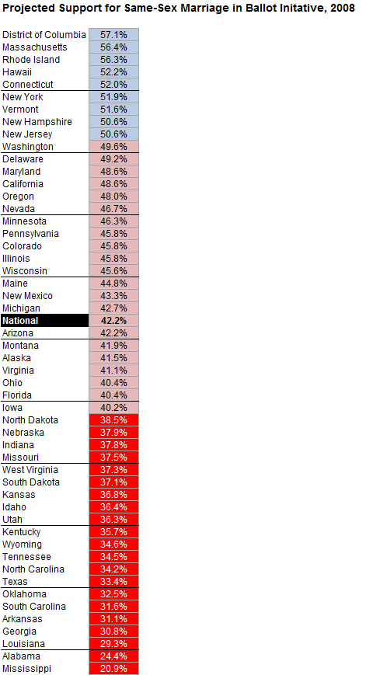
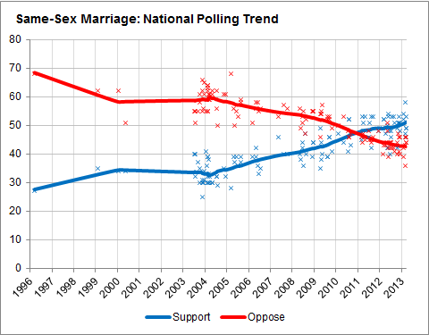

Slide 16
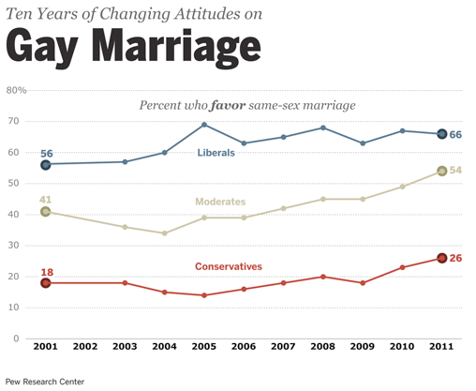
Attitudes Toward Gays and Lesbians

Slide 17
Understanding Public Opinion and Political Action
There are many limits on the role public opinion plays in the American political system.
Average person not well informed about political issue.
The fact that public opinion is often contradictory in this respect sometimes leads to policy gridlock because it is hard for politicians to know which aspect of the public’s attitudes to respond to.

Slide 18
Demographic Factors
Education—people with higher than average educational levels have a higher rate of voting than the less educated
Age– older people are more likely to vote
Race: African Americans and Hispanics are underrepresented among voters relative to their share
Gender—today women actually participate in elections at a slightly higher rate than men
Marital status– married people are more likely
Union Members- Unions are able to mobilize voters to go to the polls
Government Employee– having something at stake and being in a position to know more about the government impels higher level of participation
Religion—As people become religious they tend to be engaged more in politics
Two Party competition-- In states where either party could win, voter turn out goes way up. Why California has a poor voter turnout. We already know who won.

Slide 19
Class, Inequality, and Participation
The rates of political participation are unequal among Americans.
  “citizens of higher social economic status participate more in politics…”
  People of lower social economic tend to believe the system is against them.

Slide 20
Types of Political Participation
12%--attended a rally or speech
32%-- Signed a petition
24%--attended a political meeting on local town affairs
30%--contacted a national, state, or local government official about an issue
28%-- worked with others to solve a problem in their community
32%-- of internet users communicated with group members using a website
24%-- of social networkers communicated with members using a social network site
18% gave money to a candidate, party or group
55-57% voted in the last presidential election

Slide 21
Protest as Participation
Protest- designed to achieve policy change through dramatic and unconventional tactics
Civil disobedience- reflects a conscious decision to break a law believed to be immoral and to suffer the consequences.

