Slide 1
The Media
Textbook Chapters 7
Studyguide book Chapters 8
Coach Flu
Revised 2017-2018

Slide 2
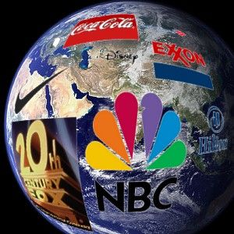
Introduction
Some important definitions:
Linkage Institution
  The media links citizens with government, along with political parties, interest groups, and elections.
Mass Media:
  Television, radio, newspapers, magazines, the Internet and other means of popular communication.
High-tech politics:
  A politics in which the behavior of citizens and policymakers and the political agenda itself are increasingly shaped by technology and mass media.

Slide 3
The Development of Media Politics
Herbert Hoover (1929-1933)-no media involvement in politics
Franklin D. Roosevelt (1933-1945)- invented modern media politics/Fireside Chats
      Gave press conferences twice a week
      First to use the radio extensively
      Press respected FDR
Until the 1960s the press respected the government
  Didn’t report private lives
  Impact of Vietnam War and Watergate Scandal
  Clinton-Lewinsky Scandal
  Investigative Journalism

Slide 4
The Mass Media Today
Effective communication through media is key to political success.
  Media Events: events purposely staged for the media that nonetheless look spontaneous.
    Media events can be staged by almost anybody.
  Image making and news management is important, especially for presidents.

Slide 5
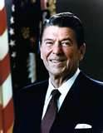
Meet the Master of Mass Media
7 principals of Reagan
Plan ahead
Control the flow of information
Limit reporters access to the president
Talk about the issues you want to talk about
Speak in one voice
Repeat the same message many times
Stay on the offensive

Slide 6
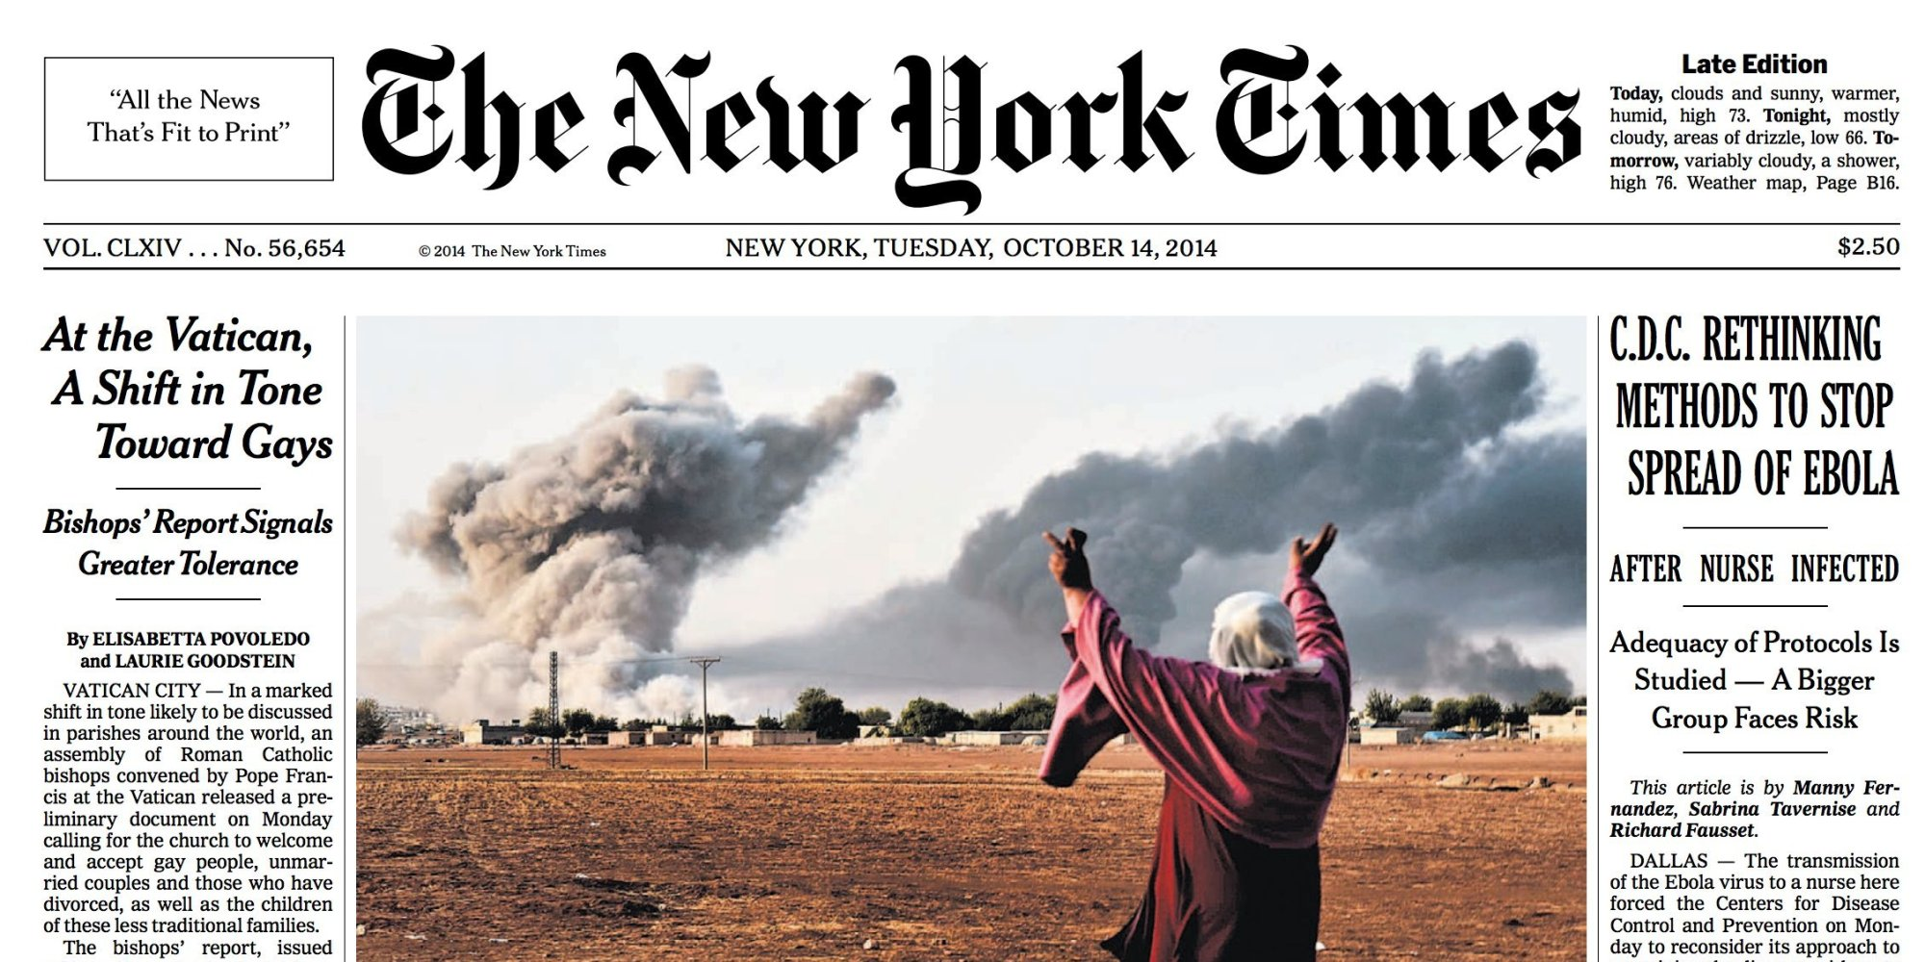
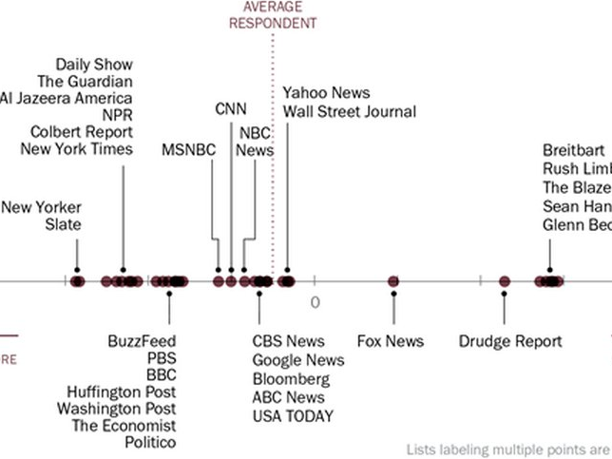
Print Media-(newspapers and magazines)
Pecking Order
      New York Times, Washington Post, LA Times, Chicago Tribune
      Smaller papers reprint the big stories
TV and the internet are causing newspaper sales to decline

Slide 7
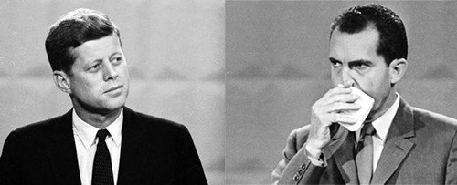
The Development of Media Politics
The Broadcast Media
  Television and radio
  Brought government and politics into peoples’ homes.
    Vietnam War
  Politicians’ appearances and mannerisms more important.
    Kennedy-Nixon presidential debate

Slide 8
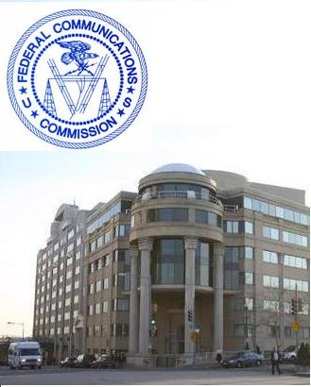
Government Regulation of the Broadcast Media
  1934: Federal Communications Commission was created
    Prevents Monopolies
    Conducts exams over goals and performance
      Stations must benefit society to get a license
    Fair treatment rules provide equal airtime to both candidates
    Equal Time Rule & Fairness Doctrine
    Telecommunications Act of 1996: drops many walls that were controlling the creation of media mono

Slide 9
The Development of Media Politics
Private Control of the Media
  Only a small number of TV stations are publicly owned in America.
  Independent in what they can report, media are totally dependent on advertising revenues. TV networks, it could be said, define news as what is entertaining to the average viewer.
  Chains: massive media conglomerates that account for over four-fifths of the nation’s daily newspaper circulation
    Also control broadcast media
    More than 90% of all media is owned by: Comcast, The Walt Disney Company, 21st Century Fox, Time Warner (Spectrum), National Amusements (CBS, MTV, BET etc)

Slide 10



Narrowcasting: Cable TV & Internet
Narrowcasting- media programming on cable TV or Internet focused on one topic and aimed at a particular audience
  MTV, ESPN, the Food Network

Slide 11
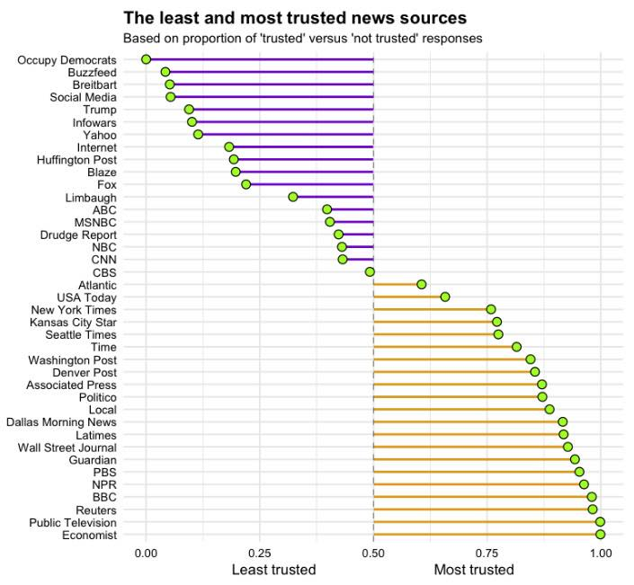
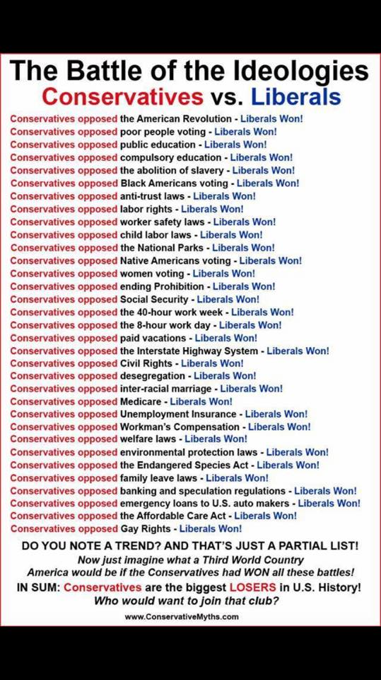
Who is honest?
resource

Slide 12
Reporting the News

Slide 13
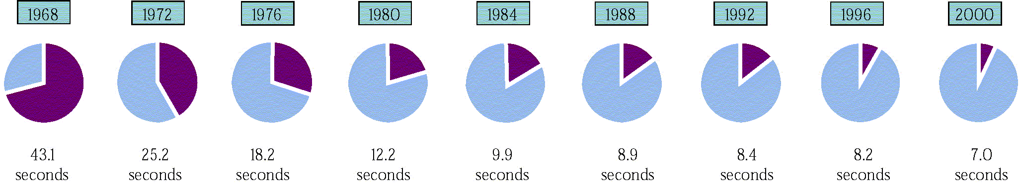
Reporting the News
Presenting the News
  Most news coverage is superficial
  Sound Bites: Short video clips of approximately 15 seconds or less.

Slide 14
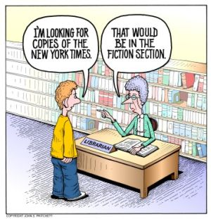
Bias in the News
  Some outlets are ideologically biased to the right or left
  Structural bias occurs when stories are chosen to attract the largest audience.
  “If it bleeds, it leads.”

Slide 15
Bias in the Media
Types of bias to look for
Selection & Omission: choice of news items; content & details used/not: words used
Placement: first page stories/above fold: lead off stories-reflect significance
Headlines: most read part of the paper-wording size can reflect bias
Photos & Camera angle: visual portrayal can show bias as can captions
Names and Titles: Choice of words such as “terrorist” or “freedom fighter” clearly indicate bias
Statistics: opinion can be reflected in method of counting- example “a hundred injured in the crash” vs “minor injuries were reported”.
Source who is the source of the story (Do we trust unnamed sources?)
Media ownership : trying to please sponsors and ownership

Slide 16
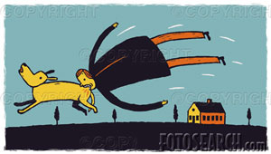
Reporting the News
.
Media is in search of unusual stories that will excite, rather than the sophisticated story.

Slide 17
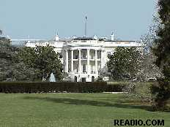
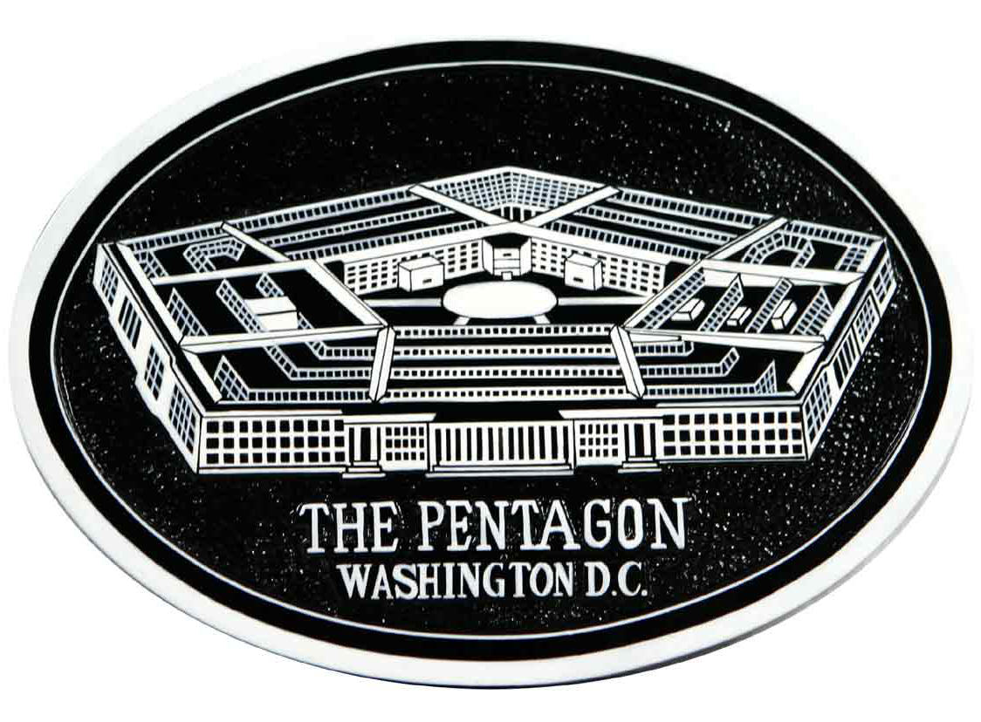
Finding the News
Beat- Specific locations from which news emanates, such as Congress or the White House.
White House press corps
Trial Balloons- An intentional news leak for the purpose of assessing the political reaction.
“Blogs” have also become popular with many adults.

Slide 18
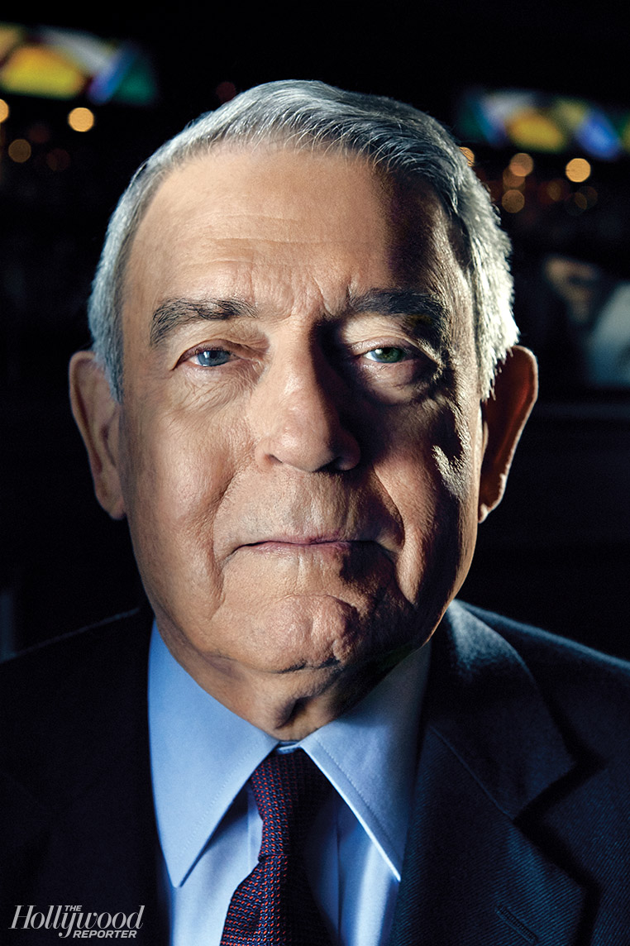
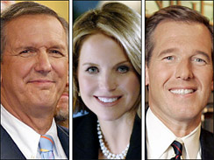
Television news can affect what people think is important.
Some policies can be made more important, others less important, depending on coverage.
Many in the media help play the role of “spin doctor” which is in its own a kind of propaganda.
The Dan Rather Scandal showed the potential story and ratings is more important than the truth.

Slide 19
Obama vs. Trump media coverage
Liberal Media covered Trump and who was part of his past (Flynn and his potential conversation with Russian spy’s?) differently than Obama’s association with convicted domestic terrorists Bill Ayers and Bernadine Dohrn.
Both have had coverage that has been reckless and lacked facts and evidence to support the stories reported.

Slide 20

Policy Agenda:
  The issues that attract the serious attention of public officials and others in policymaking
  Policy Entrepreneurs:
    People who invest their political “capital” in an issue.

Slide 21
Understanding the Mass Media
The Media and the Scope of Government
  Media as watchdog restricts politicians
  New proposals are met with skepticism which restricts scope of government
  If media identifies a problem, it forces government to address it, which expands the scope of government

Slide 22
Understanding the Mass Media
Individualism and the Media
  Candidates run on their own by appealing to people on television
  Easier to focus on one person like the president, than groups, e.g., Congress or the courts
Democracy and the Media
  “Information is the fuel of democracy.”
  But news provides more entertainment than information; it is superficial.
  News is a business, giving people what they want.

