Slide 1
Expanding the Political Spectrum
A lesson on ideology
What is it we think government should do anyway?
Notes:
After completing this lesson, students will work on two additional assignments….
Practice with Identifying Ideologies
Policy Proposals

Slide 2
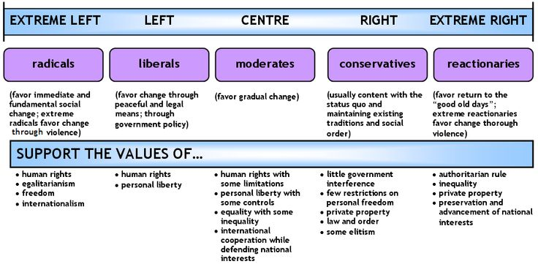
The Political Spectrum as a Straight Line

Slide 3
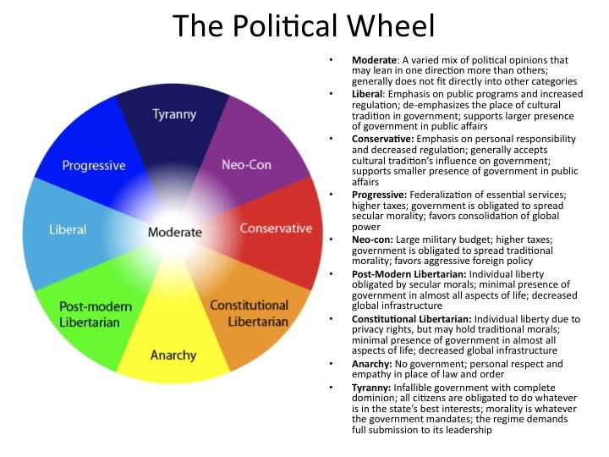

Slide 4
Social/Political Spectrum
Extreme: Anarchy
Extreme: Fascism, Theocracy
Social and political liberals favor limited government regulation of individual behavior.
Examples:
  Favor protection of offensive language.
  Oppose censorship of film, music, etc.
  Pro-choice abortion stance.
  Oppose government sponsored religious activity.
  Favor protection of homosexual rights.
  Favor affirmative action programs.
Social and political conservatives favor broad government regulation of individual behavior
Examples:
  Oppose protection of offensive language.
  Favor regulation of film, music, etc.
  Pro-life abortion stance.
  Favor government-facilitated religious activity, particularly in school.
  Oppose protection of homosexual rights.
  Oppose affirmative action programs.
Notes:
Where do the parties align? Make sure students understand that these are all generalizations; nothing is hard and fast.

Slide 5
Economic Spectrum
Extreme: Socialism, Communism
Extreme: Laissez-Faire, Monopoly
Economic liberals favor broad government involvement in economic policymaking and regulation of business.
  Favor higher taxes, particularly progressive (based on income level).
  Programs assisting the poor such as Medicaid and Head Start.
  Redistribution of income (welfare; social security).
  Anti-trust legislation.
  Sympathize with labor in Labor-Management issues.
Economic conservatives favor limited government involvement in economic policymaking and regulation of business.
  Favor lower taxes, particularly regressive (flat tax, sales taxes).
  Fewer programs with the goal of redistributing income (private charitable assistance; invest own money for retirement).
  Oppose government regulation of market choices.
  Sympathize with business in Labor-Management issues.

Slide 6
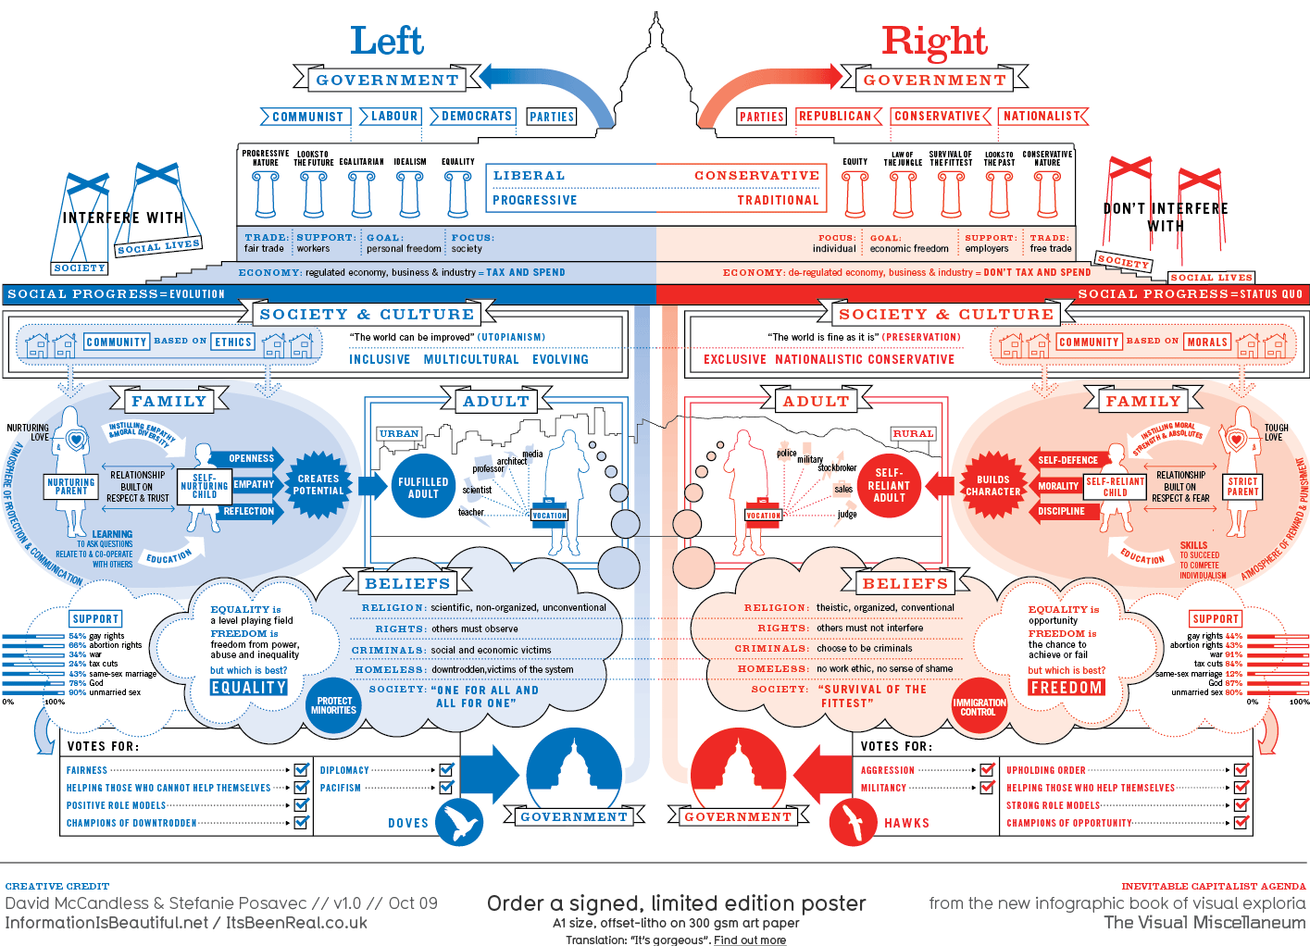
So, Where Do you fit?
Notes:
If you are like many Americans, you may tend to be more conservative on some issues and more liberal on others.
The limitation of one spectrum is that this circumstance will generally place you in the middle, which is not necessarily an accurate reflection of your ideology.
Remember, all of this discussion takes place with a base understanding and consensus on the social contract and modern “liberal” political thought.
People on every point on the spectrum generally want what is best for the country—they just differ on how to achieve it.

Slide 7
Ideology grid
Govt.
Control
Liberal
Authoritarian
Economic Issues
Libertarian
Conservative
Govt.
Control
Freedom
Social Political Issues

Slide 8
Definitions
Liberal
Support for greater government control/regulation in economic matters and less government control/regulation of individual matters.
Libertarian
Support for minimal government control of both economic and social issues
Conservative
Support for less government control/regulation in economic matters and greater government control/regulation of individual matters.
Authoritarian
Support for greater government control of economic and social issues

Slide 9
View of the constitution
Liberal
Conservative
Favor loose construction – a broad interpretation
Constitutional interpretation may change as modern society evolves
What are our standards today?
Favor strict construction – a narrow interpretation
Constitutional interpretation should remain constant through the years
What did the founders mean?

Slide 10
Tradition vs. change
Favor change over status quo
Favor tradition over change
Liberal
Conservative
Rights of the Individual are more important
Rights of the community are more important
Individual v. Community

Slide 11
Putting It together
Label your grid with these voters in the appropriate places.
Ideology?
Voter A: “I worked my way up from poverty to become the successful business owner I am today. I get frustrated when I think that my tax money goes to support people who won’t help themselves. I think part of the blame belongs with the media – they promote all the wrong values.”
Notes:
conservative

Slide 12
Putting It together
Label your grid with these voters in the appropriate places.
Ideology?
Voter B: “I really don’t care what other people do in their free time, as long as they don’t bother me. I sure don’t like it when the government tells me what to do with my money or in my own home – I’m certainly not going to turn around and do the same thing to my neighbors.”
Notes:
libertarian

Slide 13
Two more to grid
Ideology?
Voter C: “I really worry about the state of the world today. It seems like more and more kids are growing up in poverty and there’s no one there to help them. I think we need to do more toward providing healthcare and education programs for our young people.”
Notes:
liberal

Slide 14
Two more to grid
Ideology?
Voter D: “These days, you can’t be too careful. I think we need to spend a lot more money on the national defense. I wish there was a police officer on every corner! The police could search my car all they want, since I don’t break the law. I also think the government should crack down on the media – their reporting gives our enemies an inside look at all our military preparations.”
Notes:
authoritarian

Slide 15
Ideology grid
Govt.
Control
Liberal
Authoritarian
Most people will fit somewhere within the parameters of this circle.
Economic Issues
Libertarian
Conservative
Govt.
Control
Freedom
Social/Political Issues

Slide 16
Let’s Look at America
You will look at a series of charts and graphs on the following slides.
Your task will be to identify the trend you see in each graph and try to think of reasons why those trends exist.
Note to Teacher: You may have students work on this skill using a separate worksheet and then use the slides as review: That assignment is found here.
Notes:
Use these slides to work on skills building on reading charts/graphs
NOTE: Not all graphs are from the same time frame
Guide students to read the trends; what are some conclusions you can make?

Slide 17
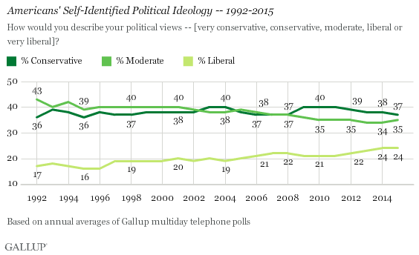

Slide 18
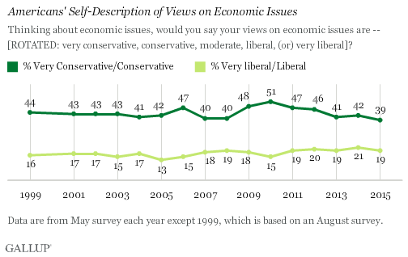

Slide 19
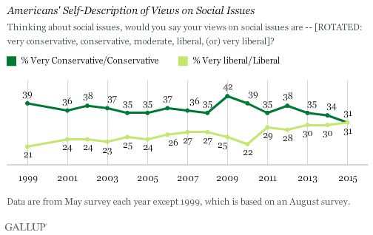

Slide 20
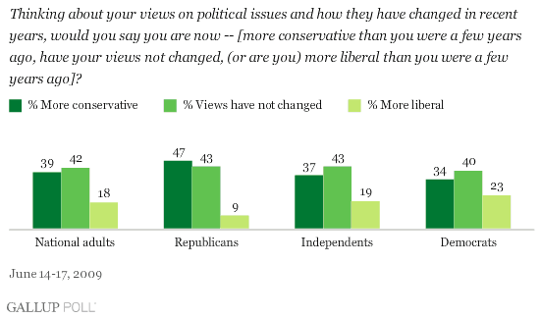

Slide 21
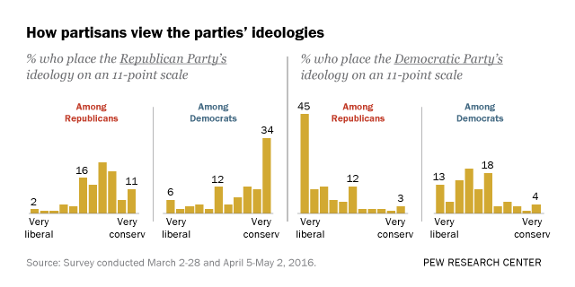

Slide 22
Why Does this Matter?
Ideology affects your perceptions of government and its appropriate role in a society.
As a result, it will affect how you act in the voting booth and outside the voting booth.
Elections have consequences!
Perceptions also affect our ability to act civilly to one another.

Slide 23
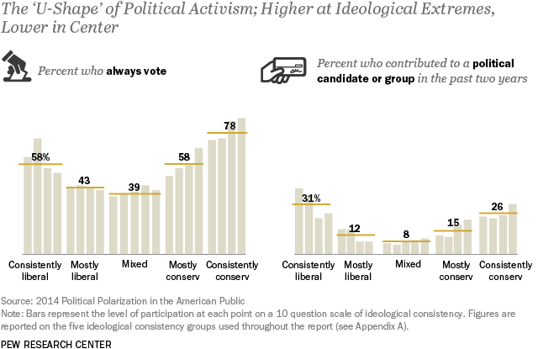

Slide 24
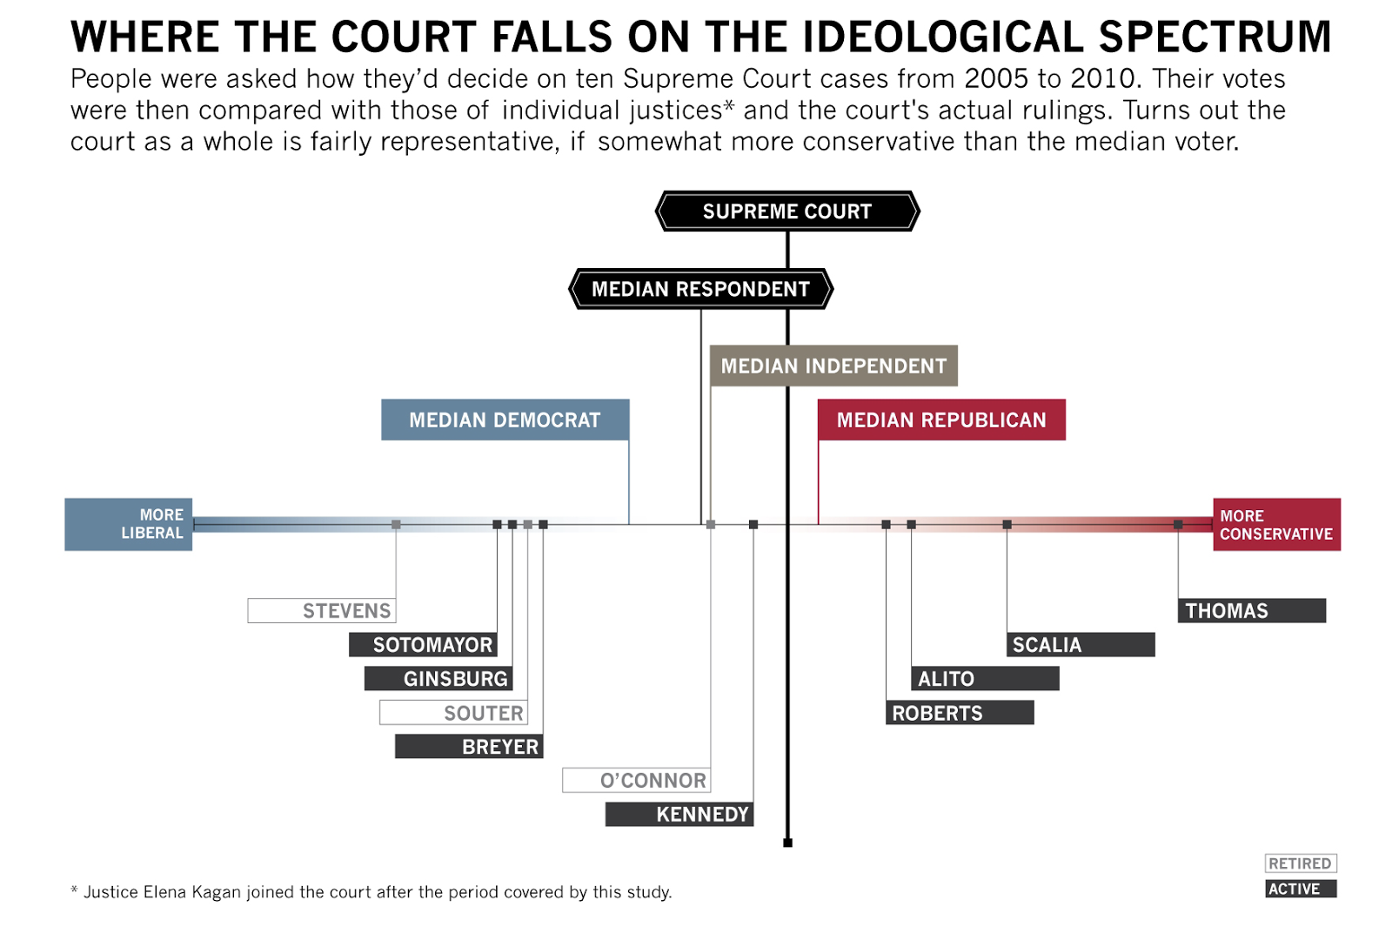

Slide 25
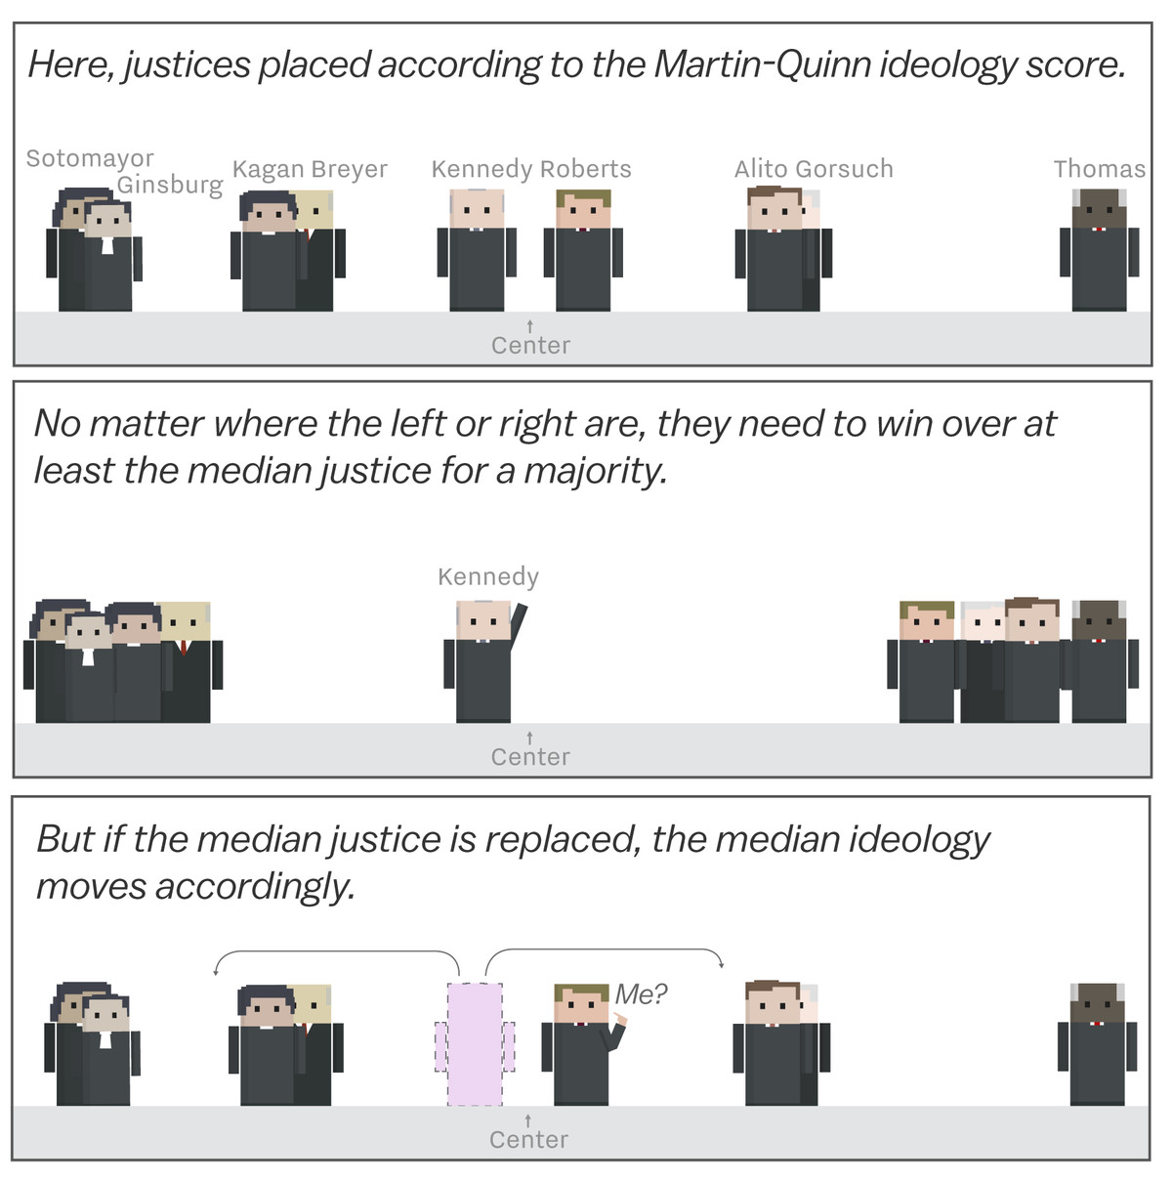

Slide 26
