Slide 1
Economic Policymaking
Chapter 17

Slide 2
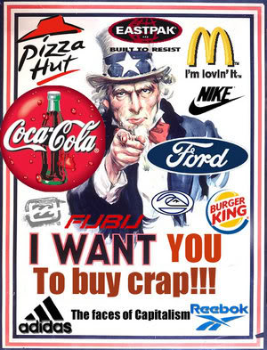
Economic Policy
Capitalism
Mixed economy
Laissez-faire

Slide 3
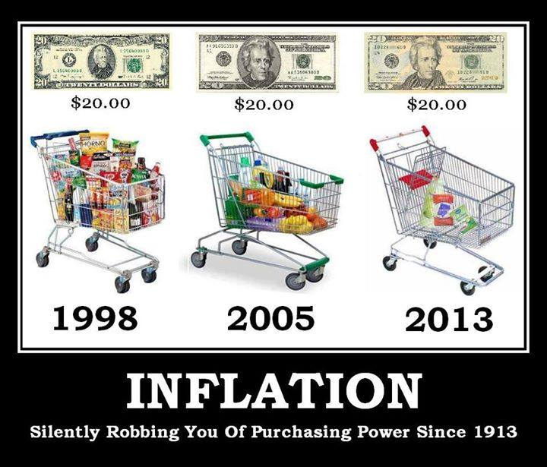
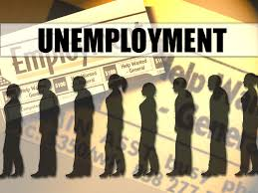
Economic Policy
Measuring unemployment
Underemployed
Inflation and the consumer price index

Slide 4
Economic Policy (Democrats View)
Keynesian Economic Theory is an economic theory named after John Maynard Keynes. He is most well-known for his simple explanation for the cause of the Great Depression. His economic theory was based on a circular flow of money, which refers to the idea that when spending increases in an economy, earnings also increase, which can lead to even more spending and earnings. Keynes' ideas spawned numerous interventionist economic policies during the Great Depression.

Slide 5
Economic Policy
In Keynes' theory, one person's spending goes towards another person's earnings, and when that person spends his or her earnings, he or she is, in effect, supporting another person's earnings. This cycle continues on and helps support a normal, functioning economy. When the Great Depression hit, people's natural reaction was to hoard their money. Under Keynes' theory, this stopped the circular flow of money, keeping the economy at a standstill.

Slide 6
Economic Policy
Keynesian economics warns against the practice of too much saving and not enough consumption, or spending, in an economy. It also supports considerable redistribution of wealth, when needed. Keynesian economics further concludes that there is a pragmatic reason for the massive redistribution of wealth: if the poorer segments of society are given sums of money, they will likely spend it, rather than save it, thus promoting economic growth.

Slide 7
Economic Policy (Republic View)
Supply-side economics is a school of macroeconomics that argues that economic growth can be most effectively created by lowering barriers for people to produce (supply) goods and services as well as invest in capital.
According to supply-side economics, consumers will then benefit from a greater supply of goods and services at lower prices; furthermore, the investment and expansion of businesses will increase the demand for employees.
Typical policy recommendations of supply-side economists are lower marginal tax rates and less regulation.

Slide 8
Other Economic Issues
Protectionism: Economic policy of shielding an economy from imports.
Wagner Act 1935: National Labor Relations Act. Sets rules to protect unions and organizers.

Slide 9
Social Welfare Policy
Chapter 18

Slide 10
Social Welfare Policy
Social Welfare policies
Entitlement programs (popular)
Means-tested programs (political conflict)
Political question: What should people be entitled too?

Slide 11
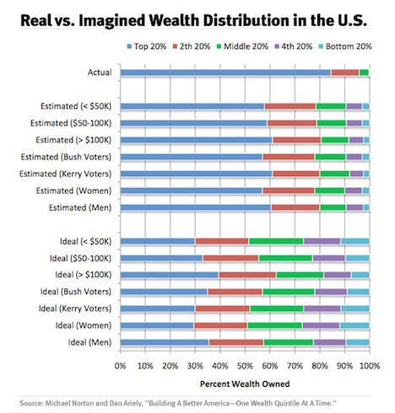
Social Welfare Policy
Income vs Wealth
Income: funds collect between any two points in time.
Wealth: The value of assets owned.
So, what causes the income distribution issues in politics?

Slide 12
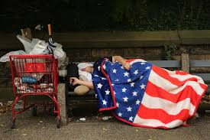
Social Welfare Policy
Poverty in America
Poverty Line ($23,000 for a family of 4)
Feminization of poverty

Slide 13
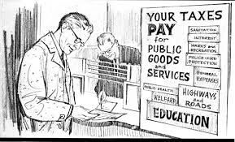
Social Welfare Policy
Taxes in America
Progressive tax
Proportional tax
Regressive tax
Earned income tax credit

Slide 14
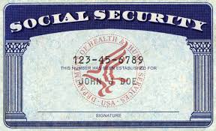
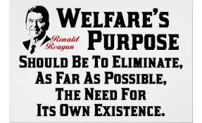
Social Welfare Policy
Reform:
Social Security Act. 1935
Personal Responsibility and
Work Reconciliation Act 1996
Temporary Assistance for Needy Families (TANF) 1996

Slide 15
Social Welfare Policy
Social Security Trust Fund is in trouble.
Bush attempted to fix Social Security overhaul. (often called “privatization”)
The world has a much larger “welfare state” than the United States. Europe was dominated by the Welfare State belief until the turn of the century (2000). This has changed as conservatives have had huge success in the past decade there in elections.

Slide 16
Health Care Policy
Uneven Coverage, Uneven Care
Health Insurance
46 million Americans have no health insurance.
Most common reason for losing health insurance is losing or changing a job
Health insurance is closely tied to race and income—higher income means more likely to have insurance
Managed Care
Health Maintenance Organization (HMO): organization contracted by individuals or insurance companies to provide health care for a yearly fee.
Designed to reduce costs through oversight and limiting patient choices.
Limits choice of health care providers

Slide 17
Health Care Policy
The Role of Government in Health Care
Government in the United States plays smaller role than governments in other countries
National Health Insurance: a compulsory insurance program for all American that would have the government finance citizens’ medical care—not passed
Medicare: provides hospitalization insurance for elderly and optional coverage for other medical expenses
Medicaid: public assistance program to provide health care for the poor, which is funded by both national and state governments

Slide 18
Health Care Policy
Policymaking for Health Care
The Politics of Health Care
Interest groups play a major role in health care policy making, leading to uneven government and private health care policies.
Elderly
Businesses
Insurance companies

Slide 19
Health Care Policy
Policymaking for Health Care
The Health Policy Issues Ahead
Nothing suggests health care will become cheaper.
Stem cell research
Limits on federal funding and research, but states spending more
Is medical rationing the solution to high health care costs?

Slide 20
Environmental Policy
Environmental Protection Agency:
A federal agency created in 1970 and charged with administering all the government’s environmental legislation
Administers policies dealing with toxic wastes
The largest independent regulatory agency

Slide 21
Environmental Policy
Clean Air Act of 1970: charged the Department of Transportation with responsibility to reduce automobile emissions
1990 amendments allowed emissions trading and this has grown into a world product of trading carbon credits

Slide 22
Environmental Policy
Water Pollution Control Act of 1972
Intended to clean up the nation’s rivers and lakes requiring the use of pollution control technology
Has helped reclaim numerous rivers and lakes since its passage
But misses “runoff” pollution from city streets and other areas

Slide 23
Environmental Policy
Environmental Policies in America
Wilderness Preservation
The U.S. is a world leader.
The national parks and national forests may be restricted to keep them for future generations.
George W. Bush proposed letting states decide on roads in wilderness areas.
Endangered Species
Endangered Species Act: federal government must protect actively endangered species—regardless of economic impact

Slide 24
Environmental Policy
Toxic Wastes
Superfund: created by Congress in 1980 to clean up hazardous waste sites; money comes from taxing chemical products
Has virtually eliminated haphazard dumping of toxic waste, but less successful in cleaning up existing waste
Nuclear waste presents a serious challenge—Yucca Flats in Nevada as home for nuclear waste

Slide 25
National Security
Instruments of Foreign Policy
Military
Economic
Diplomacy

Slide 26
National Security
United States as Actors on the World Stage
International Organizations
United Nations 1945
Regional Organizations
North Atlantic Treaty Organization 1949
European Union
Multinational Corporations
Nongovernmental Organizations (Green Peace)
Individuals (tourism)

Slide 27
National Security Policymakers
The President
Diplomats (including advisors to the President)
National Security Establishment
President
Secretary of Defense
Joint Chiefs of Staff ( made up of the top leader of each branch of the military)
CIA and FBI
Congress

Slide 28
National Security Policymakers
Nuclear Proliferation
Only a few countries have known nuclear weapon capabilities.
Fear that other “rogue” countries will have nuclear weapons capabilities and use them against their neighbors or the U.S.
The U.S. will focus on discouraging the deployment of developed nuclear weapons.

Slide 29
National Security Policymakers
The International Economy
Interdependency: mutual dependency in which the actions of nations reverberate and affect one another’s economic lifelines
International Trade
Tariffs: a tax on imported goods to raise the price, thereby protecting American businesses and workers
NAFTA and GATT are ways to lower tariffs and increase trade.
Congress approved the Central American-Dominican Republic Free Trade agreement in 2005.
Balance of Trade
Ratio of what is paid for imports to what is earned for exports

Slide 30
National Security Policymakers
Energy
America depends on imported oil, about 60 percent, but not as much as other countries like Japan.
Much of the recoverable oil is in the Middle East which is often the site of military and economic conflicts.
Organization of Petroleum Exporting Countries (OPEC): controls the price of oil and amount its members produce and sell to other nations

Slide 31
National Security Policymakers
Foreign Aid
Foreign aid is used to stabilize nations friendly to the United States.
A substantial percentage of foreign aid is military.
Foreign aid has never been very popular with Americans and is typically cut by Congress.

