Slide 1
Voters and Voter Behavior
Civics
Chapter 6
MacGruder’s American Government

Slide 2
The Right to Vote—History of Voting Rights
Suffrage/franchise—the right to vote
1789—male, white, property-owners (about 1 in 15 adults)
2018—nearly all citizens 18 years or older are eligible
The growth has stemmed from
1) elimination of restrictions on voting
2) Federal government’s assumption of the States’ power of voting

Slide 3
History of Voting Rights (continued)
5 Stages of Extending Suffrage:
1) Early 1800s: no more religious restrictions, reducing property ownership and tax payment → almost all adult white males eligible
2) 1870: the 15th Amendment intended to enfranchise African Americans, although states did not honor this for almost a century
3) 1920: the 19th Amendment allowed women to vote → now at 50% of the population
4) 1960s: especially the Voting Rights Act of 1965 established racial equality, 23rd Amendment (D.C. 1961), 24th Amendment (no poll tax 1964)
5)1971: the 26th Amendment (18-year olds)

Slide 4
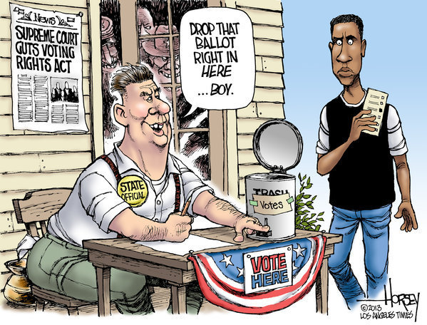
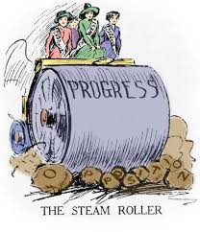
Change over time…

Slide 5
The Power to Set Voting Qualifications
The Constitution gives states—NOT the federal government—the power to set suffrage qualifications, except for 5 restrictions
1) If a state allows someone to vote for its state government, they must be allowed to vote for federal-level government
2) No state can contradict the 15th Amendment
3) No state can contradict the 19th Amendment
4) No state can contradict the 24th Amendment
5) No state can contradict the 26th Amendment
Important Case: Hill v. Stone (1975)—challenging the restriction of suffrage to property owners

Slide 6
Voter Qualifications—Universal Requirements
Citizenship—this is a state decision
Residence—to keep political machines from having outsiders vote, and to allow new voters to become familiar with the case
Age—18 now, since the 26th Amendment (1971)

Slide 7
Other Qualifications
Registration—for voter identification
Literacy—not applicable today, but has been in the past
Tax payment (poll tax)—property ownership and/or actual tax to vote
Important Case: Harper v. Board of Elections (1966)—Virginia poll tax eliminated after violation of 14th Amendment

Slide 8
Questions to Think About
Is there true democracy if not everyone can vote?
Should there be any other qualifications? Should there be fewer qualifications?
Should states continue to have control over voting, or should the federal government have more power?

Slide 9
Suffrage and civil rights—The Fifteenth Amendment
15th Amendment (1870)—“the right to vote cannot be denied to citizens because of race, color, or previous condition of servitude”
Good in theory, but it was not enforced→ discrimination in the South
White supremacy
Violence
Subtle threats/social pressures → firing men who registered, denying credit to families
Literacy tests
Registration laws (poll taxes, “white primaries”, gerrymandering)
White primaries: Democrats nominating candidates, specifically excluding African Americans; outlawed in Smith v. Allwright (1944)
Gerrymandering: drawing districts to limit the voting strength of particular people or parties; outlawed in Gomillion v. Lightfoot (1960)

Slide 10
Early Civil rights legislation
Federal laws/amendments needed enforcement → Civil Rights Act of 1957 → United States Civil Rights Commission
The Commission’s job was to look into cases of voter discrimination
Report back to the President and Congress and to the media
Attorney general can work to prevent voter discrimination through federal court orders
Civil Rights Act of 1960 → appointment of federal voting referees, helping to register people to vote

Slide 11
The Civil Rights Act of 1964
Broader and more effective →
Outlaws discrimination in the form of jobs or voter registration
Relies on the power of the federal courts by injunction
Still wasn’t perfect or easy; civil rights activists—including Dr. Martin Luther King Jr.—protested and did voter registration drives only to face violence and more discrimination
Finally President Lyndon Johnson had a say in it
Injunction: court order that forces or limits an act of individuals or officials

Slide 12
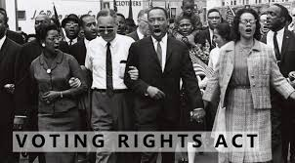
The Voting rights act of 1965
True effectiveness because it applied to ALL elections
Originally temporary (1970 → 1975 → 1982 → 2007 → 2015)
Led to Harper v. Board of Elections (1966)—no more poll tax!
New election laws or changes must be approved (given preclearance)
Upheld in 1966 by the Supreme Court
Amendments continually added more states and eliminated more restrictions

Slide 13
Voter behavior—nonvoters
Ancient Greek “idiotes” means citizens who do not vote
While millions vote, there are also millions who are eligible who do not vote

Slide 14
The size of the problem
Voter turnout has been decreasing over the years
Off-year/midterm elections always show lower voter turnout
Ballot fatigue
Notes:
https://www.nytimes.com/interactive/2016/09/13/us/politics/what-separates-voters-and-nonvoters.html

Slide 15
Why people do not vote
“Cannot-Voters”
Not residents
Ill, physically or mentally disabled
Traveling
Those imprisoned
Religiously convicted
Actual nonvoters
Not convinced they matter → things are fine/things will never change
No political efficacy
Other Factors
Complicated election procedures
“Time-zone fallout”
Lack of interest
The nature of the two-party system

Slide 16
Why people do not vote (continued)
Voters
Non-Voters
Higher income levels
Higher education
Higher job status
Involved in the community
Long-time residents in urban areas
Strong party identification
Sense of political efficacy
Women
Younger than 35
Unmarried
Lower job status
Residents of the South or rural areas
Low sense of political efficacy
Men

Slide 17
Voters and voting behavior
How do we know about voting?
Looking at results of particular elections
Doing survey research (Gallup, Ballotpedia)
Studying political socialization

Slide 18
Sociological factors for voting
Income
Occupation (Job)
Education
Gender
Age
Religious, cultural, ethnic background
Geography
Family and friends

Slide 19
Psychological factors for voting
PARTY IDENTIFICATION (long-term)
Straight-ticket voting
Split-ticket voting
Increasing number of independents
Candidates and issues (short-term)

Slide 20
Questions to think about
What are reasons you can think of why people don’t vote?
Do you think voting should be mandatory?
Is it important to analyze results of elections?

