Slide 1
Civil Rights and Public Policy

Slide 2
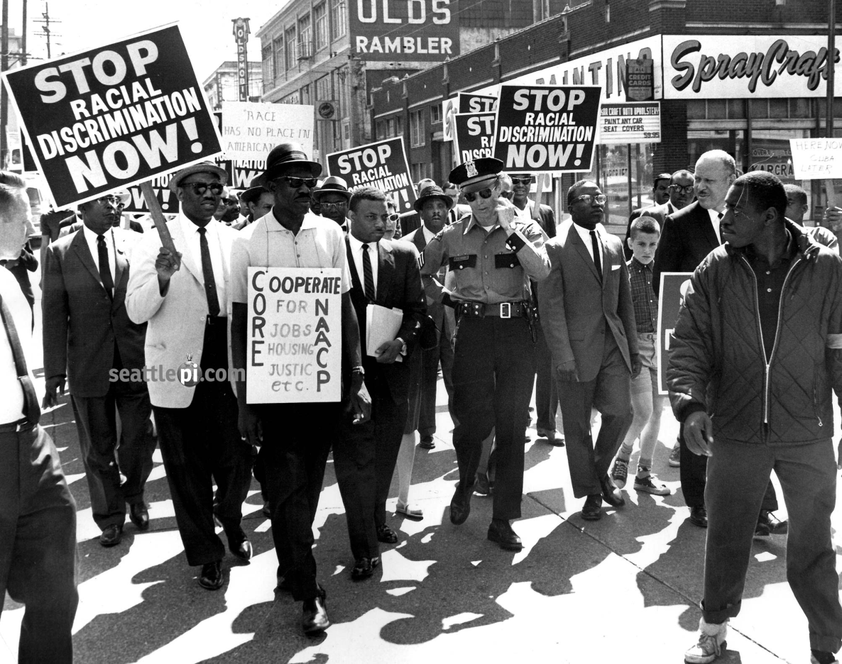
Civil Rights
Civil Rights guarantee that people are not discriminated against

Slide 3
What does equality mean?

Slide 4
Is everyone is this nation equal? African Americans, Hispanics, Muslims, Jews, juveniles, immigrants from other nations, gay people.

Slide 5
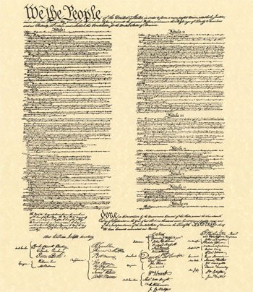
Constitution
The original document said nothing about equality

Slide 6
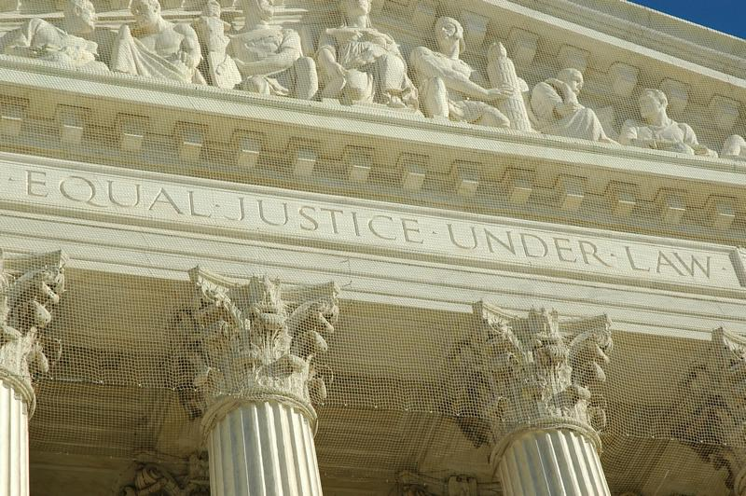
14 Amendment
Equality under the law

Slide 7
It’s up to the courts to decide what this means?

Slide 8
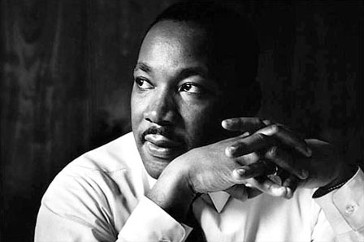
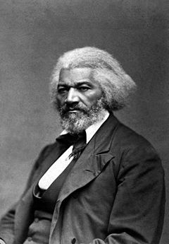
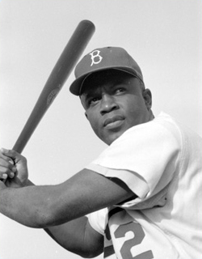
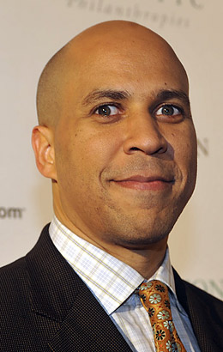
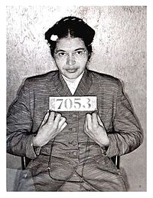
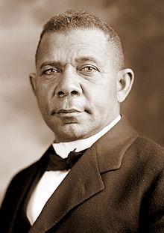
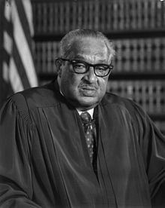
African Americans

Slide 9
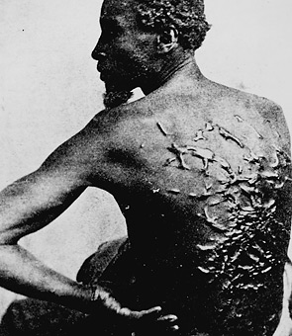
Era of slavery

Slide 10
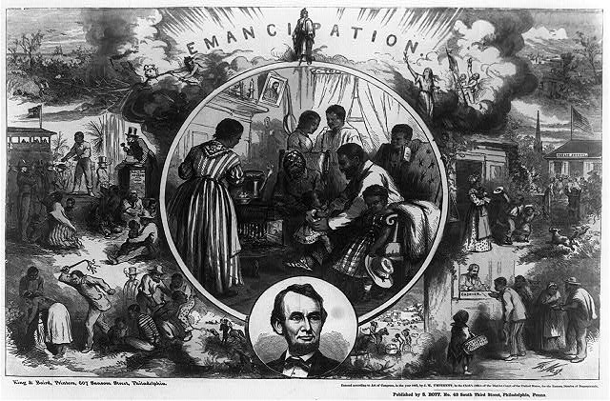
13 Amendment Ended Slavery

Slide 11
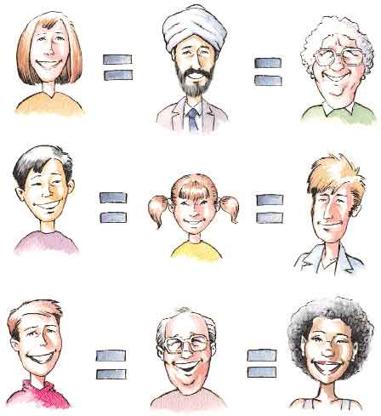
14 Amendment
Born in US=citizen
Equality under the law

Slide 12
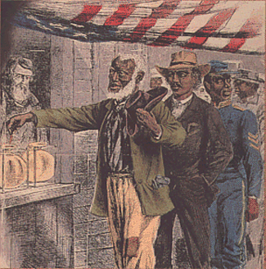
15 Amendment (African Americans can vote)

Slide 13
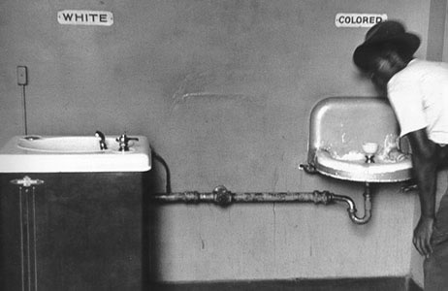
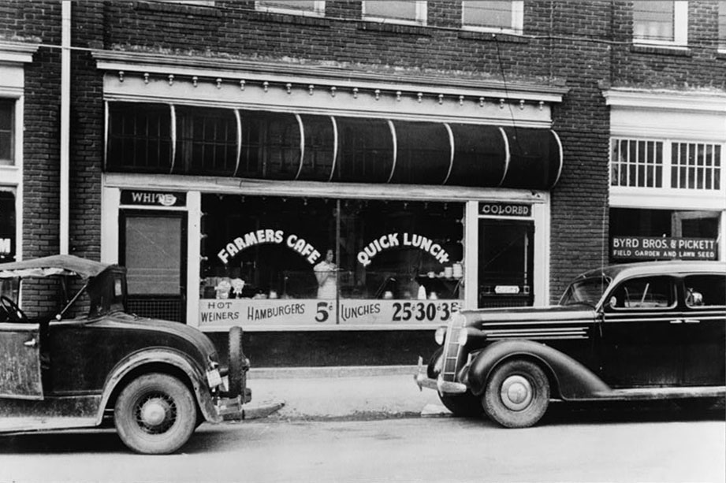
Segregation, Jim Crow, Poll taxes, literacy tests

Slide 14
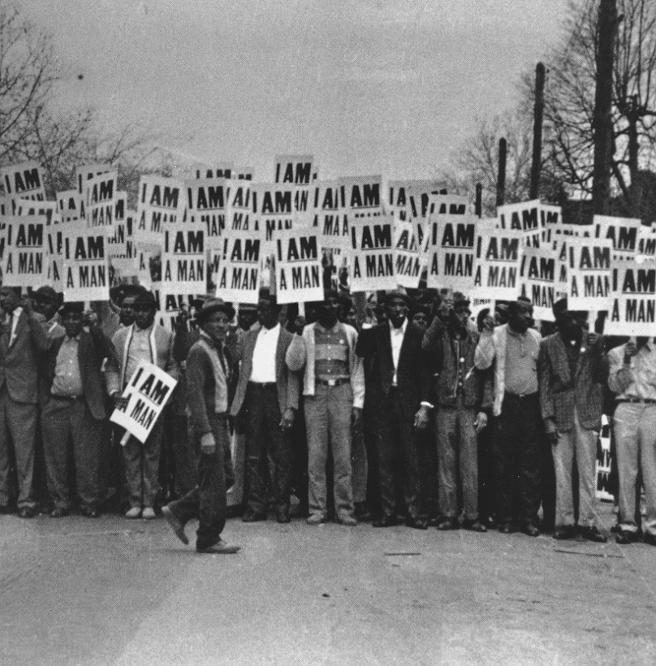
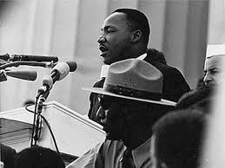
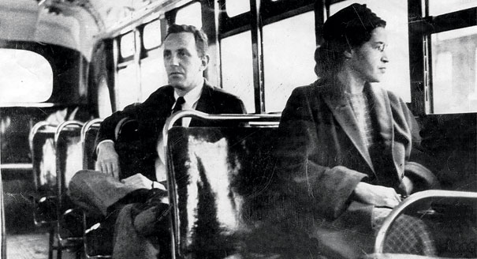
The Era of Civil Rights

Slide 15
But not all racial segregation was by law (de jure)
Children assigned to a school based in their neighborhoods
Neighborhoods could be racially segregated
School are still segregated

Slide 16
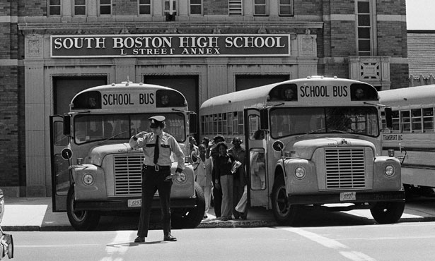
Busing

Slide 17
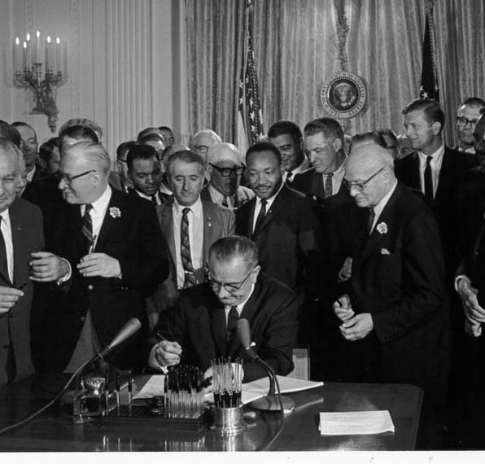
Civil Rights Act Ended segregation

Slide 18
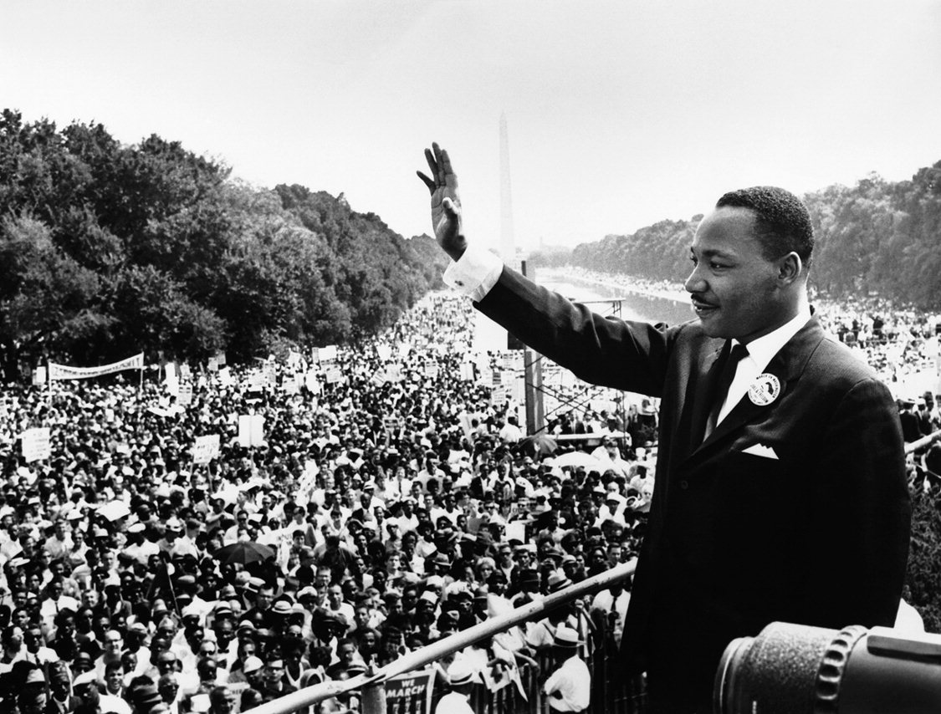
Voting Rights Act (1965) Banned laws that stopped Africans from voting

Slide 19
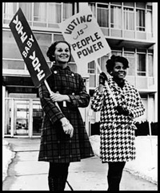
24 Amendment
Banned poll taxes

Slide 20
Affirmative Action
Colleges could use race in determining if they are going to accept a student or not.

Slide 21
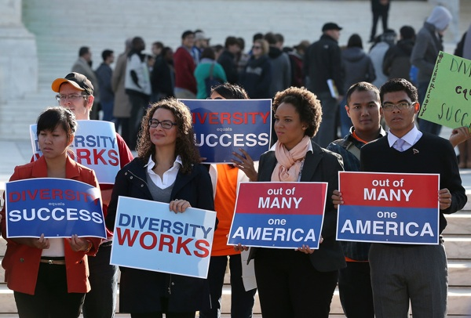
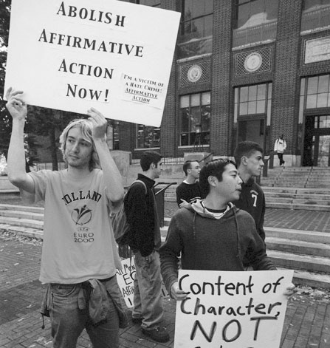
Why?

Slide 22
Is it fair?
Critics
Reverse discrimination
Punishing white, males
Base it one merit
Supporters
Discrimination still exist in America
Levels the playing field
Everyone need equal access to higher education

