Slide 1
The Electoral Process Chapter 7

Slide 2
Section 1-The Nominating Process
Nomination—deciding and naming who will run for office
Getting a nomination is the first step in the election process
Nominations are one of the main reasons for political parties
Nominations help “ensure” the two-party system in our nation
There are several ways that people can be nominated in the U.S.

Slide 3
How to Get Nominated!
Self-Announcement
The Caucus
The Convention
The Direct Primary
Petition
Simple statement by the candidate
Group of people who select candidates based on similar preferences
From caucus to county convention to State convention to National Convention
An election within a party to pick candidate(s)
Qualified voters signing in their choice for candidate

Slide 4
Primaries (continued)
The Closed Primary
The Open Primary
24 states use this
Only party members can vote (party established through registration)
Party can be changed on Election Day if needed
Keeps parties separate
Candidates are more responsive to their own members
Voters are more thoughtful
26 states use this
Any voter can vote
Either public or private choice of party
Blanket primary (once used by Washington, Alaska, and California) means voting for anyone in any party → deemed unconstitutional
Open-election law used by Louisiana → primary and election combination
Doesn’t exclude independents
Party identification is often private

Slide 5
Primaries (continued)
Runoff Primary
A “second” primary with top candidates
Nonpartisan Primary
Elections for school and city positions; no party labels
Presidential Primary
Either:
Voters elect party delegates to the national convention
Voters choose their preference for their party’s presidential nominee

Slide 6
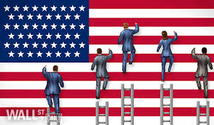
Evaluating Primary Elections
People have issues with all the forms of the primary → voter turnout tends to be very low in primary elections (at least half)
Campaigning for primaries can be expensive
Primaries can cause fights within parties
Name recognition is very important in primaries

Slide 7
Section 2- Elections
Elections in a democracy must be free, honest, and accurate
The government plays a role in maintaining these qualities, at the state and national (federal) level
Congress has the power to fix “Times, Places, and Manner of holding Elections”
For members of Congress
For presidential electors, the date for electoral votes, and other aspects of the presidential progress
Article 1, Section 4, Clause 1
17th Amendment
Article 2, Section 1, Clause 4
12th Amendment
Notes:
Hopefully most of you had a chance to register to vote the other day, right? That is an important step in helping you become part of the electorate!

Slide 8
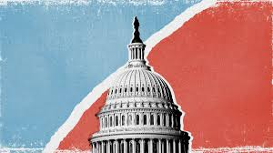
The Extent of Federal Control (continued)
Congress requires secret ballots
Congress has made efforts to protect the right to vote (Chapter 6)
Congress has removed corrupt officials and practices
Congress has regulated finances related to campaigns

Slide 9
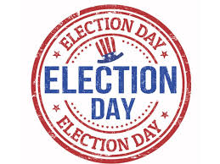
Most States align their elections with national elections
The “Tuesday-after-the-first-Monday” means elections are not on Sundays or on the first day of the month
Other elections may be held in the spring
Election dates vary by county and city as well
Absentee voting allows for people to vote days or even weeks ahead of time
Originally meant to help the ill or disabled → almost anyone qualifies now
The “coattail effect” can happen when one important party member helps other members get elected just by being in the same party

Slide 10
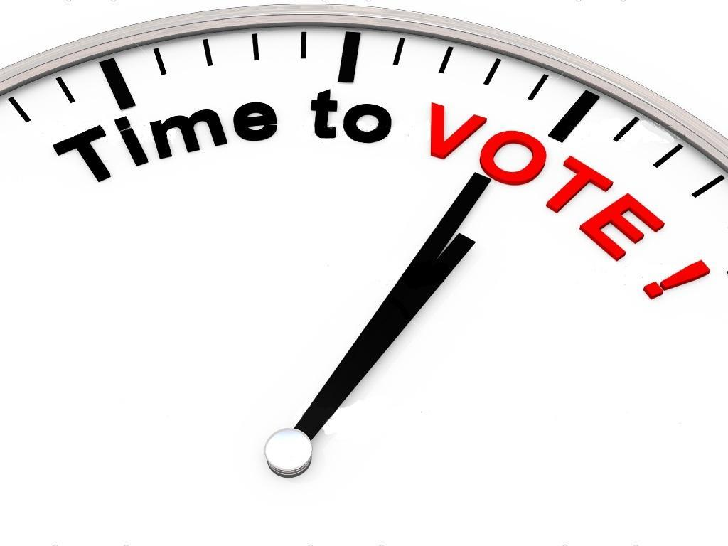
Precincts and Polling Places
Precincts are voting districts with between 500 and 1,000 voters
A polling place is located in a precinct and is where people go to vote in person
Precincts are supervised by election boards, groups of people who make sure everything is running smoothly and legally
They make sure the polling place is open at the times that the State sets
They make sure ballots and other materials are available, and that all machines are working properly
Once the voting period is over, they count the votes and send them to a county election board
“Poll watchers” are members from specific political parties who are able to be at a polling station to make sure that voters are qualified and that their party is being represented
They are even allowed to oversee the counting of the ballots as well
Notes:
Has anyone ever been to a polling place with someone? You’ve been able to see a little bit, but there are really a lot of different things that go into making Election Day possible.

Slide 11
Casting the Ballot
A ballot is a device for voters to share their choice in an election
All states must have secret ballots, but there are different forms of ballots
The Australian Ballot
Paid for by the public
Lists all candidates
The Office-Group Ballot
Candidates grouped
Name order alternated
The Party-Column Ballot
Candidates listed in columns
Favored by politicians → straight-ticket voting
Sample Ballots
Bedsheet Ballots
Only given at the polls
Marked in secret
Available before an election to prepare
Lists all candidates and measures
Typical American elections
Often difficult to get through
Viewed as “more democratic”

Slide 12
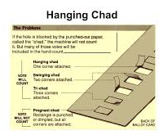
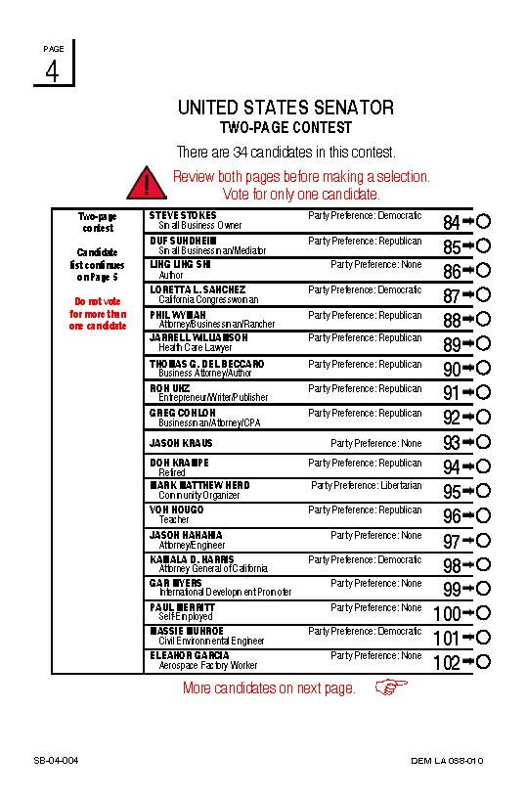
Automated Voting
From original voting machines in 1892 to today…
Electronic Vote Counting
First started in the 1960s with electronic data processing (EDP) and punch-card ballots (officially removed in 2002)
Now precincts use ink-marked ballots or touchscreen systems
Vote-by-Mail Elections
First started in 1977 in California for local elections → expanded across the country and for general and national elections
In some states you can choose to vote by mail; some states this is the only choice
Online Voting
First started in 1997 (an astronaut voted by e-mail!), first official vote in 2000
Hasn’t caught on as much, due to potential problems (fraud, viruses, computer or data crashing, etc. → what will the future of voting look like?
Notes:
Critics of vote-by-mail elections say it reduces the safety and security of secret voting. Supporters say it helps increase voter turnout for those who are not available the day of an election.

Slide 13
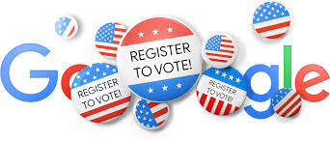
Now it’s your turn!
Go to registertovote.ca.gov
Do you have your..?
Date of Birth?
Address?
Social Security Number?
Driver’s License or CA ID?

Slide 14
Section 3- Money and Elections
Campaign Spending
There is no sure number for how much is spent on elections
The most is spent by the presidential elections
Spending for Congress campaigns has been increasing too
Money is spent on radio and television time, campaign managers, advertisements, pamphlets, office rent, and much more!
The amount of money depends on the position (the “higher” the position, the more money spent!)

Slide 15
Sources of Funding
Private contributors
Make up the most of campaign funds
Small contributors (about 10% of voters)
Wealthy contributors
Candidates (for themselves or by their families)
Political Action Committees (PACs)
Temporary organizations
Public treasury
Federal and state treasuries that give subsidies

Slide 16
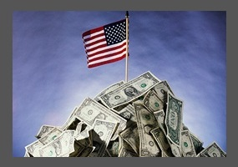
Why Do People Give Money?
People give money as a way to participate in politics
They may support a party or a candidate
They want to have a say in elections and politics
Those who donate a lot of money may want future positions in government
Businesses and other groups want to influence policy

Slide 17
Regulating Campaign Finance
Since 1907, no corporation or bank can provide money in an election
Reforms have been established in the Federal Election Campaign Act of 1971, the Amendments of 1974 and 1976, and the Bipartisan Campaign Reform Act of 2002
Congress cannot regulate the money used in State and local elections

Slide 18
The Federal Election Commission
Handles all laws relating to campaign finance
Six members appointed by the President
Information about campaign finance needs to be reported to Congress
There are limits on financial contributions for an election
Corporations can only contribute money through PACs

Slide 19
Money and Campaigning
Soft Money
Contributions (with no limits) used for party-building expenses or generic party advertising
McCain-Feingold Act (BCRA)(2002) banned soft money, increased amount individuals can contribute, and limited “issue ads.” Helped create the “ I approve of this message” ads.

Slide 20
Citizens United v. Federal election commission (2010)
A case challenging the Federal Election Commission's ruling that the documentary film entitled Hilary produced by a non profit corporation and funded by for-profit corporations constituted a violation of the ban on corporate contributions to federal campaigns. The Supreme Court ruled that corporate funding of independent political ads in candidate elections cannot be limited under the first amendment

Slide 21
Citizens United v. Federal election commission (2010)
U.S. Supreme Court on January 21, 2010, ruled (5–4) that laws preventing corporations and unions from using general treasury funds for independent electioneering communications violate the First Amendment’s guarantee of freedom of speech. In so doing the court invalidated Section 203 of the federal Bipartisan Campaign Reform Act of 2002 (BCRA)—also known as the McCain-Feingold Act

Slide 22
Bundling (Bush)
Bundling: Large donors tap their friends for maximum individual donations
then give in a ‘bundle’ to the candidate committee.
$500K bundles used to support Bush’s primary campaign
Also practiced by Unions to donate money to campaigns.
While there are disclosure requirements for bundling, they only go into effect when a bundler personally hands over checks. Most campaigns get around the disclosure provision by not having the bundler ever touch the checks

Slide 23
Money and Campaigning
Are Campaigns Too Expensive?
Fund raising takes up lots of time.
Incumbents do worse when they spend more money because they need it when they face tough challengers.
The doctrine of sufficiency suggests that candidates need just “enough” money to win, not necessarily “more.”

Slide 24
Money and Campaigning
527 Groups: A 527 group is created primarily to influence the selection, nomination, election, appointment or defeat of candidates to federal, state or local public office. They are not subject to contribution restrictions because they do not directly seek the election of a particular candidates.
501 (c) groups: groups that can not spend more than half of their funds on political activities. These groups have no actual limits on how much money that is. (not in your book)

Slide 25
How has money impacted our electoral process?
It gives wealthy people and groups an unfair advantage in influencing the
election outcomes
It affects who votes and how they vote;
It becomes a condition for who runs for office and who does not;
It affects information that the electorate receives about the candidates and their issue positions;
It affects public perceptions of how the system is working and whether it is fair and for the people.

