Slide 1
United States Federal Court System
Chapter 16
Fluharty

Slide 2
The Nature of the Judicial System
Introduction:
  Types of cases:
    Criminal Law: The government charges an individual with violating one or more specific laws.
    Civil Law: The court resolves a dispute between two parties and defines the relationship between them.
    Common Law: a collection of (judge-made) laws that developed over centuries is based on decisions made by judges.
  Most cases are tried and resolved in state, not federal courts.
    Cases of burglary or divorce are examples.

Slide 3
The Nature of the Judicial System
Participants in the Judicial System
  Litigants
    Plaintiff—the party bringing the charge
    Defendant—the party being charged
    Jury—the people (normally 12) who often decide the outcome of a case
    Standing to sue: plaintiffs have a serious interest in the case; have sustained or likely to sustain a direct injury from the government
    Justiciable disputes: a case must be capable of being settled as a matter of law.

Slide 4
The Nature of the Judicial System
Participants in the Judicial System
  Groups (NAACP & Public Interest Groups are examples)
    Use the courts to try to change policies
    Amicus Curiae briefs used to influence the courts
      “friend of the court” briefs used to raise additional points of view and information not contained in briefs of formal parties
  Attorneys
    800,000 lawyers in United States today
    Legal Services Corporation: lawyers to assist the poor
    Access to quality lawyers is not equal. (The more money someone has the better lawyer they can afford to pay for)

Slide 5
Dual Court System
The dual system of the United States Court System reflects the shared power of the National and state governments.
States:
  Allows states to develop their own Criminal code and courts to enforce the codes.
  Can appeal in the state to appeals courts and also appeal to the Federal courts

Slide 6
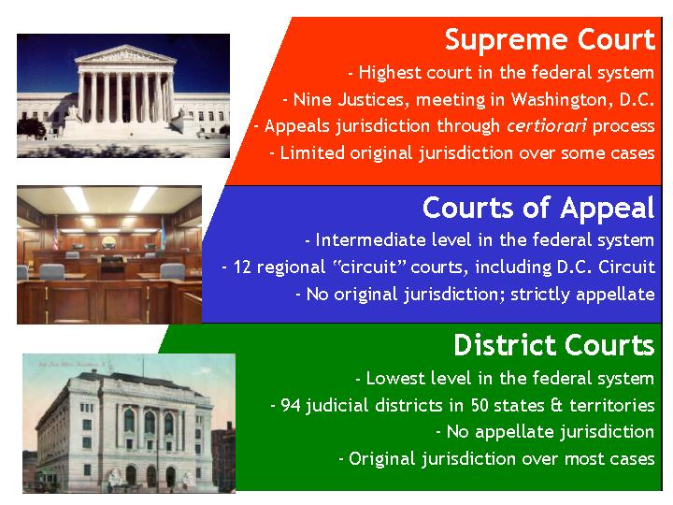
The Structure of the Federal Judicial System
Constitutional Power: Article III of the U.S. Constitution
Power granted to Congress to create “Inferior” Courts to the United States Supreme Court

Slide 7
The Structure of the Federal Judicial System
District Courts (94 Federal Courts)
  Original Jurisdiction: courts that hear the case first and determine the facts - the trial court
  Deals with the following types of cases:
    Federal crimes
    Civil suits under federal law and across state lines
    Supervise bankruptcy and naturalization
    Review some federal agencies
    Admiralty and maritime law cases
    Supervision of naturalization of aliens

Slide 8
The Structure of the Federal Judicial System
Courts of Appeal
  Appellate Jurisdiction: reviews the legal issues in cases brought from lower courts
  Hold no trials and hear no testimony
  12 circuit courts
  U.S. Court of Appeals for the Federal Circuit – specialized cases
  Focus on errors of procedure and law

Slide 9
The Structure of the Federal Judicial System
The Supreme Court
  Ensures uniformity in interpreting national laws, resolves conflicts among states and maintains national supremacy in law
    9 justices – 1 Chief Justice, 8 Associate Justices
    Supreme Court decides which cases it will hear—controls its own agenda
    Some original jurisdiction, but mostly appellate jurisdiction
    Most cases come from the federal courts
    Most are civil cases

Slide 10
The Structure of the Federal Judicial System

Slide 11
U.S. Supreme Court Selection Criteria
Political Ideology
Party and personal loyalties
Judicial Experience
Race and Gender
“Litmus Test” example: Stance on abortion

Slide 12
The Politics of Judicial Selection
Presidents appoint members of the federal courts with “advice and consent” of the Senate.
  The appointment of federal justices has as much to do with partisanship as ideology.
The Lower Courts
  Appointments handled through Senatorial Courtesy:
    Unwritten tradition where a judge is not confirmed if a senator of the president’s party from the state where the nominee will serve opposes the nomination
    Has the effect of the president approving the Senate’s choice
  President has more influence on appellate level

Slide 13
The Politics of Judicial Selection
The Supreme Court
  Fewer constraints on president to nominate persons to Supreme Court
  President relies on attorney general and DOJ to screen candidates
  1 out of 5 nominees will not make it
  Presidents with minority party support in the Senate will have more difficulty.
  Chief Justice can be chosen from a sitting justice, or as a new member to the Court

Slide 14
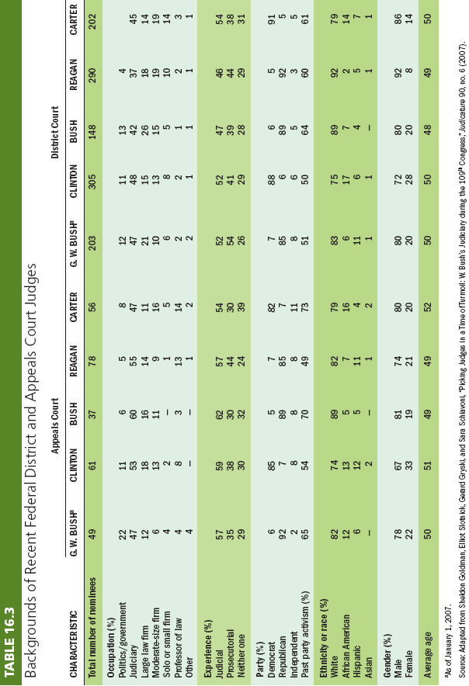
The Backgrounds of Judges and Justices

Slide 15
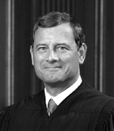
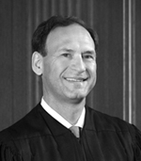
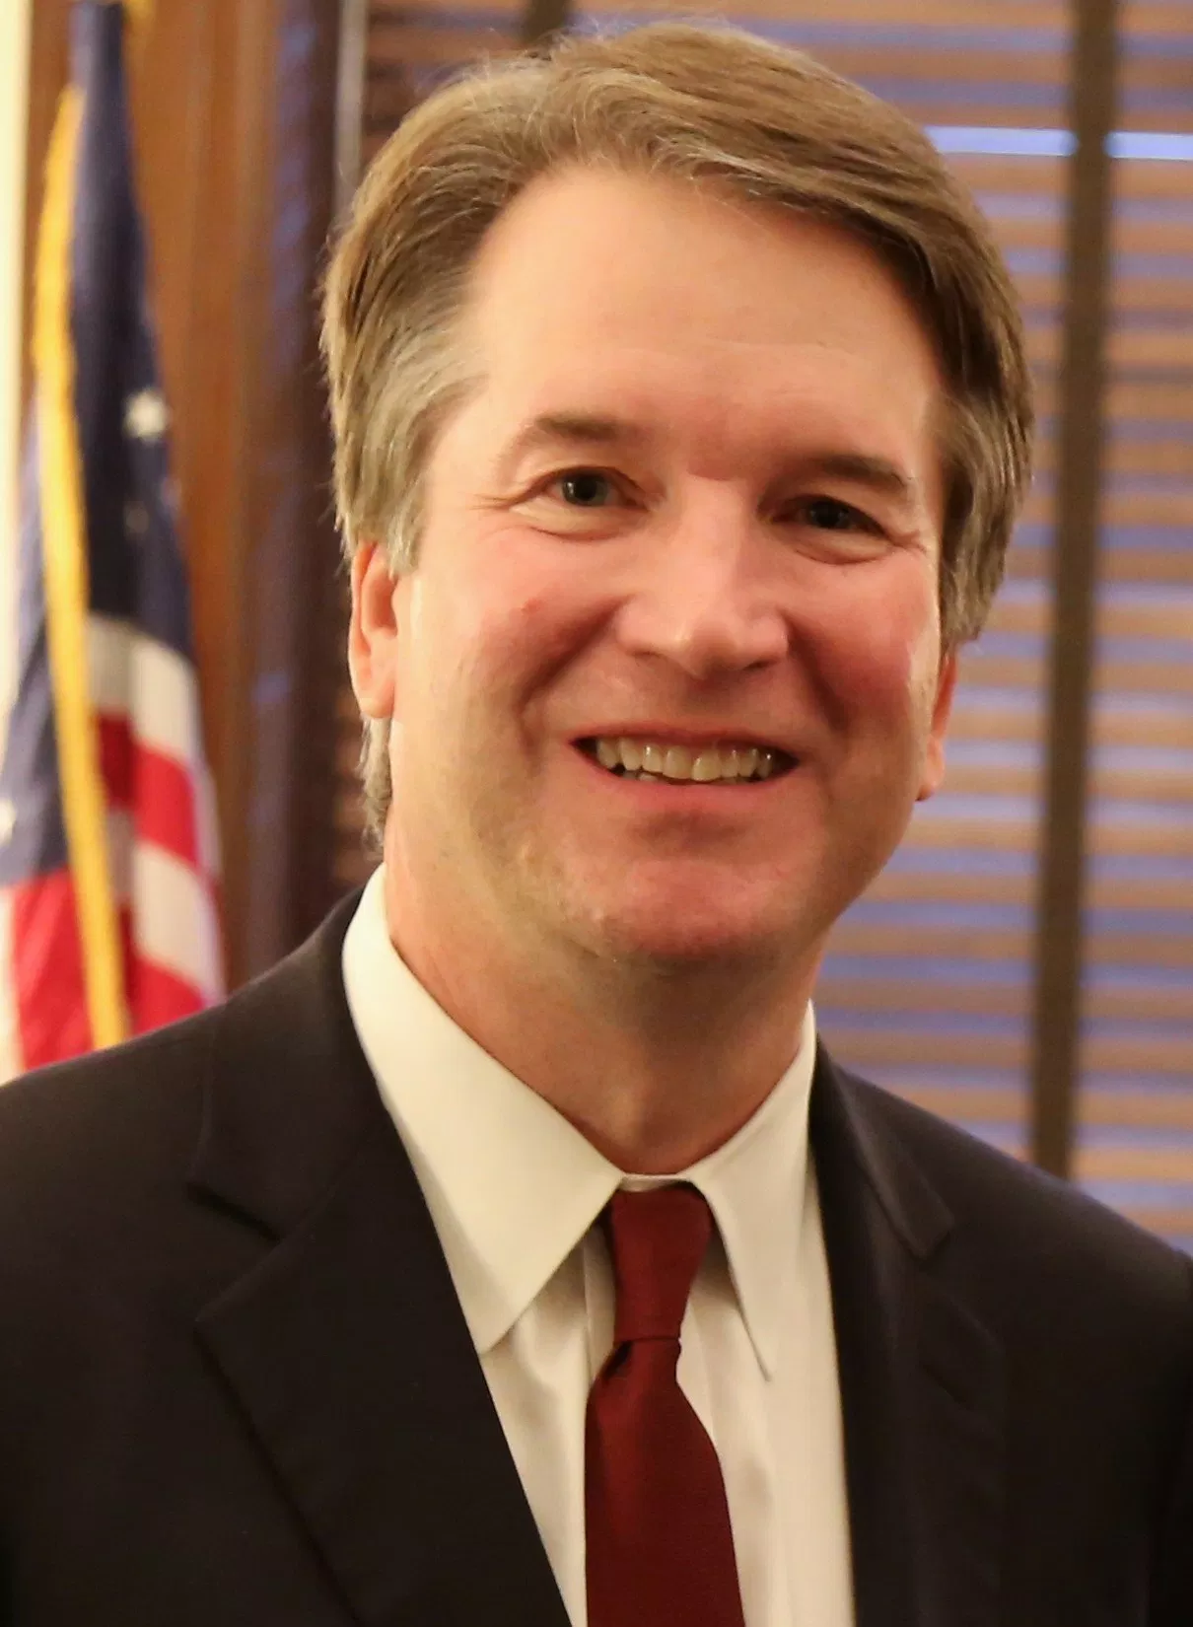
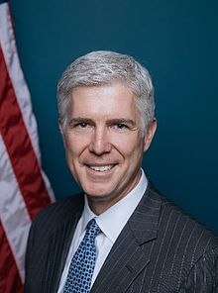
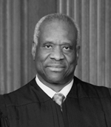
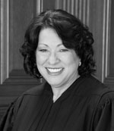
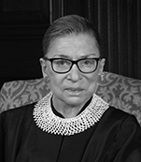
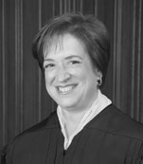
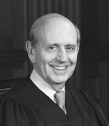
U.S. Supreme Court
Liberal
Conservative
Chief Justice John G. Roberts Jr
Stephen G. Breyer
Samuel Anthony Alito
Brett Kavanaugh
Neil Gorsuch
Clarence Thomas
Sonia Sotomayor
Ruth Bader Ginsburg
Elena Kagan
Associate Justices

Slide 16
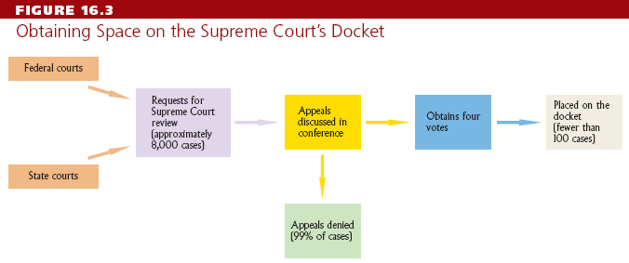
The Courts as Policymakers
Accepting Cases
  Use the “rule of four” to choose cases
  Issues a writ of certiorari to call up the case
  Supreme Court accepts few cases each year

Slide 17
The Courts as Policymakers
Accepting Cases (continued)
  The Solicitor General:
    a presidential appointee and third-ranking office in the Department of Justice
    is in charge of appellate court litigation of the federal government
    Four key functions:
      Decide whether to appeal cases the government lost
      Review and modify briefs presented in appeals
      Represent the government before the Supreme Court
      Submit a brief on behalf of a litigant in a case in which the government is not directly involved

Slide 18
The Courts as Policymakers
Making Decisions
  Oral arguments heard by the justices
  Justices discuss the case
  One justice will write the majority opinion (statement of legal reasoning behind a judicial decision) on the case

Slide 19
The Courts as Policymakers
Making Decisions (continued)
  Dissenting opinions are written by justices who oppose the majority.
  Concurring opinions are written in support of the majority but stress a different legal basis.
  Stare decisis: let previous decision stand unchanged
  Precedent: (precedence) how similar past cases were decided
    May be overruled
  Original Intent: the idea that the Constitution should be viewed according to the original intent of the framers

Slide 20
3 Levels of Scrutiny
Rational Basis Review
This is the lowest level of scrutiny applied to challenged laws, and it has historically required very little for a law to pass as constitutional.
Under the rational basis test, the person challenging the law (not the government) must prove either:
The government has no legitimate interest in the law or policy; or
There is no reasonable, rational link between that interest and the challenged law.
This test typically applies to all laws or regulations which are challenged as irrational or arbitrary as well as discrimination based on age, disability, wealth, or felony status.

Slide 21
3 Levels of Scrutiny
Intermediate Scrutiny
A level of judicial focus on challenged laws is less demanding than strict scrutiny.
This test was first accepted by the U.S. Supreme Court in 1976 to be used whenever a law discriminates based on gender or sex. Some federal appellate courts and state supreme courts have also applied this level of scrutiny to cases involving sexual orientation.
As with strict scrutiny, intermediate scrutiny also places the burden of proof on the government.
In order for a law to pass intermediate scrutiny, it must:
  Serve an important government objective
  Be substantially related to achieving the objective.

Slide 22
3 Levels of Scrutiny
Strict Scrutiny
This is the highest level of scrutiny applied by courts to government actions or laws.
  Strict scrutiny requires the government to prove that:
  There is a compelling state interest behind the challenged policy
  The law or regulation is narrowly tailored to achieve its result.
The U.S. Supreme Court has determined that legislation or government actions which discriminate on the basis of race, national origin, and religion must pass this level of scrutiny to survive a challenge that the policy violates constitutional equal protection.
This high level of scrutiny is also applied whenever a "fundamental right" is being threatened by a law, like the right to marriage.

Slide 23
The Courts as Policymakers
Judicial implementation
  How and whether court decisions are translated into actual policy, thereby affecting the behavior of others
  Must rely on others to carry out decisions
    Interpreting population: understand the decision
    Implementing population: the people who need to carry out the decision–may be disagreement
    Consumer population: the people who are affected (or could be) by the decision

Slide 24
The Courts and the Policy Agenda
A Historical Review
  John Marshall and the Growth of Judicial Review
    Marbury v. Madison (1803) established judicial review—courts determine constitutionality of acts of Congress
  The “Nine Old Men” (known for their conflict with FDR over the The New Deal Policies during the Great Depression)
  The Warren Court (Liberal Majority that expanded Civil Rights, Civil Liberties, Judicial Powers as well as Federal powers)
  The Burger Court (Conservative Majority that delivered liberal decisions in cases about abortion, capital punishment, religious establishment and school desegregation of schools with bussing etc)
  The Rehnquist Court (Conservative Majority that pushed state rights and New Federalism)

Slide 25
Understanding the Courts
The Courts and Democracy
  Courts are not very democratic.
    Not elected
    Difficult to remove judges and justices
  The courts often reflect popular majorities.
  Groups are likely to use the courts when other methods fail, which promotes pluralism.
  There are still conflicting rulings leading to deadlock and inconsistency.

Slide 26
Understanding the Courts
What Courts Should Do: The Scope of Judicial Power
  Judicial restraint: judges should play a minimal policymaking role
  Judicial activism: judges should make bold policy decisions and even chart new constitutional ground
  Political questions: means of the federal courts to avoid deciding some cases
  Statutory construction: the judicial interpretation of an act of Congress
  Strict Constructionism: Narrow view of the document meaning only what was intended from our founding fathers.
  Living Document or Loose Constructionist: The document can be interrupted differently by each generation.

