Slide 1
Election Results
Mid-Term 2018

Slide 2
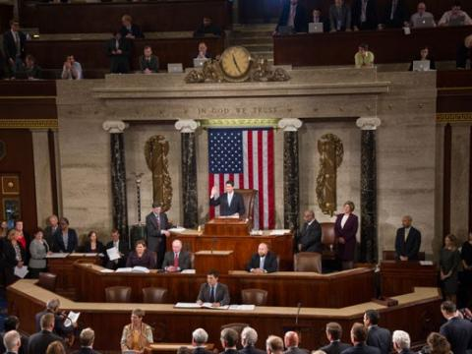


Who Controls the House of Representatives?
Democrats 229 Republicans 206

Slide 3
Who Controls the Senate?
Democrats 47 Republicans 53

Slide 4
Who Controls the Governorships?
Democrats 20 Republicans 24

Slide 5
Who Controls the State Legislators? (Still waiting for results)
Republicans controlled 67 of 99 legislative chambers in the United States and also
Republicans hold 4,134 out of 7,383 legislative seats going into the election.
Largest loss in one election since WWI was Obama losing 29 legislative chambers and 968 seats.

Slide 6
Props for California 22% reported
Prop 1 Veteran Affordable Housing Yes 51.4%
Prop 2 Housing for the Mental Ill Yes 58.7%
Prop 3 Bond for Water Projects No 54%
Prop 4 Bond for Children’s Hospital Yes 57.6%
Prop 5 Senior Property Reduction No 56.5%
Prop 6 Repeal Fuel Tax No 54.9%
Prop 7 Change Daylight Saving Yes 61.8%
Prop 8 Regulates Kidney Dialysis No 62.7%
Prop 9 Removed by court
Prop 10 Rent Control No 65.1%
Prop 11 Ambulance Breaks Yes 64.0%
Prop 12 Farm Animals Yes 59.4%

Slide 7
25th District House of Reps
Democrat Katie Hill 50%
Republican Stave Knight 50%

Slide 8
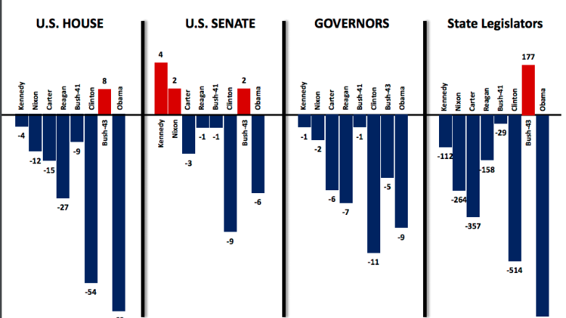
Was there a blue wave?
Was this election unusual?

