Slide 1
The Presidency
Textbook Chapter 13
Studyguide Book Chapter 11
Coach Flu
Revised 2017-2018

Slide 2
The Presidents
Great Expectations
  Americans want a president who is powerful and who can do good like Washington, Jefferson, Lincoln, Roosevelt, and Kennedy.
  Yet Americans do not like a concentration of power because they are individualistic and skeptical of authority.

Slide 3
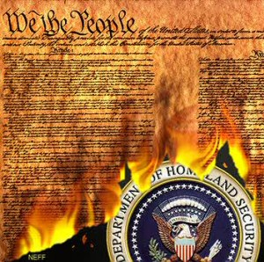
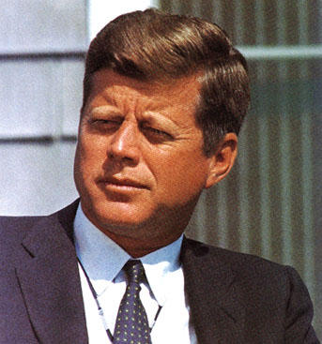
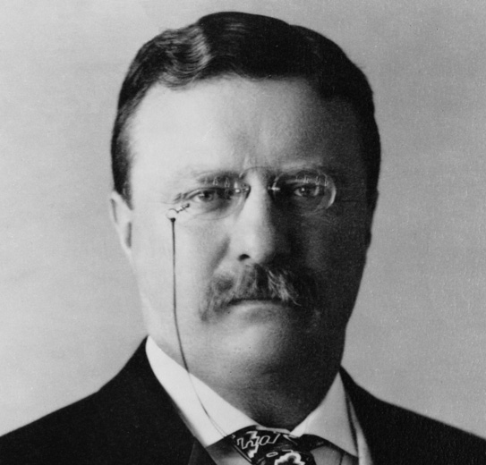
The Presidents
Formal Requirements:
    Must be 35 years old
    Must have resided in U.S. for 14 years
    Natural born citizen
  Informal “Requirements”:
    White (except current President)
    Male
    Protestant (except one)
  All manner of professions, but mostly political ones (former state governors, for example)

Slide 4
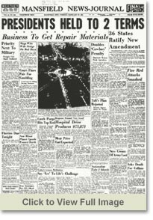
The Presidents
  Elections: The Normal Road to the White House
    Once elected, the president serves a term of four years.
    In 1951, the 22nd Amendment limited the number of terms to two.
    Most Presidents have been elected to office.

Slide 5

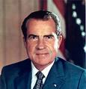
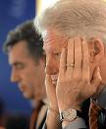
The Presidents
Secession and Impeachment
The vice-President secedes if the president leaves office due to death or resignation or convicted of impeachment
    Impeachment is investigated by the House, tried by the Senate with the Chief Justice presiding.
    Only two presidents have been impeached: A. Johnson & Clinton- neither was convicted.
resigned

Slide 6
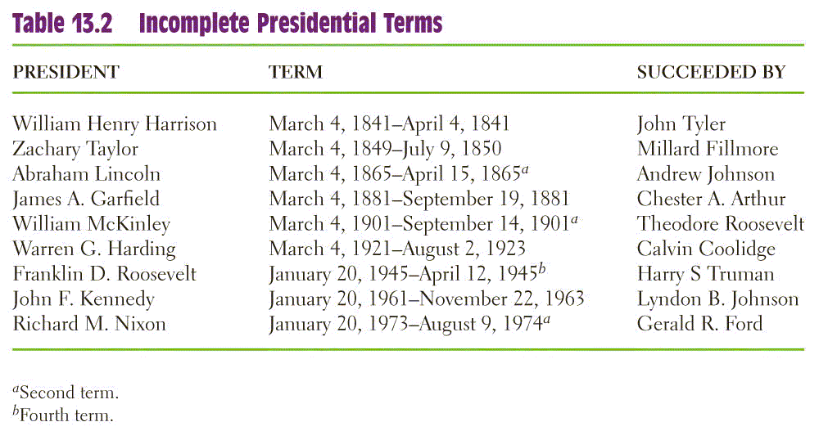
Incomplete Terms

Slide 7
The Presidents

Slide 8
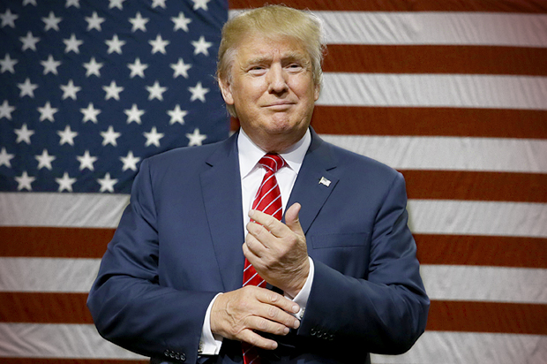
United States President (45)
Donald Trump (R)

Slide 9
Presidential Powers

Slide 10
Running the Government:
The Chief Executive
As Chief Executive, the president presides over the administration of government.
  Constitution: “take care that the laws be faithfully executed”
  Today, federal bureaucracy spends $2.5 trillion a year and numbers more than 4 million employees.
  Presidents appoint 500 high-level positions and 2,500 lesser jobs.

Slide 11
Running the Government:
The Chief Executive
The Vice President
  Basically just “waits” for things to do
  Power has grown over time, as recent presidents have given their VPs important jobs
The Cabinet
  Presidential advisors, not in Constitution
  Made up of 14 cabinet secretaries and one Attorney General, confirmed by the Senate

Slide 12
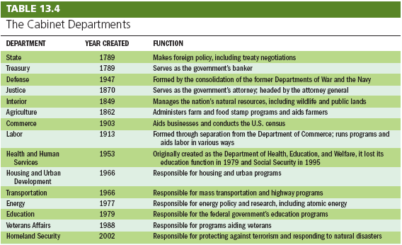
Running the Government:
The Chief Executive

Slide 13
Running the Government:
The Chief Executive
The Executive Office
  Made up of policymaking and advisory bodies
  Three principle groups: NSC, CEA, OMB

Slide 14
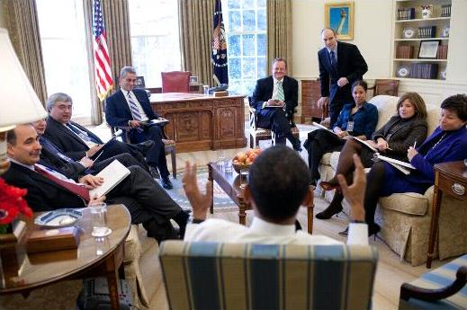
Running the Government:
The Chief Executive
The White House Office
  The White House Staff are the chief aides and staff for the president.
  They are chosen on the basis of their loyalty to the president
  Need not be confirmed
  The national security advisor is an example.

Slide 15
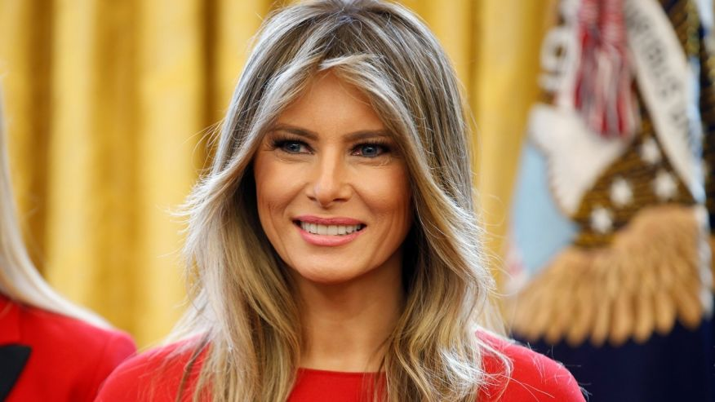
First Lady
  No official government position, but many get involved politically
  Recent ones focus on a single issue

Slide 16
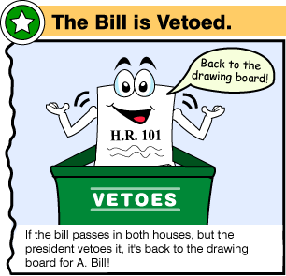
Presidential Leadership of Congress: The Politics of Shared Powers
Chief Legislator
  Veto: Sending a bill back to Congress with the reasons for rejecting it. Can be overridden.
  Pocket Veto: Letting a bill die by not signing it in 10 days when Congress is adjourned.
  Line Item Veto: The ability to veto parts of a bill. Some state governors have it, but not the president. The president must sign or veto all of a bill.

Slide 17
Signing Statements
A signing statement is a written message issued by the president upon signing a bill into law that states objectives to some of the provisions in the bill.
They are not provided for in the Constitution.
George W. Bush increased their use, and Obama has continued this trend.

Slide 18
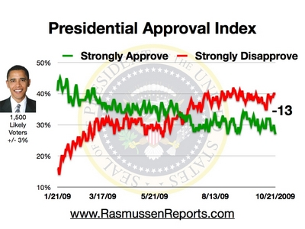
Presidential Leadership of Congress: The Politics of Shared Powers
Mandates
    Perception that the voters strongly support the president’s leadership and policies
    Mandates are infrequent, but presidents may claim a mandate anyway

Slide 19
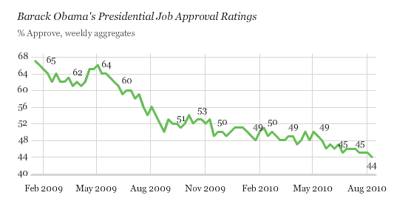
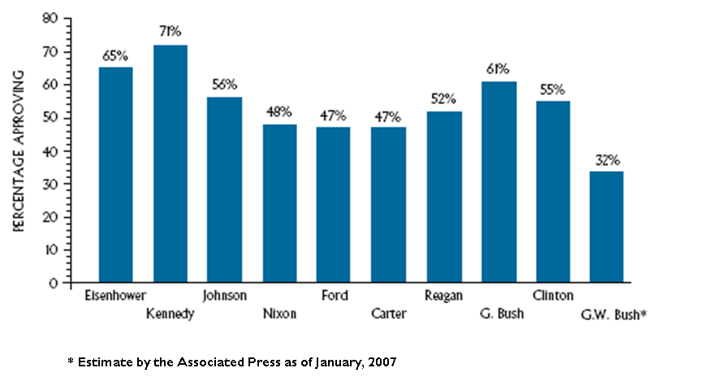
Approval Ratings

Slide 20
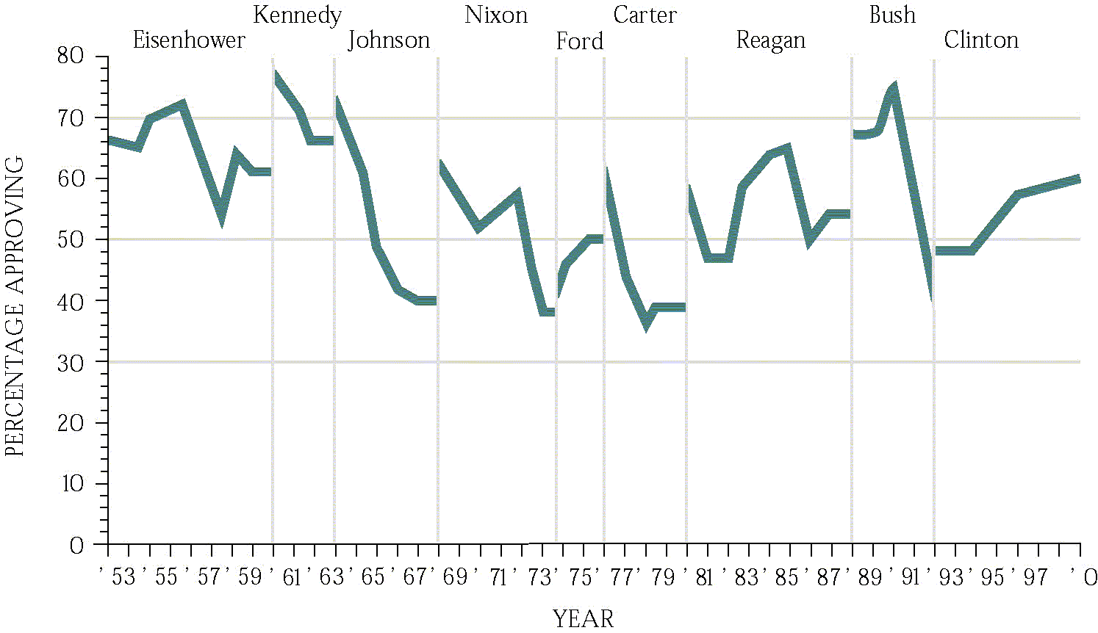
Approval Ratings

Slide 21
Power from the People:
The Public Presidency
Presidential Approval
  Receives much effort by the White House
  Product of many factors: war, the economy, the “honeymoon” period
  Changes can highlight good / bad decisions

Slide 22
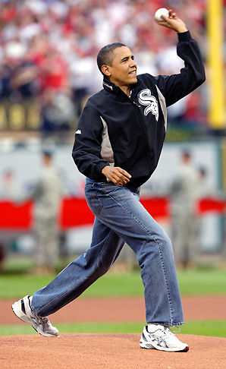
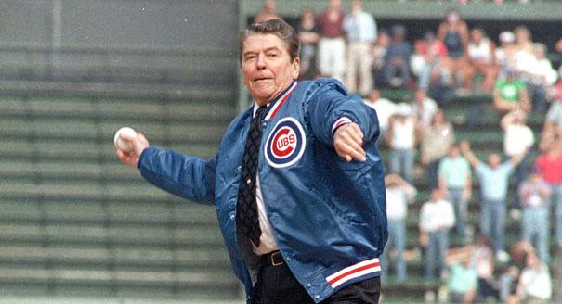
Power from the People:
The Public Presidency
Going Public
  Public support is perhaps the greatest source of influence a president has.
  Presidential appearances are staged to get the public’s attention.
  As head of state, presidents often perform many ceremonial functions- which usually result in favorable press coverage.

Slide 23
Power from the People:
The Public Presidency
Going Public
  Public support is perhaps the greatest source of influence a president has.
  Presidential appearances are staged to get the public’s attention.
  As head of state, presidents often perform many ceremonial functions, which usually result in favorable press coverage.

Slide 24
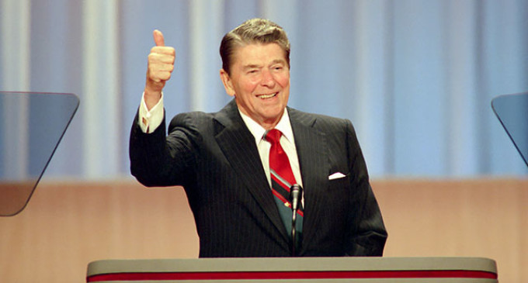
Bully Pulpit
Manage a crisis
Demonstrate leadership
Announce appointment of cabinet members and Supreme Court Justices
Set and clarify the national agenda
Achieve a legislative agenda
Announce foreign policy initiatives

Slide 25
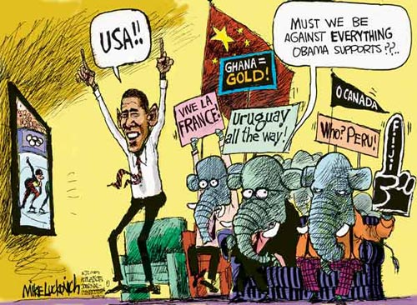
Presidential Leadership of Congress: The Politics of Shared Powers
Legislative Skills
  Variety of forms: bargaining, making personal appeals, consulting with Congress, setting priorities in the State of the Union address.
  Most important is bargaining with Congress.
  Presidents should use their “honeymoon” period
  Nation’s key agenda builder

Slide 26
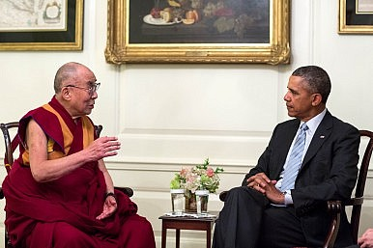
The President and National Security Policy
Chief Diplomat
  Negotiates treaties with other countries
  Treaties must be ratified by the Senate
  Signs executive agreements to take care of routine matters with other countries
  May negotiate for peace between other countries
  Leads U.S. allies in defense & economic issues

Slide 27
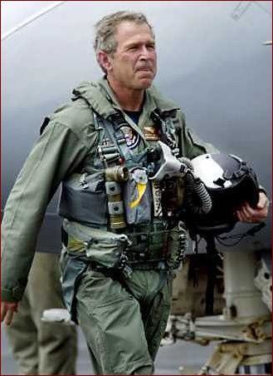
The President and National Security Policy
Commander in Chief
  Writers of the Constitution wanted civilian control of the military
  Presidents often make important military decisions
  Presidents command a standing military and nuclear arsenal
  Presidents can deploy troops without congressional consent.

Slide 28
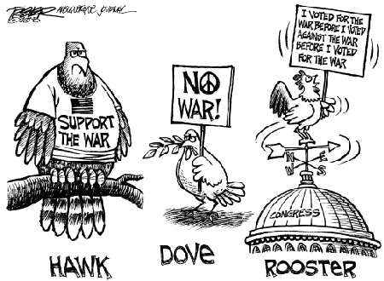
The President and National Security Policy
War Powers Resolution
  Constitution gives Congress the power to declare war, but presidents can commit troops and equipment in conflicts
  War Powers Resolution requires the president to consult with Congress before sending troops, when possible
  It requires that Congress approve of any troop commitment beyond 60 days. (then 30 days to remove troops)
  Most presidents have ignored it.
  Supreme Court avoided it using the political questions doctrine.

Slide 29
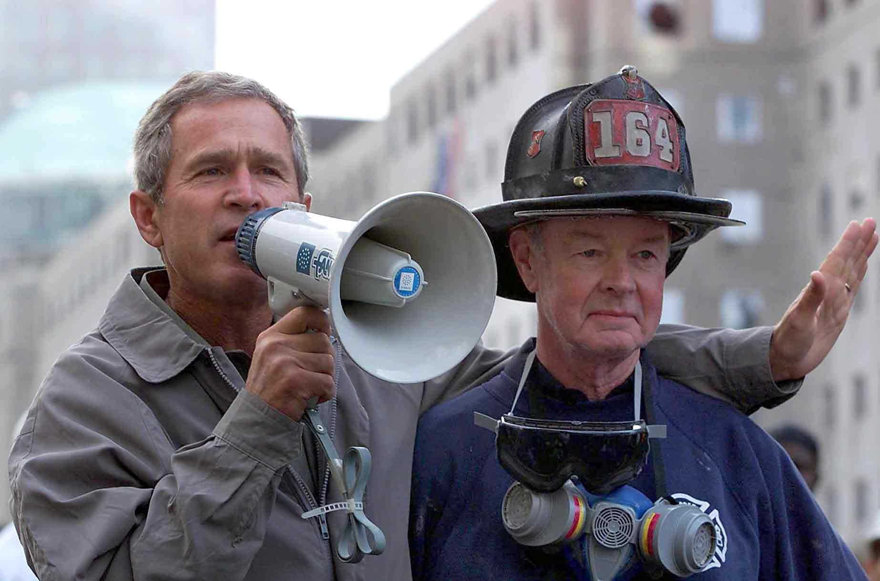
The President and National Security Policy
Crisis Manager
  The role the president plays can help or hurt the presidential image.
  With current technology, the president can act much faster than Congress to resolve a crisis.
Working with Congress
  President has lead role in foreign affairs.
  Presidents still have to work with Congress for support and funding of foreign policies.
Link to Bullhorn Speech

Slide 30
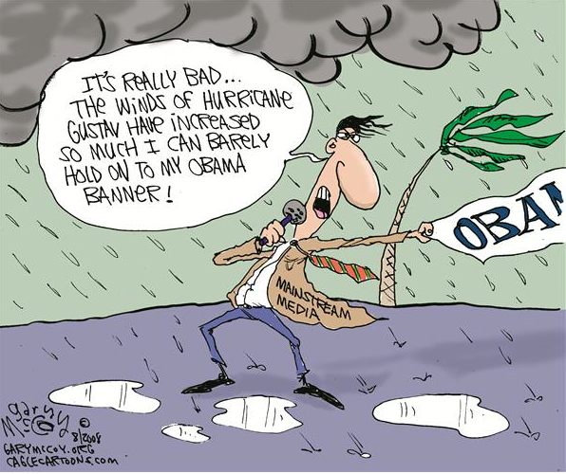
The President and the Press
Presidents and media are often adversaries.
Many people in the White House deal with the media, but the press secretary is the main contact person
Media is often more interested in the person, not the policies
News coverage has become more negative

Slide 31
Important Court Cases
United States v. Nixon (1973) held that the presidential privilege does not cover all circumstances
Nixon v. Fitzgerald (1982) held that a president can not be sued for damages for the decisions they make as president.
Clinton v. Jones (1997) held that a civil lawsuit against the president are not a distraction keeping the president from doing their job.

