Slide 1
United States Federal Court System
Chapter 16
Fluharty

Slide 2
The Nature of the Judicial System
Introduction:
  Types of cases:
    Criminal Law: The government charges an individual with violating one or more specific laws.
    Civil Law: The court resolves a dispute between two parties and defines the relationship between them.
    Common Law: a collection of (judge-made) laws that developed over centuries is based on decisions made by judges.
  Most cases are tried and resolved in state, not federal courts.
    Cases of burglary or divorce are examples.

Slide 3
The Nature of the Judicial System
Participants in the Judicial System
  Litigants
    Plaintiff—the party bringing the charge
    Defendant—the party being charged
    Jury—the people (normally 12) who often decide the outcome of a case
    Standing to sue: plaintiffs have a serious interest in the case; have sustained or likely to sustain a direct injury from the government
    Justiciable disputes: a case must be capable of being settled as a matter of law.

Slide 4
The Nature of the Judicial System
Participants in the Judicial System
  Groups (NAACP & Public Interest Groups are examples)
    Use the courts to try to change policies
    Amicus Curiae briefs used to influence the courts
      “friend of the court” briefs used to raise additional points of view and information not contained in briefs of formal parties
  Attorneys
    800,000 lawyers in United States today
    Legal Services Corporation: lawyers to assist the poor
    Access to quality lawyers is not equal. (The more money someone has the better lawyer they can afford to pay for)

Slide 5
Dual Court System
The dual system of the United States Court System reflects the shared power of the National and state governments.
States:
  Allows states to develop their own Criminal code and courts to enforce the codes.
  Can appeal in the state to appeals courts and also appeal to the Federal courts

Slide 6
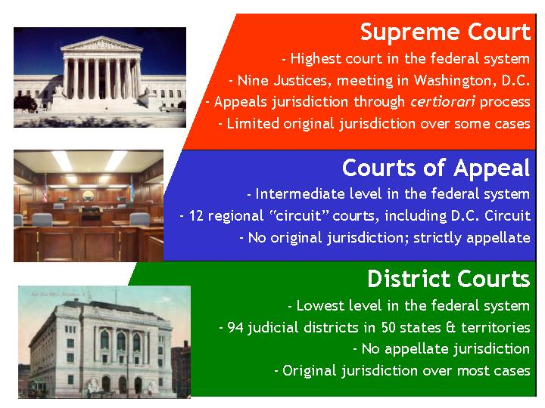
The Structure of the Federal Judicial System
Constitutional Power: Article III of the U.S. Constitution
Power granted to Congress to create “Inferior” Courts to the United States Supreme Court

Slide 7
The Structure of the Federal Judicial System

Slide 8
U.S. Supreme Court Selection Criteria
Political Ideology
Party and personal loyalties
Judicial Experience
Race and Gender
“Litmus Test” example: Stance on abortion

Slide 9
The Politics of Judicial Selection
The Supreme Court
  Fewer constraints on president to nominate persons to Supreme Court
  President relies on attorney general and DOJ to screen candidates
  1 out of 5 nominees will not make it
  Presidents with minority party support in the Senate will have more difficulty.
  Chief Justice can be chosen from a sitting justice, or as a new member to the Court

Slide 10
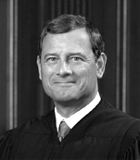
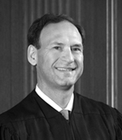
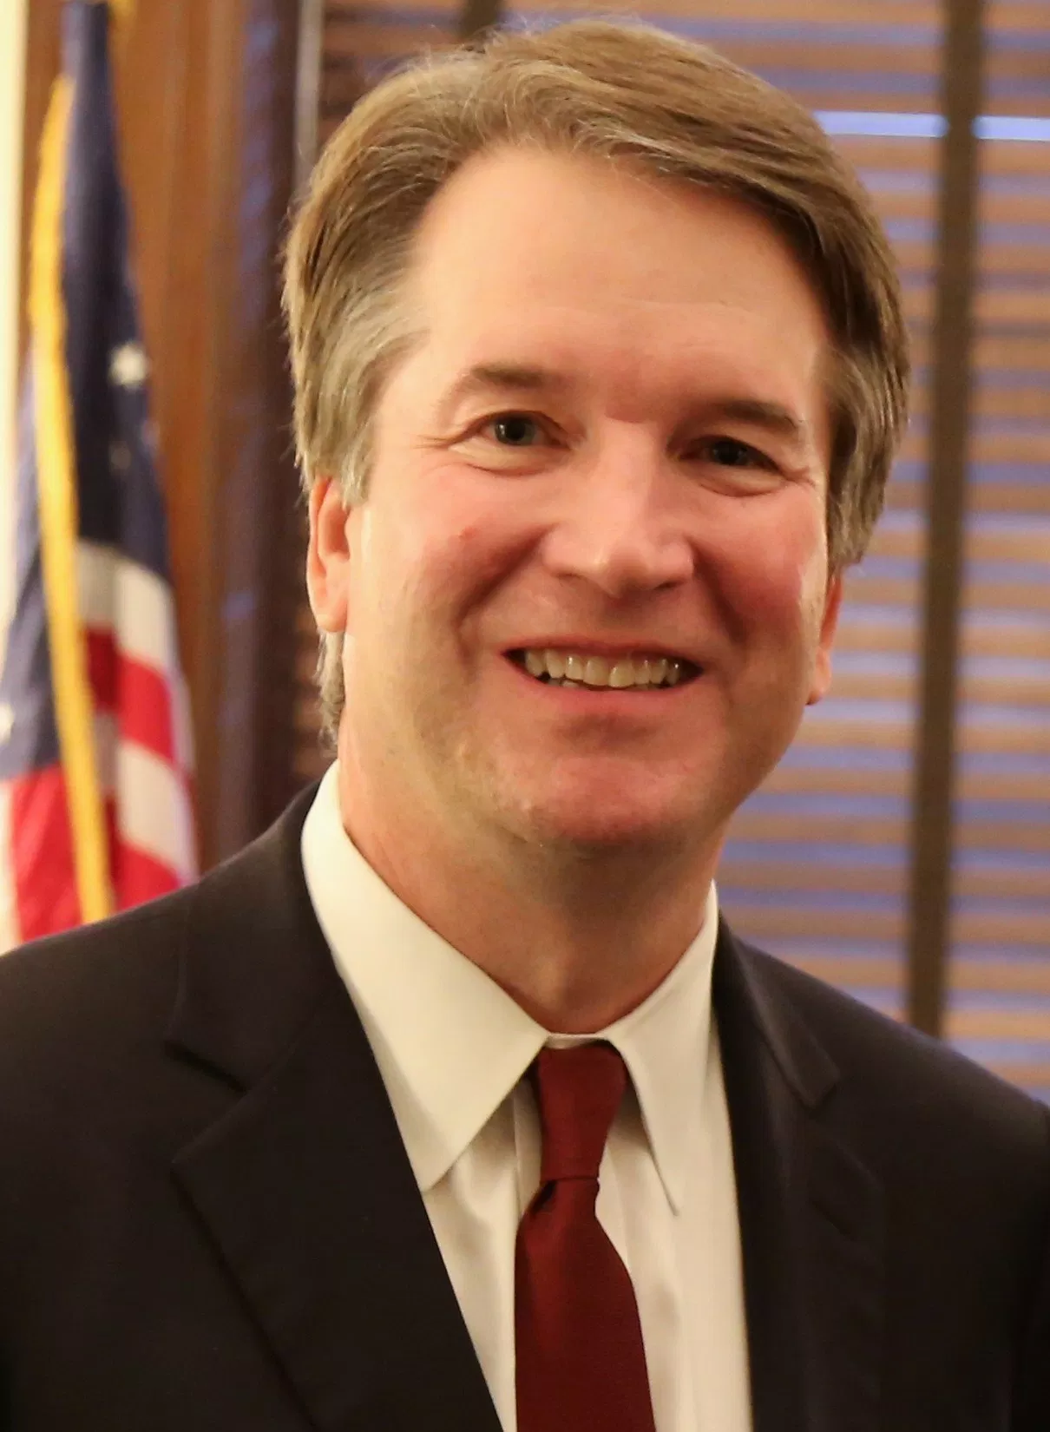
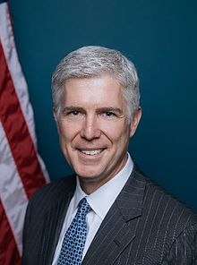
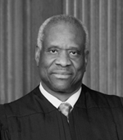
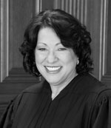
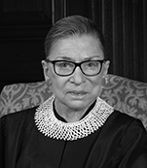
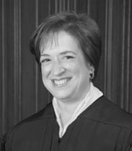
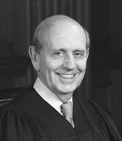
U.S. Supreme Court
Liberal
Conservative
Chief Justice John G. Roberts Jr
Stephen G. Breyer
Samuel Anthony Alito
Brett Kavanaugh
Neil Gorsuch
Clarence Thomas
Sonia Sotomayor
Ruth Bader Ginsburg
Elena Kagan
Associate Justices

Slide 11
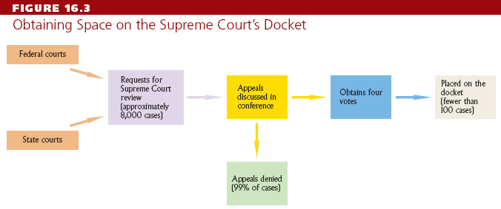
The Courts as Policymakers
Accepting Cases
  Use the “rule of four” to choose cases
  Issues a writ of certiorari to call up the case
  Supreme Court accepts few cases each year

Slide 12
The Courts as Policymakers
Making Decisions
  Oral arguments heard by the justices
  Justices discuss the case
  One justice will write the majority opinion (statement of legal reasoning behind a judicial decision) on the case

