Slide 1
The Media & Interest Groups
Coach Flu
Revised 2021-22

Slide 2
Politics
Politics- determines who we select as our governmental leaders and what policies these leaders pursue.
The famous quote from Harold D. Lasswell is “who gets what, when, and how.” It basically covers how politics work.
People get what they want through voting, supporting, comprising, lobbying and etc. which is called political participation.
Single issue groups- that have a narrow interest, tend to dislike compromise, and often draw membership from people new to politics. They are distinguished from traditional interest groups.
Individual citizens and organized groups get involved in politics because they understand that the public policy choices made by the government affect them in a significant ways.

Slide 3
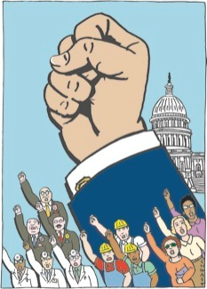



Types of Interest Groups
Economic Interests
  Labor (Union Shops & Right-to-work laws)
  Agriculture
  Business
Environmental Interests
Equality Interests
Consumer and Public Interest Lobbies

Slide 4
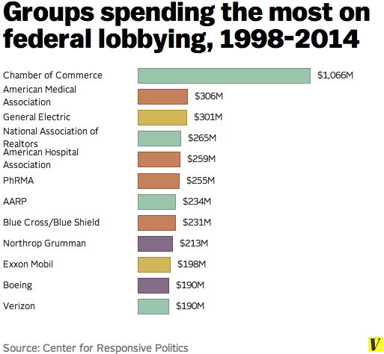
What Makes an Interest
Group Successful?

Slide 5
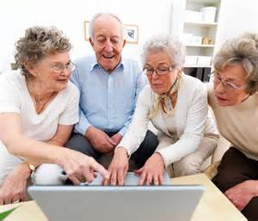


What Makes an Interest
Group Successful?
The Surprising Ineffectiveness of Large Groups
  Potential group: all the people who might be interest group members because they share a common interest
  Actual group: the part of the potential group consisting of members who actually join
  Collective good: something of value that cannot be withheld from a group member

Slide 6
What Makes an Interest
Group Successful?
Free-Rider Problem
  Some people don’t join interest groups because they benefit from the group’s activities without officially joining.
  Bigger the group, larger the problem
  Large groups are difficult to organize
Olson’s law of large groups:
  “The larger the group, the further it will fall short of providing an optimal amount of a collective good.”
  Overcome Olson’s law by providing selective benefits: Goods that a group can restrict to those who pay their annual dues

Slide 7
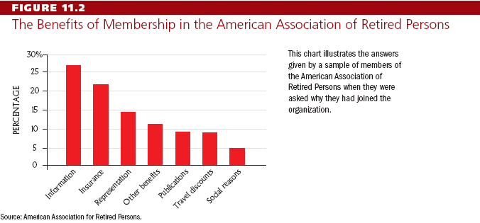
What Makes an Interest
Group Successful?

Slide 8
What Makes an Interest
Group Successful?
Small groups are better organized and more focused on the group’s goals.
  Multinational corporations are successful because there are few of them and, therefore, have an easier time organizing for political action.
  Consumer groups have a difficult time getting significant policy gains because the benefits are spread over the entire population.
  Public interest lobbies seek “a collective good, the achievement of which will not selectively and materially benefit the membership activities of the organization.”

Slide 9
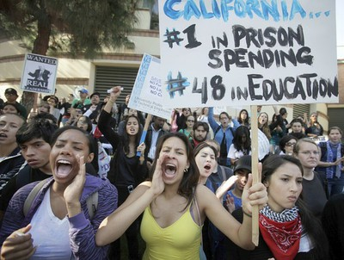
What Makes an Interest
Group Successful?
Intensity
  Single-Issue groups: groups that focus on a narrow interest, dislike compromise, and often draw membership from people new to politics
  Groups may focus on an emotional issue, providing them with a psychological advantage.
  Intensity encourages non-conventional means of participation, i.e.—protests

Slide 10
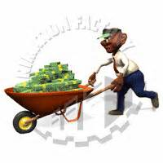
What Makes an Interest
Group Successful?
Financial Resources
  Not all groups have equal amounts of money.
  Monetary donations usually translate into access to the politicians, such as a phone call, meeting, or support for policy.
  Wealthier groups have more resources—and presumably more access—but they do not always win on policy.

Slide 11
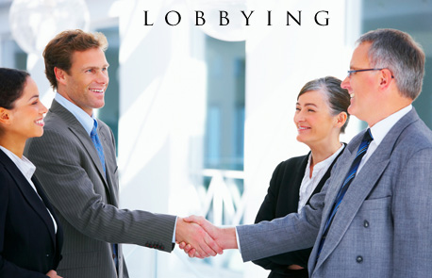
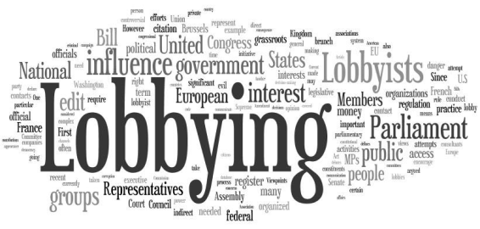
How Groups Try to Shape Policy
Lobbying
  “communication by someone other than a citizen acting on his own behalf, directed to a governmental decision maker with the hope of influencing his decision”
  Two basic types of lobbyists:
    Regular, paid employees of a group
    Temporary hires

Slide 12
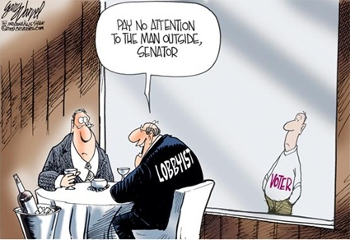
How Groups Try to Shape Policy
Lobbying
  Lobbyists:
    are a source of information
    help politicians plan political strategies for legislation
    help politicians plan political strategies for reelection campaigns
    are a source of ideas and innovations
  Mixed evidence as to whether lobbying works
  Grassroots Lobbying: is an approach that separates itself from direct lobbying through the act of asking the general public to contact legislators and government officials concerning the issue at hand, as opposed to conveying the message to the legislators directly.

Slide 13
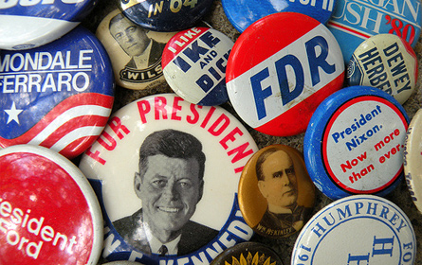
How Groups Try to Shape Policy
Electioneering
  Direct group involvement in the election process
    Groups can help fund campaigns, provide testimony, and get members to work for candidates; some form PACs.
  Political Action Committee (PAC): Political funding vehicles created by 1974 campaign finance reforms, PACs are used by interest groups to donate money to candidates.
    PACs help pay the bill for increasing campaign costs.
    Most PAC money goes to incumbents.

Slide 14
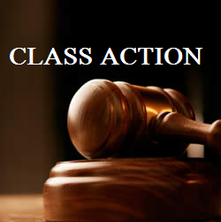
How Groups Try to Shape Policy
Litigation
  If an interest group fails in one arena, the courts may be able to provide a remedy.
  Interest groups can file amicus curiae briefs to influence a court’s decision.
    amicus curiae: briefs submitted by a “friend of the court” to raise additional points of view and present information not contained in the briefs of the formal parties
  Class Action lawsuits permit a small number of people to sue on behalf of all other people similar situated.

Slide 15
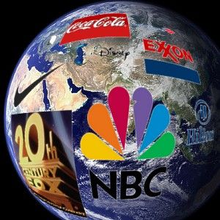
Introduction
Some important definitions:
Linkage Institution
  The media links citizens with government, along with political parties, interest groups, and elections.
Mass Media:
  Television, radio, newspapers, magazines, the Internet and other means of popular communication.
High-tech politics:
  A politics in which the behavior of citizens and policymakers and the political agenda itself are increasingly shaped by technology and mass media.

Slide 16
The Development of Media Politics
Herbert Hoover (1929-1933)-no media involvement in politics
Franklin D. Roosevelt (1933-1945)- invented modern media politics/Fireside Chats
      Gave press conferences twice a week
      First to use the radio extensively
      Press respected FDR
Until the 1960s the press respected the government
  Didn’t report private lives
  Impact of Vietnam War and Watergate Scandal
  Clinton-Lewinsky Scandal
  Investigative Journalism

Slide 17
The Mass Media Today
Effective communication through media is key to political success.
  Media Events: events purposely staged for the media that nonetheless look spontaneous.
    Media events can be staged by almost anybody.
  Image making and news management is important, especially for presidents.

Slide 18
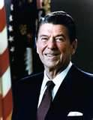
Meet the Master of Mass Media
7 principals of Reagan
Plan ahead
Control the flow of information
Limit reporters access to the president
Talk about the issues you want to talk about
Speak in one voice
Repeat the same message many times
Stay on the offensive

Slide 19
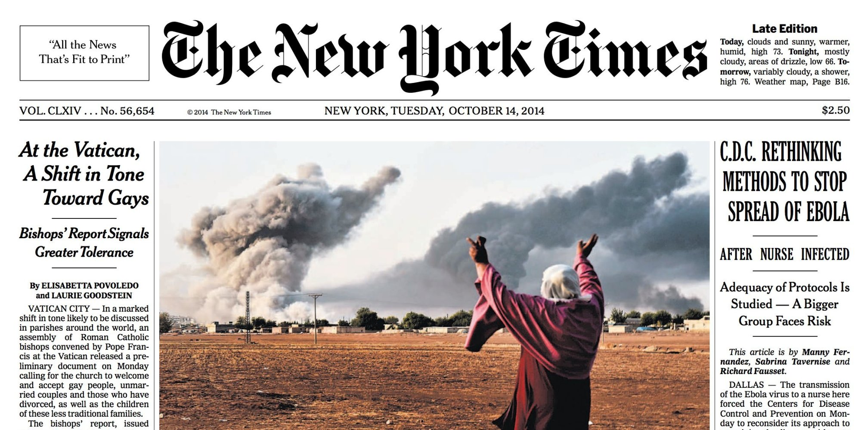
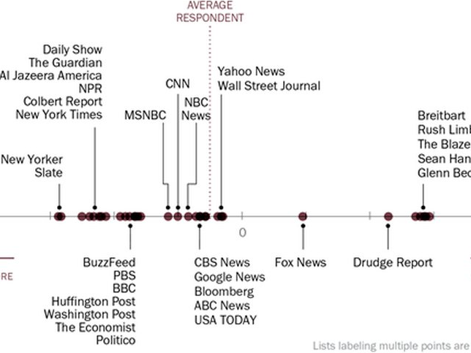
Print Media-(newspapers and magazines)
Pecking Order
      New York Times, Washington Post, LA Times, Chicago Tribune
      Smaller papers reprint the big stories
TV and the internet are causing newspaper sales to decline

Slide 20
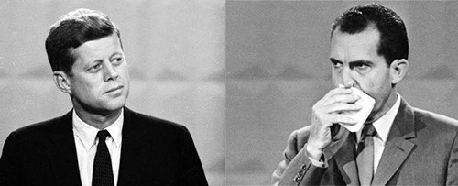
The Development of Media Politics
The Broadcast Media
  Television and radio
  Brought government and politics into peoples’ homes.
    Vietnam War
  Politicians’ appearances and mannerisms more important.
    Kennedy-Nixon presidential debate

Slide 21
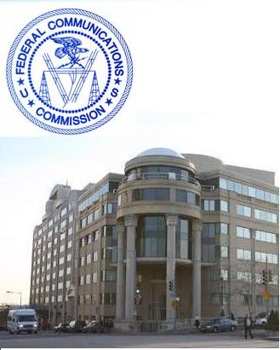
Government Regulation of the Broadcast Media
  1934: Federal Communications Commission was created
    Prevents Monopolies
    Conducts exams over goals and performance
      Stations must benefit society to get a license
    Fair treatment rules provide equal airtime to both candidates
    Equal Time Rule & Fairness Doctrine
    Telecommunications Act of 1996: drops many walls that were controlling the creation of media mono

Slide 22
The Development of Media Politics
Private Control of the Media
  Only a small number of TV stations are publicly owned in America.
  Independent in what they can report, media are totally dependent on advertising revenues. TV networks, it could be said, define news as what is entertaining to the average viewer.
  Chains: massive media conglomerates that account for over four-fifths of the nation’s daily newspaper circulation
    Also control broadcast media
    More than 90% of all media is owned by: Comcast, The Walt Disney Company, 21st Century Fox, Time Warner (Spectrum), National Amusements (CBS, MTV, BET etc)

Slide 23



Narrowcasting: Cable TV & Internet
Narrowcasting- media programming on cable TV or Internet focused on one topic and aimed at a particular audience
  MTV, ESPN, the Food Network

Slide 24
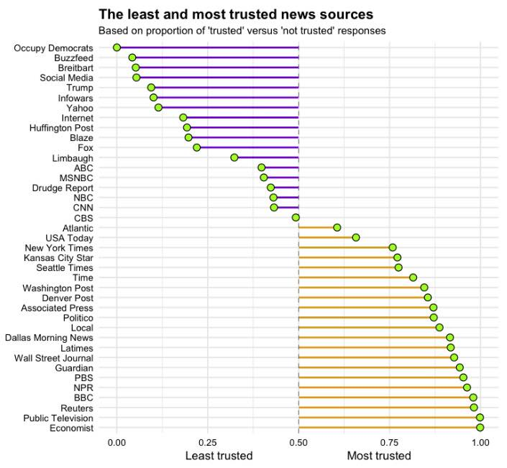
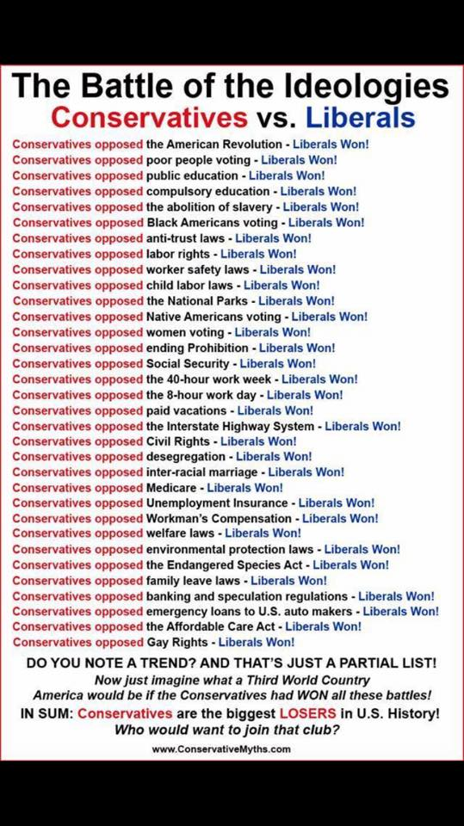
Who is honest?
resource

Slide 25
Reporting the News

Slide 26
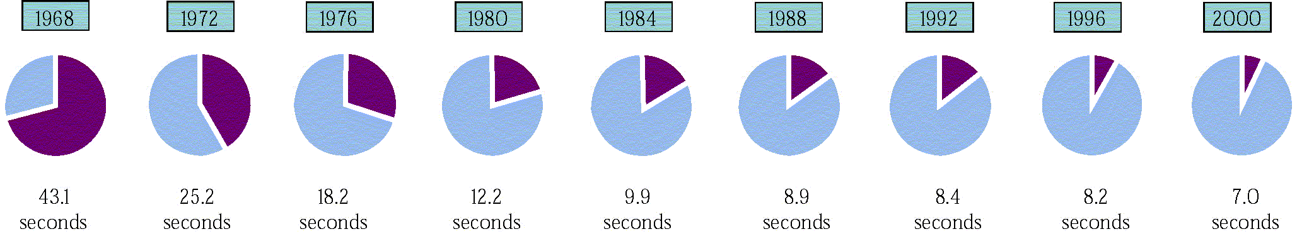
Reporting the News
Presenting the News
  Most news coverage is superficial
  Sound Bites: Short video clips of approximately 15 seconds or less.

Slide 27
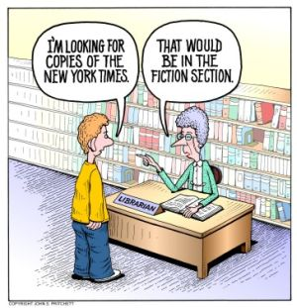
Bias in the News
  Some outlets are ideologically biased to the right or left
  Structural bias occurs when stories are chosen to attract the largest audience.
  “If it bleeds, it leads.”

Slide 28
Bias in the Media
Types of bias to look for
Selection & Omission: choice of news items; content & details used/not: words used
Placement: first page stories/above fold: lead off stories-reflect significance
Headlines: most read part of the paper-wording size can reflect bias
Photos & Camera angle: visual portrayal can show bias as can captions
Names and Titles: Choice of words such as “terrorist” or “freedom fighter” clearly indicate bias
Statistics: opinion can be reflected in method of counting- example “a hundred injured in the crash” vs “minor injuries were reported”.
Source who is the source of the story (Do we trust unnamed sources?)
Media ownership : trying to please sponsors and ownership

Slide 29
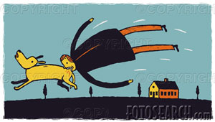
Reporting the News
.
Media is in search of unusual stories that will excite, rather than the sophisticated story.
Much of the media (News ) is Ideologically oriented programming.

Slide 30
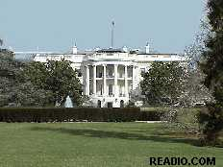
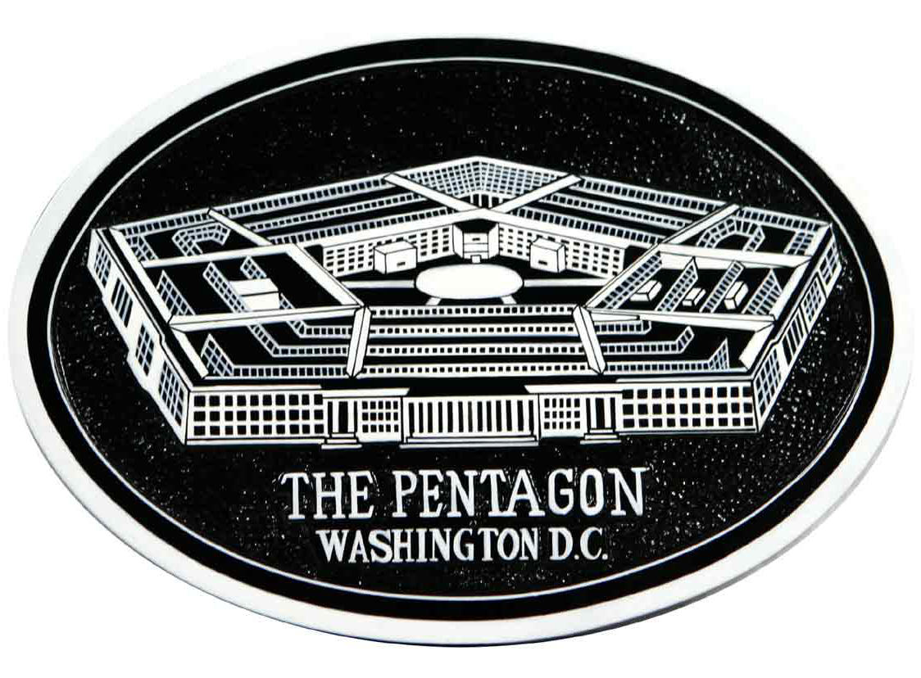
Finding the News
Beat- Specific locations from which news emanates, such as Congress or the White House.
White House press corps
Trial Balloons- An intentional news leak for the purpose of assessing the political reaction.
“Blogs” have also become popular with many adults.

Slide 31
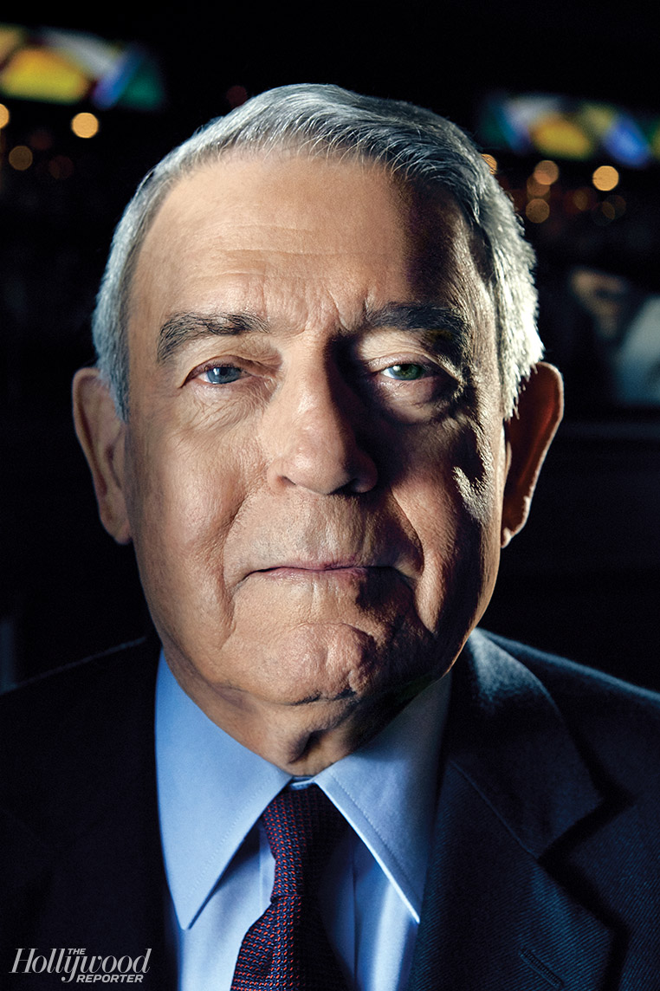
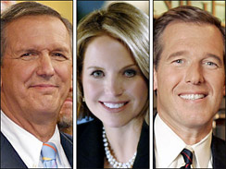
Television news can affect what people think is important.
Some policies can be made more important, others less important, depending on coverage.
Many in the media help play the role of “spin doctor” which is in its own a kind of propaganda.
The Dan Rather Scandal showed the potential story and ratings is more important than the truth.

Slide 32
Obama vs. Trump media coverage
Liberal Media covered Trump and who was part of his past (Flynn and his potential conversation with Russian spy’s?) differently than Obama’s association with convicted domestic terrorists Bill Ayers and Bernadine Dohrn.
Both have had coverage that has been reckless and lacked facts and evidence to support the stories reported.

Slide 33

Policy Agenda:
  The issues that attract the serious attention of public officials and others in policymaking
  Policy Entrepreneurs:
    People who invest their political “capital” in an issue.

Slide 34

Charting Media Bias

Slide 35
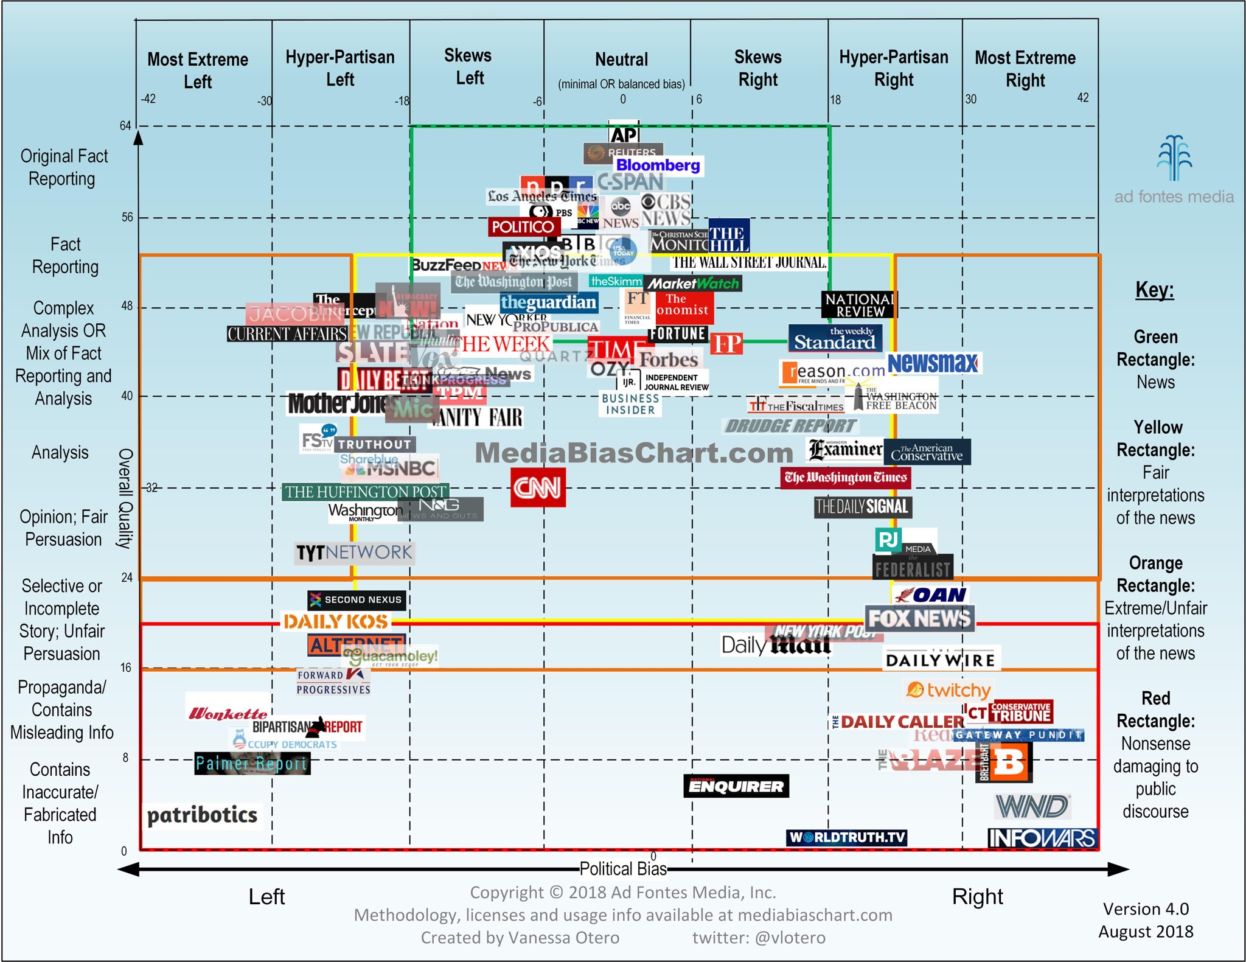
Media Bias chart

Slide 36
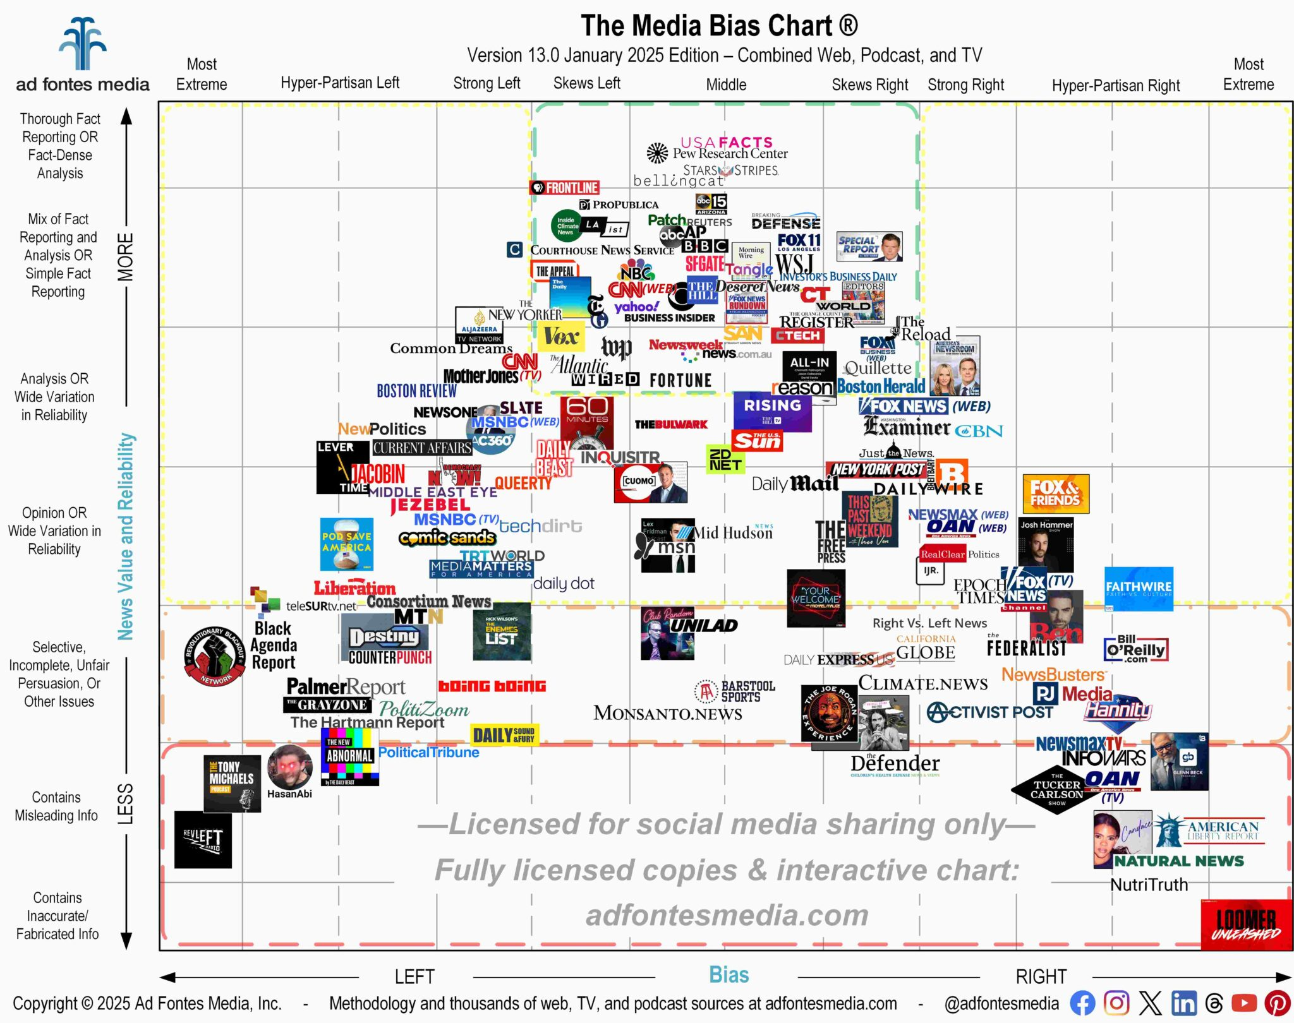

Slide 37
How to spot Media Bias

Slide 38
How to Spot Fake News
Who made this?
Who is the target audience?
Who paid for this? Or, who gets paid if you click on this?
Who might benefit or be harmed by this message?
What is left out of this message that might be important?
Is this credible (and what makes you think that)?

Slide 39
Understanding the Mass Media
The Media and the Scope of Government
  Media as watchdog restricts politicians
  New proposals are met with skepticism which restricts scope of government
  If media identifies a problem, it forces government to address it, which expands the scope of government

Slide 40
Understanding the Mass Media
Individualism and the Media
  Candidates run on their own by appealing to people on television
  Easier to focus on one person like the president, than groups, e.g., Congress or the courts
Democracy and the Media
  “Information is the fuel of democracy.” We need the media so we are informed of the actions of government as well as understanding the issues that America faces.
  But news provides more entertainment than information; it is superficial.
  News is a business, giving people what they want.

