Slide 1
Government Intro/Political Culture
Unit One
Textbook Chapter 1-4
Introduction to United States Government
Coach Flu
Revised 2018-2019

Slide 2
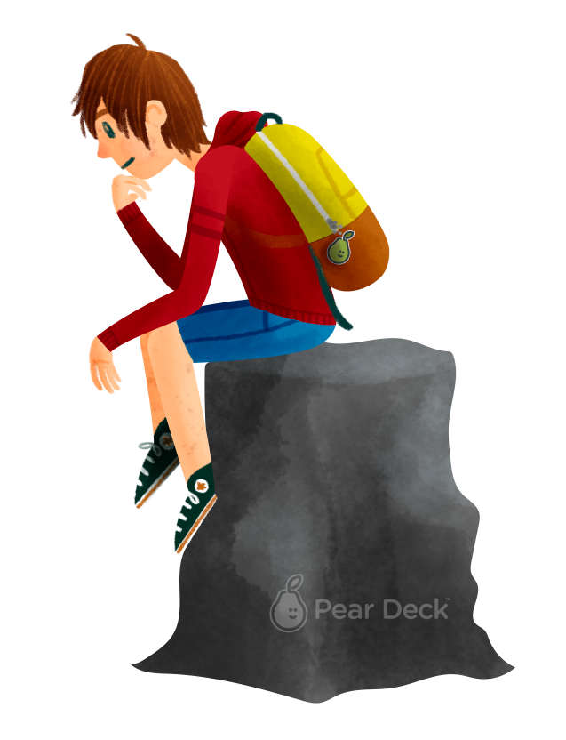
Explain how the U.S. system balances liberty and order.
Notes:
I anticipate this is a 2 day lesson in a traditional 45 minute class schedule.
EU: LOR-1: A balance between governmental power and individual rights has been a hallmark of American political development.
Big Idea: Liberty and Order
LO: LOR-1.A: Explain how democratic ideals are reflected in the Declaration of Independence and the U.S. Constitution
EK: LOR-1.A.1: The U.S. Government is based on ideas of limited government, including natural rights, popular sovereignty, republicanism and social contract.
This lesson is an overview of philosophical foundations of the American system.

Slide 3


People follow laws because they fear punishment rather than because they want a more orderly or just society.
Agree
Disagree
Notes:
The following slides can be used as a physical “Take a Stand” activity or one that you present either through Pear Deck or another way in your classroom.
If you do it as a physical “Take a Stand” activity, it could be very impactful to do it as a continuum, calling on 1 or 2 to explain why they placed themselves where they did on the continuum and then moving on to the next one.

Slide 4
Justice comes from the law itself rather than how it is administered, enforced or interpreted.
Agree
Disagree

Slide 5
The only reason a government should have power is because it has the support of the people.
Agree
Disagree

Slide 6
All should contribute to the common good.
Agree
Disagree

Slide 7
A strong military with a single strong leader is essential to national security.
Agree
Disagree

Slide 8
The surest path to economic prosperity is an unregulated market economy.
Agree
Disagree

Slide 9
The government’s job is to protect the weak from the strong.
Agree
Disagree

Slide 10
Government
What is government? it is an institution that makes authoritative decisions for any given society.
Thousands of state and local governments make policies that influence our every day lives.
There are about 500, 000 elected officials in the united states today.

Slide 11
Government Power & Authority
Politics (political Issues) Is the activity by which an issue is agitated or settled.
Power is the ability of one person to get another person to act in accordance with the first person’s intentions.
Authority is the right to use that power.
Legitimacy is the political authority conferred by law or by state or national constitution.

Slide 12
Democracy
What is democracy?
  Democracy is a form of government where the power of the government comes from the people.
The word democracy takes place among power words like freedom, justice and peace.

Slide 13
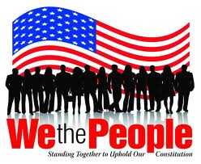
Democracy
Direct Democracy: the people being governed gather to discuss and vote directly on decisions made by the government. This style of democracy was used by the ancient Athenians and is still used today by a few small communities in New England.

Slide 14
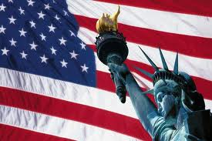
Democracy
Participatory Democracy is a model of democracy in which citizens have the power to make policy decisions. Participatory democracy emphasizes the broad participation of people in politics.
In different state governments, people retain levels of power via initiatives, referendums, and recalls.
Citizens can influence policy decisions, but do not make them. Politicians are still responsible for implementing those policy decisions. The United States does not have a pure participatory democracy, but at some levels of government, we can see examples of a participatory democracy playing out.

Slide 15
Democracy
Representative Democracy: also known as a republic, a system of government in which the power to govern comes from the people, but elected officials represent their interests. This system of government allows American citizens to participate in government in many ways.

Slide 16
Democracy
Pluralist democracy: Recognizes group-based activism by nongovernmental interests striving for impact on political decision making.
Elite democracy: decisions are made by elected representatives acting as trustees.
Majoritarianism: A political theory holding that in a democracy, the government ought to do what the majority of the people want.

Slide 17
Democracy
Majority Rule: a political principle providing that a majority usually constituted by fifty percent plus one of an organized group will have the power to make decisions binding upon the whole
Minority Rights: The majority is limited by protecting the rights of the minority from the tyranny of the majority.

Slide 18
5 Theories of American Democracy
Pluralist Theory- A theory of government and policies emphasizing that politics is mainly a competition among groups, each one pressing for its own preferred policies and anyone can participate.
Groups may be trade unions, interest groups, business organizations, and any of a multitude of formal and informal coalitions
Pluralists are generally optimistic that the public interest will eventually prevail in the making of public policy through bargaining and compromise.

Slide 19
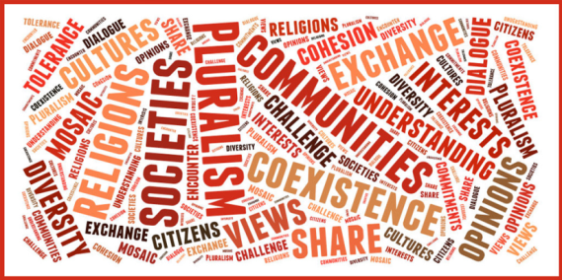
Theories of Interest Group Politics
Pluralism and Group Theory
  Groups provide a key link between the people and the government.
  Groups compete and no one group will become too dominant.
  Groups play by the “rules of the game.”
  Groups weak in one resource may use another.
  Lobbying is open to all so is not a problem.

Slide 20
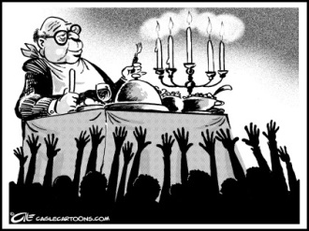
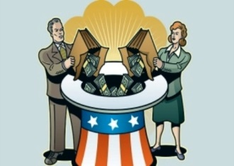
Theories of American Democracy
  Elitism or Class Theory Democracy- a model of democracy in which a small number of people, usually those who are wealthy or well-educated, influence political decision making. Advocated by some of the Framers, like Alexander Hamilton, the elite democratic model argues that participation in politics should be limited to a small group of highly-informed individuals who can make the best decisions for all citizens.
  The center of all theories of elite dominance is big business and the educated elite.
  Those who are wealthy have more power fall more into the concept of class view.
  Some who influence government the most are those whom are outside of government.
  One example of this in our system is the Electoral College

Slide 21
5 Theories of American Democracy
  Hyperpluralism- Is a theory of government and politics contending that groups are so strong that government is weakened.
  According to Hyperpluralism groups have become supreme and the government is their servant.
  Powerful groups divide the government and its authority, government gives in to every possible interest and single-issue which ends up being very confusing and contradicting.
  Creates Gridlock in government.
  Policy Gridlock- A condition that occurs when no coalition is strong enough to form a majority and establish policy.

Slide 22
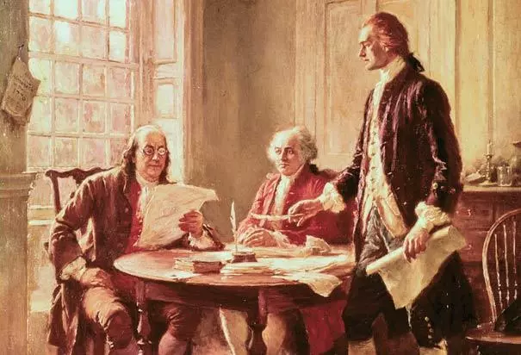
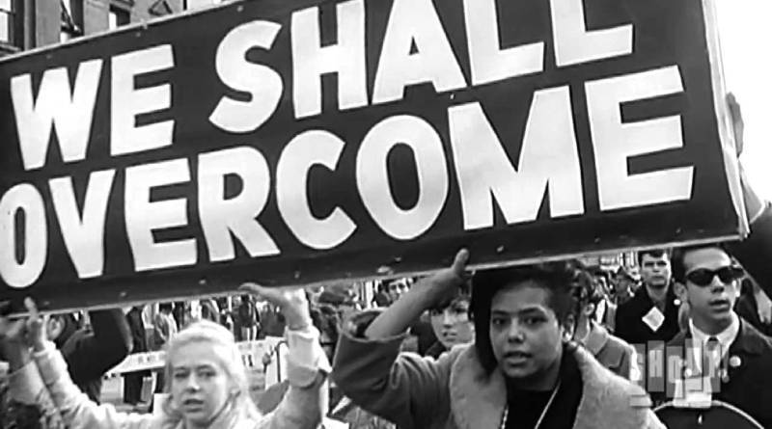
A Growing theory of American Democracy
Creedal passion view: View that morally impassioned elites drive important political change.
Examples: The American Revolution, Progressive reformers and the Civil Rights movement of the 1960’s

Slide 23
A Growing theory of American Democracy
Bureaucratic theory: The hierarchical structure and standardized procedures of modern governments allow bureaucrats, (appointed officials) who carry out the day to day workings of government, to hold the real power over public policy. (Max Weber)
Red Tape: rules and regulations that seem unnecessary and prevent things from being done quickly and easily governmental red tape
Weber saw bureaucracy as a threat to individual freedom, in which the increasing bureaucratization of human life traps individuals in the an "iron cage" of rule-based, rational control. He argues that we need competent people to manage complexed issues.

Slide 24
Theories of Interest Group Politics: Hyperpluralism
Sub-Governments (AKA Iron Triangles and Policy Networks)
  Networks of groups that exercise a great deal of control over specific policy areas.
  Consist of interest groups, government agency, and congressional committees that handle particular policies
  Also known as iron triangles
The Hyperpluralist critique
  Groups have become too powerful as the government tries to appease every interest.
  Many subgovernments (iron triangles) aggravate the process.
  Trying to please every group results in contradictory policies that are hard to understand and difficult to enforce. A great example is Obamacare (The Affordable Healthcare Act)

Slide 25
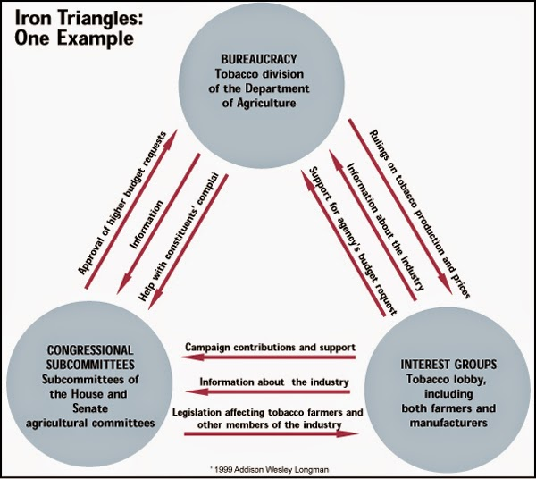

Slide 26
Politics
Politics- determines who we select as our governmental leaders and what policies these leaders pursue.
The famous quote from Harold D. Lasswell is “who gets what, when, and how.” It basically covers how politics work.
People get what they want through voting, supporting, comprising, lobbying and etc. which is called political participation.

Slide 27
Politics
Single issue groups- that have a narrow interest, tend to dislike compromise, and often draw membership from people new to politics. They are distinguished from traditional interest groups.
Individual citizens and organized groups get involved in politics because they understand that the public policy choices made by the government affect them in a significant ways.

Slide 28
The Policymaking System
Is a process by which policy comes over time. Peoples interests, problems, and concerns create political issues. these issues shape policy but also it impacts people, generating more interests, problems, and concerns.
Linkage institutions- includes elections, political parties, interest groups, and the media.

Slide 29
The Policymaking System Cont.
Policy agenda- issues that attract the serious attention of public officials and other people involved in politics at any given point in time.
  What affects the Policy agenda?
    Shared political values (how the majority view an issue)
    The weight of custom and tradition (we accept old gov powers and question new)
    The importance of events (terrorist attacks or economic downturns)
    Terms of debate (What the political elite talk about)
Political issue- an issue that arises when people disagree about a problem & how to fix it.
Policymaking institutions- Congress, the Presidency, Courts and the State and Federal Bureaucracy.

Slide 30
The Policymaking System Cont.
How do the following impact the Policy Agenda in America.
  Groups
  Government Institutions
  Media
  Action by the states.

Slide 31
Policies Impact People
All the decisions that the government makes, all the laws they pass, the budget they establish, and the rules that they make is called public policy.
Types of public policy are= the social security act, food and drug administration.

Slide 32
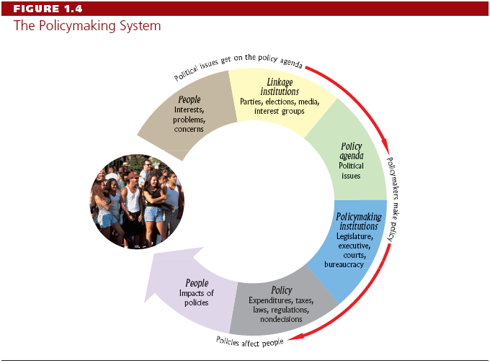
The Policymaking System
The process by which policy comes into being and evolves over time
Notes:
The six items are hyperlinked to their own slide. A return button is also on the slide.

Slide 33
Policies Impact People
Impacts of Policies:
  Does it solve the problem? (benefit)
  Does it create more problems? (cost)
Depending on the answer, policy impacts carry the political system back to its point of origin: the concerns of people.

Slide 34
Four Types of Politics
  Majoritarian Politics: A policy in which almost everyone benefits and almost everyone pays. (Social Security)
  Interest group politics: When one interest group fights for their desired policy against another interest group that opposes said policy. (labor laws)
  Client politics: When a small groups reaps a benefit as a much larger group pays for said policy. (Obama Phones)
  Entrepreneurial Politics: When almost everyone benefits from a policy but only a small amount of people pay for said policy. (Superfund as an example)
  *Can lead to the use of Pork barrel as well as log-rolling in Congress.

Slide 35
Four Types of Politics
  Policy Dynamics inside/outside the box from page 17 in text

