Slide 1
American Political Culture
Unit One
Textbook: Chapter 4

Slide 2
The American Melting Pot
Melting Pot- The mixing of cultures, ideas, and peoples that has changed the American nation.
Minority Majority- that America will eventually cease to have a White, generally Anglo-Saxon majority.

Slide 3
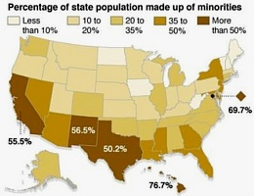
The American People
Political Culture: An overall set of values widely shared within a society. How will this change as the country changes?
Which party will benefit from the minority majority?
Notes:
“Minority Majority” links to previous slide- for the graph.

Slide 4
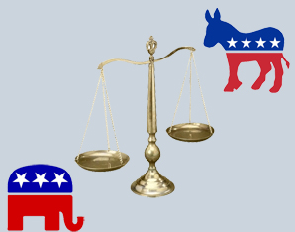
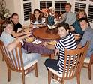
How Americans Learn About Politics: Political Socialization
Political Socialization:
the process through which an individual acquires his or her political orientation
The Process of Political Socialization
The Family
Time & emotional commitment
Political leanings of children often mirror their parent’s leanings

Slide 5
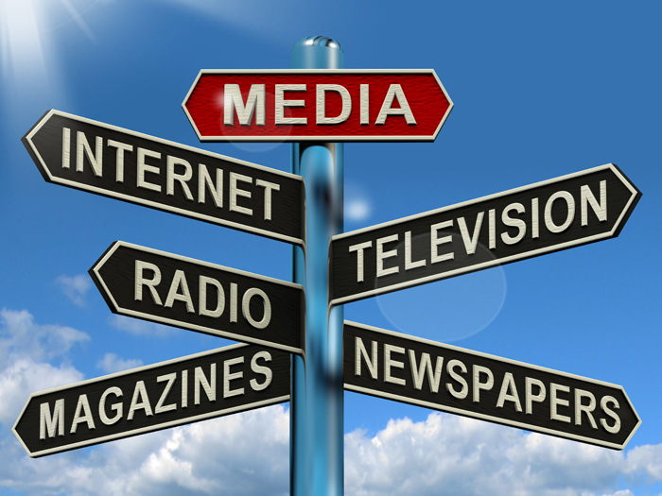
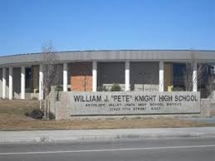
How Americans Learn About Politics: Political Socialization
The Process of Political Socialization
The Mass Media
Generation gap in TV news viewing
School / Education
Used by government to socialize the young into the culture and government

Slide 6
Common American Beliefs
Political Culture: a set of attitudes and practices held by a people that shapes their political behavior. It includes moral judgments, political myths, beliefs, and ideas about what makes for a good society.
Liberty: To live in freedom without the intrusion of government.
Egalitarianism: (Equality) The concept of equal opportunity for success. (not results)
Individualism: (Individual Responsibilty) The belief that people can and do get ahead based on their own merits and hard work.

Slide 7
Common American Beliefs
Laissez-faire: an economic policy of free markets and not interference of government into the economy.
Populism: being on the side of the ordinary people in the struggle against the government and the elites.
Political Tolerance: The ability to respect people who hold different political points of views.

Slide 8
The Economic System
Free-Market Americans support liberty especially in the economy. The idea of free-enterprise and most believe the system is fair but far from perfect. Most do not believe that the system “keeps people poor”
Americans are much more likely to support government regulations of the economic freedoms of the system.
Americans are much more likely to support economic inequality than political inequality.

Slide 9
American Attitudes compared to other nations

Slide 10
Opinions of Political Leaders
90% of people agree “Most politicians are more interested in winning elections than doing the right thing”
73% of people agree “most elected officials don’t care what people think”
71% of people agree “Our system of government is good, but the people running it are incompetent”
63% of people agree “People like me do not have a say about what government does”
45% of people agree “The police and law enforcement unfairly target racial and ethnic minorities”

Slide 11
Sources of Political Culture
Adversarial spirt (Americans preoccupation with rights)
Suspicion of the power of government
Large government participation (Federalism)
Orthodox (country founded on religious principles)
Class-consciousnes society (Americans’ believe we belong to a social class and some believe that there is a conflict between classes)

Slide 12
Trust in Federal Government

Slide 13
Trust in American Institutions

Slide 14
Are You Politically Tolerant ?
Which of the following should be permitted to hold a meeting?
A religious group hosting a revival meeting.
A parent organization that opposes mandatory annual testing in schools.
A parent group opposes CRT teaching in the school
Concerned citizens protesting the building of a cell phone tower near their homes.
A women’s rights organization campaigning for stronger legislation to punish sexual harassment in the workforce.
A civil rights group that advocates for transgender rights.
Atheists preaching against God.
Students organizing a sit-in to protest school dress codes.
A meeting of members of a group that apposes gay marriage.
A well known controversial political figure giving a lecture at your school.

