Slide 1
American Political Culture
Unit One
Textbook: Chapter 4

Slide 2
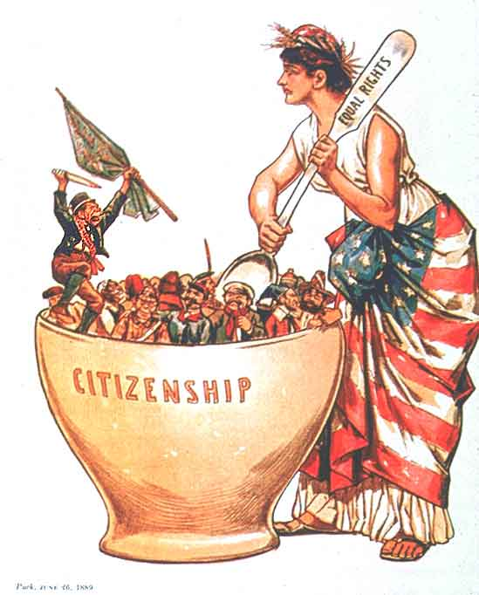
The American Melting Pot
Melting Pot- The mixing of cultures, ideas, and peoples that has changed the American nation.
Minority Majority- that America will eventually cease to have a White, generally Anglo-Saxon majority.

Slide 3
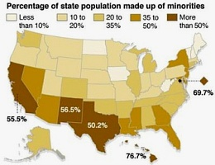
The American People
  Political Culture: An overall set of values widely shared within a society. How will this change as the country changes?
Which party will benefit from the minority majority?
Notes:
“Minority Majority” links to previous slide- for the graph.

Slide 4
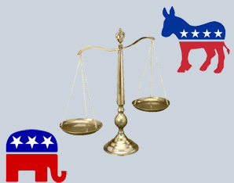
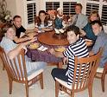
How Americans Learn About Politics: Political Socialization
Political Socialization:
  the process through which an individual acquires his or her political orientation
The Process of Political Socialization
  The Family
    Time & emotional commitment
    Political leanings of children often mirror their parent’s leanings

Slide 5
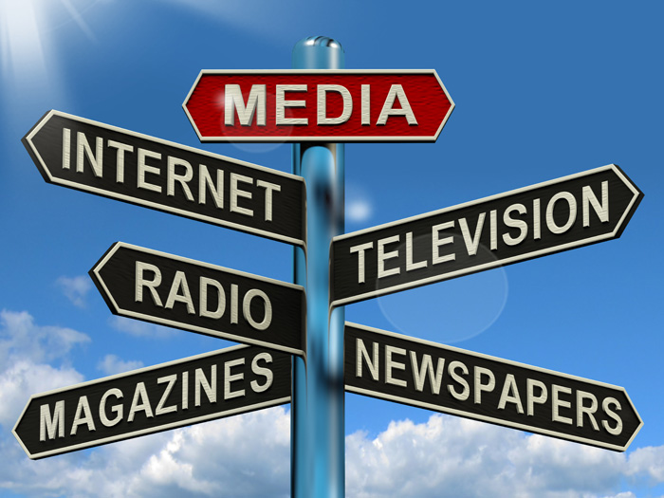
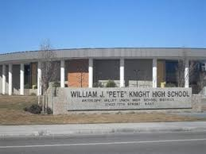
How Americans Learn About Politics: Political Socialization
The Process of Political Socialization
  The Mass Media
    Generation gap in TV news viewing
  School / Education
    Used by government to socialize the young into the culture and government

Slide 6
Common American Beliefs
Political Culture: a set of attitudes and practices held by a people that shapes their political behavior. It includes moral judgments, political myths, beliefs, and ideas about what makes for a good society.
Liberty: To live in freedom without the intrusion of government.
Egalitarianism: (Equality) The concept of equal opportunity for success. (not results)
Individualism: (Individual Responsibilty) The belief that people can and do get ahead based on their own merits and hard work.

Slide 7
Common American Beliefs
Laissez-faire: an economic policy of free markets and not interference of government into the economy.
Populism: being on the side of the ordinary people in the struggle against the government and the elites.
Political Tolerance: The ability to respect people who hold different political points of views.

Slide 8
The Economic System
Free-Market Americans support liberty especially in the economy. The idea of free-enterprise and most believe the system is fair but far from perfect. Most do not believe that the system “keeps people poor”
Americans are much more likely to support government regulations of the economic freedoms of the system.
Americans are much more likely to support economic inequality than political inequality.

Slide 9
American Attitudes compared to other nations
Figure 4.1 needs to be added here

Slide 10
Opinions of Political Leaders
Add figure 4.2 here

Slide 11
Americans’ beliefs about religion
Add figure 4.3 here

Slide 12
Sources of Political Culture
Adversarial spirt (Americans preoccupation with rights)
Suspicion of the power of government
Large government participation (Federalism)
Orthodox (country founded on religious principles)
Class-consciousnes society (Americans’ believe we belong to a social class and some believe that there is a conflict between classes)

Slide 13
Trust in Federal Government
Add figure 4.4

Slide 14
Trust in American Institutions
Add figure 4.5

Slide 15
Are You Politically Tolerant ?
Which of the following should be permitted to hold a meeting?
  A religious group hosting a revival meeting.
  A parent organization that opposes mandatory annual testing in schools.
  Concerned citizens protesting the building of a cell phone tower near their homes.
  A women’s rights organization campaigning for stronger legislation to punish sexual harassment in the workforce.
  A civil rights group that advocates for transgender rights.
  Atheists preaching against God.
  Students organizing a sit-in to protest school dress codes.
  A meeting of members of a group that apposes gay marriage.

